Slide 1
National Center for Excellence in Primary Care Research
Presents
Qualitative Methods Used in AHRQ-Funded Primary Care Research
August 3, 2023
Presented by:
Anna Steeves-Reece, PhD, MPH
Neera Goyal, MD
Ellen Lipstein, MD, MPH
Moderated by:
Andrea Heckert, PhD, MPH
Abt Associates

Slide 2
NCEPCR Webinar Series
The views expressed in this webinar do not represent official views of the U.S. Department of Health and Human Services or the Agency for Healthcare Research and Quality.
Notes:
AHRQ is hosting a new webinar series, Strengthening Primary Care Research. Today’s webinar is the first in the series. Webinar two will be focused on Getting your qualitative Study Funded at AHRQ. Stay tuned to the AHRQ channels for the date and registration.

Slide 3

Welcome
Aimee R. Eden, PhD, MPH
Acting Director,
National Center for Excellence in Primary Care Research (NCEPCR),
AHRQ
Notes:
Good day, everyone. My name is Aimee Eden. I am the acting Director for AHRQ’s National Center for Excellence in Primary Care Research. It is my pleasure to welcome you to today’s webinar, Qualitative Methods Used in AHRQ-Funded Primary Care Research.
Aimee will talk a bit about NCEPCR and her role and segue to webinar series. Share what NCECPR is doing

Slide 4


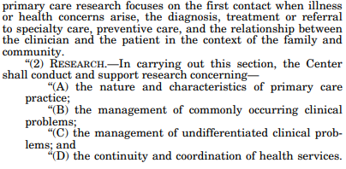
AHRQ’s 1999 Authorization
Notes:
AHRQ’s 1999 authorization

Slide 5

National Center for Excellence in Primary Care Research
Working to:
Develop a more coordinated primary care research portfolio & agenda
Create more targeted primary care research funding opportunities
Support & expand a diverse primary care research workforce
Build a more robust & systematic dissemination strategy

Slide 6
NCEPCR Webinar Series
Strengthening Primary Care Research Webinar Series
    Qualitative Methods Used in AHRQ-Funded Primary Care Research
    Next webinar:
    Tentatively Titled, Research That Includes the Innovative Use of Technology in Primary Care Delivery
Notes:
AHRQ is hosting a new webinar series, Strengthening Primary Care Research. Today’s webinar is the first in the series. Webinar two will be focused on Getting your qualitative Study Funded at AHRQ. Stay tuned to the AHRQ channels for the date and registration.

Slide 7
Today’s Webinar Objectives
Qualitative Data Used in AHRQ-Funded Primary Care Research
Describe how qualitative methods can be used to address primary care research questions
Introduce different types of qualitative methods used in primary care research, and how they can be meaningfully integrated into a mixed methods study
Highlight examples of funded grants that use qualitative research methods
Describe the benefits and challenges of using qualitative methods in primary care research
Notes:
The goal of today’s webinar is to 1. Describe how qualitative methods can be used to address primary care research questions
2. Introduce different types of qualitative methods used in primary care research, and how they can be meaningfully integrated into a mixed methods study
3. Highlight examples of funded grants that use qualitative research methods
4. Describe the benefits and challenges of using qualitative methods in primary care research
.

Slide 8

Moderator
Andrea Heckert, PhD, MPH
Senior Associate, Abt Associates
Notes:
Now I’d like to introduce the moderator for today’s webinar, Andrea Heckert, a health services researcher from Abt Associates. Andrea will facilitate the Q&A and discussion, which will take place after all of the presentations are finished. Welcome, Andrea!

Slide 9
Today’s Webinar Presenters
Anna Steeves-Reece, PhD, MPH (OCHIN), Patients' Decisions and Perspectives Regarding Healthcare-Based Social Risk Interventions
Neera Goyal, MD (Nemours Children’s Health), Group well-child care intervention for infants of mothers in treatment for opioid use disorder
Ellen Lipstein, MD, MPH (Cincinnati Children’s Hospital/University of Cincinnati College of Medicine), Comparing Family Decision Making Engagement in Telehealth versus In-person Primary Care for Children with Chronic Conditions
Notes:
Hello everyone. We have three primary care researchers here today. Each one will discuss some of the large datasets and methods they used in a recent study they completed.
Yalda Jabbarpour, MD (Robert Graham Center for Policy Studies, AAFP) will be presenting on The Primary Care Scorecard
Yong-Fang Kuo, PhD (Office of Biostatistics, University of Texas Medical Branch) will be presenting on Use of Medicare Data to Identify Primary Care Teams
Annie Elizabeth Larson, PhD (OCHIN) will be presenting on The effect of rurality and the COVID-19 pandemic on telemedicine and preventive healthcare use
Be sure to save your questions – we’ll have the Q&A session after all the presentations are over.

Slide 10

Presentation 1
Patients’ Decisions and Perspectives Regarding Healthcare-Based Social Needs Interventions
Anna Steeves-Reece, PhD, MPH
OCHIN
Notes:
Now I’d like to introduce our first presenter, Dr. Anna Steeves-Reece from OCHIN.

Slide 11
Patients’ Decisions and Perspectives Regarding Healthcare-Based Social Needs Interventions
AHRQ Grants for Health Services Research Dissertation Program (R36)
  1R36HS027707-01
Multi-Method Dissertation
  Aim 1 – Systematic Review – https://doi.org/10.1016/j.amepre.2021.12.002
  Aim 2 – Quantitative Study – https://doi.org/10.3122/jabfm.2022.220259R1
  Aim 3 – Qualitative Study – https://doi.org/10.3390/ijerph191912668
September 2020 – February 2022 (i.e., COVID-19 Pandemic)
Notes:
Hello! I’m Anna Steeves-Reece. I’m currently an Investigator with OCHIN but today I’ll be sharing about my work that was funded by AHRQ through their R36 mechanism while I was a doctoral student at the Oregon Health & Science University-Portland State University School of Public Health in Portland, Oregon. The multi-method project was called Patients’ Decisions and Perspectives Regarding Healthcare-based Social Needs Interventions and was comprised of three studies: a systematic review, a quantitative study, and a qualitative study. While the systematic review did include qualitative methods, I’m going to be focusing this presentation on the Aim 3 qualitative study. And for context, this project was carried out during the height of the COVID-19 pandemic.

Slide 12
Healthcare-based Social Needs Screening & Referral Interventions
Unmet Social Needs
(e.g., food insecurity, housing instability, transportation needs)
Identify Needs
Address Needs
Outcomes
Screen for Social Needs
Identify Unmet Social Needs
Refer to Social Services to Address Social Needs
Resource Connection for Social Needs
Decreased Unmet Social Needs
Improved Access and Quality of Healthcare
Improved Health Outcomes
Adapted from Gurewich et al. (2020) “OASIS Framework”
Notes:
My dissertation focused on social needs screening and referral interventions, which are increasingly common in primary care settings. I used this framework from Gurewich and colleagues to think about how these interventions are meant to improve health outcomes. The problem on the far left is that patients have unmet social needs – like food insecurity and housing instability – that impact their health and well-being. In response, healthcare organizations first use screening tools to systematically attempt to identify patients’ unmet social needs. Next, they refer patients who disclose social needs to resources in the community, where the hope is that patients will access helpful resources. If the intervention works as intended, the goal is that patients will have decreased unmet social needs, improved access and quality of healthcare, and improved health outcomes. So, for all three of my research aims, I sought to understand patient decisions and experiences across this framework. And – considering the pandemic and the sudden shift to telehealth – I decided to focus on phone-based social needs screening and referral.
Sources:
Gurewich, D.; Garg, A.; Kressin, N.R. Addressing social determinants of health within healthcare delivery systems: A framework to ground and inform health outcomes. J. Gen. Intern. Med. 2020, 35, 1571–1575.

Slide 13
Aim 3 – Qualitative Study
“It made me feel like things are starting to change in society:” A qualitative study to foster positive patient experiences during phone-based social needs interventions
Study Objectives:
To better understand the experiences and guidance of patients who participated in a phone-based social needs screening and referral intervention
To develop recommendations for improving the patient centeredness of phone-based social needs screening and referral interventions
Notes:
The manuscript from my qualitative study is called, “It made me feel like things are starting to change in society:” A qualitative study to foster positive patient experiences during phone-based social needs interventions. This study had two objectives. The first was to better understand the experiences and guidance of patients who took part in a phone-based social needs screening and referral intervention. And the second was to develop recommendations for improving the patient centeredness of the intervention.

Slide 14


Accountable Health Communities (AHC) Model Intervention
Centers for Medicare & Medicaid Services (CMS)
Eligibility: Community-dwelling Medicare and Medicaid Beneficiaries accessing health care at participating clinical delivery sites.
Screening Tool:
Food insecurity
Housing instability and quality
Utility needs
Transportation needs
Interpersonal violence
Implementing Organization:
Oregon Rural Practice-based Research Network (ORPRN)
Alley et al. (2016)
Billioux et al. (2017)
Notes:
The intervention I studied was the Accountable Health Communities (or AHC) Model, which was developed by the Centers for Medicare and Medicaid Services. In this intervention, community-dwelling Medicare and Medicaid beneficiaries accessing care at participating clinical delivery sites were screened for 5 social needs: food insecurity, housing instability and quality, utility needs, transportation needs, and interpersonal violence. Those who screened positive for social needs were offered a community resources summary. And those who screened positive for social needs plus self-reported 2 or more emergency department visits within the previous year were offered a community resources summary plus navigation assistance. I specifically looked at the AHC Model intervention in Oregon, which was implemented by the Oregon Rural Practice-based Research Network (or ORPRN).
Sources:
Alley, D.E.; Asomugha, C.N.; Conway, P.H.; Sanghavi, D.M. Accountable health communities—Addressing social needs through Medicare and Medicaid. N. Engl. J. Med. 2016, 374, 8–11.
Billioux, A.; Verlander, K.; Anthony, S.; Alley, D. Standardized screening for health-related social needs in clinical settings: The accountable health communities screening tool. NAM Perspect. 2017.

Slide 15
Pragmatic Qualitative Study
Interview Guide Development
Purposeful Sampling Approach (Maximum Variation)
Recruitment / Data Collection & Information Power
Research Assistant: Melissa Frangie
Reflexive Thematic Analysis
Research Assistants: Melissa Frangie, Katherin Gomez-Arboleda, Chrystal Barnes, and Minnie Kang
Notes:
So, in the following slides I’m going to walk through the major steps of our pragmatic qualitative study, including the development of the interview guide, the sampling approach, recruitment and data collection, and our reflexive thematic analysis process.

Slide 16
Pragmatic Paradigm
Pragmatism places emphasis on research that is democratic, collaborative, contextual, and action-oriented
Study Implications:
  Sought out interdisciplinary & interprofessional perspectives to inform the research process
  Took steps to ameliorate barriers to participation
  Centered our analysis on areas in which healthcare organizations may have the most agency to avoid harm and cultivate healing regarding patient experiences with healthcare-based social needs screening and referral interventions
Morgan (2014)
Biddle et al. (2015)
Kaushik et al. (2019)
Kelly et al. (2020)
Allemang et al. (2022)
Notes:
All researchers and research projects make assumptions about the world and how knowledge is and should be generated, whether those things are named or not. Pragmatism places emphasis on research that aims to be democratic, collaborative, contextual, and action-oriented, which I think all make it a great fit for primary care research. For this study, we used a pragmatic paradigm to guide everything from our research questions to our methods and analysis choices. For example, we sought out interdisciplinary and interprofessional perspectives to inform the research process, took steps to ease barriers to participation, and centered our analysis on areas in which healthcare organizations may have the most power to both avoid harm and cultivate healing regarding patient experiences with social needs screening and referral interventions.
Sources:
Morgan, D.L. Pragmatism as a paradigm for social research. Qual. Inq. 2014, 20, 1045–1053.
Biddle, C.; Schafft, K.A. Axiology and anomaly in the practice of mixed methods work: Pragmatism, valuation, and the transformative paradigm. J. Mix. Methods Res. 2015, 9, 320–334.
Kaushik, V.; Walsh, C.A. Pragmatism as a research paradigm and its implications for social work research. Soc. Sci. 2019, 8, 255.
Kelly, L.M.; Cordeiro, M. Three principles of pragmatism for research on organizational processes. Methodol. Innov. 2020, 13.
Allemang, B.; Sitter, K.; Dimitropoulos, G. Pragmatism as a paradigm for patient-oriented research. Health Expect. 2022, 25, 38–47.

Slide 17
Interview Guide Development
Sought feedback from:
Interdisciplinary dissertation committee
ORPRN employees responsible for implementing the AHC Model in Oregon
Health services researcher with experience interviewing hundreds of Medicaid beneficiaries
Included questions and prompts about:
Participants’ health
What participants remembered about the AHC Model screening call
Whether and how participants made social needs resource connections
Participants’ insights on what aspects of the intervention went well and what could be improved
Translated into Spanish by an IRB-qualified translator
Patton (2002)
Notes:
An important note about interview guides is that, while they’re helpful for ensuring that basic lines of inquiry are explored in each interview, the interviewer is free to build a natural conversation and phrase questions spontaneously. Of course, it’s still necessary to get feedback on those basic lines of inquiry, and the people you seek feedback from should bring different points of view. I sought input from my interdisciplinary dissertation committee, ORPRN employees responsible for implementing the AHC Model intervention in Oregon, and a health services researcher who had recruited and interviewed hundreds of Medicaid beneficiaries. Ultimately, the guide included questions and prompts about participants’ health, what they remembered about the screening call, whether and how they made social needs resource connections, and their insights on what aspects of the intervention went well and what could be improved. The interview guide was translated into Spanish by an IRB-qualified translator.
Sources:
Patton, M.Q. Qualitative interviewing. In Qualitative Research and Evaluation Methods; Sage Publications, Inc.: Thousand Oaks, CA, USA, 2002; Volume 3, pp. 339–428.

Slide 18
Purposeful Sampling Approach (Maximum Variation)
Goal: Develop themes that transcend a diverse sample.
ALL interviewees had:
Participated in the AHC Model in Oregon
Qualified for and accepted navigation assistance
Sought variation across characteristics and circumstances for which we had data:
Interviewees’ age, sex, race, ethnicity, primary language (English or Spanish), highest level of education, and types and total number of social needs
Patton (2002)
Notes:
For this study, we decided to use a purposeful sampling approach with a focus on maximum variation. All interviewees had participated in the AHC Model intervention in Oregon, and all of them had both qualified for and accepted navigation assistance. We sought to maximize participant variation across multiple characteristics and circumstances for which we had data, including participants’ age, sex, race, ethnicity, primary language (English or Spanish), highest level of education, and their self-reported social needs. This sampling approach had clear strengths and limitations. On the one hand, it facilitated the development of themes that transcended a diverse sample. Given that social needs screeners work with diverse patients experiencing a wide range of circumstances, it seemed worthwhile to develop themes and recommendations that would be salient for as many patients as possible. On the other hand, a maximum variation approach risked overlooking key differences across populations regarding how they experienced the intervention and what their recommendations for improvement would be.
Sources:
Patton, M.Q. Designing qualitative studies. In Qualitative Research and Evaluation Methods; Sage Publications, Inc.: Thousand Oaks, CA, USA, 2002; Volume 3, pp. 209–259.

Slide 19
Recruitment / Data Collection & Information Power
Recruitment / Data Collection:
IRB approval from Oregon Health & Science University
Eligible participants verbally consented to participate in interviews
Interviewees received $25 gift cards
Phone-based interviews (using Zoom) in both English and Spanish
Information Power:
Framework for determining sample size in qualitative research
Factors impacting sample size:
  Study Aim, Sample Specificity, Established Theory, Quality of Dialogue, Analysis Strategy
Malterud et al. (2016)
Notes:
We received IRB approval from Oregon Health & Science University and eligible participants verbally consented to participate in interviews. Interviewees received $25 gift cards for their participation and interviews were conducted remotely. First, I attempted to call each person up to three times and used a spreadsheet to track that outreach. I conducted English interviews and Spanish interviews were conducted by a bilingual and bicultural research assistant. And while the interviews were phone-based, the calls were merged with a Zoom room to both facilitate recording and allow for use of the chat function with my research assistant.
Next, knowing how many interviews is “enough” is always challenging in qualitative research. I used the concept of information power to support with this. Using this concept, sample size is driven by your study aims, the specificity of the sample you’re able to recruit, whether you’re using established theory, the quality of the dialogue in your interviews, and the analysis strategy you’ve chosen. At 34 interviews, our team felt like we had enough information power to be able to make new contributions to the literature around our research topic.
Sources:
Malterud, K.; Siersma, V.D.; Guassora, A.D. Sample size in qualitative interview studies: Guided by information power. Qual. Health Res. 2016, 26, 1753–1760.

Slide 20
Reflexive Thematic Analysis
Resource: https://www.thematicanalysis.net/
Qualitative analysis team: Me + 4 research assistants
  Created codebook to enhance understanding and reflexivity across our large team (Excel)
  Transcripts analyzed and double-coded by me and one of the other 4 analysts (Dedoose)
  Spreadsheet to document questions and memos to discuss as a team (Excel)
  I developed preliminary themes, which were iteratively refined with our full analysis team
  I checked our candidate themes against the original transcripts and reviewed them with co-authors to ensure that they were internally coherent, distinct, and had useful clinical implications
Braun & Clarke (2022)
Notes:
Next, our team used reflexive thematic analysis to develop themes and recommendations from the data. On a side note, I highly recommend the linked resource from Braun & Clarke if you plan to use reflexive thematic analysis in your own work! Our analysis team included myself and 4 research assistants, 3 of which had also been screeners for the AHC Model intervention in Oregon. First, we created a codebook for the purpose of enhancing shared understanding across our large team using Excel spreadsheets. Second, the transcripts were analyzed and double coded by me and one of the other 4 analysts in the software program Dedoose. Simultaneously, we maintained an Excel spreadsheet to document questions and memos to discuss as a team in regular meetings. Third, I developed preliminary themes, which were iteratively refined with our full analysis team. And finally, I checked our candidate themes against the original transcripts and reviewed them with all co-authors to ensure that they were internally coherent, distinct, and had useful clinical implications.
Sources:
Braun, V.; Clarke, V. Venturing Forth! Doing Reflexive Thematic Analysis. In Thematic Analysis: A Practical Guide; SAGE Publications Inc.: Thousand Oaks, CA, USA, 2022; pp. 1–117.
Braun, V.; Clarke, V. Getting your own house in order: Understanding what makes good reflexive thematic analysis to ensure quality. In Thematic Analysis: A Practical Guide; Maher, A., Ed.; SAGE Publications Inc.: Thousand Oaks, CA, USA, 2022; pp. 259–280.

Slide 21
Results (N=34 participants)
Development of 6 Themes
Patients were likely to be initially skeptical and/or have reservations about the social needs questions.
Immediate transparency and ongoing respect for autonomy were fundamental.
Showing kindness for the patient through one’s demeanor was important.
Demonstrating a genuine intention to connect patients with resources mattered.
The degree of attentiveness and responsiveness to patients’ circumstances and requests impacted their experience.
Patients could be left feeling appreciative or hopeful, whether they accessed resources or not.
Notes:
Ultimately, our team developed 6 themes from our interviews with 34 participants.
[Read through themes]
In the manuscript, we were very intentional about what quotes we selected to illustrate these themes because we wanted to highlight that the developed themes did indeed transcend a diverse sample.

Slide 22
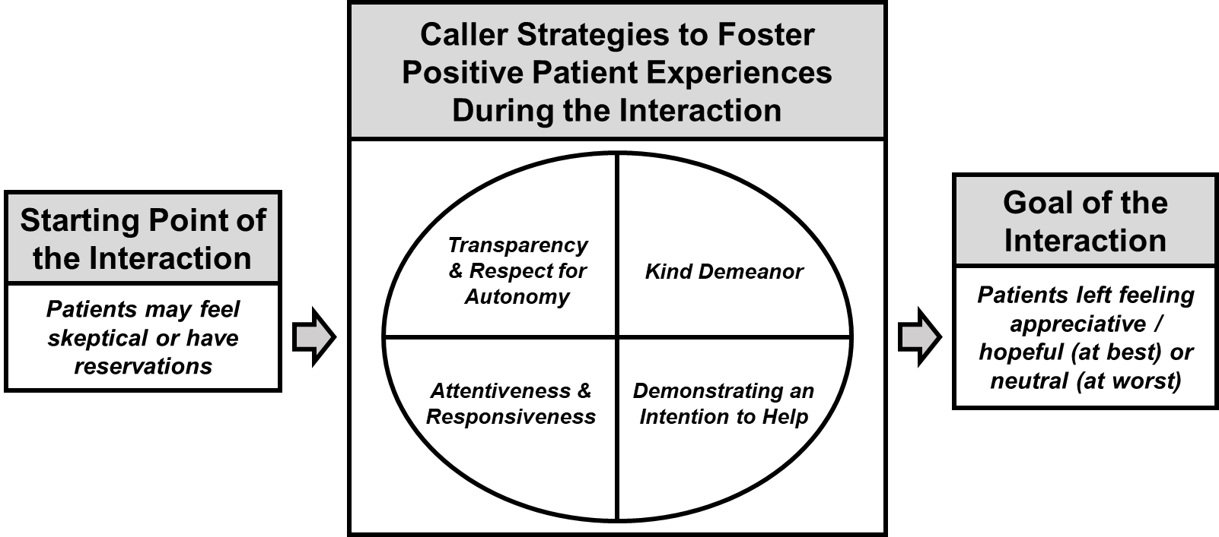
Framework for Fostering Positive Patient Experiences During Phone-based Social Needs Screening & Referral Interactions
Notes:
We used our themes to create a framework for fostering positive patient experiences during phone-based social needs screening and referral interventions. Themes correspond with different time points of the caller-patient social needs screening and referral interaction. For example, at the starting point of the interaction patients may rightfully feel skeptical or have reservations. Callers can then do a variety of things to foster positive patient experiences. They can practice transparency and respect for autonomy, bring a kind demeanor, demonstrate a genuine intention to help, and be attentive and responsive to patients’ circumstances and requests. If callers can put these activities into practice, patients can be left feeling appreciative or hopeful (at best) or neutral about the interaction (at worst). While the goal of these interventions is often to connect patients with relevant resources, first and foremost, it is also critical that healthcare organizations train callers on practices that can help with avoiding harm during these interactions. Our hope is that healthcare organizations can use this framework to practically inform both screener training and support.

Slide 23
Reflections & Lessons Learned for Primary Care Qualitative Research
Teamwork makes the dream work
  Totally fine & encouraged to have team members without prior qual research experience!
Research decisions are made using the information we have
  Choices are made based on the team’s collective expertise, context, and the study aims.
Transparency underscores rigor
  Document the reasons for making the choices you made.
Project management and documentation are crucial! Hooray for spreadsheets!
  Doesn’t need to be fancy!
Notes:
In reflecting on lessons learned for qualitative research in primary care, a few key things jumped out to me. The first is the importance of teamwork at all stages of the qualitative research process. There were countless times in which feedback from mentors, colleagues, and research assistants changed the way I thought about and approached this study, and many of those individuals didn’t have prior qualitative research experience. Further, teaching my research assistants about qualitative analysis both improved my own understanding and was helpful for their professional development.
Next, over-thinking what’s “right” and “wrong” regarding methods and analysis choices in qualitative research isn’t necessarily helpful. When facing difficult decisions, I find it’s typically more helpful to come back to the best choice possible given the goals of the study, the collective expertise of the team, and the realities of your context in terms of both organizational priorities and the resources available to you.
And relatedly, when choices are made, find a way to document them! Transparency underscores rigor because it helps reviewers to understand how deeply you thought about an issue and why you made the choice you made to support the goals of the study.
Finally, project management and documentation, in general, are crucial. I used simple Excel sheets to support basically every stage of this qualitative study and they came in very handy for manuscript writing and accurately reporting what we did.

Slide 24

Presentation 2
Group well-child care intervention for infants of mothers in treatment for opioid use disorder
Neera Goyal, MD
Nemours Childrens Health
Notes:
Now I’d like to introduce our second presenter, Dr. Neera Goyal from Nemours Children’s Health.

Slide 25
Group well child care intervention for infants of mothers in treatment for opioid use disorder
AHRQ Health Services Research Demonstration and Dissemination Grants
  1R18HS027399-01
Single-site cluster-randomized trial
  Aim 1 – Qualitative study: Develop a group-based well child care model for target population
  Aim 2 – Intervention study: Evaluate the process of implementation
  Aim 3 – Intervention study: Evaluate efficacy of group well child care to improve care and outcomes
April 2020 through January 2025

Slide 26
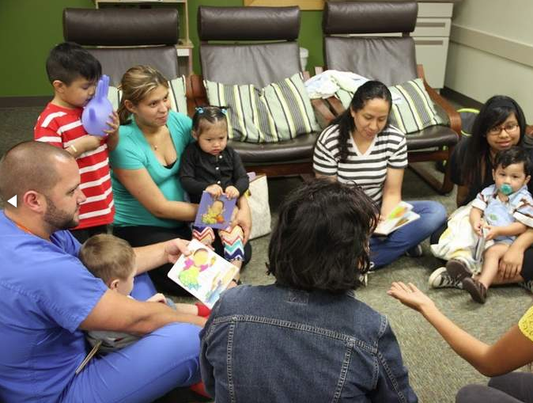
Intervention: Group-based well child care
Parents and their similarly-aged infants receive routine care together
Recommended health assessments, immunizations
PLUS: maternal participation in infant care (i.e. weighing their baby), facilitated group discussions, interactive activities, mindfulness
https://centeringhealthcare.org/what-we-do/centering-parenting

Slide 27
Aim 1 Rationale
Develop a comprehensive group-based well child care model for mothers in treatment for OUD and their children
  Where are the opportunities to improve experience of pediatric primary care?
  What aspects of care should the intervention prioritize in addressing?
  How should we approach implementation of this intervention?

Slide 28
Study Design
Semi-structured interviews to inform intervention design and delivery
  Mothers receiving comprehensive OUD care
  Single, academic treatment center
  English-speaking
  Parenting a child ≤ 2 years old
Pediatric primary care clinicians
Primary care attendings
Resident physicians
Nurses
Single university-affiliated primary care practice

Slide 29
Recruitment
Recruitment of maternal participants
  Flyers, convenience sampling
  Eligibility determination and enrollment via telephone
  Compensated $50 for Aim 1 participation
Recruitment of clinician participants
  Email to all eligible clinicians, followed by reminder 1-month later
  No compensation
No purposive sampling

Slide 30
Sample Size
Thematic saturation
  Point at which no additional issues or insights are identified
  Further data collection becomes redundant
  Affected by sample homogeneity and narrowness of study objectives
Samples size plans were based on prior empirical studies
  Target sample sizes of 30 parents, 15 clinicians
  Planned to enroll additional participants if needed
Actual sample sizes: 31 mothers, 13 clinicians

Slide 31


Study Procedures
1. Brief survey of demographics,
health care experiences
(5 min)
All procedures conducted by phone
  Led by 2 PhD investigators
  Audio recorded
  Transcribed verbatim by Rev
Approved by relevant IRBs
  Waiver of written informed consent
  All participants provided verbal informed consent
2. Semi-structured interviews
(30 min)

Slide 32
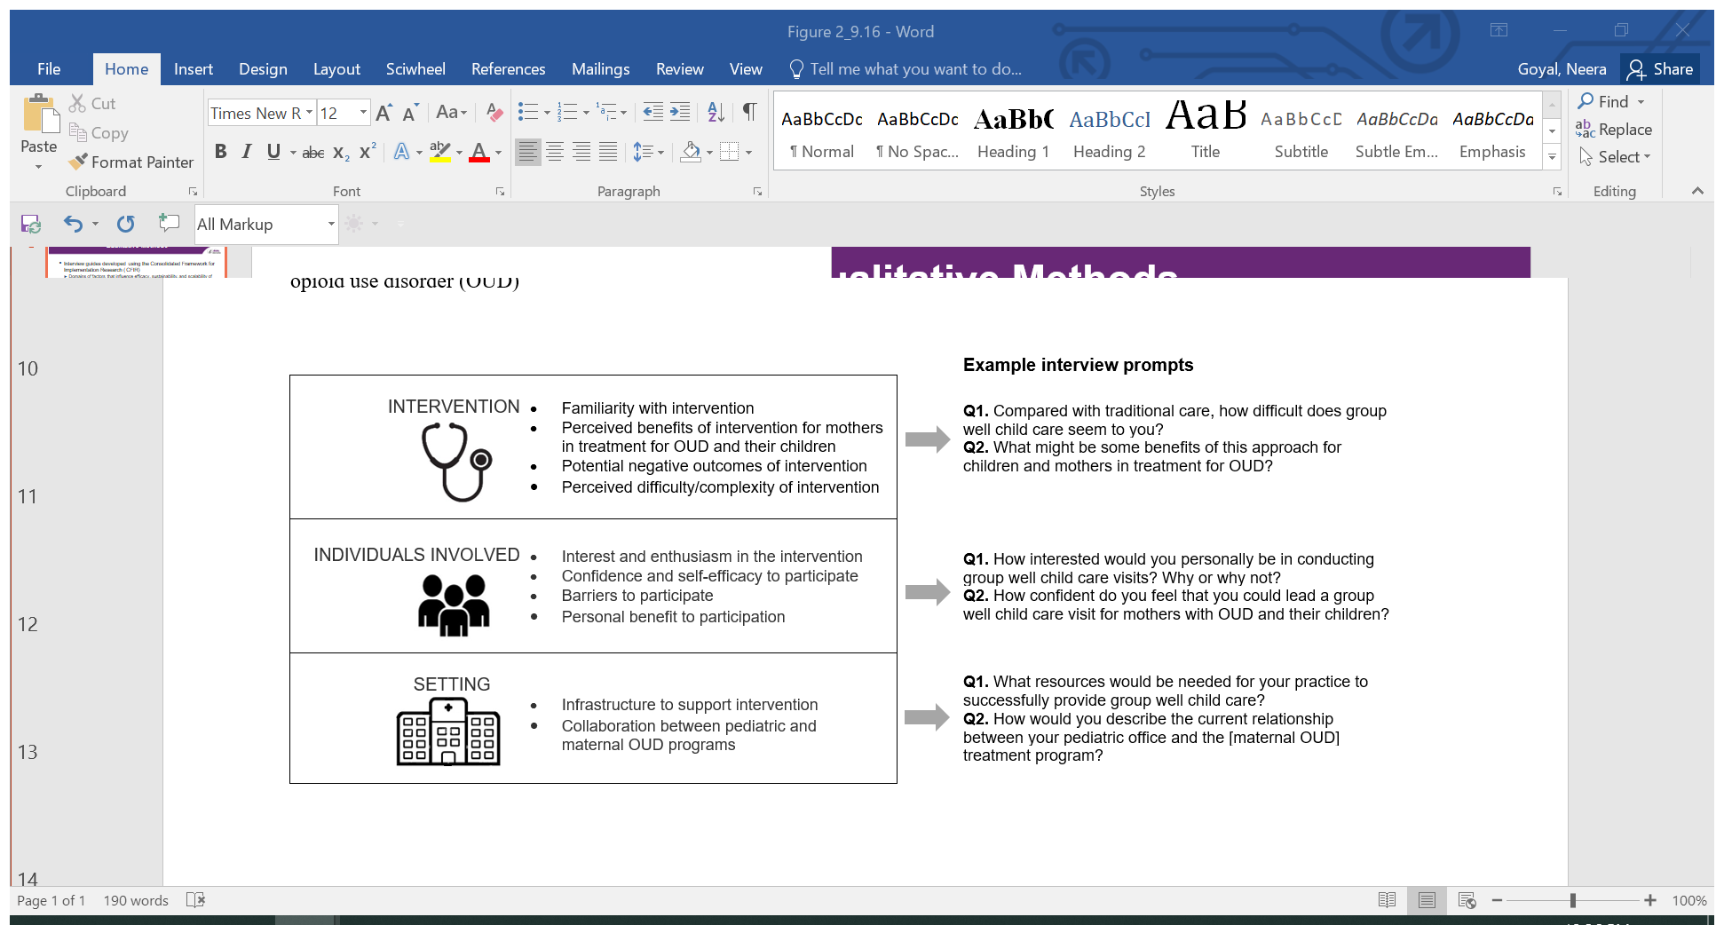
Semi-structured Interviews
Interview guides developed using the Consolidated Framework for Implementation Research (CFIR)
Maternal Interview Prompt |  | Clinician Interview Prompt
At your child’s appointments, was there ever something you talked about with the doctor that was helpful or useful? | INTERVENTION | As a primary care provider, what are your most common concerns for infants and young children whose mothers are in treatment for opioid use disorder (OUD)?
What do you wish you could have discussed more with your child’s doctor? |  | What do you believe are the core (necessary) components of well child care for children whose mothers are in treatment for OUD?
Was there anyone else at your provider’s office that provided you with useful information, such as a nurse? | INDIVIDUALS INVOLVED | What has your training and experience been in working with families affected by OUD?
Are you interested in meeting other moms with a child of the same age? |  | How interested would you personally be in conducting group well child care visits?
If you were given the option of group pediatric care at Family Center, what would make you more likely to participate? How would you feel about group pediatric care counting towards participation in your treatment program? | INNER SETTING | How would you describe the current relationship between your pediatric office and the [university- affiliated OUD treatment] program? What resources would be needed for your practice to successfully provide group well child care?

Slide 33
Analysis
Thematic analyses conducted using an inductive approach
  Emphasizes participants’ experiences, feelings and perceptions
Transcript coding and analysis led by 2 qualitative researchers
  Dedoose V 8.0.35
  8 transcripts (4 maternal, 4 clinician) first coded independently with preliminary thematic categories in mind
  Maternal and clinician codebooks developed through an iterative process
  Meetings to discuss discrepancies, examine code stability, clarify code applications
  9 more transcripts (5 maternal, 4 clinician) used to establish inter-coder reliability (K=.87 and K=.85 respectively)
  Remaining transcripts subsequently divided between coders

Slide 34
Analysis
Coded excerpts organized into emergent themes
  Thematic saturation achieved with small number of clinicians
  Maternal and clinician themes reported together
  Described areas of concordance and discordance between participant groups
Member checked with 2 mothers and 2 clinicians
  Confirmed that findings were generally consistent with their experiences
Debrief sessions also held with the entire research team
Engagement in pediatric care (assets and challenges)
Priorities for pediatric visit content
Barriers and facilitators to group care implementation

Slide 35
Emergent themes
Engaging in pediatric care - 7 themes | Engaging in pediatric care - 7 themes
Assets | Continuity in care Resources to address material needs Clinician OUD training and knowledge
Challenges | Stigma towards maternal OUD Parental knowledge gaps Competing specialized healthcare needs Insufficient time to address all concerns
Priorities for visit content - 5 themes
Improving knowledge and confidence related to child development, behavior, and nutrition Mitigating child safety concerns Addressing complex health and subspecialty needs through care coordination Acknowledging maternal health and wellbeing Health education and care related to neonatal abstinence syndrome
Group well child care implementation- 12 themes
Facilitators: Focus on maternal OUD and recovery Peer support Accessibility and coordination of care Clinician skills and experience with maternal OUD More time for patient care Clinician continuity | Barriers: Resource intensiveness Loss of privacy as a potential negative outcome Difficulty addressing comprehensive care needs Complexity of scheduling Difficulty managing group dynamics COVID-19 exposure as a potential negative outcome

Slide 36
Results
Group well child care – Facilitators
Focus on maternal OUD and recovery | “If they've never had a child on methadone before, and educating them on how this might work or how the babies might deal with coming into the world […] and what their care might look like and what the mother's care might look like and how they can be supported. Because that's really hard.” (M)
Peer support | “I would probably feel more comfortable because I'd already be in like an atmosphere where the other mothers are on the same note as me.” (M)
Accessibility and coordination of care | “I think the biggest benefit is the one-stop shopping, because I think if you can have well-care provided for the child, get them vaccinated, address their issues, et cetera, and then have group counseling available…” (C)
Clinician skills and experience with maternal OUD | “I think it would be so useful, because just feeling comfortable around your own kind almost, and all that, and not feeling judged, and knowing that they have extra experience with people who suffer [from SUD].” (M)
More time for patient care | “You could get to know the patients and their parents a lot better as well, and identify different risks or gaps in care.” (C)
Clinician continuity | “I think you'd have a better personal relationship with your doctor. I think that's important because my daughter had a bunch of different pediatricians.” (M)

Slide 37

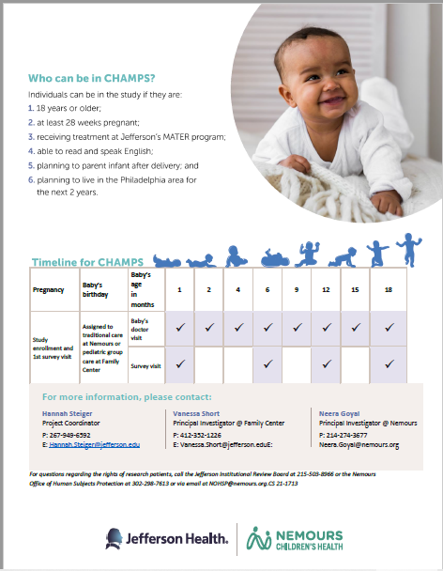
Next steps
Aim 2 – Intervention study: Evaluate implementation of group well child care
  Plans for both formative and summative evaluation
  Mixed-methods approach including quantitative and qualitative assessments (i.e. interviews with participants in intervention arm)

Slide 38
Lessons learned
Importance of patient voice
Sampling approach is a key consideration
Frameworks to guide evaluation are helpful
Multidisciplinary teamwork
Need strategic approach to dissemination

Slide 39

Presentation 3
Comparing Family Decision Making Engagement in Telehealth versus In-person Primary Care for Children with Chronic Conditions
Ellen Lipstein, MD, MPH
Cincinnati Children’s Hospital/University of Cincinnati College of Medicine
Notes:
Now I’d like to introduce our third presenter, Dr. Ellen Lipstein from Cincinatti Children’s Hospital

Slide 40
Comparing Family Decision Making Engagement in Telehealth versus In-Person Primary Care for Children with Chronic Conditions
COVID-19 pandemic led to widespread implementation of telehealth to new clinical areas.
Telehealth continues to be widely used.
Communication and structure of healthcare interaction is different in telehealth compared to in-person care.
Unknown whether quality of care is equivalent.
Any impact on quality of care is particularly relevant for children and adolescents with chronic conditions.

Slide 41
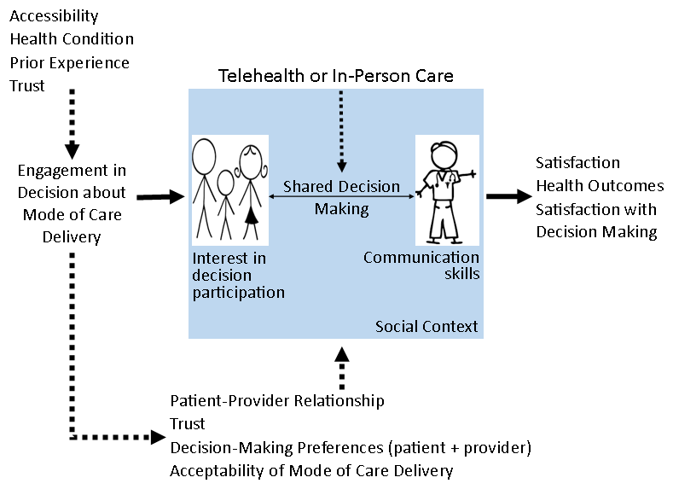
Conceptual Model

Slide 42
Specific Research Aims and Questions
Overall objective of the study:
  Compare the decision-making processes and outcomes between telehealth and in-person pediatric primary care for children with chronic conditions
Aims 1 and 2:
  Compare the effectiveness of telehealth to in-person primary care on perceived and observed shared decision making and clinical outcomes for children with chronic conditions.
Aim 3:
  Develop an in-depth understanding of the decision-making process in telehealth compared to in-person care.

Slide 43
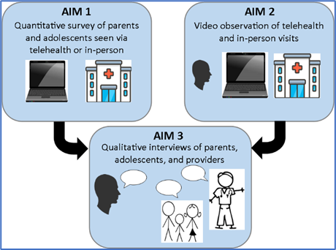
Study Overview

Slide 44
Study Sample
Primary care clinicians who do both in-person and telehealth visits
Families of patients age 5-17 years being seen for asthma, ADHD or eczema
  Video: parents consent, kids assent
  Survey:
    Age 5-11 only collected from parents
    Age 12-17 collected separately from parent and patient

Slide 45
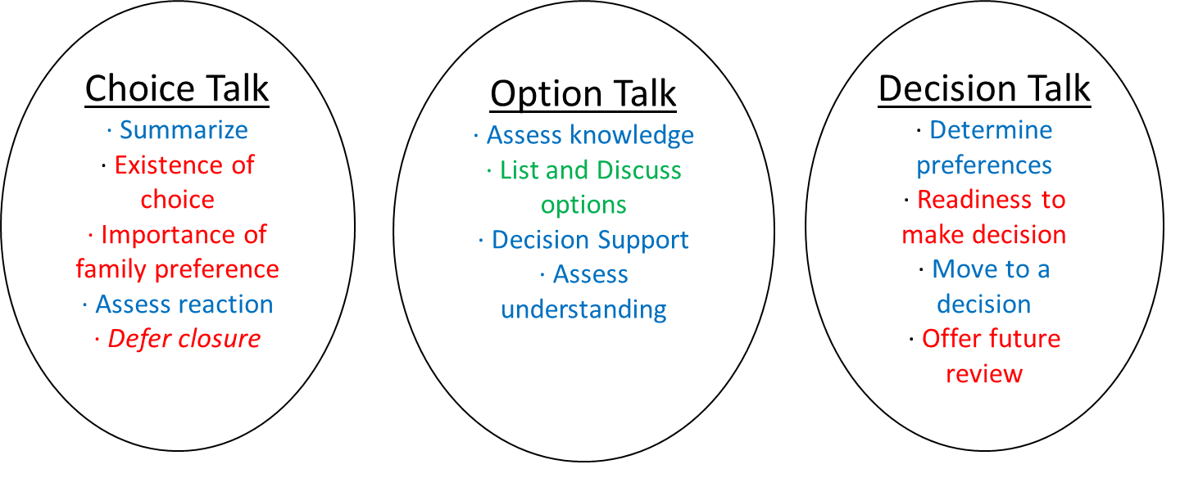
Aims 1 and 2: Observed Shared Decision Making
Prior work: Limited shared decision making in observed visits

Slide 46
Aims 1 and 2: Mixed methods
Observed shared decision making
  Video-recorded clinical encounters analyzed with mixed methods
    Quantitative: OPTION 5
    Qualitative: Content analysis of recordings
      Transcribe
      Review video
      Code from transcripts
Perceived shared decision making and outcomes
  Parent survey, adolescent survey, medical record review

Slide 47
Aim 3: In-depth understanding of decision-making processes
Sequential explanatory approach
Refine and explain findings from Aim 1
Identify areas for future intervention development
  How do we improve whichever modality has less decision engagement?
  Are there types of chronic condition visits that are more appropriate for one modality than the other?
  How do we address any inequities we find?

Slide 48
Aim 3: Methods
Individual interviews with parents, adolescents and healthcare providers
Purposeful sampling
Snowball sampling for providers and families using telehealth outside our hospital system

Slide 49
Benefits and Challenges
Benefits
  Explore understudied areas
  Inform future quantitative work
  Address “deficiencies” in quantitative approaches
Challenges
  Time and labor intensive
  Not generalizable
  Not well understood → funding and publication challenges

Slide 50
Future Directions and Reflections
Potential next steps
  Intervention development
  Comparison of primary care to specialty care
  Role of additional technology
Growth of the reluctant qualitative researcher
  Necessity is the mother of skill development
  With growth in team can delegate some aspects
  Benefit to having specific methodologic expertise

Slide 51
Questions

Slide 52
Thank you
    Stay tuned for the next webinar:
    Tentatively Titled, Research That Includes the Innovative Use of Technology in Primary Care Delivery, September 14, 1:30 ET
Please complete the short evaluation poll after this webinar!
Notes:
Stay tuned for the next webinar in the series, tentatively titled Primary Care Qualitative Studies Funded by AHRQ. Please take the short evaluation poll that will pop up after this webinar. Thank you to our esteemed presenters and to all of you for joining us today!

