Slide 1
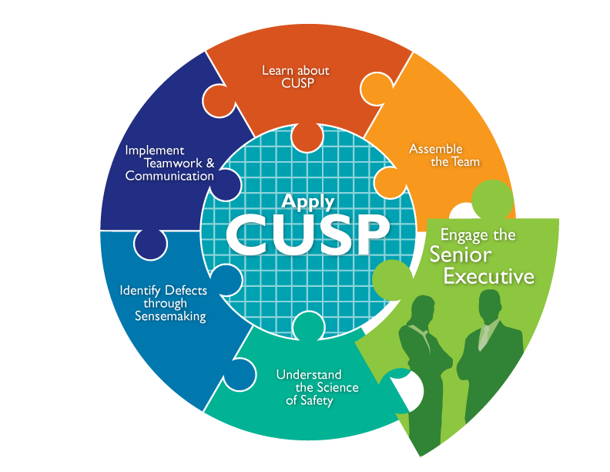

Slide 2
Learning Objectives
Explain how to engage the senior executive and develop shared accountability for the work
Explain the role of the senior executive in addressing technical and adaptive work
Describe the responsibilities of the senior executive
Identify characteristics to search for when recruiting the senior executive
2

Slide 3
Using the 4 E’s for Technical and Adaptive Work¹
Engage
(adaptive)
How does this make the world a better place?
Senior leaders
Educate
(technical)
What do we need to know?
Execute (adaptive)
What do we need to do? How can we do it with our resources and culture?
Team leaders
Staff
Evaluate (technical)
How do we know we improved safety?

Slide 4
Senior Executive’s Characteristics
Vice president level or higher when possible
Actively engaged in progress of project
Interested in clinical care, but not required to be a clinician
Willing to learn from, listen to, and work with staff to improve patient safety on the unit

Slide 5
The Senior Executive’s Characteristics

Slide 6
Senior Executive’s Responsibilities
Emphasizes effective communication
Meets monthly with the CUSP team
Supports the technical and adaptive work of change
Collaborates to develop and implement a plan addressing safety issues
Holds staff accountable for reducing patient harms

Slide 7
The Senior Executive’s Roles and Responsibilities

Slide 8
Emphasizes Effective Communication
Encourages transparent communication
Establishes clear goals for unit safety
Outlines clear project goals and expectations for leaders and staff on CUSP teams

Slide 9
Meets Monthly With the CUSP Team
Joins frontline staff and middle manager for rounds and a 1-hour monthly meeting
Considers patient risks and involves frontline personnel in creating ways to mitigate those risks
Reviews unit data with team and works with direct care providers to establish an improvement plan

Slide 10
Supports Both Technical and Adaptive Work of Change
Technical Work
Addresses problems for which:
the definition is clear
potential solutions are reasonably clear
solutions require minimal learning
Leaders and followers recognize their responsibility for implementing a solution
Teams have the resources necessary to succeed

Slide 11
Supports Both Technical and Adaptive Work of Change
Adaptive Work
Addresses problems that require a change in:
attitudes
beliefs
behaviors
Leaders, staff, and key stakeholders share responsibility for change

Slide 12
Supports Both Technical and Adaptive Work of Change
Technical Work
Synchronizes with team members to create project goals and timelines and outlines the project mission
Coordinates with team members to ensure that necessary structures are in place—staff, roles, authority, and responsibility
Collaborates with team members to maintain the material needs of the project—budgets, resources, space, and staffing
Adaptive Work
Works with team members to clarify the decisionmaking, conflict management, and problemsolving processes
Coordinates with team members to verify that necessary evaluation mechanisms are in place

Slide 13
Collaborates To Develop and Implement a Plan Addressing Safety Issues
Considers patient risks identified in the Staff Safety Assessment with team members
Involves frontline providers to help reduce risks
Helps prioritize hazards and construct an improvement plan

Slide 14
The Senior Executive’s Role on the Team

Slide 15
Holds Staff Accountable for Reducing Patient Harm
Expects resistance and is prepared to address it
Holds all team members, including executives, accountable for implementing the plan

Slide 16
The Challenges of Partnering With a Senior Executive
Lack of clinical background
Lack of recognition for the value of CUSP
Unavailability to meet with the CUSP team regularly

Slide 17
How to Engage Your Senior Executive and Develop Shared Accountability for the Work
Acknowledge the senior executive’s perspective (“What’s in it for me?”)
Increase the visibility of your senior executive
Ensure an executive is assigned to each CUSP team and participates regularly in meetings
List identified safety issues in the Safety Issues Worksheet for Senior Executive Partnership or a tracking log

Slide 18
Exercise
Questions to consider:
What are some effective ways for leaders to work with staff to bring about a change?
How can you use those methods to address the safety issues you identified in your organization?
Using the Shadowing Another Professional Tool, what are some new insights about your colleagues’ work?

Slide 19
Engage the Senior Executive: What the Team Needs to Do
The CUSP team leader or members of the safety team should meet with the senior executive before the executive holds safety rounds to share unit-specific information
In preparation, gather relevant information about the unit for the senior executive
During executive safety rounds, the patient safety team, senior executive, and unit providers should review any safety issues identified and list them on a tracking log
In preparation for executive safety rounds, the unit champion should:
Brief providers on the purpose of partnering with a senior executive
Ask them to be prepared to discuss their own safety concerns and suggestions for resolution during rounds

Slide 20
Summary
The senior executive does not need a clinical background, but should be an active team member
The senior executive is responsible for supporting effective communication, meeting with the CUSP team, understanding technical and adaptive work, collaborating with the team to address safety issues, and holding staff accountable
The 4 E’s and CUSP tools are great resources to help recruit a senior executive

Slide 21
CUSP Tools
Safety Issues Worksheet for Senior Executive Partnership
Staff Safety Assessment
CEO/Senior Leader Checklist
Infection Preventionist Checklist
Board Checklist
Shadowing Another Professional Tool

Slide 22
References
1. Pronovost PJ, Berenholtz SM, Goeschel CA, et al. Creating high reliability in health care organizations. Health Serv Res. 2006;41 (4, pt 2):1599-1617.

