Slide 1
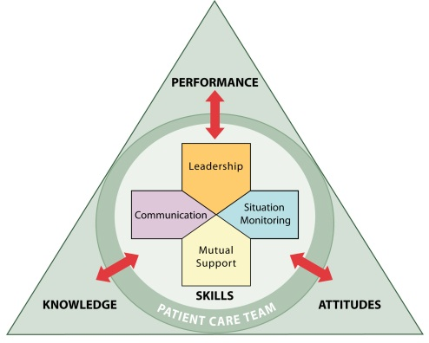
Team Strategies and Tools to Enhance Performance and Patient Safety

Slide 2
Introductions

Slide 3
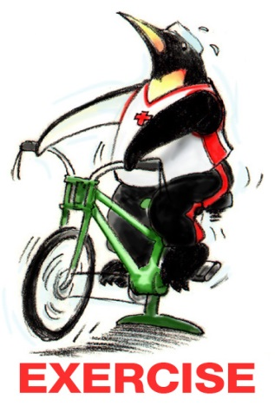
Teamwork Exercise #1

Slide 4
Objectives
Describe the TeamSTEPPS Master Trainer course
Describe the impact of errors and why they occur
Describe the TeamSTEPPS framework
State the outcomes of the TeamSTEPPS framework

Slide 5
Course Agenda
Day 1:
Module 1—Introduction
Module 2—Team Structure
Module 3—Communication
Module 4—Leading Teams
Module 5—Situation Monitoring
Module 6—Mutual Support
Module 7—Summary—Putting It All Together
Day 2:
Change Management: How to Achieve a Culture of Safety
Coaching Workshop
Measurement
Implementation Planning

Slide 6
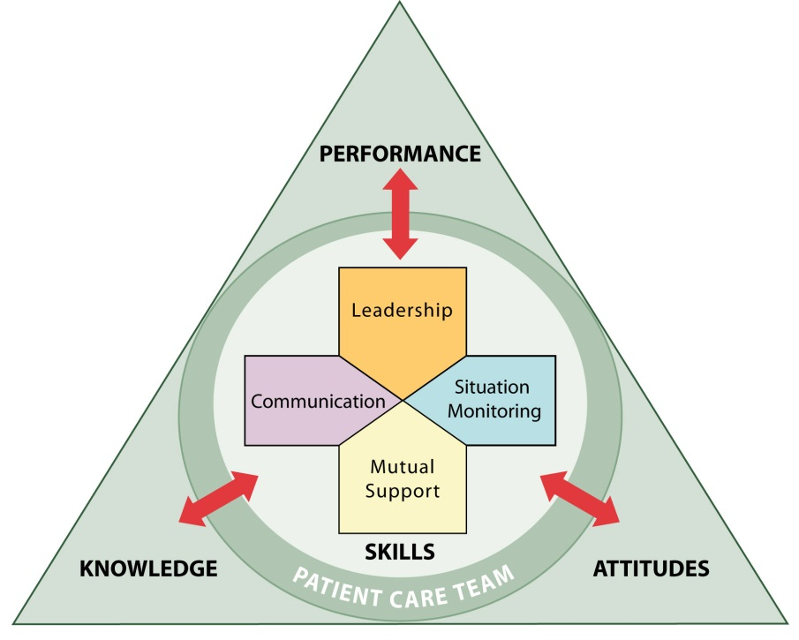
Day 1 - Core Teamwork Skills

Slide 7
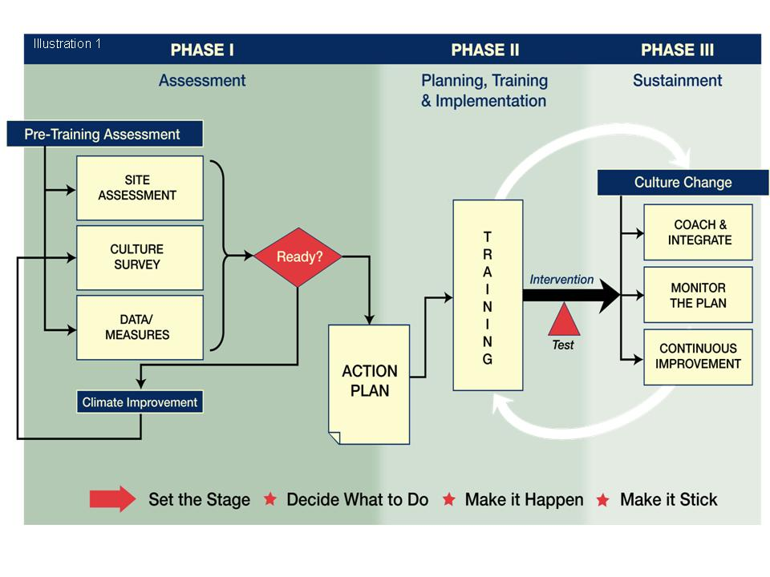
Day 2 – Coach, Implement, Sustain

Slide 8
Master Training Materials
Instructor Manual
Course Management Guide
Instructor guides
Course slides
Measurement tools
Customizable materials
Videos

Slide 9
Sue Sheridan Video

Slide 10
Video Discussion
What breakdowns in teamwork did you observe in the two stories?
How can we prevent medical errors?

Slide 11
Barriers to Team Performance
Inconsistency in team membership
Lack of time
Lack of information sharing
Hierarchy
Defensiveness
Conventional thinking
Varying communication styles
Conflict
Lack of coordination and followup
Distractions
Fatigue
Workload
Misinterpretation of cues
Lack of role clarity

Slide 12
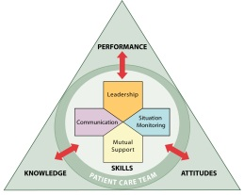
Patient Safety Movement & Team Training
TeamSTEPPS®
TeamSTEPPS Released to the Public
Centers for Medicare & Medicaid Services Partnership for Patients Campaign
“To Err Is Human” IOM Report
JCAHO National Patient Safety Goals
TeamSTEPPS National Implementation Program Began
Institute for Healthcare Improvement
100K lives Campaign
Patient Safety and Quality Improvement Act of 2005
National Implementation of CUSP
DoD MedTeams®
ED Study
Executive Memo from President
1995
1999
2001
2003
2004
2005
2006
2007
2008
2011
Medical Team Training

Slide 13
Team Strategies & Tools to Enhance Performance & Patient Safety
Based on more than 30 years of research and evidence
Team training programs have been shown to improve attitudes, increase knowledge, and improve behavioral skills
Salas, et al. (2008) meta-analysis provided evidence that team training had a moderate, positive effect on team outcomes (ρ = .38)

Slide 14
What Makes Up Team Performance?
Knowledge Cognitions “Think”
Attitudes Affect “Feel”
Skills Behaviors “Do”

Slide 15
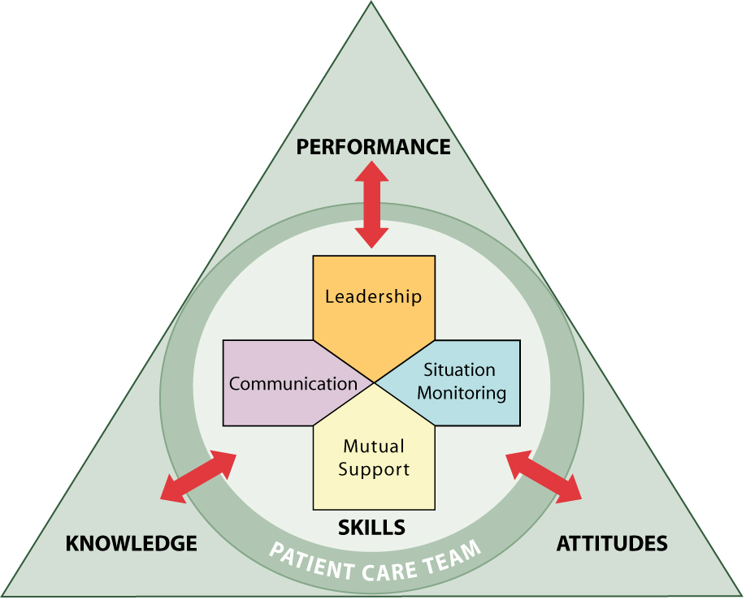
Outcomes of Team Competencies
Knowledge
Shared Mental Model
Attitudes
Mutual Trust
Team Orientation
Performance
Adaptability
Accuracy
Productivity
Efficiency
Safety

Slide 16
High-Performing Teams
Teams that perform well:
Hold shared mental models
Have clear roles and responsibilities
Have clear, valued, and shared vision
Optimize resources
Have strong team leadership
Engage in a regular discipline of feedback
Develop a strong sense of collective trust and confidence
Create mechanisms to cooperate and coordinate
Manage and optimize performance outcomes
(Salas, et al., 2004)

Slide 17
Evidence That TeamSTEPPS Works
Capella, et al. (2010)
Trauma resuscitation team implementation
Pre- and post-TeamSTEPPS training results:
Team performance improved across all teamwork skills: Leadership, Situation Monitoring, Mutual Support, Communication
Significantly decreased times from arrival to CT scanner, endotracheal intubation, and operating room
Thomas & Galla (2013)
Systemwide implementation
Pre- and post-TeamSTEPPS training results:
Significant improvement in HSOPS scores on Feedback and Communication About Error, Frequency of Events Reported, Hospital Handoffs and Transitions, and Teamwork Across Units
Incremental changes evident through reduction of nosocomial infections, falls, birth trauma, and other incidents

Slide 18
Applying TeamSTEPPS Exercise
Please answer the following question on your TeamSTEPPS Implementation Worksheet, which we will continue to complete at the end of each of the Fundamentals Course modules:
What is the patient safety issue your organization is facing that is linked to a problem with teamwork?

