Slide 1
Measurement

Slide 2
Objectives
Describe the importance of measurement
Describe the Kirkpatrick model of training evaluation
Identify measures that can be used to assess the impact of TeamSTEPPS
Describe the AHRQ Surveys on Patient Safety Culture
Prepare a plan for determining if TeamSTEPPS worked

Slide 3
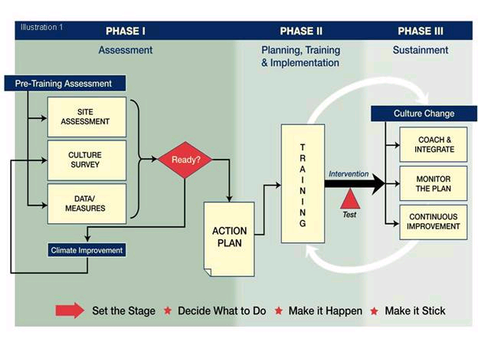
TeamSTEPPS Phases
Requires
Measurement

Slide 4
How to Measure - Kirkpatrick
M
U
L
T
I
L
E
V
E
L
A
P
P
R
O
A
C
H
Level IV – Results
(Organizational results)
Level III – Behavior
(Transfer to the job)
Level II – Learning
(Think, Do, Feel)
Level I – Reactions
(Like it and Useful)

Slide 5
Available Measures
Reactions
Course Evaluation Form
Learning
Teamwork Attitudes Questionnaire (T-TAQ)
Learning Benchmarks
Team Performance Observation Tool
Teamwork Perceptions Questionnaire (T-TPQ)
Behavior
Team Performance Observation Tool
Teamwork Perceptions Questionnaire (T-TPQ)
AHRQ Surveys on Patient Safety Culture
Results
Patient outcome and clinical process measures
AHRQ Surveys on Patient Safety Culture
Patient Safety Indicators

Slide 6
Course Evaluation Form
Level I Reactions
Found in Tab F
Includes evaluation questions for all available course modules
Customizable
Provides information about what trainees thought about the training

Slide 7
TeamSTEPPS Teamwork Attitudes Questionnaire (T-TAQ)
Level II Learning
Found in Tab F
30-item self-report tool
Respondents rate their agreement with items on a 5-point Likert scale
Measures attitudes toward:
Team Structure
Leadership
Situation Monitoring
Mutual Support
Communication
TeamSTEPPS Materials and Tools

Slide 8
Learning Benchmarks
Level II Learning
Found in Tab F
A 23-item multiple-choice test
Uses:
To assess knowledge of teamwork
To measure changes in knowledge
Caution
Items tend to be too easy

Slide 9
Team Performance Observation Tool
Level II Learning and Level III Behavior
Found in Tab F
Tool for observing team performance
Site assessment
Measure training effectiveness
Observers should practice using the tool
Can be adapted to a particular unit

Slide 10
TeamSTEPPS Teamwork Perceptions Questionnaire (T-TPQ)
Level II Learning and Level III Behavior
Found in Tab F
35-item self-report tool
Respondents rate their agreement with items on a 5-point Likert scale
Measures staff perceptions of:
Team Structure
Leadership
Situation Monitoring
Mutual Support
Communication
TeamSTEPPS Materials and Tools

Slide 11
Level III: Behavior
Measure whether information learned during training is transferred to the job
Two important factors in transfer are:
Whether there is an opportunity to use the new TeamSTEPPS tools or strategies on the job
Whether use of the TeamSTEPPS tools and strategies is valued and reinforced

Slide 12
Behavior: Measures
Team Performance Observation Tool
Teamwork Perceptions Questionnaire (T-TPQ)
AHRQ Surveys on Patient Safety Culture

Slide 13
Level IV: Results
Patient Outcome Measures
Examples: Complication rates, infection rates, measurable medication errors, and patient perceptions of care and satisfaction with their care
Clinical Process Measures
Examples: Length of patient wait time, time to intubate, medication administration delays, compliance with preventive screenings, number of misdiagnoses, number of structured handoffs used

Slide 14
AHRQ Surveys on Patient Safety Culture
Free, easy-to-use surveys to assess patient safety culture
Available for various contexts:
Hospital
Medical Office
Nursing Home
Pharmacy
Available on the AHRQ Website

Slide 15
Hospital Survey on Patient Safety Culture
Level III Behavior and Level IV Results
Composed of 51 items and 12 composites
Comprehensive instrument that assesses staff perceptions of patient safety culture
Hospitalwide
Specific work area or unit
Comparative database
Voluntarily submitted data from U.S. hospitals

Slide 16
How Can Hospitals Use the Survey on Patient Safety Culture?
Raise awareness about patient safety issues
Assess patient safety culture
Track changes in patient safety culture over time
Evaluate the impact of patient safety interventions (e.g., TeamSTEPPS)

Slide 17
Survey Measures: 12 Areas of Patient Safety and Two Overall Items
Unit-level safety areas
Hospitalwide safety areas
Hospital management support for patient safety
Teamwork across hospital units
Hospital handoffs and transitions
Overall perceptions of safety
Frequency of events reported
Supervisor/manager expectations and actions promoting safety
Organizational learning—continuous improvement
Teamwork within units
Communication and openness
Feedback and communication about error
Nonpunitive responses to error
Staffing
Overall items
The patient safety “grade” respondents would assign their work area/unit
The number of events the respondent reported in the last 12 months

Slide 18
What Support Is Available?
Hospital Survey Toolkit
Survey forms
Survey items and dimensions
Survey User’s Guide
Survey feedback report template
Data entry and analysis tool
Comparative database and reports
AHRQ Patient Safety Link
E-mail Questions to:
SafetyCultureSurveys@westat.com or
DatabasesOnSafetyCulture@westat.com

Slide 19
AHRQ Patient Safety Indicators (PSIs)
Level IV Results
Provide information on potential in-hospital complications and adverse events
Can help identify potential adverse events that might need further study
Include indicators for in-hospital complications that may represent patient safety events
Quality Indicators

Slide 20
Evaluating TeamSTEPPS Exercise
Three nurses and the infection control officer at a 16-bed post-surgical intensive care unit attend the 2-day TeamSTEPPS Master Training course. During the implementation planning session, the team agrees that hand hygiene compliance is a major problem, especially physician compliance. As a result, the unit has a relatively high surgical site infection rate. The team decides to use the CUS and Two-Challenge Rule tools as strategies to address this issue. As part of their implementation, they train all the nurses and the employed physician staff on these two tools, but struggle with getting surgeons who are not employed by the hospital to participate. Once the training is complete, they decide to launch the implementation of CUS and the Two-Challenge Rule.

