Slide 1
Implementation Planning

Slide 2
Objectives
Describe the steps involved in implementing TeamSTEPPS
Develop a TeamSTEPPS Implementation Plan

Slide 3
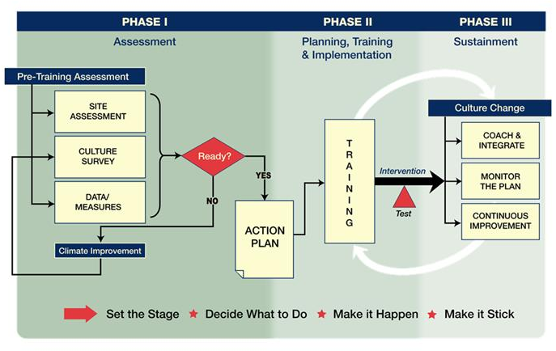
Shift Toward a Culture of Safety

Slide 4
Key Principles of Implementation
The Implementation Guide is based on the principle of improving patient safety and quality of care by improving health care team processes. Key activities include:
Identifying a recurring problem or opportunity for improvement
Developing a flowchart or map of the process
Studying the process to identify risk points
Implementing interventions aimed at eliminating the risk points
Testing the intervention
Sustaining positive changes

Slide 5
10 Steps of Implementation Planning
Create a Change Team
Define the problem, challenge, or opportunity for improvement
Define the aim(s) of your TeamSTEPPS intervention
Design a TeamSTEPPS intervention
Develop a plan for testing the effectiveness of your TeamSTEPPS intervention
Develop an implementation plan
Develop a plan for sustained continuous improvement
Develop a communications plan
Develop a TeamSTEPPS Implementation Plan timeline
Review your TeamSTEPPS Implementation Plan with key stakeholders and modify according to input

Slide 6
Describe the Targeted Unit/Work Area
Name of targeted unit/work area:
Size of unit/work area:
Number of staff within unit/work area:
Physicians:
Nurses:
Other:
Key Actions:
Describe the targeted unit or work area
Unit/Work area name
Size in terms of number of beds or admissions
Number of staff by profession

Slide 7
Step 1: Create a Change Team
Key Actions:
Select a multidisciplinary Change Team
Ensure representation from different leadership levels
Ensure at least one member has completed TeamSTEPPS Master Training
Ensure one member has experience in performance improvement
Team Member | Role | TeamSTEPPS Trained?

Slide 8
Step 2: Define the Problem or Opportunity for Improvement
Key Actions:
Review unit performance and safety data
Incident reports
AHRQ patient safety survey
Clinical process and outcome measures
Review RCAs and/or FMEAs
Ask frontline staff
Conduct the Magic Wand exercise
Refer to the teamwork issue you identified on the TeamSTEPPS Implementation Worksheet as a starting point, if applicable
What existing information will you review?
1.
2.
3.
What new information will you collect?
1.
2.
3.
What are the main problems and opportunities?
1.
2.
3.

Slide 9
Example: Problem Definition
Problem:
Suboptimal communication among surgical team members
Team Process:
What: Communication of critical information about the patient and surgical procedure
Who: Surgeons, anesthesiologists, operating room nurses, and scrub technicians in the General Surgery Service
When: Just prior to first incision
Where: In the operating room

Slide 10
Step 3: Define the Aims of TeamSTEPPS Intervention
Key Actions:
Develop one to three measurable aims
What do you hope to achieve?
Who will be involved?
When and where will the improvements occur?
Consider including team process, team outcome, and clinical outcome aims
Team Process Aim(s)
1.
2.
3.
Team Outcome Aim(s)
1.
2.
3.
Clinical Outcome Aim(s)
1.
2.
3.

Slide 11
Step 4: Design a TeamSTEPPS Intervention
Key Actions:
Flowchart or map the process during which the target problem/ challenge/opportunity occurs
Identify risk points
Determine which TeamSTEPPS tools or strategies would work best to eliminate the process risk points
State what tools and strategies will be implemented; who will use them, when and where (Refer to your responses on the TeamSTEPPS Implementation Worksheet, if applicable)
Evaluate your TeamSTEPPS intervention for potential benefits and negative effects
List the risk points you intend to address
1.
2.
3.
List the TeamSTEPPS tools and strategies that will be implemented
1.
2.
3.
List the order in which the tools and strategies will be implemented
1.
2.
3.

Slide 12
Step 5: Develop a Plan for Testing Your TeamSTEPPS Interventions
Who is responsible?
At what level will you measure and what measures will you use?
1. Level I Reactions
2. Level II Learning
3. Level III Behavior
4. Level IV Results
Key Actions:
Identify who on your Change Team will be responsible for data collection, analysis, and presentation (generation of graphs and charts)
Identify a measure and define target ranges for that measure
Measure before and after you implement TeamSTEPPS
Consider Kirkpatrick’s taxonomy when selecting measures

Slide 13
Step 6. Develop an Implementation Plan
Who will attend the training sessions?
What skills will you train?
When will the training sessions occur and for how long?
Where will the sessions occur?
How will you train (method of presentation, tools, supplies)?
What are the logistics to consider?
Key Actions:
Determine who needs to be trained on what TeamSTEPPS skills and by when
Develop a training plan for each audience
Determine if refresher training is required
Create training timelines

Slide 14
Determine How Coaches May Be Used
Will coaches be used?
If Yes:
Number required:
When will coaches be trained?
How will coaches be trained?
How will coaches be used?
What are the expectations for the role of coaches?
Key Actions:
Determine whether coaches will be used to facilitate sustainment
If coaches will be used, determine:
How many are needed
When and how they will be trained
How they will be used
Expectations for the role of coaches

Slide 15
Step 7: Develop a Sustainment Plan
Identify Components of a Monitoring Plan:
1. Measures and Targeted Outcomes
2. Data Sources
3. Resource Requirements
4. Individual Responsible
Key Actions:
For your monitoring plan, determine:
Measures and target outcomes
Data source (e.g., existing QI database)
Resources required (money, time, equipment, personnel, expertise)
Person(s) responsible for implementation and oversight
Determine how data from your monitoring plan will be used to continually improve processes and performance

Slide 16
Step 8: Develop a Communications Plan
Who are the stakeholders?
1.
2.
What do you want to achieve?
1.
2.
What information will you communicate?
1.
2.
When will you communicate?
1.
2.
How will you communicate?
1.
2.
Key Actions:
Develop a communication plan:
Identify goals for communication with this group. What do you want to achieve?
Who will receive the information?
What information will you communicate?
When and how often will you communicate?
How will you communicate (e.g., reports, presentations, emails)?

Slide 17
Step 9. Develop an Implementation Plan Timeline
Step | Lead | Completion Date | Resources Required
1. Identify the Change Team
2. Define the Main Problems
3. Define TeamSTEPPS Aims
4. Describe the Intervention
5. Develop a Test Plan
6. Develop an Implementation Plan
7. Develop a Monitoring Plan
8. Develop a Communication Plan

Slide 18
Change Team Meetings
Purpose | Lead | Meeting Date
Notes:
18

Slide 19
Step 10: Review Your Plan with Key Stakeholders
Key Actions:
Identify stakeholders who could contribute significantly to the Implementation Plan
Ask key stakeholders to review your Action Plan and to provide input
Modify your Action Plan based on their input, if needed
Who are the key stakeholders that need to review the plan?
1.
2.
3.
4.
5.

Slide 20
TeamSTEPPS Implementation Planning Exercise
Break into working groups by unit or by best alignment of common issues
Develop your Action Plan based on the 10-step process
Be ready to present and discuss your Action Plan with the larger group

