Slide 1
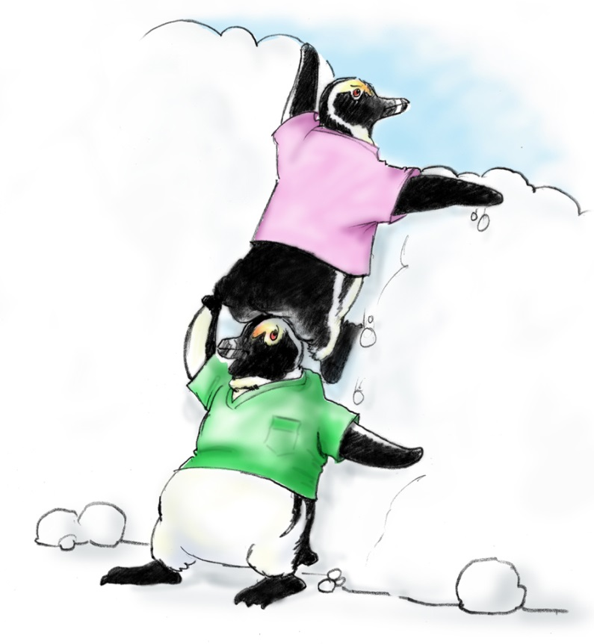
Practice Teaching Session

