Slide 1
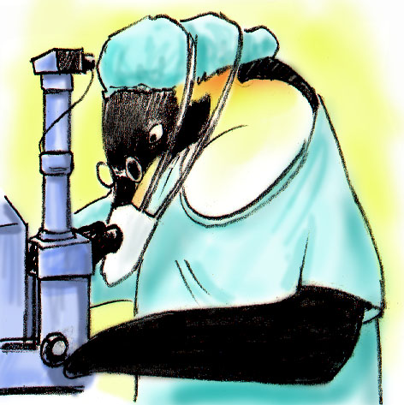
Team Structure
NEXT:

Slide 2
Objectives
Discuss benefits of teamwork and team structure
Define a “team”
Identify the role of patients and their families as part of the care team
Describe the components and composition of a multi-team system

Slide 3
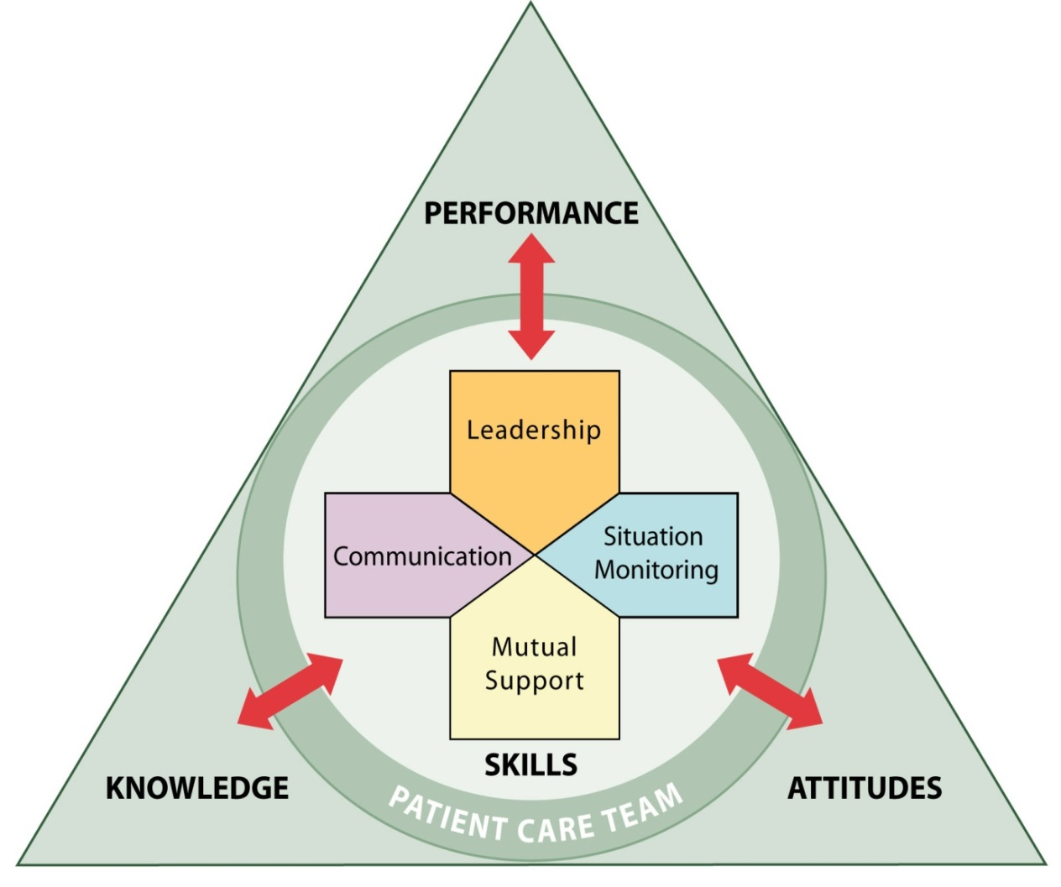
Team Structure
Teamwork cannot occur in the absence of a clearly defined team
Understanding a team’s structure and how multiple teams interact is critical for implementation planning

Slide 4
What Defines a Team?
Two or more people who interact dynamically, interdependently, and adaptively toward a common and valued goal, have specific roles or functions, and have a time-limited membership

Slide 5
Exercise: Teams and Teamwork
Write down the names (or positions) of the people in your immediate work area or unit who contribute to successful patient care.

Slide 6
Partnering With the Patient
Strategies for involving patients in their care
Include patients in bedside rounds
Conduct handoffs at the patient’s bedside
Provide patients with tools for communicating with their care team
Involve patients in key committees
Actively enlist patient participation

Slide 7
Clinical Team Responsibilities
Embrace patients and their families as valuable and contributing partners in patient care
Listen to patients and their families
Assess patients’ preference regarding involvement
Ask patients about their concerns
Speak to them in lay terms
Allow time for patients and families to ask questions
Ask for their feedback
Give them access to relevant information
Encourage patients and their families to proactively participate in patient care

Slide 8
Patient and Family Responsibilities
Provide accurate patient information
Comply with the prescribed plan of care (e.g., schedule and attend appointments as directed)
Ask questions and/or voice any concerns regarding the plan of care
Monitor and report changes in the patient’s condition
Manage family members
Follow instructions of the clinical team

Slide 9
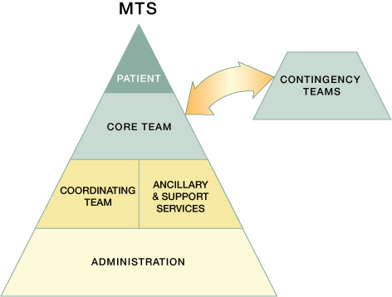
Multi-Team System (MTS) for Patient Care

Slide 10
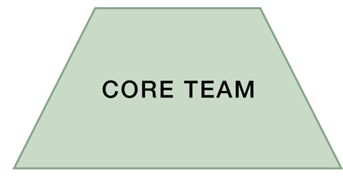
A Core Team is…
A group of care providers
who work interdependently
to manage a set of
assigned patients
from point of
assessment to
disposition
Core Team members have the closest contact with the patient!

Slide 11
A Contingency Team is…
A time-limited team formed
for emergent or specific
events and composed
of members from
various teams

Slide 12
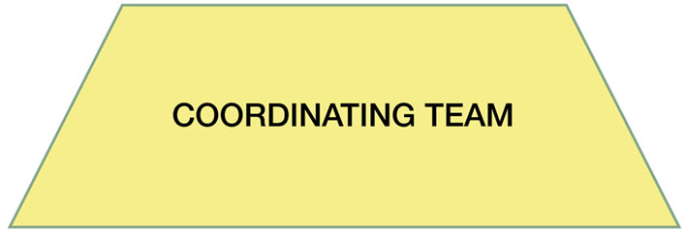
A Coordinating Team is…
A team comprising those
work area members who are
responsible for managing
the operational
environment that
supports the
Core Team

Slide 13
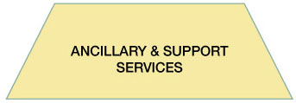
Ancillary & Support Services
Ancillary Services provide direct, task-specific, time-limited care to patients.
Support Services provide indirect service-focused tasks which help to facilitate the optimal health care experience for patients and their families.

Slide 14
The Role of Administration is to…
Establish and communicate vision
Develop policies and set expectations for staff related to teamwork
Support and encourage staff during implementation and culture change
Hold teams accountable for team performance
Define the culture of the organization

Slide 15
Team Structure Video

Slide 16
Team Structure Video Analysis
What members of the following teams were involved in the scenario?
Core team
Coordinating team
Contingency team
Ancillary and support services
Where did the breakdowns occur between the components of this multi-team system?
What could the individuals involved in this scenario have done differently to produce a better outcome?

Slide 17
Applying TeamSTEPPS Exercise
Who are the members of the team experiencing a teamwork issue?
Which team or teams within your multi-team system are experiencing the teamwork issue? Which team or teams interact with or are otherwise affected by the team(s) experiencing the issue?

