Slide 1
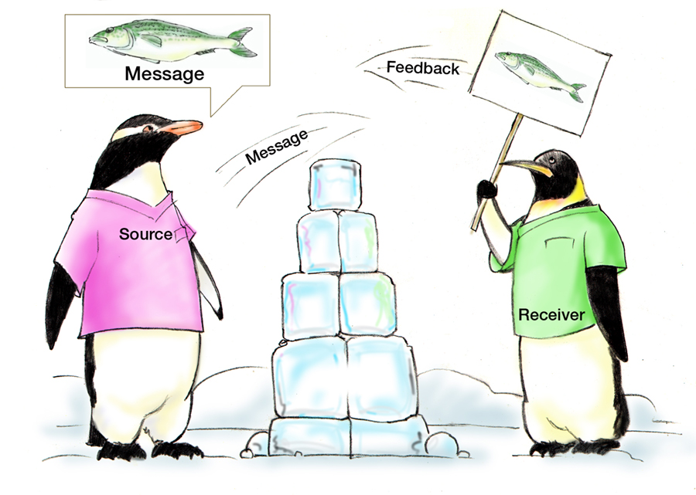
Communication
Assumptions
Fatigue
Distractions
HIPAA

Slide 2
Objectives
Describe how communication affects team processes and outcomes
Define effective communication
Identify communication challenges
Identify TeamSTEPPS tools and strategies that can improve a team’s communication

Slide 3
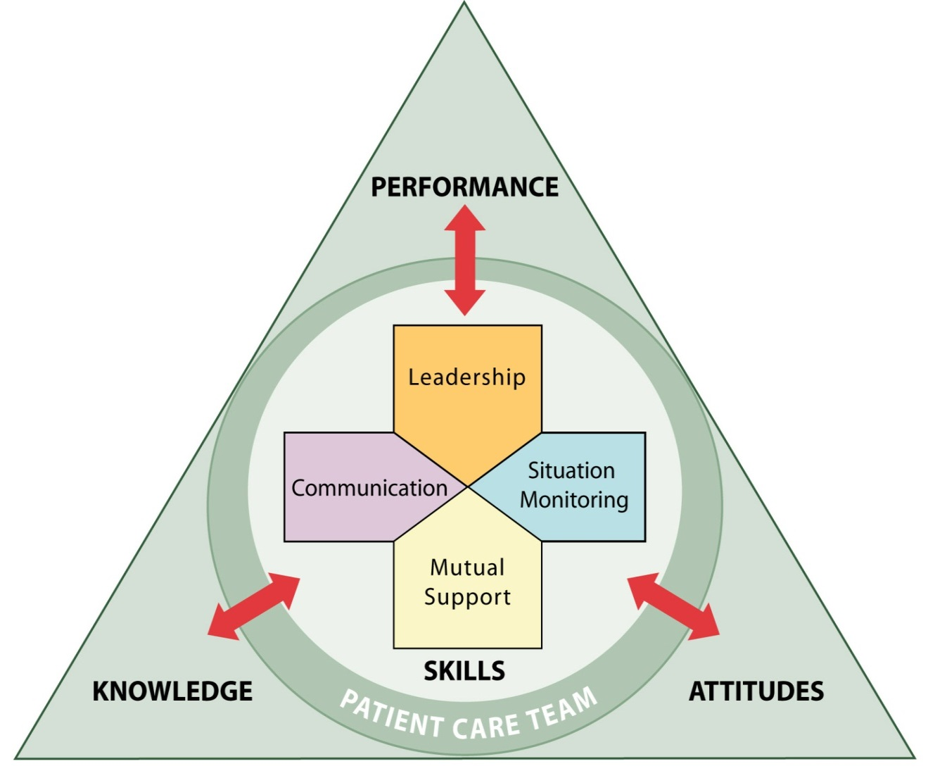
Communication
Effective communication skills are vital for patient safety
Enables team members to effectively relay information
The mode by which most TeamSTEPPS strategies and tools are executed

Slide 4
Importance of Communication
Joint Commission data continues to demonstrate the importance of communication in patient safety
1995 - 2005: Ineffective communication identified as root cause for nearly 66 percent of all reported sentinel events*
2010 - 2013: Ineffective communication among top 3 root causes of sentinel events reported**
* (JC Root Causes and Percentages for Sentinel Events (All Categories) January 1995−December 2005)
** (JC Sentinel Event Data (Root Causes by Event Type) 2004-2012)

Slide 5
Communication is…
The process by which information is exchanged between individuals, departments, or organizations
The lifeline of the Core Team
Effective when it permeates every aspect of an organization
Assumptions
Fatigue
Distractions
HIPAA

Slide 6
Standards of Effective Communication
Complete
Communicate all relevant information
Clear
Convey information that is plainly understood
Brief
Communicate the information in a concise manner
Timely
Offer and request information in an appropriate timeframe
Verify authenticity
Validate or acknowledge information

Slide 7
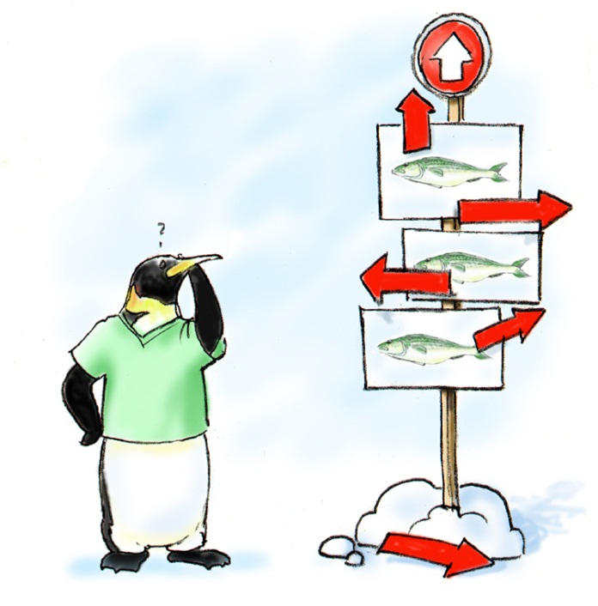
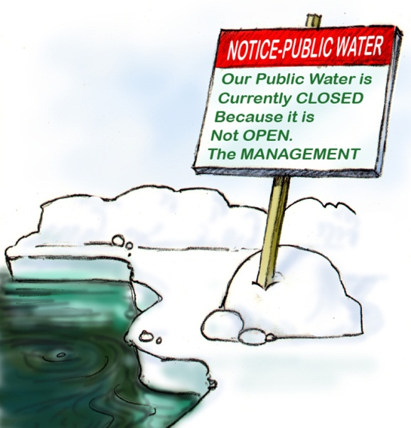
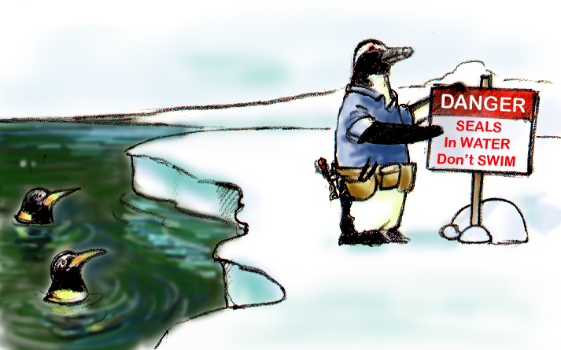
Brief
Clear
Timely

Slide 8
Communication Challenges
Language barrier
Distractions
Physical proximity
Personalities
Workload
Varying communication styles
Conflict
Lack of information verification
Shift change

Slide 9
Information Exchange Strategies
Situation – Background – Assessment – Recommendation (SBAR)
Call-Out
Check-Back
Handoffs

Slide 10
SBAR Provides…
A framework for team members to effectively communicate information to one another
Communicate the following information:
Situation―What is going on with the patient?
Background―What is the clinical background or context?
Assessment―What do I think the problem is?
Recommendation―What would I recommend?

Slide 11
SBAR Video
Notes:
For SBAR video, go to: https://youtu.be/nbJPAumzJrc

Slide 12
SBAR Exercise
Create an SBAR example based on your role.

Slide 13
Call-Out is…
A strategy used to communicate important or critical information
It informs all team members simultaneously during emergency situations
It helps team members anticipate next steps

Slide 14
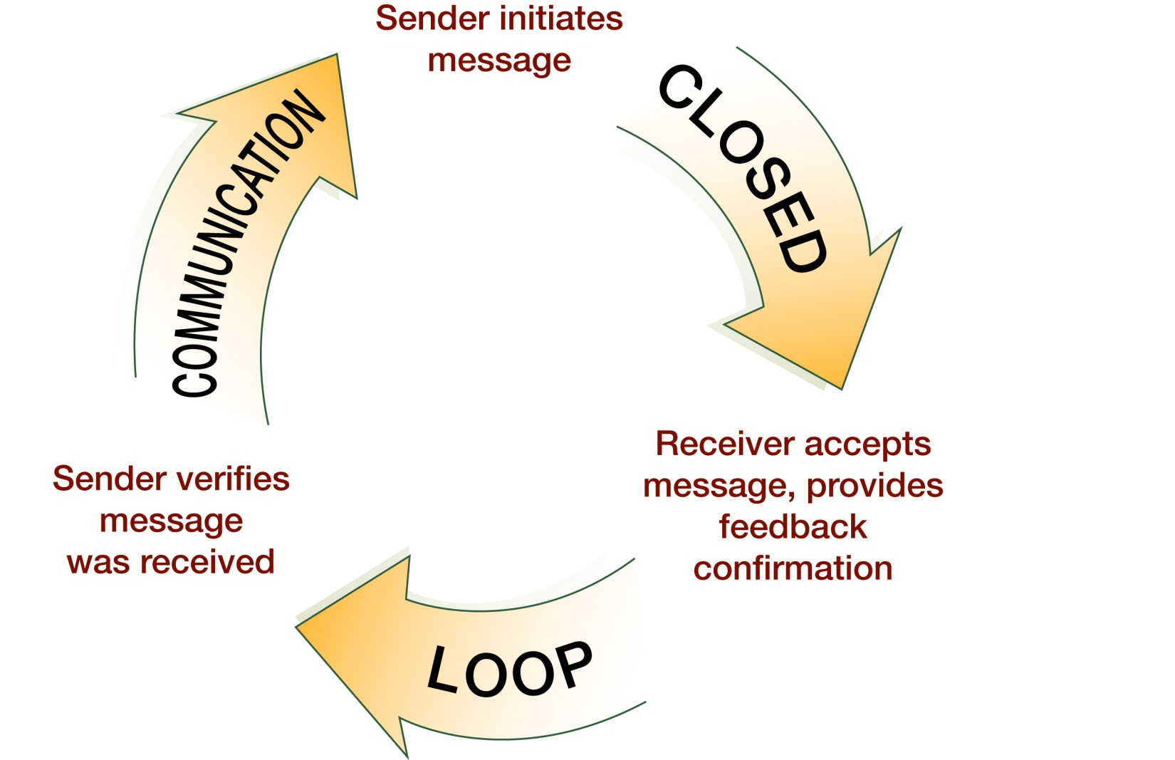
Check-Back is…

Slide 15
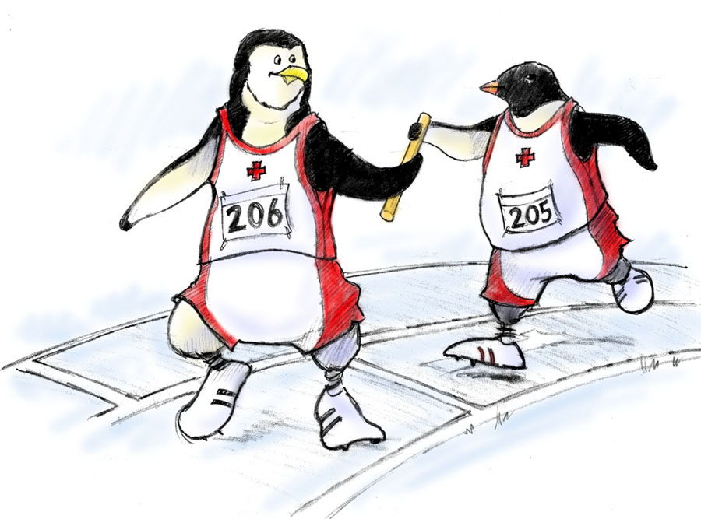
Handoff is…
The transfer of information during transitions in care across the continuum
Includes an opportunity to ask questions, clarify, and confirm
15

Slide 16
Handoff Consists of…
Transfer of responsibility and accountability
Clarity of information
Verbal communication of information
Acknowledgment by receiver
Opportunity to review
16

Slide 17
“I PASS THE BATON”
Introduction: Introduce yourself and your role/job (include patient)
Patient: Identifiers, age, sex, location
Assessment: Present chief complaint, vital signs, symptoms, and diagnosis
Situation: Current status/circumstances, including code status, level of uncertainty, recent changes, and response to treatment
Safety: Critical lab values/reports, socioeconomic factors, allergies, and alerts (falls, isolation, etc.)
THE
Background: Comorbidities, previous episodes, current medications, and family history
Actions: What actions were taken or are required? Provide brief rationale
Timing: Level of urgency and explicit timing and prioritization of actions
Ownership: Who is responsible (nurse/doctor/team)? Include patient/family responsibilities
Next: What will happen next? Anticipated changes? What is the plan? Are there contingency plans?

Slide 18
Other Example Handoff Tools
ANTICipate
Administrative Data; New clinical information; Tasks to be performed; Illness severity; Contingency plans for changes
I PASS
Illness severity; Patient Summary; Action list for the new team; Situation awareness and contingency plans; Synthesis and “read back” of the information
SHARQ
Situation; History; Assessment; Recommendations/Result; Questions

Slide 19
Tools & Strategies Summary
BARRIERS
Inconsistency in Team Membership
Lack of Time
Lack of Information Sharing
Hierarchy
Defensiveness
Conventional Thinking
Complacency
Varying Communication Styles
Conflict
Lack of Coordination and Followup with Coworkers
Distractions
Fatigue
Workload
Misinterpretation of Cues
Lack of Role Clarity
TOOLS and STRATEGIES
Communication
SBAR
Call-Out
Check-Back
Handoff
OUTCOMES
Shared Mental Model
Adaptability
Team Orientation
Mutual Trust
Team Performance
Patient Safety!!

Slide 20
Applying TeamSTEPPS Exercise
Is your teamwork issue related to communication?
If yes, what is the communication issue?
Which TeamSTEPPS tools and/or strategies might you consider implementing to address the issue?

