Slide 1
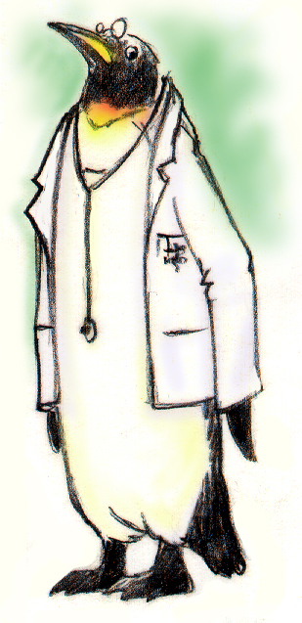
Leading Teams

Slide 2
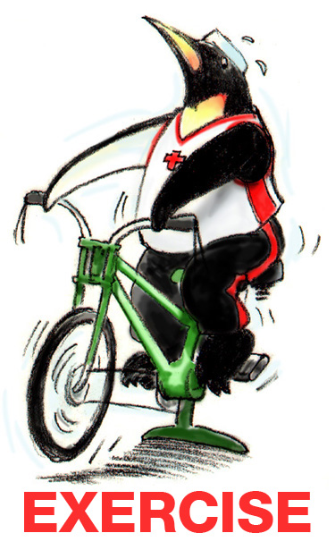
Exercise: Leadership
INSTRUCTIONS:
Begin by selecting a leader and scribe for your group.
The group will have 10 minutes to address the questions, record your answers, and report back to the group at large.

Slide 3
Objectives
Describe how leadership affects team processes and outcomes
Identify different types of team leaders
Describe the activities involved in successfully leading teams
Describe the tools for leading teams, including briefs, huddles, and debriefs
Apply the tools for leading teams to specific clinical scenarios

Slide 4
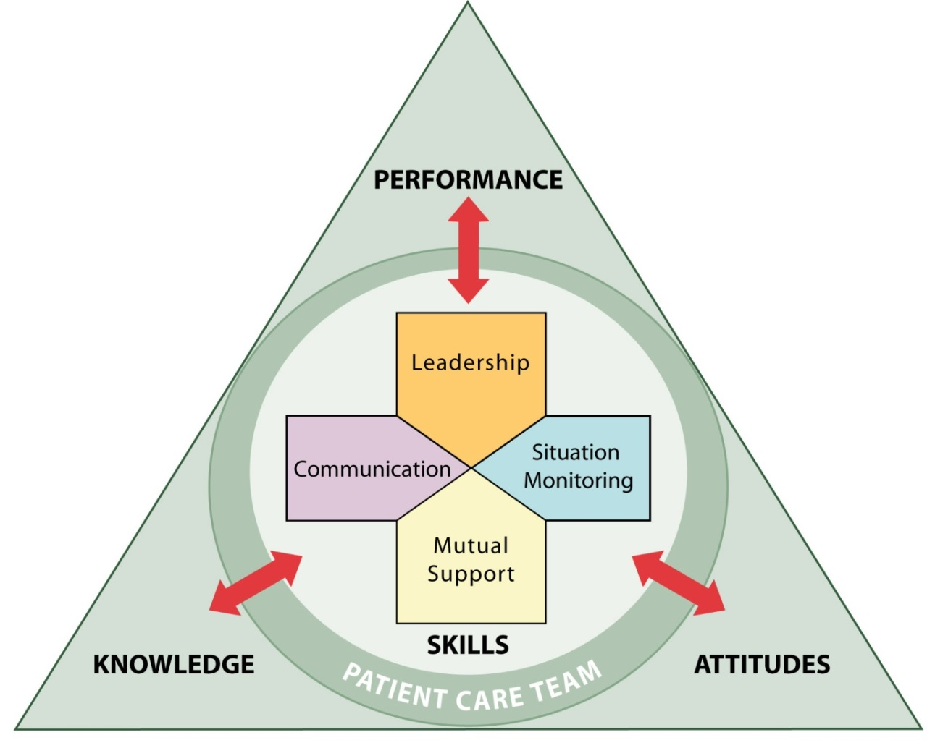
Leadership
Holds a teamwork system together
Ensures a plan is conveyed, reviewed, and updated
Facilitated through communication, continuous monitoring of the situation, and fostering of an environment of mutual support

Slide 5
Types of Team Leaders
Designated – The person assigned to lead and organize a team, establish clear goals, and facilitate open communication and teamwork among team members
Situational – Any team member who has the skills to manage the situation at hand

Slide 6
Effective Team Leaders
Define, assign, share, monitor, and modify a plan
Review the team’s performance
Establish “rules of engagement”
Manage and allocate resources effectively
Provide feedback regarding assigned responsibilities and progress toward the goal
Facilitate information sharing
Encourage team members to assist one another
Facilitate conflict resolution
Model effective teamwork

Slide 7
Defining the Plan
When developing a plan, team leaders should consider:
Time – How much time is available to complete all the necessary tasks and activities?
People – Do the available staff have the necessary knowledge and skills to perform their roles?
Equipment – Is the necessary equipment available and working?
Information – Has all of the necessary information been collected and reviewed?

Slide 8
Case Study Discussion
After attending TeamSTEPPS Master Training, a physician and nurse leader in a Level I Trauma Center decide that trauma resuscitations could be more effectively conducted. Currently, when a trauma alert is called to indicate the pending arrival of a severely injured patient, more staff show up to the trauma bay than needed, necessary equipment is sometimes missing or not functioning properly, and the lead trauma physician often shows up just as EMS is bringing the patient into the trauma bay. The newly trained Master Trainers observe that these practices have led to confusion and chaos that put patients at risk and result in valuable time being lost.

Slide 9
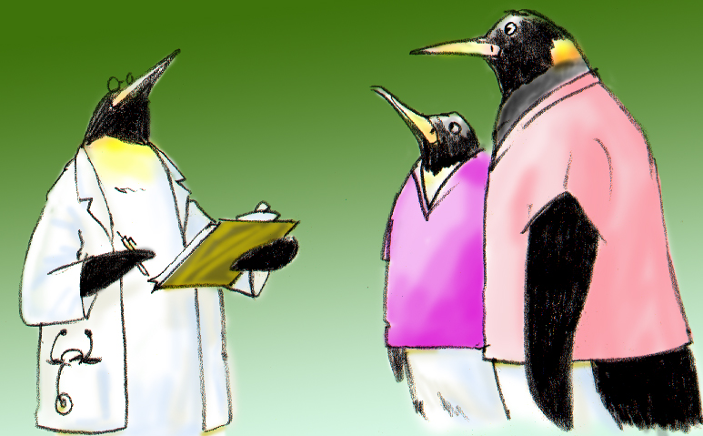
Assigning Tasks and Responsibilities
Determine the tasks and roles to be assigned
Determine which roles must be filled and allocate tasks appropriately
Communicate clear expectations of what team members need to do
Request feedback

Slide 10
Sharing the Plan: Briefs
A team briefing is an effective strategy for sharing the plan
Briefs should help:
Form the team
Designate team roles and responsibilities
Establish climate and goals
Engage team in short- and long-term planning

Slide 11
Briefing Checklist Tool
TOPIC
Who is on core team?
All members understand and agree upon goals?
Roles and responsibilities understood?
Plan of care?
Staff availability?
Workload?
Available resources?

Slide 12
Exercise: Briefing
INSTRUCTIONS:
Break into small groups with others from your unit, work area, or organization.
Identify when, why, and where briefings might be conducted. Note who should lead the brief and who should participate.
Develop a checklist for guiding the brief.
Discuss what outcomes you expect to see as a result of implementing briefs.
At the end of the exercise, present and discuss your plans with the group.

Slide 13
Monitoring & Modifying the Plan: Huddle
Problem Solving
Hold ad hoc, “touch base” meetings to regain situation awareness
Discuss critical issues and emerging events
Anticipate outcomes and likely contingencies
Assign resources
Express concerns

Slide 14
Reviewing the Team’s Performance: Debrief
Process Improvement
Brief, informal information exchange and feedback sessions
Occur after an event or shift
Designed to improve teamwork skills
Designed to improve outcomes
An accurate recounting of key events
Analysis of why the event occurred
Discussion of lessons learned and reinforcement of successes
Revised plan to incorporate lessons learned

Slide 15
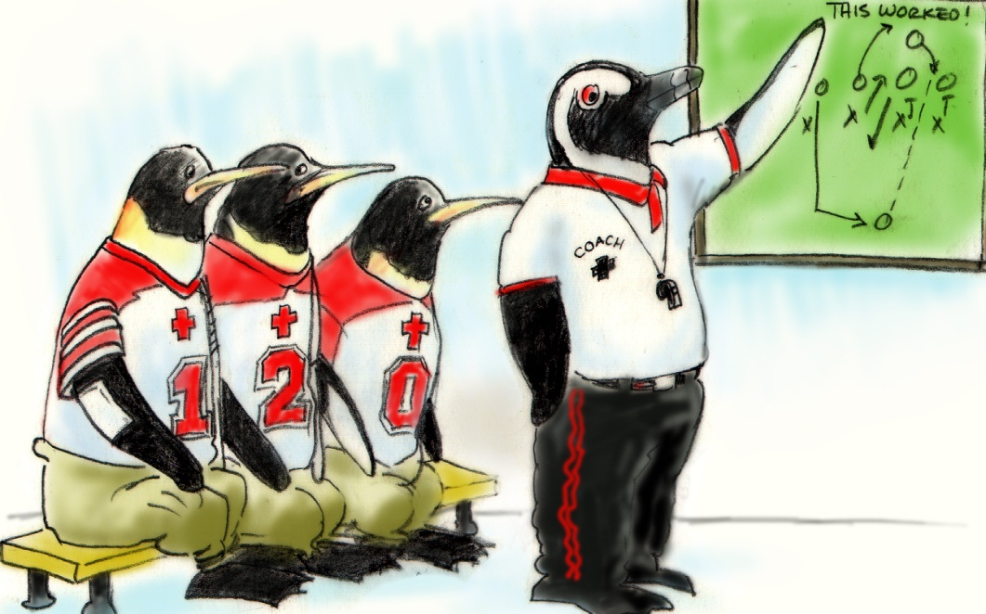
Debrief Checklist
TOPIC
Communication clear?
Roles and responsibilities understood?
Situation awareness maintained?
Workload distribution?
Did we ask for or offer assistance?
Were errors made or avoided?
What went well, what should change, what can improve?

Slide 16
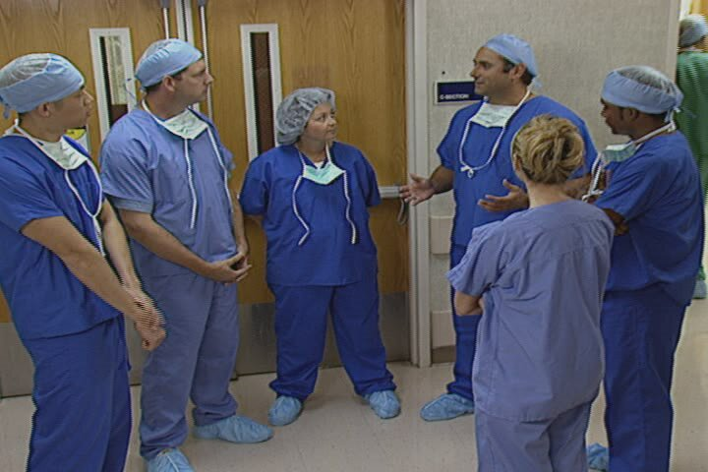
Debrief Video

Slide 17
Facilitating Conflict Resolution
Effective leaders:
Facilitate conflict resolution to avoid compromising patient safety and quality of care
Do not allow interpersonal or irrelevant issues to negatively affect the team
Help team members master conflict resolution techniques

Slide 18
Promoting & Modeling Teamwork
Effective leaders cultivate desired team behaviors and skills through:
Open sharing of information
Role modeling and effective cuing of team members to use prescribed teamwork behaviors and skills
Constructive and timely feedback
Facilitation of briefs, huddles, debriefs, and conflict resolution
Mitigation of conflict within the team

Slide 19
Team Formation Video

Slide 20
Tools & Strategies Summary
BARRIERS
Inconsistency in Team Membership
Lack of Time
Lack of Information Sharing
Hierarchy
Defensiveness
Conventional Thinking
Complacency
Varying Communication Styles
Conflict
Lack of Coordination and Followup With Coworkers
Distractions
Fatigue
Workload
Misinterpretation of Cues
Lack of Role Clarity
TOOLS and STRATEGIES
Communication
SBAR
Call-Out
Check-Back
Handoff
Leading Teams
Brief
Huddle
Debrief
OUTCOMES
Shared Mental Model
Adaptability
Team Orientation
Mutual Trust
Team Performance
Patient Safety!!

Slide 21
Applying TeamSTEPPS Exercise
Does the team experiencing the issue in your organization have a designated leader? Who is it?
Is your teamwork issue related to the team’s leadership?
If yes, what is the leadership issue?
Which of the tools and/or strategies for leading teams might you consider implementing to address the issue?

