Slide 1
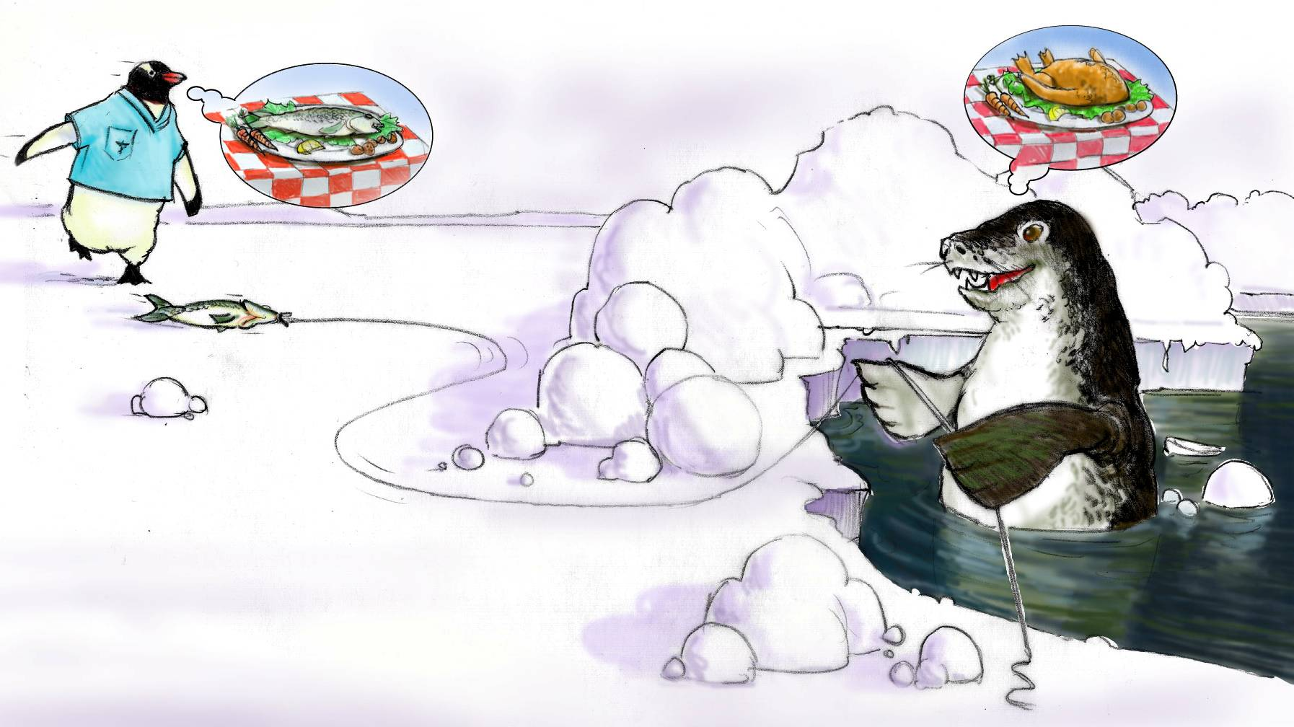
Situation Monitoring

Slide 2
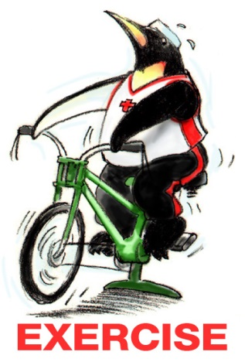
Teamwork Exercise #2

Slide 3
Objectives
Discuss how situation monitoring affects team processes and outcomes
List components of the STEP mnemonic
Explain situation awareness and identify undermining conditions
Define a shared mental model and how it is cultivated within a team

Slide 4
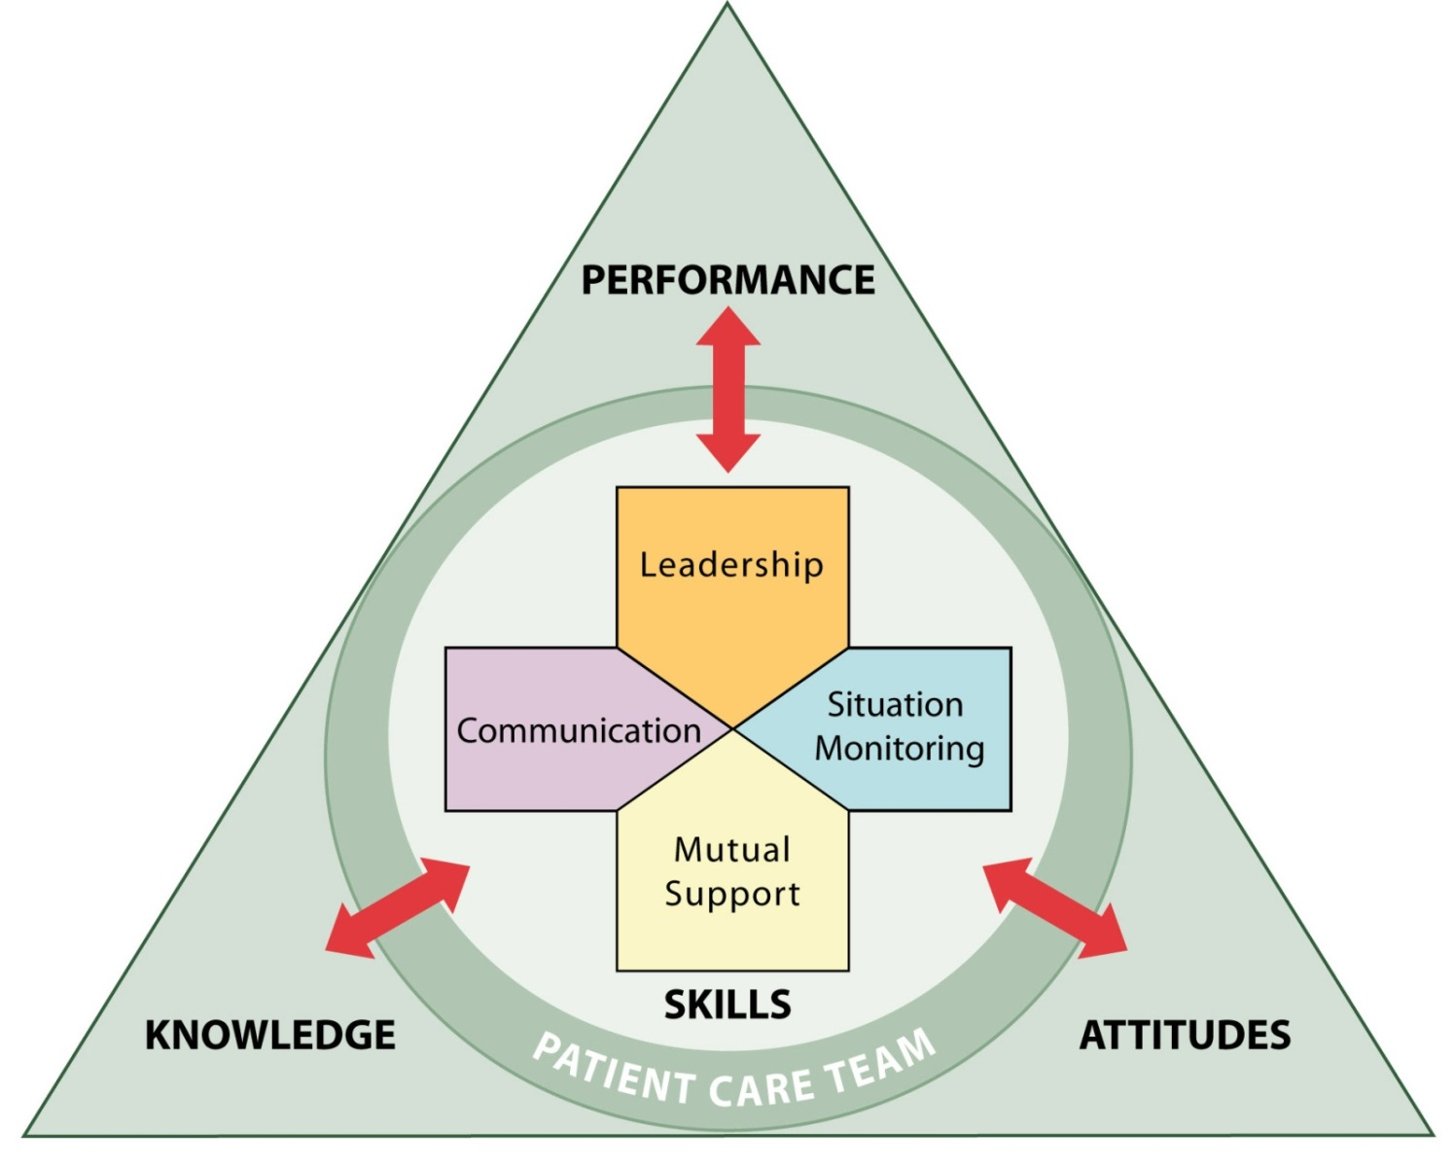
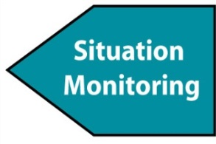
Situation Monitoring
Ensures new or changing information is identified for communication and decision-making
Leads to effective support of fellow team members

Slide 5
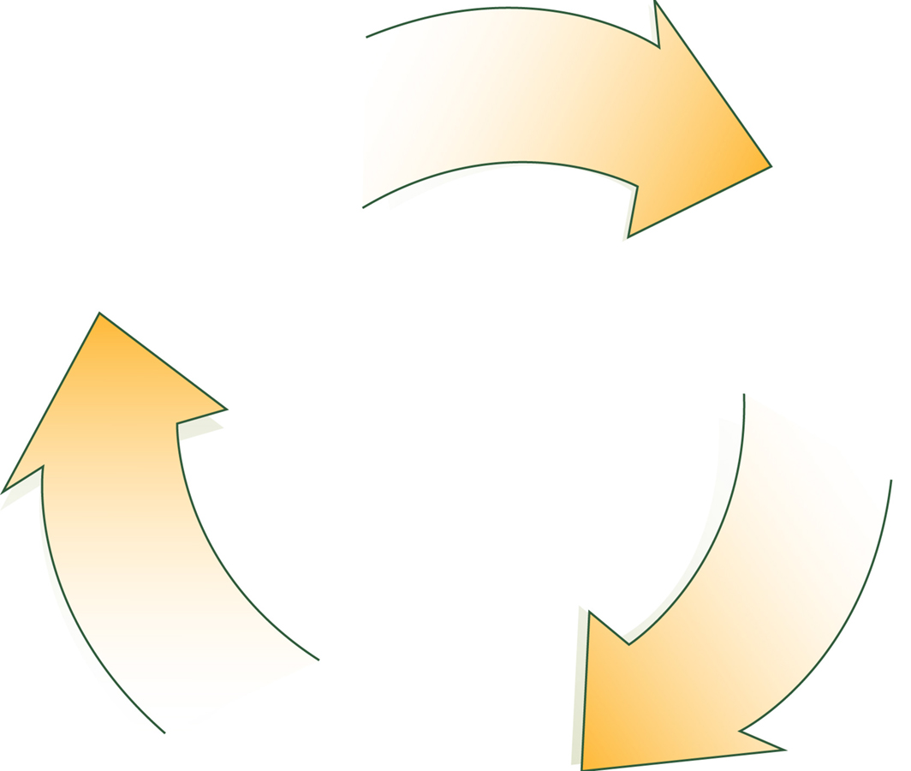
A Continuous Process
Situation Monitoring (Individual Skill)
Situation Awareness (Individual Outcome)
Shared Mental Model (Team Outcome)

Slide 6
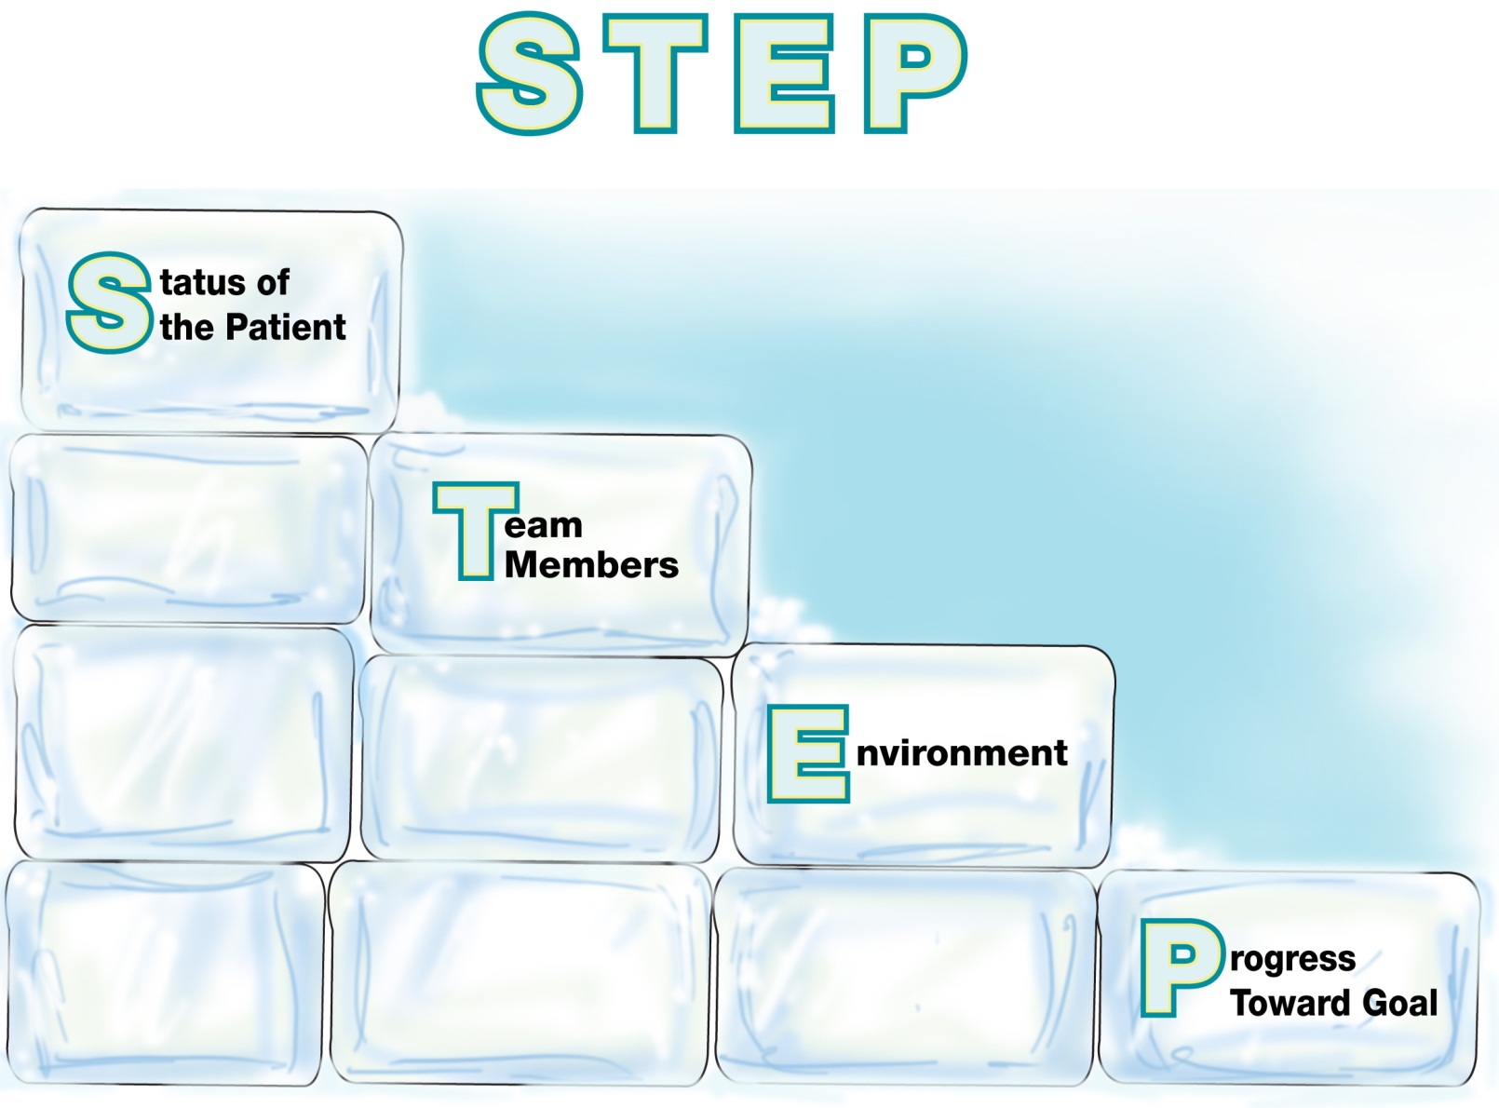
Components of Situation Monitoring:

Slide 7
Status of the Patient
Patient History
Vital Signs
Medications
Physical Exam
Plan of Care
Psychosocial Condition

Slide 8
Team Members
Fatigue
Workload
Task Performance
Skill Level
Stress Level

Slide 9
I’M SAFE Checklist
I = Illness
M = Medication
S = Stress
A = Alcohol and Drugs
F = Fatigue
E = Eating and Elimination

Slide 10
Environment
Facility Information
Administrative Information
Human Resources
Triage Acuity
Equipment

Slide 11
Progress Toward Goal
Call a Huddle!
Status of Team’s Patient(s)
Goal of Team
Tasks/Actions That Are or Need To Be Completed
Plan Still Appropriate

Slide 12
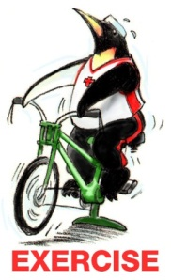
Situation Monitoring Exercise
A patient in the ICU has coded, and CPR is in progress. The Resuscitation Team is busy ensuring that IV access is available and the ET tube is inserted correctly. Dr. Matthews, the Team Leader, is calling out orders for drugs, X-rays, and labs. Judy, a nurse at the bedside, is inserting an IV. Nancy, another nurse, is drawing up meds. Judy can tell by Nancy’s expression that she didn’t get the last order called out by Dr. Matthews. Judy calls out while continuing to place the IV, “Nancy, he wants the high-dose epinephrine from the vial in the top drawer.”

Slide 13
Situation Awareness is…
The state of knowing the current conditions affecting one’s work.
Includes knowing…
Status of the patient
Status of other team members
Environmental conditions
Current progress toward the goal

Slide 14
Conditions That Undermine Situation Awareness
Failure to—
Share information with the team
Request information from others
Direct information to specific team members
Include patient or family in communication
Utilize resources fully (e.g., status board, automation)
Maintain documentation
Know and understand where to focus attention
Know and understand the plan
Inform team members the plan has changed

Slide 15
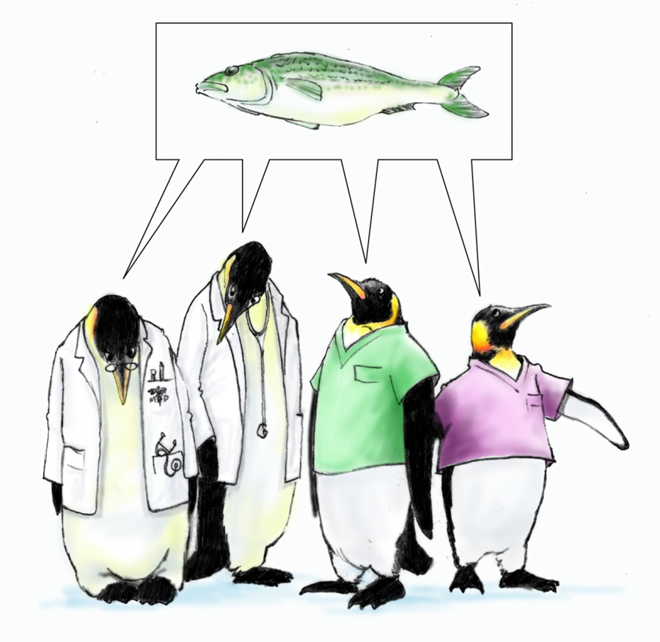
A Shared Mental Model is…
The perception of, understanding of, or knowledge about a situation or process that is shared among team members through communication

Slide 16
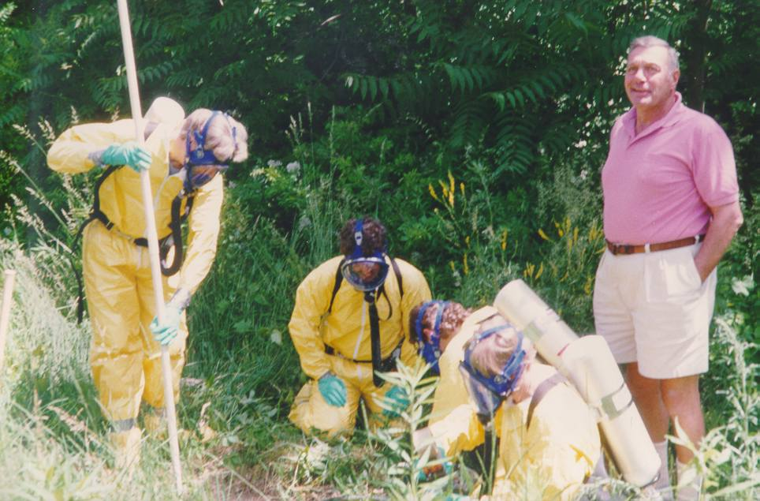
Shared Mental Model?

Slide 17
When and How to Share?
When:
Briefs
Huddles
Debriefs
Transitions in Care
How:
SBAR
Call-outs
Check-backs

Slide 18
Practical Exercise
Room # | Patient | Orders | VS
1 | Jackson | EKG, O₂, Cardiac Enzymes | HR 115 R 24 B/P 174/98
2 | Simmons | CBC, UA, HCG, IV | HR 132 R 22 B/P 92/76
3 | Bailey | CXR, neb Rx, CBC, UA, O₂ | HR 120 R 32 B/P 132/86

Slide 19
What Do You See?

Slide 20
How Shared Mental Models Help Teams
Lead to mutual understanding of situation
Lead to more effective communication
Enable back-up behaviors
Help ensure understanding of each other’s roles and how they interplay
Enable better prediction and anticipation of team needs
Create commonality of effort and purpose

Slide 21
Tools & Strategies Summary
BARRIERS
Inconsistency in Team Membership
Lack of Time
Lack of Information Sharing
Hierarchy
Defensiveness
Conventional Thinking
Complacency
Varying Communication Styles
Conflict
Lack of Coordination and Followup With Coworkers
Distractions
Fatigue
Workload
Misinterpretation of Cues
Lack of Role Clarity
TOOLS and STRATEGIES
Communication
SBAR
Call-Out
Check-Back
Handoff
Leading Teams
Brief
Huddle
Debrief
Situation Monitoring
STEP
I’M SAFE
OUTCOMES
Shared Mental Model
Adaptability
Team Orientation
Mutual Trust
Team Performance
Patient Safety!!

Slide 22
Applying TeamSTEPPS Exercise
Is your teamwork issue related to the team’s or individuals’ skill at monitoring the situation?
If yes, what is the situation monitoring issue?
Which situation monitoring tools and/or strategies might you consider implementing to address the issue?

