Slide 1
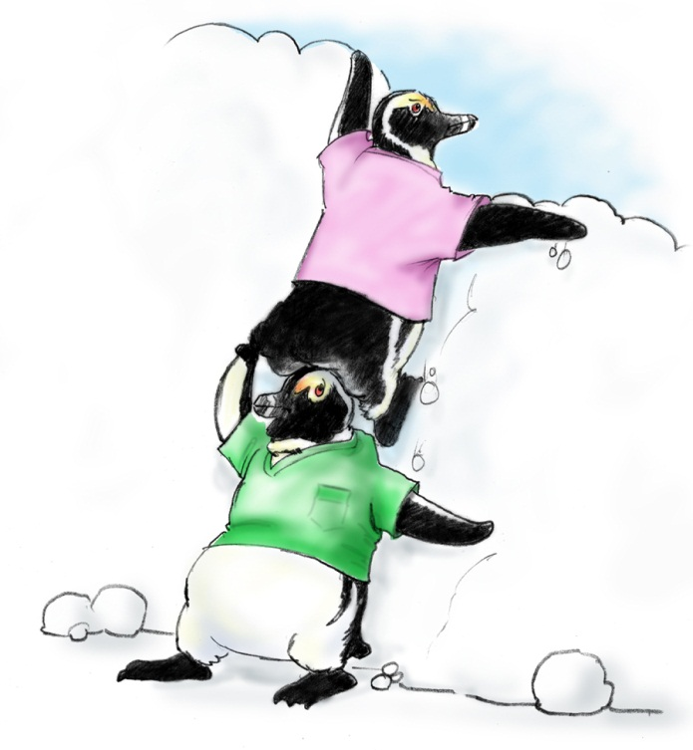
Mutual Support

Slide 2
Objectives
Describe how mutual support affects team processes and outcomes
Discuss specific strategies to foster mutual support (e.g., task assistance, feedback)
Identify specific tools to facilitate mutual support
Describe conflict resolution strategies

Slide 3
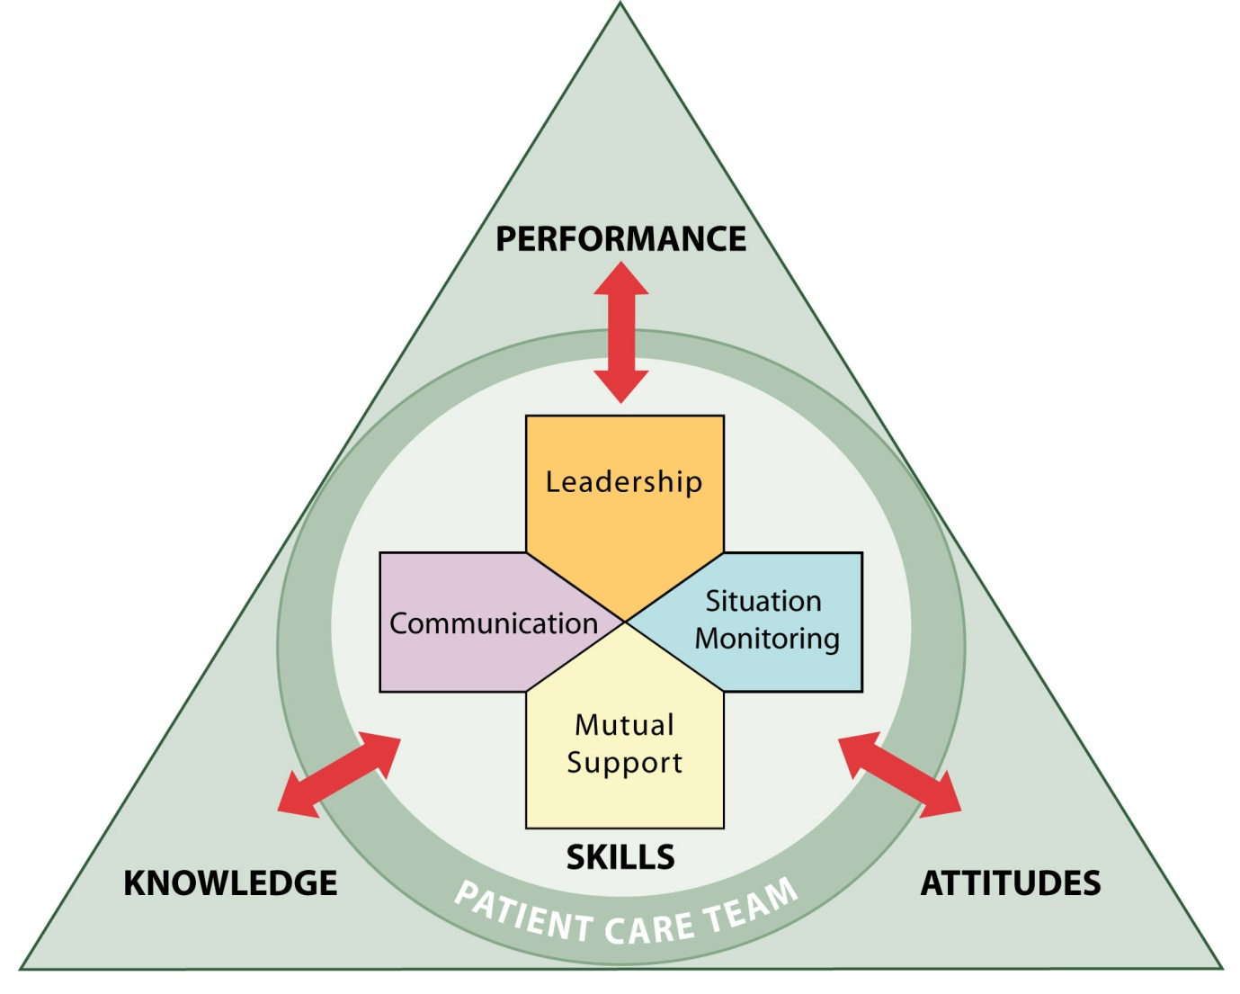
Mutual Support
Dependent upon information gathered through situation monitoring
Moderated by the communication of information
Enhanced by leaders who encourage and role model mutual support behaviors

Slide 4
Mutual Support
Mutual support involves members:
Assisting each other
Providing and receiving feedback
Exerting assertive and advocacy behaviors when patient safety is threatened

Slide 5
Task Assistance
Team members foster a climate in which it is expected that assistance will be actively sought and offered as a method for reducing the occurrence of error.

Slide 6
Task Assistance Example
Two members of the GI Laboratory are assessing an elderly patient who has just had conscious sedation for a colonoscopy. The monitor shows SVT at a rate of 150 and a BP of 76/48. The nurse calls out the vital signs while the physician continues to monitor the rhythm. A nurse passing by the room hears the call-out.

Slide 7
What Is Feedback?
Feedback is information provided for the purpose of improving team performance

Slide 8
Types of Feedback
Formal
Retrospective and typically scheduled in advance
Has an evaluative quality
Examples: Collaborative discussions, case conferences, individual performance reviews
Informal
Typically in real time
Provided on an ongoing basis
Focuses on knowledge and practical skills development
Examples: Huddles, debriefs

Slide 9
Characteristics of Effective Feedback
Effective feedback is—
Timely
Respectful
Specific
Directed toward improvement
Helps prevent the same problem from occurring in the future
Considerate

Slide 10
Providing Effective Feedback Video

Slide 11
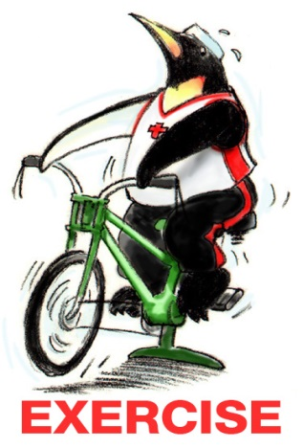
Feedback Exercise
An attending watches an intern start to place a chest tube in an obese patient in an incorrect location.
How would you provide effective feedback?

Slide 12
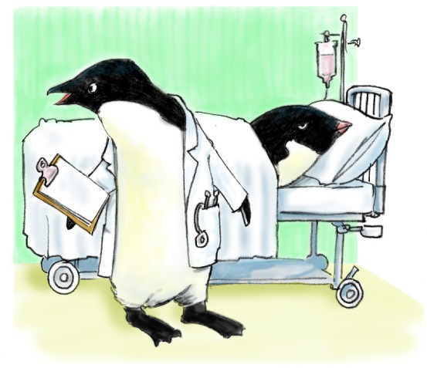
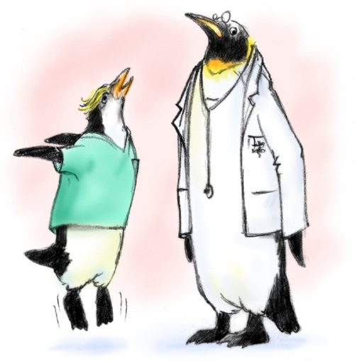
Advocacy and Assertion
Advocate for the patient
Invoked when team members’ viewpoints don’t coincide with that of a decision maker
Assert a corrective action in a firm and respectful manner

Slide 13
The Assertive Statement
Respectful and supportive of authority
Clearly asserts concerns and suggestions
Is nonthreatening and ensures that critical information is addressed
Five-Step Process:
Open the discussion
State the concern
State the problem—real or perceived
Offer a solution
Obtain an agreement

Slide 14
Two-Challenge Rule
1
2

Slide 15
Two-Challenge Rule
Invoked when an initial assertion is ignored…
It is your responsibility to assertively voice your concern at least two times to ensure that it has been heard
The member being challenged must acknowledge
If the outcome is still not acceptable
Take a stronger course of action
Use supervisor or chain of command

Slide 16
Two-Challenge Rule cont.
Empower any team member to “stop the line” if he or she senses or discovers a breach of safety.
This is an action never to be taken lightly, but it requires immediate cessation of the process and resolution of the safety issue.

Slide 17
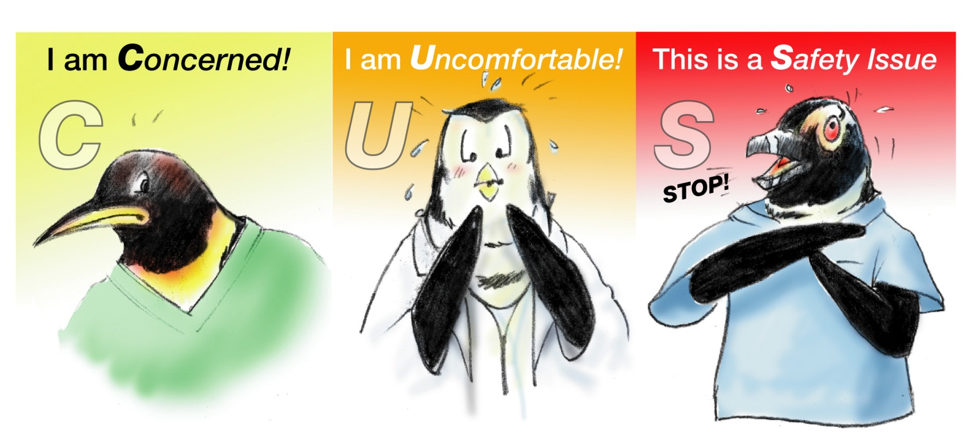
Please Use CUS Words but only when appropriate!

Slide 18
Advocacy and Assertion Scenario
A medical floor nurse is assigned to a patient following a myocardial infarction. The attending physician provides the final treatment, reviews the clinical situation, and determines that the patient is well enough to be discharged.
Before the patient is discharged, the nurse checks the patient’s vitals one last time. The nurse finds it unusual that the blood pressure and heart rate are substantially elevated.

Slide 19
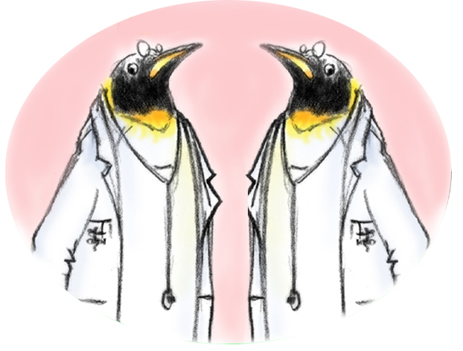
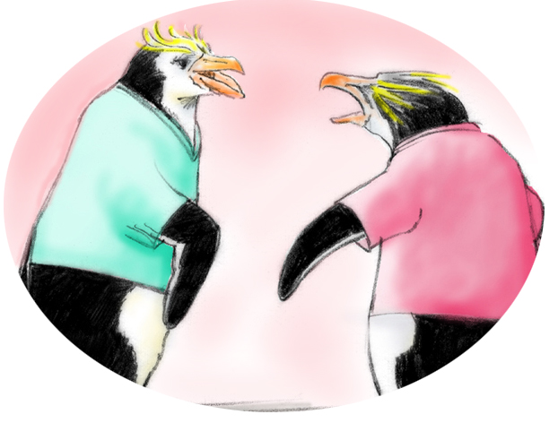
Conflict in Teams
Interpersonal Conflict
(Hostile and harassing behavior)
DESC Script
Informational Conflict
(We have different information!)
Two-Challenge Rule

Slide 20
Conflict Resolution DESC Script
A constructive approach for managing and resolving conflict
D—Describe the specific situation
E—Express your concerns about the action
S—Suggest other alternatives
C—Consequences should be stated

Slide 21
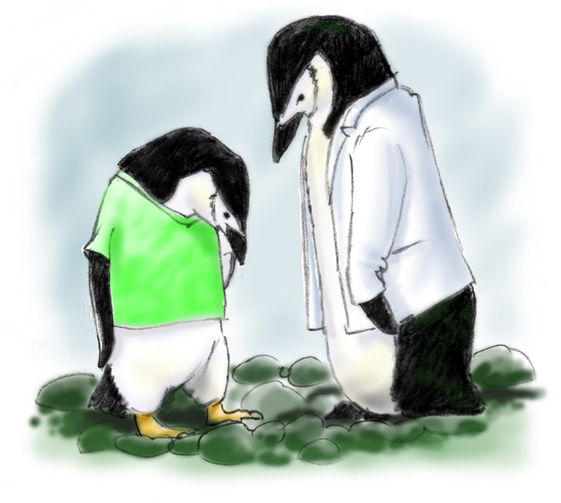
DESC-It
Let’s “DESC-It!”
Have timely discussion
Work on win-win
Frame problem in terms of your own experience
Choose a private location
Use “I” statements; avoid blaming statements
Critique is not criticism
Focus on what is right, not who is right

Slide 22
A DESC Scenario
A nurse feels that a patient has abdominal distension and pain secondary to a distended bladder and needs a Foley catheter. The nurse receives the order from the resident on call. When the attending later realizes that the order was given without his consent, he raises his voice to the resident in front of staff and the patient.

Slide 23
Tools & Strategies Summary
BARRIERS
Inconsistency in Team Membership
Lack of Time
Lack of Information Sharing
Hierarchy
Defensiveness
Conventional Thinking
Complacency
Varying Communication Styles
Conflict
Lack of Coordination and Followup With Coworkers
Distractions
Fatigue
Workload
Misinterpretation of Cues
Lack of Role Clarity
TOOLS and STRATEGIES
Communication
SBAR
Call-Out
Check-Back
Handoff
Leading Teams
Brief
Huddle
Debrief
Situation Monitoring
STEP
I’M SAFE
Mutual Support
Task Assistance
Feedback
Assertive Statement
Two-Challenge Rule
CUS
DESC Script
OUTCOMES
Shared Mental Model
Adaptability
Team Orientation
Mutual Trust
Team Performance
Patient Safety!!

Slide 24
Applying TeamSTEPPS Exercise
Is your teamwork issue related to mutual support?
If yes, what is the mutual support issue?
Which mutual support tools or strategies might you consider implementing to address the issue?

