Slide 1
Coaching Workshop

Slide 2
Objectives
Define coaching and its outcomes
Describe the role of a TeamSTEPPS coach
List competencies of an effective coach
Describe how to implement coaching in TeamSTEPPS

Slide 3
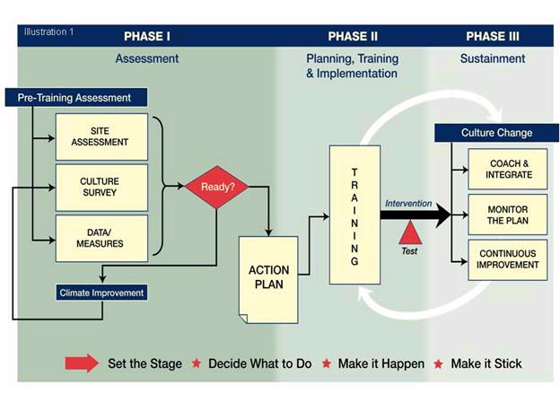
TeamSTEPPS Phases
Coaching

Slide 4
Coaching
Involves providing instruction, direction, and prompting
Includes demonstrating, reinforcing, motivating, and providing feedback
Requires monitoring and ongoing performance assessment
Continues even after skills are mastered to ensure sustainment

Slide 5
Why Is Coaching Important?
Effective coaching can result in:
Clear and defined goals
Aligned expectations between team leader and team members
“Just-in-time” knowledge transfer
Increased individual motivation and morale
Increased ability to adapt and react
Early identification of unforeseen performance barriers
Commitment to ongoing learning and improvement
Movement toward superior team performance

Slide 6
Why Is Coaching Important in TeamSTEPPS?
Effective coaching in TeamSTEPPS further aims to achieve:
Successful integration of teamwork behaviors into daily practice
Increased understanding of teamwork concepts
Increased teamwork competence among staff
Sustainment of improved performance over time
Improved team performance and safer patient care

Slide 7
The Role of a TeamSTEPPS Coach
Role model behavior
Observe performance and provide feedback
Motivate team members
Provide opportunities to practice and improve

Slide 8
The Coach as a Role Model
Demonstrates effective use of teamwork behaviors, tools, or strategies
As a respected member of the team, reinforces acceptance of behavior through performance

Slide 9
Coaches Provide Feedback That Is….
Timely
Respectful
Specific
Directed toward improvement
Two way
Considerate

Slide 10
The Coach as a Motivator
Helps team members see the bridge between new behaviors and patient safety and outcomes
Encourages belief in team members’ abilities to succeed
Expresses enthusiasm and commitment
Validates current levels of accomplishment while advocating greater achievement
Recognizes successful performance
Identifies potential challenges, pitfalls, and unforeseen consequences
Offers support, assistance, and empathy
Communicates positive results and outcomes

Slide 11
Providing Opportunities to Practice
Can be formal/structured or informal
Examples include:
Ask team members how they might have approached a situation differently by using a TeamSTEPPS tool or strategy
Use scenarios during staff or team meetings to discuss or simulate the effective use of a TeamSTEPPS tool or strategy
Develop tools that facilitate use of tool or strategy, such as notepads that outline the SBAR components
Provide staff with a TeamSTEPPS “tip of the week”

Slide 12
Exercise: Effective Coaches
Think about coaches you’ve known or observed…
What characteristics did those coaches have that made them effective?
Are coaching characteristics innate or can they be learned?

Slide 13
Coaching Competencies
Communication
Communicating Instructions
Providing Feedback
Listening for Understanding
Performance Improvement
Setting Performance Goals
Rewarding Improvement
Dealing With Failure
Assessing Strengths and Weaknesses
Relationships
Building Rapport and Trust
Motivating Others
Working With Personal Issues
Confronting Difficult Situations
Execution
Responding to Requests
Following Through

Slide 14
Exercise: Coaching Self-Assessment
Complete a coaching self-assessment form to identify coaching strengths and areas for improvement.

Slide 15
Implementing Coaching in TeamSTEPPS
Develop a coaching plan and gain buy-in
Identify coaches
Train and prepare coaches
Prepare staff to receive coaching
Ensure organizational support for coaches

Slide 16
Develop a Coaching Plan
As part of implementation planning, determine whether and how coaching will be used
To obtain buy-in, present coaching plan to leadership, including:
Importance of coaching in TeamSTEPPS
Specific plans and considerations for implementation (e.g., number of coaches required, time required, costs)
Anticipated performance improvements and results

Slide 17
Identifying and Preparing TeamSTEPPS Coaches
When identifying coaches, consider:
Where TeamSTEPPS will be implemented
Individual characteristics and competencies
Number of coaches needed
Conduct a training session on coaching for the identified coaches
Match coaches with team members, if appropriate

Slide 18
Prepare Staff for TeamSTEPPS Coaching
Identify who the coaches are to the staff
Describe the goals and positive outcomes of coaching
Explain the role and responsibilities of coaches
Describe the expectations regarding staff interactions with coaches

Slide 19
Organizational Support for Coaches
Include coaches in efforts to integrate TeamSTEPPS performance into the organization
Leverage coaches’ work with frontline staff and knowledge of barriers
Formally recognize and/or reward coaches for contributions to the team’s success
Provide opportunities for coaches to work together to plan, problem solve, and share feedback
Promotes and reinforces accountability

Slide 20
Exercise: Coaching
Divide into groups of three
Review the scenarios and Coaching Feedback Form
Each participant takes a turn playing the coach, team member, and observer
The coach provides feedback to the team member in the scenario
The team member acts out the scenario
The observer completes the Coaching Feedback Form and shares feedback

Slide 21
Exercise: Coaching cont.

Slide 22
Coaching Tips
Do…
Actively monitor and assess team performance
Establish performance goals and expectations
Acknowledge desired teamwork behaviors and skills through feedback
Coach by example; be a good mentor
Do not…
Coach from a distance
Coach only to problem solve
Lecture instead of coach

