Slide 1
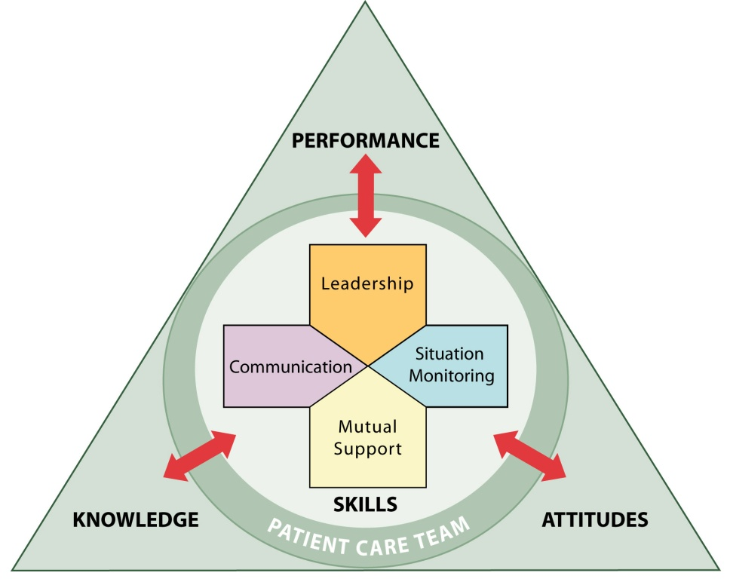
Enhancing Safety for Patients With Limited English Proficiency
Train-the-Trainer Session: Implementation
Notes:
For this portion of the training, participants need to be in groups with the others from their organization so that they can work together on the activities and worksheets.

Slide 2
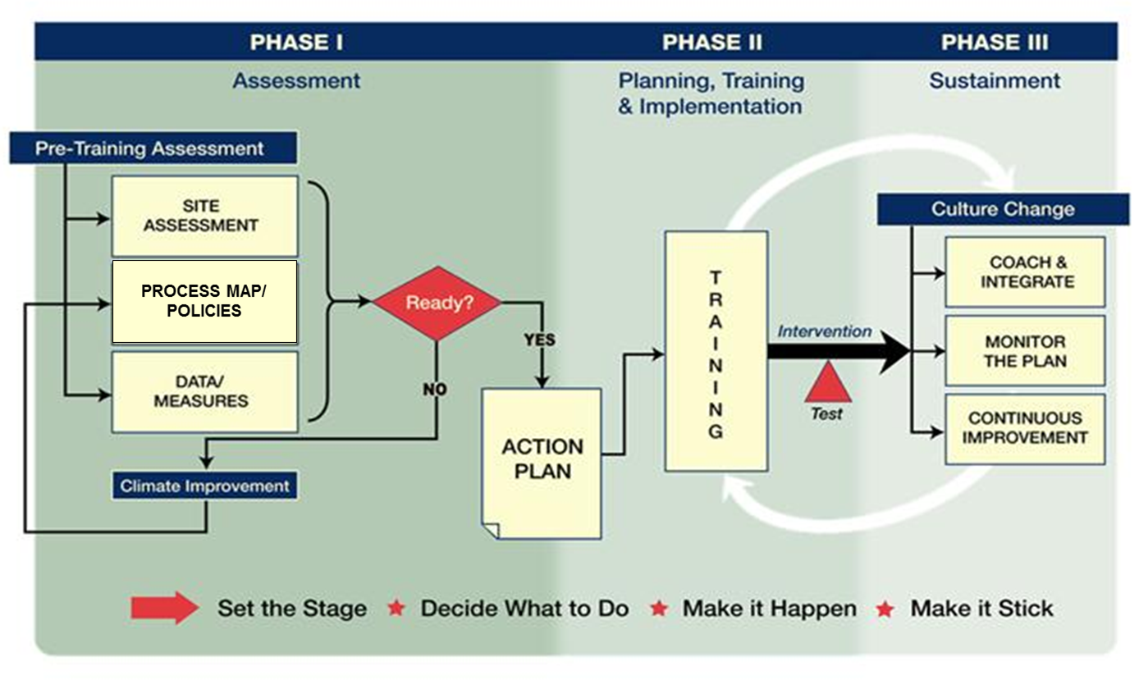
Shift Toward a Culture of Safety

Slide 3
Phase I: Assessment
Process map
Policies
Site assessment

Slide 4
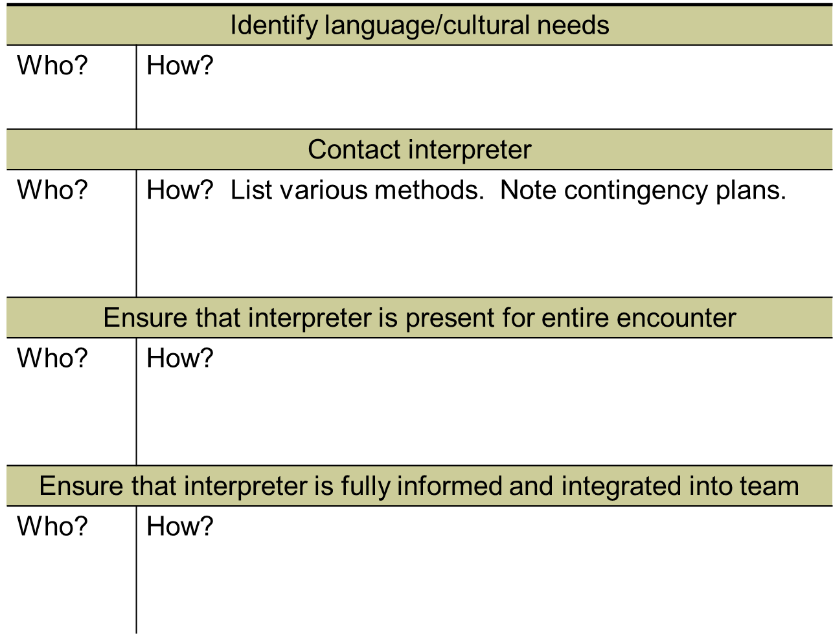
Patient Language Process Map

Slide 5
Policies and Guidelines
Title VI, Civil Rights Act: equal access for LEP
The Joint Commission: Patient-Centered Communication Standards
Hospital policy

Slide 6
Site Assessment
Data
% LEP
Common languages
Interpreter resources
Bilingual staff
Other information
Hospital incidents
Community patterns of bias or conflict

Slide 7
Phase II: Planning, Training, Implementing
Goals and desired outcomes
Measures
Processes to change
Behaviors to change
Training logistics

Slide 8
Goals and Outcomes
 | What needs to change?
Processes
Activities
Practices
Behaviors
Attitudes

Slide 9
Why Evaluate
Answers the question: Did it work?
Helps you improve over time
Improves leadership and staff buy-in

Slide 10
Evaluation Steps
Design
Process evaluation
Metrics
Analysis and report
Refer to the Evaluation Guide and Metrics

Slide 11
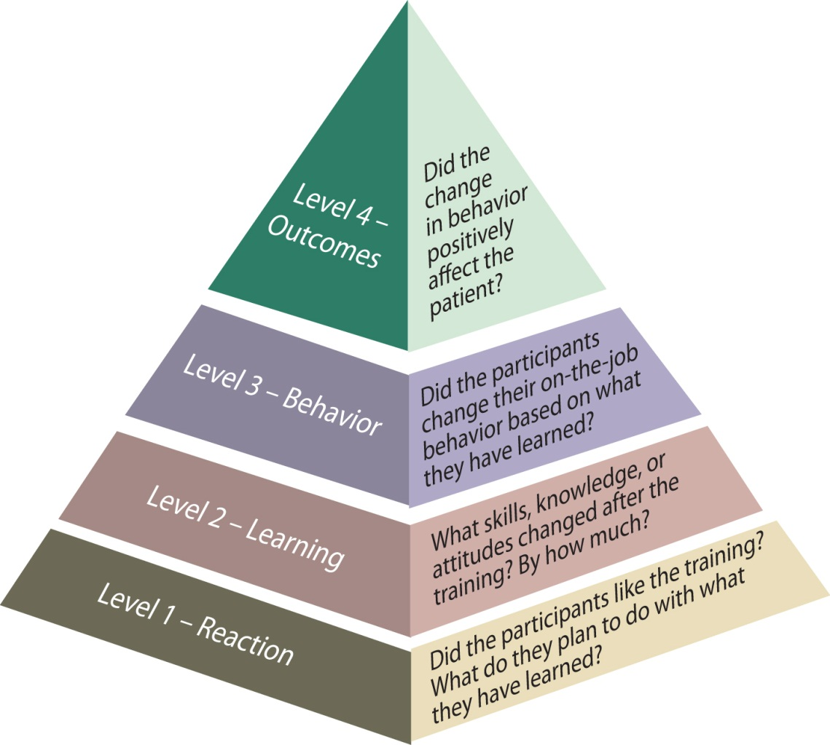
Planning Your Evaluation
What is the goal of your intervention?
What level metrics will you implement (1, 2, 3, 4)?
Any other metrics beyond what’s in the Guide?

Slide 12
Training
Who?
When?
Over what period of time?

Slide 13
Phase III: Sustainment
Ongoing training
Coaching
Leadership support

Slide 14
Action Planning
Activity | Person Responsible | Target Date

