Slide 1
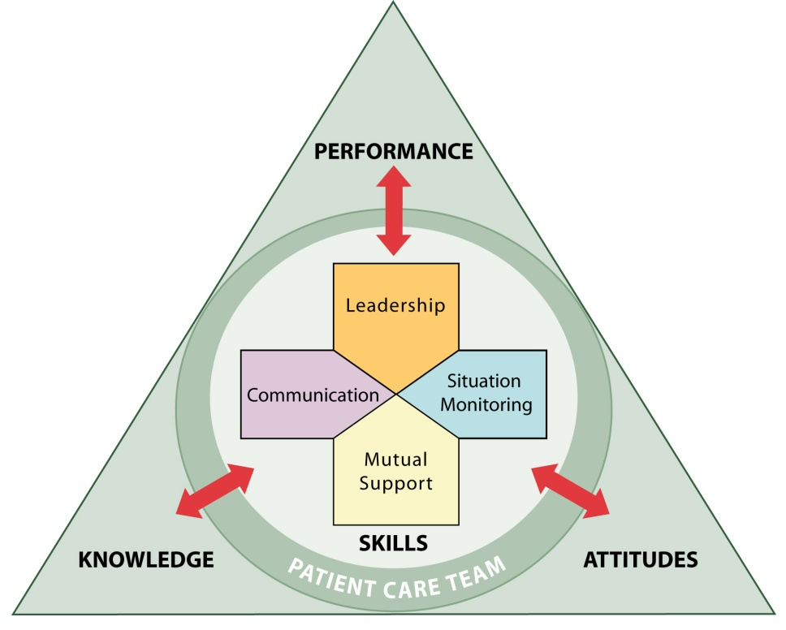
Enhancing Safety for Patients With
Limited English Proficiency

Slide 2
Overview/Objectives
Understand the safety risk to patients with limited English proficiency
Know the process to assemble the most appropriate and effective care team
Identify and raise patient communication issues
Notes:
Read objectives

Slide 3
The Story of Willie Ramirez
Results of not having an appropriate interpreter:
Misunderstanding of “intoxicado”
Inaccurate medical history
Cultural deference to authority
Quadriplegic teen
$71 million lawsuit

Slide 4
High-Risk Settings and Situations
ED
OB/GYN
Surgery
Transitions in care, including intake and discharge
Medication reconciliation

Slide 5
Added Risk for LEP Patients
Not using a professional interpreter
  Using family members or housekeeping staff as interpreters
  “Getting by” with provider’s or patient’s poor language skills
Interpreter only present for part of the encounter

Slide 6
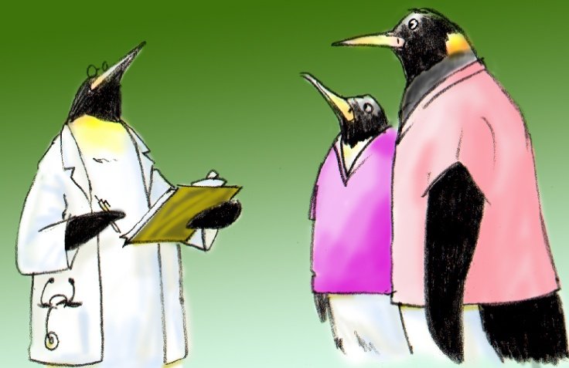
LEP Patients in Your Clinical Area
Percentage of patients LEP
Common languages spoken
Less common languages
Specific issues or problems

Slide 7
Close Call: An Interpreter’s Story
Patient spoke some English…
Interpreter not called
Inaccurate medical history
Latex allergy almost missed before surgery

Slide 8

“Opportunity” Scenario
What are the risks in this scenario?
What was done badly?
What key information was missed?
What could be done differently?

Slide 9
Benefits of Including
Interpreter on the Care Team
Receive more complete and accurate information
Facilitate better clinical decisions
Receive support from a cultural broker who is also an advocate for the patient
Notes:
9

Slide 10
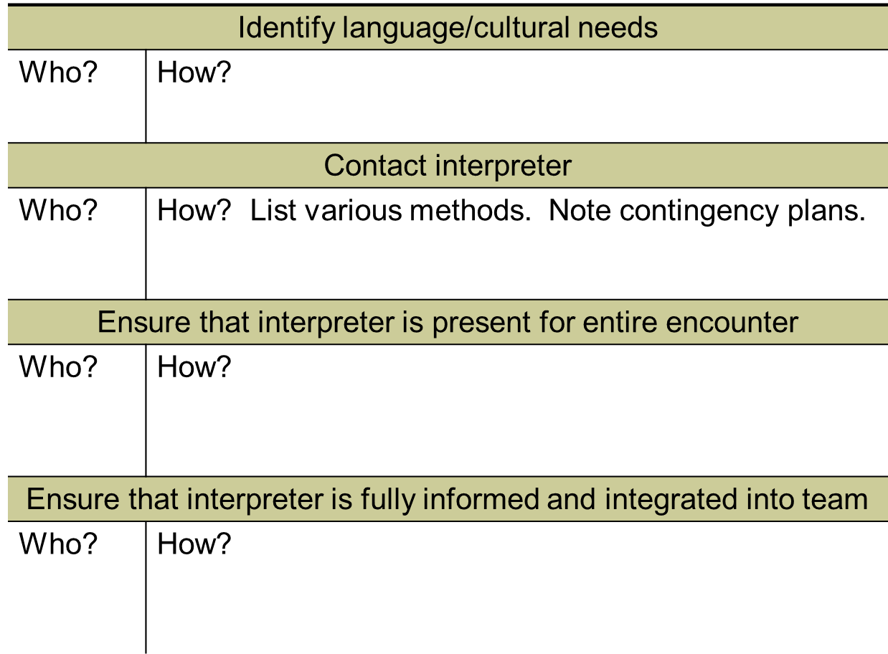
Implementation
Notes:
10

Slide 11
Assertion, Advocacy, and
Conflict Resolution
Scenario:
Mrs. Gilbert, a Haitian immigrant, is in the ED in triage. The front desk staff called the Creole interpreter, Ms. Pierre-Louis. Dr. Malbec is interviewing Mrs. Gilbert in French, but she does not understand his French. Ms. Pierre-Louis knows that Mrs. Gilbert does not understand, but when she attempts to interpret, Dr. Malbec says, “You are not needed. I’ve got it.”

Slide 12

Advocacy and Assertion
Advocate for the patient
  Stop all activity if needed
  Speak up on behalf of the patient
Assert a corrective action in a
firm and respectful manner
  Assertion is not aggression

Slide 13
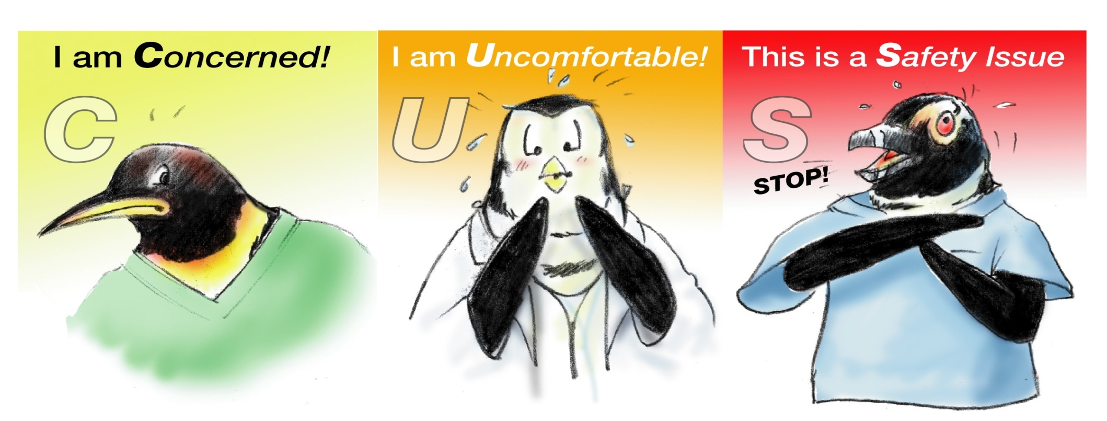

Stop the Line: CUS

Slide 14
When Initial Assertion Is Ignored…
Voice your concern at least two times…it’s your responsibility
If you are being challenged, acknowledge the concern
  Correct the problem
  Teach
If the outcome is still not acceptable
  Take a stronger course of action
  Use supervisor or chain of command

Slide 15
Briefs
Planning
  Form the team
  Designate team roles and responsibilities
  Establish climate (psychological safety) and goals
  Engage team in short- and long-term planning
15
Notes:
15

Slide 16

Psychological Safety
Proactively invite input
Be accessible
Ask for mutual support
Remember: Team leader sets tone for the team, while interpreter creates safety for the patient
  Leader: “Feel free to stop us at any time if anything is not clear, or if there is anything I should know about the patient's culture, beliefs, or concerns”
  Interpreter: “If anything we say is not clear, please let me know ”
Notes:
16

Slide 17
Practice
(Optional Exercise)
Scenario: Discharge from the hospital following myocardial infarction
3 characters: a nurse, an interpreter, and a patient

Slide 18
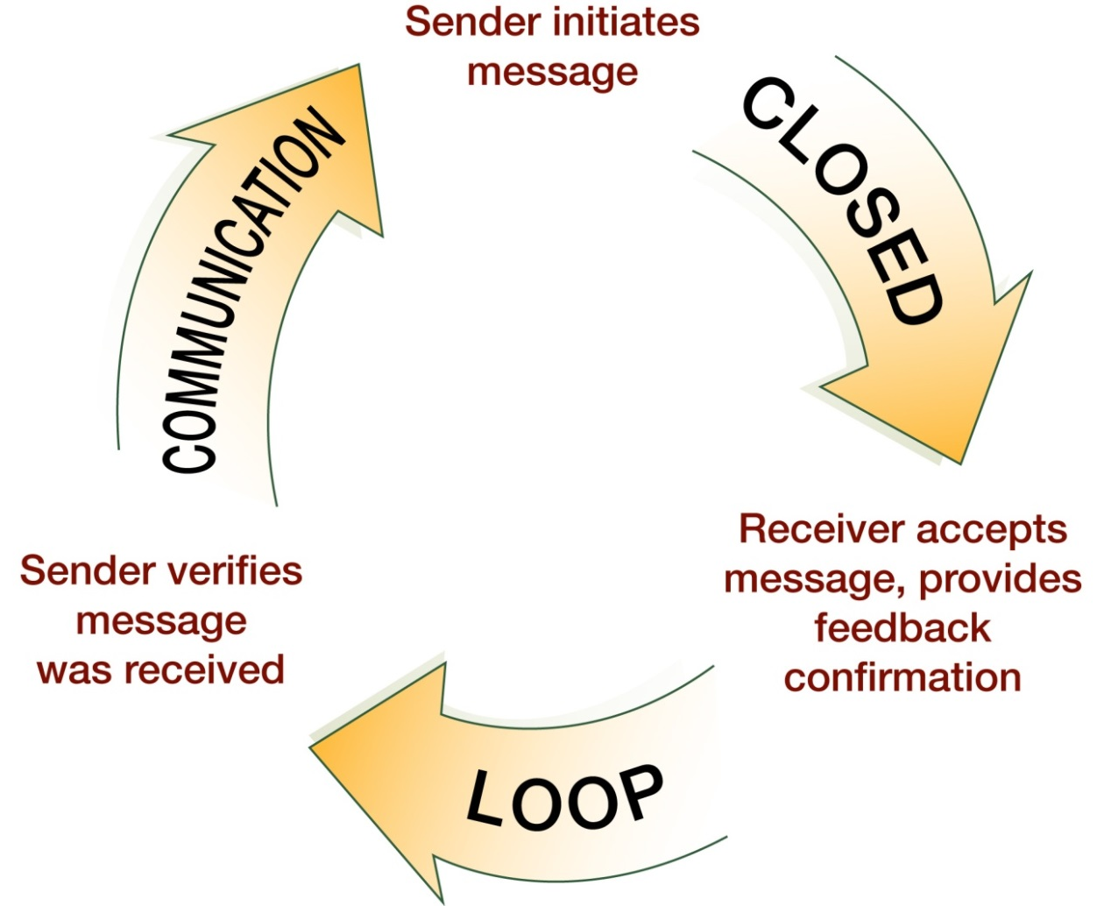
Check-Back Is…

Slide 19
Teach-Back Is…
Confirmation of understanding
Opportunity to correct miscommunication
Comprehensive
  “Tell me in your own words how you will take this medicine when you get home…”

Slide 20
Putting It All Together
“Success” video

Slide 21
Summary
TOOLS and STRATEGIES to Enhance the Safety of Patients With Limited English Proficiency:
Process for including in-person and phone interpreters
Brief/ psychological safety
Advocacy and assertion
CUS
Check-back
Teach-back

