Slide 1
for
Office-Based Care
Introduction

Slide 2
Collaboration of:
Agency for Healthcare Research and Quality (AHRQ)
Department of Defense
Team Strategies & Tools to Enhance Performance & Patient Safety
Focuses on strengthening the specific knowledge, skills, and attitudes of teamwork
Can be tailored to meet the needs of any team in any setting
Office-based care TeamSTEPPS tailors to the office-based setting

Slide 3
®
More than 40 years of research and evidence from high-risk fields
Provides specific tools and strategies for:
Improving communication in teamwork
Reducing chance of error
Enhancing patient safety
Outcomes of a high-performing team are adaptability, accuracy, productivity, efficiency, and safety

Slide 4
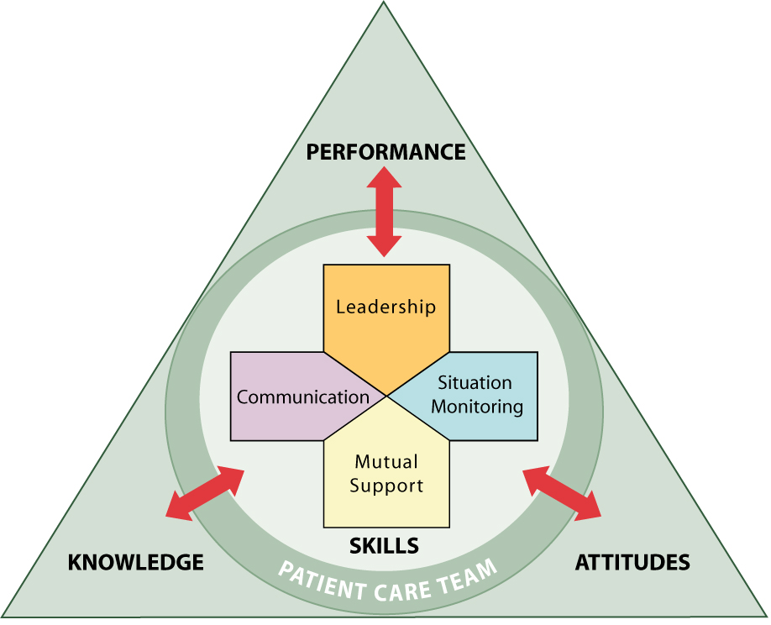
TeamSTEPPS Skills

Slide 5
Does TeamSTEPPS Work?
Research has found that teamwork plays a critical role in providing quality health care
Clinical outcomes include:
50% reduction in the Weighted Adverse Outcome Score, which describes the adverse event score per delivery
50% decrease in the Severity Index, which measures the average severity of each delivery with an adverse event (Mann, et al., 2006)
Reduced rate of adverse drug events
Improved medication reconciliation at patient admission (Haig, et al., 2006)

Slide 6
Does TeamSTEPPS Work?
Teamwork outcomes include:
Significant improvement in communication and supportive behavior
Significant increase in perceptions of teamwork after training (Weaver, et al., 2010)
Reductions in turnover rate
Increases in employee satisfaction (Leonard, et al., 2004)

Slide 7
Office Environment
Do your patients have any idea how chaotic the office really is?
How would they know?
What would they hear or see?
If you could describe the office in one word, what would it be?
If your patients could describe the office in one word, what would it be?
If someone asked you to explain a typical day, what would you say?
If patients described a typical visit, what would they say?

Slide 8
Office Environment
On the surface, the office environment can and should appear calm and orderly to patients
Like a duck – calm appearing above the water while chaos churns below
Office
Does not conform to a pattern of work
Has many components working together on multiple tasks simultaneously
Treats numerous patients simultaneously

Slide 9
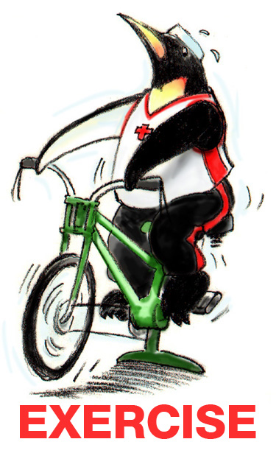
Team-Building Exercise: Paper Chains

Slide 10
Why Does Teamwork Matter in Office-Based Care?
Better continuity of care, access to care, and patient satisfaction (Stevenson, et al., 2001)
Higher patient-perceived quality of care (Campbell, et al., 2001)
Superior care for diabetes patients (Bower, et al., 2003)

Slide 11
References
Bower P, Campbell S, Bojke C, et al. Team structure, team climate, and the quality of care in primary care: An observational study. QSHC 2003;12:273-9. http://www.ncbi.nlm.nih.gov/pmc/articles/PMC1743743/
Campbell SM, Hann M, Hacker J, et al. Identifying predictors of high quality care in English general practice: observational study. BMJ 2001;323:1-6. http://www.bmj.com/content/323/7316/784
Haig K, Sutton S, Whittington J. SBAR: a shared mental model for improving communication between clinicians. Jt Comm J Qual Patient Saf 2006;32(3):167-75.
Leonard M, Graham S, Bonacum D. The human factor: The critical importance of effective teamwork and communication in providing safe care. Qual Saf Health Care 2004;13 Suppl 1:85-90. http://www.ncbi.nlm.nih.gov/pmc/articles/PMC1765783/
Mann S, Marcus R, Sachs B. Lessons from the cockpit: how team training can reduce errors on L&D. (Grand Rounds) Contemp OB/GYN 2006 Jan;51:34-45. http://www.npic.org/Projects/Lessons_From_The_Cockpit.pdf
Stevenson K, Baker R, Farooqi A, et al. Features of primary health care teams associated with successful quality improvement of diabetes care. Fam Pract 2001;18:21-26. http://www.ncbi.nlm.nih.gov/pubmed/11145623
Weaver SJ, Rosen MA, DiazGranados D, et al. Does teamwork improve performance in the operating room? A multi-level evaluation. Jt Comm J Qual Patient Saf. 2010;36(3):133-42. http://psnet.ahrq.gov/public/Weaver-JCJQPS-2010-ID-17607.pdf

