Slide 1
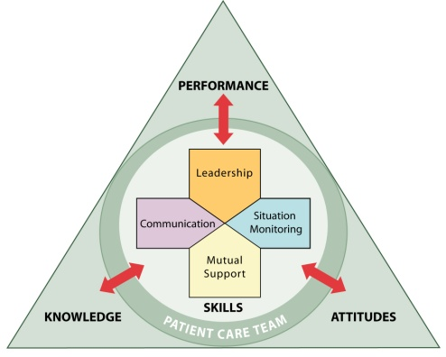

for
OFFICE-BASED CARE
Measurement
®

Slide 2
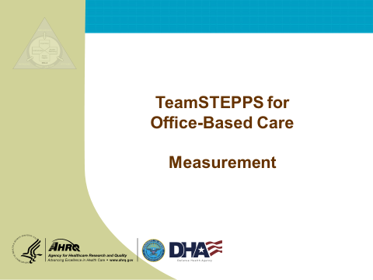
INTRODUCTION
Instructor Note:
This module presents information about how to measure the impact of TeamSTEPPS for Office-Based Care and the tools that are available to support this activity. It is important that practice facilitators learn how to assess the effects of TeamSTEPPS implementation to help guide and ensure success within an office. Further, results gathered during evaluation will help inform practice facilitators about how effective they are at training office staff on TeamSTEPPS.
This module is primarily a lecture. It presents a well-established approach for conducting training evaluation and describes the available measures and their uses. There is an exercise at the end of the module for individuals to apply what they have learned.
  Additional Resources: Below are resources you may want to use to obtain additional information:
  Kirkpatrick, D.L. (1967). Evaluation of training. In R.L. Craig (Ed.). Training and development handbook: a guide to human resource development. New York: McGraw-Hill.
Salas, E., Almeida, S.A., Salisbury, M., et al. (2009). What are the critical success factors for team training in health care? J Comm J Qual Pat Saf 35, 398–405.
Weaver, S.J., Salas, E., & King, H. (2011). Twelve best practices for team training evaluation in health care. Jt Comm J Qual Pat Saf 37, 341–9.
MODULE TIME:
50 minutes
MATERIALS:
Evaluating TeamSTEPPS Worksheet

Slide 3
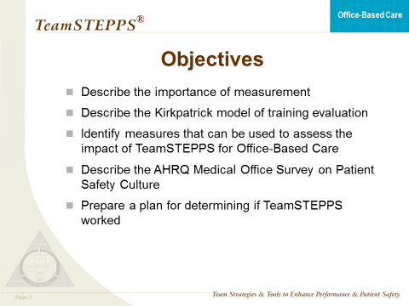
OBJECTIVES
SAY:
Upon completion of this module, participants will be able to:
  Describe the importance of measurement;
  Describe the Kirkpatrick model of training evaluation;
  Identify measures that can be used to assess the impact of TeamSTEPPS for Office-Based Care;
  Describe the AHRQ Medical Office Survey on Patient Safety Culture; and
  Prepare a plan for determining if TeamSTEPPS worked.

Slide 4
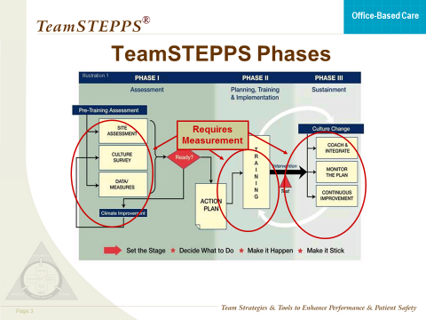
INTRODUCTION
SAY:
Measuring the impact of TeamSTEPPS within an office is critical. Measurement enables you to answer questions such as:
Did TeamSTEPPS work?
Did TeamSTEPPS produce the expected outcomes?
Was TeamSTEPPS worth implementing in my unit?
If TeamSTEPPS did not work or did not produce the expected outcomes, why not?
As a practice facilitator, you need to know how effective your work was in training office staff on TeamSTEPPS and assisting them with implementing TeamSTEPPS to improve the delivery of care within a practice.
As shown on the slide, measurement is important across all phases of the TeamSTEPPS implementation process. The results of measurement provide many benefits, including:
Helping you identify quality improvement needs;
Providing you with data to help generate leadership, stakeholder, and/or staff buy-in of your efforts;
Assessing training needs;
Providing information to drive the plans for how you will use and implement TeamSTEPPS;
Providing an evaluation of the effectiveness of TeamSTEPPS training;
Assessing how TeamSTEPPS affects staff attitudes, patient perceptions, and organizational culture; and
Demonstrating successes and areas for continued improvement, which is important for adapting implementation plans.
The measures we will cover in this module will help you assess your TeamSTEPPS implementation across the TeamSTEPPS phases.

Slide 5
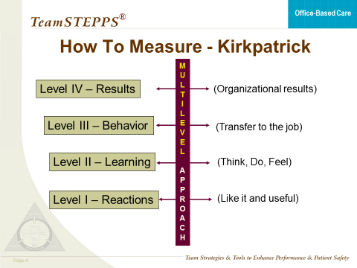
A MODEL OF TRAINING EVALUATION
SAY:
In 1967, Kirkpatrick defined a multilevel model for evaluating the impact of training programs. This model continues to be widely used and regarded as a practical approach to training evaluation. When determining the effectiveness of any training intervention, Kirkpatrick advocated examining four different outcomes of training:
  Level I – Reactions – Reactions are defined as participants’ perceptions of the training. There are two types: (1) affective reactions, which are related to whether participants “liked” the training; and (2) instrumentality reactions, which are related to whether participants found the training “useful.”
  Level II – Learning – Learning is defined at three levels: (1) attitudes (feel), (2) knowledge (know), and (3) skills (do). Regarding attitudes, the basic question to be answered is “Do participants feel differently as a result of training?” Regarding knowledge, the basic question to be answered is “Do participants know something new as a result of training?” Regarding skills, the question is “Can participants do something differently/new as a result of training?”
  Level III – Behavior – Behavior is defined as to whether the new attitudes, knowledge, and/or skills are transferred to the job. In other words, behavior assesses whether participants use what they learned in training on the job and whether that produces improved job performance.
  Level IV – Results – Results are defined as organizational benefits that are produced from training. In the case of TeamSTEPPS, results include patient outcomes, such as infection rates and patient perceptions of care, and clinical process outcomes, such as number of structured handoffs used and staff perceptions of safety. The types of results depend on what the TeamSTEPPS intervention targeted.

Slide 6
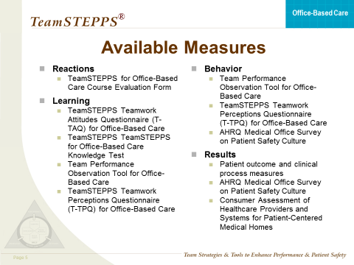
AVAILABLE MEASURES
SAY:
TeamSTEPPS provides a number of useful measures for evaluating the impact of TeamSTEPPS. These measures are aligned with the Kirkpatrick model of training evaluation.
Reactions – TeamSTEPPS for Office-Based Care Course Evaluation Form.
Learning – TeamSTEPPS Teamwork Attitudes Questionnaire (T-TAQ) for Office-Based Care (Attitudes), TeamSTEPPS for Office-Based Care Knowledge Test (Knowledge), Team Performance Observation Tool for Office-Based Care (Skills), and TeamSTEPPS Teamwork Perceptions Questionnaire (T-TPQ) for Office-Based Care (Skills).
Behavior - Team Performance Observation Tool for Office-Based Care (Skills), TeamSTEPPS Teamwork Perceptions Questionnaire (T-TPQ) for Office-Based Care (Skills), and the AHRQ Medical Office Survey on Patient Safety Culture.
Results – Patient outcome and clinical process measures, including the Consumer Assessment of Healthcare Providers and Systems (CAHPS) for Patient-Centered Medical Homes and the AHRQ Medical Office Survey on Patient Safety Culture.
We will review these measures in more detail and provide information about where to access them.

Slide 7
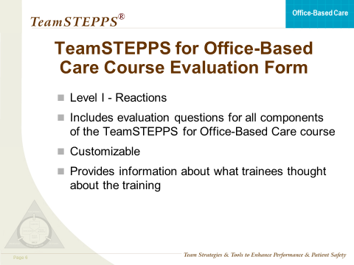
REACTIONS: COURSE EVALUATION FORM
SAY:
Participant reactions tell you whether participants liked the course, the facilities, and the instructor, among other things. These types of reactions are referred to as affective reactions. In addition, participant reactions can tell you whether participants found TeamSTEPPS useful and if they believe they can apply the information they have learned to their office. These types of reactions are referred to as instrumentality reactions. Research has shown that participants who find training useful and report that they will use it on their jobs are more likely to do so.
Participant reactions also provide information regarding:
What participants will say about the course to others who may attend in the future; and
Where the course could be improved in terms of what is taught and how it’s taught.
  If you plan to use a course evaluation form for continuing education credit purposes, please check with your continuing education provider to ensure that the form meets the specific requirements of the respective accrediting organization.
  A customizable TeamSTEPPS for Office-Based Care Course Evaluation Form for assessing participant reactions can be found online in the materials for this program. This form captures both affective and instrumentality reactions.

Slide 8
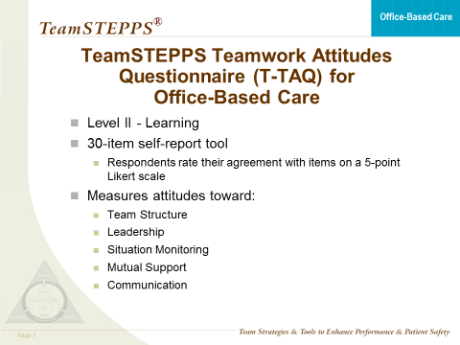
LEARNING: TEAMSTEPPS TEAMWORK ATTITUDES QUESTIONNAIRE
SAY:
As noted, the evaluation of learning accomplished through training can be in the form of assessing attitudes, knowledge, and skills.
One indication that training is effective is that participants’ attitudes about the importance of teamwork change as a result of attending TeamSTEPPS training. To identify changes in attitudes, participant attitudes should be measured both before and after TeamSTEPPS training, with the expectation that participants’ scores will be higher after training. This would be an indication of improved attitudes toward teamwork as a result of TeamSTEPPS training.
The TeamSTEPPS Teamwork Attitudes Questionnaire, or T-TAQ, was designed to measure participant attitudes about the teamwork skills and behaviors taught in TeamSTEPPS. A version of the T-TAQ for use in office settings, named the T-TAQ for Office-Based Care, has been developed by modifying terms on the original T-TAQ to apply to the office setting. The T-TAQ for Office-Based Care can be found online in the materials for this program.
It is very important to note that, with the explosion of the patient safety movement and growing acceptance of the importance of teamwork in the delivery of safe care, health care professionals are likely to report positive attitudes toward teamwork regardless of whether they have attended TeamSTEPPS training. Therefore, TeamSTEPPS recommends that you do not rely solely on measuring participant attitudes as an indication of learning.

Slide 9
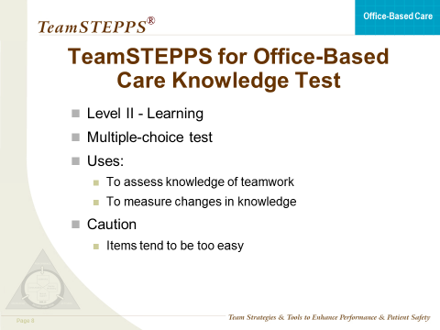
LEARNING: TEAMSTEPPS FOR OFFICE-BASED CARE KNOWLEDGE TEST
SAY:
Another indication that training was effective is that participants know something new after participating in training. Similar to measuring attitude changes, measurement of participant knowledge would take place both before and after TeamSTEPPS training using a knowledge test. The expectation would be that participants would score higher on the test after training.
The TeamSTEPPS for Office-Based Care Knowledge Test, found online, can be used for this purpose. The test is a short, multiple-choice exam that measures participant knowledge of the teamwork principles taught in TeamSTEPPS.
It is very important to note that, as with the attitude measure, knowledge measures should not be used alone. Items on such tests tend to be easy, and many individuals can answer the items correctly without participating in TeamSTEPPS training.

Slide 10
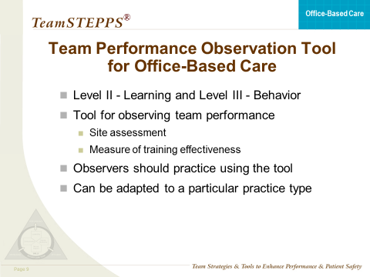
LEARNING: TEAM PERFORMANCE OBSERVATION TOOL
SAY:
The third indication that training was effective in terms of participant learning is that participants can do something new after participating in training. Similar to measuring attitudes and knowledge, you would expect that if you observed participant behavior in a simulation before and after TeamSTEPPS training, participants would behave quite differently. For example, if you trained and implemented briefs and check-backs as your TeamSTEPPS intervention, you might test the office staff by developing scenarios that could be role played to determine if learning occurred. Observing the staff on the job as they conduct a daily team briefing prior to opening the practice could also be an indication of learning; note, though, that under the Kirkpatrick hierarchy this is considered a measure of behavior—learning transferred to the actual job.
The Team Performance Observation Tool for Office-Based Care is a customizable tool that can be found online. This tool can be used as a guide when observing team performance on the job.
The Team Performance Observation Tool for Office-Based Care included in TeamSTEPPS is generic; that is, it is not designed to focus on any particular type of practice. Therefore, TeamSTEPPS recommends that individuals:
Customize the observation form to the practice type of interest.
Practice using the tool before conducting observations. It is important that anyone acting as an observer use the tool in the same way so observations are accurate.
Revise the observation tool as needed so that information is clear to all observers.

Slide 11
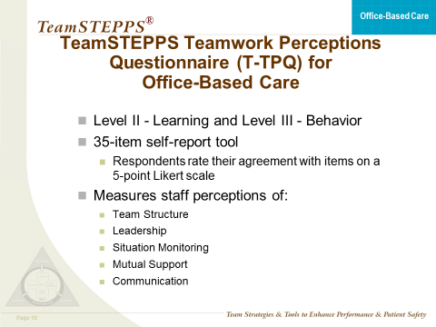
LEARNING: TEAMSTEPPS TEAMWORK PERCEPTIONS QUESTIONNAIRE
SAY:
The TeamSTEPPS Teamwork Perceptions Questionnaire, or T-TPQ, can also be used to measure the learning of skills by training participants. The T-TPQ is completed by individual members of the team. In this measure, individuals report their perceptions regarding the effectiveness of the teamwork within their office.
A version of the T-TPQ for use in office settings, named the T-TPQ for Office-Based Care, has been developed by modifying terms on the original T-TPQ to apply to the office setting. The T-TPQ for Office-Based Care can be found online.

Slide 12
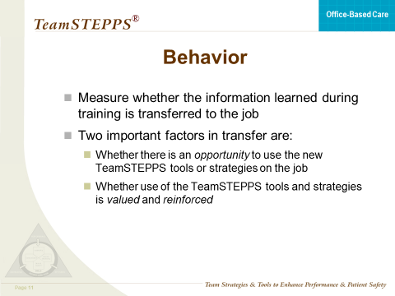
BEHAVIOR
SAY:
It is important to measure whether the information learned during training is transferred to the job. Two important environmental factors for producing transfer are:
Whether there is an opportunity to use the new TeamSTEPPS tools or strategies on the job; and
Whether use of the TeamSTEPPS tools and strategies is valued and reinforced.

Slide 13
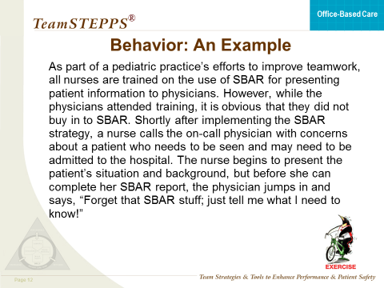
BEHAVIOR: AN EXAMPLE FOR DISCUSSION
SAY:
Let’s review an example scenario for discussion.
EXAMPLE:
As part of a pediatric practice’s efforts to improve teamwork, all nurses are trained on the use of SBAR for presenting patient information to physicians. However, while the physicians attended the training, it is obvious they did not buy in to SBAR. Shortly after implementing the SBAR strategy, a nurse calls the on-call physician with concerns about a patient who needs to be seen and may need to be admitted to the hospital. The nurse begins to present the patient’s situation and background, but before she can complete her SBAR report, the physician jumps in and says, “Forget that SBAR stuff; just tell me what I need to know!”
DISCUSSION:
Was the use of SBAR valued and reinforced?
What do you think the nurse should do?
Will the nurse use SBAR in the future?
What other factors can you think of that are important for ensuring that skills learned in TeamSTEPPS training transfer to the job?
      Aligning training objectives with organizational goals
      Providing organizational support for the training initiative
      Ensuring that frontline care leaders are on board
      Using measurement to determine the effectiveness of the program in terms of whether skills are being used on the job

Slide 14
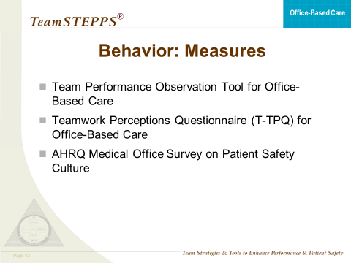
BEHAVIOR: MEASURES
SAY:
Various tools are available for assessing the transfer of participants’ learning to their jobs, including:
  Team Performance Observation Tool for Office-Based Care ;
  TeamSTEPPS Teamwork Perceptions Questionnaire
  (T-TPQ) for Office-Based Care ; and
  AHRQ Medical Office Survey on Patient Safety Culture.
  We have already discussed the Team Performance Observation Tool for Office-Based Care and the T-TPQ for Office-Based Care, as these can also be used to measure learning of new teamwork skills. The AHRQ Medical Office Survey on Patient Safety Culture can be used to assess behavior and results. We will first discuss a few other results measures, and then focus our attention on a more detailed discussion of the patient safety culture survey.

Slide 15
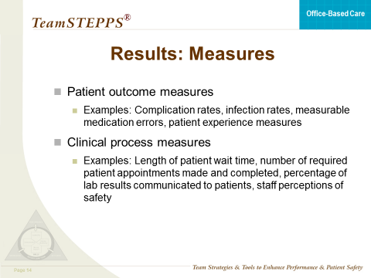
RESULTS: MEASURES
SAY:
  The final level of training evaluation in the Kirkpatrick hierarchy is results. As we discussed earlier, this level of evaluation provides an assessment of the organizational benefits produced from training.
It is important to note that this level of evaluation is difficult to assess, in that any number of organizational changes, initiatives, and/or interventions could contribute to organizational results. However, for evaluating TeamSTEPPS, selecting measures that align with the teamwork issue being addressed by TeamSTEPPS will help ensure that the results can be linked to the training intervention.
Results measures include:
  Patient outcome measures, such as complication rates, infection rates, measurable medication errors, and the like, as well as patient experience measures such as the Consumer Assessment of Healthcare Providers and Systems (CAHPS) for Patient-Centered Medical Homes.
  Clinical process measures, such as length of patient wait time, time to admit patients who require it, compliance with preventive screenings, number of misdiagnoses, number of required patient followup appointments made and completed, percentage of lab results communicated to patients, and staff perceptions of safety as measured by the AHRQ Medical Office Survey on Patient Safety Culture.

Slide 16
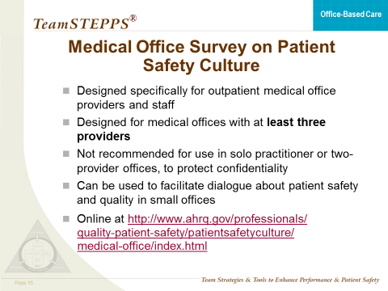
MEDICAL OFFICE SURVEY ON PATIENT SAFETY CULTURE
SAY:
In response to medical offices’ interest in a survey that focuses on patient safety culture in their context, AHRQ sponsored the development of the Medical Office Survey on Patient Safety Culture. This survey is designed specifically for outpatient medical office providers and staff, and asks for their opinions about the culture of patient safety and health care quality in their medical offices.
The Medical Office Survey on Patient Safety Culture was designed for medical offices with at least three providers. “Providers” refers to: physicians, either M.D. or D.O.; physician assistants; nurse practitioners; and other providers licensed to diagnose medical problems, treat patients, and prescribe medications. Survey administration in solo practitioner or two-provider offices is not recommended, because it would not be possible to maintain the confidential nature of individual responses. In small offices, rather than administering the survey, it can be used as a tool to initiate open dialog or discussion among providers and staff about patient safety and quality issues.
The survey is available on the AHRQ Web site at: http://www.ahrq.gov/professionals/quality-patient-safety/patientsafetyculture/medical-office/index.html
DISCUSSION:
Have any of your practices used the Medical Office Survey on Patient Safety Culture?
Can you describe how your practice used the survey and its results?
Do you have any lessons learned you would like to share?
Continued…

Slide 17
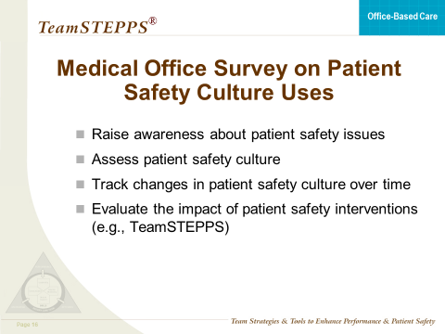
MEDICAL OFFICE SURVEY ON PATIENT SAFETY CULTURE (Continued)
SAY:
The Medical Office Survey on Patient Safety Culture has a number of uses, including:
Raising awareness about patient safety issues;
Assessing patient safety culture;
Tracking changes in patient safety culture over time; and
Evaluating the impact of patient safety interventions.
The survey can be used to assess whether TeamSTEPPS has a positive impact on the medical office’s patient safety culture. If TeamSTEPPS is effective, survey scores should increase after TeamSTEPPS tools and strategies have been implemented. Such a result would be considered an organizational outcome or result of the training (i.e., Level IV in the Kirkpatrick hierarchy).
Continued…

Slide 18
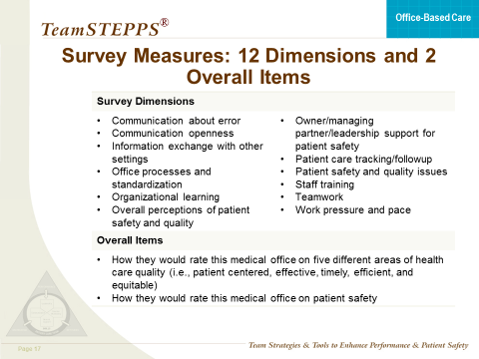
MEDICAL OFFICE SURVEY ON PATIENT SAFETY CULTURE (Continued)
SAY:
The Medical Office Survey on Patient Safety Culture includes 52 items and requires 10-15 minutes to complete. The 52 items measure the following dimensions:
Communication about error;
Communication openness;
Information exchange with other settings;
Office processes and standardization;
Organizational learning;
Overall perceptions of patient safety and quality;
Owner/managing partner/leadership support for patient safety;
Patient care tracking/followup;
Patient safety and quality issues;
Staff training;
Teamwork; and
Work pressure and pace.
In addition, the Medical Office Survey on Patient Safety Culture includes three items about respondent background characteristics and two overall rating questions:
How respondents would rate their medical office on five different areas of health care quality (i.e., patient centered, effective, timely, efficient, and equitable); and
How respondents would rate their medical office on overall patient safety.
Continued…

Slide 19
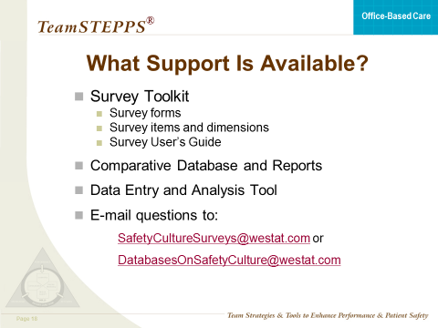
MEDICAL OFFICE SURVEY ON PATIENT SAFETY CULTURE (Continued)
SAY:
The Medical Office Survey on Patient Safety Culture has an accompanying toolkit that contains the following materials:
Survey forms;
Survey items and dimensions; and
A Survey User's Guide that provides step-by-step instructions on how to select a sample, administer the survey, obtain high response rates, and analyze and report results.
In addition, comparative databases and reports are available, as well as a data entry and analysis tool that works with Microsoft® Excel and makes it easy to input individual-level data from the survey. The tool then automatically creates tables and graphs to display survey results. To request the tool, email: DatabasesOnSafetyCulture@westat.com
If you have questions about the medical office survey, or need technical assistance, you can request help by email to SafetyCultureSurveys@westat.com or DatabasesonSafetyCulture@westat.com

Slide 20
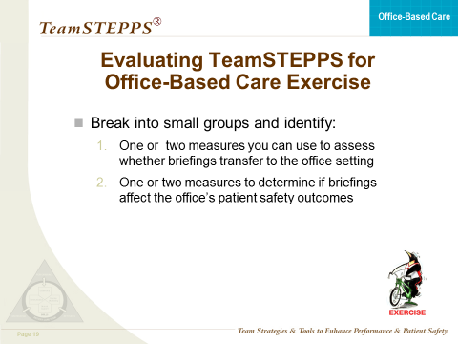
EXERCISE: EVALUATING TEAMSTEPPS FOR OFFICE-BASED CARE
SAY:
Now that we have reviewed the four levels of the Kirkpatrick model of training evaluation and discussed available measures for each, we will use a scenario to apply what you’ve learned. Our scenario follows:
    You have been asked to work with a fairly large medical practice that has been struggling with its management of Type 2 diabetes patients. In particular, you observed that a high rate of diabetic patients are not achieving the treatment goals that have been recorded in the patients’ charts to manage this chronic condition. Followup visits for HbA1c testing are notoriously unreliable, and poor HbA1c control has led to serious kidney disease for some of this office’s patients. Your observations of the practice suggest that it has yet to develop an effective system for managing these patients, as followup visits, while ordered by the physician, often fall through the cracks. You recently met with staff from the practice and recommended that the office adopt briefings prior to the office opening and after the office closes each day to ensure that patient followups improve.
Break into small groups and identify (1) one or two measures you can use to assess whether your TeamSTEPPS intervention – briefings – transfers to the practice; and (2) one or two measures to determine if the briefings affect patient outcomes.
DO: After a few minutes, reconvene the participants and ask some groups to report on their identified measures, using the questions below.
DISCUSSION: Go to next page >
TIME:
10 minutes
MATERIALS:
Evaluating TeamSTEPPS Worksheet
Continued…

Slide 21
EXERCISE: EVALUATING TEAMSTEPPS FOR OFFICE-BASED CARE (Continued)
DISCUSSION:
Which measure or measures did you identify for assessing whether instruction about briefings transfers to this practice’s work environment?
      Why did you choose the identified measure(s)?
    What organizational barriers might interfere with successful training transfer and how can these barriers be addressed?
Which measure or measures did you identify for determining whether briefings affected patient outcomes?
      Why did you choose the identified measure(s)?

