Slide 1
for
Office-Based Care
Team Structure

Slide 2
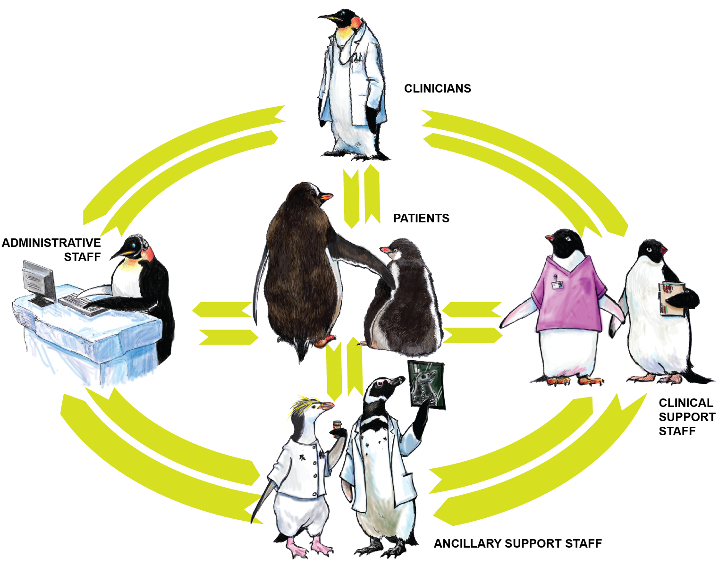
Care Team Structure

Slide 3
Let’s Talk About Your Team
What does it look like?
Who are the team members?
When do you interact?
How do you exchange critical patient information?
If you had a magic wand, how would you change your team (if at all)?

Slide 4
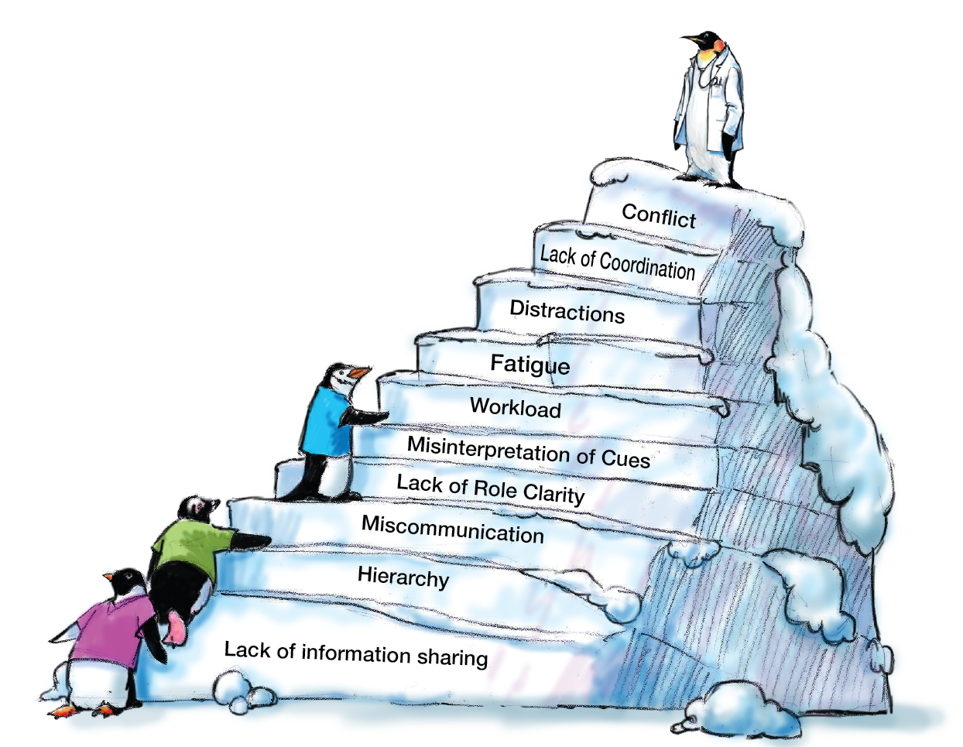
Teamwork & the Care Team
The Care Team has all these obstacles to effective care:

Slide 5
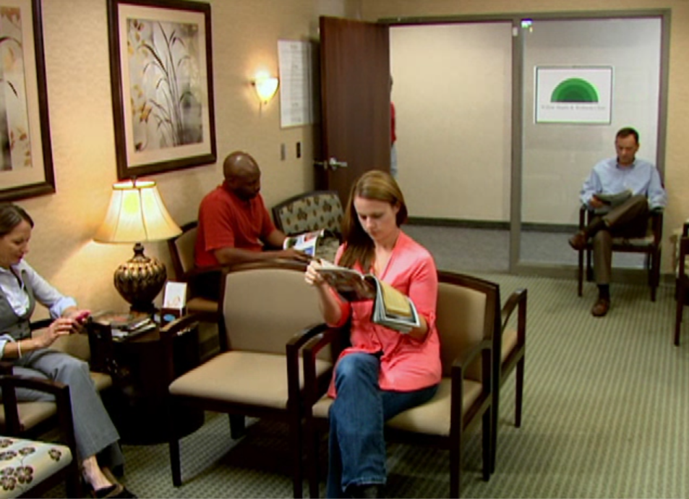
Example of Poorly Functioning Medical Office Team
Let’s watch four different care teams in action.

Slide 6
What Breakdowns Did You See?
What did the team do wrong in the video?
How could the situation have been handled better?
Are these situations that you could see happening at your office?

Slide 7
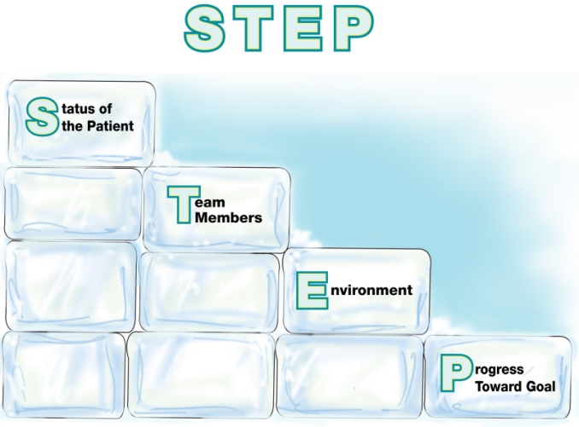
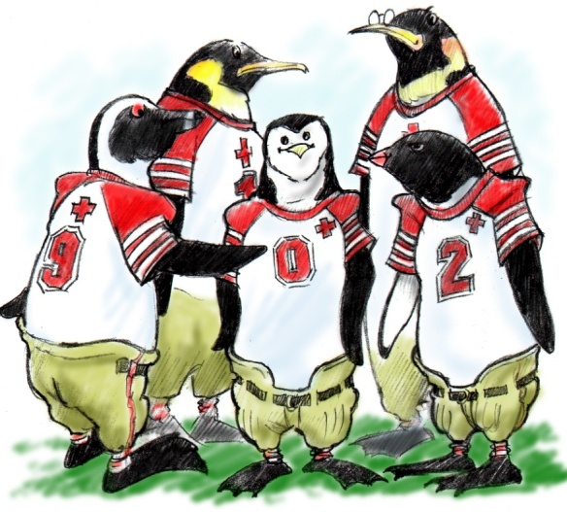
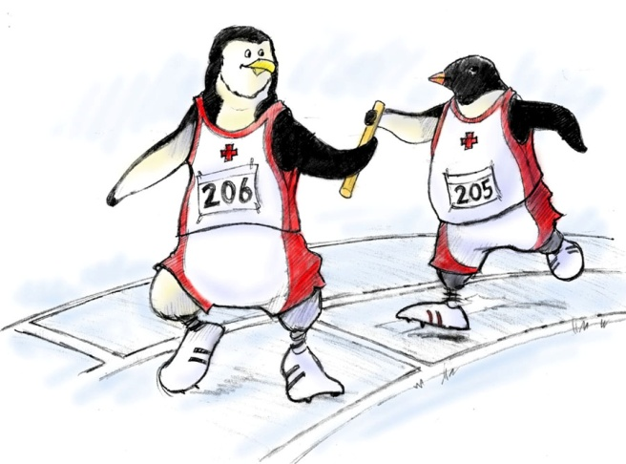
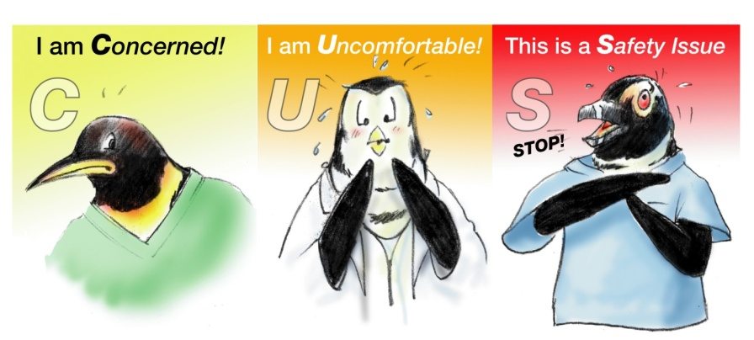
Teamwork Strategies for Addressing Breakdowns

