Slide 1
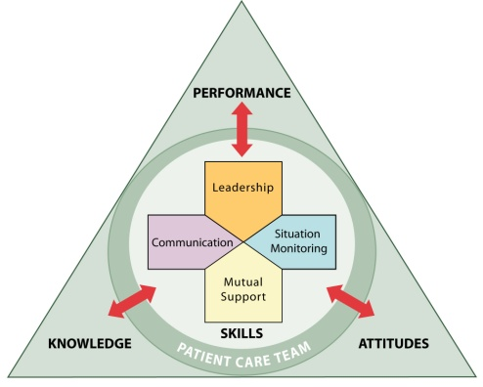

for
OFFICE-BASED CARE
Communication
®

Slide 2
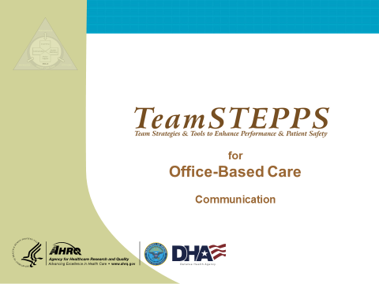
INTRODUCTION
SAY:
Communication is the first of the four main components of TeamSTEPPS. It is “the process by which information is clearly and accurately exchanged between two or more team members in the prescribed manner and with proper terminology and the ability to clarify or acknowledge the receipt of information” (Cannon-Bowers, et al., 1995). There is a tremendous body of evidence to support the efficacy of good communication skills for effective teamwork.
MODULE TIME:
30 minutes
MATERIALS:
  Flipchart and markers
  Copies of Handouts
  Video of Office-Based Team

Slide 3
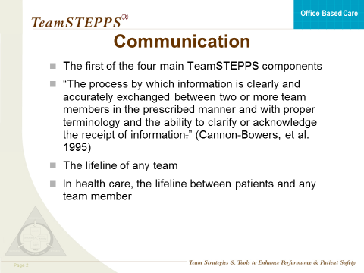
COMMUNICATION
SAY:
Cannon-Bowers et al. (1995) found that communication comprises two critical skills: exchanging information and consulting with others. Information exchange is defined as such behaviors as closed-loop communication, which is the initiation of a message by a sender, the receipt and acknowledgment of the message by the receiver, and the verification of the message by the initial sender. Other behaviors include information sharing, procedural talk, and volunteering and requesting information.

Slide 4
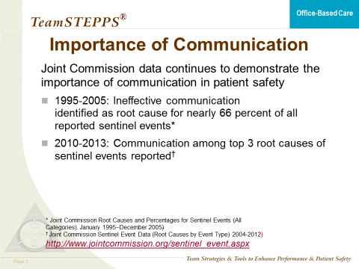
IMPORTANCE OF COMMUNICATION
SAY:
The continued importance of effective communication in care teams cannot be understated. According to sentinel event data compiled by the Joint Commission between 1995 and 2005, ineffective communication was identified as the root cause for 66 percent of reported errors. More recent Joint Commission data from 2010 to 2013 show that communication has remained among the top three root causes of sentinel events. As these data illustrate, failure to communicate effectively as a team significantly increases the risk of error.
Additional information about sentinel events and root causes can be found on the Joint Commission Web site:
http://www.jointcommission.org/sentinel_event.aspx

Slide 5
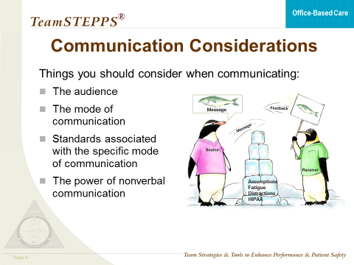
COMMUNICATION CONSIDERATIONS
SAY:
Communication is the lifeline of any team. In health care, it is the lifeline between patients and any member of the team. By history, medical plans of care were developed and shared with the patients for consents to the plan. In the Joint Commission 2008 publication Guiding Principles for Development of Hospitals of the Future, health care practitioners are expected to “share complete, unbiased information with patients and families in ways that are affirming and useful. Patients and families are to receive timely, accurate information in order to effectively participate in care and decision-making.” For this commitment to be effective, information must flow freely through excellent communication processes that permeate every aspect of an organization.
Some things to consider include the following:
The audience—How might your interaction with a receptionist be different from that with a primary care provider?
The mode of communication—Verbal, nonverbal, written, e-mail
Standards associated with the specific mode of communication—Nonverbal communication requires verbal clarification to avoid making assumptions that can lead to error. The simple rule is, “When in doubt, check it out, offer information, or ask a question.”
The power of nonverbal communication—The way you make eye contact and the way you hold your body during a conversation are signals that can be picked up by the person with whom you are communicating, although powerful, nonverbal communication does not provide an acceptable mode to verify or validate (acknowledge) information. For safety to exist, the message must be verified orally or written.
Here are some examples of nonverbal communication:
The nonverbal cues a primary care provider gives when looking at an EKG would quickly tell the nurse the severity of the situation and might lead to proactive action.
The nonverbal cues from the nurse’s face communicate the urgency of a situation and the need to interrupt a doctor who is with a patient’s family members.

Slide 6
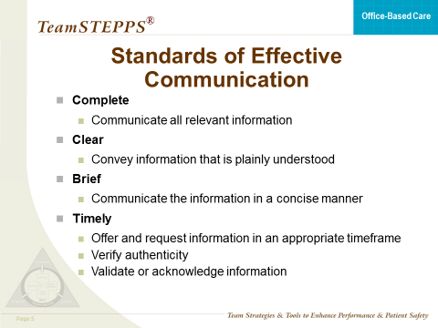
STANDARDS OF EFFECTIVE COMMUNICATION
SAY:
When sharing information with the team, which can include other providers, patients, or family members, communication must meet four standards to be effective.
Effective communication is:
Complete
  Communicate all relevant information while avoiding unnecessary details that may lead to confusion
  Leave enough time for questions, and answer questions completely
Clear
  Use information that is plainly understood (layman’s terminology with patients and their families)
  Use common or standard terminology when communicating with members of the team
Brief
  Be concise
Timely
  Be dependable about offering and requesting information
  Avoid delays in relaying information that could compromise a patient’s situation
  Note times of observations and interventions in the patient’s record
  Update patients and families frequently
  Verify authenticity, which requires checking that the information received was the intended message of the sender
  Validate or acknowledge information

Slide 7
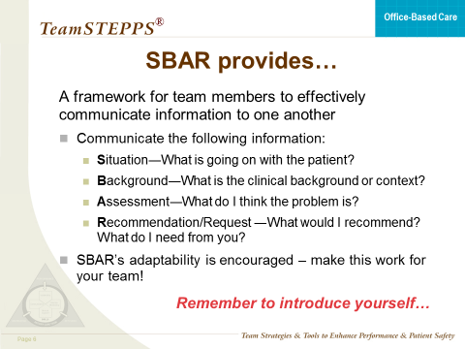
SBAR
SAY:
SBAR is a framework that team members can use to effectively communicate information about a patient’s condition to one another. SBAR stands for situation, background, assessment, recommendation, an easy-to-remember mechanism useful for framing any conversation, especially a critical one requiring a clinician’s immediate attention and action. SBAR is one technique that can be used to standardize communication, which is essential for developing teamwork and fostering a culture of patient safety. It creates a consistent format for information to be sent and creates an expectation for information to be received.
SBAR originated in the US Navy submarine community to quickly provide critical information to the captain. It provides members of the team with an easy and focused way to set expectations for what will be communicated and how. Standards of communication are essential for developing teamwork and fostering a culture of patient safety.
In phrasing a conversation with another member of the team, you should consider the following:
Situation—What is happening with the patient?
Background—What is the clinical background or context?
Assessment—What do I think the problem is?
Recommendation—What would I recommend? What do I need from you?
SBAR provides a vehicle for individuals to speak up and express concern in a concise manner.
Also, never forget to introduce yourself. You should not assume that everyone knows who you are.
Finally, SBAR is adaptable and it ‘s adaptability is strongly encouraged! Try to think of SBAR as a menu. The parts you choose to use and the order in which they are used depend on your team’s unique needs. Determine which parts you need and use those when communicating critical information among your team members.

Slide 8
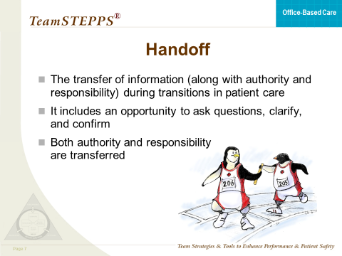
HANDOFF
SAY:
A handoff is a standardized method for transferring information (along with authority and responsibility) during transitions in patient care. When a team member is temporarily or permanently relieved of duty, there is a risk that necessary information about the patient might not be communicated. The handoff strategy is designed to enhance information exchange at critical times such as transitions in care. It maintains continuity of care despite changing caregivers and patients.
Handoffs include the transfer of knowledge and information about the degree of uncertainty (uncertainty about diagnoses, etc.), response to treatment, recent changes in conditions and circumstances, and the plan (including contingencies).
In addition, both authority and responsibility are transferred. Lack of clarity about who is responsible for care and for decision-making has often been a major contributor to medical error (as identified in root cause analyses of sentinel events and poor outcomes).

Slide 9
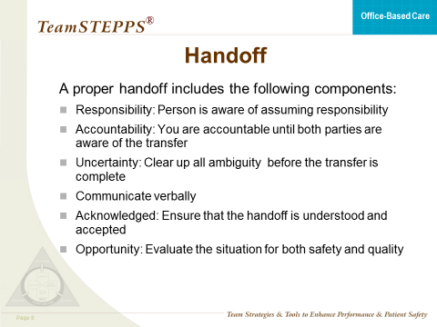
HANDOFF
SAY:
A proper handoff includes the following components:
Responsibility—When handing off, it is your responsibility to know that the person who must accept responsibility is aware of assuming responsibility.
Accountability—You are accountable until both parties are aware of the transfer of responsibility.
Uncertainty—When uncertainty exists, it is your responsibility to clear up all ambiguity about responsibility before the transfer is completed.
Communicate verbally—You cannot assume that the person obtaining responsibility will read or understand written or nonverbal communications.
Acknowledged—Until it is acknowledged that the handoff is understood and accepted, you cannot relinquish your responsibility.
Opportunity—Handoffs are a good time to review and have a new pair of eyes evaluate the situation for both safety and quality.

Slide 10
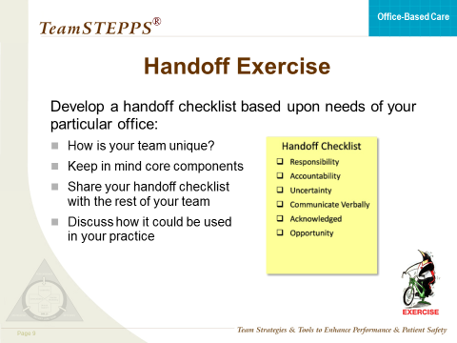

HANDOFF EXERCISE
SAY:
We’re now going to work as a group to develop a handoff checklist based upon the needs of our own medical office team.
INSTRUCTOR NOTE:
Refer participants to the handout titled Creating a Handoff Checklist and ask them to form a small group (if their team members are in attendance, with their own teams) and develop a handoff checklist based on the needs of their particular medical office. Ask participants to think about how their team is unique and to keep in mind core components of TeamSTEPPS. Allow 10 minutes for this activity and then sample responses from the group.

Slide 11
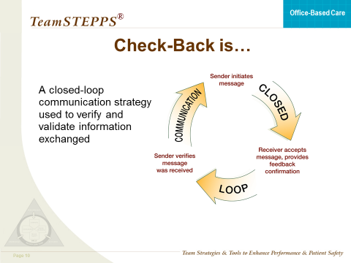
CHECK-BACK
SAY:
A check-back is a closed-loop communication strategy used to verify and validate information exchanged. The strategy involves the sender initiating a message, the receiver accepting the message and confirming what was communicated, and the sender verifying that the message was received. This can be described as similar to placing an order at a fast food counter or drive-through window—the sender of the information places the order, the receiver accepts the message and repeats the order to ensure that he or she has the correct information, and the sender verifies that the message was received and confirms that the order is accurate.

Slide 12
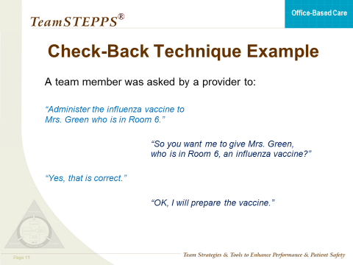
CHECK-BACK TECHNIQUE EXAMPLE
SAY:
Typically, when a team member calls out information, he or she anticipates a response on any order that must be checked back. For example, if a team member was asked by a primary care provider to administer the influenza vaccine to Mrs. Green in room 6, upon hearing this, the team member should check back to the primary care provider. The team member should confirm by saying, “So, you want me to give Mrs. Green in room 6 the influenza vaccine? I will prepare the vaccine. Please provide the follow on order.”

Slide 13
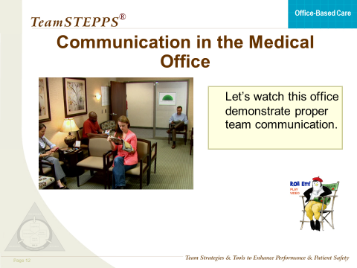


COMMUNICATION VIDEO
SAY:
Let’s watch the fourth primary care office demonstrate proper team communication.
DO: Play the video by clicking the director icon on the slide.
VIDEO TIME:
3:32 minutes
MATERIALS:
  Video

Slide 14
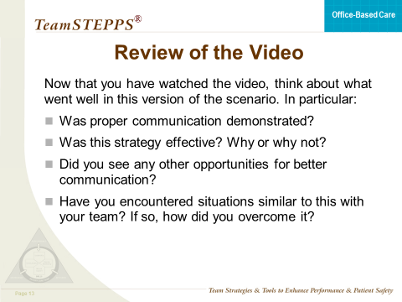
COMMUNICATION VIDEO
DISCUSSION:
Discuss the video and what they did right this time . Ask participants if anything else could have been done to improve the situation.
Possible discussion points:
Was proper communication demonstrated in this video?
Was this strategy effective? Why or why not?
Did you see any other opportunities for better communication in this video?
Have you encountered situations similar to this with your team? If so how did you overcome it?

Slide 15
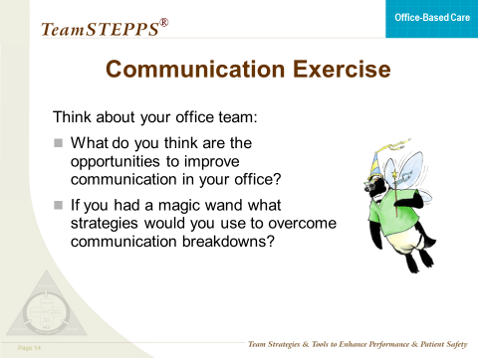
COMMUNICATION EXERCISE
SAY:
We’re now going to take a few minutes and think about our team’s communication. What are some areas for improvement? How are staff involved? How are patients and families involved? If you had a magic wand, what strategies would you use to address the communication breakdowns on your team?
INSTRUCTOR NOTE:
Allow them about 5 minutes to group with two or three other participants and share their experiences. Then ask if there are volunteers who are willing to share their experiences as well as their suggestion for a strategy that can be used to address the issue.

Slide 16
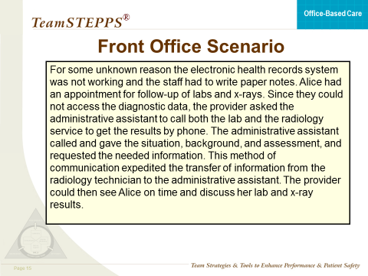
FRONT OFFICE SCENARIO
SAY:
Now let’s look at the following scenario and see how communication can be demonstrated in the nonclinical aspects of the primary care team:
READ THE SCENARIO:
For some unknown reason the electronic health record was not working and the staff had to write paper notes. A patient had an appointment for followup of labs and x rays. Since they could not access the diagnostic data, the provider asked the secretary to call both the lab and the radiology service to get the results by phone. The secretary called and explained the situation, background, and assessment, and requested the needed information. This method of communication expedited the transfer of information from the radiology technician to the secretary. The provider could then see the patient on time and discuss her lab and x ray results.

Slide 17
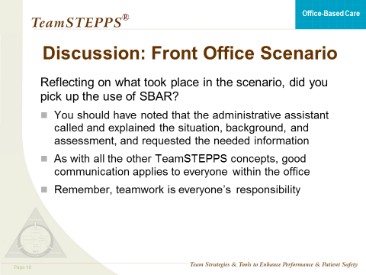
FRONT OFFICE SCENARIO
SAY:
Did anyone pick up on the use of SBAR in this scenario? The administrative assistant called and explained the situation, background, and assessment, and requested the necessary information.
As with all the other TeamSTEPPS concepts, good communication applies to everyone within the medical office. Remember, teamwork is everyone’s responsibility.

Slide 18
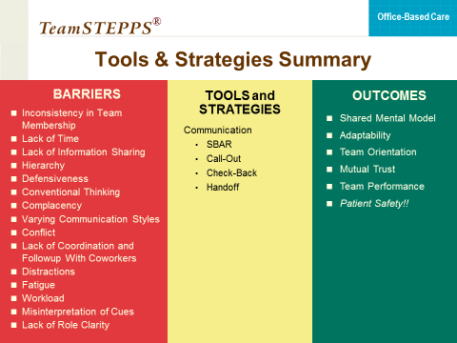
BARRIERS – TOOLS – OUTCOMES
SAY:
Communication skills interact directly with leadership, situation monitoring, and mutual support. These are the principles you will learn about in the following presentations.
Team leaders require effective communication skills to convey clear information, provide awareness of roles and responsibilities, and provide feedback.
Team members monitor situations by communicating any changes to keep the team informed and the patient protected.
Communication facilitates a culture of mutual support when team members request or offer assistance and verbally advocate for the patient.
Communication tools that can enhance teamwork include SBAR, call-out, check-back, and handoff. These tools facilitate effective and efficient communication within and across teams. Good communication facilitates the development of shared mental models, adaptability, mutual trust, and patient safety.
INSTRUCTOR NOTE:
This ends the Communication module and may be a good place to break again. The next module will begin the discussion on Leading Teams.

