Slide 1

for
Office-Based Care
Communication

Slide 2
Communication
The first of the four main TeamSTEPPS components
“The process by which information is clearly and accurately exchanged between two or more team members in the prescribed manner and with proper terminology and the ability to clarify or acknowledge the receipt of information.”^{i}
The lifeline of any team
In health care, the lifeline between patients and any team member
^{i} Cannon-Bowers JA, Tannenbaum SI, Salas E, et al. Defining competencies and establishing team training requirements. In: Guzzo RA, Salas E, eds. Team effectiveness and decision making in organizations. San Francisco: Jossey-Bass; 1995. p. 333.

Slide 3
Importance of Communication
Joint Commission data continue to demonstrate the importance of communication in patient safety
1995-2005: Ineffective communication
identified as root cause for nearly 66 percent of all reported sentinel events*
2010-2013: Communication among top 3 root causes of sentinel events reported†
  * Joint Commission Root Causes and Percentages for Sentinel Events (All Categories). January 1995-December 2005
  † Joint Commission Sentinel Event Data (Root Causes by Event Type). 2004-2012
http://www.jointcommission.org/sentinel_event.aspx

Slide 4
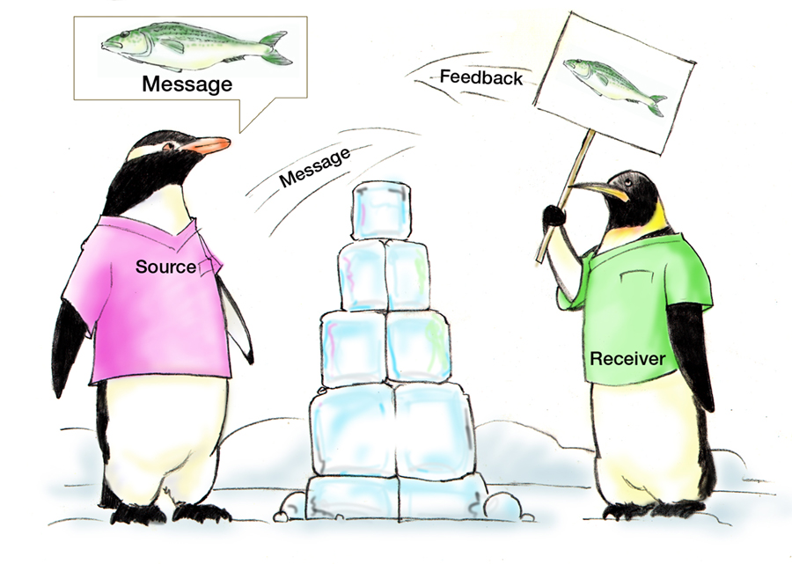
Communication Considerations
Things you should consider when communicating:
The audience
The mode of
communication
Standards associated
with the specific mode
of communication
The power of nonverbal
communication
Assumptions
Fatigue
Distractions
HIPAA

Slide 5
Standards of Effective Communication
Complete
  Communicate all relevant information
Clear
  Convey information that is plainly understood
Brief
  Communicate the information in a concise manner
Timely
  Offer and request information in an appropriate timeframe
  Verify authenticity
  Validate or acknowledge information

Slide 6
SBAR provides…
A framework for team members to effectively communicate information to one another
Communicate the following information:
  Situation―What is going on with the patient?
  Background―What is the clinical background or context?
  Assessment―What do I think the problem is?
  Recommendation/Request ―What would I recommend? What do I need from you?
SBAR’s adaptability is encouraged – make this work for your team!
Remember to introduce yourself…

Slide 7
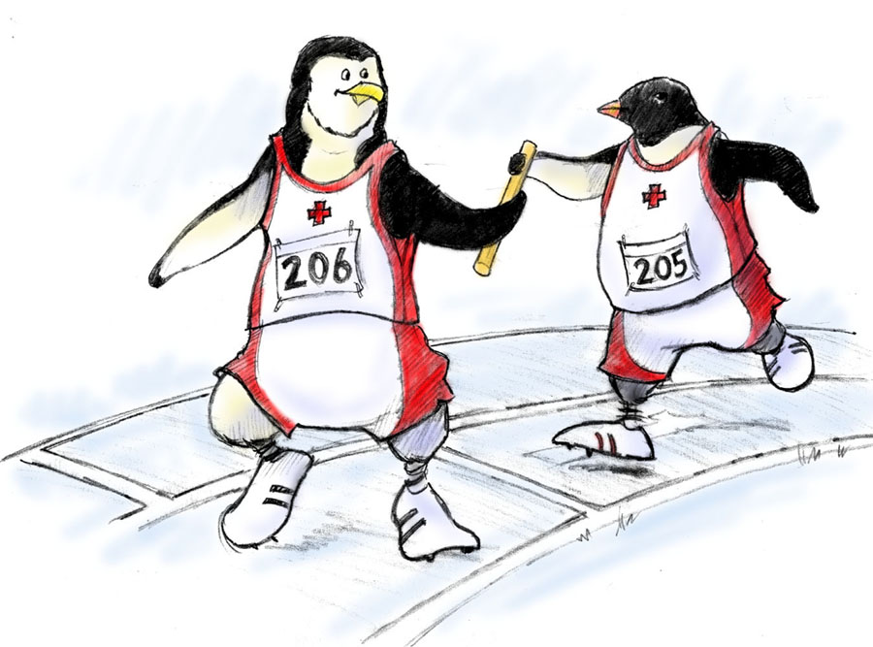
Handoff
The transfer of information (along with authority and responsibility) during transitions in patient care
It includes an opportunity to ask questions, clarify, and confirm
Both authority and responsibility
are transferred

Slide 8
Handoff
A proper handoff includes the following components:
Responsibility: Person is aware of assuming responsibility
Accountability: You are accountable until both parties are aware of the transfer
Uncertainty: Clear up all ambiguity before the transfer is complete
Communicate verbally
Acknowledged: Ensure that the handoff is understood and accepted
Opportunity: Evaluate the situation for both safety and quality

Slide 9

Handoff Exercise
Develop a handoff checklist based upon needs of your particular office:
How is your team unique?
Keep in mind core components
Share your handoff checklist
with the rest of your team
Discuss how it could be used
in your practice

Slide 10
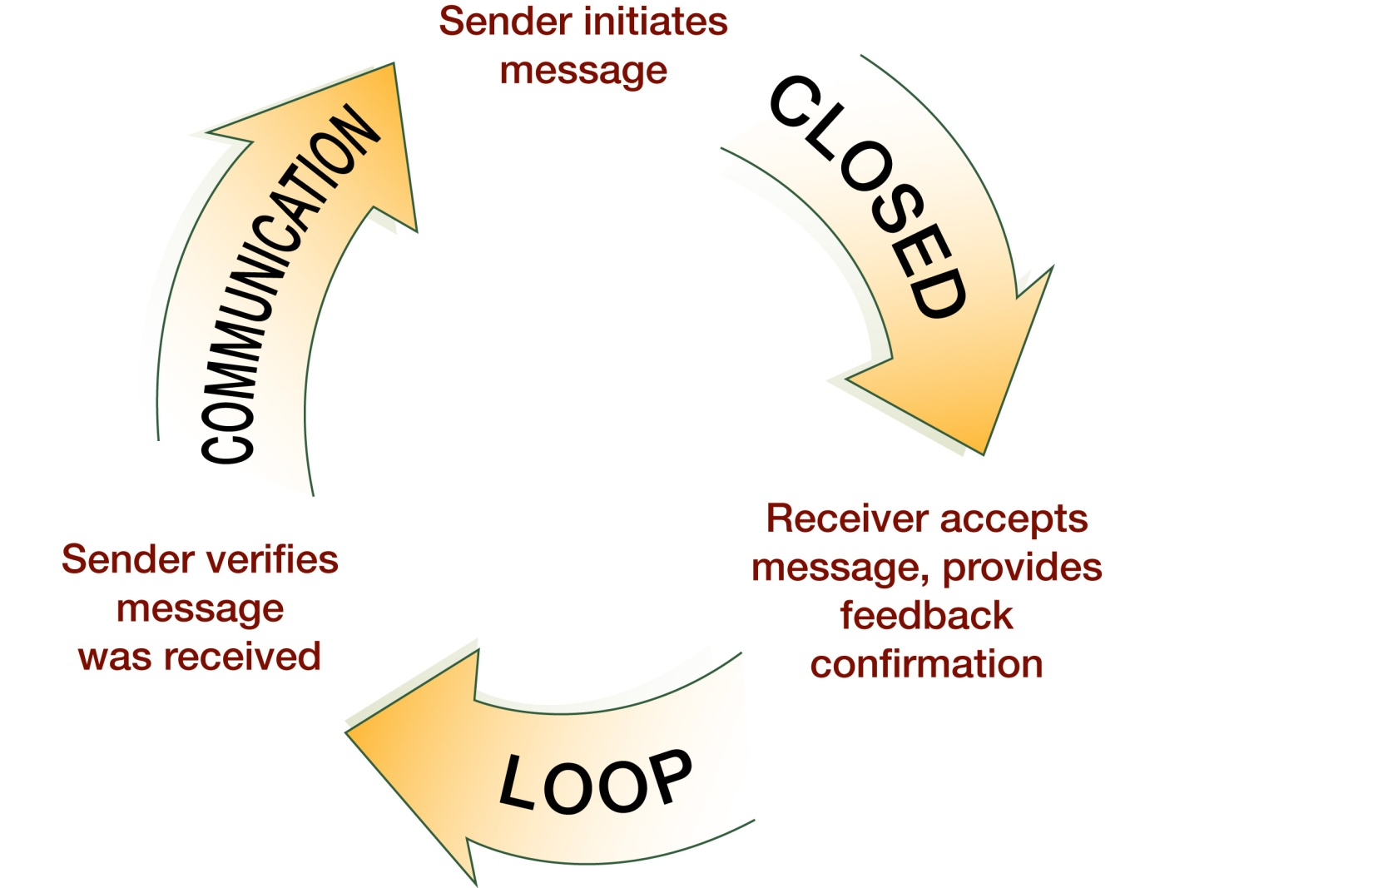
Check-Back is…
A closed-loop communication strategy used to verify and validate information exchanged

Slide 11
Check-Back Technique Example
A team member was asked by a provider to:
“Administer the influenza vaccine to
Mrs. Green who is in Room 6.”
“So you want me to give Mrs. Green, who is in Room 6, an influenza vaccine?”
“Yes, that is correct.”
“O.K., I will prepare the vaccine.”

Slide 12
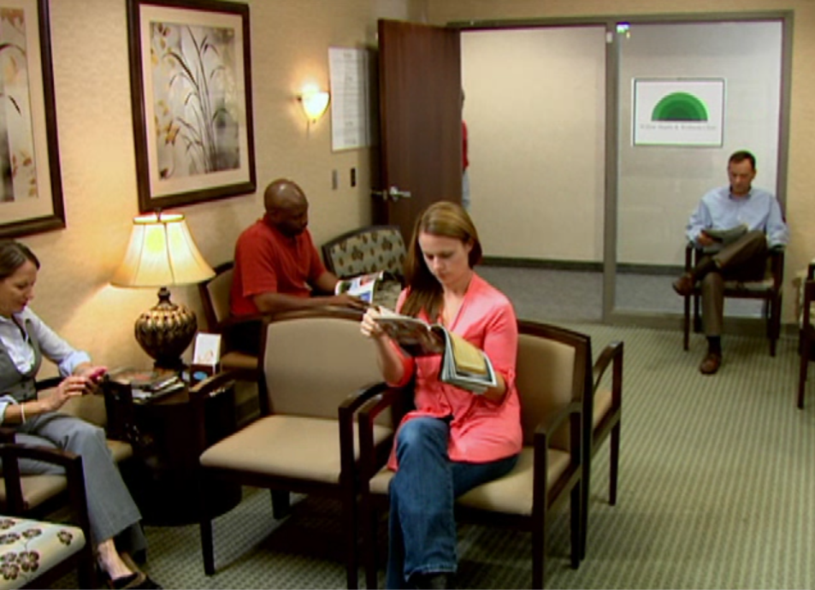

Communication in the
Medical Office
Let’s watch this office demonstrate proper team communication.

Slide 13
Review of the Video
Now that you have watched the video, think about what went well in this version of the scenario. In particular:
Was proper communication demonstrated?
Was this strategy effective? Why or why not?
Did you see any other opportunities for better communication?
Have you encountered situations similar to this with your team? If so, how did you overcome it?

Slide 14

Communication Exercise
Think about your office team:
What do you think are the opportunities to improve communication in your office?
If you had a magic wand what strategies would you use to overcome communication breakdowns?

Slide 15
Front Office Scenario
For some unknown reason the electronic health records system was not working and the staff had to write paper notes. Alice had an appointment for followup of labs and x rays. Since they could not access the diagnostic data, the provider asked the administrative assistant to call both the lab and the radiology service to get the results by phone. The administrative assistant called and gave the situation, background, and assessment, and requested the needed information. This method of communication expedited the transfer of information from the radiology technician to the administrative assistant. The provider could then see Alice on time and discuss her lab and x ray results.

Slide 16
Discussion: Front Office Scenario
Reflecting on what took place in the scenario, did you pick up the use of SBAR?
You should have noted that the administrative assistant called and explained the situation, background, and assessment, and requested the needed information
As with all the other TeamSTEPPS concepts, good communication applies to everyone within the office
Remember, teamwork is everyone’s responsibility

Slide 17
Tools & Strategies Summary
BARRIERS
Inconsistency in Team Membership
Lack of Time
Lack of Information Sharing
Hierarchy
Defensiveness
Conventional Thinking
Complacency
Varying Communication Styles
Conflict
Lack of Coordination and Followup With Coworkers
Distractions
Fatigue
Workload
Misinterpretation of Cues
Lack of Role Clarity
TOOLS and STRATEGIES
  Communication
  SBAR
  Call-Out
  Check-Back
  Handoff
OUTCOMES
Shared Mental Model
Adaptability
Team Orientation
Mutual Trust
Team Performance
Patient Safety!!

