Slide 1
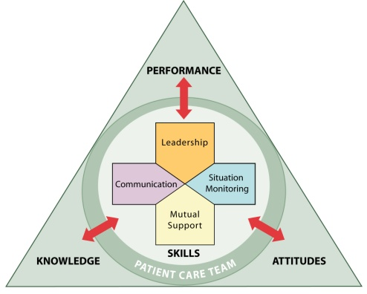

for
OFFICE-BASED CARE
Situation Monitoring
®

Slide 2
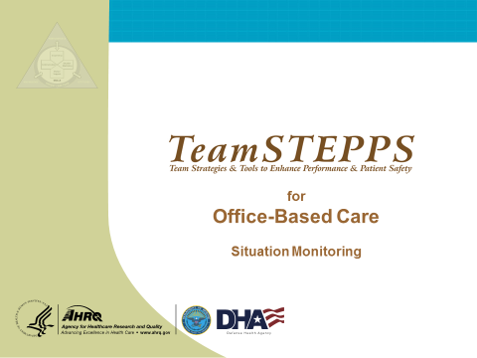
INTRODUCTION
SAY:
We will now consider the third component of TeamSTEPPS, situation monitoring.
MODULE TIME:
30 minutes
MATERIALS:
  Flipchart and markers
  Copies of Handouts
  Situation Monitoring video

Slide 3
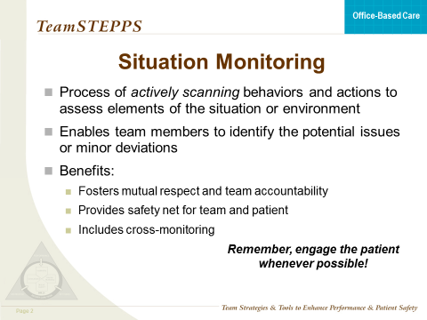
SITUATION MONITORING
SAY:
Situation monitoring is defined as the process of actively scanning behaviors and actions to assess elements of the situation or environment. Situation monitoring is a skill that individual team members can acquire, practice, and improve on. It enables team members to identify the potential issues or minor deviations early enough so that they can correct and handle them before they become a problem or pose harm to the patient.
The benefits of situation monitoring are that it fosters mutual respect and team accountability, and through the process of cross-monitoring provides a safety net for both the patient and the team.
Examples of situation monitoring include assessing the patient’s condition, noting malfunctioning equipment, and being aware of workload spikes and stress levels among team members.
Finally, remember that you should engage the patient whenever possible.
INSTRUCTOR NOTE:
Ask participants to describe some of the ways in which they monitor the situation in their medical offices.

Slide 4
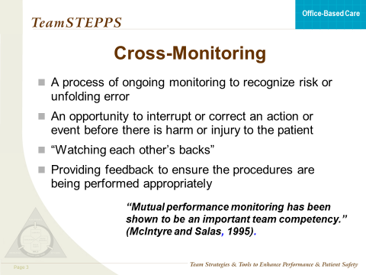
CROSS-MONITORING
SAY:
Cross-monitoring is a process of ongoing monitoring of the environment of care to recognize risk or unfolding error and to take action to interrupt or correct an action or event before the patient is harmed or injured.
Commonly referred to as “watching each other’s back,” cross-monitoring involves monitoring all actions against the established plan and advocating or asserting a position or corrective action when the plan and actions differ or when risk is perceived as escalating and task assistance is required.
Cross-monitoring actions include providing feedback and keeping track of fellow team members’ behaviors to ensure that procedures are being performed appropriately. Cross-monitoring is an act of patient and caregiver advocacy and allows team members to check and correct their actions, if necessary.
Cross-monitoring is not a way to “spy” on other team members, but a way to provide a safety net or error prevention/error interruption mechanism for the team, ensuring that mistakes or oversights are caught early. When all members of the team trust the intentions of their fellow team members, a strong sense of team orientation and a high degree of psychological safety result.
INSTRUCTOR NOTE:
Refer to the handout titled Cross-Monitoring. Ask participants to form pairs and share an example of a situation in which cross-monitoring was successful and one in which cross-monitoring should have been used, but was not. After about 5 minutes, ask for a few pairs to volunteer to share their examples with the larger group.

Slide 5
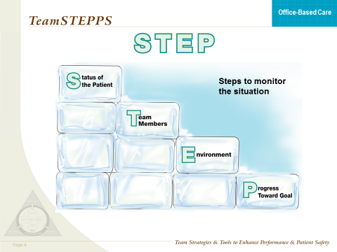
STEP
SAY:
How can team members acquire a trained eye as they “monitor the situation?” What components of the situation provide clues about impending complications or contingencies? The STEP process is a mnemonic tool that can help team members monitor the situation and the overall environment. The STEP process involves ongoing monitoring of the:
Status of the patient—Ask, What are the patients’ status? Vital Signs? Medications? Stress level?
Team members—Ask, What are my team members doing? Workload? Fatigue level? Stress level? Skill level?
Environment—Ask, Are the exam rooms properly stocked? Are the blood pressure cuffs, otoscope, and ophthalmoscope working properly? Do we need any special equipment for a procedure today? Are there enough staff to attend to all patients?
Progress toward the goal—Ask, What is the progress toward today’s goals (i.e., how is the day progressing?) Are we behind? Are patients waiting too long? Are things being left undone because of time pressure? Is the plan still appropriate or does it need to be revised?
Examples in the medical office might include the following: A patient comes in complaining about a sore throat but it turns out she may have pneumonia.
Status of the patient: Patient has pneumonia.
Team members: Physician isn’t available or is at lunch.
Environment: Need a room with oxygen.
Progress toward goal: Ask nurse to come in and assess patient and administer oxygen. Find a nurse to help her with other duties.

Slide 6
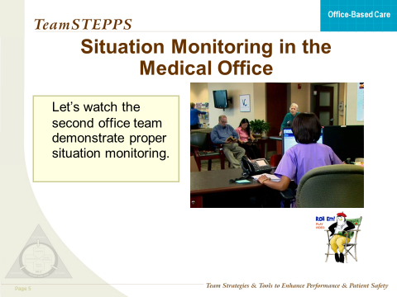


SITUATION MONITORING VIDEO
SAY:
Let’s watch the second office demonstrate proper team situation monitoring.
DO: Play the video by clicking the director icon on the slide.
VIDEO TIME:
2:23 minutes
MATERIALS:
  Video

Slide 7
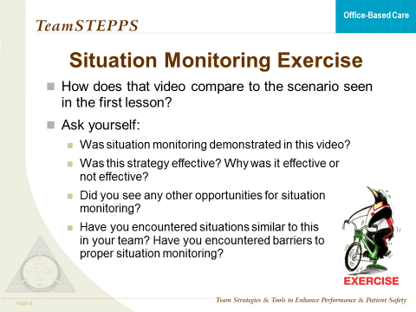
SITUATION MONITORING VIDEO
DISCUSSION:
Discuss the video and what went better this time.
Possible discussion points:
Was situation monitoring demonstrated in this video?
Was this strategy effective? Why was it/was it not effective?
Did you see any other opportunities for situation monitoring to be demonstrated in this video?
Have you encountered situations similar to this in your team? If so, how did you overcome it?

Slide 8
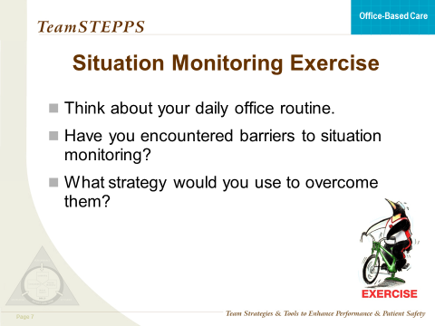

SITUATION MONITORING EXERCISE
SAY:
Think about your own office team and daily routines in terms of situation monitoring. Have you encountered barriers to proper situation monitoring or, if not, do you anticipate barriers in this new team structure?
INSTRUCTOR NOTE:
After a few minutes:
    Ask participants to suggest an appropriate strategy (STEP, cross-monitoring) to address and overcome the problem.
    Allow them about 5 minutes to group with two or three other participants and share their experiences.
    Then ask if there are volunteers who are willing to share their experiences as well as their suggestion for a strategy that can be used to address the issue.

Slide 9
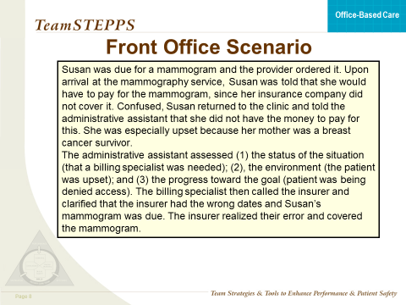
FRONT OFFICE SCENARIO
SAY:
Now let’s look at the following scenario and see how situation monitoring can be demonstrated in the nonclinical aspects of the care team.
READ THE SCENARIO:
Susan was due for a mammogram and the provider ordered it. Upon arrival at the mammography service, Susan was told that she would have to pay for the mammogram, since her insurance company did not cover it. Confused, Susan returned to the clinic and told the administrative assistant that she did not have the money to pay for this. She was especially upset because her mother was a breast cancer survivor.
The administrative assistant assessed (1) the status of the situation (that a billing specialist was needed); (2) the environment (the patient was upset); and (3) the progress toward the goal (patient was being denied access). The billing specialist then called the insurer and clarified that the insurer had the wrong dates and Susan’s mammogram was due. The insurer realized their error and covered the mammogram.
As with leadership, situation monitoring can be practiced by everyone within the office. Remember, teamwork is the responsibility of everyone.

Slide 10
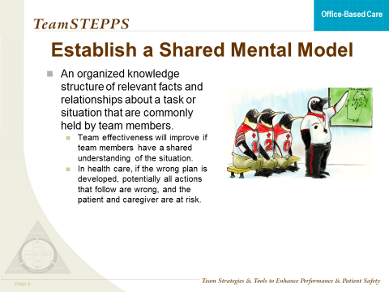
SHARED MENTAL MODEL
SAY:
Because teams are typically composed of members with distinct roles who tend to have unique information, it is important to pay attention to the factors that promote and undermine the opportunity for team members to present and discuss their diverse information and observations. The act of sharing and discussing information gained from situation monitoring provides the opportunity to gather more information about the situation and helps cultivate a mutual understanding, commonly referred to as a shared mental model. A shared mental model is an organized knowledge structure of relevant facts and relationships about a task or a situation that are commonly held by members of a team. The basic premise about the relationship between teamwork and shared mental models is that team effectiveness will improve if team members have a shared understanding of the situation. Evidence suggests that team members who possess shared mental models yield teams that:
Can anticipate
Back up and fill in for one another
Communicate to ensure that team members have the necessary information for task performance
Understand each other’s roles and how they interplay
In health care, if the wrong plan is developed, potentially all actions that follow are wrong, and the patient and the caregiver are at risk. A shared mental model serves as an error reduction strategy, and caregivers who understand the plan monitor all actions relative to that plan.

Slide 11
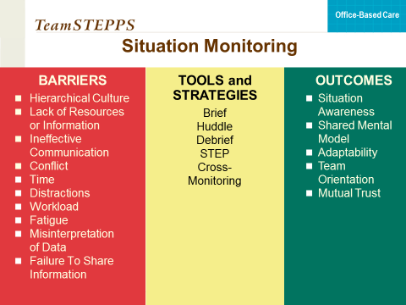
SITUATION MONITORING TOOLS
SAY:
This is a summary of what this training has covered under situation monitoring. There are now additional barriers, additional tools and strategies, and additional outcomes.
INSTRUCTOR NOTE:
This is the end of the Situation Monitoring module and is a good place to break. The next module will begin the discussion on Mutual Support.

