Slide 1
Learn About the Comprehensive
Unit-based Safety Program for
Perinatal Safety
AHRQ Safety Program for Perinatal Care
AHRQ Publication No. 17-0003-1-EF
May 2017

Slide 2
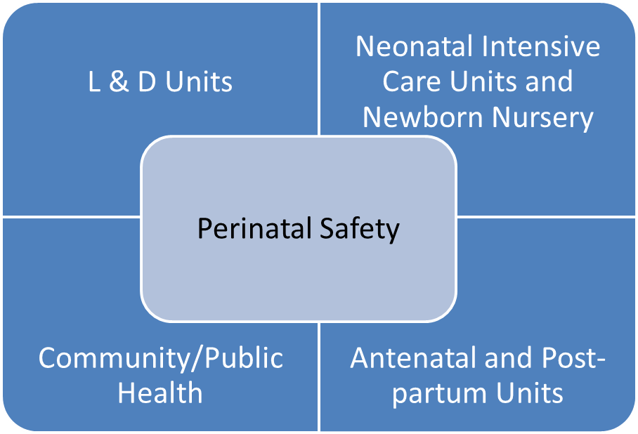
CUSP and Perinatal Safety
Learn About CUSP

Slide 3
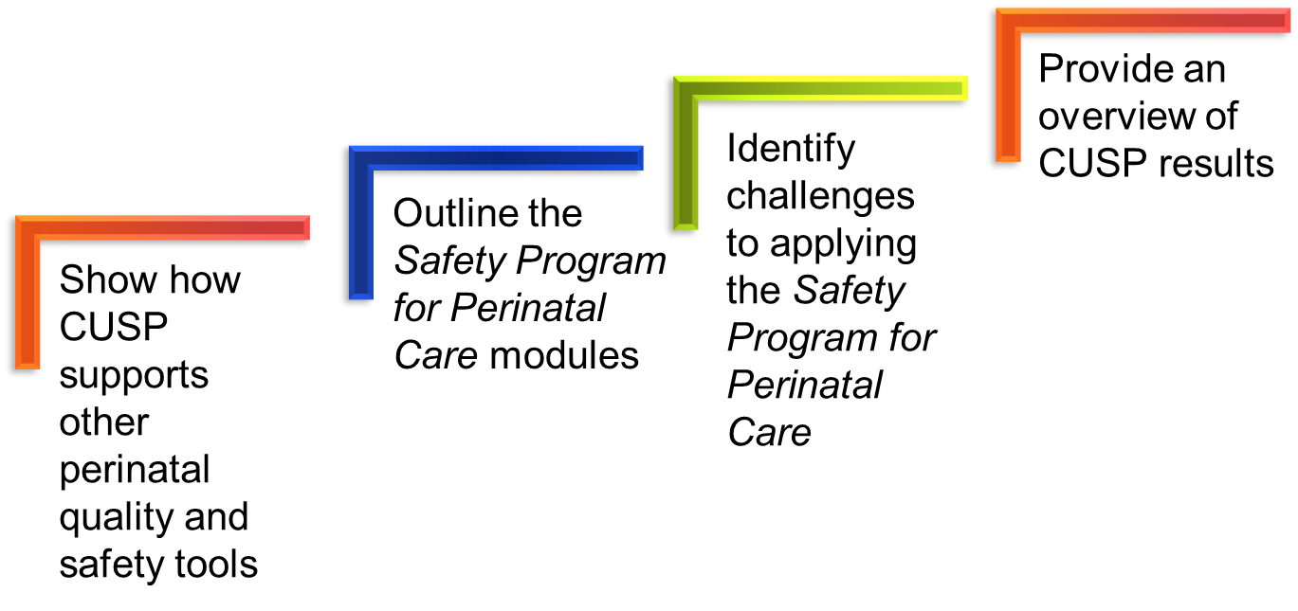
Learning Objectives

Slide 4
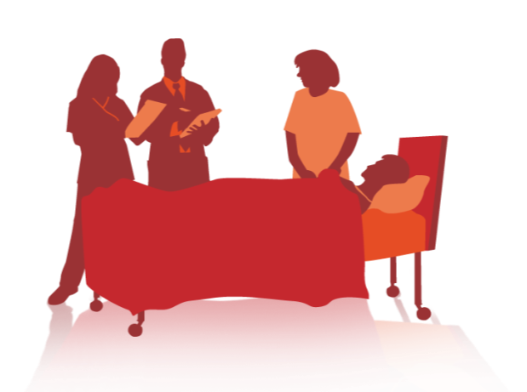
Is Your Hospital Safe?
Would you want a loved one to be a patient at your hospital? Your unit?
Would you want to be a patient in the unit where you work?
Can you say with 100 percent certainty that you believe that your hospital does everything it can to protect its patients?
Learn About CUSP

Slide 5
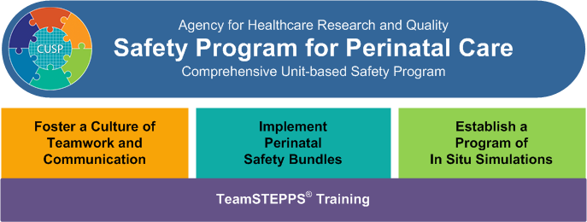
Safety Program for Perinatal Care
Learn About CUSP

Slide 6
SPPC CUSP Modules
Learn About CUSP
Assemble the Team/Engage Leadership
Understand the Science of Safety
Sensemaking and Learn From Defects
Implement Teamwork and Communication
Engage Patients and Families
Learn About CUSP

Slide 7
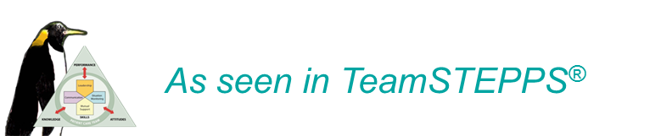
CUSP Aligns With and Supports
Other Quality and Safety Tools
Kotter’s 8 Step Process for Leading Change
TeamSTEPPS®
Six Sigma
Institute for Healthcare Improvement Model for Improvement
Plan-Do-Study-Act
Root Cause Analysis
Failure Mode Effect Analysis
Just Culture
Learn About CUSP

Slide 8
The CUSP Model
Created through a collaborative effort of the Agency for Healthcare Research and Quality and State and national-level innovators in patient safety
Dovetails with, and supports, a range of quality and safety improvement models
Encompasses a wide range of safety tools and approaches
Based on the understanding that all culture is local, and that work to improve culture must be owned at the unit level
Believes that harm is not an acceptable “cost of doing business”
Can be applied by anyone, anywhere
Learn About CUSP

Slide 9
A Collaborative Effort¹
Johns Hopkins Quality and Safety Research Group developed CUSP with AHRQ funding.
Infection reduction project at Keystone Center for Patient Safety and Quality demonstrated CUSP's success.
On the CUSP: Stop BSI and other national projects applied the CUSP model.
CUSP Toolkit using Kotter's change model combines CUSP and existing team communication frameworks to provide complete toolset to support units in improving culture.
Learn About CUSP

Slide 10
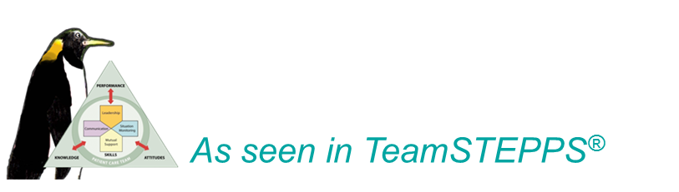
CUSP Supports
Kotter’s Eight Steps of Change²
Kotter | CUSP Toolkit Modules
Step 1. Create a sense of urgency. | Understand the Science of Safety
Step 2. Create a guiding coalition. | Assemble the Team/Engage Leadership
Step 3. Develop a shared vision. | Identify Defects Through Sensemaking
Step 4. Communicate the vision. | Understand the Science of Safety Identify Defects Through Sensemaking

Slide 11
CUSP Supports
Kotter’s Eight Steps of Change²
Kotter | CUSP Toolkit Modules
Step 5. Empower others to act. | Assemble the Team/Engage Leadership Identify Defects Through Sensemaking Implement Teamwork and Communication
Step 6. Generate short term wins. | Implement Teamwork and Communication
Step 7. Consolidate gains and produce more change. | Identify Defects Through Sensemaking
Step 8. Anchor new approaches in culture. | Understand the Science of Safety Implement Teamwork and Communication

Slide 12
Introduction to Just Culture Introduction to Just Culture Principles
Learn About CUSP

Slide 13


Understand Just Culture
CLICK LINK BELOW TO PLAY VIDEO:
http://www.ahrq.gov/professionals/education/curriculum-tools/cusptoolkit/videos/07a_just_culture/index.html
Learn About CUSP

Slide 14

Just Culture³
A system that—
Holds itself accountable
Holds leaders and managers accountable
Holds staff members accountable
Has staff members who hold themselves accountable
Learn About CUSP

Slide 15
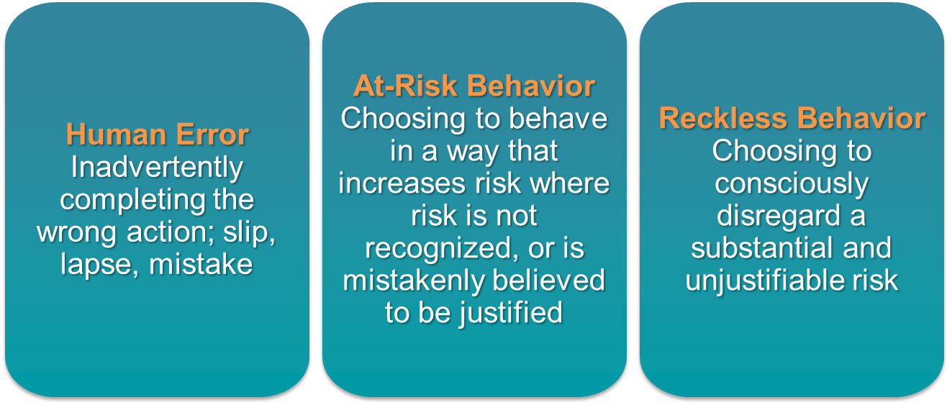
Understanding Risk and Human Behavior³
Learn About CUSP

Slide 16
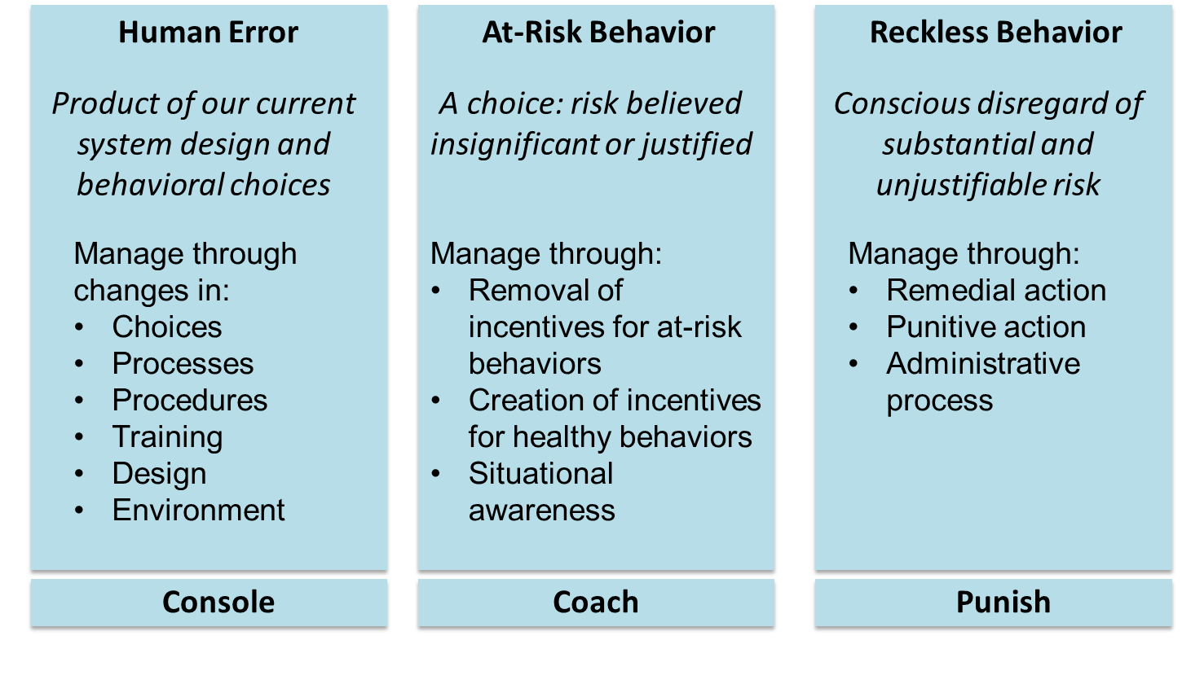
Managing Error and Risk³
Learn About CUSP

Slide 17
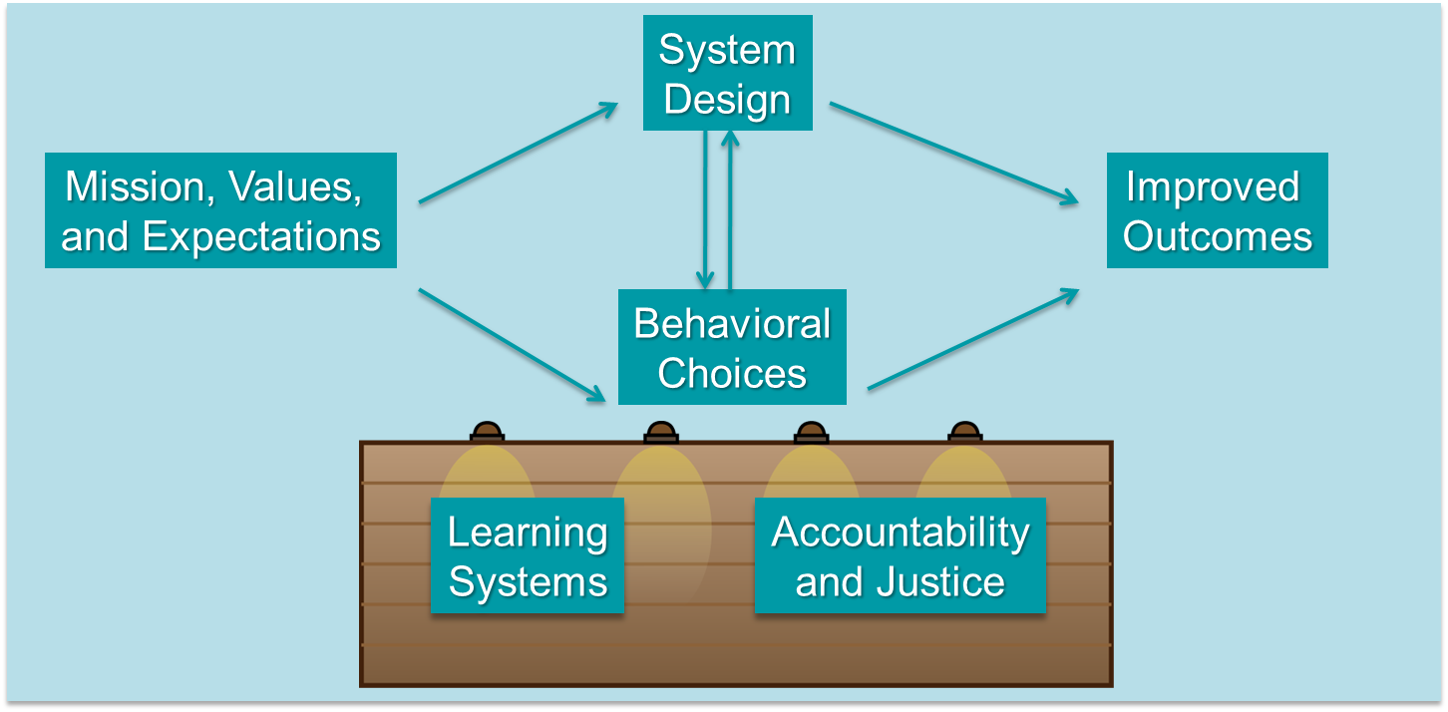
Systems and Behaviors Work Together
To Improve Outcomes³
Learn About CUSP

Slide 18
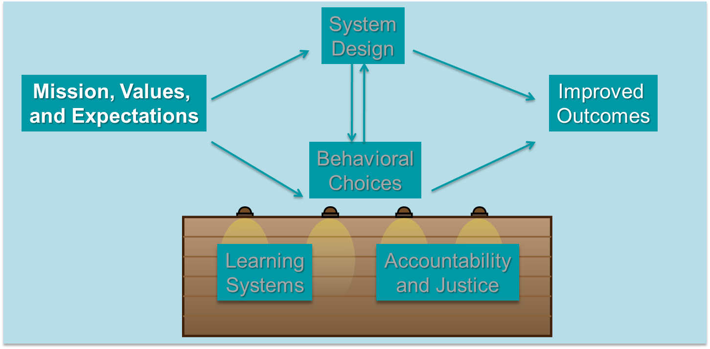
Systems and Behaviors Work Together
To Improve Outcomes³
Learn About CUSP

Slide 19
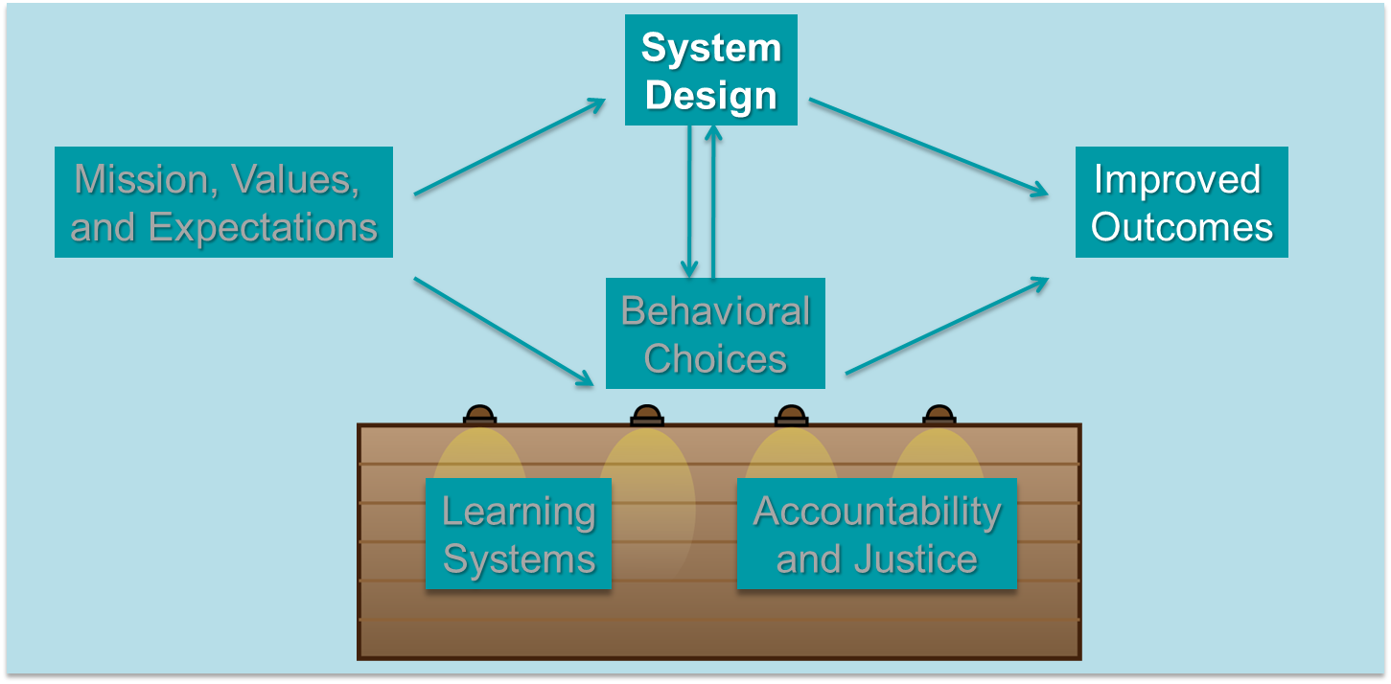
Systems and Behaviors Work Together
To Improve Outcomes³
Learn About CUSP

Slide 20
Systems and Behaviors Work Together
To Improve Outcomes³
Learn About CUSP

Slide 21
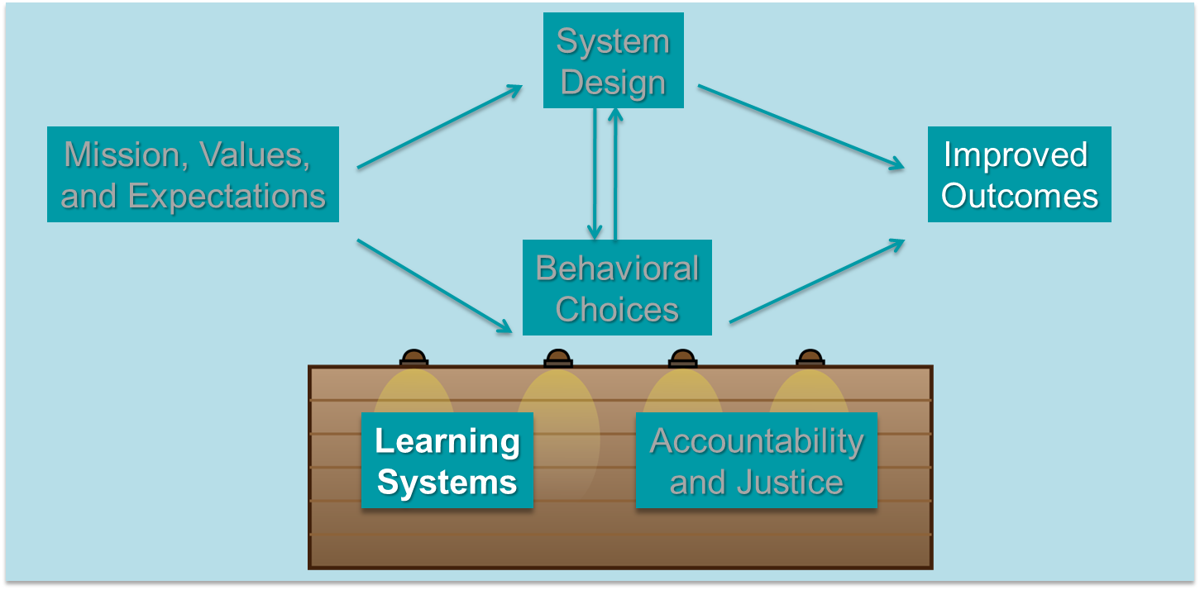
Systems and Behaviors Work Together
To Improve Outcomes³
Learn About CUSP

Slide 22
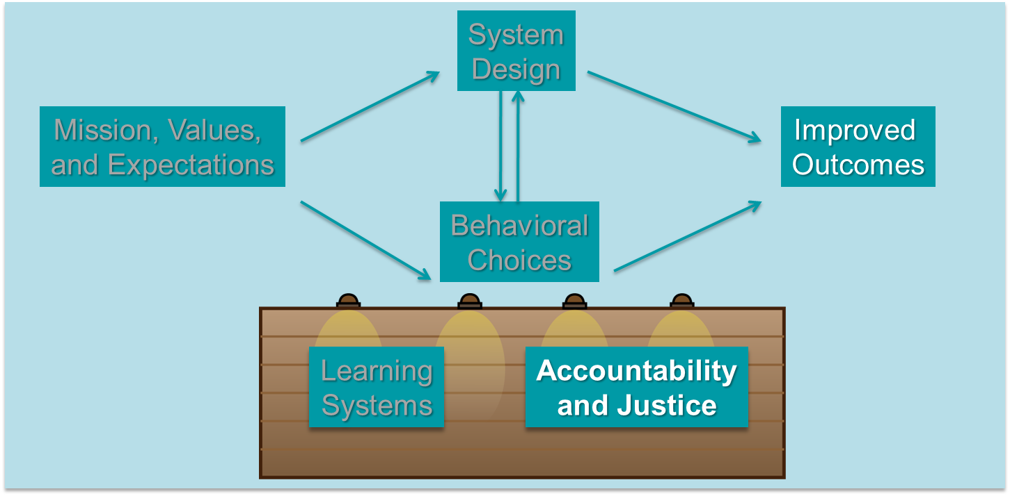
Systems and Behaviors Work Together
To Improve Outcomes³
Learn About CUSP

Slide 23
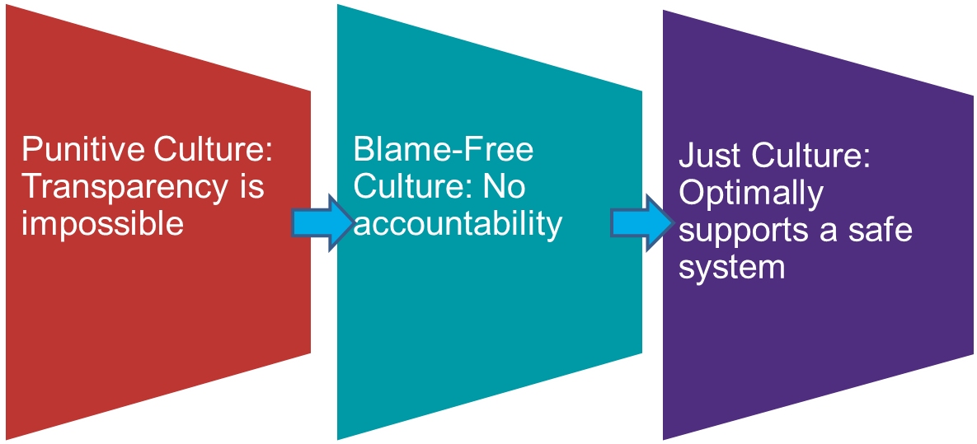
Engineering System Design
To Support Behavior Choices³
Learn About CUSP

Slide 24

Leadership Team’s Role in
Applying Just Culture Principles
Have a procedure in place for employees to follow
Ensure employees are properly trained and have clear expectations
Offer positive reinforcement at the monthly Learning From Defects meeting
Learn About CUSP

Slide 25

CUSP Is Compatible With TeamSTEPPS⁴
TeamSTEPPS Step | CUSP Toolkit Modules
Step 1. Create a change team. | Assemble the Team/Engage Leadership
Step 2. Define the problem. | Identify Defects Through Sensemaking Understand the Science of Safety
Step 3. Define the aims. | Identify Defects Through Sensemaking
Step 4. Design an intervention. | Identify Defects Through Sensemaking Understand the Science of Safety
Learn About CUSP

Slide 26
CUSP is Compatible With TeamSTEPPS⁴
TeamSTEPPS Step | CUSP Toolkit Modules
Step 5. Develop a plan for testing the effectiveness. | Identify Defects Through Sensemaking
Step 6. Develop an implementation plan. | Assemble the Team/Engage Leadership Identify Defects Through Sensemaking Understand the Science of Safety
Step 7. Develop a plan for sustained improvement. | Understand the Science of Safety
Step 8. Develop a communication plan. | Assemble the Team/Engage Leadership Identify Defects Through Sensemaking
Learn About CUSP

Slide 27

CUSP Results
Heightened engagement of staff
and senior leaders
Improved communication among
care team members
Shared mental models
Expanded knowledge of potential
hazards and barriers to safety
Collaborative focus on
systems of care
Learn About CUSP

Slide 28
Summary
CUSP integrates with and supports a broad range of quality and safety models
Communication is cited as a root cause of most errors
Individuals across an organization can use CUSP and expect measurable results
Learn About CUSP

Slide 29
References
Health Research & Educational Trust, Johns Hopkins University Quality and Safety Research Group, Michigan Health & Hospital Association Keystone Center for Patient Safety and Quality. Eliminating CLABSI: A National Patient Safety Imperative. A Progress Report on the National On the CUSP: Stop BSI Project. AHRQ Publication No. 11-0037-EF. Rockville, MD: Agency for Healthcare Research and Quality; April 2011.
Kotter J, Rathgeber H. Our Iceberg Is Melting: Changing and Succeeding Under Any Conditions: 1st ed. New York; St. Martin's Press; 2006.
Griffith S. Just Culture. Plano, TX: Outcome Engineering; 2011.
Agency for Healthcare Research and Quality, Department of Defense. TeamSTEPPS. http://www.ahrq.gov/professionals/education/curriculum-tools/teamstepps/index.html.
Learn About CUSP

Slide 30
Disclaimers
Every effort was made to ensure the accuracy and completeness of this resource. However, the U.S. Department of Health and Human Services makes no warranties regarding errors or omissions and assumes no responsibility or liability for loss or damage resulting from the use of information contained within.
The U.S. Department of Health and Human Services cannot endorse, or appear to endorse derivate or excerpted materials, and it cannot be held liable for the content or use of adapted resources. Any adaptations of this resource must include a disclaimer to this effect.
Reference to any specific commercial products, process, service, manufacturer, company, or trademark does not constitute endorsement or recommendation by the U.S. Government, HHS, or AHRQ of the linked Web resources or the information, products, or services contained therein. The Agency does not exercise any control over the content on these sites.
Learn About CUSP

