Slide 1
Module 1: Introduction
Welcome to the
Online Master Trainer Course
Notes:
Welcome to the TeamSTEPPS Master Trainer course.
As you will soon realize, this introduction module sets the stage for the entire course.
Please select the forward arrow in the lower right corner to begin this module.

Slide 2
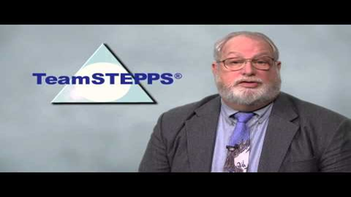
Welcome: Dr. James Battles
Select the image to launch a web browser where you can watch the video
Notes:
Hello, welcome to the TeamSTEPPS Online Master Training Course!
My name is Jim Battles and I direct TeamSTEPPS program at the Agency for Healthcare Research and Quality.
TeamSTEPPS is an evidence-based teamwork system designed to improve the quality, safety, and efficiency of health care, by improving communication and other teamwork skills amongst health care professionals.
We know it works because of the stories shared by organizations that have successfully implemented and sustained the initiative, using the tools and strategies that will be discussed over the course of this curriculum.
For example, Reynolds Army Community Hospital in Oklahoma saw a decrease in O-R delays in start-time, and an increase in productivity, in just 6 months after implementing TeamSTEPPS.
In another example, Montgomery Memorial Hospital, a critical access hospital in North Carolina, using a TeamSTEPPS simulation especially for pediatric care, has improved the efficiency and effectiveness in high-risk situations by increasing the empowerment of their emergency nurses.
The Madigan Army Medical Center, in Washington state, improved the time from decision to the performance of a Caesarean section, with no adverse outcomes for either the mother or the child.
I could go on and on as to the reports of improved outcomes as they arrive almost daily.
Check out the AHRQ website for descriptions of success stories we have received.
To start YOUR journey toward a stronger culture of safety at YOUR organization, please complete the TeamSTEPPS modules. Upon your certification as a Master Team Trainer, you will have everything you need to train, coach, implement and sustain the TeamSTEPPS initiative at your facility.
And then YOU’LL be able to contact me with YOUR success story.
Now, please select the next slide to begin Module 1.

Slide 3
How This Online Course Works
This online course will walk you through the TeamSTEPPS content just as you will present it when you train your colleagues and staff
It teaches you all the concepts that comprise the TeamSTEPPS initiative
While also teaching you to teach TeamSTEPPS to your colleagues
Use the navigation buttons in the lower right to work through the online modules
Select here to move back to the previous slide
Select here to move to the next slide
Notes:
This online course will walk you through the TeamSTEPPS content just as you will present it when you train your colleagues and staff at your facility. It teaches you all the concepts that comprise the TeamSTEPPS initiative while also teaching you how to teach the TeamSTEPPS content to your colleagues. Use the navigation buttons on the lower right to work through the online modules. Select the forward arrow to move to the next slide. And select the back arrow to go back to the previous slide.

Slide 4
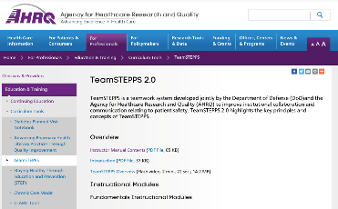
The Materials You Will Use
When you deliver your training you will use these materials:
Instructor Manual
Course Management Guide
Instructor guides
Course slides
Measurement tools
Customizable materials
Videos
Select here to review materials on the TeamSTEPPS website
Notes:
When you deliver the TeamSTEPPS training at your facility, you will use a variety of materials and resources provided on the AHRQ TeamSTEPPS website. We will discuss them more later in this module. Please select the link provided if you would like to review these materials on the TeamSTEPPS website.

Slide 5
Please Print the Instructor Guide
To best use this online module, please print the Module 1 Instructor Guide, located here
Read pages 1-4 in the guide before we begin
Then we will proceed to work through the slides you will use to train – just as if you are delivering this module at your facility
Notes:
To best use this online module, we recommend that you print the Instructor Guide for Module 1 as a reference to use throughout the module.
Before continuing to the next slide, we recommend that you take a moment to read through pages 1-4 in the guide.
Once you have done that, select the forward button and we will proceed to work through the slides you will use to train – just as if you are delivering this module at your facility.

Slide 6
Slide 2: Introductions
You will begin your training with introductions
See page 4 in the Instructor Guide for details on how to facilitate this slide
Notes:
As this course is about teams and teamwork, when you teach the course at your facility, this is the point when you would encourage teams to sit together if they have not already done so.
Before we begin the formal agenda, allow me to introduce myself.
I'm Dr. Brigetta Craft. I'm a retired Air Force nurse with many years of experience in both inpatient and ambulatory arenas at the bedside and in executive positions. As a TeamSTEPPS Master Trainer since 2006, I have had the pleasure of training and coaching TeamSTEPPS in both military and civilian sectors. I've been involved with the DoD Patient Safety Program for more than 10 years and am thrilled to be a part of the development and presentation of this curriculum.
Before you begin the formal agenda when you're teaching, introduce yourself. Share your name, position in the organization, and background with TeamSTEPPS, as I have just done.
As you teach the course, after facilitating the introduction of the instructors, facilitate the introductions of the participants in the room. Ask them to share their name, title, role in the organization, and the area in which they work.
For each team of participants, at least one member should also be asked to indicate the area in which they plan to implement TeamSTEPPS. Depending on the size of the class and time limitations, introductions may be limited to teams who can simply indicate the area in which they plan to implement TeamSTEPPS.
Participants will benefit from knowing about others in the room so that they can identify teams with similar issues to address or similar plans for implementation.

Slide 7
Slide 3: Teamwork Exercise #1
After introductions you will kick-off your training with a “Paper Chain” teamwork exercise
Please proceed to the next slide to observe how this activity works in the classroom
Notes:
After the introductions have been made, you will introduce a teamwork exercise which involves making paper chains.
Please proceed to the next slide to watch a video to observe how this activity works in the classroom.

Slide 8
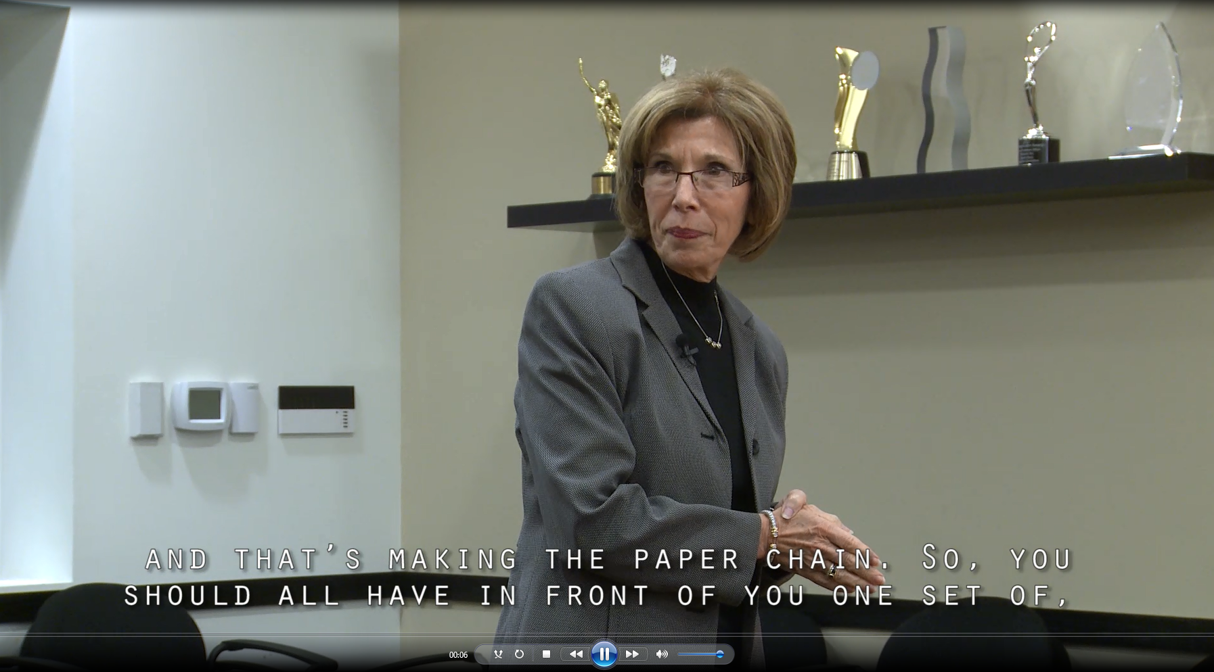
Video: Example of Teamwork Exercise #1
Select the image to launch a web browser where you can watch the video
Notes:
Brigetta Craft: All right, so now that we’ve gotten into our groups, we are going to do our first exercise and that’s making the paper chain. So, you should all have in front of you one set of, pair of scissors, your construction paper, and tape. So, the goal is to make the longest paper chain, looped paper chain. So, as an example, just pretend like I did this straight, remember when you were children, you made those little loops, you taped them together, put another strip and put it through, okay. You’re going to have two minutes to complete this task. Are there any questions before we get started? Okay, then, go!
Brigetta: 10, 9, 8, 7, 6, 5, 4, 3, 2, 1, and stop. Okay, let’s hold up your chains. Who has the longest chain? Group number one, all right. So let me ask you, what team behaviors helped you make the longest chain?
Phillip: Talking to one another.
Kelly: And being able to change midstream.
Karin: Being adaptable and assigning tasks.
Susannah: Yeah, I think that we delegated tasks a little bit.
Brigetta: You did delegate some tasks.
Phillip: I think, generally being smarter than the other group helped too.
All: Laughter
Brigetta: What was a hindrance, do you think?
Susannah: We had a technical problem with the tape, so, getting rushed sort of like, and started to fumble.
Kelly: I think I was at a hindrance by not knowing what I should be, not clearly jumping in.
Karin: No, you did jump in because you told me that I could put them on top of each other and cut.
Brigetta: So maybe a lack of clear roles and responsibilities?
Kelly: Yes.
Brigetta: And you said your tape was a hindrance, so resources. How often in our workplace do we have all the resources that work all of the time?
Brigetta: Not all of the time, right? So, that puts us behind, maybe increases some of our frustrations on the team. Okay. So, you said, somebody I think on this side said, somebody was a leader. Did somebody jump in, maybe it was over here. You suggested, I’m sorry, Jim, that why don’t you start cutting, why don’t you be the cutter? So trying to take that leadership role, assigning tasks, to get a plan going and you did do some talking at the beginning, who’s going to do what, or how are we going to do it.
So that’s important to remember when we start any task, okay. Same thing, we want you to take those behaviors back to your team when you go back to the workplace. Thinking about what’s going on in the environment, keeping that situational awareness, supporting one another, assisting with the tasks, that task assist. Excuse me. So we’re going to be discussing these types of behaviors throughout the whole course. So as we bring up new tools, new behaviors, think back to the paper chain and reflect and bring some of that fun back to the work environment. That’s what we’re asking.

Slide 9
Slide 3: Debriefing Teamwork Exercise #1
You should debrief as you saw in the previous video:
What helped you work well?
What hindered your group?
Review pages 6-7 in the Instructor Guide for details on how to debrief this exercise
Notes:
As you observed in the video, the instructor started with the group who made the longest chain and asked the various teams these questions.
What helped you work well as a team when making the chains?
What hindered your group?
Where appropriate, rephrase the participants' responses back to them in terms of TeamSTEPPS skills that are covered in the training. To review the step-by-step instructions for completing and discussing this exercise, please refer to the Instructor Guide.

Slide 10
Slide 4: Objectives
Once you complete the exercise, you will use slide 4 to introduce the objectives for this course
See page 8 in the Instructor Guide for details on how to facilitate this slide
Notes:
The purpose of the exercise you just viewed was to get teams to work together and begin to identify some of the skills that will be discussed in this course.
Now, you'll use slide four to introduce the content they will learn in this first introductory module.
After completing this module, you'll be able to discuss the TeamSTEPPS Master Trainer course, describe the impact of errors and why they occur, discuss the TeamSTEPPS framework, and state the outcomes of the TeamSTEPPS framework.

Slide 11
Slide 5: Course Agenda
In this curriculum, you will complete the 11 modules online instead of a two-day class
You will conduct a practice teaching session
Upon completion you will be a TeamSTEPPS Master Trainer
Notes:
When you deliver the Train the Trainer curriculum at your facility, you will likely be delivering the full course over two days. Slide five in the materials is used to share the standard agenda with your learners. However, you will be completing this series of online modules over the next few months. During that time, you'll complete the Fundamentals modules one through seven. And in addition, you will learn about activities in support of change management, coaching, measurement, and implementation of the TeamSTEPPS critical skills and tools, modules eight through 11.
As a potential trainer and coach, after completion of these modules, you'll be given an opportunity to conduct a practice teaching session of a portion of a module. At the completion of the Master Trainer course, you will be a TeamSTEPPS Master Trainer and will serve as a change agent in your organization. It's important to remember that your role as a Master Trainer extends beyond the completion of this course.
The goal is for you to take what you learned during this course and do something with what you've learned. You, as the Master Trainer, as a change agent, must serve as a leader in your organization to implement and sustain TeamSTEPPS and facilitate change. This course will equip you to facilitate and train the TeamSTEPPS curriculum.
Remember, you will be continually supported to succeed through reinforcement, networking, email, and feedback. As you learn about the TeamSTEPPS skills, tools, and strategies, we hope our instruction will serve as a model for the instruction you will provide at your facility.

Slide 12
Slide 6: Core Teamwork Skills
Using slide 6, you will provide an overview of the core TeamSTEPPS skills
See page 9 in the Instructor Guide for details on how to facilitate this slide
Notes:
When you deliver training to your learners, you will use slide six to present the broad overview of the TeamSTEPPS skills using the triangle infographic.
This infographic will be seen throughout the course as it illustrates the core principles of TeamSTEPPS.
You can refer to page nine in the Instructor Guide for more information on facilitating this slide.
To provide an example of how to present this information, proceed to the next slide to hear from our master trainer for this module, Miss Barbara Edson from Chicago, Illinois.

Slide 13
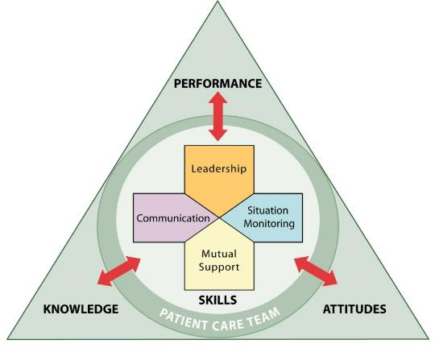
Core Teamwork Skills
Module
1
Introduction
Module
7
Pulling It All Together
4
3
5
6
2
Notes:
I'm Barbara Edson. I'm the VP of Clinical Quality at HRET. My background is in nursing, and I am a master trainer for TeamSTEPPS. Today we're going to discuss core teamwork skills.
An individual's and the team's knowledge and attitudes and performance are affected and affect the way that leadership, communication, mutual support, and situation monitoring tools are utilized. This diagram here looks at the first seven modules and is considered the fundamentals course, which teaches the core teamwork skills. Those first seven modules are the introduction, which provides an overview of master training in TeamSTEPPS and the science of team performance. Team structure is module two. It defines a team and its members, including their patients and families, and it is really a multi-team system, which is important in planning your TeamSTEPPS implementation.
Communication is module three, and this provides tools and strategies for communicating effectively through standardized information exchange, such as SBAR, checkbacks, callouts, and hand-offs.
Leading teams is module four. This identifies activities conducted to effectively lead teams and tools and support these activities, things such as briefs, huddles, and debriefs, things we use in our communications in our hospitals.
Situation monitoring, module five, describes the importance of team members gaining or maintaining an accurate awareness or understanding of a situation in which the team is functioning and outcomes of the situation monitoring, including a shared mental model among team members.
Module six deals with mutual support. Mutual support is your backup behaviors that allow teams to become self-correcting. It helps them distribute workload effectively, and it provides effective feedback in managing conflict.
And then finally, module seven is the summary. It pulls it all together. It provides an opportunity for participants to review and apply the TeamSTEPPS tools and strategies learned throughout the course.

Slide 14
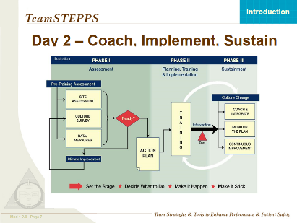
Slide 7: Coach, Implement, Sustain
Using slide 7, you will show the full three phases of successful implementation
You’ll outline that Day 2 training focuses on coaching, implementation, and sustainment
See page 11 in the Instructor Guide for details on how to facilitate this slide
Notes:
When you present, you will use slide seven to show the full three phases of successful implementation and sustainment of this TeamSTEPPS initiative.
You will outline that day two of the training focuses on coaching, implementation, and sustainment.
As you can see by looking at the infographic, training really is a small portion of a much larger journey.
You can refer to the Instructor Guide for more information on facilitating this slide.
In this online course, you will learn those day two topics-- change management, coaching, measurement, and implementation workshop-- in modules 8 through 11.
To provide an example of how to present this information, select the next slide to hear once again from our guest Master Trainer, Barbara Edson.

Slide 15
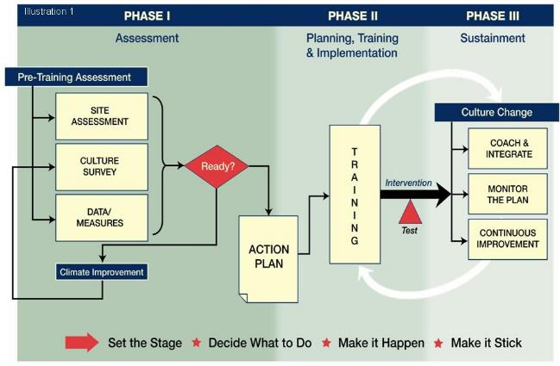
Coach, Implement, Sustain
Notes:
Following the Fundamentals Course topics on day one, day two of the Master Trainer Course focuses on topics related to implementation and sustainment of TeamSTEPPS.
This includes change management, providing information about organizational change through discussion of Kotter's eight steps of change.
It also discusses coaching. Coaching is very important, and it describes how to coach.
It describes what coaching is. It describes the role of coaching and implementation of TeamSTEPPS.
Measurement provides information about how we evaluate the success of your TeamSTEPPS implementation, including any available assessment tools and resources that you may have or want to use.
Implementation workshop really serves as a capstone for the course by allowing you and your team members to think through your implementation plans and strategies.

Slide 16
Slide 8: Master Training Materials
Explain to your learners that all the materials they need will be provided
See pages 12-13 in the Instructor Guide for details on how you should describe all the materials available
Select here if you would like to review all the materials on the TeamSTEPPS website
Notes:
As part of the Master Trainer course, materials have been developed for your use and reference.
You received the links to these references when you registered, but you can also access them now using the link on the slide or by selecting the Help button on any slide.
The Instructor Manual contains several sections of information.
These sections provide the materials you will cover over the course of this training as well as materials you will need to teach the TeamSTEPPS skills to others.
For each module, the materials include instructor guides that provide instructor notes and other information, such as instructions for facilitating exercises.
Also located on the AHRQ website are the videos from this training as well as some additional videos you may wish to integrate into your training.
A matrix of the available videos is included in the Course Management guide.
Several of these videos are vignettes where there is an opportunity for improvement version and a success version.
In addition, a set of scenarios organized by clinical area or specialty is available.
These can be used to supplement your training or to develop exercises or simulations that'll be relevant to your participants.

Slide 17
Materials For Your Delivery
Fundamentals Course
3.5-4 hours
Modules 1-7 of this online course
Essentials Course
Not covered here
You can customize as needed
Select here if you would like to review all the materials on the TeamSTEPPS website
Notes:
The Instructor Guide is designed to help you develop and deploy a customized plan to train your staff in teamwork skills and lead a medical teamwork improvement initiative in your organization from initial concept development through to sustainment of positive changes.
The Instructor Guide consists of two main components-- the Fundamentals course, modules one through seven, and the Essentials course, which we will not cover in this Master Trainer course.
The Essentials course is designed for nonclinical staff, but you may find it beneficial to train staff together as a team using the Fundamentals course, which can be accomplished in three and a half to four hours.
When teaching TeamSTEPPS to staff, the ideal class size is 25 to 30 participants to maximize interaction, learning, and teaching effectiveness.
All classes, whether Train the Trainer or Train the Staff, should be interdisciplinary and cross-functional.
This curriculum can be customized, where appropriate, for use in your organization. Refer to the Course Management guide for detailed information on course versions.
These and many additional resources are available online on the Agency for Healthcare, Research and Quality website.
Select the link provided if you'd like to review the materials on the website now.

Slide 18
Slide 9: Sue Sheridan Video
We must remember why patient safety is so important
See page 13 in the Instructor Guide for details on how to facilitate this slide
Select the image to launch a web browser where you can watch the video
Notes:
Now that you're oriented to the Master Trainer course and materials, it is important to understand why patient safety is so important and how teamwork can make a difference.
You will use slide nine in your training to share the Sue Sheridan video with your learners.
The video is available on the web for viewing.
Selecting the slide image will open a new browser window so you can view the video.
After viewing, please return to this browser window to continue this module.

Slide 19
Slide 10: Video Discussion
Think about the breakdowns you observed in the stories:
Can you think of similar events in your work area?
Ask participants:
What breakdowns in teamwork did you observe?
How can we prevent medical errors?
Can something similar happen in our organization?
See page 15 in the Instructor Guide for details on how to facilitate this slide
Notes:
TeamSTEPPS is about improving teamwork and communication to help prevent stories like this from happening.
Think about the breakdowns you observed in the two stories.
Can you think of something similar or an event that could or did happen in your environment or work area as a result of a breakdown in teamwork?
If you can, write them down so that you can use them as examples when you teach.
Of course, you would want to scrub them so that you're only sharing the sequence of events. There should be no identifiable information.
Think about some ways we prevent medical errors. As you teach, ask participants these same questions.
What breakdowns in teamwork did you observe?
How can we prevent medical errors?
Can something similar happen in our organization?
The goal is to get the participants thinking about medical errors and the impact of teamwork on mitigating or preventing errors.
If participants' responses indicate a skill, tool, or strategy taught in the course but use different terminology, rephrase back to them using the TeamSTEPPS terminology you will have mastered at the completion of this course.
If any of your learners answer negatively, focus the discussion on improvement opportunities.

Slide 20
Slide 11: Barriers to Team Performance
You will use slide 11 to lead a discussion on potential barriers, asking:
Do these barriers resonate with you?
Have you observed these behaviors?
What was the result?
See page 16 in the Instructor Guide for details on how to facilitate this slide
Notes:
When you deliver to your learners, you will use slide 11 to lead a discussion on the barriers that might undermine team performance.
Ask the participants: Do any of these barriers resonate with you?
Have you observed these behaviors?
What was the result?
You can refer to the Instructor Guide for more information on facilitating this slide.
To provide an example of how to lead a discussion of barriers, proceed to the next slide to once again hear from our guest Master Trainer Barbara Edson.

Slide 21
Barriers to Team Performance
Inconsistency in team membership
Lack of time
Lack of information sharing
Hierarchy
Defensiveness
Conventional thinking
Varying communication styles
Conflict
Lack of coordination and followup
Distractions
Fatigue
Workload
Misinterpretation of cues
Lack of role clarity
Notes:
There are several barriers that we think of when we think of working in teams together within the hospital.
There's the thing such as inconsistency in team membership, lack of time.
These errors can occur for many reasons, and a single error can often be linked to a number of causal factors.
Many obstacles can impair an individual's team or ability to work effectively and prevent errors.
The slide here lists some of those barriers to effective team performance. Let me share a few that I've encountered over the years.
I was in an operating room where we were preparing a patient for shoulder surgery, and the physician was pulling the team together, and they did not go ahead and introduce themselves.
And there were two new members to the team, so it was not a consistent team that the physician was working with.
They did not go ahead and talk about what the case would be, so they did not provide a briefing, and they did not have role clarity on who was doing what.
They each had their roles, such as the scrub nurse, and the circulating nurse, and the anesthesia provider, but they did not go ahead and discuss who would be doing what during a case.
When something went awry during the case, there was confusion on who was going to pull which piece of equipment to move the C-ARM around the table and intervene.
By having a briefing beforehand, understanding the roles of every individual within the room, making sure that they understood who the individuals were in the room, they could have avoided some of that confusion.

Slide 22
Patient Safety Movement & Team Training
TeamSTEPPS®
TeamSTEPPS Released to the Public
Centers for Medicare & Medicaid Services Partnership for Patients Campaign
JCAHO National Patient Safety Goals
“To Err Is Human” IOM Report
TeamSTEPPS National Implementation Program Began
Institute for Healthcare Improvement
100K lives Campaign
Patient Safety and Quality Improvement Act of 2005
DoD MedTeams®
ED Study
Executive Memo from President
National Implementation of CUSP
TeamSTEPPS 2.0, TeamSTEPPS Online, and TeamSTEPPS for Primary Care
1995
1999
2001
2003
2004
2005
2006
2007
2008
2011
2014
Medical Team Training
Notes:
The Patient Safety Movement seeks to reduce medical errors. As you can see here by this timeline, really the Patient Safety Movement began in 1995 with an emergency department study that was part of a multiyear Department of Defense research project that introduced formal teamwork training based upon aviation's crew resource management training concepts, and they applied those to health care.
The retrospective closed claim review of the emergency department risk management cases determined that 43% of errors resulted from problems with team coordination. In these cases, an effective team structure and caregivers trained in team behavior would have mitigated or prevented 79% of these identified failures. You can see along the timeline, the IOM report is a report where everybody's attention through the media and through government and health care professionals were all focused in on the problems with patient safety.
Former President Clinton established a quality interagency coordination task force to develop a coordinated federal plan for reducing the number and severity of medical errors. Among their recommendations was the widespread adoption of things such as crew resource management for improving medical team performance. Other things to note on this timeline, the joint commission National Patient Safety Goals, the IHI, 100,000 Lives Campaign.
TeamSTEPPS in 2005 was developed and available to the public. In 2006 AHRQ released TeamSTEPPS in the public domain. In 2008, the Quality Improvement Organizations in their ninth scope of work picked up TeamSTEPPS and really was supporting developing of master trainers throughout the country. In 2011, CMS initiated the Partnership for Patients Campaign to reduce hospital-acquired conditions by 40% and readmissions by 20%. And many facilities today leverage their successes with the use of TeamSTEPPS tools, strategies, and behaviors.
There's a lot of information here on the history of medical errors and patient safety. Like all things in medicine, it continually evolves through identification, implementation of best practices, which does include teamwork.

Slide 23
Slide 12: Patient Safety Timeline
When you’re teaching slide 12, take the time to highlight key moments
You do not need to speak to each individual point of time
See pages 17-19 in the Instructor Guide for details on the information you should share for each key moment
Notes:
When you're teaching slide 12, be sure to highlight key moments from each event and how TeamSTEPPS components are an important part of each of these moments.
You do not need to speak to each individual point of time.
See the Instructor Guide for details on the information you should share for each key moment.

Slide 24
TeamSTEPPS
Team Strategies & Tools to Enhance Performance & Patient Safety
Based on more than 30 years of research and evidence
Team training programs have been shown to improve attitudes, increase knowledge, and improve behavioral skills
Salas, et al. (2008) meta-analysis provided evidence that team training had a moderate, positive effect on team outcomes (ρ = .38)
Notes:
TeamSTEPPS is now part of the ongoing patient safety movement and is a solution to the barriers discussed earlier.
This course is based on evidence derived from teams working in high-risk environments, those areas where consequences of error are great, and has evolved from research in these high-risk fields to the health care environment, a high-risk, high-stakes environment in which poor performance may lead to serious consequences or death.
Throughout the course of this training, teamwork concepts will be introduced that provide specific tools and strategies for improving communication and teamwork, reducing chance of error, and providing safer patient care.
Because of the research accumulated on teams and team performance in diverse areas, such as aviation, military, nuclear power, health care business and industry, we now know what defines a team, what teamwork requires, really how to train team members, and how to manage team performance.
Although the meta analysis performed by Dr. Salas was not specific to team training and health care, its results demonstrated evidence that team training had a moderate, positive effect on team outcomes. Later in this module, we'll present health-care-specific TeamSTEPPS evidence.

Slide 25
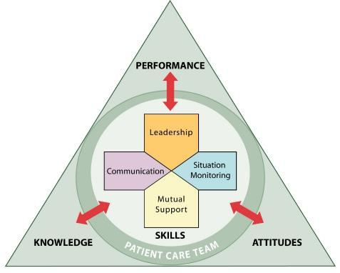
What Makes Up Team Performance?
Knowledge Cognition “Think”
Attitudes Affect “Feel”
Skills – Behaviors - “Do”
Notes:
So what makes up team performance?
The core of TeamSTEPPS model is really composed of four teachable, learnable skills-- communication, leadership, situation monitoring, and mutual support.
These red arrows here depict a two-way dynamic interplay between these four core skills and the team-related outcomes of enhanced knowledge, positive attitudes, and exceptional performance.
The interaction between these outcomes and skills is really the basis of a team striving to deliver safe, quality care.
And circling the four skills, you can see here, is the patient team, which not only represents the patient and direct caregivers but also those who play a very supportive role within the health care delivery system.

Slide 26
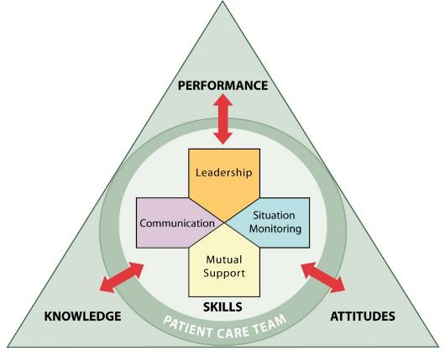
Outcomes of Team Competencies
Knowledge
Shared Mental Model
Attitudes
Mutual Trust
Team Orientation
Performance
Adaptability
Accuracy
Productivity
Efficiency
Safety
Notes:
Team members with strong communication, leadership, situation monitoring, and mutual support skills typically yield important team outcomes.
This interrelationship is the foundation of a strong continuous improvement model.
Knowledge-- when there's strong communication, leadership, situation monitoring, and mutual support are evident on the team-- there exists this shared mental model. That is really a shared awareness about what is going on with the team and how we progress towards a common goal. Team members will be familiar with their roles and responsibilities as teammates.
There's attitudes. When you speak of attitudes, teams in which the members have effective communication, leadership, situation monitoring, and mutual support skills are really more likely to have a positive experience. People like being on these teams. These teams we enjoy working on, teams that we can trust the intentions of our teammates.
Performance. When these teams' competencies are present, the performance of the team improves. You'll be able to adapt to changes in the care plan. Team members will know when and how to back each other up.
The team becomes much more efficient in providing care. There's a plan, and the team knows who's supposed to do what, and how they're supposed to do it. Finally, your team is going to be safer, allowing the team to more readily identify and correct errors if they should occur.

Slide 27
High-Performing Teams (Slide 16)
Teams that perform well:
Have clear roles and responsibilities
Have clear, valued, and shared vision
Hold shared mental models
Optimize resources
Have strong team leadership
Engage in a regular discipline of feedback
Develop a strong sense of collective trust and confidence
Create mechanisms to cooperate and coordinate
Manage and optimize performance outcomes
(Salas, et al., 2004)
Notes:
As the result of team competencies, teams can become really high performing. Throughout this training, we'll touch on many of the interrelated aspects of high-performing teams, moving from a team of experts to an expert team.
High-performing teams have members with very clear roles and responsibilities.
Their members have a clear value, a shared vision. There's common purpose, an engaging purpose.
There's a leader who really promotes this vision with an appropriate level of detail.
High-performing teams also have this shared mental model I spoke of earlier.
They optimize their resources, and they really possess a strong team leadership.
They engage in regular feedback, meaning they regularly provide feedback to each other and the team. They establish and revise their goals and plans as necessary, and they differentiate between higher and lower priorities.
They have mechanisms in place for anticipating and reviewing team member issues. They periodically diagnose and address team effectiveness. They include results, processes, morale. They also look at energy and retention of the team members.
There's a strong sense of trust and confidence in these teams. High-performing teams are usually able to manage conflict effectively, confronting one another. There's a strong sense of team orientation. And they really do trust each other's intentions. They believe strongly in the team's collective ability to succeed and develop a collective efficacy and possess a high degree of psychological safety.
There are mechanisms to cooperate and coordinate, including identifying teamwork and task requirements, ensuring that the team has the right mix of competencies through staffing and development and distributing of assigning work thoughtfully. Involving the right people in decisions and examining and adjusting the team's physical workplace all works to optimize coordination, communication, cooperation, and generates ongoing collaboration.
High-performing teams communicate often and at the right time to ensure fellow team members have the information they need to contribute. They use closed loop communication, learn from each performance outcome, and continually strive to learn. This is how performance outcomes are managed and optimized.

Slide 28
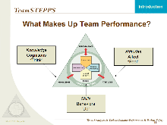
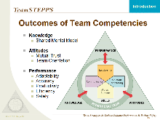
Slides 13 through 16
You have just seen these slides delivered by a Master Trainer
As you present these slides on the design of the TeamSTEPPS process, be sure to share your own insights
See pages 20-24 in the Instructor Guide for details on how to facilitate these slides
Notes:
You have just seen slides 13 through 16 delivered by a Master Trainer.
When presenting these slides, be sure to share your own insights and experiences and ask for input from the class.
Use open-ended questions to encourage class participation.
Refer to the Instructor Guide for details on how to facilitate these slides.

Slide 29
Slide 17: Evidence that TeamSTEPPS Works
As you wrap up your presentation, you should share the evidence that TeamSTEPPS works
See page 25 in the Instructor Guide for details on the evidence you should share
Notes:
So far in this module, we have described the TeamSTEPPS framework, outcomes of team competencies, and characteristics of high-performing teams. While this information is critical to understanding the basis of TeamSTEPPS, you're probably asking yourself, how do we know that any of this works?
If you remember, we previously mentioned the work of Dr. Eduardo Salas and his colleagues, which showed that team training had a positive effect on team outcomes. But what about TeamSTEPPS, in particular, and in health care? Evidence has shown that TeamSTEPPS training does produce these outcomes in health care organization. Let's look at two such studies.
Capella and colleagues found that trauma resuscitation team performance improved across all teamwork skills after TeamSTEPPS training. In addition, TeamSTEPPS improved the team's performance, which, in turn, improved the critical aspects of patient care in the trauma bay.
Thomas and Galla describe a system wide implementation of TeamSTEPPS that involves providing TeamSTEPPS training to more than 30,000 employees across several hospitals, long-term care centers, and outpatient areas. Scores on the hospital survey of patient safety culture increased from pre-TeamSTEPPS implementation to post-implementation. This suggests an important link between team training and organizational outcomes.
New research is emerging regularly, allowing the evidence base for TeamSTEPPS to continue to grow. Will your facility be next to add to this growing body of evidence?

Slide 30
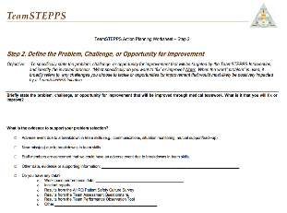
Slide 18: Applying TeamSTEPPS Exercise
You will close Module 1 by answering this question:
What is the patient safety issue your organization is facing that is linked to a problem with teamwork?
Select here to download and print the TeamSTEPPS Implementation Worksheet and answer the question.
Notes:
If you don't already have a copy of the worksheet, select the link provided to print out your own copy of the TeamSTEPPS implementation worksheet and take a few minutes to answer this question.
What is the patient safety issue your organization is facing that is linked to a problem with teamwork?
If you and your change team have not already begun this discussion, be sure to do so at the next meeting.
When you teach, you will conclude module one by asking the participants to answer this same question.
If the change team and/or leadership have come up with answers to this question, be sure to share these after those of the class have answered.

Slide 31
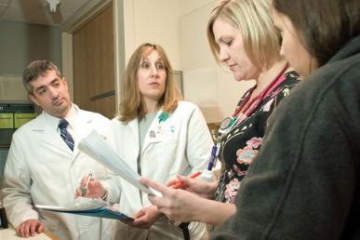
Module 1 Summary
In this module you learned to:
Describe the TeamSTEPPS Master Trainer course
Describe the impact of errors and why they occur
Describe the TeamSTEPPS framework
State the outcomes of the TeamSTEPPS framework
Notes:
In this module, you learned to describe the TeamSTEPPS Master Trainer Course, describe the impact of errors and why they occur, describe the TeamSTEPPS framework, and state the outcomes of the TeamSTEPPS framework.

Slide 32
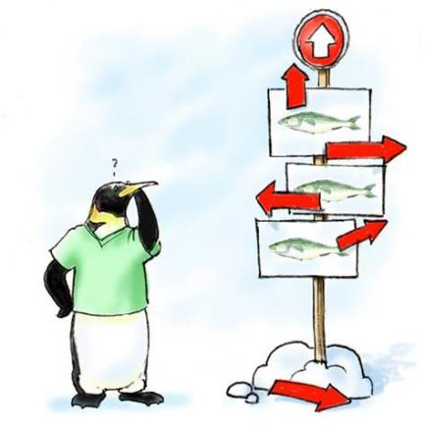
Module 1 Conclusion
This concludes Module 1 of the TeamSTEPPS 2.0 Online Master Trainer Course
Go to Module 2
Module 1
Module 2
Notes:
This concludes Module 1 of the TeamSTEPPS 2.0 Online Master Trainer Course.
To complete this module, you must return to the TeamSTEPPS learning management system and complete the Module 1 reaction survey.

