Slide 1
Module 10: Measurement
Welcome to the
Online Master Trainer Course
Notes:
Welcome to the 10th module of the TeamSTEPPS 2.0 Online Master Trainer course, Measurement. This is Dr. Brigetta Craft, and I'll be guiding you through this module. It's important that you assess the effects of your TeamSTEPPS implementation. In other words, you need to ask, is it working, and are you producing the desired outcomes? And because it's so important, we'll be presenting information about how to measure the impact of TeamSTEPPS in your organization or facility, as well as the tools that are available to support evaluation, including Kirkpatrick's Training Evaluation Model.

Slide 2
How This Online Course Works
This online course will walk you through the TeamSTEPPS content just as you will present it when you train your colleagues and staff
It teaches you all the concepts that comprise the TeamSTEPPS initiative
While also teaching you to teach TeamSTEPPS to your colleagues
Use the navigation buttons in the lower right to work through the online modules
Select here to move back to the previous slide
Select here to move to the next slide
Notes:
This online course will walk you through the TeamSTEPPS content just as you will present it when you train your colleagues and staff at your facility. It teaches you all the concepts that comprise the TeamSTEPPS initiative while also teaching you how to teach the TeamSTEPPS content to your colleagues and staff. Use the navigation buttons on the lower right to work through the online modules. Select the forward arrow to move to the next slide. And select the back arrow to go back to the previous slide.

Slide 3
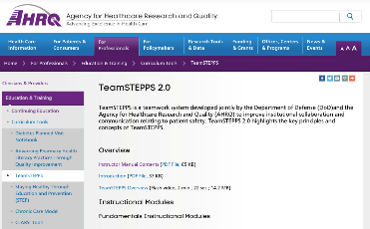
The Materials You Will Use
When you deliver your training you will use these materials:
Instructor Manual
Course Management Guide
Instructor guides
Course slides
Measurement tools
Customizable materials
Videos
Select here to review materials on the TeamSTEPPS website
Notes:
When you deliver the TeamSTEPPS training at your facility, you will use a variety of materials and resources provided on the AHRQ TeamSTEPPS website. We will discuss them more later in this module. Please select the link provided if you would like to review these materials on the TeamSTEPPS website.

Slide 4
Please Print the Instructor Guide
To best use this online module, please print the Module 10 Instructor Guide, located here
Read pages 3-4 in the guide before we begin
Then we will proceed to work through the slides you will use to train – just as if you are delivering this module at your facility.
Notes:
To best use this online module, we recommend that you print the Instructor Guide for module 10 as a reference to use throughout the module. Before continuing to the next slide, we recommend that you take a moment to read through pages three and four in the guide. Once you've done that, select the forward button, and we'll proceed to work through the slides you will use to train, just as if you are delivering the modules at your facility.

Slide 5
Additional Resources
Additional resources regarding measurement that you may find helpful:
What are the critical success factors for team training in health care?
Evaluating Training Programs: The Four Levels
Twelve best practices for team training evaluation in health care
Notes:
There are additional resources regarding measurement that you may find helpful. These include the 2009 article, "What are the Critical Success Factors for Team Training in Health Care," the book, Evaluating Training Programs, The Four Levels, and the 2011 article, "Twelve Best Practices for Team Training Evaluation in Health Care.".

Slide 6
Slide 2: Objectives
You will use slide 2 to introduce the objectives for this module
See page 4 in the Instructor Guide for details on how to facilitate this slide
Notes:
You will use slide two to introduce the objectives for this module. Refer to page four in the Instructor Guide for details on how to facilitate this slide. After completing this module, you'll be able to describe the importance of measurement, describe the Kirkpatrick model of training evaluation, identify measures that can be used to assess the impact of TeamSTEPPS, describe the AHRQ surveys on patient safety culture, and prepare a plan for determining if TeamSTEPPS worked.

Slide 7
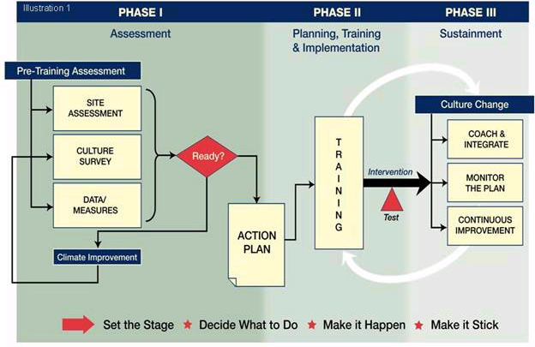
TeamSTEPPS Phases: Measurement (Slide 3)
Requires Measurement
Notes:
Measuring the impact of your TeamSTEPPS implementation is critical. Measurement enables you to answer questions, such as, Did TeamSTEPPS work? Did TeamSTEPPS produce the expected outcomes? Was TeamSTEPPS worth implementing in my unit? And finally, if TeamSTEPPS did not work or did not produce the expected outcomes, why not? As you collectively lead the charge to implement TeamSTEPPS, not only should you and your colleagues care about the answers to these questions but so should your organization's leadership.
As shown in the slide, measurement is important across all phases of the TeamSTEPPS implementation process. The results of measurements provide many benefits, including helping you identify where there are quality improvement needs, providing you with data to help generate leadership, stakeholder, and/or staff buy-in of your efforts, assessing training needs, providing information to drive the plans for how you will use and implement TeamSTEPPS, providing evaluation of the effectiveness of TeamSTEPPS training, assessing how TeamSTEPPS affects staff attitudes, patient perceptions, and the organizational culture. And, finally, demonstrating successes and areas for continued improvement, which is important for adopting implementation plans.
To lead the discussion on measures, I would like to introduce our guest speaker, Dr. David Baker. Dr. Baker is chief program officer at IMPAQ International. Throughout his career, Dr. Baker has focused his efforts on transitioning the most current research findings on team performance into evidence-based tools that promote better teamwork in health care.
Dr. Baker is a nationally known expert on health care teamwork, patient safety, and performance improvement, and he has been a TeamSTEPPS Master Trainer since 2007. He has also been involved with TeamSTEPPS since its inception, contributing to its development. The measures Dr. Baker will cover in this module will help you assess your TeamSTEPPS implementation across the TeamSTEPPS phases.

Slide 8
How to Measure – Kirkpatrick (Slide 4)
M
U
L
T
I
L
E
V
E
L
A
P
P
R
O
A
C
H
Level IV – Results
(Organizational results)
Level III – Behavior
(Transfer to the job)
Level II – Learning
(Think, Do, Feel)
Level I – Reactions
(Like it and Useful)
Notes:
Hi. My name is David Baker, and I have the distinction, like a few others, of having been with TeamSTEPPS since before there was a TeamSTEPPS. Originally, my team was funded by AHRQ and the Department of Defense to conduct an evaluation of existing medical team training programs. One of the conclusions from that work was that a new publicly available, evidence-based team training program for health care professionals was needed. This work resulted in TeamSTEPPS and the subsequent national implementation program that was funded by AHRQ.
When we first developed TeamSTEPPS and launched a national training program around the curriculum, we did not have a module on measurement. In part, this was an oversight on our part, and in part, there were few measures available to assess the impact of the program. This module grew out of the work that was stimulated from the launch of the TeamSTEPPS program. It summarizes some of the lessons learned and measures and strategies you can use to assess the impact of TeamSTEPPS.
Our approach to evaluating TeamSTEPPS is based on the Kirkpatrick Multi-level Model of Training Evaluation. This model continues to be widely used and is regarded as the most prevalent and practical approach to assessing the impact of training programs. When determining the effectiveness of any training intervention, Kirkpatrick advocated that you should examine four different levels of outcomes related to training.
Referring to the slide, the first level is reactions. Reactions are defined as participants' perceptions of the training. There are two types of reactions. Effective reactions, which basically ask whether or not the participants liked the training, and instrumentality reactions, which are related to whether or not participants found the training useful.
The second level in Kirkpatrick's hierarchy is learning. Learning can be defined in terms of three different levels-- changes in attitudes, changes in knowledge, or changes in skills. With respect to attitudes, a basic question to be answered is, do participants feel differently as a result of the training program? Regarding knowledge, the basic question is, did participants learn something new or know something new as a result of training? And regarding skills, the question is, can participants do something differently as a result of the training program?
The next level, level three in Kirkpatrick's hierarchy, is behavior. Behavior is defined as to whether the new attitudes, knowledge, and/or skills that were required or acquired during training are actually transferred to the job. In other words, it measures whether participants use what they've learned in the training on their job, and does training help them improve their own job performance.
The final level is results. Results are defined as organizational benefits that are produced from training. In the case of TeamSTEPPS, results include patient outcomes, such as infection rates and patient perceptions of care, and clinical process outcomes, such as the number of structured hand-offs used, wait times, door-to-balloon times or incision times and the like. The types of results depend on what the TeamSTEPPS intervention targeted.

Slide 9
Available Measures (Slide 5)
Reactions
Course Evaluation Form
Learning
Teamwork Attitudes Questionnaire
Learning Benchmarks
Team Performance Observation Tool
Teamwork Perceptions Questionnaire
Behavior
Team Performance Observation Tool
Teamwork Perceptions Questionnaire
AHRQ Surveys on Patient Safety Culture
Results
Patient outcome and clinical process measures
AHRQ Surveys on Patient Safety Culture
Patient Safety Indicators
Notes:
TeamSTEPPS provides a number of useful measures for evaluating the impact of the program. Each can be aligned with the Kirkpatrick Model of Training Evaluation, and are therefore organized into four categories.
To measure reactions, there is the TeamSTEPPS Course Evaluation Form.
To measure learning, there is the TeamSTEPPS Teamwork Attitude Questionnaire, or T-TAQ, which measures attitudes, the TeamSTEPPS Learning Benchmarks that measures knowledge, the TeamSTEPPS Performance Observation Tool which measures skills, and the TeamSTEPPS Teamwork Perceptions Questionnaire, or T-T-P-Q, that also measure skills.
To measure behavior, your resources include, the Team Performance Observation Tool, the T-T-P-Q or TeamSTEPPS Teamwork Perceptions Questionnaire, and the AHRQ surveys on patient safety culture tools.
And finally to measure results, there is the AHRQ surveys on patient safety culture tools and the AHRQ Patient Safety Indicators.
As we proceed through this module, we will review each of these measures in more detail and provide more information about where you can access them.

Slide 10
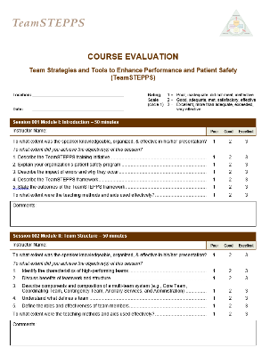
Course Evaluation Form (Slide 6)
Level I - Reactions
Found in Tab F or select image at right to download
Provides information about what trainees thought about the training
Includes evaluation questions for all available course modules
Customizable
Notes:
Participant reactions tell you whether participants liked the course, the facilities, and the instructor among other things. These types of reactions are referred to as affective reactions. In addition, participant reactions can tell you whether participants found TeamSTEPPS useful and if they believe they can apply the information they have learned in their units. These types of reactions are referred to as instrumentality reactions.
Research has shown that participants who find training useful and report that they will use it on their jobs are more likely to do so or transfer the training to the actual job environment. Participant reactions also provide additional important information regarding what participants will say about the course to others, who may attend or participate in the future, and where the course could be improved in terms of what is taught and how it is taught.
If you plan to use a course evaluation form for continuing education credit purposes, please be sure to check with your continuing education provider to ensure that the form meets the specific requirements of the respective accreditation organization. A customizable TeamSTEPPS Course Evaluation Form for assessing participant reactions can be found in Tab F of the TeamSTEPPS materials, or you may wish to select the image and download it now. This form captures both affective and instrumentality reactions.

Slide 11
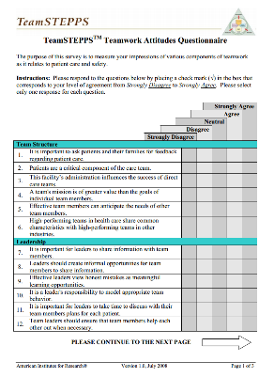
TeamSTEPPS Teamwork Attitudes Questionnaire (Slide 6)
Evaluates Level II - Learning
Found in Tab F or select image at right to download
30-item self-report tool
Respondents rate their agreement on a 5-point scale
Measures attitudes toward:
Team Structure
Leadership
Situation Monitoring
Mutual Support
Communication
Notes:
As noted earlier, the degree of learning accomplished through training can be determined by assessing attitudes, knowledge, and skills. One instrument that you can use to measure attitudes is the TeamSTEPPS Teamwork Attitude Questionnaire, or T-TAQ. The T-TAQ and its instructions for using it can be found in Tab F of your TeamSTEPPS materials, or select the image to download it now.
One indication that training is effective is that participants' attitudes about the importance of teamwork change as a result of attending TeamSTEPPS training. To identify changes in attitudes, participant attitude should be measured both before and after TeamSTEPPS training with the expectation that participants' scores will be higher after training. This would be an indication of improved attitudes towards teamwork as a result of TeamSTEPPS training. The T-TAQ is a 30-item self-report tool that has respondents rate their agreement of each item on a five-point Likert scale. It measures attitudes towards team structure, leadership, situation monitoring, mutual support, and communication.
It is important to note that with the explosion of the patient safety movement and growing acceptance of the importance of teamwork in the delivery of safe care, health care professionals are likely to report positive attitudes towards teamwork regardless of having attended TeamSTEPPS training. Therefore, TeamSTEPPS recommends that you do not rely solely on measuring participant attitudes as an indication of learning.

Slide 12
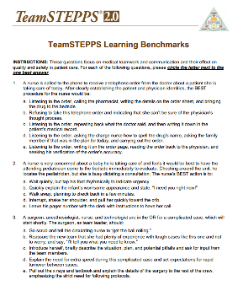
Learning Benchmarks (Slide 8)
Evaluates Level II - Learning
Found in Tab F or select image at right to access online
A 23-item multiple-choice test
Uses:
To assess knowledge of teamwork
To measure changes in knowledge
Caution:
Items tend to be too easy
Notes:
Another indication that training was effective is that participants know something new after participating in the training. Similar to measuring attitude changes, measurement of participant knowledge would take place both before and after TeamSTEPPS training. The expectation would be that participants would score higher on the knowledge test after completing the training program. This is very similar to the multiple choice items you completed for modules two through six.
The Learning Benchmarks Knowledge Test can be used to evaluate learning. They can be found in Tab F of the Instructor Manual, or you can select the image to view it online. The test is a short 23-item multiple choice exam that measures participant knowledge of the teamwork principles taught in TeamSTEPPS.
It is important to note that just as the attitude measure poses some challenges, and the measurement of attitudes in general when it comes to teamwork, so do knowledge measures. TeamSTEPPS has found that despite careful construction of the learning benchmarks, these items tend to be pretty easy, and individuals can in fact answer the items correctly even before participating in training.

Slide 13
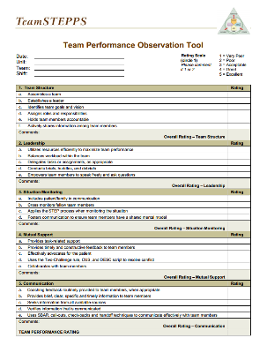
Team Performance Observation Tool (Slide 9)
Level II - Learning and Level III - Behavior
Found in Tab F or select image at right to download
Tool for observing team performance
Site assessment
Measure training effectiveness
Can be adapted to a particular unit
Observers should practice using the tool
Notes:
The third indication that training was effective is that participants can do something new after participating in TeamSTEPPS. Similar to measuring attitudes and knowledge, you would expect that if you observe participant behavior in a simulation after TeamSTEPPS training, participants would behave quite differently. For example, if you trained and implemented briefs, call-outs, and check-backs during trauma resuscitation as your TeamSTEPPS intervention, you might test the trauma team by developing scenarios that could be delivered using a human patient simulator to determine if learning in fact occurred. Observing the trauma team on the job as a team responds to an actual trauma resuscitation could also be an indication of learning. But under the Kirkpatrick framework, this is considered a measure of behavior-- the fact that learning transferred to the actual job, or in this case, the actual resuscitation.
The Team Performance Observation Tool is a customizable tool that measures both learning at level two, in terms of skills, and behavior at level three. Again, it can also be found in Tab F of the Instructor Manual, or you can select the image to download it. This tool can be used as a guide when observing team performance, like the trauma team we talked about earlier. It can be used as a site assessment or a measure of training effectiveness. This tool is also part of your pocket guide.
The Team Performance Observation Tool included in TeamSTEPPS is generic, meaning it's not designed to focus on any particular clinical unit, but rather, it's applicable across the organization. Therefore, if you're going to use this observation tool, TeamSTEPPS recommends that individuals customize the tool to the clinical unit in which you're going to be conducting the observations, to have the observers practice using the tool prior to conducting any observations. It's really important that observations are a function of what's actually observed and not the particular observer using the tool. And finally, between the customization and the practice, make sure that you revise the observation tool as necessary so that it's clear, appropriate to the clinical unit, and can be used effectively by all the observers.

Slide 14
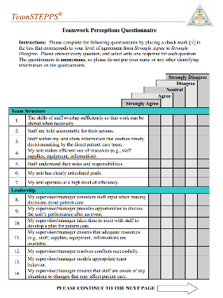
TeamSTEPPS Teamwork Perceptions Questionnaire
Evaluates Level II - Learning and Level III - Behavior
Found in Tab F or select image at right to download
35-item self-report tool
Respondents rate their agreement on a 5-point scale
Measures staff perceptions of :
Team Structure
Leadership
Situation Monitoring
Mutual Support
Communication
Notes:
The TeamSTEPPS Teamwork Perceptions Questionnaire, or TTPQ, also can be used to measure the learning of skills by the training participants. The TTPQ is completed by individual members of the team. In this measure, individuals report their perceptions regarding the effectiveness of the teamwork within the unit in which they work.
In other words, the TTPQ is a self-report measure. The TTPQ and instructions for using it can be found in Tab F of the TeamSTEPPS materials, or again, you can select the image to download it now. A detailed guide for using and interpreting the TTPQ is available on the AHRQ website.

Slide 15
Level III: Behavior (Slide 11)
Measure whether information learned during training is transferred to the job
Two important factors in transfer are:
Whether there is an opportunity to use the new TeamSTEPPS tools or strategies on the job
Whether use of the TeamSTEPPS tools and strategies is valued and reinforced
Notes:
The third category of measurement is behavior. It is important to measure whether the information learned during training is transferred to the job.
The two important environmental factors for producing transfer are whether there is an opportunity to use the new TeamSTEPPS tools or strategies on the job, and whether use of the TeamSTEPPS tools and strategies is valued and reinforced. We can all think of cases where we went to training and never had an opportunity to use that skill in our actual work environment or other cases where we tried to learn something new and somebody negatively reinforced it or told us not to do it when we got back to work.
To illustrate behavior measurement, let's proceed to the next slide, and we will consider an example scenario.

Slide 16
Level III: Behavior: Example Scenario
As part of a pediatric ICU’s efforts to improve teamwork within the unit, all nurses are trained on the use of SBAR for presenting patient information to physicians. However, the physician group decides not to attend training. Shortly after implementing the SBAR strategy, a nurse calls the on-call physician about a patient on the unit she is concerned about. She begins to present the patient’s situation and background, but before she can complete her SBAR report, the physician jumps in and says, “Forget that SBAR stuff; just tell me what I need to know!”
Take 10 minutes and answer these questions:
Was the use of SBAR valued and reinforced?
What do you think the nurse should do?
Will the nurse use SBAR in the future?
What other factors are important for training transfer to the job?
Notes:
As part of the pediatric ICU's efforts to improve teamwork within the unit, all nurses are trained on the use of SBAR for presenting patient information to physicians. However, the physicians' group decides not to attend training. Shortly after implementing the SBAR strategy, a nurse calls the on-call physician about a patient on the unit she is concerned about. She begins to present the patient's situation and background, but before she can complete her SBAR report, the physician jumps in and says, "Forget that SBAR stuff. Just tell me what I need to know."
So take 10 minutes now to write down your answers to the following questions and then proceed to the next slide. Was the use of SBAR valued and reinforced? What do you think the nurse should do? Will the nurse use SBAR in the future? And what other factors can you think of that are important for ensuring that skills learned in TeamSTEPPS training transfer to the job?

Slide 17
Example Scenario Debrief
You should have noted:
The SBAR was not valued or reinforced by the physician
To ensure TeamSTEPPS training transfers to the job, you should:
Align training objectives with organizational goals
Provide organizational support for the training initiative
Ensure that frontline care leaders are on board
Use measurement to determine the effectiveness of the program
When you teach, ask participants these same questions and be sure to include these answers if not mentioned by the participants.
Notes:
Reviewing what you wrote, you should have noted that the SBAR was not valued or reinforced by the physician, making it unlikely the nurse will attempt to use it in the future. As for the factors to ensure that the skills learned in TeamSTEPPS training transfer to the job, you should align your training objectives with organizational goals, provide organizational support for the training initiative, ensure that front-line care leaders are on board, and use measurement to determine the effectiveness of the program in terms of whether skills are being used on the job.
When you teach this section, facilitate discussion by asking participants these same questions. After they have shared their responses, be sure to include the answers I've provided if not already mentioned by the participants.

Slide 18
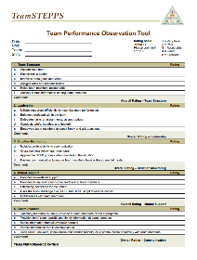
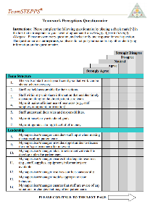
Level III - Behavior: Measures (Slide 12)
Team Performance Observation Tool
Teamwork Perceptions Questionnaire (T-TPQ)
AHRQ Surveys on Patient Safety Culture
We will discuss these surveys in the next section on Level IV - Results
Notes:
Tools available for assessing the transfer of participants' learning to their jobs include the Team Performance Observation Tool, the TeamSTEPPS Teamwork Perceptions Questionnaire, and the AHRQ Surveys on Patient Safety Culture. Earlier, we discussed the Team Performance Observation Tool and the Teamwork Perceptions Questionnaire as these measures can also be used for measuring learning of the new teamwork skills. The AHRQ Surveys on Patient Safety Culture can be used to assess behaviors and results. First, we will discuss a few other results measures, and then we'll focus our attention on the AHRQ Patient Safety Culture Surveys.

Slide 19
Level IV: Results (Slide 13)
Patient Outcome Measures
Examples: Complication rates, infection rates, measurable medication errors, and patient perceptions of care and satisfaction with their care
Clinical Process Measures
Examples: Length of patient wait time, time to intubate, medication administration delays, compliance with preventive screenings, number of misdiagnoses, number of structured handoffs used
Notes:
The final level of training evaluation in the Kirkpatrick hierarchy is results. As we discussed earlier, this level of evaluation provides an assessment of the organizational benefits produced from training. Two types of outcome measures may be examined to determine the impact of TeamSTEPPS. Patient outcome measures, such as complication rates, infection rates, measurable medication errors and the like, as well as patient experience measures, such as the Hospital Consumer Assessment of Health Care Providers and Systems, commonly referred to as HCAPs. Clinical process measures, such as length of patient wait time, time to intubate, medication administration delays, compliance with preventative screenings, number of misdiagnoses, number of structured handoffs used, and staff perceptions of safety as measured by the AHRQ Surveys on Patient Safety Culture.
It should be noted that health care facilities already routinely collect many clinical quality and safety measures that can be used to measure organizational results. These include for example, the Joint Commission ORYX Quality Measures, patient safety event databases, and staff and patient satisfaction measures. Don't reinvent the wheel. If you aren't sure what measures are already being collected, meet with staff in your quality department and ask. Better yet, encourage them to be part of the change team if they are not already involved.
It is important to note that this level of evaluation is difficult to assess in that any number of organizational changes, initiatives, and or interventions could contribute to the organizational results. However, for evaluating TeamSTEPPS, selecting measures that align with the teamwork issue being addressed by TeamSTEPPS will help ensure that the results can be linked to the training intervention.

Slide 20
AHRQ Surveys on Patient Safety Culture (Slide 14)
Free, easy-to-use surveys to assess patient safety culture
Available for various contexts:
Hospitals
Medical Offices
Nursing Homes
Pharmacies
Notes:
As noted, measures that assess perceptions of safety are a type of results measure. We previously mentioned the AHRQ Surveys on Patient Safety Culture since they can also be used to measure level three under Kirkpatrick's framework, which is behavior, that transfer measure. AHRQ actually offers a free easy-to-use suite of measures for assessing patient safety culture.
The Patient Safety Culture Assessment Tools that are available from AHRQ include a survey for hospitals, a survey for medical offices, a survey for nursing homes, and a survey for community pharmacies. You can select the title of any of the surveys to review it on the AHRQ website. Because the Hospital Survey on Patient Safety Culture is a commonly used culture survey, we will use this as an example and provide more detailed information about this specific assessment.

Slide 21
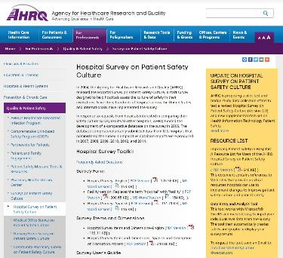
Hospital Survey on Patient Safety Culture (Slide 15)
Level III Behavior and Level IV Results
Composed of 51 items and 12 composites
Comprehensive instrument that assesses staff perceptions of patient safety culture
Hospital-wide
Specific work area or unit
Comparative database
Voluntarily submitted data from U.S. hospitals
Notes:
In 2004, AHRQ released the Hospital Survey on Patient Safety Culture, or HSOPS, a staff survey designed to help hospitals assess the culture of safety in their institution. Since then, hundreds of hospitals across the US and internationally have used the survey. The survey, as we have mentioned, measures both level three behavior, that transfer measure, and level four under Kirkpatrick's taxonomy, organizational results. The HSOPS is composed of 51 items that are organized into 12 composites or sub-scales. Combined, they create a comprehensive instrument that assesses staff perceptions of patient safety culture within the organization. The assessment can be used hospital-wide or focused on a specific work area or unit.
In response to requests from hospitals interested in comparing their safety culture results to other hospitals, AHRQ actually funded the development of a comparative database for the survey in 2006. The database is composed of voluntarily submitted data from US hospitals that administered the HSOPS tool. Comparative databases have been produced since 2007.

Slide 22
Hospital Survey Exercise
Please take 5 minutes now and write your answers to the following:
Have you used the Hospital Survey on Patient Safety Culture in your institution?
If so, how did you use the survey results?
What lessons did you learn from the survey?
When you teach the TeamSTEPPS 2.0 Master Trainer course, you should discuss these same three questions with your participants
Notes:
Let's review that hospital survey on patient safety culture and how you have or have not used it in your institution.
So take five minutes now, and write your answers to the following questions. Have you used the hospital survey on patient safety culture in your institution? If so, how did you use the survey results? And what lessons did you learn from the survey?
If you are participating with your team, share and discuss your answers, then proceed to the next slide. When you teach the TeamSTEPPS 2.0 Master Trainer course, you may want to discuss these questions with your participants. Again they are; Have any of you used the hospital survey on patient safety culture in your institution? Can you describe how you use the survey results? And, do you have any lessons learned that you would like to share?

Slide 23
How Can Hospitals Use the Survey? (Slide 16)
Raise awareness about patient safety issues
Assess patient safety culture
Track changes in patient safety culture over time
Evaluate the impact of patient safety interventions, such as TeamSTEPPS
Notes:
The Hospital Survey on Patient Safety Culture, or HSOPS, has a number of uses including raising awareness about patient safety issues, assessing patient safety culture, tracking changes in patient safety culture over time, and evaluating the impact of patient safety interventions. The HSOPS can be used to assess whether TeamSTEPPS has a positive impact on the organization's patient safety culture. If TeamSTEPPS is effective, survey scores should increase after TeamSTEPPS tools and strategies have been implemented. Such a result would be considered an organizational outcome or result of the training. Again, that level four in Kirkpatrick's hierarchy.

Slide 24
Survey Measures (Slide 17)
Survey Measures: 12 Areas of Patient Safety and Two Overall Items:
Unit-level safety areas
Overall perceptions of safety
Frequency of events reported
Supervisor/manager expectations and actions promoting safety
Organizational learning—continuous improvement
Teamwork within units
Communication and openness
Feedback and communication about error
Nonpunitive responses to error
Staffing
Hospitalwide safety areas
Hospital management support for patient safety
Teamwork across hospital units
Hospital handoffs and transitions
Overall items
The patient safety “grade” respondents would assign their work area/unit
The number of events the respondent reported in the last 12 months
Notes:
A hospital survey includes 51 items that assess nine unit-level safety areas and three hospital-wide safety areas. Respondents also provide an overall patient safety grade for the unit as well as report the number of events the respondent has reported in the past 12 months. The survey takes approximately 10 minutes to complete. Most of the items use an agree, disagree, or never, always kind of response categories, making it very easy to answer. There's also room on the form for written comments to be provided by the respondent at the end of the survey.

Slide 25
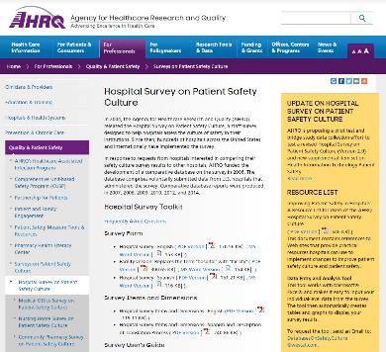
What Support Is Available? (Slide 18)
AHRQ Patient Safety Link
Hospital Survey Toolkit
Survey forms
Survey items and dimensions
Survey User’s Guide
Survey feedback report template
Data entry and analysis tool
Comparative database and reports
E-mail Questions to:
SafetyCultureSurveys@westat.com; or
DatabasesOnSafetyCulture@westat.com
Notes:
Each survey on patient safety culture has an accompanying toolkit that contains the following materials-- the actual survey form; the survey items and dimensions; a survey users guide that provides step-by-step instructions on how to select a sample, administer the survey, obtain high response rates, and analyze and report results; and a survey feedback report template in Microsoft PowerPoint, which can be customized to display survey results to administrators and staff throughout the organization and for presentation purposes In addition, there is a data entry and analysis tool that works with Microsoft Excel and makes it easy to input your individual level data from the survey. The tool then automatically creates tables and graphs to display your survey results.
You also may access information on the AHRQ patient safety website by selecting the link provided.

Slide 26
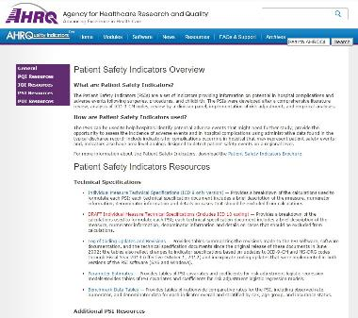
AHRQ Patient Safety Indicators (PSIs) (Slide 19)
Measure Level IV - Results
Provide information on potential in-hospital complications and adverse events
Can help identify potential adverse events that might need further study
Include indicators for in-hospital complications that may represent patient safety events
Select the image at right to view PSIs on AHRQ’s website
Notes:
Another tool for assessing the impact of TeamSTEPPS training on organizational results, that level four in Kirkpatrick's hierarchy, are the AHRQ Patient Safety Indicators, or PSIs. The PSIs are a set of measures that provide information about potential in-hospital complications and adverse events following surgeries, other hospital or care procedures, and childbirth. This information is based on routinely collected hospital discharge administrative data.
The PSIs can be used to help hospitals identify potential adverse events that might require further study. The PSIs also include indicators for complications occurring in the hospital that may represent patient safety events. Such events can be mitigated with the implementation of TeamSTEPPS tools and strategies. Select the image of the web page to view the PSIs on AHRQ's website.

Slide 27
Evaluating TeamSTEPPS Exercise (Slide 20)
Three nurses and the infection control officer from a 16-bed postsurgical intensive care unit attend the 2-day TeamSTEPPS Master Training course. During the implementation planning session, the team agrees that hand hygiene compliance has been a major problem, especially physician compliance. As a result, the unit has a relatively high surgical site infection rate. The team decides to use the CUS and Two-Challenge Rule tools as strategies to address this issue. As part of their implementation, they train all the nurses and the employed physician staff on these two tools, but struggle with getting surgeons who are not employed by the hospital to participate. Once the training is complete, they decide to launch the implementation of CUS and the Two-Challenge Rule.
Download the Evaluating TeamSTEPPS Worksheet
Take 15 minutes to review the scenario and answer the four questions
Notes:
Now that we've reviewed the four levels of the Kirkpatrick Model of Training Evaluation and discussed available measures for each, we'll use a scenario to apply what you've learned.
The scenario is: Three nurses and the infection control officer from a 16-bed post-surgical intensive care unit attend the two-day TeamSTEPPS Master Training course. During the implementation planning session, the team agrees that hand hygiene compliance has been a major problem, especially physician compliance. As a result, the unit has a relatively high surgical site infection rate.
The team decides to use the CUS and two-challenge rule tools as strategies to address this issue. As part of their implementation, they train all the nurses and the employed physician staff on these two tools but struggle with getting surgeons who are not employed by the hospital to participate. Once the training is complete, they decide to launch the implementation of CUS and the two-challenge rule.
Please select the link provided to download and print the Evaluating TeamSTEPPS worksheet. Then take 15 minutes to review this scenario and answer the four questions. If you're taking this course as a team, discuss your responses. If you're not participating as a team, be sure to share and discuss your responses with your change team.
When you're finished, proceed to the next slide to continue this module.

Slide 28
Evaluating TeamSTEPPS Exercise: Debrief
Let’s Review:
Which measure or measures did you identify?
Why did you choose the identified measures?
What organizational barriers might interfere with successful transfer?
See pages 22 and 23 in the Instructor Guide for details on how to facilitate this exercise
Notes:
Let's review your responses to the questions. Did you include the Team Performance Observation Tool as one measure to assess whether instruction about CUS and the two-challenge rule transferred to the work environment? If so, that was correct.
Observation is a powerful tool to identify if the desired behaviors are actually occurring in the work environment. The TeamSTEPPS Teamwork Perceptions Questionnaire and the AHRQ surveys on patient safety culture are other tools available for assessing the transfer of participants' learning to their jobs.
When identifying measures to determine the effect on patient outcomes, you could've included the use of the AHRQ Patient Safety Indicators or PSIs. Remember, this is a tool for assessing the impact of training on organizational results. As Dr. Baker explained previously, it is difficult to assess this level of evaluation because any number of organizational changes, initiatives, and/or interventions could contribute to organizational results. But, for evaluating TeamSTEPPS, selecting measures that align with the teamwork issue being addressed by TeamSTEPPS will help ensure that the results can be linked to the training intervention.
And what organizational barriers did you identify? Did you include not allowing staff to practice the behaviors in the daily practice? You should also have included not holding staff accountable to practicing the desired behaviors as well as leadership not being fully engaged and on board. Review the Change Management and Coaching modules for examples on how to address and overcome these barriers.
When you teach, you should instruct participants to break into small groups and identify one or two measures they can use to assess whether their TeamSTEPPS intervention affects patient outcomes. Please see pages 22 and 23 in the Instructor Guide for details on how to facilitate this exercise.

Slide 29
Module 10 Summary
In this module you learned to:
Describe the importance of measurement
Describe the Kirkpatrick model of training evaluation
Identify measures that can be used to assess the impact of TeamSTEPPS
Describe the AHRQ Surveys on Patient Safety Culture
Prepare a plan for determining if TeamSTEPPS worked
Notes:
In this module, you learned to describe the importance of measurement, describe the Kirkpatrick Model of Training Evaluation, identify measures that can be used to assess the impact of TeamSTEPPS, describe the AHRQ surveys on patient safety culture, and prepare a plan for determining if TeamSTEPPS worked.

Slide 30
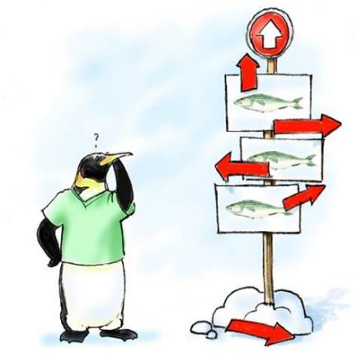
Module 10 Conclusion
This concludes Module 10 of the TeamSTEPPS 2.0 Online Master Trainer Course
Go to Module 11
Module 10
Module 11
Notes:
This concludes Module 10 of the TeamSTEPPS 2.0 online Master Trainer course.

