Slide 1
Module 2: Team Structure
Welcome to the
Online Master Trainer Course
Notes:
Welcome to Module 2 of the TeamSTEPPS Online Master Trainer Course-- Team Structure. My name is Dr. Brigetta Craft, and I will be guiding you through this module. Learning about properly forming a team is essential to creating an effective teamwork environment. Please select the Forward arrow in the lower right corner to begin this module.

Slide 2
How This Online Course Works
This course will walk you through the TeamSTEPPS content just as you will present it when you train your colleagues and staff
It teaches you all the concepts that comprise the TeamSTEPPS initiative
While also teaching you to teach TeamSTEPPS to your colleagues
Use the navigation buttons in the lower right to work through the online modules
Select here to move back to the previous slide
Select here to move to the next slide
Notes:
This online course will walk you through the TeamSTEPPS content just as you will present it when you train your colleagues and staff at your facility. It teaches you all the concepts that comprise the TeamSTEPPS initiative while also teaching you how to teach the TeamSTEPPS content to your colleagues. Use the navigation buttons on the lower right to work through the online modules. Select the forward arrow to move to the next slide. And select the back arrow to go back to the previous slide.

Slide 3
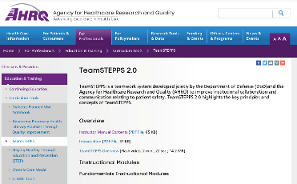
The Materials You Will Use
When you deliver your training you will use these materials:
Instructor Manual
Course Management Guide
Instructor guides
Course slides
Measurement tools
Customizable materials
Videos
Select here to review materials on the TeamSTEPPS website
Notes:
When you deliver the TeamSTEPPS training at your facility, you will use a variety of materials and resources provided on the AHRQ TeamSTEPPS website. We will discuss them more, later in this module. Please select the link provided if you'd like to review any of the materials on the TeamSTEPPS website.

Slide 4
Please Print the Instructor Guide
To best use this online module, please print the Module 2 Instructor Guide, located here.
You may also want to print the TeamSTEPPS Pocket Guide
Then we will proceed to work through the slides you will use to train – just as if you are delivering this module at your facility.
Notes:
To best use this online module, we recommend printing the Instructor Guide for Module 2 as a reference to use throughout the module. An additional resource you may find beneficial is the TeamSTEPPS Pocket Guide. The Pocket Guide contains all the tools that will be discussed throughout this course in a convenient flip-type book. Select the link provided if you would like to download the Pocket Guide. Once you have done that, select the Forward button, and we will proceed to work through the slides you will use to train, just as if you are delivering this module at your facility.

Slide 5
Cover Slide: Prepare
To promote teamwork you must first understand the structure of teams
See pages 3-4 in the Instructor Guide for details on how to prepare to deliver this module
Notes:
Teamwork cannot occur in the absence of a clearly defined team. Therefore, improving upon an existing or designing a new team structure is the first step in implementing a teamwork system in any environment. To learn how to promote teamwork and create a climate conducive to effective team functioning, it is important to first understand the structure of teams. Page 3 to 4 in the Instructor Guide provides details on how to prepare to deliver this module.

Slide 6
Slide 2: Objectives
Use slide 2 to introduce your learners to what will be covered in this module
See page 5 in the Instructor Guide for details on how to facilitate this slide
Notes:
You will use slide two to introduce your learners to the content they will learn in this team structure module. After completing this module, you will be able to discuss the benefits of team structure in teamwork, define a team, identify the role of patients and their families as part of the care team, and describe the components and composition of a multi-team system.

Slide 7
Slide 3: Introduce Team Structure
Using slide 3, you will provide an overview of Team Structure
See page 6 in the Instructor Guide for details on how to facilitate this slide
Notes:
When you deliver to your learners, you will use slide three to present the broad overview of team structure. Team structure refers to the composition of an individual team or of a multi-team system and is an integral part of the teamwork process. It is the glue that holds together an effective strategy for ensuring patient safety and reducing medical error, taking into account the knowledge, performance, skills, and attitudes of team members.
A properly structured patient care team is an enabler for and the result of effective communication, leadership, situation monitoring, and mutual support. Proper team structure can promote teamwork by including a clearly defined leader, involving the patient, and ensuring that all team members commit to their roles in effective teamwork. It is important to identify and recognize the structure of teams because teamwork cannot occur in the absence of a clearly defined team.
In addition, understanding a team's structure and how multiple teams interact in a unit is critical for planning the implementation of TeamSTEPPS tools and strategies. It is also critical to know which teams are targeted for TeamSTEPPS, who on the team will adopt the TeamSTEPPS intervention, and how the intervention may affect other teams in the care environment. You can refer to page six in the Instructor Guide for more information on facilitating this slide.
Now, to present the next few slides, just as if she was delivering to a class, I would like to introduce our guest master trainer for the module, Dr. Karyn Baum, Professor of Medicine at the University of Minnesota. Dr. Baum is not only a practicing hospitalist, but is also the Associate Chair for Quality and the Director of the Minnesota TeamSTEPPS Training Center. Dr. Baum?

Slide 8
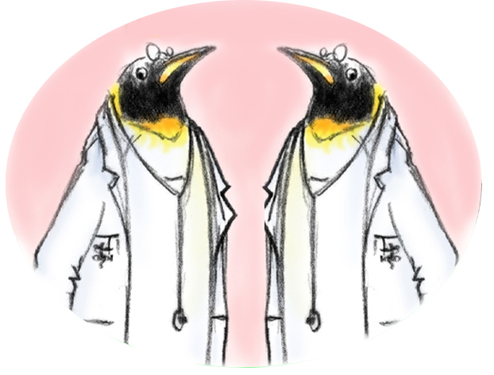
Slide 4: What Defines a Team?
“Two or more people who interact dynamically, interdependently, and adaptively toward a common and valued goal, have specific roles or functions, and have a time-limited membership”
Notes:
My name is Dr. Karyn Baum. I'm a hospitalist and the director of the University of Minnesota TeamSTEPPS Training Center. I've worked with over 1,000 master trainers from across the country and the world as well as organizations working to implement team training. And I'm delighted to be speaking to you today.
As you work through this material, I recognize that not only are you learning the material, you're learning to teach the material. So I will try to give you examples of the ways that I teach specific slides. And you may want to consider instituting that in your training.
So let's begin with defining a team. To effectively understand team structure, we do need to begin with defining what a team actually means. And a team is different than a group. A group can achieve its goals independently. They don't need each other. Real-time coordination of tasks is not required.
A team, however, consists of two or more people, who interact dynamically, interdependently, and adaptively towards a common and valued goal. That common and valued goal is actually quite important. And I do stress this point when I teach this slide. For example, if I think the goal is to make dinner and my husband thinks the goal is to go out for dinner, you can see how our evening plans might go awry if we lack that common goal.
Teams also have specific roles and functions. And unlike a marriage, they do have a time-limited membership. During the temporal life of a team, the mission is greater for the team than it is for the goals of the individual team members.
So team members include anyone in the process of patient care who can take action. They have, as we said, defined roles and responsibilities. They are accountable to the team for their actions. And they must stay continuously informed for effective team functioning. And that's a point that will be stressed over and over again in the TeamSTEPPS training. The teamwork skills that you will learn in this course will provide team members with tools and strategies for being effective team members.

Slide 9
Slide 5: Teams & Teamwork Exercise
Download the Teams & Teamwork Exercise Sheet
Worksheet questions:
Who are the team members in your area or unit?
What is the goal of your unit or work area?
What characteristics make a group a team?
See page 8 in the Instructor Guide for details on this exercise
Notes:
If you were teaching, this is the point where you would ask participants to complete the teams and teamwork exercise sheet, giving the class about 5 to 10 minutes to answer the questions on the worksheet. The worksheet, along with all the other materials and resources we will be mentioning during this course, can be found on the AHRQ website. Use the link provided to download the worksheet. And please review page 8 in the Instructor Guide for more information on facilitating this exercise.

Slide 10
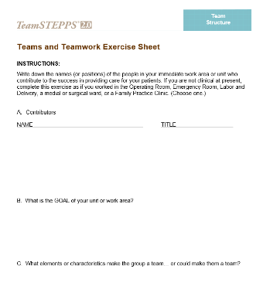
Complete Your Own Worksheet
Download and print the worksheet at right.
Use it to answer these questions:
Who are the team members in your immediate work area or unit?
What is the Goal of your unit or work area?
List 2-3 characteristics that make the group a team
Select here to download and print the worksheet and answer the question.
Notes:
For the purpose of this course, I'd like you to take 10 minutes and, using the worksheet, answer these questions. Who are the team members in your area or unit? Who are the team members, using names or positions, in your immediate work area or unit who contribute to successful patient care?
What is the goal of your unit or work area? List two to three characteristics that make the group a team or could make them a team. And when you have completed this worksheet, select the Forward button to continue the module.

Slide 11
Worksheet Discussion
Review your worksheet answers:
Did you include patients in your list of team members?
A key concept of team structure is partnering with the patient and their family
As you are teaching, ask the group to share some of their answers.
Notes:
Did you include patients in your list of team members? If you did, congratulations. A key concept of team structure is partnering with the patient and their family.
As you are teaching, after the participants have completed the worksheet, you will facilitate a discussion around these same questions. Ask the group to share some of their answers. Be sure to ask how many included patients in their list. Ask for volunteers to share the characteristics they believe make a group a team. If you can, share a personal example of an effective team and the characteristics they possessed or ask someone in the class to provide a personal example of their current or past teams based on these discussion questions.

Slide 12
Partnering With the Patient (Slide 6)
Strategies for involving patients in their care:
Include patients in bedside rounds
Conduct handoffs at the patient’s bedside
Provide patients with tools for communicating with their care team
Involve patients in key committees
Actively enlist patient participation
See Instructor Guide, pages 9-10
Notes:
It is critical to acknowledge that a patient care team is not complete without the patient or their family members. Patients and their families should be embraced and valued as contributing members to patient care, which is why patient-centered care has been so important in the recent years. Throughout this course, you will learn teamwork skills that can easily be adapted for use by patients and their families, and have been by other institutions. Thinking about how to include patients and their families is an important part of an effective TeamSTEPPS implementation.
Effective strategy examples might include bedside rounding, which we do at University of Minnesota, and has been very well received by patients; conducting hand-offs at the patient's bedside, and, again, we have been doing this at Minnesota for nursing shift change; providing patients with tools for communicating with their care team, including things like notebooks and the use of whiteboards; involving patients in key committees and actively enlisting patients' participation, especially in improvement and safety efforts. A number of organizations provide information, materials, and suggested strategies related to patient engagement, including AHRQ, the Department of Defense Patient Safety Program, the Joint Commission, the National Patient Safety Foundation, the US Department of Health and Human Services, and the Institute for Clinical Systems Improvement, and the Consumers Advancing Patient Safety, or CAPS.

Slide 13
Clinical Team Responsibilities (Slide 7)
Embrace patients and their families as valuable and contributing partners in patient care
Listen to patients and their families
Ask patients’ preference regarding involvement
Ask patients about their concerns
Speak to them in lay terms
Allow time for patients and families to ask questions
Give them access to relevant information
Ask for their feedback
Encourage patients and their families to proactively participate in patient care
Notes:
In order to properly involve patients and their families, the clinical team does have significant responsibilities. Their responsibilities for working as true partners include listening to patients and their families despite, of course, all the data that shows that physicians interrupt patients within seconds of beginning an interview. So we have to overcome that.
We need to ask patients how involved they prefer to be in their own care, because this varies quite a bit. We find that at Minnesota with some of our different cultural groups. Before launching into detailed information, asking patients about their concerns, to be honest, sometimes their concerns are not my concerns as a physician, and I need to realize that and be respectful of that. Otherwise, they may not understand what's being said to them.
The use of translators is also incredibly important. Speaking in lay terms-- and as I said, the University of Minnesota does bedside rounding. Speaking in lay terms for our medical students is one of the most difficult things they have to learn.
It's hard for them to remember after they've paid a lot of money to learn a lot of fancy words, that things like "renal" don't mean anything to the average patient. And if you say that to a patient and family member, they can become very confused. And unfortunately, often they don't feel comfortable speaking up. So even words like "mass" can mean a different thing for a patient and a family than it does for us.
We also need to allow time for patients and families to ask questions and actually do it in a way that's permissive for questions. So we tend at Minnesota to try to say, what questions do you have? Rather than do you have any questions? The latter patients know they're supposed to say, no, I have no questions. But the first one is more permissive and will tend to get a lot more questions from patients and families.
You need to provide patients and families with access to relevant information. And you need to ask patients and families for feedback and be proactive participants in their own patient care. They're responsible as well as us for transforming relationships between health care providers and patients.

Slide 14
Patient & Family Responsibilities (Slide 8)
Provide accurate patient information
Comply with the prescribed plan of care (e.g., schedule and attend appointments as directed)
Ask questions and/or voice any concerns regarding the plan of care
Monitor and report changes in the patients’ condition
Manage family members
Follow instructions of the clinical team
Notes:
The responsibilities of the patient and their families or their friends as part of the team differ from those of the clinical team members. And they do have their own set of responsibilities, including providing accurate patient information. This can certainly be difficult, certainly on a medicine service like I am on, where we have large numbers of patients who, unfortunately, may suffer from dementia or may be admitted with confusion. But hopefully the family members can provide that information, at least be available for a phone call or come to the ER.
To comply with prescribed plan of care; medication non-adherence is a big issue these days. They are responsible for helping to schedule appointments and to attend them as directed. However, to be honest, we also need to be pretty sensitive to the fact that it can be very difficult if a patient has an appointment a day for an entire week. I don't know the last time that you went to the physician, but it can be an all-day affair.
They are responsible for asking questions and voicing concerns. We do need to create that permissive culture where they feel safe to do that, and we provide the space for them to do that, though. They are responsible for monitoring and reporting changes in a timely manner, just like we're responsible for telling them what things to look out for.
They're also responsible to manage family members to prevent destructive behavior during care. We've actually had to call security regarding family members a couple of times, unfortunately, on our unit. And they are responsible for following the instructions of the clinical team, or at least asking if they have concerns with the instructions, or they don't make sense, or if they are counter to their own goals for care.

Slide 15
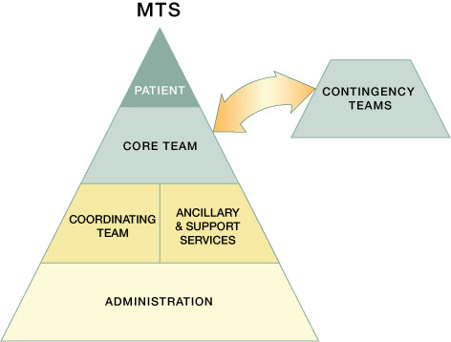
Multi-Team System (MTS) for Patient Care
Notes:
So we have discussed what defines a team. But in health care, it turns out multiple teams are involved in care. This slide shows one model of a multi-team system.
Each team within this multi-team system is responsible for various parts of the care. But they all have to act in concert. And in fact, as an individual, you may end up in multiple different parts of this team. A multi-team system is composed of multiple different teams. And we'll talk about each one of these in the slides that we have coming up.
And these include core teams, contingency teams, coordinating teams, administration. And again, it's important to acknowledge the patient as a critical part. The patient is right at the top, as they should be.
As we discuss each component, think about whether this should be included in your own personal TeamSTEPPS implementation plan. And I would encourage you to stretch the boundaries of who you would consider in training. For example, people like environmental services. So environmental services plays a crucial role in the prevention of hospital-acquired infections. But to be honest, they don't always realize how important they are because we don't always tell them what crucial members of the team they are.

Slide 16
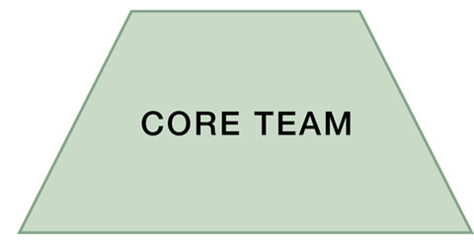
Slide 10: A Core Team is…
A group of care providers
who work interdependently
to manage a set of
assigned patients
from point of
assessment to
disposition
Core Team members have the closest contact with the patient!
Notes:
So the core team are the members that have the closest contact with the patient. So take a moment and think about who is on your core team. And I do, when I teach this, have people do this in real time and give them about 30 seconds. So as you did this, did you include the patient? Even though the patient is shown in a separate box in the triangle, they're really part of the core team, as is their family member.
So core teams consist of team leaders and team members who are involved in the direct care of the patient. So that's why people tend to think of the physician and the bedside nurse. They include the direct providers and continuity providers. The continuity providers manage the patient from assessment to disposition. So case managers are a really good example here, or care managers, or social workers, depending on what title you use at your organization.
The core team is based where the patient receives care. So they'll often be the people that have an office. Although certainly for myself as a hospitalist, I have patients on six or seven different units. Core teams should be small enough to ensure that situation monitoring, the development of situational awareness, and direct communication is possible. Again, you can start to see how that's hard even with myself, a bedside nurse, and a care coordinator.
To establish a shared mental model, the core team should be large enough to include skill overlap to allow for work load sharing and redistribution. Every core team member has a leader who's readily identified by all members of the team. The core team leadership, though, is dynamic. Core team leaders are required to take on different roles. Often they may be non-leadership roles such as supporting a nurse starting an IV.
For example, I probably have not started an IV at this point for seven or eight years. If the patient really needed an IV, they were having a GI bleed and boy, they need two large bore IVs immediately, it's probably my job to run and get the supplies for the nurse who's going to be better at getting that IV than me. In a clinic, it's probably a physician, a nurse, an administrative staff member responsible for treating a patient.
In an OR, the core team's probably going to be the surgeon, the anesthesiologist, the circulating nurse, and a scrub tech. When I teach this slide, I often ask people who would be on their core teams. Because you'll be teaching this in different settings, possibly including long-term care. And so the teams will look a little bit different depending on where you are rolling this out.

Slide 17
Slide 11: A Contingency Team is…
A time-limited team formed
for emergent or specific
events and composed
of members from
various teams
The TeamSTEPPS Rapid Response Systems Guide is available from AHRQ
Notes:
Contingency teams, on the other hand, are formed for emerging or specific events and are very time limited. When I teach this-- and when you teach this you may want to do this as well-- I often pause and ask for examples of this. They're responsible for immediate direct patient care during emergency situations. And it usually requires more resources than are available to the core team. Examples of these contingency teams are things like code teams, rapid response teams, or even a disaster response team.
They generally consist of pre-identified members derived from varying units or core teams, and have limited time to prepare. So for example, our trauma teams at the University of Minnesota, they call for a trauma code, and because they don't know each other at all, and many of them have never met before that moment in time, having very clearly defined roles and responsibilities becomes crucial. In fact, our trauma teams are even told to stand in a specific place based upon their role and responsibility, so that everybody knows who they are.
When you're teaching this, make sure to ask participants what contingency teams are used in their facility, and who is on that team. If they're unable to answer, you can always provide your own examples. Please note that a TeamSTEPPS rapid response systems guide is available for AHRQ as well. You can download a copy using the link provided.

Slide 18
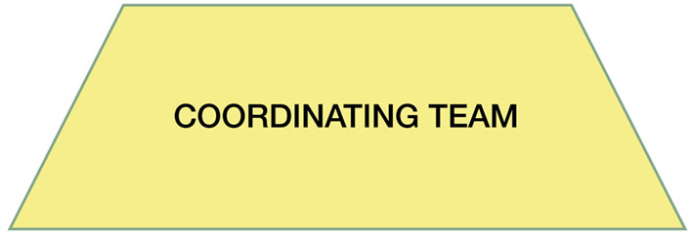
Slide 12: A Coordinating Team is…
A team comprising those
work area members who are
responsible for managing
the operational
environment that
supports the
Core Team
Notes:
The coordinating team, on the other hand, is that group that is responsible for managing the operational environment that supports the core team. So they do things like triaging emerging events and prioritizing decisions to make sure that the core team is supported. For example, at the University of Minnesota, we have a triage physician on the medicine service.
There are seven different medicine teams. They take the phone calls from throughout the organization for anybody admitting a patient to medicine, whether they're coming from clinic, the emergency room, or even North Dakota. They decide what level of care the patient needs, And then they contact the service and hand off the patient so that they can ensure quick care for the patient. Also, though, they have that 20,000-foot idea. So they'll often get a census update in the morning, so they know what the hospital's looking like in terms of bed availability.
Direct patient care for coordinating team members may not happen, with the exception of small facilities. And again, for example, our triage doctor does not do direct patient care, because they literally spend their day on the phone and on our electronic health record. Small facilities may have them do this or in emergent situations. So, for example, if our medicine services are overwhelmed, our triage doctor does occasionally see patients.
The coordinating team frequently includes experienced personnel with strong clinical background. That way, they know the system, and they know the players within the system. So this combination enhances their ability to rapidly assess the overall picture, to anticipate the needs or potential needs between and across teams, and make priority-based decisions.
So who is on your coordinating team in the area in which you work? The coordinating team in the operating room, for a different example, might be a charge nurse and an anesthesiologist and a unit clerk. When you're teaching this, it is really helpful to ask the participants who is on their coordinating team. If they're not able to answer, be ready to provide your own example or examples.

Slide 19
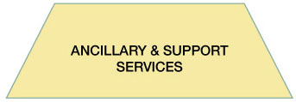
Slide 13: Ancillary & Support Services
Ancillary Services provide direct, task-specific, time-limited care to patients.
Support Services provide indirect service-focused tasks that help to facilitate the optimal health care experience for patients and their families
Notes:
Next is ancillary and support services. Ancillary services consist of individuals who provide direct, task-specific, and time-limited care to patients, support services that facilitate the care of the patients, and are often not located where the patients receive their routine care. They are primarily a service delivery team whose mission is to support the core team.
In general, an ancillary services team functions independently. So I often think of lab or radiology. Support services are primarily a service-focused team whose mission is to create efficient, safe, comfortable, clean environments, market perception, operational efficiency, patient safety. Support services would be environmental services. They may be nutrition-- who frankly is one of the biggest predictors of patient satisfaction is your nutrition program-- bioengineering, human resource management, even sterile processing or laundry.
Think about what would happen in your facility if there wasn't clean laundry. Think about what happens to patient flow if environmental services is short that day for people. As you teach this, after explaining what ancillary services means and support services teams mean and before you provide examples, ask them what some examples are.

Slide 20
The Role of Administration is to…
Establish and communicate vision
Develop policies and set expectations for staff related to teamwork
Support and encourage staff during implementation and culture change
Hold teams accountable for team performance
Define the culture of the organization
ADMINISTRATION
Notes:
And finally, there's administration. This is not the biggest section because they are the most important or because there should be the largest number of them. Administration includes executive leadership of a unit or facility. They may have 24-hour accountability for the overall function and management of the organization. At Minnesota, we are actually instituting a Leadership Officer of the Day. So there will always be a member of senior leadership available for questions 24/7.
The administrative team has no responsibility in the direct delivery of care, but they provide framework and guidance. Depending on your organization, they may have some responsibility for patient care, but not at the time they're acting as administrators. For example, we have a smaller institution within our organization that has a vice president for medical affairs who still practices as an emergency room physician because the VPMA job isn't really a full-time job, given the size of the institution.
Administration creates the culture and the climate for a teamwork system to flourish. They may be, for example, the people that asks you to complete this training. And they create this culture by establishing and communicating a vision, by developing and enforcing-- which is the hardest part-- policies and procedures that clearly articulate roles and responsibilities.
They set expectations for staff and for themselves. They provide necessary resources. And, again, they hold teams accountable, as well as individuals, for team performance. And they define and they should exemplify the culture of the organization. They should strive to create a learning culture, where there's trust and transparency, where it's safe to report, to analyze, and to share information openly. This is a specific philosophy. And it serves to define a culture of safety.
Aviation has done this quite well. However, they are also very clear that these changes do not happen overnight. And you'll learn a little bit more about the culture change and the timeline for that in later modules. Now that we've examined the structure of teams, we're going to go back and look at team leaders and team members in action.

Slide 21
Slide 15: Team Structure Video
As you watch the video, consider how the lack of team structure plays a role in the situation shown.
See page 19-20 in the Instructor Guide for details on how to facilitate this slide
Select the image to launch a web browser where you can watch the video
Notes:
You will use slide 15 in your training to share the team structure video with your learners. As you watch the video, consider how the lack of team structure plays a role in the situation shown. The video is available on the web for viewing. Selecting the slide image will open a new browser window, so you can view the video. After viewing the video, please return to this browser window to continue the module.

Slide 22
Slide 16: Video Discussion
Let’s discuss what you saw in the video:
What members of the teams were involved?
Who from the Core Team?
Who from the Coordinating Team?
From the Contingency Team?
From the Ancillary & Support Services?
Where did the breakdowns occur?
See pages 19-20 in the Instructor Guide
Notes:
Let's discuss what you saw in the video. What members of each of the following teams were involved in this scenario? The core team? By identifying the nurse, Amy, you're correct. The physician was not involved at all.
How about the coordinating team? Yes, the clerk, Sherry. And the contingency team? That's right, no members of this team appeared in the video. However, when Mrs. Everett coded, the members of the team that responded would make up the contingency team. How about ancillary and support services? The med tech, Greg, that's right.
Now, where did the breakdowns occur between the components of this multi-team system? That's correct, the med tech did not provide any information to the clerk to indicate there was a real concern that needed to be shared with the nurse. And the med tech and the nurse never followed up with one another to share information. Yes, because the nurse was not aware of the med tech's observations and concerns, the physician was never alerted to the changes in Mrs. Everett's behavior.
When you teach, lead in to the video by asking participants to consider how the lack of team structure plays a role in the situation they will see in the video, just as I asked you. After the video has played, you will then guide them through the discussion questions you just answered. If they miss mentioning a team member or breakdown in the multi-team system, be sure to add it to the discussion. Details on facilitating the video discussion can be found on pages 19 through 20 in this module's instructor guide.

Slide 23
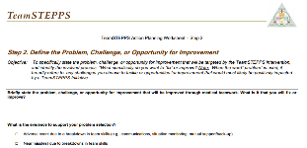
Slide 17: Applying TeamSTEPPS Exercise
Close Module 2 by answering these questions:
Who are the members of the team experiencing a teamwork issue?
Which team or teams within your multi-team system are experiencing the teamwork issue?
Which teams interact with or are otherwise affected by the team(s) experiencing the issue?
Select here to download and print the TeamSTEPPS Implementation Worksheet and answer the questions.
Notes:
If you don't already have a copy of the worksheet, select the link provided to print out your own copy of the TeamSTEPPS implementation worksheet and take a moment to answer the following questions. Who are the members of the team experiencing a teamwork issue? Which team or teams within your multi-team system are experiencing the teamwork issue? Which team or teams interact with or are otherwise affected by the teams experiencing the issue?
When you teach, you will conclude Module 2 by asking the participants to write the answers to these same questions on their implementation worksheet. Remember, if at any time during this or any module you have questions, you only need to select the Question Mark button on the bottom of the slide.

Slide 24
Module 2 Summary
In this module you learned to:
Discuss benefits of teamwork and team structure
Define a “team”
Identify the role of patients and their families as part of the care team
Describe the components and composition of a multi-team system
Notes:
In this module, you learned to discuss the benefits of teamwork and team structure, define a team, identify the role of patients and their families as part of the care team, and describe the components and composition of a multi-team system.

Slide 25
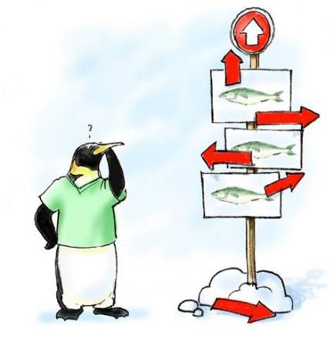
Module 2 Conclusion
This concludes Module 2 of the TeamSTEPPS 2.0 Online Master Trainer Course
Go to Module 3
Module 2
Module 3
Notes:
This concludes Module Two of the TeamSTEPPS 2.0 online master trainer course. To complete this module and receive accreditation, you must return to the TeamSTEPPS Learning Management System and complete the Module Two post-test.

