Slide 1
Module 3: Communication
Welcome to the
Online Master Trainer Course
Notes:
Welcome to Module 3 of the TeamSTEPPS 2.0 online Master Trainer course: Communication. This is Dr. Brigetta Craft, and I will be guiding you through this module.
Learning to properly communicate critical information is an essential TeamSTEPPS principle. Please select the Forward arrow in the lower-right corner to begin this module.

Slide 2
How This Online Course Works
This module will walk you through the TeamSTEPPS content just as you will present it when you train your colleagues and staff
It teaches you all the concepts that comprise the TeamSTEPPS initiative
While also teaching you to teach TeamSTEPPS to your colleagues
Use the navigation buttons in the lower right to work through the online modules
Select here to move back to the previous slide
Select here to move to the next slide
Notes:
This online course will walk you through the TeamSTEPPS content just as you will present it when you train your colleagues and staff at your facility. It teaches you all the concepts that comprise the TeamSTEPPS initiative while also teaching you how to teach the TeamSTEPPS content to your colleagues. Use the navigation buttons on the lower right to work through the online modules. Select the forward arrow to move to the next slide. And select the back arrow to go back to the previous slide.

Slide 3
The Materials You Will Use
When you deliver your training you will use these materials:
Instructor Manual
Course Management Guide
Instructor guides
Course slides
Measurement tools
Customizable materials
Videos
Select here to review materials on the TeamSTEPPS website
Notes:
When you deliver the TeamSTEPPS training at your facility, you will use a variety of materials and resources provided on the AHRQ TeamSTEPPS website. We will discuss them more, later in this module. Please select the link provided if you'd like to review any of the materials on the TeamSTEPPS website.

Slide 4
Please Print the Instructor Guide
To best use this online module, please print the Module 3 Instructor Guide, located here.
You may also want to print the TeamSTEPPS Pocket Guide
Then we will proceed to work through the slides you will use to train – just as if you are delivering this module at your facility.
Notes:
To best use this online module, we recommend that you print the instructor guide from Module 3 as a reference to use throughout the module. If you haven't already done so, you may also want to print the TeamSTEPPS Pocket Guide. Once you've done that, select the Forward button, and we'll proceed to work through the slides you will use to train, just as if you were delivering this module at your facility.

Slide 5
Cover Slide: Prepare to Train
As you teach this module, you will present information about communication
Convey the importance of communication and how the use of effective information exchange strategies can improve patient safety
Communications Tools on page 9 of the Pocket Guide
See page 3 in the Instructor Guide
Notes:
As you teach this module, you will present information about communication. From the start it is important to convey the importance of communication and how the use of effective information exchange strategies can improve patient safety. Let the participants know that communication tools can be found starting on page 9 of the TeamSTEPPS Pocket Guide. Please refer to page 3 of the instructor guide for details on this module.

Slide 6
Slide 2: Objectives
Use slide two to preview what will be covered in this module
See page 5 in the Instructor Guide for details on how to facilitate this slide
Notes:
After completing this module, you will be able to:
Describe how communication affects team processes and outcomes;
Define effective communication;
Identify communication challenges; and
Identify TeamSTEPPS tools and strategies that can improve a team’s communication.

Slide 7
Slide 3: Introduce Communication
Using slide 3, you will provide an overview of Communication
Communication is the lifeline of a well-functioning team
We will discuss the standards of effective communication
Notes:
When you deliver to your learners, you will use slide three to present the broad overview of communication. So far, we have covered the following in the TeamSTEPPS framework, Team Structure, which facilitates teamwork by identifying the individuals among which information must be communicated, the importance of a clearly designated leader, and the fact that mutual support must occur. This module will cover communication. It is the lifeline of a well-functioning team, and serves as a coordinating mechanism for teamwork.
Effective communication skills are vital for patient safety and interact directly with the other components of the TeamSTEPPS framework. As communication is the mode by which most of the TeamSTEPPS tools and strategies are executed, this module will serve as the basis for the leading teams, situation monitoring, and mutual support modules that will follow. We will discuss the standards of effective communication and will present information exchange strategies and specific tools to enhance communication among team members. I would now like to introduce Ross Ehrmantraut, a TeamSTEPPS Master Trainer at the University of Washington.

Slide 8
Importance of Communication (Slide 4)
Joint Commission data continues to demonstrate the importance of communication in patient safety:
1995 - 2005: Ineffective communication identified as root cause for nearly 66 percent of all reported sentinel events *
2010 - 2012: Ineffective communication among top 13 root causes of sentinel events reported **
See Instructor Guide, pages 7-9
* (JC Root Causes and Percentages for Sentinel Events (All Categories) January 1995−December 2005)
** (JC Sentinel Event Data (Root Causes by Event Type) 2004-2012)
Select Here for Joint Commission Data
Note: When presenting, update this slide annually by going to the Joint Commission Web site and locating the updated data.
Notes:
Hello, my name is Ross Ehrmantraut, and I've been at Harbor View Medical Center, part of UW Medicine, since 1984. My background is I'm a registered nurse. I have 17 years at the bedside working in the trauma intensive care for about nine years, working in the burn center for nine years. And I was the critical care educator here as well. Over about the last 10 years, I've been the patient safety officer. I became a Master Trainer in TeamSTEPPS in 2009.
And today I'm going to talk about communication. The joint commission data continues to demonstrate the importance of communication in patient safety. From 1995 to 2005, ineffective communication was identified as the root cause for nearly 66% of all reported sentinel events. And then again in 2010 to 2013, ineffective communication remained among the top thirteen root causes of sentinel events reported.
You can actually click on the link at the bottom of this slide and it can show you the actual data related to the joint commission. I think we can all think of examples of where communication played a role in a patient error or medical error. As a patient safety officer, I covered all our sentinel events, as well as any other adverse events, which may not have been sentinel events. But in our root cause analysis, there was often discussions about somebody in the room knowing something was going on or felt like they should speak up, but didn't feel comfortable speaking up. So communication is not only a style, but it's empowering people to speak up. And that's what we'll do with TeamSTEPPS.
When you're teaching, you may want to discuss findings regarding root cause analysis within your institution. If we can bring all this back to what actually occurs in our institution, it is way more meaningful for the people that are involved. Pages seven through nine of the instructor guide contains additional discussion on communication failures and an optional exercise you might want to include when you present this module.

Slide 9
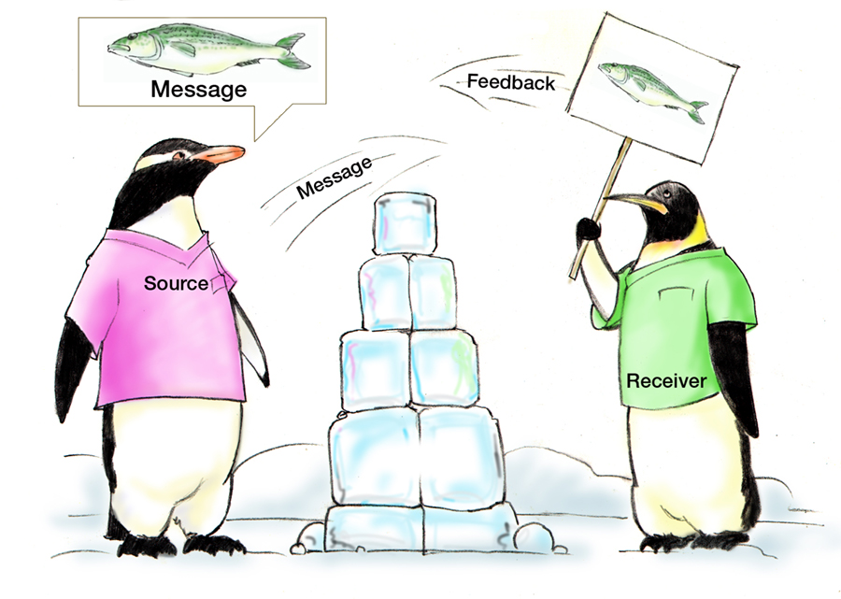
Communication is…
The process by which information is exchanged between individuals, departments, or organizations
The lifeline of the core team
Effective when it permeates every aspect of an organization
Consider: Who? How?
Two modes:
Verbal
Nonverbal
Assumptions
Fatigue
Distractions
HIPAA
See Instructor Guide, pages 10-11
Notes:
Communication is the process by which information is exchanged between individuals, departments, or organizations. Information is clearly and accurately conveyed to another person using a method that is known and recognized by all involved.
It is a lifeline of a core team and it is effective when it permeates every aspect of an organization.
One critical result of effective communication is a shared understanding between the source, or sender, and receiver of the information conveyed. So basically, we're just trying to get everybody working from the same page or a shared mental model, which you'll learn more about in a different module as we communicate.
Two considerations in communication are whom you are communicating with and how you are communicating information. Whom you are communicating with, or the audience, will influence how information is conveyed. For example, information exchange would be much different, or may be much different from an exchange with a physician versus an exchange with a technician or versus an exchange with a patient.
In terms of how you communicate, there are two modes of communication. There's the verbal and then there's the nonverbal. And we're going to talk a little bit about both of these. We'll cover the standards of effective communication shortly. These relate primarily to verbal communication.
But first, I want to discuss nonverbal communication. So please proceed to the next slide for this discussion. In addition, you can also see the instructor guide on pages 10 through 11 to get some more information on how to teach this module.

Slide 10
Nonverbal Communication
Written Communication – adheres to standards we will discuss
Body Language
In face-to-face communication:
Words: 7% of meaning
Tone of voice: 38%
Body language: 55%
Visual Cues
Such as color coding
See pages 10-11 in the Instructor Guide
Notes:
Nonverbal communication can take several forms. Written communication is one form common in the health care setting. We see it quite frequently-- everywhere we go in the health care setting. This form of nonverbal communication should adhere to many of the same standards associated with verbal communication, which we will discuss shortly.
In addition, one should be mindful of standards associated with written communication, such as the Joint Commission's "Do Not Use" list of abbreviations. Another form of nonverbal communication is the body language. The way you make eye contact and the way you hold your body during a conversation are signals that can be picked up by the person with whom you're communicating.
Body language plays a significant role in communication. In fact, did you realize that in face-to-face communication, words account for 7% of the meaning? Tone of voice is 38% of the meaning. And that body language accounts for 55% of the meaning for the receiver. Although powerful, this mode of communication does not provide an acceptable mode to verify or validate information.
A third form of nonverbal communication is visual cues. For example, the use of color-coding for assignments, charts, scrubs, orders, and so on, can help team members identify the information they need quickly. Visual cues can also serve as reminders, such as the use of signs reminding staff to wash their hands.
To avoid making assumptions that can lead to error, you should verify in writing or orally any nonverbal communication such as body language or visual cues. To ensure patient safety, the simple rule is “when in doubt, check it out.” Offer information or ask a question. Trying to get everybody on the same page using all these ways of communication.
Now think about your work setting. Can you think of an example when nonverbal communication produced a breakdown in teamwork? Did you know the actual intent of the person?
I can think of many examples in our institution. One of the big ones is one of the groups I worked with here to roll out TeamSTEPPS included physical therapists, occupational therapists, and nursing on one of our teams. And there was an ongoing communication breakdown, and a lot of it was nonverbal.
It related to splinting of patients-- putting the splints on and the appropriate application of the splint. The therapists would write in the chart exactly what they wanted. But nursing didn't always have the time to go to the chart to review, so they would ask the therapists to help clarify how to put a splint on.
Often, the response of the body language was something as simple as rolling of the eyes. And then the tone of voice was-- read the chart, I put it there. This instantly closed down the communication and provided a barrier to decrease patient safety.
See pages 10 and 11 in the instructor guide for more information on how to effectively facilitate the discussion on nonverbal communication.

Slide 11
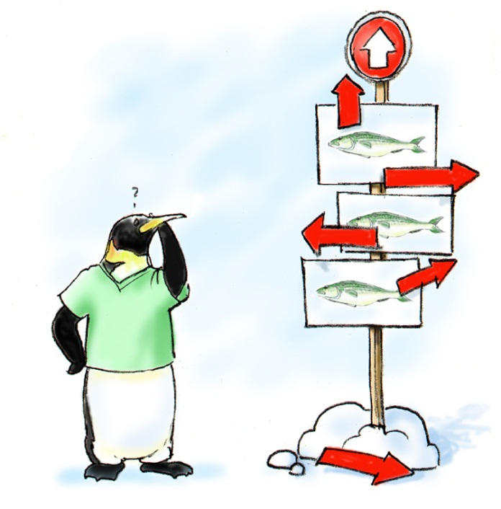
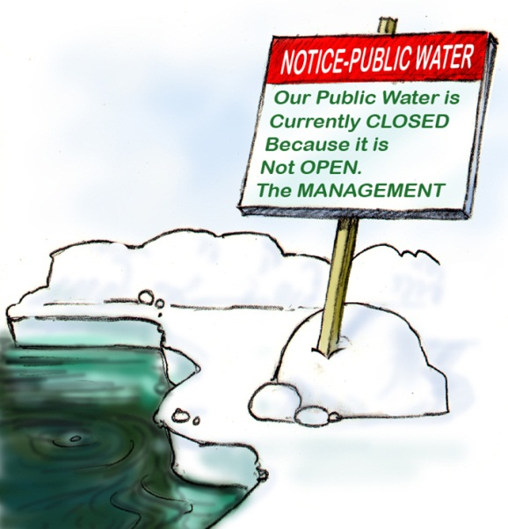
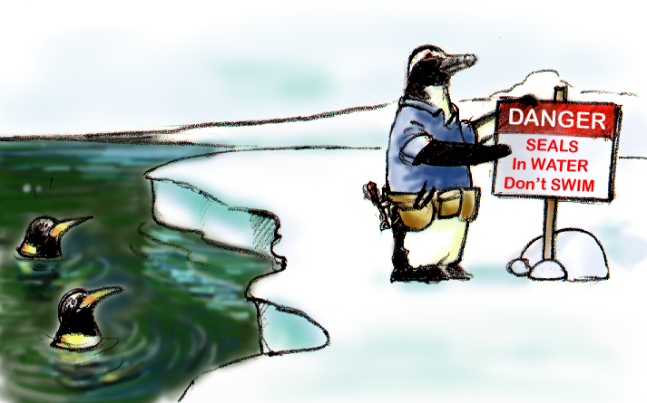
Standards of Effective Communication
Complete
Communicate all relevant information
Clear
Convey information that is plainly understood
Brief
Communicate the information concisely
Timely
Offer and request information in an appropriate timeframe
Verify authenticity
Validate or acknowledge information
Clear
Brief
Timely
See Instructor Guide, page 12
Notes:
Standards of effective communication involve four major components. They need to be complete, clear, brief, and timely. When sharing information with the team-- which can include other providers, patients, or family members-- communication must meet each of these four standards.
Complete would be communicate all the relevant information while avoiding unnecessary details that may lead to confusion. It's always important to leave enough time for questions and answers, and answer questions completely. Clear communication uses information that is plainly understood. Lay terminology with patients and their families is very important. Use common or standard terminology when communicating with members of the team.
Now this is not only in verbal communication, but nonverbal communication as well. I do a lot of chart reviews. And more and more you're seeing abbreviations that don't necessarily make sense, especially in our texting world. I recently saw somebody put in the chart-- instead of writing the word before-- B-E-F-O-R-E-- they wrote B number 4, using that texting way that we communicate now. So everybody needs to be on the same page on how we use our abbreviations.
Communication needs to be brief. It needs to get to the point quickly and provide the information as quickly and concisely as possible. And finally, it needs to be timely. Be dependable about offering and requesting information in an appropriate time frame. Avoid delays in relaying information that could compromise a patient's situation. Note times of observations and interventions in the patient's record. And update patients and families frequently.
We need to verify the authenticity, which requires checking that the information received was the intended message of the sender. So getting that feedback. And validate or acknowledge all the information, stating back what you heard.
A prescription is a great example of good communication. It's complete. It includes the medication, the dosage, and frequency. It should be clear. It is clearly written and legible. It's generally brief. It contains only the necessary information. And it's concise. It's written before discharge and filled when the patient is ready to leave the hospital.

Slide 12
Communication Challenges
Language barriers
Distractions
Physical proximity
Personalities
Workload
Varying communication styles
Conflict
Lack of information verification
Shift change
See Instructor Guide, pages 14-15
Notes:
There are many communication challenges, which sets us up for some failure. I'm going to go over these briefly here. One of them is a language barrier. Non-English speaking patients and staff pose particular challenges.
And a great example we had with that here was with our patient identification. A lot of our patients, English is a second language, or don't speak English at all. And we struggled with how do we positively identify every one of those patients using the standards of asking a patient their name and their birthday. Working through that and trying to figure that out has been a challenge. But we've done that now.
There's always distractions. Emergencies can pull you away from what you're doing. And it takes your attention away from that current task at hand.
Physical proximity, the person you're communicating with may not be anywhere near where you are. And it puts up another barrier there. Personalities, it's just sometimes difficult to communicate with particular individuals. I used the example of the nurses versus the therapist earlier. Same thing, there are some personality issues that went on there that we've worked through.
During heavy workload times, all the necessary details may not be communicated. Or they may be communicated, but not verified. People just want to go into the next task and don't necessarily communicate what, exactly, needed to be done on the previous one.
There's always varying communication styles. Health care workers have historically been trained with different communication styles. That is something-- over history, nursing’s been taught one way to communicate in school, physicians, another way, pharmacists, another way. Somehow, we need to bring all those together.
Conflict is a big part of barrier for communication challenges. Disagreements may disrupt the flow of information between communication and individuals. This could be directly disagreement about the patient itself, or it could just be a disagreement on a personal level.
Lack of verification of information. Often, we don't verify what was said in the exchange. And we're no longer working from the same page.
And then shift change. We talked about 66% of all medical errors can be traced back to communication challenges. A lot of these have to do with transitions in care during those shift changes, or those hand-offs. And we're going to talk more about that as we go.
One thing that we worked with here is we looked at standardizing our hand-off process to make it better. And the first thing we looked at is how many hand-offs in our trauma and intensive care unit do we have in a 24-hour period? And there's 24 patients in that unit. And we have 12-hour shifts.
So just the shift change alone, that was 48 hand-offs that occur a day. But then if you throw in the lunch times—which people don't always consider that as an official hand-off, but it is. As one nurse covers for another, there's another hand-off that's occurring. When you transfer your patient to radiology, when you send your patient to OR-- we did the math and found out that there's about 150 hand-offs that occur every single day in the trauma ICU if you include the hand-offs between physicians and such.
So there's huge opportunity for error to occur. So trying to standardize that communication to make things clear will be a huge step to improving communication.
So thinking back, have you experienced a situation involving a breakdown of communication? Now, take a moment to write down some examples. You will be able to share these examples when you teach.
And then when you are teaching, ask these questions to encourage discussion amongst the students. Have you experienced a situation in your unit involving a breakdown of communication? And then ask them for some examples. Again, the instructor guide on pages 14 and 15 can help with this part of the module.

Slide 13
Communication Challenges Scenario
Scenario:
An 89-year-old female with a history of chest pain
Many tests are being run
Family requests code status be changed to DNR
Night shift documents DNR in the progress note, but does not flag the patient’s chart, relay during shift change, or notify the attending physician
Morning shift does not read the night shift’s notes
Where might miscommunication occur in this situation?
What are the possible outcomes?
Notes:
Let's spend a few minutes reviewing a scenario in which communication challenges are present. An 89-year-old female presents to the hospital and has a history of chest pain. Many tests are being run to determine the cause of the chest pain. The patient and her family decide they no longer want aggressive measures taken and request that the patient's code status be changed to DNR.
The night shift documents in the progress note, that the patient requested not to be resuscitated. The night shift does not flag the patient's chart, relay the information during shift change, or notify the attending physician. The morning shift does not read the night shift’s notes because of several immediate emergencies.
Please take a few moments to review this scenario and write your answers to the following questions. Where might miscommunication occur in this situation? And what are the possible outcomes? Once you have written out your thoughts on the scenario and how it might be avoided, select the Next button to continue.

Slide 14
Scenario Questions Discussion
Miscommunication in the scenario:
Night shift failed to flag the patient chart
Night shift failed to relay the information during shift report
Doctor was not notified
The possible outcomes:
The day shift resuscitated the patient
Patient underwent additional testing/procedures
Miscommunication could be avoided if:
Night shift took more time to discuss the patient during the shift change
Proper documentation occurs
Doctor is notified
Notes:
So what were your answers to the questions? Miscommunication occurred in the scenario when the night shift failed to properly flag the patient's chart, when the night shift failed to relay the information during shift report, and when the doctor was not notified of the patient's request. The possible outcomes of the miscommunication could include the day shift resuscitating the patient when they shouldn't have, and the patient having additional tests or procedures. The miscommunication in this scenario could've been avoided if the night shift took more time to discuss the patient during the shift change, the chart was flagged to alert a new order, and the doctor was notified.

Slide 15
Slide 9: Information Exchange Strategies
We will review four strategies to improve communication:
SBAR
Call-Outs
Check-Backs
Handoffs
See page 9 of the TeamSTEPPS Pocket Guide for additional information
See Instructor Guide, page 16
Notes:
Now we're going to review four strategies to improve communications. These include SBAR, call-outs, check-backs, and hand-offs. And if you wanted to download the pocket guide, you can click on the link there and it will go over some of these tools with us. You can also find these tools in the instructor guide on page 16, on how to instruct on this section of the module.
We will discuss each one of these in detail on the following slides. Now of these strategies, hand-offs, in particular can take many forms. In this course, we'll describe the I PASS the BATON hand-off tool in the most detail. However, it is only one tool among many that have been created to standardize the process. Examples of additional resources will also be available.

Slide 16
SBAR Provides… (Slide 10)
SBAR provides a standardized framework for communication
In conversation, consider:
Situation
What is happening with the patient?
Background
What is the clinical background?
Assessment
What do I think the problem is?
Recommendation
What would I recommend?
See Instructor Guide, page 17
Notes:
So let's start with SBAR. SBAR provides a standardized framework for communication. So in conversation, when we're having this discussion related to patient care, let's consider four things. What is the situation, or what is happening with the patient? What is the background, or what is the clinical background? What do I think the problem is? What is my assessment of what's going on with this patient? And what will my recommendation be to treat this problem?
This is a great standardized framework for members of the health care team to communicate about a patient's condition. Sometimes this is also referred to as ISBAR, where I at the beginning stands for Introductions. Keep in mind, we may not always know everybody we're communicating with right from the beginning.
So starting out with a simple introduction can often open up lines of communication. So let's just go through an example here. When I teach SBAR, I always like to tell people to say the word situation, say the word background, and so here would be an example that I would see occur in our institution.
I'm calling a physician, and I start with, the situation is Mr. Smith in bed one. Hematocrit has dropped from 30 to 22 in 10 hours. His blood pressure is down, and his heart rate is up. The background is Mr. Smith was admitted last night for a lower GI bleed. My assessment is Mr. Smith is bleeding. He's tachycardic. And he's hypotensive.
My recommendation would be that we transfuse him stat with two units of blood right now, and then follow up closely. You can also use SBAR for a non clinical scenario, and we use it significantly in our institution for lots of things. We use it in our adverse event reports. We use it when we go over cases with teams, and we use it when we present proposals to our administration.
A classic example of that would be looking at trying to implement just culture in our institution, the official just culture. And here's an SBAR I would use for something like that. The situation is our culture of safety survey results show people believe we have a punitive reporting environment. The background is historically the medical profession has treated medical errors punitively.
My assessment is a perception of punitive environment leads to decreased reporting and decreased patient safety. And my recommendation would be to institute a just culture utilizing the Algorithm. So we've taken a clinical tool, and we've used it in a non clinical setting. So again, see instructor guide on page 17 for more on this.
So take a few minutes to answer the following questions. Have you used SBAR in your own institution, and if so, how was it used? And what was the result of its use? What were the challenges to implement the use of SBAR, and how were these challenges overcome? And then when you're teaching this, ask participants these same discussion questions you just answered.
This should stimulate some good conversation. And some of the barriers in implementing SBAR will come out, and you guys can discuss them through there. So again, those questions are have you used SBAR in your institution? If so, how was it used? What was the result of its use? And what were the challenges to implement the use of SBAR, and how were these challenges overcome?
As you're working with your group, if none of the participants mention anything about non-clinical examples, be sure to have one available to provide for them.

Slide 17
Using SBAR with Patients
SBAR can also be used by patients
Share information on situation, background
Ask the care team about their care
See page 17 of the Instructor Guide
Visit DOD’s Engaging Patients through TEAM UP website
Notes:
SBAR can also be used with patients. Although it's typically used as a communication tool between clinical staff, we can modify it to use with a patient to communicate with the care team. So we can actually teach our patients an SBAR tool technique so they can share information on their situation. They can tell us their background and assessment or recommendations. Again, we've just done a nice job of standardizing the process, not only within the medical team, but including the patient as part of the team as well.

Slide 18
Slide 11: SBAR Video
Review the SBAR technique
See page 18 in the Instructor Guide for details on how to use this video
After you watch the video, return to this window to continue the module
Select the image to launch a web browser where you can watch the video
Notes:
Let's now review how to properly use the SBAR technique. In this video, the patient's condition has worsened, resulting in a call to the physician. Please refer to page 18 in the instructor guide for information on how to use this video when you deliver the training. The video is available on the web for viewing. Selecting the slide image will open a new browser window so you can view the video. Once you have viewed the video, please return to the browser window to continue this module.

Slide 19
Video Discussion
Lead a discussion of this question:
How did the SBAR technique improve communication between the nurse and physician?
Point out:
Identified herself and reason for call
Provided background of DVT diagnosis
Assessment of the patient
Recommendation for additional labs
Notes:
After showing the video, lead a discussion of this question-- how did the SBAR technique improve communication between the nurse and physician? During the discussion, point out that the nurse identified herself and the reason she was calling; the physician was quickly made aware of Mrs. Everett's deteriorating situation; the nurse provided the background of the DVT diagnosis and all current labs; the recent assessment of the patient has led the nurse to call the physician with her concerns; and the recommendation was initiated by the nurse for additional labs, and a plan was discussed for future care. With regard to the recommendation made by the nurse, be sure to point out that the purpose of the recommendation is to be clear and concise, not to attempt a diagnosis.

Slide 20
Slide 12: SBAR Exercise
See page 19 in the Instructor Guide
Take a few minutes to write out your own SBAR example
Questions? Use the “FAQ” button below
Notes:
When you are delivering the training, you will lead the learners in creating an SBAR example. Page 19 in the instructor guide contains detailed instructions to facilitate this exercise. Take a few minutes now to write out your own SBAR example based on your specific role. If you have any questions as you work on your example, please use the FAQ, F-A-Q, button at the bottom right to submit a question, or read through previous questions and answers.

Slide 21
Call-Out Is… (Slide 13)
A strategy used to communicate important or critical information
It informs all team members simultaneously during emergency situations
It helps team members anticipate next steps
See Instructor Guide, page 20
Notes:
Call-out as a strategy used to communicate important or critical information. Critical information called out in these situations helps the teams anticipate and prepare for vital steps in patient care, and informs all team members simultaneously during emergency situations, and it helps team members anticipate the next steps.
So think about that a little bit. If you're the recorder in a code situation and somebody hollers out, they've just given an amp of epi, that's important for you to know and for you to document. If they don't call-out that they've given an amp of epi, you're going to miss that. And that could be important down the road on that code situation.
One important aspect of a call-out is directing the information to a specific individual. So hopefully, you'll know everybody's name and you would call out their name. John, can you please go get me a Yankauer suction?
But sometimes you don't, in a code situation, know everybody's name right at the moment. So you would point to that person and say, will you please get me a Yankauer suction? That would be a call-out, identifying exactly who you want to complete the task.
We kind of call those county call-outs, if somebody just says, I need Yankauer suction, we don't know who's going to get it. Nobody may go, or two or three people may go. And that will create some issues. So again, identifying who you want to complete the task is important.
Another way to do a call-out is-- an example would be as anesthesia is intubating a patient. I would stand at the head of the bed, watching the patient's O2 stats, and holler out, O2 stats are 96%. O2 stats are 94%. Anesthesia, then, knew where this patient was going oxygenation wise, and would know if they would have to stop trying to intubate them, and we would have to re-oxygenate the patient.
Call-outs can be very valuable in many situations. Anesthesia walking into the room, just saying, Anesthesia is here. That would also be an example of a call-out. It really helps the team members out. Now continue to the next slide to watch the video demonstrating call-out.

Slide 22
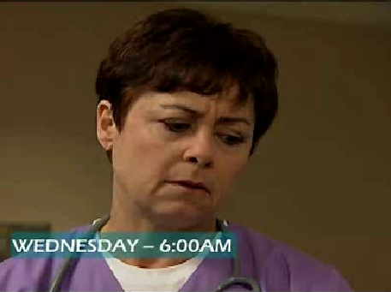
Call Out Video
After viewing the video, discuss this question:
How did the call-outs made by the nurse and intern aid the team during this emergent Labor and Delivery event?
Select the image to launch a web browser where you can watch the video
Notes:
The call-out video. After viewing this video, discuss this question-- how did the call-outs made by the nurse and the intern aid the team during this emergent labor and delivery event? Select the image to launch a web browser where you can watch the video, then return to this browser window to continue the module.

Slide 23
Call-Out Video Discussion
How did the call-outs aid the team?
Team members verbally confirmed critical information
The team was anticipating future actions
Information was directed by name to Dr. Dean for response and feedback
Notes:
So let's talk about the video just a little bit. How did the callout aid the team? Well, you saw team members verbally confirm the critical information. Both the nurse and the students spoke up about what was going on with the patient.
The team was anticipating future actions. Possible C-section and a call to the attending were discussed in the video.
And information was directed directly to Dr. Dean for response and feedback. You heard the nurse say, Dr. Dean, the patient, the baby is decelerating. When you deliver the training, you will show the callout video, and then lead a discussion using the same questions. Again, how did the callouts made by the nurse and intern aid the team during this emergent labor and delivery event? And after the participants have had a chance to share, if the ones seen on the slide weren't mentioned, share your observation to include those on the slide.
Going back to my example of the anesthesiologist walking in the room and identifying themselves as the anesthesiologist, that's a simple callout. An anesthesiologist intubating a patient as somebody's standing at the bedside calling out the O2 saturations is another example. Multiple examples, so please try to share those, and get more from your staff.

Slide 24
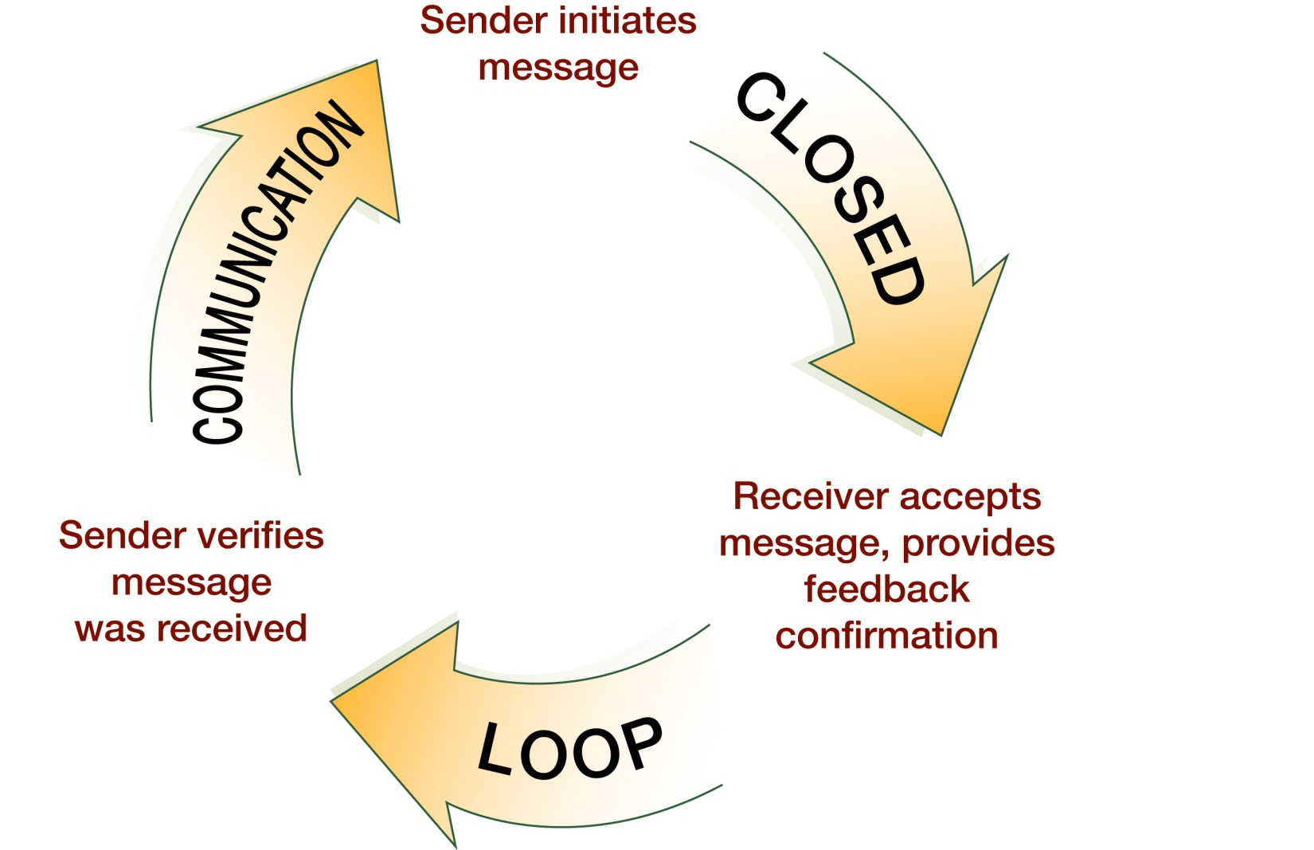
Check-Back Is… (Slide 14)
See Instructor Guide, page 21
Notes:
A check-back is a closed loop communication strategy used to verify and validate information exchange. This strategy involves the sender initiating a message, the receiver accepting the message and confirming what was communicated, and the sender verifying that the message was received. Here's an example of a check-back.
One member of the team calls out, "BP is falling. 80 over 48, down from 90 over 60." Another team member verifies and validates receipt of the information by saying, "Got it. BP is falling and at 80 over 48, down from 90 over 60." The original sender of the information completes the loop by saying "Correct."
We see this check-back-- this closed loop communication occurring every day in the medical profession, as well as in every other aspects of our life. Daily, I go into Starbucks and I walk in and I order a venti nonfat, sugar-free vanilla misto. And the person taking my order then repeats it back to me, as well as to the barista-- venti nonfat, sugar-free vanilla misto.
The barista looks over and says, venti nonfat, sugar-free vanilla misto. The person at the register says that's correct. And then when the barista makes the drink and puts it on the counter, they say, venti nonfat, sugar-free vanilla misto. They've now said this call-out and check-back four times, to confirm that the order is correct.
So we see this in every aspects of our lives. Sometimes we look at that and think, maybe giving a patient epinephrine-- the last time we gave a patient an EPI-- amp of EPI in a code situation might be as important as our morning Starbucks. A check-back is an effective tool for all members of the team, including patients and their family members. For example, patients and families can use the check-back to verify the receipt of care instructions or confirm understanding of symptoms to monitor.

Slide 25
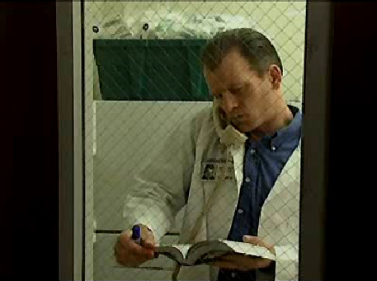
Check-Back Video
After viewing the video, discuss these questions:
Who was the sender? Receiver?
How did they “close the loop” ?
What errors were avoided?
Select the image to launch a web browser where you can watch the video
Notes:
When you deliver the training, you will show the check back video and then lead a discussion using these questions.
Who was the sender? Who was the receiver? How did the sender and receiver close the loop? What communication errors were avoided? Think about how you would answer these questions as you watch the video. Select the image to launch a web browser where you can watch the video, then return to this browser window to continue the module.

Slide 26
Check-Back Video Discussion
Share these observations:
Pharmacist was Sender and Resident was Receiver
Closed the loop with “Correct.”
They avoided errors because:
The Pharmacist did not rely on memory
The Resident wrote the exact dosing instructions
Notes:
After watching the video, share these observations with your learners. The pharmacist was the sender and the resident was the receiver. They closed the loop when the pharmacist said, correct.
They avoided communication errors because the pharmacist didn't rely on memory to give correct dosing information. The resident wrote the exact dosing instructions to avoid depending on memory, and could check back using notes, since the dosing was more complicated by dilution. Errors caused by misunderstood dosage amounts or drugs with similar sounding names were avoided.

Slide 27
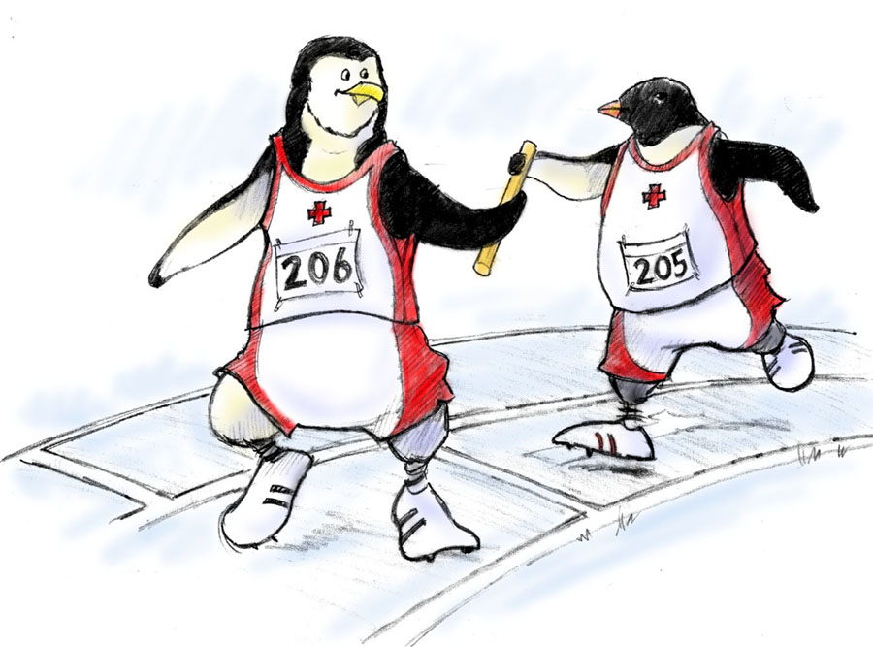
Handoff is… (Slide 15)
The transfer of information during transitions in care across the continuum
Includes an opportunity to ask questions, clarify, and confirm
See page 22 in the Instructor Guide for more information
Joint Commission's Tool to Tackle Miscommunication Among Caregivers
Notes:
When a team member is temporarily or permanently relieved of duty, there is a risk as necessary information about the patient that might not be communicated. Throughout the hand-off scenario, we can standardize our process to make sure the transfer of information during transitions is standardized. It includes the opportunity to ask questions and clarify, as well as confirm.
The hand-off strategy is designed to enhance information exchange at critical times, such as transitions in care. Remember, we talked about over 150 times a day, in one 24-bed ICU, hand-offs occur. More important, it maintains continuity of care despite changing caregivers.
According to the Joint Commission, the primary objective of a hand-off is to provide accurate information about a patient's, or client's, or resident's care, treatment and services, current condition, and any recent or anticipated changes that have occurred. The information communicated during a hand-off must be accurate to meet the patient safety goals. The Joint Commission National Patient Safety Goal, NPSG 2E, which relates to communication, mandates implementing the use of hand-offs within each institution.
In addition, a standardized approach to hand-off communications, including an opportunity to ask and respond to questions is required. So as we look at hand-offs, we need to make sure we make it standardized, and allow for people to ask questions. We have used hand-offs in many different ways in our institution. We have the advantage of the electronic medical record helping us with our standardized approach for hand-offs for our physicians, as well as our nursing staff and pharmacy staff. It pulls real-time data out of the patient's chart. They can print up a tool, a hand-off tool and share with the person they're handing-off to, so all that information transfer is occurring.
Please refer to page 22 in the instructor guide for more information on how to facilitate the delivery of this information. You can also use the link provided to read the Joint Commission’s tool to tackle miscommunication among caregivers.
One last thing I wanted to say about hand-offs, and I said this earlier, is we really need to keep in mind what a hand-off is. The obvious ones are change of shift reports, but when we go to lunch, and we hand-off our patient to another staff member, that's an important time to keep in mind that that's an official hand-off. And people need to know what's going on with that patient at that point.

Slide 28
A Handoff Consists of… (Slide 16)
Transfer of responsibility and accountability
Clarity of information
Verbal communication of information
Acknowledgment by receiver
Opportunity to review
See Instructor Guide, page 23
Notes:
A proper hand-off includes the following-- transfer of responsibility and accountability. So when handing off, it is your responsibility to know that the person who must accept responsibility is aware of assuming responsibility. Similarly, you're accountable until both parties are aware of the transfer of responsibility.
Needs to be clear information-- when uncertainty exist, it is your responsibility to clear up all ambiguity of responsibility before the transfer is completed.
Verbal communication of information-- you can never assume that the person obtaining responsibility will read or understand written or nonverbal communications. So I talked about this tool that we use that we get out of our electronic medical record. It's not adequate just to hand that tool to somebody. You should be working off that tool together, as you have the verbal communication throughout the hand-off.
And the receiver needs to acknowledge the information. Until it is acknowledged that hand-off is understood and accepted, you cannot relinquish your responsibility. And finally, the receiver needs to have an opportunity to review, have opportunity to ask questions. And often the hand-offs are a good time to review and have a new pair of eyes evaluate the situation for both safety and quality. Bringing somebody in that hasn't seen the patient yet for a while, sometimes can bring a different perspective that will be valuable to patient care.

Slide 29
Handoffs Transfer…
The degree of certainty regarding a patient
The patient’s response to treatment
Recent changes in condition and circumstances
The plan of care, including contingencies
Both authority and responsibility are transferred in a handoff
See Instructor Guide, page 23
Notes:
Hand-offs include the transfer of knowledge and information about the degree of certainty regarding the patient, such as whether a diagnosis has been confirmed, or not, how the patient is responding to the treatment, any recent changes in conditions and circumstances, and the plan of care, including contingencies. If this happens, what will we do?
It is important to highlight that both authority and responsibility are transferred in a hand-off.
As identified in root cause analysis of sentinel events in poor outcomes, lack of clarity who is responsible for care and decision making has often been a major contributor to medical error. We see that quite frequently, especially when you have multiple services and multiple people working with a patient.
In our institution, we'll see trauma patients. We'll see trauma patients with medical histories. They have orthopedic consults going. And sometimes, at the end of the day, nobody was quite sure who is ultimately responsible for that patient's care, which leads to problems with that patient and poor patient outcomes.

Slide 30
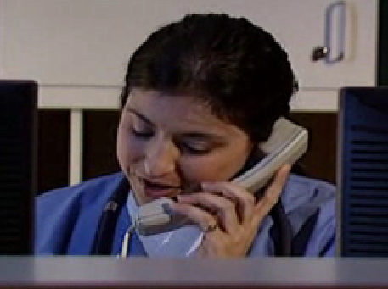
Handoff Video
While watching the video, ask these questions:
What went well in the handoff in this video?
Was there anything about the handoff that could have been improved?
Select the image to launch a web browser where you can watch the video
Notes:
While watching the video, ask yourself these questions. What went well in the hand-off? Was there anything about the hand-off that could have been improved?
When you deliver the training, you will show the hand-off video and then lead a discussion using these same questions. Ask participants, what went well in the hand-off in this video? Was there anything about the hand-off that could've been improved? Select the image to launch a web browser where you can watch the video, then return to this browser window to continue the module.

Slide 31
Handoff Video Discussion
What went well:
Continuity of care was maintained
Pain management was discussed
Medications were reviewed
Plan of care was discussed
High threats were announced
Expectations and responsibilities were completed
Face-to-face or in-person handoffs could have improved the handoff
Notes:
After watching the video, did you have these same observations? The things that went well in the hand-off included continuity of care was maintained, pain management was discussed, medications were reviewed, plan of care was discussed, high threats unique to Mrs. Peters were announced, and expectations and responsibilities for the hand-off were completed.
The hand-off could have been improved, if it was face-to-face. Face-to-face, or in-person hand-offs allow you to see the nonverbal communication between you and the receiver, for better confirmation that the message has been properly received. When you teach, after participants have had a chance to answer, add these observations, if they were not already covered.

Slide 32
I PASS the BATON (Slide 17)
Introduction: Introduce yourself and your role/job (include patient)
Patient: Identifiers, age, sex, location
Assessment: Present chief complaint, vital signs, symptoms, and diagnosis
Situation: Current status/circumstances, including code status, level of uncertainty, recent changes, and response to treatment
Safety: Critical lab values/reports, socioeconomic factors, allergies, and alerts (falls, isolation, etc.)
THE
Background: Comorbidities, previous episodes, current medications, and family history
Actions: What actions were taken or are required? Provide brief rationale
Timing: Level of urgency and explicit timing and prioritization of actions
Ownership: Who is responsible (nurse/doctor/team)? Include patient/family responsibilities
Next: What will happen next? Anticipated changes? What is the plan? Are there contingency plans?
Notes:
OK, let's talk about one of the tools available to us to standardize the hand-off approach. This is called "I Pass the Baton", and it's a systematic way to work through the hand-off to make sure everybody's giving and receiving the same information. Every facility should determine a standard protocol for delivering hand-offs, and make it known to everyone. This tool, "I PASS THE BATON", is the TeamSTEPPS tool that provides one option of conducting a structured hand-off.
I stands for the introduction. Introduce yourself, and your role, and your job, and include the patient. And remember, Simple introductions open up lines of communication. P stands for a patient-- name, identifier, sex, and location. A stands for the assessment-- presenting chief complaint, vital signs, symptoms, and diagnosis. S is for situation-- current status, circumstances, including the patient's code status, level of uncertainty, recent changes, and responses to treatment.
The next S stands for safety concerns-- critical lab values, reports, socioeconomic factors, allergies, alerts. This is a good time to share whether a patient's on isolation precautions, or fall precautions. The B stands for background-- comorbidities, previous episodes, current medications, family history.
A is for actions. What actions were taken, or are required yet. Provide a brief rationale for these actions. T is for timing-- level of urgency and explicit timing and prioritization of actions.
And O is for ownership. Who is responsible? Is it the nurse, the doctor, the team? Include patient and family responsibilities in O. And N stands for next-- what will happen next, anticipated changes, what is the plan, are there contingency plans?

Slide 33
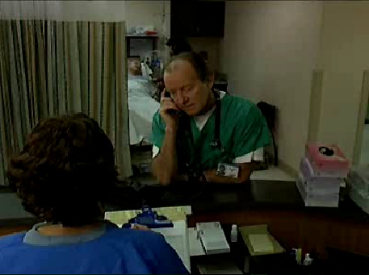
I PASS the BATON Video
As you watch this video, consider this question:
How was I PASS the BATON used in this physician-to-physician example?
Select the image to launch a web browser where you can watch the video
Notes:
Now as you watch this video, consider how you would answer the following question-- how was I PASS THE BATON used in the physician-to-physician example? When you deliver the training, you will show the I PASS THE BATON video, and then lead a discussion based on that same question. Select the image to launch a web browser where you can watch the video, then return to this browser window to continue the module.

Slide 34
I PASS the BATON Video Discussion
I PASS the BATON was demonstrated in:
Physician shift change (showing responsibility)
Discussed the evolving patient condition
Sharing of information for better decision making
See Instructor Guide, page 26
Notes:
Now that you've seen the video, did your observations match the following? It was demonstrated in the physician shift change, showing change of responsibility from one physician to another. They discussed the evolving patient condition, and there was sharing of information for better decision making between care leaders.
When you deliver the training after showing the I PASS THE BATON video, lead a discussion by asking, how was I PASS THE BATON used in the physician-to-physician example? If not already mentioned by the group, share the observations we just discussed. Refer to page 26 in the instructor guide for information on facilitating this discussion.

Slide 35
Other Handoff Tools (Slide 18)
ANTICipate
Administrative Data; New clinical information; Tasks to be performed; Illness severity; Contingency plans for changes
I PASS
Illness severity; Patient Summary; Action list for the new team; Situation awareness and contingency plans; Synthesis and “read back” of the information
SHARQ
Situation; History; Assessment; Recommendations/Result; Questions
See page 27 in the Instructors Guide for additional handoff tools
Notes:
Numerous tools and resources are available to facilitate effective hand-offs, and each facility should adopt a tool that best meets its needs. In addition to I PASS the BATON, other hand-off tools and resources include ANTIC-ipate, which stands for Administrative data, New clinical information, Tasks to be performed, Illness severity, and Contingency plans for changes. There's also just I PASS: illness severity, patient summary, action list for new team, situation awareness and contingency plans, and synthesis and read-back of the information.
We use I PASS for our certified nursing assistants as they give report. This does a nice job of getting through the main parts of the patient. It also allows for them to talk about fall-risk precautions and isolation precautions. And then SHARQ, which stands for situation, history, assessment, recommendations, results, and questions. You can select the title of each of these tools shown to learn more about each one. Please refer to page 27 in the instructor guide for other hand-off tools.

Slide 36
Tools & Strategies Summary
BARRIERS
Inconsistency in Team Membership
Lack of Time
Lack of Information Sharing
Hierarchy
Defensiveness
Conventional Thinking
Complacency
Varying Communication Styles
Conflict
Lack of Coordination and Follow-up With Coworkers
Distractions
Fatigue
Workload
Misinterpretation of Cues
Lack of Role Clarity
TOOLS and STRATEGIES
Communication
SBAR
Call-Out
Check-Back
Handoff
OUTCOMES
Shared Mental Model
Adaptability
Team Orientation
Mutual Trust
Team Performance
Patient Safety!!
36
Notes:
Within this module, we identified some barriers to a team's effective communication and introduced tools for your use in communicating more efficiently and effectively within and across teams. Communication tools that can enhance teamwork include the SBAR, Call-Out, Check-Back, and Handoff. Communication skills interact directly with leadership, situation monitoring, and mutual support.
Team leaders require effective communication skills to convey clear information, provide awareness of roles and responsibilities, and provide feedback. Team members monitor situations by communicating any changes to keep the team informed and the patient protected. Communication facilitates a culture of mutual support when team members request or offer assistance and verbally advocate for the patient. Effective communication facilitates the development of shared mental models, adaptability, mutual trust, and patient safety.

Slide 37
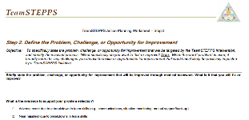
Slide 20: Applying TeamSTEPPS Exercise
Close Module 3 by answering these questions:
Is your teamwork issue related to communication?
If yes, what is the communication issue?
Which TeamSTEPPS tools and/or strategies might you consider implementing to address the issue?
Select here to download and print the TeamSTEPPS Implementation Worksheet and answer the question.
Notes:
When you teach, at the conclusion of Module Three, ask participants to write the answers to these questions in their implementation worksheet. Is your teamwork issue related to communication? If yes, what is that communication issue? Which TeamSTEPPS tools and/or strategies might you consider implementing to address this issue?
If you don't already have a copy of the worksheet, open the link provided to print out your own copy of the TeamSTEPPS implementation worksheet and take 10 minutes to answer these questions yourself. When you have completed this exercise, select the forward button to wrap up this module.

Slide 38
Module 3 Summary
In this module you learned to:
Describe how communication affects team processes and outcomes
Define effective communication
Identify communication challenges
Identify TeamSTEPPS tools and strategies that can improve a team’s communication
Notes:
In this module, you've learned to describe how communication affects team processes and outcomes, define effective communication, identify communication challenges, and identify TeamSTEPPS tools and strategies that can improve a team's communication.

Slide 39
Module 3 Conclusion
This concludes Module 3 of the TeamSTEPPS 2.0 Online Master Trainer Course
Go to Module 4
Module 3
Module 4
Notes:
This concludes Module 3 of the TeamSTEPPS 2.0 online Master Trainer course. To complete this module and receive accreditation, you must return to the TeamSTEPPS Learning Management System and complete the Module 3 post-test.

