Slide 1
Module 4: Leading Teams
Welcome to the
Online Master Trainer Course
Notes:
Welcome to the fourth module of TeamSTEPPS, called Leading Teams. I'm Dr. Brigetta Craft, and I will be guiding you through this module. Leading Teams is the cornerstone that holds the teamwork system together. Please select the forward arrow in the lower right corner to begin this module.

Slide 2
How This Online Course Works
This online course will walk you through the TeamSTEPPS content just as you will present it when you train your colleagues and staff
It teaches you all the concepts that comprise the TeamSTEPPS initiative
While also teaching you to teach TeamSTEPPS to your colleagues
Use the navigation buttons in the lower right to work through the online modules
Select here to move back to the previous slide
Select here to move to the next slide
Notes:
This online course will walk you through the TeamSTEPPS content just as you will present it when you train your colleagues and staff at your facility. It teaches you all the concepts that comprise the TeamSTEPPS initiative while also teaching you how to teach the TeamSTEPPS content to your colleagues and staff. Use the navigation buttons on the lower right to work through the online modules. Select the forward arrow to move to the next slide, and select the back arrow to go back to the previous slide.

Slide 3
The Materials You Will Use
When you deliver your training you will use these materials:
Instructor Manual
Course Management Guide
Instructor guides
Course slides
Measurement tools
Customizable materials
Videos
Select here to review materials on the TeamSTEPPS website
Notes:
When you deliver the TeamSTEPPS training at your facility, you will use a variety of materials and resources provided on the AHRQ TeamSTEPPS website. We will discuss them more, later in this module. Please select the link provided if you'd like to review any of the materials on the TeamSTEPPS website.

Slide 4
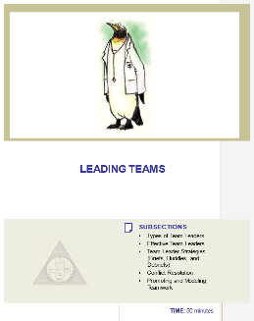
Please Print the Instructor Guide
To best use this online module, please print the Module 4 Instructor Guide, located here
Read pages 2-4 in the guide before we begin
Then we will proceed to work through the slides you will use to train – just as if you are delivering this module to your colleagues and staff
Notes:
To best use this online module, we recommend that you print the instructor guide for Module Four as a reference to use throughout the module. Before continuing to the next slide, we recommended that you do take a moment to read through pages two through four in the guide. Once you've done that, select the forward button, and we will proceed to work through the slides you will use to train, just as if you are delivering this module at your organization.

Slide 5
Leadership Exercise
You will begin Module 4 with a leadership exercise
Review page 5 in the Instructor Guide
Use the worksheet or a piece of paper to answer the following questions:
What characteristics, attitudes, or skills made the leaders that you have known effective and successful?
If there was room for improvement, what could they have done to be more effective?
Do you feel that leadership can be learned or taught, or is it an innate skill?
What one characteristic is most important to the success of effective leaders?
Select here to download the worksheet
Notes:
Let's begin Module Four with a leadership exercise. Please review page five in the instructor guide for more information on facilitating this exercise. For the purpose of this online course, either download the worksheet or write your answers to the questions on a piece of paper. Take about 10 minutes to consider and answer the following four questions.
What characteristics, attitudes, or skills made the leaders that you have known effective and successful? If there was room for improvement, what could they have done to be more effective? Do you feel that leadership can be learned or taught, or is it an innate skill? And finally, what one characteristic is most important to the success of effective leaders? When you finish, proceed to the next slide. If you have questions, you can ask them via email by selecting the question mark button.

Slide 6
Slide 2: Leadership Exercise
You will begin Module 4 with the leadership exercise
Participants form groups to answer the questions:
What characteristics, attitudes, or skills made the leaders that you have known effective and successful?
If there was room for improvement, what could they have done to be more effective?
Does your group feel that leadership can be learned or taught, or is it an innate skill?
What one characteristic is most important to the success of effective leaders?
See page 5 in the Instructor Guide
Notes:
When you deliver this training, you will begin Module 4 with this same leadership exercise. Have participants form groups, and have each group select a leader and a scribe. Let them know that they will have 10 minutes to discuss and answer the following four questions and that the scribe will document their responses. Then ask them the four questions.
What characteristics, attitudes, or skills made the leaders that you have known effective and successful? If there was room for improvement, what could they have done to be more effective? Does your group feel that leadership can be learned or taught, or is it an innate skill? And what one characteristic is most important to the success of effective leaders?
When 10 minutes is up, reconvene the group and facilitate a discussion by allowing groups to share their responses. If you have one, share your own personal example of an effective and successful leader you've worked with. Page 5 in the Instructor Guide provides details on facilitating this exercise. And again, if you have questions, you can ask them via email by selecting the question mark button.

Slide 7
Slide 3: Objectives
Once you complete the Leadership Exercise activity, you will introduce the objectives for this module to the participants
See page 6 in the Instructor Guide for details on how to facilitate this slide
Notes:
You will use slide three to introduce the content they will learn in this module. So after completing this module, you'll be able to describe how leadership affects team processes and outcomes; identify different types of team leaders; describe the activities involved in successfully leading teams; describe the tools for leading teams, including briefs, huddles, and debriefs; and apply the tools for leading teams to specific clinical scenarios.

Slide 8
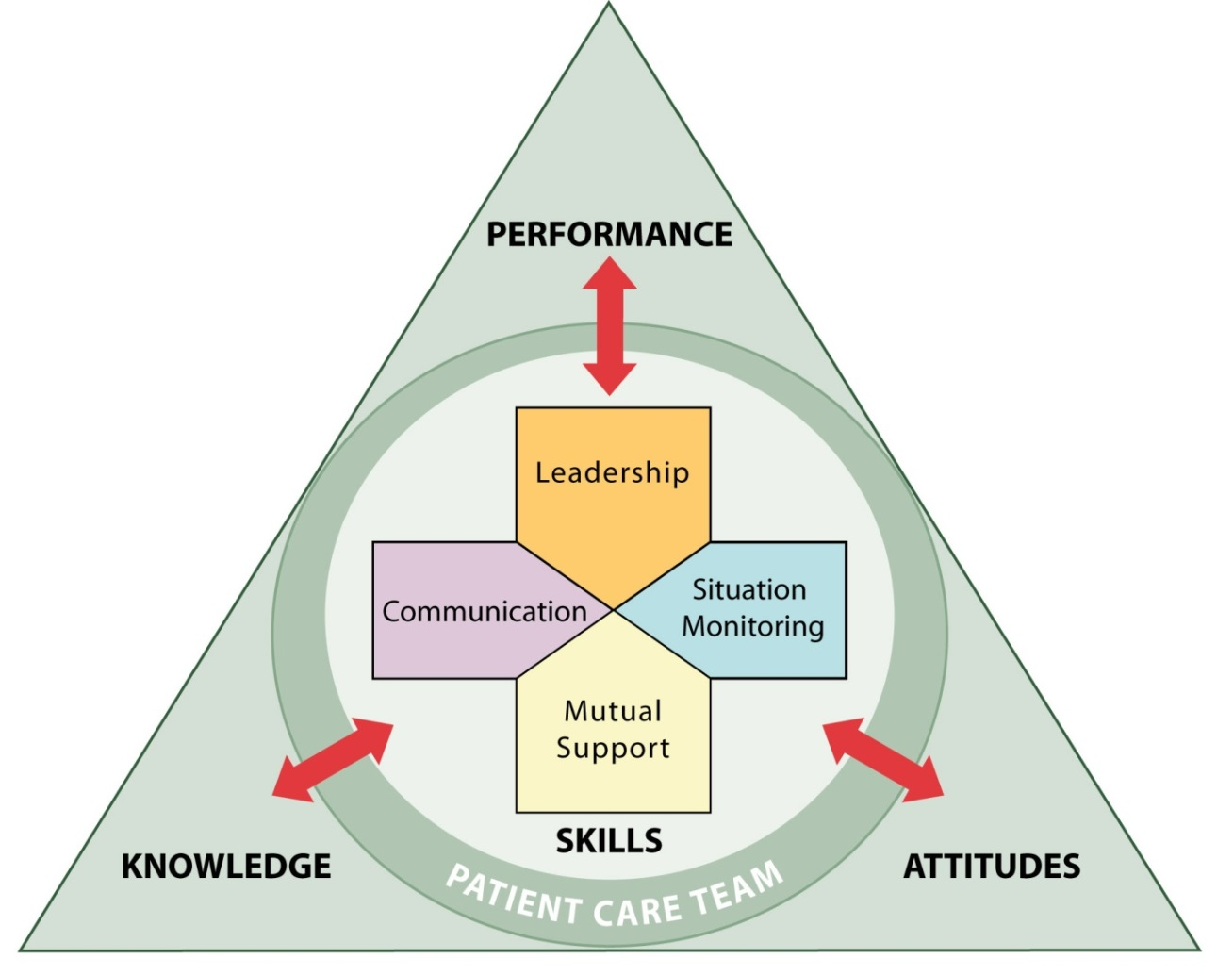
Slide 4: Leadership
Holds a teamwork system together
Ensures a plan is conveyed, reviewed, and updated
Facilitated through communication, continuous monitoring of the situation, and fostering of an environment of mutual support
Notes:
So far we've covered the following in the TeamSTEPPS framework, team structure, which facilitates teamwork by identifying the individuals among which information must be communicated. That a leader must be clearly designated and mutual support must occur. Communication, which facilitates teamwork by enabling team members to effectively relay relevant information in a manner that is known and understood by all team members.
In this module, we'll discuss leading teams. Leadership is the linchpin that holds a teamwork system together. Usually the physician is identified as the designated team leader. However, within teams, the formal leader may not always be the one truly leading the team to address the situation at hand. Therefore, we have titled this module Leading Teams because any team member may take on the leadership role depending on the situation and the current team membership.
When leading teams, a climate must be created that allows teamwork to flourish in support of patient safety and the delivery of high quality care. Leading teams involves establishing a plan of care. This includes identifying roles and responsibilities of team members, developing norms within the team for operating and communicating the plan to all team members, monitoring the plan of care as well as the surrounding situation to better anticipate patients' needs.
A key component of monitoring the plan of care is effectively managing the resources to meet those needs and adjusting the plan when necessary. When leading teams, it's also important to model appropriate behavior. And remember to reinforce and reward appropriate behavior when it's exhibited by team members.
To provide an example of how to present this information, proceed to the next slide to hear from our guest Master Trainer for this module, Dr. Kevin Krane, Professor of Medicine and Vice Dean for Academic Affairs at Tulane University School of Medicine. Dr. Krane?

Slide 9
Types of Team Leaders
Designated
The person assigned to lead and organize a team, establish clear goals, and facilitate open communication and teamwork among team members
Situational
Any team member who has the skills to manage the situation at hand
See page 8 in the Instructor Guide
Notes:
Hi. I'm Dr. Kevin Krane. I'm a nephrologist at Tulane University School of Medicine, and I spend a lot of my time working in teams that are particularly important for making sure that complex patients receive the best care. And so this is an area of particular interest to me, and I'd like to talk to you about the importance of teams and team leaders.
So let's start with a discussion of the types of team leaders. So first of all, team leaders are going to be people who are well-informed team members. They need to make decisions and take actions. And they also have to establish the goals of the team and help maintain the focus.
And there really are two types of team leaders that we need to consider. First of all, are those that are the designated team leaders. So these are people who, for a team to function successfully, they're the people who are already assigned and have the knowledge, the skills, and the attitudes that establish the goals. So, for example, when a patient with kidney disease is admitted to the hospital, I certainly might be the person who is designated as the team leader for the care of those patients on the traditional floors of the hospital.
On the other hand, there are leaders who are situational leaders. And these are people where the responsibility for the team changes and therefore somebody else will step up. And these are situational leaders who emerge for real specific times such as during anesthesia induction and spontaneous times like a first responder to a code.
And in my situation, if a patient that I'm providing care for as the designated leader is transferred to the intensive care unit, then the situational leader becomes the intensivist who is supervising the care in the intensive care unit, or when a patient goes to surgery and is under the care of a surgeon.
So in those settings, it's very important that the teams are functioning well together. And in high performance teams, any member of the team with the skills that best manage the situation assumes the role of the situational leader. So once the situation has been resolved or the designated leader is ready to resume control, the situational leader assumes the role of the team member.

Slide 10
Slide 5: Types of Team Leaders
Thinking of your work area:
Who are the designated team leaders for your unit?
Is the role of the designated team leader acknowledged and understood by team members?
Can you describe a case in which someone assumed the role of situational team leader?
Can the roles of the designated leader and situational leader be better defined on your unit?
When you teach this module, ask participants these same questions
Notes:
Let's talk about the types of team leaders, and I want you to think about your work area. So in your work area, who are the designated team leaders for your unit? And is the role of the designated team leader acknowledged and understood by the team members?
And if you think about situational team leaders, can you think about a case in which someone assumed the role of the situational team leader, but also think about can the roles of the designated and the situational leaders be better defined on your units. Because we all deal with people who are both designated and situational leaders at various times. So when you teach this module, you want to be sure to ask participants these same questions and facilitate a discussion as appropriate, getting people to focus on their own units. And usually that brings out the discussion very effectively.
For example, if someone answers that the roles of the designated or situational leader could be better defined in their unit, ask them how. And then let the class know that you'll be discussing the characteristics of effective team leaders later in this module. All of this provides a good opportunity for an open discussion about the roles of team leaders, both situational and designated.

Slide 11
Effective Team Leaders
Identifying a goal and defining a plan to achieve the goal
Assigning tasks and responsibilities
Sharing the plan
Monitoring the plan and progress toward the goal
Modifying the plan and communicating changes
Reviewing the team’s performance
When Leading Teams:
Manage and allocate resources effectively
Provide feedback to team members
Facilitate information sharing
Encourage team members to assist one another
Facilitate conflict resolution
Model effective teamwork
Notes:
What's important, regardless of the type of leader that we're dealing with, there are certain characteristics that effective team leaders have. And most of them will be obvious to you. So when you think of leading a team, you want somebody who can identify a goal and define a plan to achieve the goal, and assign the tasks and responsibilities that are expected of the team.
The plan has to be shared. It has to be monitored. And someone has to keep track of the progress towards the goal, which should be the team leader. And then as always happens, plans need to be modified and any changes that occur need to be communicated to all the team members while keeping track of the team's performance. So, again, think about your own setting, and in that setting is this what your team leader is doing?
Also, other important aspects are necessary in terms of skills for leading teams. So first of all, the team leader has to establish certain rules of engagement where everyone understands how the team will operate and perform their duties. So it's clear from the very beginning.
And then second of all, there are always resource issues in any setting. And the team leader has to be able to manage and allocate them to make sure that the team members function successfully.
While difficult, it's also important that the team leaders provide some feedback to the different team members regarding the responsibilities, and make sure that people know where they stand as you're progressing toward a team's goal. This is really best done by facilitating information, sharing among the team members by encouraging team members to assist one another when necessary.
And then, finally, one of the things that happens is there always is some conflict which occurs. It does not have to be significant conflict, but it's a natural part of the environments that we live in and working with teams. And good team leaders know how to resolve conflict and make sure that the team works most effectively.
And of course, a team leader always models effective teamwork so that people can see how best to do things. So the team members, when they become team leaders or if they become situational leaders, can effectively achieve the goals necessary for their teams as well

Slide 12
Defining the Plan
When developing a plan, team leaders should consider:
Time – How much time is available to complete all the necessary tasks and activities?
People – Do the available staff have the necessary knowledge and skills to perform their roles?
Equipment – Is the necessary equipment available and working?
Information – Has all of the necessary information been collected and reviewed?
Notes:
Leading a team requires that we define the plan. And think back how many times you've been in settings, such as health care situations or even a committee meeting, where the plan of action was not well defined, and how difficult that makes achieving a goal. So it's important to start with developing a plan. And when doing so, a number of things have to be considered as part of that.
So in the health care team, the leader-- regardless of whether it's designated or a situational person, really has to come up with a plan of care for the patient to achieve the best specific health care outcome. It can be simple outcomes that are focused very specifically, such as getting somebody off of a ventilator in an intensive care unit. Or it may be to get somebody through a complex surgical procedure. Or it may be as simple as making sure that a procedure is performed safely and effectively.
So all of these things factor into that. Now, on the other side, there are administrative areas. And so this may not directly impact patient care, but they're equally as important in the health care setting. And the leader in that setting must develop a plan for the day, establish priorities and goals, and also gather the appropriate information, which includes information from the staff that are there, from everybody who's involved, and make sure that everybody has the information shared across the entire team.
So team members have to be empowered to speak up. And they have to have a sense that if necessary, they can challenge comments to provide necessary information, because the goal is to get the team focused on a specific plan, and particularly in health care to assure that that's a safe patient outcome, regardless of who speaks up to assure that that occurs. So developing the plan involves thinking about the resources that are time related, the people, the equipment, and the information necessary. And the goal is really to come up with a encompassing plan that makes effective use of those resources, while making sure that you're using the highest standards, and particularly with respect to patient care and safety for the patient, which is our ultimate goal in health care.

Slide 13
Slide 7: Defining the Plan
Think about the area you work in:
How do your team leaders communicate a plan of care to the care team?
If not in direct patient care, how do your team leaders communicate the plan to the team?
Which strategies have been effective and which have not been effective?
How do your team leaders communicate changes to the plan to the team?
When you teach this module, ask participants these same questions
See page 10 in the Instructor Guide
Notes:
So think about the area that you work in. Think about your team leaders. And think about, do they really communicate a plan of care to the care team? If you're in direct patient care, think about the last time you were in a setting with several health care workers, usually across multiple professions, and did the team leader make sure that there was a plan, particularly for complex patients where multiple teams may be involved?
And if you're not working directly in patient care, how do you make sure that your team leaders communicate the plan to the team? All of which are important in achieving safe patient outcomes. And if so, which strategies have you used that have been effective in communicating information? And equally as important, what things have you seen done or have you done yourself that really are not very effective and you'd want to be sure that you and others avoid doing?
And what things have really been done by your team leaders in terms of communicating any changes that occur, which are inevitable, as you're moving through a plan for the team? So, again, the information is shared, there's a common vision, and everybody's working together regardless of the changing landscape, particularly in patient care. So when you move forward and you teach this module, try and get the participants to think about these questions and facilitate a discussion as you provide this for them.

Slide 14
Case Study
After attending TeamSTEPPS Master Training, a physician and nurse leader in a Level I Trauma Center decide that trauma resuscitations could be more effectively conducted.
Currently, when a trauma alert is called to indicate the pending arrival of a severely injured patient, more staff show up to the trauma bay than needed, necessary equipment is sometimes missing or not functioning properly, and the lead trauma physician often shows up just as EMS is bringing the patient into the trauma bay.
The newly trained Master Trainers observe that these practices have led to confusion and chaos that put patients at risk and result in valuable time being lost.
Notes:
So let's look at a specific example. And I'll provide the following case study that you have in front of you. So after attending a TeamSTEPPS Master Training, a physician, nurse, leader in a level one trauma center decide that trauma resuscitations could be more effectively conducted at their institution.
So currently, when a trauma alert is called to indicate the pending arrival of a severely injured patient, more staff show up to the trauma bay than needed, necessary equipment is sometimes missing or not functioning properly, and the lead trauma physician often shows up just as EMS is bringing the patient into the trauma bay. The newly trained Master Trainers observed that these practices have led to confusion and chaos that put patients at risk and result in valuable time being lost.
Does this sound familiar? With regards to this scenario, what changes would you recommend to improve performance in the trauma bay? Consider your answers to those questions, and then select the Forward arrow to continue.

Slide 15
Slide 8: Case Study Discussion
When you are teaching, have participants read the case study, then facilitate a discussion by asking them this same question:
What changes would you recommend to improve performance in the trauma bay?
If you have suggestions that weren’t mentioned by the group, be sure to share them with the participants
See page 11 in the Instructor Guide
Notes:
So as I think about this case, there are several opportunities for improvement in this setting. One of which might be that when a call comes in and there is a pending trauma that will be coming to the trauma bay, that there could be a brief of the appropriate individuals brought forward by the team leader to discuss the exact roles of every one when that particular patient arrived. Another example might be to assign somebody the role of just crowd control in those settings as we know that that can be a significant problem.
So when you're teaching, have the participants read the case study. Then facilitate a discussion by asking them the same question-- what changes would you recommend to improve performance in the trauma bay from the example provided? And if you have suggestions that weren't mentioned by the group, be sure to share them with participants.
You can also take this opportunity to think of examples from your own experience that might also apply. A simple one that many people are familiar with is that of the code blue team with similar experiences of too many people arriving, roles being unclear, and that also provides another opportunity for a case discussion as well.

Slide 16
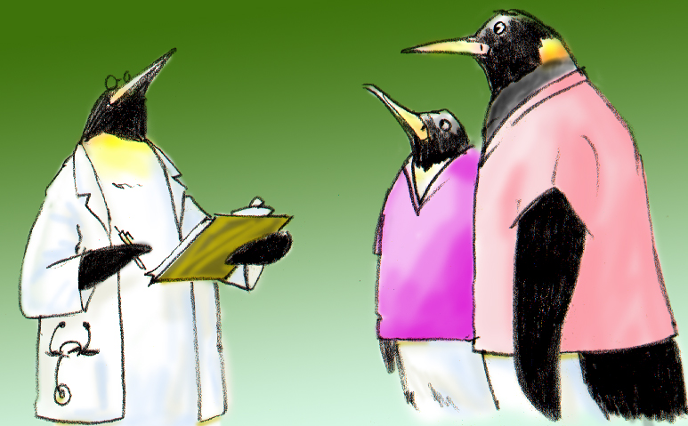
Assigning Tasks and Responsibilities (Slide 9)
When leading the team, you should:
Determine the tasks and roles to be assigned
Determine which roles must be filled and allocate tasks appropriately
Communicate clear expectations of what team members need to do
Request feedback
Notes:
So when leading a team, how do we assign tasks and responsibilities? Well that's really the role of the team leader. So first of all, you want to know what are the tasks and roles that need to be assigned. So that seems obvious, but it's important in understanding the overall situation to provide that to people.
And then assigning the tasks and roles based on some important issues, such as priorities, the work requirements, the resources available. And then you really have to determine which roles would be filled and allocate those tasks appropriately. And that relies upon understanding the knowledge, the experience, the skill, the availability, and really the abilities of those who are part of the team itself.
And then doing that, you have to be sure that you communicate the expectations of everyone very clearly so that the team members know what is expected of them given those tasks and given their responsibilities. And the plan has to be clearly communicated to everyone.
So thinking of a patient going to the operating room and the many different team members that are involved and the different roles that they play in making sure that they're clear to everyone and not assuming that people know their responsibilities. And then once that's communicated, it's important that you request feedback about the plan and about any progress towards the plan's goals, particularly should things change.
So, for example, the setting that I certainly participate in the most is in the dialysis unit. And if something changes during the dialysis procedure, whether it's a technician or whether it's a nurse, they feel very comfortable in pointing out problems or concerns as we proceed through a treatment. And adjustments are made accordingly to take care of the patient.
This is all provided and spelled out when the patient starts their treatment so everybody is well familiar with their own roles and responsibilities. But, again, the goal in that type of setting or most patient care settings is to make sure that the outcomes are achieved safely and that the patient has the best possible outcomes through the use of team efforts.

Slide 17
Slide 9: Assigning Tasks & Responsibilities
When you teach, ask participants the following two questions:
How do team leaders assign tasks in your units, once a plan has been established?
What approaches to assigning tasks and responsibilities are effective and what has not been effective?
See page 12 in the Instructor Guide
Notes:
So when you teach slide nine, you should ask the participants the following two questions and try and really focus on the discussion. And most of the time, people will draw from their previous experiences, and usually it's a good opportunity to have people think about how they've done things before and what they've seen done by others, both positive and negative.
And the two questions are:
How do team leaders assign tasks in their units once a plan has been established?
And, what approaches to assigning these tasks and responsibilities really do work and what really doesn't work?
So again, a discussion of these topics will get people to think about how they can better perform in their areas and also give them enough think about how they will teach these and model these behaviors for others as well.

Slide 18
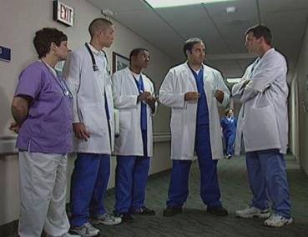
Sharing the Plan: Briefs (Slide 10)
A team briefing is an effective strategy for sharing the plan
During briefs, discuss:
Team membership and roles
Clinical status of the team’s patients
Plan of care for patients
Issues affecting team operations
Defining clear goals and plan
Notes:
So let's talk about some very specific techniques that can be used, some of which you may be familiar with, but this is an opportunity to be very explicit about using TeamSTEPPS tools in improving patient safety. So let's start with talking about briefs. Now briefs are a strategy for sharing the plan when leading a team, and is done in advance of an event. So during a brief, it provides dedicated time for the team members to define the roles for the team to form, and to make it clear to the team who is the designated team leader.
It also gives an opportunity to review the clinical status of any patients. For example, current status, the diagnosis, and status of each patient assigned to the team. And what is the plan of care for the patients for the day? And if someone is not working in direct patient care, what can they do as part of the health care team to contribute to the direct patient care outcomes as well?
This also is a particularly good time to discuss issues that might affect how the team works. So are there resource issues that might be restricted during a particular period of time or during patient care? Any particular concerns? And it also provides an opportunity to very specifically define the goals and a plan to achieve those goals as part of the brief and as part of that discussion, making sure that everyone has a clear role and everyone has the same expectation for the successful outcome for the patient.
And successful teams will measure their effectiveness based on how well they performed against that specific established plan that you have. Most of the time the briefs will be introduced and conducted by the designated team leader, but certainly all team members should actively present and participate in the brief.
So this is an opportunity before an event for the entire team to get together under the leadership of either designated or sometimes situational leader to discuss all of the aspects of what will be coming forward so everybody is clear in their expectations, their roles. And so there is a common vision and a common plan, and the best opportunity to achieve the safest outcome for the patient care.

Slide 19
Slide 10: Briefs Video
As you view the video, consider these questions:
Who is the designated team leader?
Did the team develop a comprehensive plan for Mrs. Keys?
Did the team address contingencies and was the patient included in those discussions?
Select the image to launch a web browser where you can watch the video
Notes:
When you teach, you'll use slide ten to view and discuss a video example of a briefing. As you view the video, think about how you would answer the following questions. Who's the designated team leader? Did the team develop a comprehensive plan for Mrs. Keys? And did the team address contingencies? And was the patient involved in those discussions?
The video is available on the web for viewing. Selecting the slide image will open a new browser window so you can view the video. After viewing, please return to this browser window to continue the module.

Slide 20
Slide 10: Briefs Video Discussion
Did you identify Dr. Upton as the designated team leader?
Do you agree that a comprehensive plan was developed for Mrs. Keys?
Were you able to identify the contingencies the team addressed and how the patient was included in those discussions?
When you teach this module, facilitate the discussion using these same questions.
See page 13 in the Instructor Guide
Notes:
Did you identify Dr. Upton as the designated team leader? He set the tone by coordinating the brief and establishing a plan of care for Mrs. Keys.
Do you agree that a comprehensive plan was developed for Mrs. Keys? Dr. Upton sought input from all team members before communicating the care plan. Team members were well aware of their roles and responsibilities and were eager to share information and questions were encouraged.
Were you able to identify the contingencies the team addressed and how the patient was included in those discussions? The team understood what specific factors could lead to a C-section, and Dr. Upton made plans to communicate that information to Mrs. Keys.
When you teach this module, after playing the video, facilitate the discussion using these same questions. If not covered by the participants, be sure to add the correct responses just as I have done.
Refer to page 13 in the Instructor Guide for detailed explanation of facilitating discussion of this video.

Slide 21
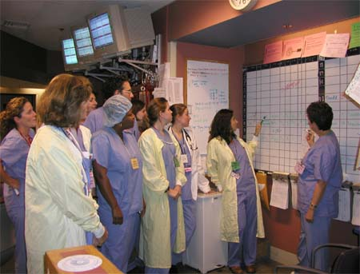
Briefing Checklist Tool (Slide 11)
The team leader should cover the items on this (or a similar) checklist:
TOPIC
Who is on the team?
All members understand and agree upon goals?
Roles and responsibilities understood?
Plan of care?
Staff availability?
Workload?
Available resources?
Notes:
There are several ways to do the briefing, and there are briefing checklist tools that can be used. So similar to thinking about how important it is to make sure that when we are flying that we want everybody involved in the flight to make sure that the plane both leaves and arrives safely that we will be flying on, there's a checklist. And the team leader is responsible to make sure that items on the checklist are covered based on the roles of the members of the team. So conducting a brief at the beginning of the day or shift or prior to a specific procedure or a case is the perfect time to make sure that the goals for the patient are clearly communicated to all members of the team and best provides the opportunity to ensure patient safety.
So, for example, if a patient has to undergo a specific procedure, for example, in my area in nephrology, a procedure such as a kidney biopsy, the briefing checklist is very important in terms of making sure that the patient has been well informed of the procedure, that the appropriate consents have been signed, that the appropriate bleeding tests have been reviewed, the patient's blood pressure is appropriate, and that all the necessary things for the procedure are performed before anyone even brings the patient into a procedure area or begins to prep a patient for that. And I'm sure there are many examples you can think of in your own areas that are very, very similar regardless of what the procedure or what the event will be. So if you think about checklists, one of the most important checklists that have been developed is the surgical safety checklist, which has been developed by the World Health Organization, WHO, which is used to promote safety in surgical procedures. And this list itself has three phases of an operation which correspond to the different periods in the procedure.
First of all, before the induction of anesthesia there's a sign in. Second of all, before the incision of the skin, which is the time out. And third, before the patient leaves the operating room, a sign out. And during each phase, a checklist coordinator has to confirm that the surgical team completed the list of tasks before it proceeds with the next phase. And while the surgical checklist seems that it adds something to the procedure, what it really adds is safety. And this is a checklist that has been studied extensively and is evidence based and is particularly effective in almost all procedures.
So those of you who are spending a lot of time in the operating room are much more familiar with it, but this is the same type of procedure and checklist similar to what we're doing in all procedures and all events. So when you teach this module to others, you should ask questions that are based on whatever examples you share and ask people to share examples, such as:
Have they participated in briefs? Did the items on the checklist occur? And if not, what was done? And if they were designing a brief checklist for a unit, what items would they include? When would you do a briefing, and who would you expect to attend?
So this again is another opportunity to assure that anything we do in health care is performed as safely as possible.

Slide 22
Slide 12: Briefing Exercise
This exercise is to develop a checklist to facilitate briefings
Have your learners discuss:
Identify when, why, and where briefings might be conducted. Note who should lead the brief and who should participate
Develop a checklist for guiding the brief
What outcomes would you expect to see as a result of implementing briefs?
See page 15 in the Instructor Guide
Notes:
As a TeamSTEPPS Master Trainer, you may choose to implement briefings as a strategy to improve coordination of care in your unit or work environment. You may also choose to develop a checklist as a tool to guide these briefs. The purpose of this exercise is to develop a checklist to facilitate briefings in your unit, work area, or organization.
When you teach this module, have participants form small groups with others from their unit or work area. Give participants approximately 10 minutes to discuss and answer the following within their team. Identify when, why, and where briefings might be conducted. Note who should lead the brief and who should participate. Develop a checklist for guiding the brief. What outcomes would you expect to see as a result of implementing briefs?
After 10 minutes, reconvene the group and ask the small groups to report on what they developed and their expected outcomes. For the purpose of this course, take five minutes now to consider your responses and write them down. These can be used to share with the class when you present. Refer to page 15 in the instructor guide for details on facilitating this exercise. If you have questions, you can ask them via email by selecting the Question Mark button.

Slide 23
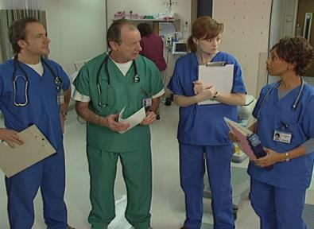
Monitoring & Modifying the Plan: Huddle
Huddle to make adjustments to the plan
Ad hoc, “touch base” meetings to regain situation awareness
Huddles allow you to:
Discuss critical issues and emerging events
Anticipate outcomes and likely contingencies
Assign resources
Express concerns
Notes:
Now a second technique that is often used is called the huddle, which is a tool that communicates adjustments to a plan that you already have in place. It's really sort of an ad hoc type of approach. And so when something changes or there's an event, it's getting the team together for a brief discussion to make adjustments based on the members of the team's input. So the team leader, who often will be the one to call the huddle, wants to get the team together to discuss specific issues such as any critical issues that are actively emerging to anticipate any outcomes and likely contingencies.
And at that time, the resources can be assigned and everyone on the team has an opportunity to express concerns. This may be the case, for example, if a designated team leader is managing many patients and is relying on other teams to provide information, this provides a good opportunity for that discussion and transmission of information. These type of important updates for information can be provided using huddles.
So, for example, think about the times that there are teams of physicians who are making rounds and an acute event occurs on a specific patient. Rather than immediately watching everyone rush off to provide care, this provides an opportunity using a huddle to have a very brief discussion which can be often as short as 60 seconds to two minutes to very quickly identify what the concerns are, how to assign the resources, how to anticipate the problems, and make critical decisions that will assure the most effective care during an acute setting.

Slide 24
Slide 13: Huddle Video
As you view the video, consider these questions:
What event necessitated the need for the huddle?
What key information was shared in the huddle?
Select the image to launch a web browser where you can watch the video
Notes:
When you teach, you will use slide 13 to view and discuss a video example of a huddle. As you view the video, think about how you would answer the following questions. What event necessitated the need for the huddle? And what key information was shared in the huddle?
The video is available on the web for viewing. Selecting the slide image will open a new browser window so you can view the video. After viewing, please return to this browser window to continue the module.

Slide 25
Slide 13: Huddle Video Discussion
What event necessitated the need for the huddle?
The patient’s ECG indicated a possible acute MI requiring additional team action, planning and coordination
What key information was shared in the huddle?
Most recent patient history and current status
Distribution of tasks and workload
Emergent plan of care
See page 16 in the Instructor Guide
Notes:
What event necessitated the need for the huddle?
As you observe, the patient’s ECG indicated a possible acute MI requiring additional team action, planning, and coordination, due to the emergent nature of the patient’s condition.
What key information was shared in the huddle?
Your response should include the most recent patient history and current status, the distribution of tasks and workload, and the emergent plan of care.
When you instruct this module, ask these same two questions to the group after they have viewed the video.
Refer to page 16 in the Instructor Guide for additional detail on facilitating these discussion questions.

Slide 26
Reviewing the Team’s Performance: Debrief
Process Improvement
Brief, informal information exchange and feedback sessions
Occur after an event or shift
Designed to improve teamwork skills
Designed to improve outcomes
An accurate recounting of key events
Analysis of why the event occurred
Discussion of lessons learned and reinforcement of successes
Revised plan to incorporate lessons learned
Notes:
So having discussed both briefs and huddles, another important team activity is the debrief. And this is a tool that is often underutilized. And it's particularly important because research has shown that using a debrief, teams can most effectively look through and criticize their own performance and activity in a positive way to assure that in future events, they can provide the best care.
So it may be difficult to find times to actually sit down and do a debrief, and people think that it takes a lot of time. It's important, and the TeamSTEPPS program particularly advocates the use of an after-action review using a debrief that, as new Master Trainers in particular, you should try and include opportunities to debrief for critical team events. And what's important to think about is that this is not a debrief, necessarily, because things went poorly, but to take advantage of the opportunity to look at when things went well.
Too often, there's a difficult patient outcome and people come together to discuss what they could have done to prevent the problem. But equally as important, when outcomes are good, when things go particularly well, it's important for team members to get together and discuss those issues that made the performance go particularly well. So these really are an excellent learning opportunity for the team members. And they do promote the implementation of TeamSTEPPS as well.
When doing a debrief, what you really want to be able to do is accurately go through the events that occurred and document them, analyze why an event occurred if that was a problem-- regardless, you want to know what worked and what didn't work. And you want to discuss those things that you learned from the event that will actually make the plan better the next time around. And you want to reinforce those. So particularly for members of the team that perform particularly well, it gives a good opportunity to reinforce the behaviors that they performed and let them know that what they did significantly and positively contributed to patient care.
Then, you want to find some way that you can actually formally change that existing plan that you used to have to incorporate the new lessons so the next time things also go well. Now, when you do debriefs, it's important to keep several things in mind. They're most effective when you conduct them in an environment and in a setting where people can fairly and honestly talk about mistakes that might have been done, and see this as a learning opportunity.
The debrief needs to be kept short. If they're consistently concise and short, maybe three minutes or less, then they're not seen as a burden, but seen as an asset to patient care. And they need to be facilitated by the team leader. And they really need to relate to the specific team goals or address particular issues that have to do with recent team actions. And they should always focus on performance improvement and not on specific behaviors of individuals within the team. So you want to go out of your way to avoid assigning blame or failure to specific individuals, or if things didn't go well, for individuals to feel that they were at fault.
So for example, one opportunity might be a very difficult patient in an intensive care unit who is intubated for pneumonia, some other problem, and is subsequently extubated within a very, or relatively, short period of time-- shorter than most people would have expected. That would be a great opportunity to sit down and talk about the patient, and say, what was it that facilitated extubating this difficult patient so much more rapidly. Was it the equipment that was available? Was it support provided by the respiratory therapist? Was it certain medications that were used-- postures, other behaviors? But again, a short debriefing following both events that go well, as well as those that don't go well, provide an excellent opportunity to improve patient care for continuous improvement.

Slide 27
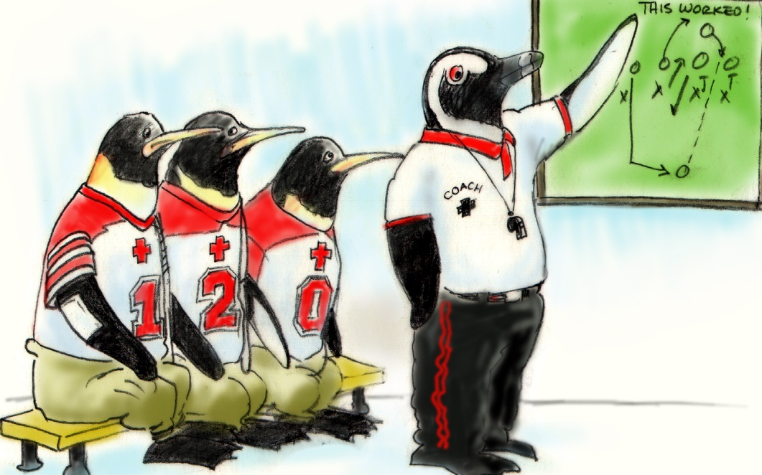
Debrief Checklist
Facilitate the discussion by asking questions related to team performance
Recap the situation, background, and key events that occurred
TOPIC
Communication clear?
Roles and responsibilities understood?
Situation awareness maintained?
Workload distribution?
Did we ask for or offer assistance?
Were errors made or avoided?
What went well, what should change, what can improve?
See page 18 in the TeamSTEPPS Pocket Guide
Notes:
Now if we turn our attention to debriefing in a little more detail, you can also think about debriefing as even having its own checklist as well. So those are shown in the slide. And there's some specific things that one can always ask when doing a debriefing The simple questions are, what do we do well? And what did we perform not so well that we really could improve upon?
And when doing that, using the debrief checklist, you can recap the situation and the events. You can think about which specific information needs to be discussed. And then really, as the team leader, you want to be the one who is summarizing the lessons that are learned and set the goals for improvement.
And the debrief checklist can be found in the TeamSTEPPS pocket guide which is an easy way to remember a lot of this information. But again, focusing on understanding the importance of doing a debrief, keeping it short, and that you can use a structured approach, again, as a way to improve patient care.

Slide 28
Slide 16: Debrief Video
As you view the video, consider these questions:
What were some of the positive effects from this debrief?
How would you describe the tone set by Dr. Upton for the debrief?
Select the image to launch a web browser where you can watch the video
Notes:
The following video provides an excellent opportunity to watch a debriefing in action. Watch how Dr. Upton leads the Labor and Delivery team debrief immediately following a procedure. This is a real-time debriefing and shows how efficiently, effectively, and in a very short time period, he's able to achieve the necessary elements of a debriefing.
After viewing this video, take a few minutes and consider the following two questions. What were some of the positive effects from this debriefing? And secondly, how would you describe the tone set by Dr. Upton for the debrief?
This video is available on the web for viewing. Select the slide image and open a new browser window so you can view the video. And after you view it, please return to this browser window to continue this module.

Slide 29
Slide 16: Debrief Video Discussion
Did you observe these from Dr. Upton’s debrief?
Team members shared best practices that improved performance
All team members were encouraged to participate
It reinforced that teamwork skills produce good outcomes
Self-learn and provide a teaching opportunity
Regarding the tone Dr. Upton set for the debrief:
Set a positive tone for open communication
Encouraged feedback
Facilitated lessons learned
Reinforced team behaviors and successes with the team
See page 19 in the Instructor Guide
Notes:
Did you observe the following positive effects from Dr. Upton's debrief? That team members shared best practices that improved individual and overall team performance. All team members were encouraged to participate. The debrief reinforced that teamwork skills produce good outcomes. And staff were able to self learn and provide juniors with a teaching opportunity.
Now thinking about the tone Dr. Upton set, did you identify the following? That he set a positive tone for open communication. Feedback was encouraged. He facilitated lessons learned. And he reinforced team behaviors and successes with the team.
When you're teaching this module, after viewing the video, facilitate discussion by asking participants these same questions I just asked you. If any of these observations are missed, be sure to add them to the discussion. You can refer to page 19 in the instructor guide for more details on facilitating discussion of this video.

Slide 30
Facilitating Conflict Resolution
Effective Leaders:
Facilitate conflict resolution to avoid compromising patient safety and quality of care
Do not allow interpersonal or irrelevant issues to negatively affect the team
Help team members master conflict resolution techniques
Select this button to request DoD’s Professional Conduct Toolkit
Notes:
As I mentioned earlier, one of the important things that team leaders must be able to do is facilitate conflict resolution and recognize that conflict is a common problem in teams, though it should never be a severe conflict or conflict that interferes with the care of the patient. So let's talk about some of the tools that effective leaders can do to address conflict which often comes up because people have different work approaches or values or opinions. But it also may differ based on the clinical knowledge of the people involved and even their personalities.
If you've worked in teams before you realize that when conflict occurs it can interfere with the ability for us to deliver safe and quality care. And that if somebody can step in and effectively resolve the conflict, it can assure that the patient gets good care, but it also provides learning opportunities as well. So think of it that way as well.
And you don't want a conflict to negatively impact the ability of the team members to work together effectively. So there are several techniques that are part of the TeamSTEPPS program that are effective in helping us learn how to address conflict. So, for example, many times I've had the experience of having multiple physicians involved in the care of a patient with different opinions on how to approach the problem. And one might ask, how can one resolve different physicians with different opinions?
And one effective way that I've had is for us to try and do it from an evidence based approach where there's a discussion of what's in the literature, what's available as evidence, and what provides the best evidence given the situation for that patient for the best outcomes? And this provides, again, an opportunity for learning and for discussion about what's most effective, having a contingency plan along with the primary plan, and this provides a good opportunity to move forward.
The other problem that we sometimes deal with are other disruptive behaviors which should never be tolerated. And certainly, one needs to be sure that even small gestures such as rolling eyes or assuming body language that is a negative approach to a team member's comments needs to be addressed as well to assure that everybody on the team works together effectively.
And these are things that good team leaders, difficult as they may be, also address in making sure by reminding everyone that the primary goal in health care is to assure that the patient has the best and the safest outcome. If there are behaviors that are not appropriate, there are a variety of different conduct codes that have been developed including one from the Department of Defense. And almost all hospitals have their own codes of conduct that are appropriate and if necessary can be utilized. One example, as mentioned, the one from the Department of Defense is provided on the link if you would like to download it as well.

Slide 31
Promoting & Modeling Teamwork
Effective leaders cultivate desired team behaviors and skills through:
Open sharing of information
Role modeling and effective cuing of team members
Constructive and timely feedback
Facilitation of briefs, huddles, debriefs, and conflict resolution
Mitigation of conflict within the team
Notes:
Effective designated team leaders must promote and model teamwork. And that way, they reinforce the effective team behaviors that they're trying to achieve. There are several ways in which they do so, and this includes the items that are shown on the slide-- the open sharing of information, role model and the effective cueing of team members, providing constructive and timely feedback, and demonstrating how to facilitate briefs, huddles, debriefs, and conflict resolution. And finally, mitigating conflict that may arise within the team. All of this helps team members understand the performance expectations, and it cultivates a desired team behavior that occurs within the team.

Slide 32
Slide 19: Team Formation Video
This video example demonstrates:
Briefs
Huddles
Briefing checklists
Conflict resolution
Debriefs
As you watch, consider the tools and strategies used
Select the image to launch a web browser where you can watch the video
Notes:
So we've discussed a variety of important team behaviors that reinforce and provide positive teamwork outcomes. And they're demonstrated in the video of 27-year-old Mrs. Keys, who's under the care of a team that uses effective and very timely leadership strategies. And these are the ones that we've just discussed-- using briefs, huddles, briefing checklists, conflict resolution, and debriefs.
So watch this video. And then, after you do that, think about, what are the leadership tools and strategies that are used by Dr. Dean, the nurse, and Dr. Upton. This video is available on the web for viewing. And you can select the slide image to open a new browser window so you can view the video. And after viewing it, you can come back to this browser window to continue this module.

Slide 33
Slide 19: Video Discussion
Reflecting on what you saw in the video:
Were you able to identify the following leadership tools and strategies used by Dr. Dean?
Did you observe the nurse, Dana, demonstrating leadership?
Did you notice the use of the following leadership tools and strategies used by Dr. Upton?
See page 22 in the Instructor Guide
Notes:
Reflecting on what you saw in the video, consider these questions and answers:
Were you able to identify the following leadership tools and strategies used by Dr. Dean? He conducted a huddle with the team before RN shift change, briefed the team about concerns and the current status of Mrs. Keys, established himself as the current situational team leader, and he verbalized the current plan of care.
Did you observe the nurse demonstrating leadership? She demonstrated leadership when she conducted a huddle at shift change to discuss high threats even with competing tasks and distractions, prompted use of the time out checklist, and when she offered valuable feedback during the debrief.
Did you notice the use of the following leadership tools and strategies by Dr. Upton? He conducted a huddle for the emergent need to perform a C-section, used a pre-procedure briefing checklist, included the patient in the time out, held the debrief to recap the event and share lessons learned, and he empowered team members to speak freely and share team workload.
When you are teaching this module, after viewing the video, facilitate discussion by asking participants the same questions I just asked you. If key observations of leadership tools and strategies are missed, be sure to include them in the discussion.
Refer to page 22 in the Instructor Guide for more details on facilitating discussion of this video.

Slide 34
Tools & Strategies Summary
BARRIERS
Inconsistency in Team Membership
Lack of Time
Lack of Information Sharing
Hierarchy
Defensiveness
Conventional Thinking
Complacency
Varying Communication Styles
Conflict
Lack of Coordination and Follow-up With Coworkers
Distractions
Fatigue
Workload
Misinterpretation of Cues
Lack of Role Clarity
TOOLS and STRATEGIES
Communication
SBAR
Call-Out
Check-Back
Handoff
Leading Teams
Brief
Huddle
Debrief
OUTCOMES
Shared Mental Model
Adaptability
Team Orientation
Mutual Trust
Team Performance
Patient Safety!!
34
Notes:
Team leaders must ensure that information is being shared, and that all team members have the resources they need to do their job. Team leaders must also ensure that the situation within the work environment is continually monitored, and that appropriate behaviors are modeled and reinforced across the team. Tools for leaders to use with their team include the brief, huddle, and the debrief. Use of these tools leads to gaining a shared mental model or understanding of a situation or event, adaptability, and mutual trust.

Slide 35
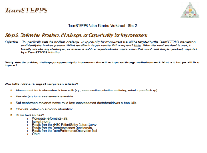
Slide 21: Applying TeamSTEPPS Exercise
Take ten minutes to answer these questions:
Who is the designated leader on the team your TeamSTEPPS implementation will target?
Is your teamwork issue related to this team’s leadership?
If so, what is the issue and can any of the tools or strategies learned in this module be used to address the issue?
Select here to download and print the TeamSTEPPS Implementation Worksheet and answer the questions.
Notes:
Please note: this slide is intended for the Master Training course only. The previous slide will be the last one shown when teaching staff at your facility using the Train the Staff curriculum.
Using your TeamSTEPPS Implementation Worksheet, take 10 minutes now to answer the questions related to leading teams as you think about your identified teamwork issue.
Who is the designated leader on the team your TeamSTEPPS implementation will target?
Is your teamwork issue related to this team’s leadership?
If so, what is the issue and can any of the tools or strategies learned in this module be used to address the issue?
When you are teaching the Master Trainer course, have participants discuss with the team and document the answers on the worksheet. Ask a few individuals to share any identified leadership issue and which TeamSTEPPS tools or strategies they might consider implementing to address the issue.
If you have questions, remember to select the question button to ask via email. When you have completed this exercise, select the forward button to wrap up this module.

Slide 36
Module 4 Summary
In this module you learned to:
Describe how leadership affects team processes and outcomes
Identify different types of team leaders
Describe the activities involved in successfully leading teams
Describe the tools for leading teams, including briefs, huddles, and debriefs
Apply the tools for leading teams to specific clinical scenarios
Notes:
In this module, you learned to describe how leadership affects team processes and outcomes; identify different types of team leaders; describe the activities involved in successfully leading teams; describe the tools for leading teams, including briefs, huddles, and debriefs; and apply the tools for leading teams to specific clinical scenarios.

Slide 37
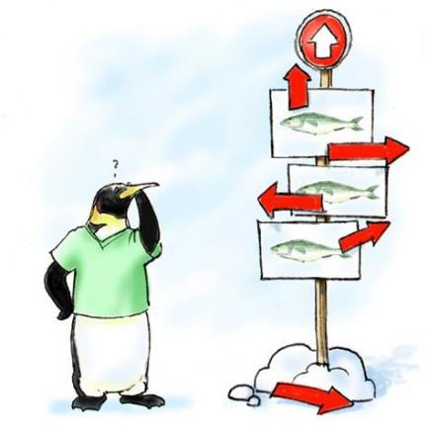
Module 4 Conclusion
This concludes Module 4 of the TeamSTEPPS 2.0 Online Master Trainer Course.
Go to Module 5
Module 4
Module 5
Notes:
This concludes Module Four of the TeamSTEPPS 2.0 Online Master Trainer Course. To complete this module and receive accreditation, you must return to the TeamSTEPPS Learning Management System and complete the Module Four post-test.

