Slide 1
Module 5: Situation Monitoring
Welcome to the
Online Master Trainer Course
Notes:
Welcome to module five of the TeamSTEPPS 2.0 online master trainer course, Situation Monitoring. This is Dr. Brigetta Craft, and I will be guiding you through this module. Situation monitoring is an integral piece of the TeamSTEPPS framework and directly links to the other three essential elements of teamwork-- communication, leadership, and mutual support. Please select the forward arrow in the lower right corner to begin this module.

Slide 2
How This Online Course Works
This online course will walk you through the TeamSTEPPS content just as you will present it when you train your colleagues and staff
It teaches you all the concepts that comprise the TeamSTEPPS initiative
While also teaching you to teach TeamSTEPPS to your colleagues
Use the navigation buttons in the lower right to work through the online modules
Select here to move back to the previous slide
Select here to move to the next slide
Notes:
This online course will walk you through the TeamSTEPPS content just as you will present it when you train your colleagues and staff at your facility. It teaches you all the concepts that comprise the TeamSTEPPS initiative while also teaching you how to teach the TeamSTEPPS content to your colleagues. Use the navigation buttons on the lower right to work through the online modules. Select the forward arrow to move to the next slide. And select the back arrow to go back to the previous slide.

Slide 3
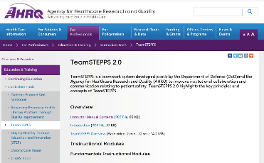
The Materials You Will Use
When you deliver your training you will use these materials:
Instructor Manual
Course Management Guide
Instructor guides
Course slides
Measurement tools
Customizable materials
Videos
Select here to review materials on the TeamSTEPPS website
Notes:
When you deliver the TeamSTEPPS training at your facility, you will use a variety of materials and resources provided on the AHRQ TeamSTEPPS website. We will discuss them more later in this module. Please select the link provided if you would like to review these materials on the TeamSTEPPS website.

Slide 4
Please Print the Instructor Guide
To best use this online module, please print the Module 5 Instructor Guide, located here
Read pages 3-4 in the guide before we begin
Then we will proceed to work through the slides you will use to train – just as if you are delivering this module at your facility
Notes:
To best use this online module, we recommended that you print the instructor guide for module five as a reference to use throughout the module. Before continuing to the next slide, we recommend you take a moment to read through pages 3 and 4 in the guide. Once you've done that, select the forward button and we'll proceed to work through the slide you will use to train just as if you are delivering this module at your facility.

Slide 5
Slide 2: Teamwork Exercise #2
Remember the paper chain teamwork exercise from Module 1?
When you are teaching slide 2, you will ask the learners to get back into their teams, and this time identify a team leader
Please proceed to the next slide to watch a video to observe how this activity works in the classroom
Notes:
Remember the paper chain exercise from module one? When you are teaching, this is the point where you would ask learners to get back into their teams and, this time, identify a team leader. Please proceed to the next slide to watch a video to observe how this activity works in the classroom.

Slide 6
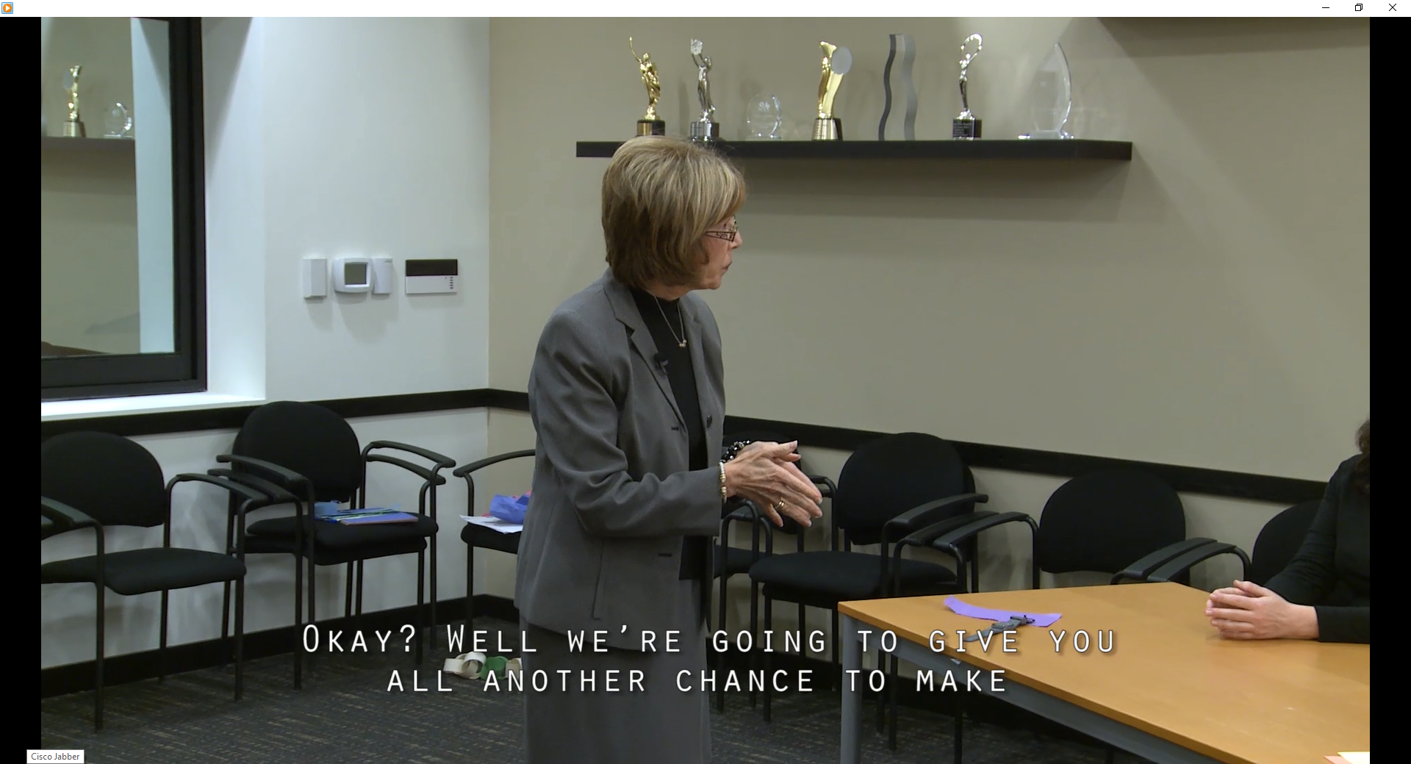
Watch an Example of Teamwork Exercise #2
Select the image to launch a web browser where you can watch the video
Notes:
Brigetta: Okay so now if you remember back in the first module we did the paper chain. Okay? Well we’re going to give you all another chance to make the longest looped paper chain, but with a twist.
So I’d like each group to please assign a leader.
[Group chatter]
Brigetta: Okay? Kelly? Will the two of you come out in the hall with me for a moment please?
[Group chatter]
Brigetta: Oh not at all.
Brigetta: Okay so your esteemed leadership has the rules. The goal is the same: the longest looped paper chain. So I’m going to give you 30 seconds to meet with your leaders. Okay? And you can discuss. But after that, there is no talking.
Alright? So go ahead and begin your 30 seconds.
[Group chatter]
Brigetta: Okay and stop. Now begin. No talking.
You can laugh, just no talking.
No whispering either.
And you have one minute.
30 seconds
10…9…8…7…6…5…4…3…2…1. And stop. Alright let’s hold them up here.
[Group chatter]
Alright, so what helped you make the longest chain?
Jim: I think teamwork.
Brigetta: Teamwork? What specifically about the teamwork? What did you do differently this time?
Jim: well we cut the paper more efficiently, maybe that’s the biggest thing.
Kiera: We all had our assigned roles and then toward the end we shared more of the responsibility but we knew going into it exactly what everybody would be doing.
Brigetta: did that make you more comfortable? Knowing what was expected and who was going to do what and who you could rely on? Right? And helping one another, that’s the point. That’s mutual support. Having that situational awareness to see I’m done with this so we can help.
Jim: Actually that made the difference at the end. The fact that we all jumped in and got the last few loops in there.
Brigetta: Right, because you knew you didn’t have to cut any more paper. That was done. Awesome. So what were some of the limitations? What made it difficult to work as a team? No talking?
Group: No talking, lack of communication, one hand is tough. It’s hard not to use your other hand, too.
Brigetta: Again, your resources. But sometimes, you made a much longer chain without talking than you did when you could talk, so sometimes too much talking, or confusion, gets in the way, and that has an outcome barrier, right? Any other barriers? Difficulties?
Phillip: Well we weren’t able to troubleshoot, the communication, we weren’t able to troubleshoot when we realized we had cut out all the pieces and then just needed to do one task. We hadn’t quite thought that all the way through.
Brigetta: So what about that 30 seconds? What did you discuss during the 30 seconds?
Kelly: What our roles would be.
Brigetta: The roles? Okay.
Karin: The roles and the rules.
Brigetta: The roles and the rules. Right. Okay. But I like the fact that you then got up and said let me go over here and do that. Again, that situational awareness. The monitoring of what’s going on. And that’s what we again want you to take back as you go back to the workplace. Okay? Questions?
Alright, awesome. Good job. Give yourselves a hand. Way to go.

Slide 7
Slide 2: Debriefing Teamwork Exercise #2
Think about and answer the following:
What did the leader do before the exercise began?
Did it appear there was a clear plan?
Did it appear team members had a clear understanding of their roles and responsibilities?
Did it appear that team members knew the roles and responsibilities of others on their team?
Did you notice roles changing during the exercise?
What types of communication techniques were used?
What were team members monitoring throughout the task?
If you were a member of this team, what would you do differently?
Notes:
For the purpose of this exercise, take 10 minutes to think about and answer the following. What did the leader do before the exercise began? Did it appear there was a clear plan? And what was the plan? Did it appear team members had a clear understanding of their roles and responsibilities?
If not, what information do you think would have been helpful? Did it appear team members knew the roles and responsibilities of others on their team? Do you have a clear understanding of the roles and responsibilities of all members on your team? Did you notice roles changing during the exercise?
What types of communication techniques were used? Given the information the leader shared at the start of the exercise, what were team members monitoring throughout the task? Did you notice anyone monitoring the progress of the team or individual members? Did they step up and assist as able? If you were a member of this team, what would you do differently if you performed this exercise?

Slide 8
Slide 2: Facilitating the Exercise
Refer to pages 5 and 6 in the Instructor Guide for the instructions
Privately provide the leaders with the detailed instructions
You will let the teams know they have 30 seconds to brief
At the end of the 2 minutes, tell the teams to stop and identify the longest chain
Conclude the exercise with a discussion of the questions
Notes:
When you teach, after participants have moved back into their teams and have identified a leader, ask the leaders to join you in the hall and provide them with the following instructions-- when we return to the room, direct your team to make the longest paper chain. Your team members may only use their non-dominant hand and there will be no talking. You will have 30 seconds to brief your team.
At the end of the 30 seconds, the talking must stop. You will have two minutes to work after I say begin. Ask the leaders if they have any questions. And then you and the leaders will return to the classroom. Refer to pages five and six in the instructor guide for detailed instructions on facilitating this exercise.
Just as you saw in the video, as the facilitator, you will let the teams know they have 30 seconds to brief. When the 30 seconds has expired, tell them to begin. And let the teams know they have two minutes to complete the task. At the end of the two minutes, tell the teams to stop and identify the longest chain.
To conclude this exercise, conduct a debrief using the same discussion questions I asked you. You may find it helpful to list any key points during the discussion on a flip chart or white board. Be sure to share your observations as well.

Slide 9
Slide 3: Objectives
Once you complete the exercise, you will use slide 3 to introduce the objectives for this module
See page 7 in the Instructor Guide for details on how to facilitate this slide
Notes:
Once you complete the exercise, you will use Slide 3 to introduce the objectives for this module. Please refer to page seven in the Instructor Guide for details on how to facilitate this slide. After completing the module, you'll be able to discuss how situation monitoring affects team processes and outcomes. List components of the STEP mnemonic, explain situation awareness and identify undermining conditions, and define a shared mental model and how it is cultivated within a team.

Slide 10
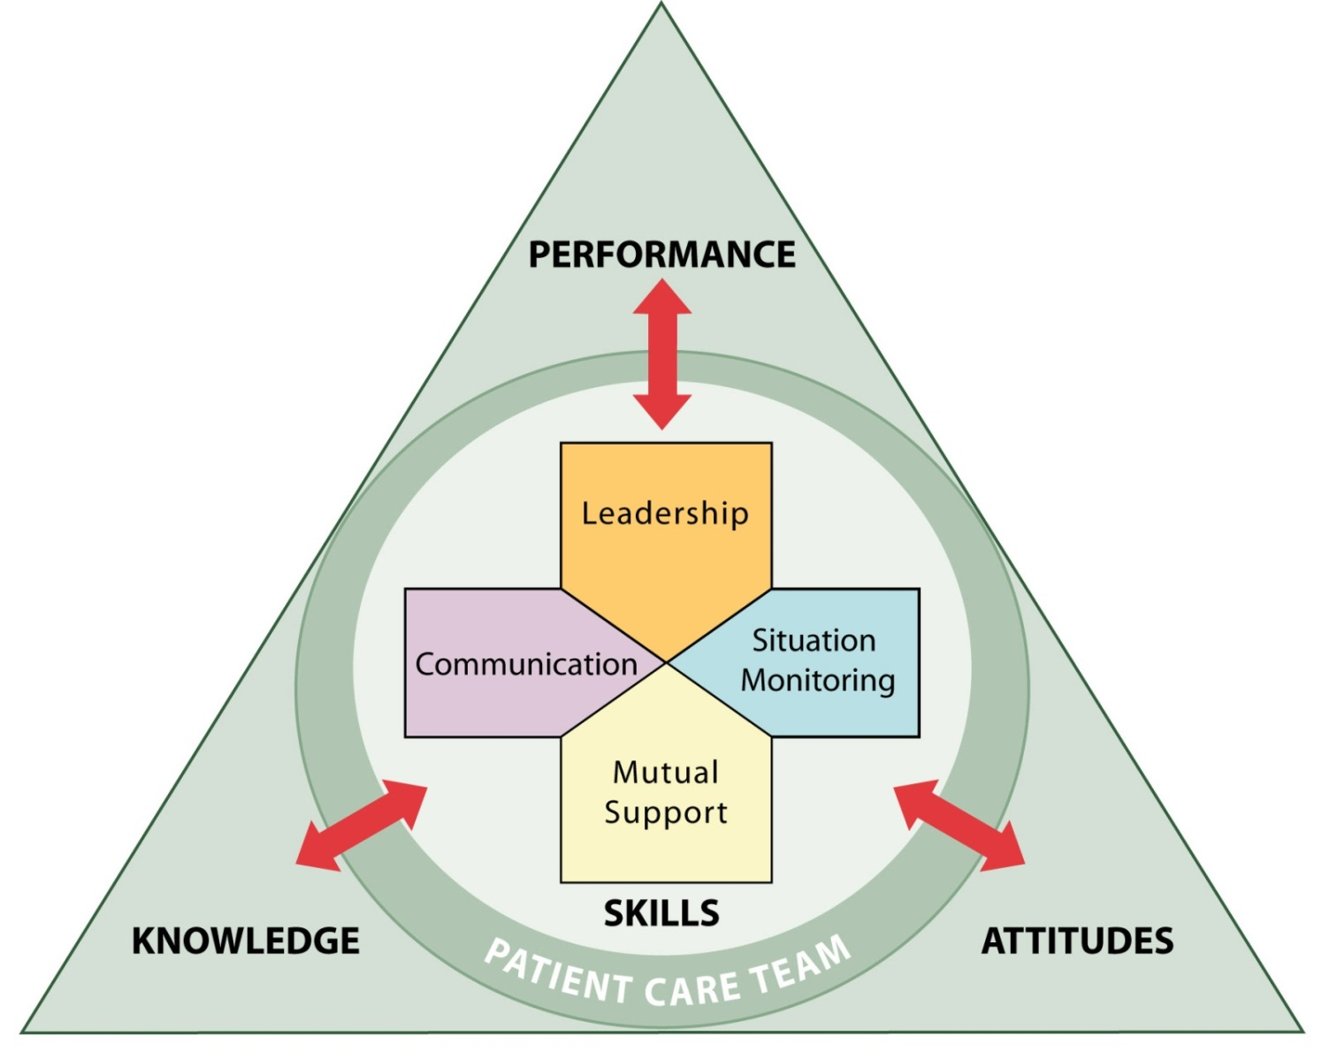
The TeamSTEPPS Framework
So far, we have covered:
Team Structure
Communication
Leadership
In this module, we will cover Situation Monitoring
Notes:
So far, we have covered the following in the TeamSTEPPS framework.
Team structure, which facilitates teamwork by identifying the individuals among which information must be communicated, a leader must be clearly designated, and mutual support must occur. Communication, which facilitates teamwork by enabling team members to effectively relay relevant information in a manner that is known and understood by all.
Leadership, which facilitates teamwork through leaders' effective communication with their team members to ensure that a plan is conveyed, reviewed, and updated; continuous monitoring of the situation to better anticipate team members' needs and effectively manage resources; and fostering of an environment of mutual support for role-modeling and reinforcement.In this module, we will cover situation monitoring. To provide an example of how to present the situation monitoring information, please proceed to the next slide to hear from our master trainer for this module, Lieutenant Michael Vastola, who is an aerospace physiologist with the US Air Force, stationed in San Antonio, Texas. Lieutenant Vastola.

Slide 11
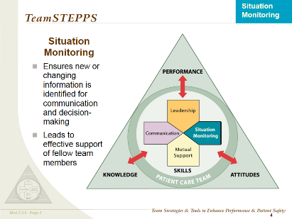
Slide 4: Situation Monitoring
Situation Monitoring:
A way for team members to be aware of what is going on around them
Is moderated by communication
Is enhanced by team leadership
Allows for mutual support by anticipating other team members’ needs
Notes:
Hello, my name's Lieutenant Mike Vastola, and I am an aerospace physiologist in the United States Air Force. I've been practicing situation monitoring in the Air Force for almost 19 years. For the past two years, I've been utilizing the ideas of TeamSTEPPS and, specifically, situation monitoring, not only within my flight, in aerospace physiology, but also within the military health system.
Situation monitoring is important, and there are topics that I will cover with situation monitoring today. A way for team members to be aware of what's going on around them is crucial for situation monitoring. Also, this idea is moderated by good communication, not only amongst peers but enhanced by team leadership as well. And lastly, an ideal that I will cover with you is situation monitoring allows for mutual support by anticipating other team members' needs.

Slide 12
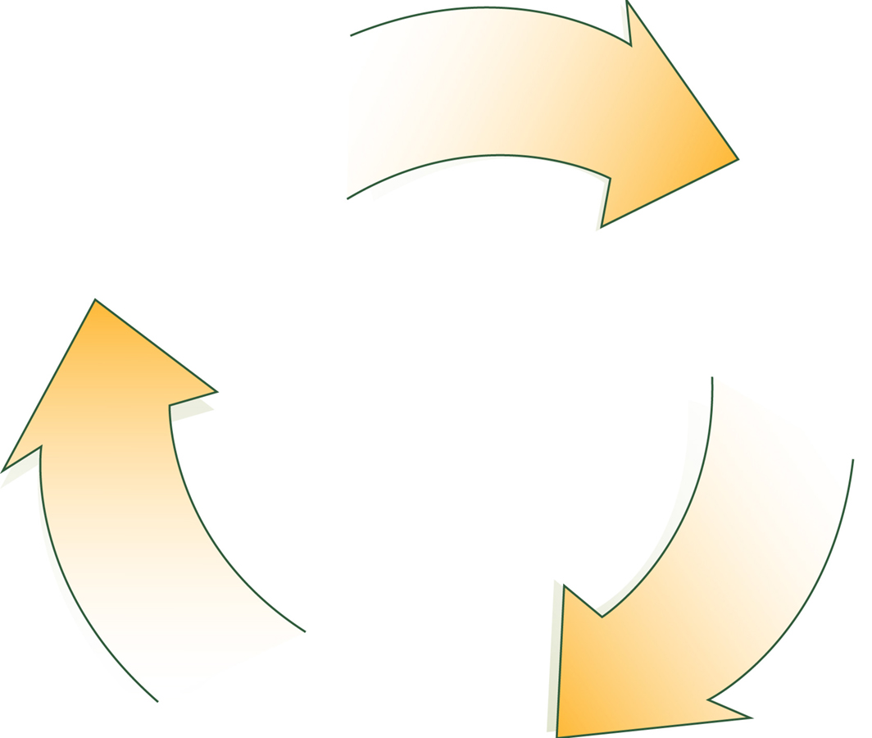
A Continuous Process (Slide 5)
Situation Monitoring (Individual Skill)
Situation Awareness (Individual Outcome)
Shared Mental Model (Team Outcome)
Notes:
Situation monitoring is a continuous process. It's made up of three components. First, situation monitoring is your individual skill. Second, situation awareness results in an individual outcome. And lastly, not only when the individual is practicing situation monitoring, but when a group of people or team members practice, we have a shared mental model and a team outcome.
How can we ensure that this continuous process is achieved? Both individually and as team members, we can actively scan and assess elements of the situation so that our perceptions match our predictions of what's to occur. As an individual, this is fairly simple and it gets a little more challenging when you add multiple people into the idea. But as long as we all maintain good communication, good expectation, we get our priorities straight, and eventually, we'll be able to perform at any given task. This ensures that our mental model is shared amongst all folks in the team.
Think about situations when you have used situation monitoring in your day-to-day activities and in your work. How did the information that you obtained from the environment affect your approach or response to the situation? Write down your answers to these questions and use them as examples when you teach this module.
An example that I like to share for situation monitoring for my work environment is essentially, as a supervisor and a team leader in my section, I ensure that the three individuals that I work with on a day-to-day basis are present and accounted for to start the day. And if there's something that's out of the ordinary I go and I inquire about whatever the thought I might have, or the concern I may have is. This way I know that either we'll have to reprioritize what we've planned for the day and have a new shared perception, or understand that there's just a minimal delay before the normal events of the day will occur, and we'll be able to perform as we normally do.

Slide 13
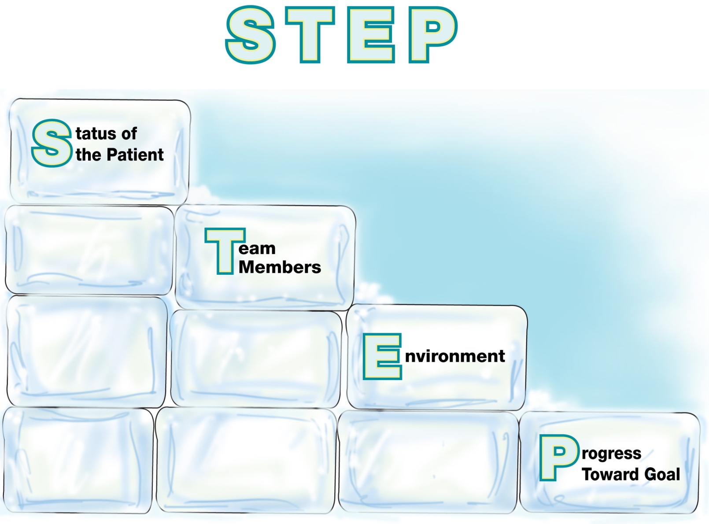
The STEP Mnemonic (Slide 6)
Components of Situation Monitoring
Notes:
The STEP mnemonic components of situation monitoring are as follows-- S, status of the patient, T, team members, E, environment, and P, progress toward goal. In a busy health care environment, knowing which elements you need to monitor and being able to keep track of each element can feel overwhelming. Yet knowing the relevant components of the situation that provide clues about impending complications or contingencies is critical for patient safety.
The STEP mnemonic tool can help you monitor critical elements of the situation and the overall environment. It is not only the responsibility of the direct care team member to monitor these elements, anyone involved in the care of patients or the environment should be expected to monitor the situation. Remember, some crucial ideas of situation monitoring is the fact that leadership's involved and anyone in between down to the most important member of the team structure, the patient.
And STEP is critical for us maintaining components of situation monitoring. Here's an example of the STEP critical elements in action. Status, the respiratory therapist notes that a ventilated patient is showing a marked increase in respiratory rate that might indicate an increased level of pain that cannot be communicated. Team, the patients nurse is busy helping another patient. Environment, it is a shift change and everyone is busy, so you check the medication record, and note the patient is overdue for his morphine. Progress, you notify the oncoming nurse of your concern.

Slide 14
Status of the Patient
Patient History
Vital Signs
Medications
Physical Exam
Plan of Care
Psychosocial Condition
Notes:
The STEP mnemonic is also a good tool when we consider the status of the patient, and there are quite a few sub-ideas of status of the patient that we could follow to ensure that our patient is in good hands, and we all understand what is expected for the perception, prediction, priority, and the performance of the end goal of us and the patient. When assessing patient status consider the following-- the patient's history, vital signs, medications, physical exam, plan of care, and psychosocial condition. For example, the patient's stress level.

Slide 15
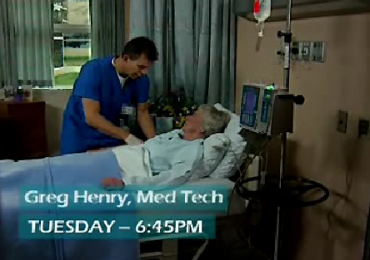
Status of the Patient: Video Example
Let’s view a video example of the first STEP element
After you view the video, please return to the this browser window to continue this module
Select the image to launch a web browser where you can watch the video
Notes:
Let's view a video example of the first element in STEP. The video is available on the web for viewing. Selecting the slide image will open a new browser window so you can view the video. After viewing the video, please return to this browser window to continue this module.

Slide 16
Status of the Patient: Video Discussion
Why did Greg have reason for concern?
Patient was not lucid
Patient did not “seem” herself
Patient’s stress level was elevated
When you teach, ask participants the same question to generate discussion
Notes:
Now that you have seen the video, let's discuss Greg's reaction. Even though the patient's vital signs were normal, why did Greg have reason for concern? Your response should include the following observations-- the patient was not lucid, the patient did not seem herself, and the patient's stress level was elevated. As you are teaching to staff, after viewing the video, ask participants the same question I just asked you. If the observations we just discussed are not mentioned, be sure to add them to the discussion.

Slide 17
Team Members
Fatigue
Workload
Task Performance
Skill Level
Stress Level
Notes:
The STEP mnemonic also encompasses team members and their subtopics that help us as busy health care providers stay well and manage our day-to-day activities in a positive way. The topics that are included-- fatigue level, workload, task performance, skill level, and stress level. Teams that recognize and maintain awareness of each of their individual team members function better and are more likely to provide constructive feedback. They also have a better shared understanding of the situation and are more willing to lend assistance when needed.
Just by simply observing the actions of fellow team members, similarly to the way I start my day when I'm waiting for members of my section to report in, I get a better idea of their preparedness and their effectiveness when they're going to start their task at hand for the day. So essentially we're watching each other's back, monitoring and keeping track of each other's behaviors. And this ensures that all of our procedures are being followed appropriately. And it allows team members to self-correct actions if necessary. All staff members need to constantly be aware of the situation, anticipate next steps, and take appropriate corrective action to prevent errors from reaching the patient or staff members.

Slide 18
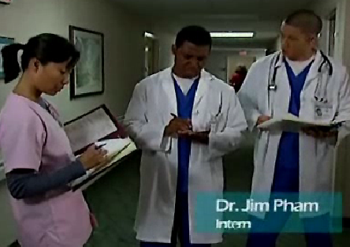
Team Members: Video Example
Let’s view a video example of the “Team Members” element of STEP
After you view the video, please return to the this browser window to continue this module
Select the image to launch a web browser where you can watch the video
Notes:
Now, let's watch how Dr. Pham prevents a possible medication error, an example of the team members element in STEP.
The video is available on the web for viewing. Selecting the slide image will open a new browser window so you can view the video. After viewing the video, please return to this browser window to continue the module.

Slide 19
Team Members: Video Discussion
What did Dr. Pham do in this scenario?
Actively listened and participated in the care plan
Detected and corrected an error
Offered support in the form of clarification and correction
When you teach, ask participants the same question to generate discussion
Notes:
What did Dr. Pham do in this scenario? You are correct if you identified that he actively listened and participated in the care plan, detected and corrected an error, and offered support in the form of clarification and correction.
As you are teaching to staff, after viewing the video, ask participants the same question I just asked you. And if the observations we just discussed are not mentioned, be sure to add them to the discussion.

Slide 20
I’M SAFE Checklist
I = Illness
M = Medication
S = Stress
A = Alcohol and Drugs
F = Fatigue
E = Eating and Elimination
Notes:
The “I'm Safe” checklist. Being aware of and honest about your current status is also a vital component of a safe environment. We will now discuss how to assess your own condition as well as the condition of your team members.
This I'm Safe is a simple checklist that can be used to determine your ability to perform safely. I'm Safe stands for:
I, illness, am I feeling so bad that I cannot perform my duties?
M, medication, is the medication I am taking affecting my ability to maintain situation awareness and perform my duties?
S, stress, is there anything, such as a life event or a situation at work, that is detracting from my ability to focus and perform my duties?
A, alcohol and drugs, is my use of alcohol or illicit drugs affecting me so that I cannot perform and focus on my duties? Of course, we don't want anyone to come to work under the influence, and it is an individual responsibility as well as the team's responsibility to be mindful and aware to speak up if a team member does appear to be under the influence.
F, fatigue am I tired? The effects of fatigue should not be ignored. Team members should alert the team regarding their state of fatigue. For example, saying, “Watch me a little closer today, I only had three hours of sleep last night.”
And E, eating and elimination, how long has it been since I've eaten or used the restroom?
Many times we are so focused on ensuring our patients’ basic needs that we forget to take care of our own. Not taking care of our own elimination needs or eating affects our ability to concentrate and stresses us physiologically.
Teams should be encouraged to set goals concerning the items on this checklist. For example, everyone will be given the opportunity to take a break and have lunch today.

Slide 21
Slide 9: I’M SAFE Checklist
Take 10 minutes to answer the following questions:
Would you feel able to express that you're not safe?
What are the factors that inhibit you from speaking up?
If you feel inhibited, what can you and your team do to change the culture?
When you teach, ask participants these same questions
Notes:
For the purpose of this course, take 10 minutes and think about how you would answer the following questions. In your current situation, would you feel able to express that you're not safe? What are the factors that inhibit you from speaking up or that contribute to your inability to do so? And if you feel inhibited, what can you and your team do to change the culture?
The goal is to build a culture in which staff feel safe to be honest without fear of reprisal, retribution, or disdain. When you're teaching, after presenting this slide, ask participants these same questions and facilitate discussion accordingly. If participants are reluctant to share an example, share your example or an example of what you have observed.

Slide 22
Environment
Facility Information
Administrative Information
Human Resources
Triage Acuity
Equipment
Notes:
E-- the environment. Our work environment directly affects the quality of care delivered. Is the needed equipment present? Is it functioning properly?
Are the phones working? Is connectivity down? Have we lost the ability to chart electronically, view the record or test results?
Are there enough staff to tend to all the patients? Are there enough staff to accomplish the tasks or the goal? The environment can change quickly and dramatically, and teams must be able to adapt to the dynamic nature of the situation. When assessing the environment, consider the following-- facility information, administrative information, human resources, triage acuity, and equipment status.

Slide 23
Progress Toward Goal
Call a Huddle!
Status of Team’s Patient(s)
Goal of Team
Tasks/Actions That Are or Need To Be Completed
Plan Still Appropriate
Notes:
P, progress toward the goal. By monitoring progress toward the team's established goals, team members will be able to alert the team when strategies or the plan of care may need to be reconsidered or revised, or when additional resources are needed. When assessing progress, team members need to consider the following, call a huddle to discuss the following-- status of the team’s patients, goal of the team, tasks or actions completed or that need to be completed, and continued appropriateness of the plan. Since goals were established and agreed on at the team briefing, if something changes, a huddle should be called to discuss how the plan needs to be modified.

Slide 24
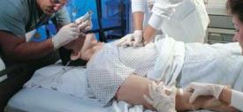
Situation Monitoring Exercise
A patient in the ICU has coded, and CPR is in progress. The Resuscitation Team is busy ensuring that IV access is available and the ET tube is inserted correctly. Dr. Matthews, the Team Leader, is calling out orders for drugs, X-rays, and labs.
Judy, a nurse at the bedside, is inserting an IV. Nancy, another nurse, is drawing up meds. Judy can tell by Nancy’s expression that she didn’t get the last order called out by Dr. Matthews.
Judy calls out while continuing to place the IV, “Nancy, he wants the high-dose epinephrine from the vial in the top drawer.”
Notes:
Let's look at this scenario, keeping in mind how well members of this team worked together. A patient in the ICU has coded, and CPR is in progress. The resuscitation team is busy ensuring that IV access is available and the ET tube is inserted correctly. Dr. Matthews, the team leader, is calling out orders for drugs, x-rays, and labs.
Judy, a nurse at the bedside, is inserting an IV. Nancy, another nurse, is drawing up meds. Judy can tell by Nancy's expression that she didn't get the last order called out by Dr. Matthews. Judy calls out while continuing to place the IV, “Nancy, he wants the high-dose epinephrine from the vial in the top drawer.“
Now take five minutes to consider and answer these questions. What TeamSTEPPS tools and strategies were exhibited in this scenario? Identify each component of the STEP framework in this scenario. How was the STEP framework useful? Did you identify that Dr. Matthews used a call-out to alert the team to what he needed?
Judy did not lose sight of the situation at hand, even though she was involved in a task. She was able to provide task assistance to Nancy by clarifying Dr. Matthews' request and helping her locate the medication. She had Nancy's back. Judy used both situation monitoring and situation awareness in that she was aware of Nancy's nonverbal cues.
Judy was aware of what was going on around her even though she was engaged in a task. She heard the order called out by Dr. Matthews and was aware of her teammate's confusion. Judy was aware of her environment and was able to assist her teammate in locating the correct medication. Progress towards the goal was achieved as the patient received the correct medication and dose in a timely manner to yield a positive outcome for the patient and the team.

Slide 25
Situation Monitoring Exercise: Discussion
When you teach, ask your learners to discuss these questions:
What TeamSTEPPS tools and strategies were exhibited in this scenario?
Identify each component of the STEP framework in this scenario. How was the STEP framework useful?
For more information on facilitating this exercise, see page 16 in the Instructor Guide
Notes:
When you teach, after your learners have read the exercise scenario, ask them the same questions I just asked you and facilitate discussion appropriately. Those questions were-- What TeamSTEPPS tools and strategies were exhibited in this scenario? Identify each component of the STEP framework in this scenario. And how was the STEP framework useful?
If the observations we just discussed are not mentioned, be sure to add them to the discussion. For more information on facilitating this exercise, see page 16 in the Instructor Guide.

Slide 26
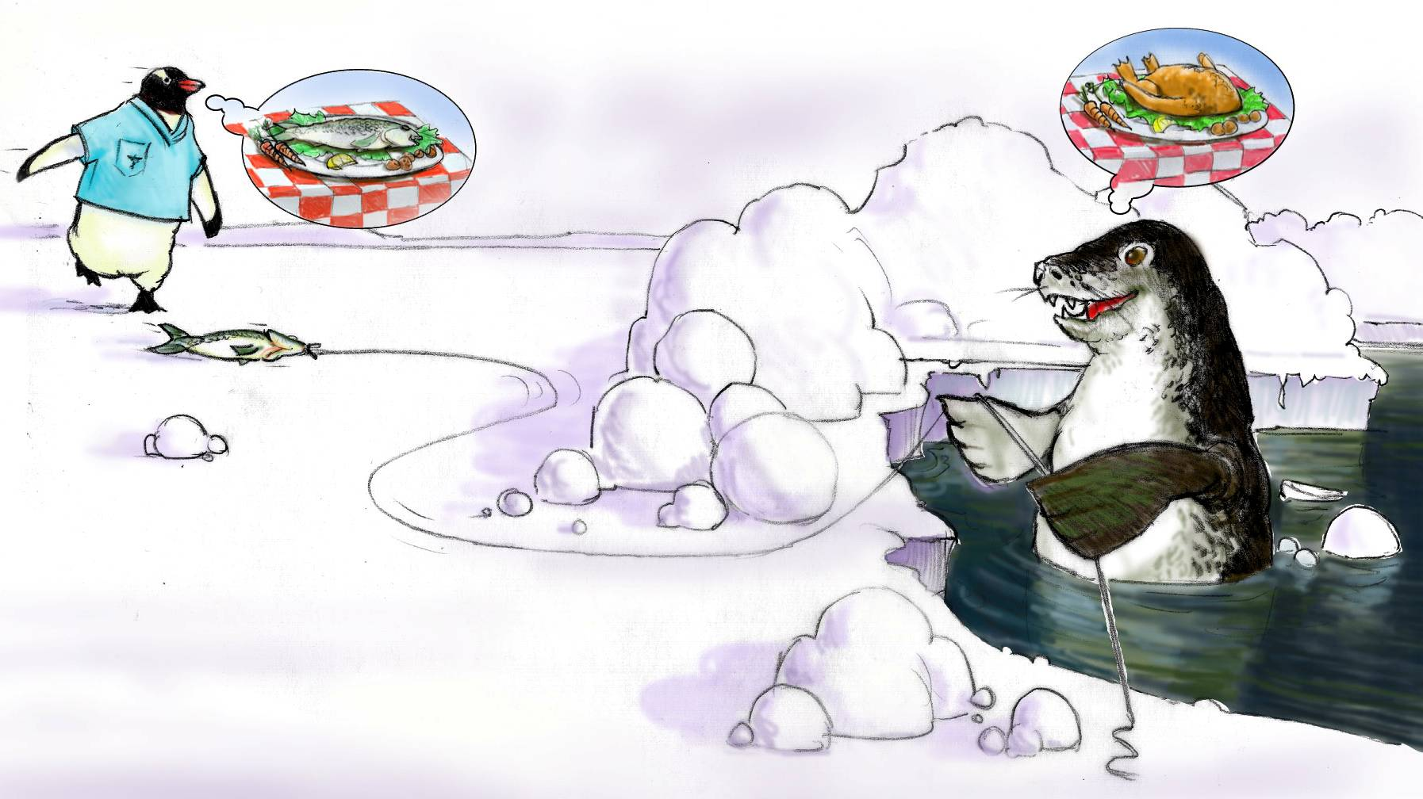
Situation Awareness is…
The state of knowing the current conditions affecting one’s work
Includes knowing…
Status of the patient
Status of other team members
Environmental conditions
Current progress toward the goal
Notes:
Situation awareness is the state of knowing the conditions that affect one's work. This awareness is achieved by constantly monitoring the ever-changing situation. How mindful of a situation do you think the penguin is in this slide?
Situation awareness is the extent to which team members are aware of the following, status of the patient or the situation at hand, status of the other team members, status of the environment, and status of the progress toward the goal.
The health care environment is dynamic, requiring team members to continually reassess situations to update their situation awareness. What results is a sense of knowing what's going on around them and the ability to support each other where needed. A loss of situation awareness results in ambiguity, confusion, and a decrease in communication.
What causes us to lose our situation awareness? Let's take five minutes to list some of the factors you believe undermine situation awareness. We'll also be referring to these factors on the next slide. An example of loss of situation awareness that I can share is while driving, I'll be focused on a news broadcast program and miss my turn and go five miles out of the way to where my desired destination was. May not seem like a big deal, but in the long run, it definitely affected my ultimate goal of getting to where I need to be on time.

Slide 27
Conditions That Undermine Situation Awareness
Failure to:
Share information with the team
Request information from others
Direct information to specific team members
Include patient or family in communication
Utilize resources fully (e.g., status board, automation)
Maintain documentation
Know and understand where to focus attention
Know and understand the plan
Inform team members the plan has changed
Notes:
There are numerous barriers to maintaining situation awareness. Did your list include any of these? Usually the loss of situation awareness is as a result of the team members failure to share information with the team; request information from others; direct information to specific team members, include patient or family in communication; utilize resources fully, example, using status boards or automation; maintain documentation that is adequate, complete, and timely; know and understand where to focus attention; know and understand the plan; and inform team members the plan has changed.
Some of the specific examples for where failure can occur in the STEP process-- remember the STEP mnemonic-- status of the patient, there would be a failure to take a patient's vital signs; in the team considerations, a failure to assist a team member who you know is overloaded; environmentally, failure to know where the necessary equipment is stored; and the progress towards the goal, a potential failure to call a huddle and update the team when the plan has changed. Pages 17 and 18 in the instructor guide provide further guidance for facilitating this slide, as well as an optional exercise you may want to use when teaching to prompt discussion prior to sharing a list of conditions that undermine situation awareness.

Slide 28
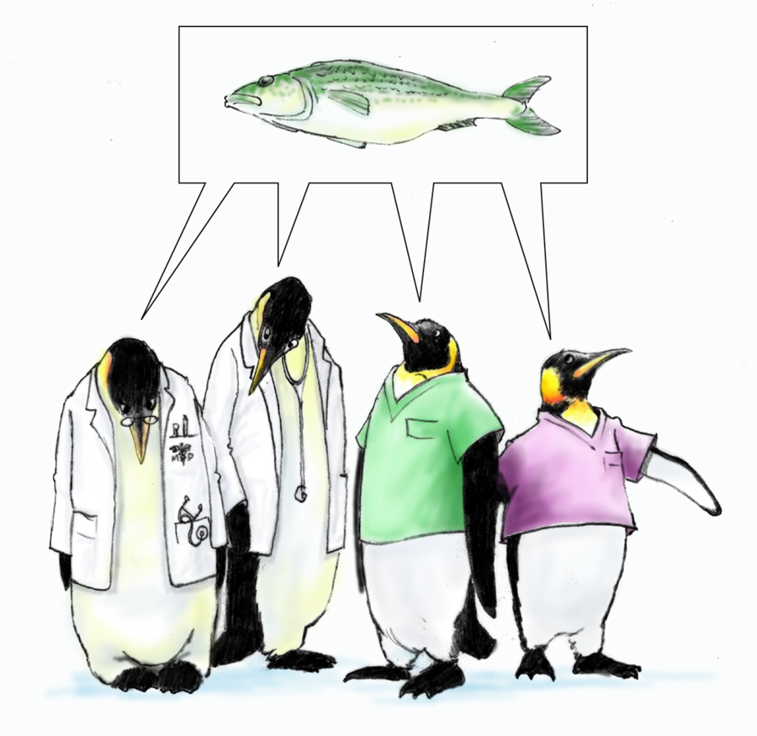
A Shared Mental Model is…
The perception of, understanding of, or knowledge about a situation or process that is shared among team members through communication
Notes:
A shared mental model is the perception of understanding of or knowledge about a situation or process that is shared among team members through communication. Also, another way to describe mental model is a mental picture or a sketch of the relevant facts and relationships defining an event, situation, or problem.
When all members of your team share the same mental model, this is referred to as a shared mental model. Sharing your situation awareness with fellow team members results in a shared mental model and everyone being on the same page. This is a continuous process requiring relevant input from all team members.
Similar to the way situation awareness is the result of an individual team member's situation monitoring, a shared mental model is the result of each team member maintaining his or her situation awareness and sharing relevant facts with the entire team. In isolation, it is possible for an individual team member to misinterpret cues or to place too much emphasis on one piece of information. Shared mental models enable the team to anticipate and predict each other's needs, identify changes in the team, task, or teammates, and adjust the course of action or the strategies as needed.

Slide 29
Sustaining Shared Mental Models (Slide 15)
Shared mental models are sustained by:
Huddles
Briefings
Monitoring
Communication
Please see page 19 in the Instructor Guide for more information on facilitating the discussion for slide 15
Notes:
Sustaining shared mental models.
Shared mental models are sustained by the tools huddles, briefings, monitoring, and communication. Huddles, for instance, are used in my flight when we have a last minute team member change on a schedule. When the new member is added, we ensure that all the other team members know that indeed, there was a team member change, and all the folks on the team are still aware of what our shared goal and endpoint will be.
For briefings, we do this every time we have a training event where I work. Prior to the training event, we'll get together. We'll answer questions such as, who are the members of the team? Do all the members of the team know their responsibilities? And we even ask challenge questions. That helps us monitor each other and know what each one of us will do in the event of any type of unexpected situation. This ensures that we're communicating with each other, and the communication typically rolls into the training event and is sustained throughout that episode.
Shared mental models provide team members with a common understanding of who is responsible for which task and what the information requirements are. In turn, this allows them to anticipate each other's needs so they can work, for example, provide patient care, in synchronicity.
When you teach slide 15, ask your learners these questions about shared mental models. What is an example from your own experience of being on the same page with others on your team? How was a shared understanding maintained? You could also discuss your answers to these questions here. Please see page 19 in the instructor guide for more information on facilitating the discussion for slide 15.

Slide 30
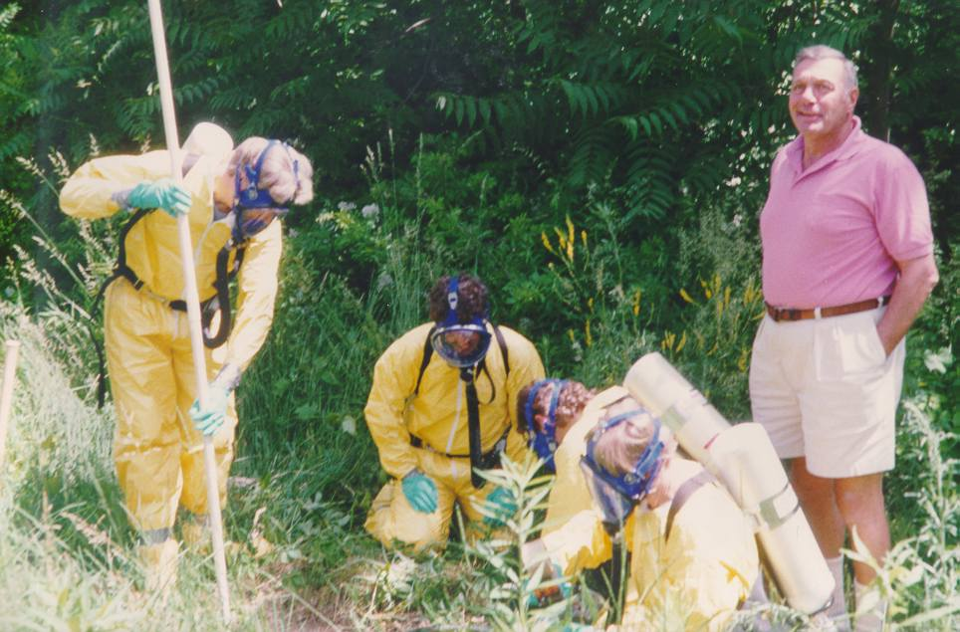
Shared Mental Model?
Notes:
On our continuum of situation monitoring, situational awareness, and a shared mental model, where are these individuals? Four of the individuals in the picture are working wearing biohazard suits. And the fifth individual is standing next to them wearing shorts and a polo shirt. Seems that someone didn't get or understand the memo.
This is a lack of shared mental model, and this can effect safety. I also am aware of a very similar situation when we had a team of members go out for an aircraft accident to take a look around the aircraft crash site. And there are some specific hazards that could be present for an individual if they don't wear the appropriate protective gear. And I've seen a very similar photograph where there are pilot members, maintenance members, human factor consultants, military medical members all dressed in the appropriate safety gear analyzing a crash site. But one individual wasn't necessarily sharing the same mental model, and they also lacked the protective gear similar to the picture here on the slide.
At this time, take five minutes to write down an example of when you or someone you know was involved with a team who did not share the same mental model. Explain the outcome. When you teach this model, share this example with those in the class.

Slide 31
How and When to Share?
When:
Briefs
Huddles
Debriefs
Transitions in Care
How:
SBAR
Call-outs
Check-backs
Notes:
How and when to share. Sharing information with other team members is necessary to establish and maintain a shared mental model. When each team member shares his or her unique information, the team will have a more accurate assessment of the situation. There are both ad hoc and structured opportunities to share vital information with team members.
Some examples of when information can be shared include team events, such as briefs, any huddles you may experience, and debriefs. Another opportunity when to share information would be during transitions in care. It is important to establish the expectation that these team events will occur and that all team members are empowered to speak up and expected to participate.
Some examples of how to share information include SBAR, which stands for Situation, Background, Assessment, and Recommendations. Call-outs and check-backs may also be used. Teams should communicate often and at the right time to ensure that everyone is on the same page and has a comprehensive view of the situation.

Slide 32
Shared Mental Model: Practical Exercise
Room # | Patient | Orders | VS
1 | Jackson | EKG, O₂, Cardiac Enzymes | HR 115 R 24 B/P 174/98
2 | Simmons | CBC, UA, HCG, IV | HR 132 R 22 B/P 92/76
3 | Bailey | CXR, neb Rx, CBC, UA, O₂ | HR 120 R 32 B/P 132/86
Write down your priority order and then go to the next slide
Notes:
Let's take 10 minutes and try a practical exercise to demonstrate the importance of establishing a shared mental model. Review the patients' status board shown on the screen and decide how you would prioritize the patients using only the information provided.
Room one is patient Jackson and has orders for an EKG, oxygen, and cardiac enzymes. The vital signs are heart rate 115, respirations 24, and blood pressure 174 over 98. In room two is patient Simmons who has orders for CBC, UA or urinalysis, HCG, a pregnancy test, and an IV. In room three is patient Bailey who has orders for a chest x-ray, nebulizer treatment, CBC, UA, and oxygen. Write down your priority order, and then select the forward arrow to go to the next slide.

Slide 33
Shared Mental Model: Practical Exercise
Room # | Patient | Orders | VS
1 | Jackson | EKG, O₂, Cardiac Enzymes | HR 115 R 24 B/P 174/98
2 | Simmons | CBC, UA, HCG, IV | HR 132 R 22 B/P 92/76
3 | Bailey | CXR, neb Rx, CBC, UA, O₂ | HR 120 R 32 B/P 132/86
Patient Jackson is a 23-year-old male.
Patient Simmons is a 19-year-old female.
Patient Bailey is a 76-year-old male.
Revise your priority order and then go to the next slide
Notes:
Here are some additional information about the patients. Patient Jackson in Room 1 is a 23-year-old male. Patient Simmons in Room 2 is a 19-year-old female. And patient Bailey in Room 3 is a76-year-old male.
Based on this additional information, would your priority ordering change? Revise your priority order and then select the forward arrow to go to the next slide.

Slide 34
Shared Mental Model: Practical Exercise
Room # | Patient | Orders | VS
1 | Jackson | EKG, O₂, Cardiac Enzymes | HR 115 R 24 B/P 174/98
2 | Simmons | CBC, UA, HCG, IV | HR 132 R 22 B/P 92/76
3 | Bailey | CXR, neb Rx, CBC, UA, O₂ | HR 120 R 32 B/P 132/86
Patient Jackson is a known cocaine user with chest pain, and you are concerned about a possible MI.
Patient Simmons is hypotensive and experiencing tachycardia, and you are concerned about a ruptured ectopic pregnancy.
Patient Bailey has tachypnea, tachycardia, and fever, and you are concerned about pneumonia.
Patient Jackson is a 23-year-old male.
Patient Simmons is a 19-year-old female.
Patient Bailey is a 76-year-old male.
Would your priority ordering change?
Notes:
Now, consider this additional information about the patients. Patient Jackson is a known cocaine user with chest pain, and you are concerned about a possible MI. Patient Simmons is hypotensive and experiencing tachycardia, and you are concerned about a ruptured ectopic pregnancy. Patient Bailey has tachypnea, tachycardia, and fever, and you are concerned about pneumonia.
Now that you have the full mental model, would your priority ordering change? How your prioritization changed as you gathered additional information illustrates the importance of your team sharing information in a timely manner to build a shared mental model.

Slide 35
Slide 18: Practical Exercise
When you facilitate the exercise, you can alter the information and exercise to best fit your situation
Please review pages 22 and 23 in the Instructor Guide for more information on how to facilitate this exercise
Notes:
When you facilitate the practical exercise with your staff, you can alter the information and how you run the exercise to best fit your situation. Please review pages 22 and 23 in the Instructor Guide for detailed information on how to facilitate this exercise.

Slide 36
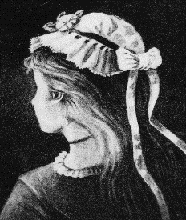
What Do You See?
Take five minutes to write down the two images you find in each sketch
Notes:
What do you see? Each team member has a unique perspective and information that benefits the team as a whole when shared. Different people may view the same situation differently, but without sharing and communicating, each team member may have a different understanding.
Here's an exercise to illustrate and to let you understand this point. Look at each of these three sketches on the screen. Each of them can be perceived as two very different images depending on your perspective and your interpretation. Take five minutes to write down the two images you find in each sketch, and then select the forward arrow to continue.

Slide 37
What Do You See?
Were you able find the two images in each sketch?
Native American or Alaska Native
Duck or Rabbit
Old Lady or Young Woman
Refer to page 24 in the instructor guide for more information
Notes:
Were you able to find the two images in each sketch?
The sketch on the left can be perceived as a profile of a Native American, or as an Alaska Native, entering a cave. The center sketch can be perceived either the head of a duck, or a rabbit. The sketch on the right can be perceived as either the profile of an old lady, or back and side profile of a young woman.
Remember that your teammates may view the same situation differently. Sharing and communicating is the key to achieving a shared mental model.
When you are teaching and speaking to this slide, ask participants what they see as they look at each image. If they are having difficulty seeing both images suggest they look right to left vs. left to right. Be sure to include in your discussion that just as the class may have viewed these images differently the first time, teammates may view the same work-related situation differently, and the importance of sharing and communicating to achieve a shared mental model.
Refer to page 24 in the instructor guide for more information on facilitating discussion of this slide.

Slide 38
How Shared Mental Models Help Teams
Shared mental models can help teams by:
Leading to a mutual understanding of problems, goals, team strategies, patients’ conditions, and plans of care
Leading to more effective communication to ensure that team members have the necessary information for task performance
Enabling team members to back up and fill in for each other
Helping team members understand each other’s roles and how they interplay
Improving the ability of individual team members to provide mutual support by predicting and anticipating the needs of the team
Creating commonality of effort and purpose
Notes:
How shared mental models help teams is an important concept. Teams will work more efficiently and effectively if all members of the teams are on the same page. If teams are better able to predict and anticipate, the team will know what is supposed to happen, and will have a better understanding of how the case is progressing.
Here's some ways that shared mental models are used by teams-- leading to a mutual understanding of problems and goals, team strategies, patient's condition, and plan of care; leading to more effective communication to ensure that team members have the necessary information for task performance; enabling team members to back up and fill in for each other; helping team members understand each other's roles and how they interplay; improving the ability of the individual team members to provide mutual support by predicting and anticipating the needs of the team; and lastly, creating commonality of effort and purpose. Most important, shared mental models help teams avoid errors that put patients and staff at risk.

Slide 39
Tools & Strategies Summary
BARRIERS
Inconsistency in Team Membership
Lack of Time
Lack of Information Sharing
Hierarchy
Defensiveness
Conventional Thinking
Complacency
Varying Communication Styles
Conflict
Lack of Coordination and Follow-up With Coworkers
Distractions
Fatigue
Workload
Misinterpretation of Cues
Lack of Role Clarity
TOOLS and STRATEGIES
Communication
SBAR
Call-Out
Check-Back
Handoff
Leading Teams
Brief
Huddle
Debrief
Situation Monitoring
I’M SAFE
STEP
OUTCOMES
Shared Mental Model
Adaptability
Team Orientation
Mutual Trust
Team Performance
Patient Safety!!
39
Notes:
As I said earlier, situation monitoring is an integral piece of the TeamSTEPPS framework and directly links to communication, leadership, and mutual support. Engaging in effective communications techniques will enable team members to relay relevant and timely information. Leadership’s role in continually monitoring and updating the team when changes to the plan are necessary helps to maintain a shared mental model.
Likewise, when team members are aware of the situation, they are better able to support each other, either when asked, or when they see a need. The tools and strategies introduced in this module include STEP and the “I’m Safe” checklist. Use of these tools will aid in awareness of the situation and development of a shared mental model, which will enable team members to anticipate, prevent, and correct potential errors in care.

Slide 40
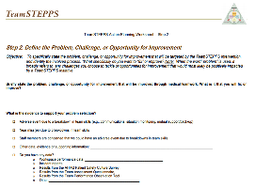
Slide 22: Applying TeamSTEPPS Exercise
Take 15 minutes to answer these questions:
Do the team or individuals targeted for your TeamSTEPPS implementation have an issue related to their ability to monitor the situation?
If so, which of the Situation Monitoring tools or strategies might you use to address the issue?
Select here to download and print the TeamSTEPPS Implementation Worksheet and answer the questions.
Notes:
Note, this slide is intended for the master trainer course only. The previous slide should be the last one shown when you teach to staff using the train the staff curriculum. Now, return to your TeamSTEPPS implementation worksheet and take 15 minutes to complete the questions.
Think about whether any aspect of your teamwork issue is related to situation monitoring. And answer the questions for this module. Do the team or individuals targeted for your TeamSTEPPS implementation have an issue related to their ability to monitor the situation? If so, which of the situation monitoring tools or strategies might you use to address the issue?
When you are teaching the master trainer course, have participants discuss with the team and document the answers on the worksheet. Ask a few individuals to share any identified situation monitoring issue and which TeamSTEPPS tools or strategies they might consider implementing to address the issue. If you have questions, remember to select the Question button to ask via email. When you have completed this exercise, select the Forward button to wrap up this module.

Slide 41
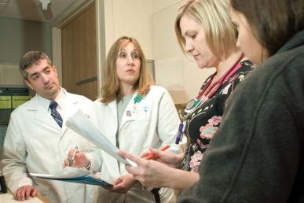
Module 5 Summary
In this module you learned to:
Discuss how situation monitoring affects team processes and outcomes
List components of the STEP mnemonic
Explain situation awareness and identify undermining conditions
Define a shared mental model and how it is cultivated within a team
Notes:
In this module, you learned to discuss how situation monitoring affects team processes and outcomes. List components of the STEPP mnemonic, explain situation awareness, and identify undermining conditions, and define a shared mental model and how it is cultivated within a team.

Slide 42
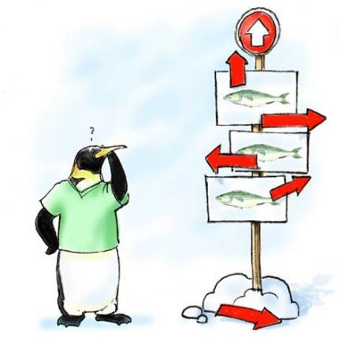
Module 5 Conclusion
This concludes Module 5 of the TeamSTEPPS Online Master Trainer Course
Go to Module 6
Module 5
Module 6
Notes:
This concludes Module 5 of the TeamSTEPPS 2.0 online master trainer course. To complete this module and receive accreditation, you must return to the TeamSTEPPS Learning Management System and complete the Module 5 post-test.

