Slide 1
Module 6: Mutual Support
Welcome to the
Online Master Trainer Course
Notes:
Welcome to module six of the TeamSTEPPS 2.0 Online Master Trainer Course, Mutual Support. This is Dr. Brigetta Craft, and I'll be guiding you through this module.
What comes to mind when you hear the words mutual support? Do you think about helping each other, supporting one another, having your team member's back? Consider your answers as you select the Forward arrow in the lower right corner to begin this module.

Slide 2
How This Online Course Works
This online course will walk you through the TeamSTEPPS content just as you will present it when you train your colleagues and staff
It teaches you all the concepts that comprise the TeamSTEPPS initiative
While also teaching you to teach TeamSTEPPS to your colleagues
Use the navigation buttons in the lower right to work through the online modules
Select here to move back to the previous slide
Select here to move to the next slide
Notes:
This online course will walk you through the TeamSTEPPS content just as you will present it when you train your colleagues and staff at your facility. It teaches you all the concepts that comprise the TeamSTEPPS initiative while also teaching you how to teach the TeamSTEPPS content to your colleagues. Use the navigation buttons on the lower right to work through the online modules. Select the forward arrow to move to the next slide. And select the back arrow to go back to the previous slide.

Slide 3
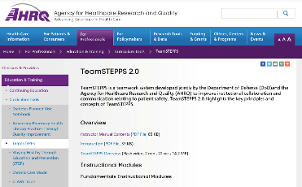
The Materials You Will Use
When you deliver your training you will use these materials:
Instructor Manual
Course Management Guide
Instructor guides
Course slides
Measurement tools
Customizable materials
Videos
Select here to review materials on the TeamSTEPPS website
Notes:
When you deliver the TeamSTEPPS training at your facility, you will use a variety of materials and resources provided on the AHRQ TeamSTEPPS website. We will discuss them more later in this module. Please select the link provided if you would like to review these materials on the TeamSTEPPS website.

Slide 4
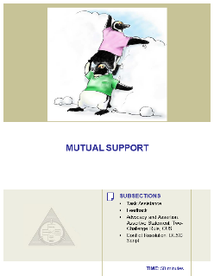
Please Print the Instructor Guide
To best use this online module, please print the Module 6 Instructor Guide, located here
Read pages 3-4 in the guide before we begin
Then we will proceed to work through the slides you will use to train – just as if you are delivering this module at your facility.
Notes:
To best use this online module, we recommend that you print the instructor guide for module six as a reference to use throughout the module. Before continuing to the next slide, we recommend that you take a moment to read through pages three and four in this guide. Once you've done that, select the Forward button, and we'll proceed to work through the slides you will use to train, just as if you are delivering this module at your facility.

Slide 5
Slide 2: Objectives
You will use slide 2 to introduce the objectives for this module
See page 5 in the Instructor Guide for details on how to facilitate this slide
Notes:
You will use slide two to introduce the objectives for this module. Please refer to page five in the instructor guide for details on how to facilitate this slide. After completing this module, you'll be able to describe how mutual support affects team processes and outcomes, discuss specific strategies to foster mutual support such as task assistance and feedback, identify specific tools to facilitate mutual support, and describe conflict resolution strategies.

Slide 6
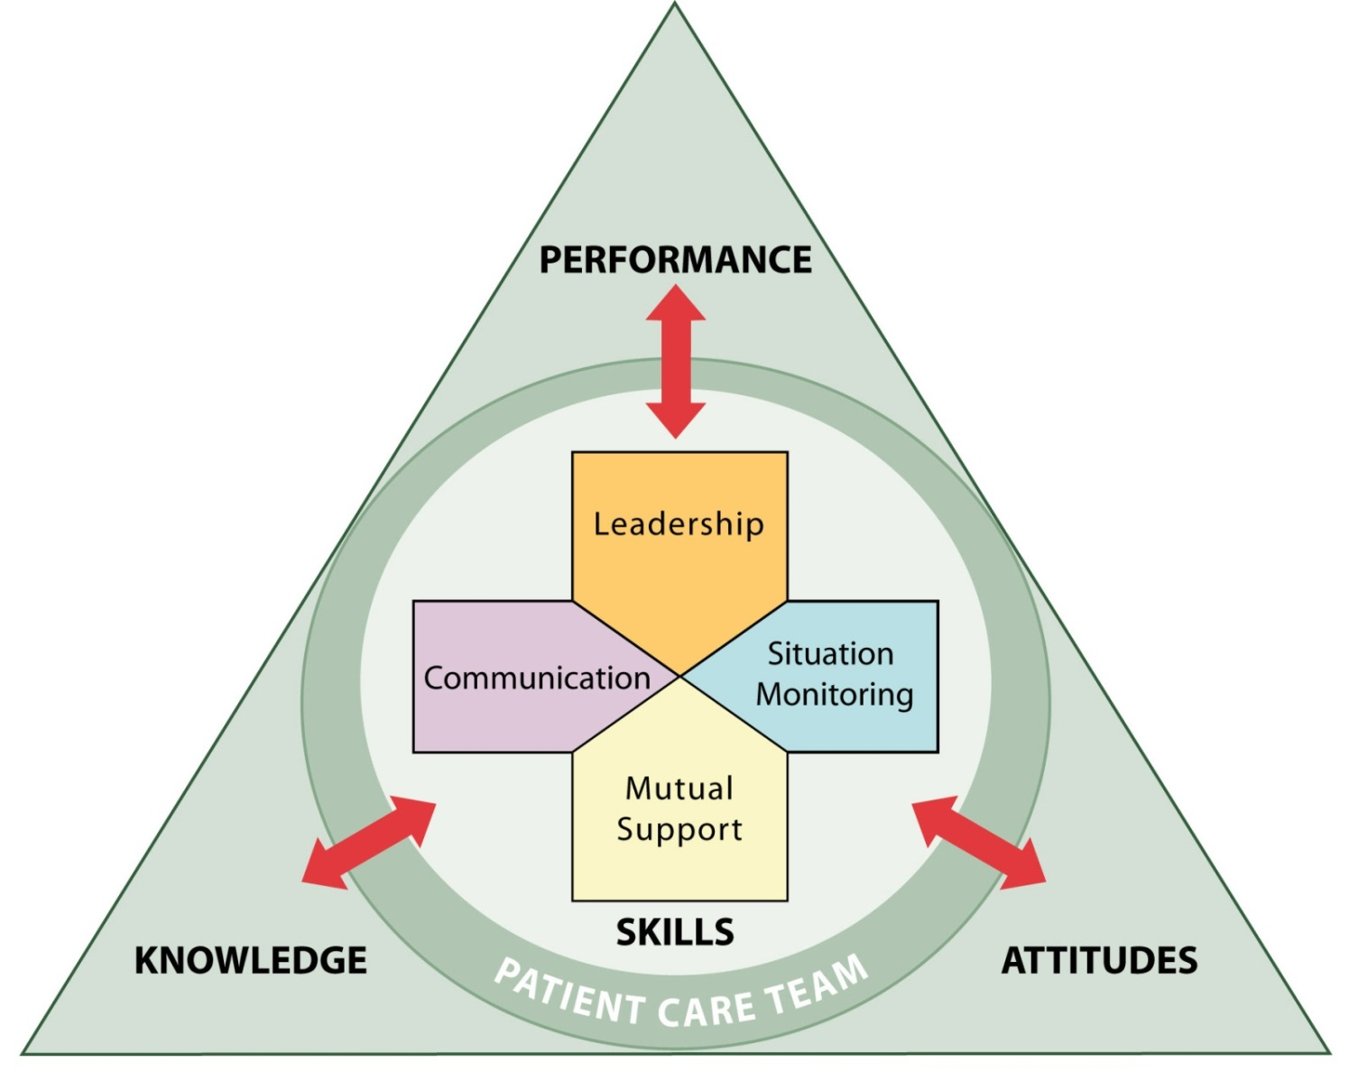
The TeamSTEPPS Framework
So far, we have covered:
Team Structure
Communication
Leadership
Situation Monitoring
In this module, we will cover Mutual Support
Notes:
So far we have covered the following in the TeamSTEPPS framework. Team Structure, which facilitates teamwork by identifying the individuals among which information must be communicated, a leader must be clearly designated, and mutual support must occur. Communication, which facilitates teamwork by enabling team members to effectively relay relevant information in a manner that is known and understood by all.
Leadership, which facilitates teamwork through leaders' effective communication with their team members to ensure that a plan is conveyed, reviewed, and updated. Continuous monitoring of the situation to better anticipate team members' needs and effectively manage resources and fostering of an environment of mutual support through role modeling and reinforcement. Situation monitoring, which facilitates teamwork by providing skills to ensure that new or changing information about the environment or the patient is identified for communication and decision making by the leader and leads to the effective support of fellow team members.
In this module, we will cover the TeamSTEPPS skill which is mutual support. To provide an example of how to present the mutual support information, please proceed to the next slide to hear from our master trainer for this module, Ms. Julia Gannon. She's a pharmacist with the office of the Army Surgeon General in Falls Church, Virginia. Ms. Gannon.

Slide 7
Slide 3: Mutual Support
Mutual Support:
Dependent upon information gathered through situation monitoring
Is moderated by communication
Enhanced by leaders who encourage and role model mutual support behaviors
Notes:
Hi, I'm Julia Gannon, and I'm a pharmacist. My passion about TeamSTEPPS comes from all the great tools I learned from TeamSTEPPS to improve my team and our performance in patient safety. In pharmacy we participate in multiple levels of patient care, from our ancillary role to our professional clinical responsibilities. And we're relied upon to provide safe and timely professional service and care.
Situational monitoring and mutual support are fundamental to our roles in providing exceptional team support and patient care. So let's get started and talk about mutual support. Mutual support is dependent upon information gathered through situation monitoring. And it is moderated by communication, which influences the delivery and ultimate effectiveness of the mutual support.
Because mutual support involves a willingness and preparedness to assist other team members during operations, it is enhanced by team leadership, given that our team leaders encourage and role model these backup behaviors. Mutual support is derived from situation monitoring through the ability to anticipate our patients' needs, as well as our other team members' needs with accurate knowledge of their responsibilities.

Slide 8
Mutual Support
Mutual support involves members:
Assisting each other
Providing and receiving feedback
Exerting assertive and advocacy behaviors when patient safety is threatened
Take 5 minutes and ask yourself:
“When I think of mutual support, I think of…”
Notes:
Mutual support, which is commonly referred to as backup behavior in the teamwork literature, is critical to team performance. Mutual support involves team members assisting one another, providing and receiving feedback, and exerting assertive and advocacy behaviors when patient safety is threatened. Mutual support is the essence of teamwork.
For example, in health care environment, one team member's work overload may result in fatal consequences. Mutual support provides a safety net to help prevent those errors, increase effectiveness, and minimize strain caused by work overload. Over time, continuous mutual support fosters team adaptability, mutual trust, and team orientation.
Take five minutes and ask yourself, when I think of mutual support, I think of, and write down your responses. In pharmacy we have multiple levels of professionals, from our technicians to our lead clinical pharmacists. In all that we do, we also have multiple checks in our processes. Each level relies on each other to perform at our best and support each other's roles, and always have each other's back, and sharing responsibilities for best outcomes.
Each person's responsibility builds on the others and creates a better, safer environment for all our checks. Without mutual support, we have decreased effectiveness, and a chance of overlooking or missing process errors, which can have negative consequences.

Slide 9
Slide 4: Mutual Support
What did you think of for “mutual support”?
When you teach, use a flipchart to discuss the question:
What types of behavior do you think make up mutual support?
Facilitate the discussion to include the potential answers on page 7 of the Instructors Guide
Notes:
Did your answers include any of the following? Monitoring other team members performance to anticipate assistance requests. Offering or requesting assistance. Filling in for a member who cannot perform a task. Cautioning team members about potentially unsafe situations. Self-correcting and helping others correct their mistakes. Distributing and assigning work thoughtfully. Rerouting, delaying work so that the overburdened team member can recover. Regularly providing feedback to each other. And providing encouragement.
When you teach, ask participants the same question Ms. Gannon just asked you. That is, what types of behavior do you think makes up mutual support? Use a flip chart or whiteboard to document the participants' response as you lead a discussion of this question. If the participants don't include the potential answers just mentioned, be sure to add them to the discussion. These potential answers can be found on page seven of the instructor guide.

Slide 10
The Three Mutual Support Strategies
In this module we will present three strategies you can use to foster Mutual Support:
Task Assistance
Feedback
Advocacy & Assertion
Notes:
In this module, we'll present three strategies that can be used to foster mutual support. Task assistance, feedback, and advocacy and assertion. Select the Forward button to hear our guest speaker, Julia Gannon, begin the discussion of task assistance.

Slide 11
Task Assistance (Slide 5)
Team members foster a climate in which it is expected that assistance will be actively sought and offered as a method for reducing the occurrence of error.
Notes:
One method of providing mutual support is through task assistance. This includes both asking for assistance when needed and offering assistance to team members when the opportunity arises. Task assistance is guided by situation monitoring. Because situation monitoring allows team members to effectively identify when they or other team members need assistance.
When our inpatient pharmacy staff may have a lull in activity between rounds or task, they may offer to assist in the IV prep areas that may be busier at that time. They may ask to help in checking or distributing, or to do whatever is needed to assist the other group.
Which is more difficult-- asking for help or offering help? And why is that? To a certain degree, some of us have been conditioned to avoid to ask for help. Because we fear that would suggest a lack of knowledge or confidence. Many people refuse to seek assistance when overwhelmed or unsure of a task.
In support of patient safety, seeking task assistance is expected. In addition, when it is recognized that a team member needs assistance, offering help should be a cultural norm. Offering assistance should be verbally articulated so that each team member has a shared understanding of what will be done and by whom. Offering assistance may include helping team members to perform their task, correcting task performance when needed, shifting workload by distributing task to other team members, delaying or rerouting work to the overburdened member so the overburdened member can recover.
An example would be when someone is overwhelmed, we can be stressed, and we can get distracted more easily. And we're prime to overlook errors or become easily fatigued by being overwhelmed. In pharmacy, this is a distraction. And this makes us more apt to make an error. So offering assistance to those who are overwhelmed should be our norm.
People are vulnerable to make errors when they're under stress and are in high risk situations, and when they're fatigued. One of the most important concepts to remember with regard to task assistance is that the assistance could be actively given and offered whenever there's a concern for patient safety.

Slide 12
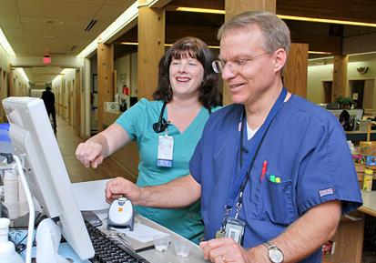
Task Assistance Factors
Factors that influence task assistance include:
The type of situation
Attitudes and beliefs
Style of communication
Notes:
Several factors influence task assistance. Type of situation. Some team members react differently to offer and requests for help during emergent versus routine situations. Effective teams place all offers and requests for assistance in the context of patient safety and progress towards team goals, regardless of the situation.
Attitudes and beliefs. Some attitudes restrict team members from offering or requesting assistance.
Style of communication. Personal style can have a significant influence on support actions taken by the team. A person's tone of voice or use of avoidance
behaviors, such as being inaccessible or elusive, may inhibit others from asking for help.
I worked with a pharmacist who was extremely meticulous and appeared standoffish to anyone who offered any assistance. In reality, this person was somewhat insecure, and this prohibited him from asking for help, feeling that this was a sign of weakness on his part.
When he became more comfortable and trusting with our team and our team's open approach to assistance, we were able to break down those barriers and all work better together. Effective teams demonstrate a willingness to engage in support behaviors whenever there is a need, and they communicate the information necessary to achieve that objective.

Slide 13
Task Assistance Solves A Problem
In regard to task assistance, remember to:
Communicate clear and specific availability of time and skills
Foster a climate supportive of task assistance
Use common courtesy when asking for help
Close the loop on task communication
Account for experience level when asking for help
Notes:
Task assistance completes an activity or solves a problem. In regard to task assistance, remember to communicate clear and specific availability of time and skills when offering assistance. For example, your team looks swamped today. I have 10 minutes before my next patient checks in. I can check in a few of your patients or drop those specimens off at the lab.
Foster a climate supportive of task assistance. Helping each other may have a domino effect. Use common courtesy when asking for help. I worked with a person who, when busy, would shout out, hey, I'm getting creamed. Can I have some help here? His tone and body language was not endearing, but we would provide task assistance, and we coached him to develop a more appropriate way to ask for help.
Close the loop on task communication. Ensure the task was completed correctly, and account for experience level when asking for help. This is one reason why it's important to know who is on your team, their roles and responsibilities, and their experience. You wouldn't want to ask a team member who's never started an IV before to start an IV on a patient who is a known difficult stick, right?

Slide 14
Slide 6: Task Assistance Example
Two members of the GI Laboratory are assessing an elderly patient who has just had conscious sedation for a colonoscopy. The monitor shows SVT at a rate of 150 and a BP of 76/48. The nurse calls out the vital signs while the physician continues to monitor the rhythm. A nurse passing by the room hears the call-out.
Take 5 minutes to consider these two questions:
How would you offer task assistance in this example?
How would you request task assistance in this example?
Notes:
Let's look at an example of task assistance.
Two members of the GI laboratory are assessing an elderly patient who has just had conscious sedation for a colonoscopy. The monitor shows SVT at a rate of 150 and a blood pressure of 76 over 48.
The nurse calls out the vital signs while the physician continues to monitor the rhythm. A nurse passing by the room hears this call out.
Take five minutes and consider how you would answer these two questions. How would you offer task assistance in this example? And how would you request task assistance in this example?
As the nurse passing by the room, you might stop and ask the nurse or doctor if they needed help. Or if they would like you to call the rapid response team. As the nurse in the room, consider calling out to the nurse and asking for help, being specific as to what is needed and the urgency.
Using slide six when you teach, you will review the same brief example of task assistance, and then lead a discussion of the same questions I just asked you.
After participants have had an opportunity to respond, be sure to share your examples if they have not already been mentioned.

Slide 15
What is Feedback? (Slide 7)
Feedback is information provided for the purpose of improving team performance
Ways feedback benefits the team:
Fostering improvement in work performance
Meeting the need for growth
Promoting better working relationships
Helping the team set goals for ongoing improvement
Notes:
Now let's consider the second mutual support strategy, feedback. What is feedback? Feedback is information provided for the purpose of improving team performance. It's the ability to communicate self-improvement information in a useful and respectful way, and is an important skill in the team improvement process. Feedback can be given by team members at any time.
It is not limited to leadership roles or formal evaluation mechanisms. Effective feedback benefits a team in several ways, including fostering improvements in work performance, meeting the team and individual's needs for growth, promoting better working relationships, and helping the team set goals for ongoing improvement.
Take five minutes, and thinking about your experiences, can you describe a situation in which you had to give feedback to another team member? What was the situation? What was the result? An example of when I had provided feedback was when I worked closely with our pharmacy interns.
One of our interns had a pretty aggressive medication counseling technique that could scare any patient out of taking their medication, because the explanation of the potential side effects was just scary. Just positively scary for all involved. Shortly after viewing this technique, I took him aside and provided some guidance on how I counsel, and helped him counsel the next few patients that day.
The result was very positive, and the intern learned from the experience and grew into a great pharmacist today. On a side note, regarding the patient that I viewed that had the original previous aggressive counseling, with the intern we returned to that patient to ensure the patient understood the medication directions, and we addressed any of his concerns from that day, all with a positive outcome.
When you teach after presenting slide seven, facilitate a discussion asking participants these same questions. Can you describe a situation in which you had to give feedback to another team member? What was the situation? What was the result? If participants are having difficulty thinking of an example, share your example to encourage discussion.

Slide 16
Types of Feedback (Slide 8)
Formal
Retrospective and typically scheduled in advance
Has an evaluative quality
Examples: Collaborative discussions, case conferences, individual performance reviews
Informal
Typically in real time
Provided on an ongoing basis
Focuses on knowledge and practical skills development
Examples: Huddles, debriefs
Take five minutes to think about a time when you provided or received feedback.
Was the feedback helpful?
Notes:
Feedback can be provided by anyone on the team at any time. It can be either formal or informal and can be categorized as constructive or evaluative.
Formal feedback tends to be retrospective in nature, is typically scheduled in advance, takes place away from the clinical area, and has an evaluative quality. Examples include collaborative discussion, case conferences, and individual performance reviews.
Informal feedback, on the other hand, typically occurs in real time, on an ongoing basis, and focuses on knowledge and practical skill development. Examples of informal feedback include huddles or debriefs.
Take 5 minutes to think about a time when you provided or received formal feedback. How was the feedback helpful? And now think about a time you provided or received informal feedback. How was that helpful?
I’ve noticed that informal feedback is used frequently in various settings because there are real-time situations that need to be resolved with information sharing. Sometimes feedback can be as simple as complimenting a team member’s skills, the appropriate use of SBAR, or offering an alternative course of action that may yield a better outcome. Other feedback may require the involvement of multiple disciplines when resolving a patient safety issue, and this can be shared with the team as well.
Feedback is a method of providing rich and useful information to enhance teamwork processes and increase patient safety. Ultimately, the aim is to provide feedback that is effective. When you are teaching, facilitate a discussion with your learners by asking someone to share an example of when they provided or received formal or informal feedback and how that feedback was helpful.

Slide 17
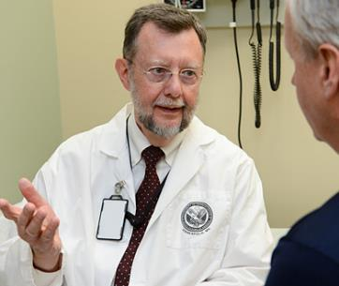
Characteristics of Effective Feedback (Slide 9)
Effective feedback is:
Timely
Respectful
Specific
Directed toward improvement
Helps prevent the same problem from occurring in the future
Considerate
See Instructor Guide, page 13
Notes:
Feedback is the facet of team communication in which learning occurs. Rules of feedback include the following:
It is timely. It is not acceptable to give delayed feedback. Feedback must be timely enough for an individual to be able to readily associate it with the behavior. If you wait too long, facts are forgotten and the feedback loses its punch. Feedback is most effective when the behavior being discussed is still fresh in the mind of the receiver. Delivering feedback several days or weeks after poor performance has occurred is too late for it to be effective. Waiting this long to provide the feedback also allows a person to continue doing something incorrectly, unknowingly, and that can cause harm to a patient or a staff member.
Feedback should be respectful. It should not be personal and it should not be about personality. It should be about behavior. Never attribute a team member's poor performance to internal factors, because such destructive feedback lowers self-efficacy and subsequent performance. When providing negative feedback, it should never be delivered to individuals in front of other team members because there’s the possibility that this approach will cause the individual receiving the feedback to feel humiliated.
It should be specific. Feedback should relate to a specific situation or task. Imagine that you are receiving feedback from a peer who tells you your surgical techniques or patient relationship skills need work. That statement is too general to use as a basis for improvement. The person receiving feedback will be better able to correct or modify their performance if specific actions are mentioned during the feedback.
Feedback should be directed. Goals should be set for improvement. This helps prevent the same problem from occurring in the future.
And feedback should be considerate. Be considerate of team members' feelings when delivering feedback and remember to praise good performance. A feedback message will seem less critical if you provide information on the positive aspects of the person's performance, as well as how the person may improve.
Generally, fairness and respect will cushion the effect of any negative feedback. Feedback is an important tool to reinforce positive behaviors. We all benefit from knowing that we've done a good job and that others have recognized our performance. However, for the feedback to be effective, it must be delivered properly. You must give thought to when and where to give feedback to an individual.
More information on leading a discussion on feedback can be found on Page 13 in the Instructor Guide for this module.

Slide 18
Slide 10: Providing Effective Feedback Video
Let’s view a video example of providing effective feedback
After you view the video, please return to the this browser window to continue this module
Select the image to launch a web browser where you can watch the video
Notes:
Let's view a video example of a doctor providing effective feedback. As you watch the video, keep in mind the guidelines for giving effective feedback. The video is available on the web for viewing. Selecting the image will open a new browser window so you can view the video. After viewing the video, please return to this browser window to continue the module.

Slide 19
Providing Effective Feedback: Video Discussion
What was effective in the feedback provided?
Timely
Respectful and related to behavior
Specific
Directed
Considerate
Why would it be a good practice to share the experience with other team members?
Notes:
Now that you've seen the video, let's discuss it. What was effective in the feedback provided?
You should have noted that the feedback appears to be timely, was respectful and related to behavior, was specific to the situation. It was directed, and it was considerate.
Why would it be a good practice to share the experience with other team members? Because sharing the effective communication technique with others will promote continuous learning.
As you are teaching to staff, after viewing the video ask participants the same questions I just asked you. If the observations we just discussed are not mentioned by your learners, be sure to add them to the discussion.

Slide 20
Feedback Exercise (Slide 11)
Consider this scenario:
An attending physician watches an intern start to place a chest tube in an obese patient in an incorrect location.
Take 10 minutes to write down how you would provide feedback in this scenario
After you have written out your answers, select the Forward button to continue
Notes:
Think about providing effective feedback as you consider this scenario.
An attending watches an intern start to place a chest tube in an obese patient in an incorrect location. Now take 10 minutes to think about and write down your answers describing how you would provide feedback as the attending in this situation.
How would you provide effective feedback in this situation? How would you be timely, respectful, and related to behavior, specific, directed, and considerate?
After you have written out your answers, select the Forward button to continue.

Slide 21
Feedback Exercise Discussion
Example response:
The attending physician corrects the placement of the planned incision by pulling the intern aside, showing the intern the landmarks to use, and demonstrating how the patient’s position on the table is slightly distorting the anatomy.
When you teach, be sure to analyze the responses of your learners for all the aspects of effective feedback
See Instructor Guide, page 15
Notes:
How did you decide to give feedback in this scenario? An example of an appropriate response would be for the attending to correct the placement of the planned incision by pulling the intern aside, showing the intern the landmarks to use, and demonstrating how the patient's position on the table is slightly distorting the anatomy. Let's analyze this response.
Was it timely? Yes. It's immediate. Was it respectful and related to behavior? I'd say yes. The behavior is the focus, and criticism is not directed at the intelligence of the intern. Was it specific? Yes. It suggests specific considerations to be aware of in the future. Was it directed? Yes. It is directed in showing the intern how to evaluate future patients and to be sure the anatomy is not distorted.
Was it considerate? Again, I'd say yes, it is considerate to show that this is an abnormal situation and one the intern had not yet been trained to consider. Also, pulling the intern aside and not embarrassing him in front of the patient was very appropriate. When you teach, ask learners to think about the aspects of providing effective feedback as they review the same scenario we just discussed.
After learners have had a chance to review the scenario, ask them, how would you provide effective feedback? Give them time to plan how they would provide feedback in this example. After about 5 to 10 minutes, ask individuals to share how they would provide their feedback. After allowing a few individuals to share with the group, share the example of actions taken we just discussed.
Be sure to analyze the responses of your learners for all the aspects of effective feedback. See page 15 in the instructor guide for more information on how to facilitate this exercise.

Slide 22
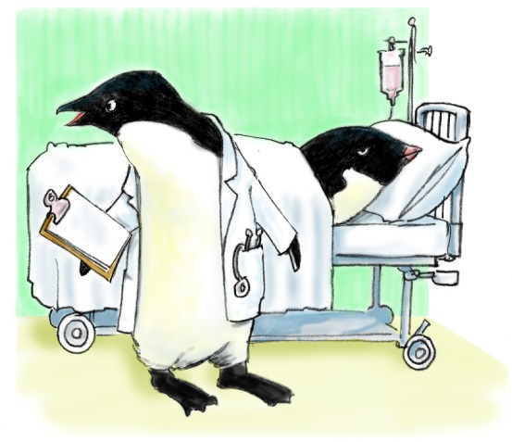
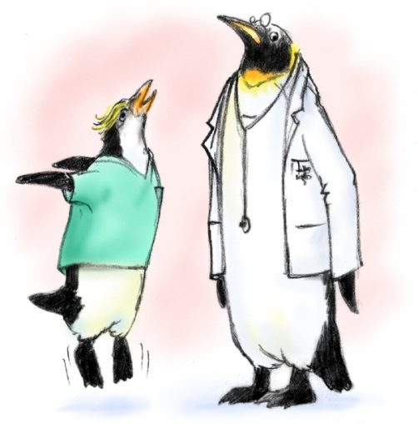
Advocacy and Assertion
Advocate for the patient
Invoked when team members’ viewpoints don’t coincide with that of a decision maker
Assert a corrective action in a firm and respectful manner
Notes:
The third strategy used to facilitate mutual support is advocacy and assertion. These interventions are invoked when a team member's viewpoint does not coincide with that of the decision maker. In advocating for the patient and asserting a corrective action, the team member has an opportunity to correct errors or the loss of a situation awareness.
Failure to use advocacy and assertion has been frequently identified as a primary contributor to the clinical errors found in malpractice cases and sentinel events. You should advocate for the patient, even when your viewpoint is unpopular, is in opposition to another person's view, or questions authority. When advocating, assert your viewpoint in a firm and respectful manner. You should also be persistent and persuasive, providing evidence or data for your concerns.

Slide 23
Advocacy and Assertion Tools
Three Tools:
The Assertive Statement
The Two-Challenge Rule
Using CUS Words
Notes:
We will discuss three tools to empower team members to advocate for the patient and to be assertive when needed-- the Assertive Statement, the Two-Challenge Rule, and using CUS-- that's C-U-S-- words. Each of these tools provides a mechanism whereby team members are able to bring up ideas and concerns using language that is mutually understood by all team members. We will now go through each of these tools in more detail.

Slide 24
The Assertive Statement (Slide 13)
Respectful and supportive of authority
Clearly asserts concerns and suggestions
Is nonthreatening and ensures that critical information is addressed
Five-Step Process:
Open the discussion
State the concern
State the problem—real or perceived
Offer a solution
Obtain an agreement
Notes:
The assertive statement is one tool used to facilitate speaking up when there is a concern for patient safety. Hospital and medical team leadership must foster an atmosphere in which the participation of each medical team member can flourish. This is accomplished by maintaining an environment that is predictable but at the same time retaining the ability to respond to changing clinical situations.
Team members at all levels must always feel their input is valued. More important, their input should be expected, especially in situations that threaten patient safety. Team members must respect and support the authority of the team leader, while clearly asserting suggestions or communicating concerns.
When the situation dictates that the team member must be assertive and address concerns regarding patient care, the assertive statement is the action. It is a nonthreatening, respectful way to make sure the concern or critical information is addressed. It can easily be taught to patients and their family members in a structured way to communicate their concerns to the rest of the care team.
The assertive statement is one tool used to facilitate speaking up when there is concern for patient safety. Step one, open the discussion. Step two, state the concern. Step three, state the problem, real or perceived. Step four, offer a solution. Step five, obtain an agreement.

Slide 25
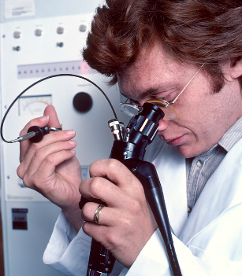
Assertive Statement Example
You’re in the endoscopy suite, and a patient is undergoing a colonoscopy. As the endoscopy nurse, you think you see a possible lesion that was missed.
What should the nurse say in this situation?
Take 10 minutes to write out exactly what you would say
Notes:
Here's an example of a situation in which you could use the Assertive Statement.
Let's say you're in the endoscopy suite and a patient is undergoing a colonoscopy. The endoscopy nurse thinks she sees a possible lesion that may have been missed.
What should the nurse say in this situation? Please take 10 minutes to write down exactly what you would say in this situation, and then select the Forward button to continue.

Slide 26
Assertive Statement Example Discussion
Five-Step Process:
Open the discussion
State the concern
State the problem—real or perceived
Offer a solution
Obtain an agreement
Refer to page 18 in the Instructor Guide for information on facilitating this discussion
Notes:
An example of using the five steps to make your assertive statement might sound like this. Open the discussion. Say the person's name to whom the concern is addressed. Dr. Myers. Then state the concern. I thought I saw something abnormal looking in the cecum just as you started to withdraw the scope.
State the problem, real or perceived. I can't be certain, but the mucosa looked abnormal.
Offer a solution. Since you're so close, it would be easy to check the area.
Obtain an agreement. Would you advance the scope back into the cecum and I'll point out the area I thought might be abnormal?
Check your response to see how similar it was to the response I just provided.
When you are teaching, after providing this scenario to the learners, ask them to consider what an assertive statement might be for this scenario. Then ask them, what should the nurse say in this situation? Ask a few learners to share their possible answers and be sure to share the example I shared with you. Refer to page 18 in this module's instructor guide for information on facilitating this discussion.

Slide 27
The Two-Challenge Rule (Slide 14)
Challenge colleagues if you have requested clarification, but the response does not alleviate the concern
The goal is to create a teamwork culture where team members respectfully challenge one another when the plan is unclear
Notes:
The two challenge rule is another tool used to facilitate team members’ speaking up. In the clinical environment, team members should challenge colleagues if they have requested clarification but the response or confirmation does not alleviate the concern regarding potential harm to the patient.
The two-challenge rule is a way to help team members frame communications about thoughts and reasonings about plans and decisions related to the patient care. The goal is to create a teamwork culture where team members respectfully challenge one another when the plan is unclear or of concern.

Slide 28
Two-Challenge Rule (Slide 15)
Invoked when an initial assertion is ignored…
It is your responsibility to assertively voice your concern at least two times to ensure that it has been heard
The member being challenged must acknowledge
If the outcome is still not acceptable:
Take a stronger course of action
Use supervisor or chain of command
Notes:
It's important to voice your concern by advocating and asserting your statement at least twice, if the initial assertion is ignored, thus the name, the two challenge rule. These two attempts may come from the same person or two different team members.
The first challenge should be in the form of a question. The second challenge should provide some support for your concern. Remember, this is about advocating for the patient. The two challenge rule insures that an express concern has been heard, understood, and acknowledged.
There may be times when an initial assertion is ignored. If after two attempts the concern is still disregarded, but the member believes patient or staff safety is or may be severely compromised, the two challenge rule mandates taking a stronger course of action, or using a supervisor, or chain of command. This overcomes our natural tendency to believe the team leader must always know what he or she is doing, even when the actions depart from established guidelines.
When invoking this rule and moving up the chain, it's essential to communicate to the entire medical team that additional input has been solicited. It's important to have an agreed upon approach of delivering the two challenge rule within your institution. And to obtain buy in from all involved. For example nurses, physicians, and administration.
As with any of the tools and strategies discussed throughout the TeamSTEPPS training, having a standardized method of delivery is critical for effectiveness. The chosen approach must be made known to all team members. That is, everyone must be on the same page and speaking the same language.
An example of the two challenge rule that I had is, really every time I call a provider almost, regarding a prescription or a dose issue, I always state the problem. Then I recommend the dosing schedule that it needs to be. So I may say to the doctor, hi, I've found that the prescription that you are prescribing for should be a once-a-day dosing, but you've prescribed it for twice-a-day. Did you intend twice-a-day?
And usually the response is that they didn't intend twice-a-day. If they did intend it as twice-a-day, then I'd raise it again, and say, can you show me documentation? Is there a reference you could use that states beyond the once-a-day dosing? And if I don't receive an acceptable response, I continue to further question it and not release the medication until there's a consensus, or an understanding is met between us.

Slide 29
Two-Challenge Rule (Slide 16)
Empower any team member to “stop the line” if he or she senses or discovers a breach of safety
This is an action never to be taken lightly, but it requires immediate cessation of the process and resolution of the safety issue
When you teach, ask your learners to share a situation in which they used or could have used the Two-Challenge Rule
See Instructor Guide, page 21
Notes:
If you are personally challenged by a team member, it is your responsibility to acknowledge the concerns instead of ignoring the person. Any team member should be empowered to stop the line if he or she senses or discovers an essential patient safety breach. This is an action that should never be taken lightly, but requires immediate cessation of the process to resolve the safety issue.
Let me provide an example of what a successful use of the two challenge rule might look like. It's late at night during a particularly hectic shift. A distressed young female having an allergic reaction arrives in the ED. She has developed a rash, and is beginning to wheeze. Dr. Andrew, who is new to the ED, orders Benadryl, 125 milligrams IV.
Clara, an experienced pharmacy technician, questions the drug dosage. Dr. Andrew repeats his order for Benadryl, 125 milligrams IV. Clara pursues her challenge a second time, stating, Dr. Andrew, that dose seems high. I've never dispensed more than 50 milligrams IV at a time. Yes, you're right. I was confusing the dose with that of Solu-Medrol, states Dr. Andrew.
Dr. Andrew changes his order, she repeats the correct order back to him, and the correct dose of Benadryl is administered. When you teach the course, you should ask your learners to share a situation in which they used or could have used the two challenge rule. If they are reluctant to speak up, share an example of your own, or you can share the example found on page 21 of the instructor's guide.

Slide 30
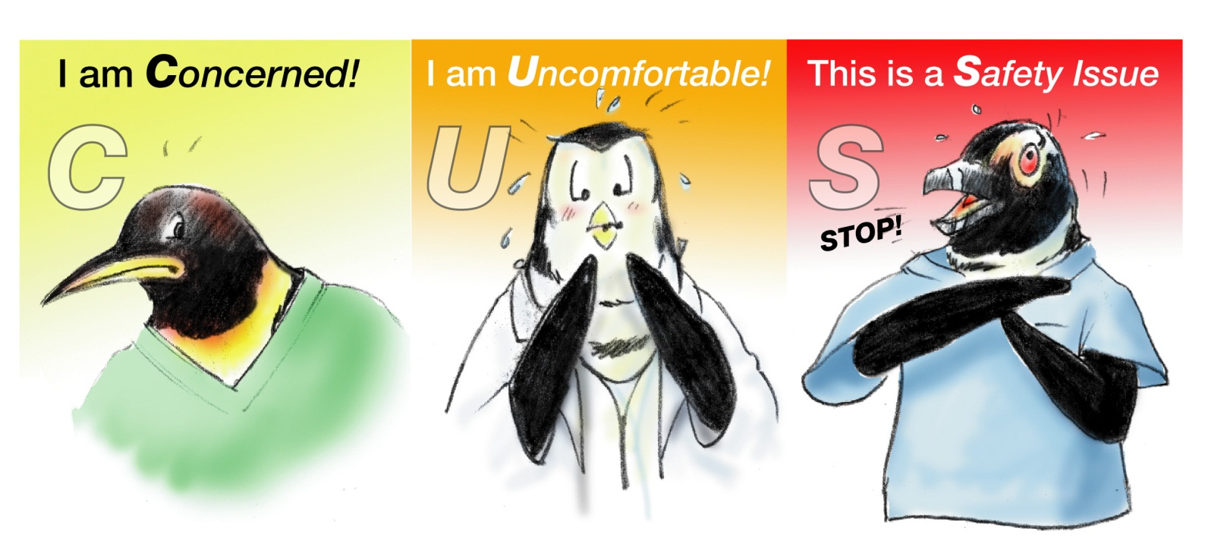
Please Use CUS Words (Slide 17)
“CUS” signal phrases catch the listener’s attention
To use CUS:
Notes:
Using the CUS technique provides another tool for advocacy, assertion, and mutual support. Signal words such as danger, warning, and caution are common in the medical arena. They catch the reader's attention. In verbal communication, CUS and other signal phrases have a similar effect.
If all team members have a shared mental model and are on the same page, when these words are spoken, all team members will clearly understand the issue and its magnitude. To use CUS, first state your concern, then state why you're uncomfortable. If the conflict is not resolved, state that there is a safety issue. Discuss in what way the concern is related to safety.
If the safety issue is not acknowledged, a supervisor should be notified. If your organization is concerned, patients may be alarmed hearing staff say to each other, I am concerned, or I am uncomfortable, or this is a safety issue, there are a few other phrases you can use in this situation as well, such as, I would like some clarity about, or would you like some assistance?

Slide 31
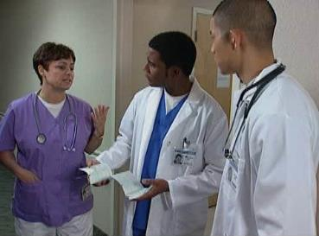
CUS Example Video
Let’s view a video example of using CUS words
After you view the video, please return to the this browser window to continue this module
Select the image to launch a web browser where you can watch the video
Notes:
Let's view a video example of the CUS technique in action. The video is available on the web for viewing. Selecting the image will open a new browser window so you can view the video. After viewing the video, please return to this browser window to continue this module.

Slide 32
CUS Example: Video Discussion
How was the “challenge” presented to the doctor?
Did she state that she was:
Concerned
Uncomfortable
Safety Issue
See Instructor Guide, page 22
Notes:
Now that you've seen the video, let's discuss it.
How was the challenge presented to the doctor? Did you hear her state her concern and that she was uncomfortable with the potential safety issue?
She got the doctor's attention by beginning the challenge in the form of a statement. I am concerned. And then followed up with additional patient vitals.
The nurse was uncomfortable with the late decelerations. She became concerned and uncomfortable that the patient's safety may be at risk.
When you're teaching this portion of the module, after the class has viewed the video ask them this question. How was the challenge presented?
Be sure to include the answers I just provided if not already covered during the discussion. Refer to page 22 in the instructor guide for additional information in facilitating discussion of this video.

Slide 33
Advocacy and Assertion Scenario (Slide 18)
A medical floor nurse is assigned to a patient following a myocardial infarction. The attending physician provides the final treatment, reviews the clinical situation, and determines that the patient is well enough to be discharged.
Before the patient is discharged, the nurse checks the patient’s vitals one last time. The nurse finds it unusual that the blood pressure and heart rate are substantially elevated.
Please take 10 minutes to write out what you would do to address the problem
Notes:
To review our advocacy and assertion strategies, let's analyze this scenario. A medical floor nurse is assigned to a patient following a myocardial infarction. The attending physician provides the final treatment, reviews the clinical situation, and determines that the patient is well enough to be discharged. Before the patient is discharged, the nurse checks the patient's vitals one last time. The nurse finds it unusual that the blood pressure and heart rate are substantially elevated.
Please take 10 minutes to write out what you would do and exactly what you would say to address the problem. When you are finished, select the Forward button to continue.

Slide 34
Advocacy and Assertion Scenario Discussion
What would you do to address the problem?
Would you use:
The Assertive Statement
The Two-Challenge Rule
CUS words
See Instructor Guide, page 23
Notes:
So what was your response? If you were in this situation, what would you do to address the problem? How might you raise the issue to the physician? What TeamSTEPPS tools could you use to help? Did you think about using the assertive statement, the two-challenge rule, or CUS?
Advocating for the patient, and asserting your viewpoint, are both important aspects of engaging in mutual support. However, even when used correctly, the techniques and tools presented may still lead to conflict. Conflict resolution is a skill team members need to develop and cultivate in order to overcome challenges that may arise.

Slide 35
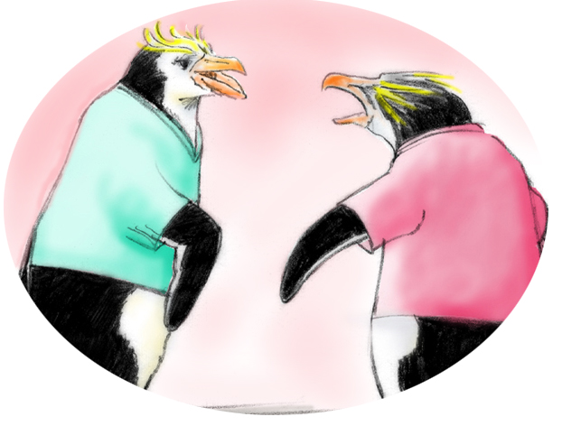
Conflict in Teams (Slide 19)
Informational
Interpersonal
Informational Conflict
(We have different information!)
Interpersonal Conflict
(Hostile and harassing behavior)
Notes:
Because conflict can occur in teams, it is important to know how to handle such situations when they occur. We will be addressing two types of conflict, informational and interpersonal.
Informational conflict involves differing views, ideas, or opinions related to information. This is task related and could involve disagreement about the best method to proceed with a plan of care.
Interpersonal conflict stems from interpersonal compatibility and is not usually task related. This type of conflict tends to revolve around the team members themselves, not the actions or the information. Tension, annoyance, animosity are common, and interactions can become very argumentative. Attempts should be made to resolve both types of conflict before they interfere with work or undermine quality and patient safety.
Informational conflicts left unresolved may evolve into interpersonal conflicts in the long run and severely weaken the teamwork. When you teach this course, ask your learners to share examples of an informational or interpersonal conflict they've encountered and how it was resolved. One of the strongest personal examples of informational conflicts I experienced was when I worked in an environment that lacked updated SOPs or Standard Operating Procedures.
When our group members needed direction, they had to come up with their own answers. This created a lack of continuity in our processes and it led to real problems for our team. Luckily, we had leadership who recognized the problem before it became an individual or interpersonal problem between our members, and it improved by our group getting help and updating the procedures to be more workable for the team.

Slide 36
Disruptive Behavior
Disruptive behavior that should be actively discouraged:
Condescending language
Impatience with questions
Refusal to answer questions
Strong verbal abuse
Threatening body language
Physical abuse
Select here to visit the Department of Defense’s Professional Conduct Toolkit webpage
Notes:
Disruptive behavior among staff should be actively discouraged. Organization should develop guidelines for acceptable behaviors to assist staff in better identifying, reporting, and managing behaviors that cause disruption to patient safety.
Types of disruptive behavior include condescending language or voice intonation, impatience with questioning, rolling of one's eyes in response to a comment or a question, reluctance or refusal to answer questions or telephone calls, strong verbal abuse or threatening body language, and physical abuse.
Resources are available to help address disruptive behavior. For example, the Department of Defense Professional Conduct Toolkit. If you wish to know more about this topic, select the link provided to view the toolkit online.

Slide 37
Tools to Address Conflict in Teams
Informational Conflict
(We have different information!)
Interpersonal Conflict
(Hostile and harassing behavior)
Two-Challenge Rule
DESC Script
Notes:
Two tools that can be used to address conflict in teams are the two challenge rule and the DESC script. The two-challenge rule. As we have already discussed, the two challenge rule can serve as a method to advocate and assert for patient safety, but it can also be used as a strategy to resolve conflict. When team members have different information, the two challenge rule can be used to bring up the differing information so it can be addressed.
The DESC script can be used for both informational and interpersonal conflict, but is more effective when conflict is of a personal nature. Select the forward button to go to the next slide and we will discuss DESC script in more detail.

Slide 38
Conflict Resolution: DESC Script (Slide 20)
A constructive approach for managing and resolving conflict:
D—Describe the specific situation
E—Express your concerns about the action
S—Suggest other alternatives
C—Consequences should be stated
Notes:
The DESC script can be used to communicate effectively during all types of conflict and is most effective in resolving interpersonal conflict. The DESC script can be used in situations involving greater conflict, such as when hostile or harassing behaviors are ongoing and safe patient care is suffering.
DESC is the mnemonic for D, describe the specific situation. E, express your concerns about the action. S, suggest other alternatives. C, consequences should be stated. Ultimately, consensus should be reached.

Slide 39
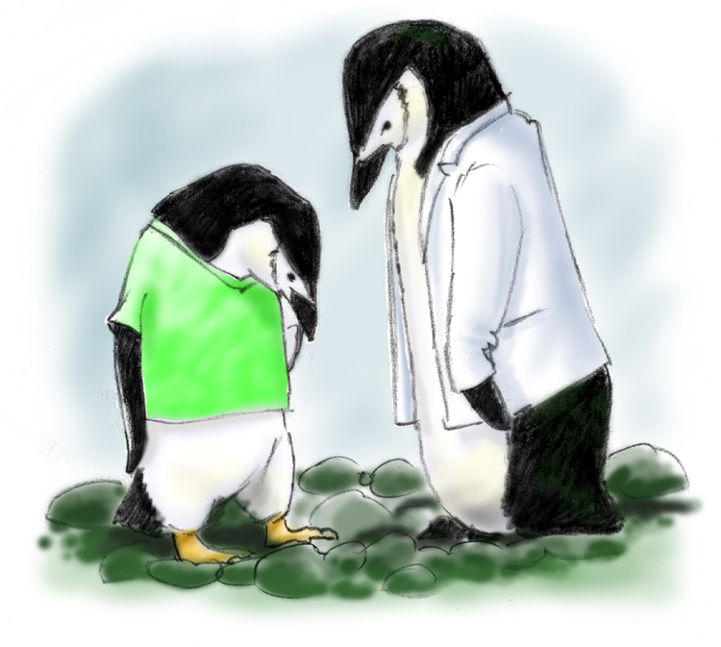
Let’s “DESC It!” (Slide 21)
When using the DESC script:
Have timely discussion
Work on win-win
Frame in terms of your own experience
Choose a private location
Use “I” statements; avoid blaming
Critique is not criticism
Focus on what is right, not who is right
Notes:
There are some crucial things to consider when using DESC script. Have a timely discussion. Work on a win-win. Despite your interpersonal conflict with the other party, team unity and quality of care depend on coming to a solution that all parties can live with. Frame problems in terms of personal experience and lesson learned. Choose the location.
A private location that is not in front of the patient or other team members will allow both parties to focus on resolving the conflict rather than on saving face. Use I statements rather than blaming statements. Critique is not criticism, and focus on what is right, not who is right. One of my TeamSTEPPS co-trainers always gave a great example of DESC scripting her teenagers regarding conflicts in house chores and expectations.
So you can use these tools other than at work. She would describe the problem, and it was always just too funny, but it always worked for her. So her description was once that I noticed that you left dirty dishes in the living room again. That was the description. Then for express, I'm concerned that we may get ants or other undesirable critters about. I need you to step up and help me.
Suggestion, might I suggest you place the dirty dishes in the dishwasher to be washed, or wash them in the sink, or put them away? Consequences. Leaving dirty dishes around isn't good for the cleanliness of our house, and none of us like having to clean up after each other.
Having food outside the kitchen or dining room is a convenience that could easily go away. It's your responsibility, too, to help and keep our environment comfortable and clean. So what do you say? Can we come to an agreement with your help?

Slide 40
A DESC Scenario (Slide 22)
Consider this scenario:
A nurse feels that a patient has abdominal distension and pain secondary to a distended bladder and needs a Foley catheter. The nurse receives the order from the resident on call. When the attending later realizes that the order was given without his consent, he raises his voice to the resident in front of staff and the patient.
Take 10 minutes to write down how you would use the DESC script in this scenario
Notes:
Let's examine a scenario with conflict. A nurse feels that a patient has abdominal distension and pain secondary to a distended bladder and needs a Foley catheter. The nurse receives the order from the resident on call. When the attending later realizes that the order was given without his consent, he raises his voice to the resident in front of staff and the patient. Please take 10 minutes to write out how you would use the DESC Script in this situation and then select the Forward button to continue.

Slide 41
A DESC Scenario (Slide 22)
How did you use DESC?
D - Describe the specific situation
E - Express your concerns about the action
S - Suggest other alternatives
C - Consequences should be stated
Notes:
So how did you use DESC script in this scenario? Here's one example of how the resident could use DESC in this situation.
D, describing the situation. I am sensing that you are upset with me for ordering the Foley catheter for your patient.
E, expressing your concerns about the action. When you question my judgment in front of others, it embarrasses me and makes me very uncomfortable. It also undermines my credibility with the patient.
S, suggesting other alternatives. If you're concerned or have a question regarding my performance, I would appreciate it if you would speak to me in private.
And then C, stating the consequences. A private conversation would be more beneficial to me because I would feel less embarrassed, and would be able to ask questions and supply information. Can we agree to follow such a procedure if this were to occur again?
When you are teaching, after reading the DESC scenario, give learners 10 minutes to write down their DESC script for this situation. When 10 minutes has passed, ask for one to two volunteers to share their DESC script.
If no one volunteers, to facilitate discussion, share your example, or you can share the example I just shared with you. Refer to page 28 in the instructor guide for further information on facilitating this slide, and for an example DESC script corresponding to this scenario.

Slide 42
Tools & Strategies Summary
BARRIERS
Inconsistency in Team Membership
Lack of Time
Lack of Information Sharing
Hierarchy
Defensiveness
Conventional Thinking
Complacency
Varying Communication Styles
Conflict
Lack of Coordination and Follow-up With Coworkers
Distractions
Fatigue
Workload
Misinterpretation of Cues
Lack of Role Clarity
TOOLS and STRATEGIES
Communication
SBAR
Call-Out
Check-Back
Handoff
Leading Teams
Brief
Huddle
Debrief
Situation Monitoring
STEP
I’M SAFE
Mutual Support
Task Assistance
Feedback
Assertive Statement
Two-Challenge Rule
CUS
DESC Script
OUTCOMES
Shared Mental Model
Adaptability
Team Orientation
Mutual Trust
Team Performance
Patient Safety!!
Notes:
Effectively communicating, having active leadership, and continually monitoring the situation will all affect the ability of team members to support one another. Continuous mutual support behaviors among team members will ultimately foster a shared mental model, adaptability, team orientation, and mutual trust.
Tools and strategies to enhance mutual support include task assistance, feedback, the assertive statement, the two-challenge rule, CUS, and DESC script. Use of these tools will lead to more adaptive and effective patient care.

Slide 43
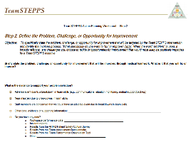
Slide 24: Applying TeamSTEPPS Exercise
Take 15 minutes to answer these questions:
Is your teamwork issue related to mutual support?
If yes, what is the mutual support issue?
Which mutual support tools or strategies might you consider implementing to address the issue?
Select here to download and print the TeamSTEPPS Implementation Worksheet and answer the questions.
Notes:
Now return to your TeamSTEPPS implementation worksheet and take 15 minutes to complete these questions.
Is your teamwork issue related to mutual support?
If yes, what is the mutual support issue?
Which mutual support tools or strategies might you consider implementing to address the issue?
If you have questions, remember to select the Question button to ask via email. When you have completed this exercise, select the Forward button to wrap up this module.

Slide 44
Module 6 Summary
In this module you learned to:
Describe how mutual support affects team processes and outcomes
Discuss specific strategies to foster mutual support (e.g., task assistance, feedback)
Identify specific tools to facilitate mutual support
Describe conflict resolution strategies
Notes:
In this module, you learned to describe how mutual support affects team processes and outcomes, discuss specific strategies to foster mutual support, for example, task assistance and feedback, identify specific tools to facilitate mutual support, and describe conflict resolution strategies.

Slide 45
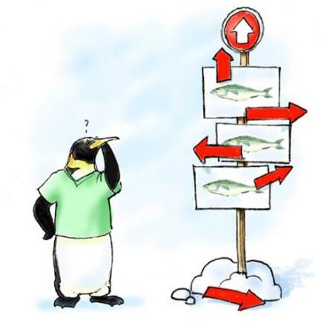
Module 6 Conclusion
This concludes Module 6 of the TeamSTEPPS 2.0 Online Master Trainer Course
Go to Module 7
Module 6
Module 7
Notes:
This concludes module six of the TeamSTEPPS 2.0 Online Master Trainer Course. To complete this module and receive accreditation, you must return to the TeamSTEPPS Learning Management System and complete the Module Six post test.

