Slide 1
Module 7: Pulling It All Together
Welcome to the
Online Master Trainer Course
Notes:
Welcome to module seven of the TeamSTEPPS 2.0 online master trainer course, pulling it all together. This is Dr. Brigetta Craft, and I'll be guiding you through this module. Here, we will review the TeamSTEPP skills, tools, and strategies, review TeamSTEPPS outcomes, conduct a skills practice exercise, and identify opportunities to use effective TeamSTEPPS tools.

Slide 2
How This Online Course Works
This online course will walk you through the TeamSTEPPS content just as you will present it when you train your colleagues and staff
It teaches you all the concepts that comprise the TeamSTEPPS initiative
While also teaching you to teach TeamSTEPPS to your colleagues
Use the navigation buttons in the lower right to work through the online modules
Select here to move back to the previous slide
Select here to move to the next slide
Notes:
This online course will walk you through the TeamSTEPPS content just as you will present it when you train your colleagues and staff at your facility. It teaches you all the concepts that comprise the TeamSTEPPS initiative while also teaching you how to teach the TeamSTEPPS content to your colleagues. Use the navigation buttons on the lower right to work through the online modules. Select the forward arrow to move to the next slide. And select the back arrow to go back to the previous slide.

Slide 3
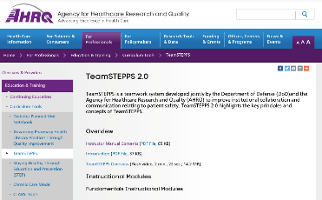
The Materials You Will Use
When you deliver your training you will use these materials:
Instructor Manual
Course Management Guide
Instructor guides
Course slides
Measurement tools
Customizable materials
Videos
Select here to review materials on the TeamSTEPPS website
Notes:
When you deliver the TeamSTEPPS training at your facility, you will use a variety of materials and resources provided on the AHRQ TeamSTEPPS website. We will discuss them more later in this module. Please select the link provided if you would like to review these materials on the TeamSTEPPS website.

Slide 4
Please Print the Instructor Guide
To best use this online module, please print the Module 7 Instructor Guide, located here
Read page 3 in the guide before we begin
Then we will proceed to work through the slides you will use to train – just as if you are delivering this module at your facility.
Notes:
To best use this online module, we recommend that you print the instructor guide for module seven as a reference to use throughout the module if you have not already done so. Before continuing to the next slide, please take a moment to read through page three in the guide. Once you've done that, select the forward button and we'll proceed to work through the slides you will use to train, just us if you were delivering the module at your facility.

Slide 5
Slide 2: Objectives
You will use slide 2 to introduce the objectives for this module
See page 4 in the Instructor Guide for details on how to facilitate this slide
Notes:
You will use slide two to introduce the objectives for this module. Please refer to page four in the instructor guide for details on how to facilitate this slide. After completing the module you'll be able to discuss how to use the tools and strategies presented in this training, and demonstrate how to appropriately apply the tools and strategies in clinical scenarios.

Slide 6
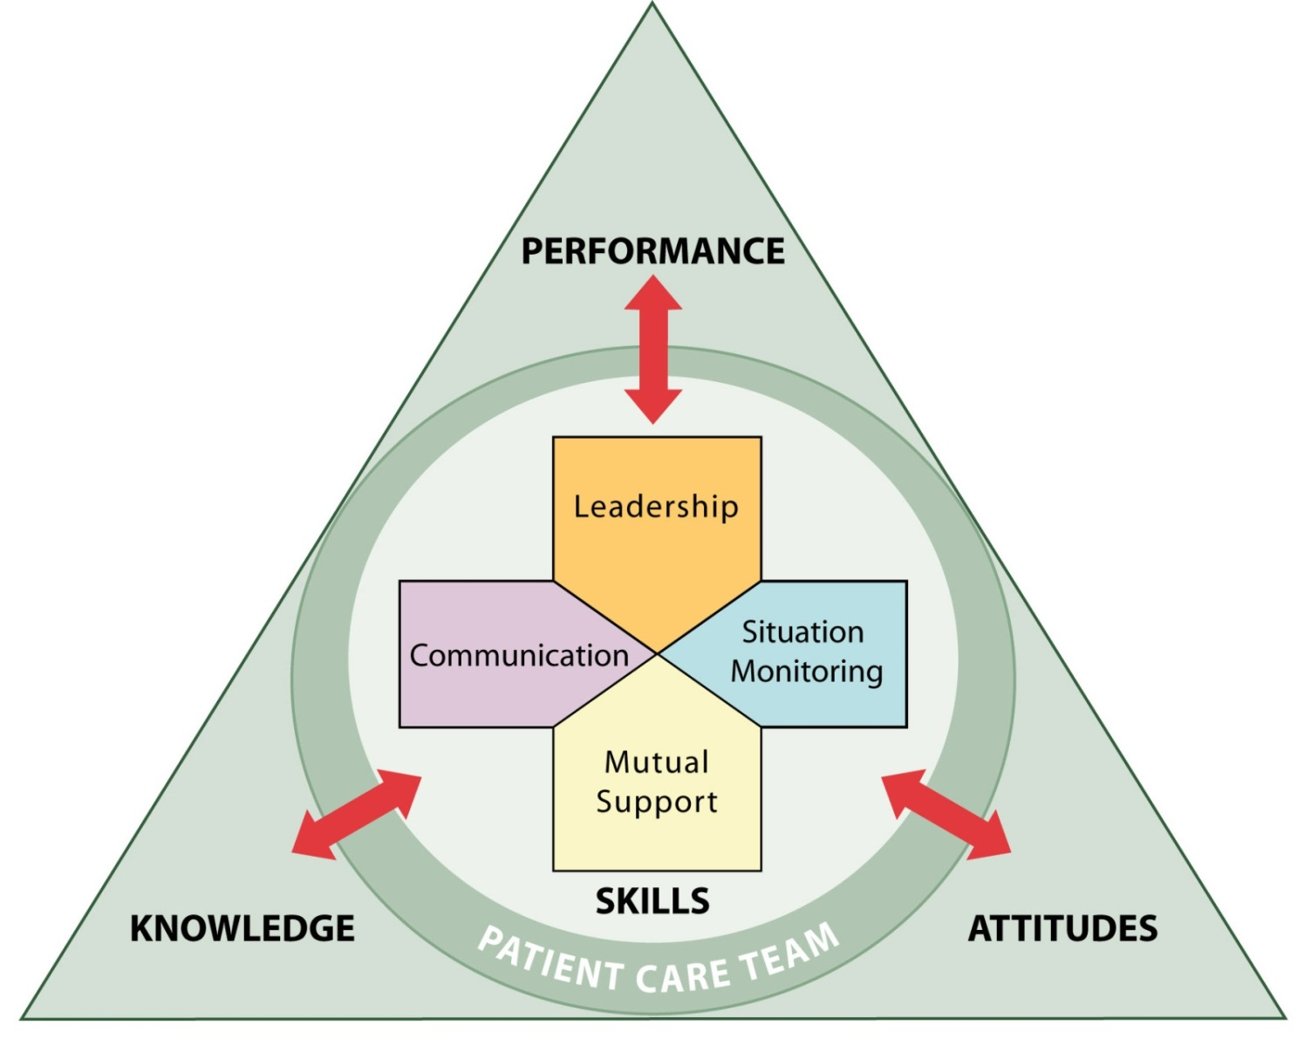
The TeamSTEPPS Framework
We covered these topics:
Team Structure
Communication
Leadership
Situation Monitoring
Mutual Support
Each TeamSTEPPS skill:
Facilitates teamwork
Is dependent upon the other skills
Contributes to performance, quality of care, and patient safety
Notes:
The tools and strategies presented in the TeamSTEPPS curriculum correspond to individual teamwork skills. The topics we've covered in previous modules are team structure, communication, leadership, situation monitoring, and mutual support. Each tool and strategy within these topics can be applied to facilitate teamwork in a variety of complex situations. As you have seen, all of the teamwork skills are dependent upon or moderated by the other skills. And in each case, the tool or strategy can have a direct effect on team results such as team performance, quality of care, and patient safety.
Throughout the course, we've stressed the importance of recognizing the patient and their family as part of the team. When the patient and their family feel that they have been heard, respected, and valued as part of that team, they report a more favorable experience. Do your patients report the same? You may consider comparing your patient satisfaction results pre- and post-implementation of your TeamSTEPPS initiative. Equally important, is recognizing and acknowledging that both clinical and non-clinical staff have an important role in impacting the care of the patient.
Select the forward button to hear our guest speaker, Colonel Beard-Howell, review the teamwork skills covered in the previous modules. Colonel Beard-Howell is a dentist stationed at Fort Detrick, Maryland, and has been a TeamSTEPPS master trainer since 2009. Colonel Beard-Howell?

Slide 7
Review: Team Structure (Module 2)
Team Structure:
Identifying the individuals among which information must be communicated
A leader must be clearly designated
Mutual support must occur
Notes:
Hello, my name is Dr. Ingrid Beard-Howell. I'm a dentist in the United States Army and I currently serve as the officer in charge of the dental clinic at Fort Detrick. I have been a TeamSTEPPS instructor for five years. And TeamSTEPPS has been a focal point of clinic operations at every facility I have worked in and/or have managed since its implementation in the Army. It is the foundation for clinic and team cohesiveness, which is essential in our fast paced, ever changing military environment.
In module two, we learned about team structure. Team structure facilitates teamwork by identifying the individuals among which information must be communicated, a leader must be clearly designated, and mutual support must occur. You'll remember that in this module, Dr. Karen Baum from the University of Minnesota, discussed different teams that make up the multi-care system for patient care. This includes the patient, the core team, the contingency team, the coordinating team, ancillary and support services, and administrative services. For each, she discussed the team's roles and responsibilities.
For example, when discussing the contingency team, Dr. Baum provided the example of trauma teams. Because more often than not, individuals on the trauma team are not familiar with one another, having clearly defined roles and identifying a leader becomes critical. At the University of Minnesota, members of the trauma team are told to stand in a specific place based on their roles and responsibilities so everyone else knows who they are so information can be communicated clearly and mutual support can be facilitated.
When you teach, remember to provide examples of team membership and discuss how these teams function in your organization, and stress that all areas are part of the patient care system. Remember, there are no areas that we interact with that do not, in some manner, impact our health care system.

Slide 8
Review: Communication (Module 3)
Communication:
Effectively relaying relevant information in a manner that is known and understood by all
Strategies:
SBAR
Call-Outs
Check-Backs
Handoffs
Notes:
In module three, we learned about communication. Communication facilitates teamwork by enabling team members to effectively relay relevant information in a manner that is known and understood by all. Ross Ehrmantraut from the University of Washington discussed four TeamSTEPPS strategies to effectively communicate, including SBAR, call-outs, check-backs, and handoffs.
SBAR provides a standardized form of communication. It is important to let the team know what we are seeing or thinking and be able to explain our reasoning for what we think is going on. This enables us to be on the same page. Ross provided both a medical example and a real life example of a check-back.
The medical example was regarding a patient's blood pressure that was falling. His real life example is something that we encounter daily at Starbucks when we place an order, such as a venti nonfat sugar free vanilla latte. The cashier taking the order repeats it back to the customer, as well as the barista. The barista repeats the order back to the cashier and the cashier confirms by saying "correct" to verify and close the communication loop.
This every day example is a great way to reinforce TeamSTEPPS strategies in a simplistic manner. And, as Ross said, wouldn't it be great if we treated our communication about patients as important as our morning coffee? When you teach, be sure to provide examples applicable to the various areas within your organization.

Slide 9
Review: Leading Teams (Module 4)
Leadership:
Facilitates teamwork through effective communication
Continuously monitors the situation to anticipate needs and manage resources
Fosters of an environment of mutual support
Remember to use the brief and debrief checklists contained in the Pocket Guide
Notes:
In module four, Leading Teams, we learned about leadership. Leadership facilitates teamwork through leader's effective communication with their team members to ensure a plan is conveyed, reviewed, and updated. It also includes continuous monitoring of the situation to better anticipate team member's needs and effectively manage resources, as well as fostering an environment of mutual support through role modeling and reinforcement.
In this module Dr. Kevin Krane, from Tulane University, highlighted several strategies to help leaders effectively communicate, to facilitate that environment of mutual support through briefs, huddles, and debriefs. If you remember, Dr. Krane discussed how to effectively hold a brief and components of a briefing checklist. Similar to when flying in an airplane, Dr. Krane mentioned there is a briefing checklist for everyone involved, including the pilot and the flight attendants. This should be no different in health care.
The perfect time for a brief might be at the start of a shift or before procedure. Dr. Krane shared that in his area, nephrology, a briefing would occur before a procedure-- like a kidney biopsy. On the briefing checklist he highlighted that some of the items include having the consent signed, whether or not appropriate bleeding tests have been reviewed, and if the patient's blood pressure is appropriate. Items such as these are critical for the team to review together before the start of a procedure.
Use the brief and debrief checklist contained in the pocket guide as a template as what minimally should be included. But add specifics relevant to your area of work. What information is important for the team to share before starting the day, the shift, or the procedure? The brief is one mechanism that allows us to be proactive. The team should know the plan, know what is needed, and who is needed. This decreases surprises. And while surprises are nice on your birthday, the same is not true in health care. The debrief is an opportunity to provide feedback to the team as to what went well, what should change, and what should improve. This allows the team to discuss and make adjustments as necessary.

Slide 10
Review: Situation Monitoring (Module 5)
Situation Monitoring:
Ensures that new information is identified for communication
Leads to the effective support of fellow team members
Notes:
In module five, we learned about situation monitoring. Situation monitoring facilitates teamwork by ensuring that new or changing information about the environment or the patient is identified for communication and decision making by the leader, and leads to the effective support of fellow team members. Remember the paper chain video? And how the team leader was mindful of the time remaining, and directed staff to stop cutting strips of paper, and assist with building the chain? You could say he used the STEP process. He was aware of the status of the chain, the length, the team members, who was performing what tasks, the environment, the time remaining, and the progress toward the goal to make the longest looped paper change.
Lieutenant Vastola spoke about situation monitoring being a continuous process of actively scanning and assessing elements of the situation to gain information, and also to maintain an accurate understanding of the situation in which the team functions. This enables team members to identify potential issues or minor deviations early enough to correct and handle them before they become a problem, or pose a harm to the patient.
This then leads to the individual outcome of situational awareness. And here, that individual has two choices. They can keep this information to themselves-- and we all know individuals who do just that-- or they can share the information with the team, resulting in a team outcome, a shared mental model. Sharing relevant information helps ensure that everyone on the team is on the same page.
We don't want our team to be the team in the picture Lieutenant Vastola shared with us, where one member of the team showed up in shorts and a polo shirt, when he should have been wearing full protective gear. Observing the actions of fellow team members-- or cross-monitoring-- is not spying. It is a safety mechanism that should be used to prevent or mitigate errors before the patient or staff are harmed. This is commonly referred to as, "watching each other's back." During this module, we heard Lieutenant Vastola stress that all staff members need to be constantly aware of the situation, anticipate the next steps, and watch each other's back. And take appropriate corrective action to keep our staff and patients safe.

Slide 11
Review: Mutual Support (Module 6)
Mutual Support:
Giving task assistance
Sharing feedback
Speaking up
Moderated by communication
Modeled by team leaders
Depends on information gathered through situation monitoring
Notes:
In module six, we learned about mutual support. Mutual support facilitates teamwork by ensuring that by giving task assistance, sharing feedback, and speaking up, team members provide safe, timely, and quality care. It is moderated by communication and modeled by team leaders. In addition, mutual support depends on information gathered through situation monitoring.
Our guest speaker Miss Julia Gannon described mutual support as the essence of teamwork. She went on to describe it as a safety net to help prevent errors, increase effectiveness, and minimize strain caused by work overload. What happens when we are stressed and have too much on our plate? Things tend to fall through the cracks, don't they? We may forget details or a task.
Trust is a critical aspect of mutual support. It is important that you feel that you can trust your team member to watch your back and not stand back. Over time, Miss Gannon explained, continuous mutual support fosters team adaptability, mutual trust, and team orientation.

Slide 12
Tools & Strategies Summary
BARRIERS
Inconsistency in Team Membership
Lack of Time
Lack of Information Sharing
Hierarchy
Defensiveness
Conventional Thinking
Complacency
Varying Communication Styles
Conflict
Lack of Coordination and Follow-up With Coworkers
Distractions
Fatigue
Workload
Misinterpretation of Cues
Lack of Role Clarity
TOOLS and STRATEGIES
Communication
SBAR
Call-Out
Check-Back
Handoff
Leading Teams
Brief
Huddle
Debrief
Situation Monitoring
STEP
I’M SAFE
Mutual Support
Task Assistance
Feedback
Assertive Statement
Two-Challenge Rule
CUS
DESC Script
OUTCOMES
Shared Mental Model
Adaptability
Team Orientation
Mutual Trust
Team Performance
Patient Safety!!
Notes:
Throughout this course, you have received information about barriers to team effectiveness, tools and strategies to overcome such barriers, and outcomes of effective teamwork. You have learned communication tools, such as SBAR, handoffs, and call-outs. You have also learned about leadership strategies for managing resources, along with tools for facilitating team events, such as briefs, huddles, and debriefs. In addition, you learned the situation monitoring mnemonic STEP, and mutual support tools, such as the two-challenge rule, CUS, and DESC Script.
Remember, that enhanced patient safety is the ultimate outcome of consistently incorporating the TeamSTEPPS tools, strategies, and behaviors into your daily activities to overcome barriers to team effectiveness. Everyone in the organization is part of the health care system and TeamSTEPPS helps us function as a part of a team within that system to achieve our goal of ensuring our patient's and our staff's safety. This is the basis of a culture of safety. To quote a colleague of mine, "Don't shortchange your personnel by not allowing them to feel and be a part of the team. We owe our patients that diligence."

Slide 13
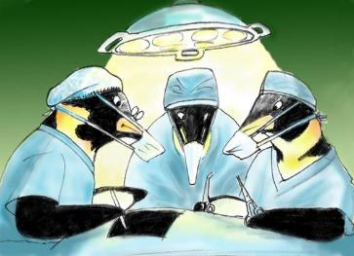
TeamSTEPPS Outcomes
Team Training results in:
Improved team performance
(see: Weaver, et al., 2010)
Improved team processes
(see: Capella, et al., 2010)
Improved patient safety culture
(see: Thomas & Galla, 2013)
Notes:
Before you practice applying the TeamSTEPPS tools and strategies, let's review what implementation of this program can do for your facility, unit, or organization. Research has shown that team training in general, and specifically for health care teams, results in positive team outcomes. These include improved team performance, improved processes, and improved patient safety culture.
In our dental clinic, we use the TeamSTEPPS tools-- brief, huddle, debrief, task assistance, and check back-- regularly, on a daily basis. And what we have found is that we have minimized our chart disorder, we have improved the type of care that we provide to our patients, and our patients feel that they're getting the very best that the Army dental care system can provide for them. These are the advantages of TeamSTEPPS in our facility.

Slide 14
Skills Practice (Slide 6)
When you teach, you will have the participants practice skills they have learned
For now, choose one teamwork skill to practice
Use the scenario in the Practice Exercise Sheet
Take 10 minutes to read and answer questions
When you teach:
Four small groups
Remind groups that they may refer to their course materials for specific tools and strategies
See pages 8 – 10 in the Instructor Guide for more information
Notes:
When you are teaching this module, this is the point at which you will have the participants practice some of the skills they have learned. As with most exercises and activities in this course, the details of the scenario used for exercises may be modified so the activity is relevant to your specific group of learners.
For the purpose of this course, of the teamwork skills we have discussed-- communication, leadership, situation monitoring, and mutual support-- I'd like you to choose one teamwork skill to practice. Using this scenario, which is included on the summary skills practice exercise sheet, take 10 minutes to read through the scenario and answer the questions on the exercise sheet. You may find it helpful to refer to your course materials for specific tools and strategies.
So when you're teaching the exercise, you'll help the participants form four small groups. Then you'll distribute the summary skills practice exercise sheet to each group, and assign one teamwork skill-- communication, leadership, situation monitoring, or mutual support-- to each group to practice. When you're ready to begin, you'll provide your participants the following instructions:
Each of you should be in one of four small groups, each assigned to focus on one of four teamwork skills. Read the scenario. Identify the instances where a breakdown in teamwork has occurred as it relates to the specific teamwork skill assigned to your team. Identify two to three tools or strategies related to the specific teamwork skill assigned to your team that can be applied to remedy the teamwork breakdowns.
Please refer to your course materials if needed. Assign roles among your team members and create a script to enact the scenario based on the tools and strategies that your team has decided on. Time permitting, be prepared to present your scripted scenario to the class. During the exercise, you may need to remind groups that they may refer to the course materials for specific tools and strategies for their assigned teamwork skill. The detailed explanation of this exercise and questions to facilitate discussion can be found on pages 8 to 10 of this module's instructor guide.

Slide 15
Identify TeamSTEPPS Opportunities (Slide 7)
Use the Pocket Guide to review the following videos
This first video demonstrates breakdowns in teamwork
Make notes of any barriers presented and strategies that could be used to address them
Select the image to launch a web browser where you can watch the video
Notes:
Now would be a great time to pull out your pocket guide to help you review the following videos. To review what you've learned across the modules, you will first watch a video scenario that demonstrates breakdowns in teamwork. Let's see if you can identify the breakdowns and apply a TeamSTEPPS tool or strategy to remedy them. As you watch the video make note of any barriers presented and the tools and strategies that could be used to address the barriers.
The video is available on the web for viewing. Selecting the slide image will open a new browser window so you can view the video. After viewing please return to this browser window to continue the module.

Slide 16
TeamSTEPPS Opportunities: Discussion
What were the barriers?
Lack of:
Information-sharing
Coordination
Follow-up
Shared mental model
Which tools and could have been used?
Debrief after the surgery
Handoff from recovery to floor nurse
Follow-up by the nurse
Sharing of test results
Sharing of information by Mrs. Peters
Including family member in instructions
When you teach, discuss these questions with your participants
Notes:
Let's review what you saw in the video. What were the barriers presented in this video scenario? You should have noted a lack of information sharing, a lack of coordination, lack of follow-up, and lack of a shared mental model.
Which of the TeamSTEPPS tools and strategies could have been used, and how would the outcome have been different? Debrief after the surgery or a huddle after Mrs. Peters was in the recovery room to ensure the entire care team knew of Dr. Daniel's concerns. A better hand-off from recovery to floor nurse. Follow-up by the nurse who noticed something in the charts, but did not follow up with the doctor to confirm or clarify. Sharing of test results that came back with important information that was not shared with the care team. Sharing of information by Mrs. Peters to make the care team aware of her changing symptoms. And including a family member in instructions since Mrs. Peters was not fully recovered from anesthesia.
When you teach, you should discuss these same questions with your participants after they have viewed the video. Be sure to remind participants that they can use their pocket guides as a resource while viewing the video. Be sure to include the answers we just reviewed if not brought up by the participants.

Slide 17
Effective Use of TeamSTEPPS (Slide 8)
This second video demonstrates effective use of TeamSTEPPS tools and strategies
Make notes of how the tools and strategies are used effectively
Select the image to launch a web browser where you can watch the video
Notes:
Now that we have analyzed this scenario and identified opportunities to use TeamSTEPPS strategies and tools to improve the outcome, let's watch an example of the same scenario when effective teamwork is displayed. As you watch the video, make note of how the TeamSTEPPS tools and strategies are used effectively. The video is available on the web for viewing. Selecting the slide image will open a new browser window so you can view the video. After viewing, please return to this browser window to continue the module.

Slide 18
Effective Use of TeamSTEPPS: Discussion
Which TeamSTEPPS strategies and tools were used?
SBAR between physician and the nurse
Handoff from recovery nurse to floor nurse
Brief at start of new nursing shift
Check-back by Mrs. Peters and her daughter
Check-back between the physician and pharmacist
How did the TeamSTEPPS tools and strategies affect the course and outcome of the scenario?
When you teach, discuss these questions with your participants
Notes:
Let's review what you saw in the video. Which TeamSTEPPS strategies, and tools did you identify in this scenario? Several TeamSTEPPS strategies and tools were used, including SBAR between the physician and the recovery room nurse, a structured hand-off from the recovery room nurse to the floor nurse, there was a brief at the start of the new nursing shift, check-back by Mrs. Peters and her daughter of signs and symptoms to monitor, and a check-back to confirm understanding of medication orders and dosing between the physician and the pharmacist.
How did the use of these TeamSTEPPS tools and strategies affect the course and outcome of this scenario? Mrs. Peters and her daughter were included as valued members of the team. They had a clear understanding of when to notify the nurse, and Mrs. Peters’ daughter was able to remind her mother of these symptoms. Information was continually shared with the care team, resulting in a shared mental model of Mrs. Peters’ status and plan of care. Also, the team members appeared aware of their roles and responsibilities and ensured that the team leader-- the physician-- was informed of changes in Mrs. Peters’ status so that she could modify the plan of care.
The result? Mrs. Peters was discharged because the team's performance ensured patient safety. When you teach, facilitate a discussion of these same questions with your participants. And be sure to add what we have just reviewed, if not already brought up by those in the class.

Slide 19
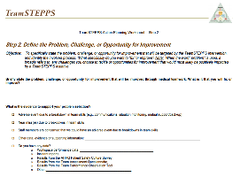
Applying TeamSTEPPS Exercise
Take 15 minutes to answer these questions:
Are there any changes you would make to your assessment your teamwork issue?
If yes, what is the teamwork issue that needs to be addressed?
If you had to identify only one tool or strategy to implement first, which one would it be and why?
Select here to download and print the TeamSTEPPS Implementation Worksheet and answer the questions.
Notes:
Now return to your TeamSTEPPS implementation worksheet and take 15 minutes to complete these questions. Are there any changes you would make to your assessment of the teamwork issue that needs to be addressed in your organization? If yes, what is the teamwork issue that needs to be addressed? If you had to identify only one tool or strategy to implement first, which one would it be, and why? If you have questions, remember to select the question button to ask via email. When you have completed this exercise select the forward button to wrap up this module.

Slide 20
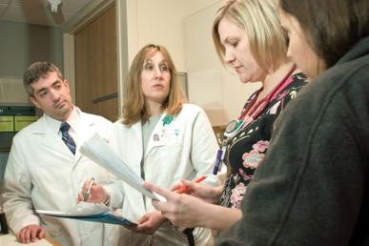
Module 7 Summary
In this module you learned that team strategies and tools:
Are available to both team members and leaders
Can be used to address barriers to team effectiveness
Can all be applied to most situations because they complement one another
Notes:
In this module, we reviewed the previous modules in the TeamSTEPPS online master trainer course, and learned that team strategies and tools are available to both team members and leaders, can be used to address barriers to team effectiveness in a given situation, and can be applied to most situations because they complement one another. As I mentioned before it does not matter where we work in the health care system, we all need to be cognizant of the role we can play in the safety of our patients, even if we never touch a patient. As you teach this curriculum, be sure to share your examples and stories, just as each of our speakers have throughout this course. Never underestimate the power of a good story to influence behavior over time.

Slide 21
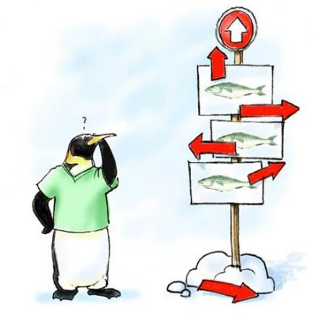
Module 7 Conclusion
This concludes Module 7 of the TeamSTEPPS 2.0 Online Master Trainer Course
You have completed the Fundamentals course. The remaining modules are supplemental.
Go to Module 8
Module 7
Module 8
Notes:
This concludes module seven of the TeamSTEPPS 2.0 online master trainer course, and is the final module that makes up the fundamentals course. These are the modules you will use to introduce your staff to the tools, strategies, and behaviors of the TeamSTEPPS initiative. Supplemental modules are available that address additional topics such as change management, coaching, and implementation.

