Slide 1
Module 8: Change Management
Welcome to the
Online Master Trainer Course
Notes:
Welcome to module eight of the TeamSTEPPS 2.0 online master trainer course, Change Management: How to Achieve a Culture of Safety. This is Dr. Brigetta Craft, and I'll be guiding you through this module. Cultivating a culture of safety will require you to put in place a new organizational change strategy.
In this module, we'll present information about change management and how it can help you achieve a culture of safety. Also, we'll highlight John Kotter's eight steps of change and introduce change management strategies that can be adapted by any organization.

Slide 2
How This Online Course Works
This online course will walk you through the TeamSTEPPS content just as you will present it when you train your colleagues and staff
It teaches you all the concepts that comprise the TeamSTEPPS initiative
While also teaching you to teach TeamSTEPPS to your colleagues
Use the navigation buttons in the lower right to work through the online modules
Select here to move back to the previous slide
Select here to move to the next slide
Notes:
This online course will walk you through the TeamSTEPPS content just as you will present it when you train your colleagues and staff at your facility. It teaches you all the concepts that comprise the TeamSTEPPS initiative while also teaching you how to teach the TeamSTEPPS content to your colleagues.
Use the navigation buttons on the lower right to work through the online modules. Select the forward arrow to move to the next slide. And select the back arrow to go back to the previous slide.
Select the question mark button to send a question to the TeamSTEPPS experts, or select the FAQ button to get help and view frequently asked questions.

Slide 3
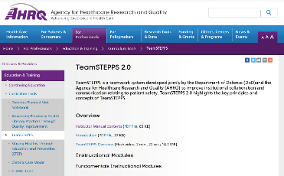
The Materials You Will Use
When you deliver your training you will use these materials:
Instructor Manual
Course Management Guide
Instructor guides
Course slides
Measurement tools
Customizable materials
Videos
Select here to review materials on the TeamSTEPPS website
Notes:
When you deliver the TeamSTEPPS training at your facility, you will use a variety of materials and resources provided on the AHRQ TeamSTEPPS website. We will discuss them more later in this module. Please select the link provided if you would like to review these materials on the TeamSTEPPS website.

Slide 4
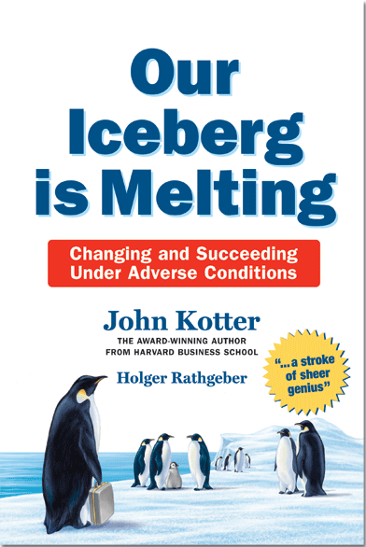
Resources for this Module
There are additional resources for this module you may want to refer to:
TeamSTEPPS Materials:
Sizing Up the Iceberg Exercise
Sizing Up the Culture Exercise
John Kotter Books:
Leading Change
Our Iceberg is Melting
Notes:
There are additional resources for this module that you may want to reference. The TeamSTEPPS materials include two additional exercises related to change management, the sizing up the iceberg exercise and the sizing up the culture exercise. These exercises are a great opportunity to form the class into teams of two to three individuals and assign each group three to four discussion questions related to the culture in their work environment and the opportunity they see for change. Then bring the class back together and have each group share their responses.
You may also want to read two books by John Kotter on change management, Leading Change and Our Iceberg is Melting: Changing and Succeeding Under Adverse Conditions. Our Iceberg is Melting is based on work that shows how eight steps produce needed change in any sort of group. It's a simple fable about a penguin colony faced with a melting iceberg. Their tale is one of resistance to change and heroic action, seemingly unmanageable obstacles and the most clever tactics for dealing with those obstacles. User experience and feedback on this book sparked the graphic design concept within the TeamSTEPPS course materials. So now you know why all the penguins.

Slide 5
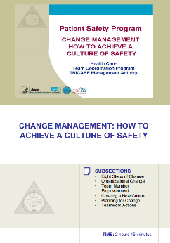
Please Print the Instructor Guide
To best use this online module, please print the Module 8 Instructor Guide, located here
Read pages 3-4 in the guide before we begin
Then we will proceed to work through the slides you will use to train – just as if you are delivering this module at your facility.
Notes:
To best use this online module, we recommend that you print the instructor guide for module eight as a reference to use throughout the module. Before continuing to the next slide, we recommend that you take a moment and read through pages three and four in this guide. Once you've done that, select the Forward button and we'll proceed to work through the slides you will use to train, just as if you're delivering this module at your facility.

Slide 6
Slide 2: Objectives
This module will guide you through the phases necessary to successfully change your organization’s culture
You will use slide 2 to introduce the objectives for this module
See page 5 in the Instructor Guide for details on how to facilitate this slide
Notes:
TeamSTEPPS provides a set of strategies and tools for improving performance in patient safety. A key element in implementing TeamSTEPPS is changing the culture within the organization. As we work through this module, you'll learn about the phases and steps necessary to successfully change your organization's culture. Use slide two to introduce the objectives for this module. Refer to page five in the instructor guide for details on how to facilitate this slide.
After completing this module, you'll be able to list the eight steps of change, identify errors common to organizational change, discuss what is involved in creating a new culture, and begin planning your organizational change strategy.

Slide 7
Change Management Activity
When you teach, lead the activity:
About 40 minutes
Step 1: Story Telling
Step 2: Identify Best Practices
Step 3: Prioritize Best Practices
Step 4: Review Kotter’s 8 Steps of Change
Step 5: Common Errors
Take 5 minutes to read through pages 6 – 8 in the Instructor Guide
Then take 25 minutes to work through the activity yourself and write down your thoughts on how best to manage change in your organization
Notes:
When you teach, after you've discussed the module objectives, you would lead your participants to complete a change management activity that takes about 40 minutes to complete. To introduce this exercise, this is the point at which you would ask learners to form into groups of two or three. This exercise will facilitate discussion on the topic of change management and ensure that all important aspects of culture change are covered.
There are five steps in the activity. Step one, storytelling. Have small groups share their stories of dealing with change in organizations. Step two, identifying best practices. Have the groups discuss ideas about the best practices for managing change. You'll want to record these on a white board or a flip chart.
Step three, prioritize best practices. From those best practices identified, select those that are most important. Step four is reviewing Kotter's eight steps of change. These are listed on page eight in your instructor guide. And then step five, common errors. Discuss what some of the common errors are when trying to make an organizational change.
Take five minutes now to read through pages six through eight in the instructor guide for a detailed explanation of how to present and facilitate this exercise. I'd like you to now work through this exercise yourself. Take 25 minutes to work through the activity steps and write down your thoughts on how best to manage change in your organization. If you're taking this course as a team, share and discuss your answers. Are there similarities? Will the best practices you or your team identified work in your unit, facility, or organization?

Slide 8
Slide 3: Kotter’s 8 Steps of Change
Using slide 3, you will teach your participants about John Kotter’s Eight Steps of Change
See page 8 in the Instructor Guide
Notes:
Using slide three, you'll teach your participants about the eight steps of change that John Kotter outlines in his seminal book, Leading Change. A summary of these eight steps can be found on page eight in the instructor guide. To provide an example of how to deliver this change management module, I'm going to turn this presentation over to our guest master trainer, Kurt O'Brien.
Kurt is currently the director, organization development and training with the University of Washington Medicine Health System. Be sure to compare your list you developed while completing the previous exercise with what you're about to hear from our guest speaker.

Slide 9
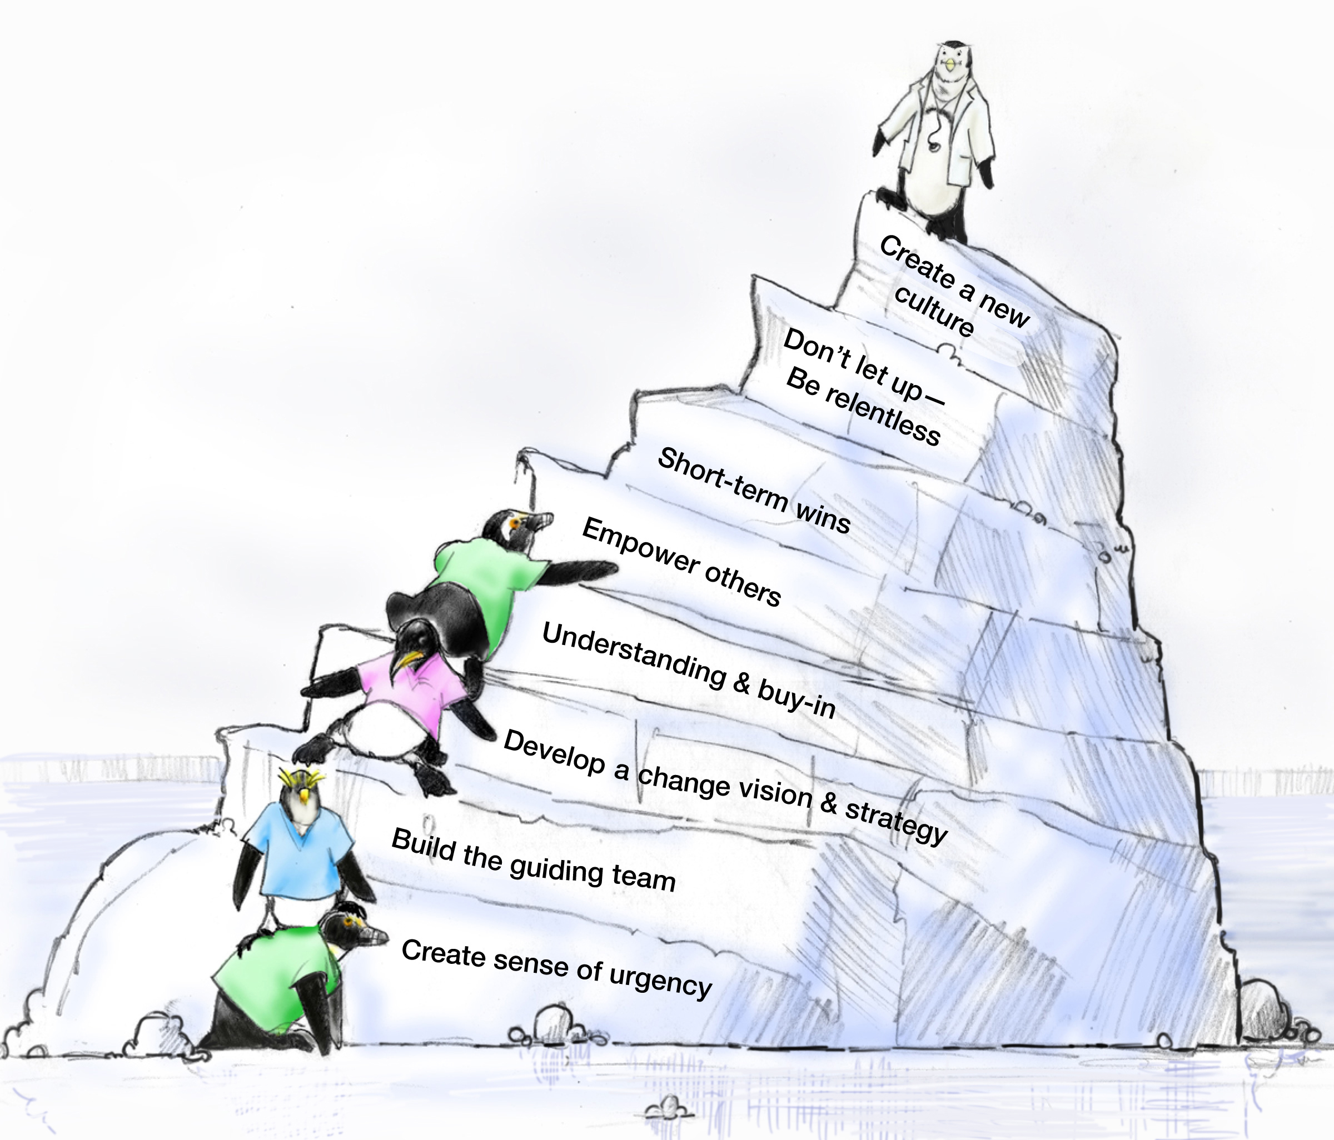
8 Steps of Change (Slide 3)
John Kotter
Notes:
Hi, I'm Kurt O'Brien, and I've been with the University of Washington Medicine Health System 13 years now, and I've been working with TeamSTEPPS for a total of six years doing various projects and implementations throughout our health system, as well as a faculty member with our national training program.
Today I'm going to be working through the change management slides with you. As an introduction, Harvard Business School professor Dr. John Kotter has outlined an eight-step model for successful change efforts. Steps one through four help unfreeze the status quo. Steps five through seven introduce new practices. Step eight grounds the changes in a new culture to ensure sustainability. Because we know that implementing and sustaining change is difficult, it requires a comprehensive strategy.
In brief the steps are: Step one, create a sense of urgency. This is intended to help others see the need for change and the importance of acting immediately.
Step two, pull together the guiding team. I would say this is a really critical step, and pay particular attention to this in your own organizations and as you're doing the training. Make sure there's a powerful group guiding the change, one with leadership skills, credibility, communications ability, authority, analytical skills, and a sense of urgency.
Step three, develop the change vision and strategy. Clarify how the future will be different from the past and how you make that future a reality.
Step four, communicate for understanding and buy-in. Make sure as many others as possible understand and accept the vision and strategy.
Step five, empower others to act. Remove as many barriers as possible so that those who want to make the vision a reality can do so. Step five, empower others to act. Remove as many barriers as possible so that those who want to make the vision a reality can do so.
Step six, produce short-term wins. Create some visible, unambiguous successes as soon as possible. This is an important step. People need to know that they're making progress, that they're seeing some improvement occur.
Step seven, don't let up. This is where you really need to put the pedal to the metal, drive faster and harder, be relentless with instituting the change until the vision becomes a reality. This is a step I think many organizations let up on, so it's that sustainability piece.
Step eight, create a new culture. Hold on to the new ways of behaving and make sure they succeed until they become a part of the very culture of the group.

Slide 10
Details on Kotter’s 8 Steps (Slides 4 – 12)
Change Management Activity:
Step 1: Story Telling
Step 2: Identify Best Practices
Step 3: Prioritize Best Practices
Step 4: Review Kotter’s 8 Steps
Step 5: Common Errors
See pages 9-16 in the Instructor Guide
Notes:
So how did your list compare to Kotter's eight steps? When you teach, be sure to facilitate a discussion with the learners regarding any similarities and differences they listed during the exercise. On the following slides, Kurt will demonstrate how to teach each step in the Kotter model to your training participants.
However, when you teach and you lead the 40-minute change management activity described at the beginning of this module, you will have covered the key aspects of change management. You may choose to skip slides 4 through 12, which detail the eight steps. Incorporate these slides and their topics into the activity, or you may choose to cover each step in detail as you will hear our speaker do so on the following slides. It will be up to you to decide how best to present these ideas to your learners. See pages 9 through 16 in the instructor guide for more information.

Slide 11
Set the Stage & Create a Sense of Urgency (Slide 4)
Get people’s attention!
Sell the need for change … describe the consequences of not changing
Immerse people in information about the change
Discuss ways to solve the problems people identify with the change
Empower people to solve the “problem”
Take 10 minutes to write down ways you can set the stage and create that sense of urgency in your organization or work area
Notes:
The first phase in implementing change is setting the stage and creating a sense of urgency. You need to get people's attention and sell the need for change. Ensuring a sense of urgency among people is absolutely critical to getting cooperation for the change. Unless individuals understand the urgency of a situation, complacency can set in and the change becomes that much more difficult, if not impossible.
Think about the forces of complacency. What would you identify? Complacency can signal we're good enough, we've arrived, or problem solved. A colleague of mine once described it as, we get seduced by our reputation. Resting too long on one's laurels prevents focusing on moving to the next steps. For example, have you heard of teams that elatedly partied too soon in the semi-finals of the game so that they had difficulty focusing on the championship? We're all at risk for this.
Begin thinking about who are the key stakeholders, groups, and individuals in your organization, who must feel the need for change for team training to happen. Are they on board yet? What will it take to bring them on board? You need to immerse people in information about the change in order to get them on board. You should discuss ways to solve the problems people identify with the change, and help empower them to solve the problem. Talking about the need for change, the consequences of not changing, and ways to solve the problems is essential to making the case for change.
In an organization that I've been working with here at UW Medicine, an OB department at one of our hospitals, we went in several years ago, about six years ago, and we worked with this team around implementing some aspects of team training TeamSTEPPS. And they wanted to focus on bringing in briefs. And they had a great change team in place, but as I look back and reflect on that, we really didn't heighten that sense of urgency to the point where it really drove people to action.
Subsequently, we're back working with that group and there are different players in place now, and they've had some situations come up that they can really point to that are driving the urgency that much more. They've had some events that have occurred that really are rallying them now. So they're taking that urgency and really feeding off of that, and it's driving the group in a different direction and we think they're going to be much more effective in the long run.
So at this point, I'll ask you to take 10 minutes and think about the change you are planning to make in your own organization. Write down ways you can set the stage and create that sense of urgency in your organization or work area. How will you make the case for change? Will you use metrics to get their attention? If so, which ones? When you teach, be sure to share your own experiences with change management and how this step was or was not demonstrated or successful.

Slide 12
Pull Together the Guiding Team (Slide 5)
Choose key players, especially staff-level managers
Identify a Guiding Team that is multidisciplinary
Consider the credibility and integrity of change leaders
Choose proven leaders who can drive the change process
Strong position power, broad expertise, and high credibility
Ensure the Guiding Team has both management and leadership skills
Management skills control the process
Leadership skills drive the change
Notes:
For the change effort to be successful, a powerful group must lead the change. And members of that group must work together as a team. I would say right behind sense of urgency, this is a critical step. Getting the right players together, having a diverse group of people is really important to the success of your effort.
So you should carefully consider and choose the key players, especially staff level managers, so you're able to form a guiding team that has that multidisciplinary background. Key characteristics that must be represented on the team include leadership, credibility, communication, expertise, authority, and again, a sense of urgency.
Remember that no one person can implement wide-scale change. A coalition is essential. Most organizations have a guiding coalition or team of individuals who lead change efforts already in place. So think about that for your own organization.
Is there a guiding coalition that's already in place? Do they have the right mix of skills, knowledge, and capabilities? Be sure that the guiding team has both management and leadership skills.
John Kotter pays particular attention to this and separating out, we need both of those skills, management and leadership. The management skills help control the process and the leadership skills drive the change. One recommendation is to consider existing committees within the organization and designate the one most appropriate as the guiding coalition. Especially in larger organizations, a change team should be in place in each unit. These teams can then all report updates to the guiding coalition as need be.

Slide 13
Develop the Change Vision and Strategy (Slide 6)
Senior Leadership is responsible for:
Establishing the definition of a “culture of safety” aligned with expectations, core values, and shared beliefs
Informing the organization of these values and evaluating the culture
Leading the process of:
Translating values into expected behaviors
Establishing trust and accountability
Communicating a commitment to shaping the culture
Notes:
In step three of the change process, senior leadership must develop the change vision and strategy. They are responsible for establishing the definition of a culture of safety aligned with expectations, core values, and shared beliefs. An organization fosters a culture of safety with its practices, processes, and procedures. Patterns of behavior determine the commitment, style, and proficiency of an organization in relation to safety.
A positive culture of safety has the following three elements: One, foundation built on mutual trust. Two, shared perceptions of the importance of safety. And three, confidence in the efficacy of preventative measures. Leadership is responsible for informing the organization of these values and evaluating the culture. I would say, when you're working with your guiding coalition, your change team, make sure they're really clear about what those values are and how they plan to articulate them.
The second phase in implementing change is deciding what to do. Leaders must create a compelling vision, one that answers the questions, what do we want to achieve? Where we want to be in the future? It's important that the vision engage both the head and the heart. Again, another important point: it's not unusual for us to get a little analytical about these change processes and coming up with a vision. And these are most effective, the vision statements are most effective when it does an adequate job of engaging both the head and the heart.
Leadership must lead the process of translating values into expected behaviors and establishing trust and accountability. Then they must regularly communicate a commitment to shaping the culture. Thinking about your own organization, is there already a vision and strategy in place? Do you know what it is? Looking back at the examples I've introduced around the OB department at UW Medicine, if I think of several years ago when we started working with them, there wasn't an overall-- overriding vision. Certainly there was a desire to improve teamwork, but that really wasn't captured in that urgent, compelling vision. And that's something that's really in place this time around as we're working with this group. Being very clear about the urgency, being very clear about that vision. And it's making an impact in terms of their focus and their energy.
So, when you teach, facilitate discussion by asking participants the following question: Does your organization have a vision and strategy in place? And if so, ask them to elaborate on that a bit and describe what that is.

Slide 14
Communicate for Understanding and Buy-In (Slide 7)
Provide supportive actions for fear, anger, and resistance
Encourage discussion, dissent, disagreement, debate—keep people talking
Tell people what you know―and what you don’t know
Acknowledge concerns, perceived losses, and anger
Model the expected behaviors
Value resisters
They clarify the problem and identify other problems that need to be solved first
Their tough questions can strengthen the change
They may be right: It is a dumb idea!
See page 12 in the Instructor Guide
Notes:
The fourth step in the Kotter change model is to communicate for understanding and buy-in. Once the vision and strategies have been determined, they must be effectively communicated. This is a step that's often under-emphasized in organizations. Failure to implement change is often the result of under-communicating or communicating poorly. In addition, everyone involved must both understand and accept the vision and strategy. Creating a vision and implementing change is very time-consuming, and it takes a great deal of hard work and focus. It's essential that trust be built in the early stages within and among the change team and guiding coalition, as well as the staff and other leaders. It's also important that an environment be established where concerns can be brought forward and discussed without fear of retribution. Every communication channel available should be used to put forth a vision and the strategies in a planned and thoughtful way.
It's also essential that the guiding coalition and change team model the expected behavior to staff. Accept and plan for resistance. Things you should consider are: provide supportive actions for fear, anger, and resistance when you see that arise. Encourage discussion, dissent , disagreement, even debate. It helps keep people talking. Tell people what you know and what you don't know. They will appreciate the honesty. Acknowledge concerns, perceived losses, and anger. Model the expected behaviors. And finally, value the resisters. These folks help clarify the problems and concerns. By addressing their concerns, you can actually help improve the change effort.
Take 10 minutes and list two to three avenues of communication you will use to increase understanding and buy-in for your planned change. Who will you target first? List that person or group. And then list at least one way you can minimize negative impact from resisters. Please see Page 12 in the Instructor Guide for more information on how to overcome resistance to change, such as acknowledging change as a process, empowering stakeholders, and developing strategies for dealing with emotions and managing conflict.
When I think back to the examples I used previously with the OB department, this was something that became critical for them to continue that communication strategy. And as we work with them currently, we are, as we speak, working with them to develop specific plans for how they can keep that communication going, because it leads to that sense of ownership of the entire staff.

Slide 15
Empower Others to Act (Slide 8)
Provide direction
Allow others to find their own team-driven solutions
Encourage others to speak up and take risks
Share the information you know
Encourage teamwork and collaboration
Encourage personal reflection and learning
Train employees so they have the desired skills and attitudes
Track activities and progress
Set short-term goals
Notes:
The fifth step in the Kotter model is to empower others to act. Leaders must change the systems or structures that undermine the change vision and remove other obstacles to change. They should also encourage risk-taking and nontraditional ideas, activities, and actions. It is essential that leaders remove as many barriers as possible so that those who want to make the vision a reality can do so. Here are some examples of empowering others to act: give people freedom and direction.
Give people permission to find their own team-driven solutions. Encourage people to speak up, even presenting their differing views. Encourage people to take risks. Affirm and refine the vision. Make room for others' ideas. Tell people as much as you know. Encourage teamwork and collaboration. Additionally, encourage personal reflection and learning. This learning step and reflective piece is a step that's often missed or under-emphasized. Provide people with training and support. Use existing quality improvement methods in your organization to track activities on a daily basis. And finally, set some short-term goals.
Going back to my examples with the OB department here within UW Medicine, the work we're doing with them right now, we're really trying to focus on this empowerment piece. And one of the ways we're getting at that is by really diversifying that change team. So we're bringing in, as I mentioned earlier, a chief resident, a multitude of attending physicians, charge nurses, quality improvement folks. And what that allows us to do is really spread the ownership for the change that needs to occur, and asking those folks to go out on the unit on a regular basis and involve and engage other people. So now they feel like they're really owners of the process.
When you teach, be sure to share your own experiences with empowering others and the results you observed. You can also ask participants to share their own experiences. You need a lot of rich ideas, and it furthers the communication amongst the group.

Slide 16
Produce Short-Term Wins (Slide 9)
Show visible success; further impetus for change
Provide positive feedback; recognize and reward contributions to wins
Further builds morale and motivation
Leverage lessons learned to help plan next goal
Create greater difficulty for resisters to block further change
Provide leadership with evidence of success
Build momentum
Helps draw in neutral or reluctant supporters
Ask Yourself:
What methods have you used to integrate lessons learned into your own process modification?
How can you leverage your change team to strategize, plan, and control the impact of resistance?
See page 14 in the Instructor Guide
Notes:
The sixth step in the Kotter change model is to produce short-term wins. This is a step that's also often overlooked. We get so focused on just driving through with the change that we forget to recognize the advances that we're making and the improvements that we're making. So creating visible, unambiguous successes connected to the change effort as early as possible demonstrates that success. Plan and create the wins, and be sure to visibly recognize and reward the people who made the wins possible. Again, another important step that will encourage people to keep on with the change initiative and keep their focus and keep working.
You should also provide positive feedback. Recognize and reward contributions to wins, as this further builds morale and motivation for the change. Whenever you can, leverage lessons learned to help plan the next goal for the change. These short-term wins will create greater difficulty for resisters to block further change. Provide leadership with evidence of success. Build momentum. Help draw on the neutral or reluctant supporters.
Take five minutes for yourselves now, and think through and write down your answers to the following questions: First, what methods have you used to integrate lessons learned into your own process modification? Will that method or methods work here? Why or why not? It takes courage to openly communicate when resisters are present, for example, at a staff meeting. So what methods do you find successful for communication to staff when numerous resisters are present? What's worked for you in the past? What particular strategies have you used that you have found to be successful, and how can you replicate those in your own change efforts? And finally, how can you leverage your change team to strategize, plan, and control the impact of resistance? Please see Page 14 in the Instructor Guide for more information on how to produce short-term wins. When you teach, use these questions as well as those found on Page 14 of the Instructor Guide to facilitate discussion.
Back to my earlier examples, I would say we could have done a better job on highlighting the short-term wins in the first session we did with the OB department. We sort of declared victory and then went on from there. With this second effort, we're trying to pay more attention to calling out some of those short-term wins and really recognizing the folks for those efforts, recognizing that it really is a learning process and while there'll be some bumps along the way, we can also really take credit for the wins that have been implemented.

Slide 17
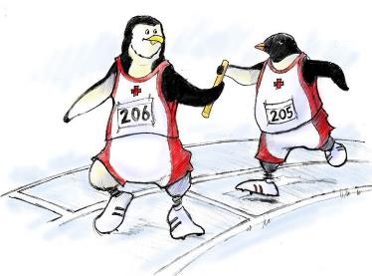
Don’t Let Up (Slide 10)
Acknowledge hard work
Celebrate successes and accomplishments
Reaffirm the vision
Bring people together toward the vision
Acknowledge what people have left behind
Develop long-term goals and plans
Provide tools and training to reinforce new behaviors
Reinforce and reward the new behaviors
Create systems and structures that reinforce new behaviors
Prepare people for the next change
Notes:
So now you've arrived at a critical point. Don't let up. This is absolutely critical to your change efforts. This is also step seven in the Kotter model. Press harder and faster after the first successes. You want to be relentless in instituting all the necessary changes until the vision becomes a reality.
To realize the vision, you may have to change systems, structures, and policies that don't fit together and don't fit the transformation vision. You may need to reinvigorate the process with new projects, themes, and change agents. Kotter recommends that to solidify the changes, you should do the following. Hire, promote, and develop people who can implement the change vision. Reinvigorate the process with new projects, themes, and change agents.
Throughout the change process, you must maintain momentum by doing the following. Acknowledge the hard work. Celebrate successes and accomplishments. Reaffirm the vision. Continuing to bring people back to that vision helps solidify that ownership and empowerment. Bring people together toward the vision.
Acknowledge what people have left behind. Develop long-term goals and plans. Provide tools and training to reinforce the new behaviors. Redosing should be a continuous process. Don't make your training a once-a-year annual event. Reinforce and reward the new behaviors. Create systems and structures that reinforce the new behaviors. And finally, prepare people for the next change.

Slide 18
Create a New Culture (Slide 11)
Develop action steps for stabilizing, reinforcing, and sustaining the change:
Give people time to mourn their actual losses
Provide skill and knowledge training
Develop new reward systems
Recognize and celebrate accomplishments
Develop performance measures to continually monitor the results from the change and to identify opportunities for further improvements
Make adjustments to the change vision and strategy to reflect new learning and insights
Encourage people to be open to new challenges, forces, and pressures for the next change
Notes:
The final phase in implementing change is making it stick. Hold on to the new ways of behaving and make sure they succeed until they become the norm and are part of the culture of the group. And develop a means to ensure leadership development succession planning is also accounted for. To help develop the new culture, you should develop action steps for stabilizing, reinforcing, and sustaining the change.
These steps may include the following. Give people time to mourn their actual losses. We've mentioned this before. Provide people the skill and knowledge and the training that they need. Develop new reward systems. And finally, recognize and celebrate accomplishments. You should also develop performance improvement measures to continually monitor the results from the change, and identify opportunities for further improvement.
This will include making adjustments to the change vision and strategy to reflect the new learning and insights. This is often a step that we don't pay enough attention to. Actually having those metrics in place, measuring our improvement, and coming back and adjusting as need be. Finally, you should help create a culture of continued change by encouraging people to be open to new challenges, forces, and pressures for the next change.
When I think back to the work we've done with the OB department, the first time around several years ago these pieces didn't stick. We were never able to actually have a result of a new culture change. And so that's something we're paying particular attention to this time around is really following these eight steps, ensuring that the urgency remains, ensuring that we're being relentless about the effort and the focus. So again, that change ultimately results in following through some type of change process.
Thinking back to the exercise at the beginning of this module when you were asked to write down what you believe to be some of the common errors that occur when trying to make an organizational change, review your answers and see how they compare to what I'm about to discuss as you proceed to the next slide that lists these common errors related to change. When you teach, before proceeding to the next slide, review with the class the lists they compiled during the exercise and ask them to consider how their answers compare to the common errors listed on the following slide.

Slide 19
Errors Common to Organizational Change (Slide 12)
Common errors:
Allowing for complacency
Failing to create a sufficiently powerful Guiding Coalition and Change Team
Not truly integrating the vision
Allowing obstacles to block change
Not celebrating short-term wins
Declaring victory too soon
Neglecting to anchor changes firmly in the culture
Take 10 minutes to write down an example of when you saw an initiative fail due to one of these common errors
See page 17 in the Instructor Guide
Notes:
Now that we've reviewed all eight steps in the Kotter Steps of Change model, let's look at some common errors that can derail change in an organization.
Common errors include allowing for complacency, failing to create a sufficiently powerful guiding coalition and change team, not truly integrating the vision, allowing obstacles to block change, not celebrating the short-term wins, declaring victory too soon, or neglecting to anchor changes firmly in the culture. Remember that training is not a stand-alone function. Pitfalls commonly arise and derail organizations that are overly eager in their rush to change. New approaches and methods become part of a culture when they are effective.
Please review Page 17 in the Instructor Guide for a list of the strategies Kotter identifies to counter these errors in change management. For example, providing opportunities for discussions and tools to reinforce skills, such as the TeamSTEPPS Pocket Guide, may assist staff in institutionalizing processes by building new habits and skills. Another strategy listed is making all staff accountable.
Take 10 minutes right now to write down an example of when you saw an initiative fail due to one of these common errors. And then based on what you've learned so far, write down what you would have done differently.
Going back to my examples with the OB department, that first session we did with them years ago, some of these errors that we're talking about here were definitely present as I look back and reflect on it. Over time, we actually did get complacent. And part of that was because we hadn't heightened the sense of urgency to the point where it needed to be.
We also didn't really address the short-term wins. There were a lot of great things going on, and we didn't always give that the attention needed. So as we're engaging with this group again today, we're really paying attention to these pitfalls and making sure that we are strategizing to make sure we don't fall back into these traps.
To facilitate discussion when you teach, you may want to share an example of when you saw a change initiative fail due to one of the common errors listed, and then ask participants what they believe could have been done differently. Or you can ask one or two participants to share an example they have experienced and then ask what could have been done differently.

Slide 20
Culture Change Comes Last, Not First! (Slide 13)
Most alterations in norms and shared values come at the end of the process
New approaches sink in after success is shown
Feedback and reinforcement are crucial to buy-in
Sometimes the only way to change culture is to change key people
Individuals in leadership positions need to be on board, or the old culture will reassert itself
Notes:
Remember that changing the culture comes last, not first. It is only after people change their actions that there can be a change in the culture.
According to Kotter, the process of anchoring change in the culture has the following characteristics. It comes last, not first. Most alterations in norms and shared values come at the end of the transformation process. It depends on results. New approaches usually sink into the culture only after it's very clear that they work, and are superior to the old methods.
It requires a lot of talk. Without verbal instructions and support, people are often reluctant to acknowledge the validity of new practices. It may involve turnover. Sometimes the only way to change a culture is to change the key people. And it is critical that individuals in leadership positions are on board, model the behavior, and clearly communicate their expectations, or the old culture will quickly reassert itself.

Slide 21
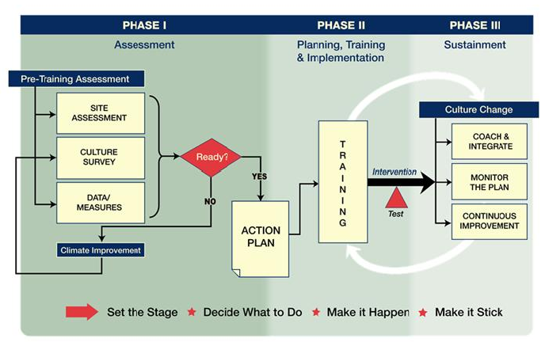
TeamSTEPPS Change Model (Slide 14)
Notes:
While TeamSTEPPS teaches the teamwork, skills, strategies, and tools to enhance teamwork, at its roots, TeamSTEPPS is an organizational change initiative. This slide depicts the TeamSTEPPS model of change, which can be organized into three phases.
Phase 1, setting the stage and deciding what to do-- the assessment. As members of the cohort and noncohort group, you accomplished this step by completing your pre-work.
Phase 2, making it happen-- training and implementation. This is the phase you are in now. And Phase 3, making it stick-- monitoring, integrating, and providing coaching for the initiative to sustain over time.
As you can see, each of these major action organizers correlates with Kotter's steps. During the implementation planning module, you'll be applying the TeamSTEPPS change model as you develop a plan for implementing the TeamSTEPPS initiative in your work area, facility, or organization.

Slide 22
Change Management Models (Slide 15)
Change Management Models:
PDSA: Plan, Do (TeamSTEPPS), Study, Act
DMAIC: Define, Measure, Analyze, Improve (TeamSTEPPS), Control
IHI Model for Improvement: Forming the Team, Setting Aims, Establishing Measures, Selecting Changes, Testing Changes, Implementing Changes (TeamSTEPPS), Spreading Changes
CUSP: Assemble the Team, Engage the Senior Executive, Understand the Science of Safety, Identify Defects through Sensemaking, Implement Teamwork and Communication (TeamSTEPPS)
Select for more information on CUSP
Notes:
The TeamSTEPPS change model is one of a number of change management strategies. Other change management models include the following: Plan, do, study, act. This particular model comes out of the world of quality improvement. Many of you may be familiar with it. Six Sigma-DMAIC: Define, Measure, Analyze, Improve, Control.
Next is the IHI model for improvement. These steps include: forming the team, setting aims, establishing measures, selecting changes, testing those changes, implementing the changes, and finally spreading the change. And lastly, the CUSP model. CUSP stands for Comprehensive Unit-based Safety Program. The steps involved in this model include: assemble the team, engage the senior executive, understand the science of safety, identify defects through sense-making, implement teamwork, and communication.
I think you'll see as you review these various models that there are elements of overlap between Kotter's eight steps and these models. Each strategy includes very similar components. Your organization may already use or be familiar with one of these approaches. If so, TeamSTEPPS recommends that you use the approach your organization already knows instead of the TeamSTEPPS change model.
As shown on the slide, the implementation of TeamSTEPPS tools and strategies fits within the components of other models for change. As such, TeamSTEPPS can complement and be coordinated with your existing change strategy. If you'd like additional information on CUSP, the Comprehensive Unit-based Safety Program, select the link provided.

Slide 23
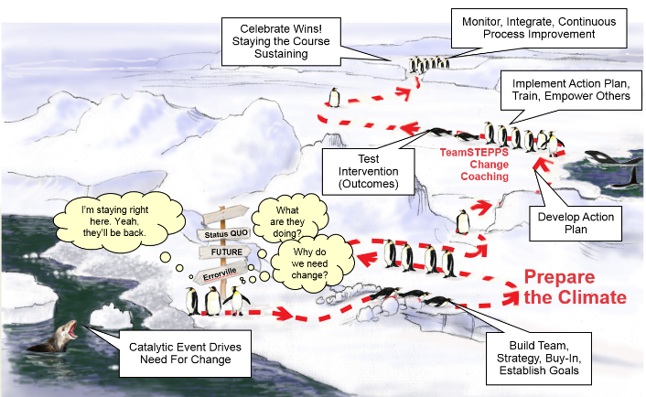
Roadmap to a Culture of Safety (Slide 16)
Notes:
These steps and activities form a high-level road map to create a culture of safety and provide an outline for a vision and strategy. In the next activity, you'll begin to think through these issues in your own organization. Once the vision and strategy are determined, you must take these high-level ideas and develop a TeamSTEPPS Action Plan for your own organization.
So looking back at the story I've been sharing about the OB department here at UW Medicine and looking at the work we're doing with them today, I would say having this road map in place has been absolutely critical and key. It's really helped us keep the change team and the leadership group focused on where do they need to go.
It's so easily derailed in terms of getting distracted with other priorities and so forth. So having these guiding principles is really helpful. Furthermore, we've really used a consulting and coaching approach working with this group. So if you have the opportunity to provide resources within your own organization, you'll find it will really help keep those teams on track and on task.

Slide 24
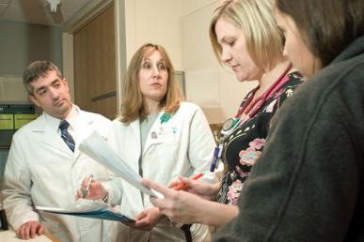
Module 8 Summary
In this module you learned to:
List the Eight Steps of Change
Identify errors common to organizational change
Discuss what is involved in creating a new culture
Begin planning your organizational change strategy
Notes:
In this module, you learn to list the eight steps of change, identify errors common to organizational change, discuss what is involved in creating a new culture, and begin planning your organizational change strategy.

Slide 25
Additional Resources
For further information on change management, we suggest these three books.
Notes:
For further information on change management and for those interested in reading more about how individuals are motivated and the impact of incentives, we recommend the following three books: Drive by Dan Pink; Nudge by Sunstein and Thaler; and Predictably Irrational by Daniel Ariely.

Slide 26
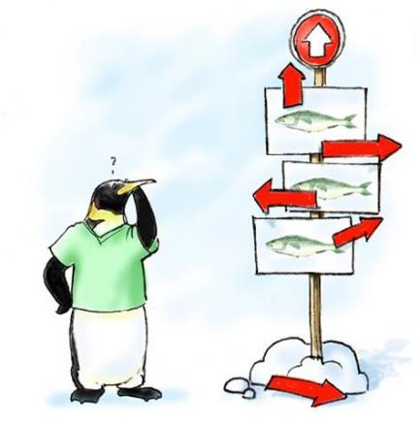
Module 8 Conclusion
This concludes Module 8 of the TeamSTEPPS 2.0 Online Master Trainer Course
Go to Module 9
Module 8
Module 9

