Slide 1
Essentials Course

Slide 2
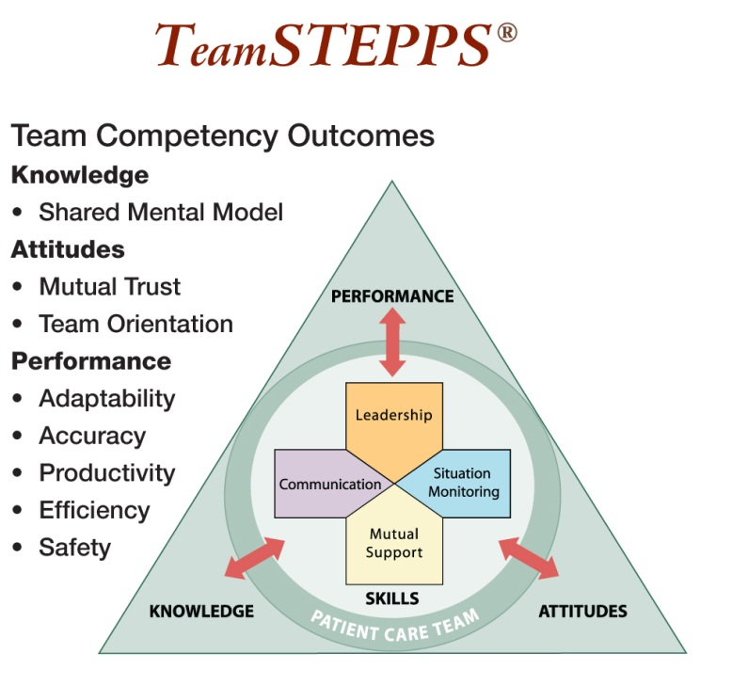
Framework and Competencies
TeamSTEPPS is composed of four teachable-learnable skills: Leadership, Situation Monitoring, Mutual Support, and Communication: the core of the TeamSTEPPS framework. The arrows depict a two-way dynamic interplay between the four skills and the team-related outcomes. Interaction between the outcomes and skills is the basis of a team striving to deliver safe, quality care. Encircling the four skills is the resident care team, which not only represents the resident and direct caregivers but also those who play a supportive role within the health care delivery system.
…TeamSTEPPS is an evidence-based framework to optimize team performance across the health care delivery system.

Slide 3
Key Principles
Team Structure
Identification of the components of a multi-team system that must work together effectively to ensure resident safety
Communication
Structured process by which information is clearly and accurately exchanged among team members
Leadership
Ability to maximize the activities of team members by ensuring that team actions are understood, changes in information are shared, and team members have the necessary resources
Situation Monitoring
Process of actively scanning and assessing situational elements to gain information or understanding, or to maintain awareness to support team functioning
Mutual Support
Ability to anticipate and support team members’ needs through accurate knowledge about their responsibilities and workload

Slide 4
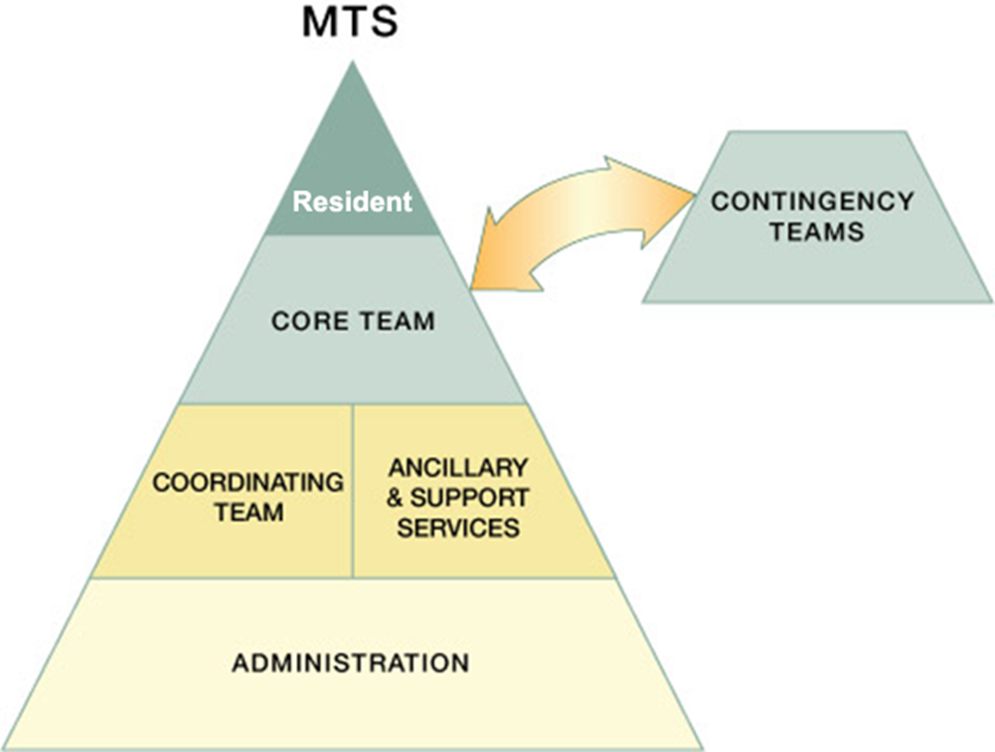
Multi-Team System (MTS) for Resident Care
Safe and efficient care involves the coordinated activities of a multi-team system

Slide 5
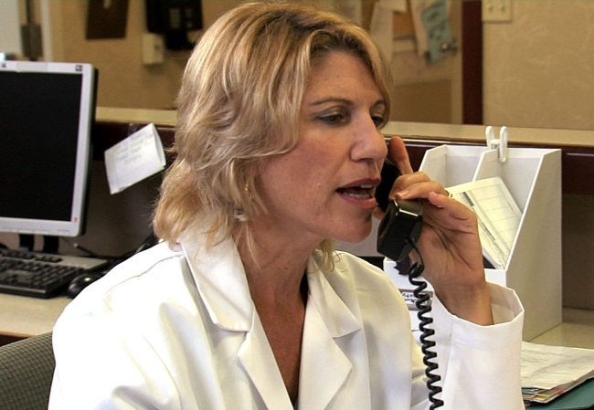
SBAR
A technique for communicating critical information that requires immediate attention and action concerning a resident’s condition
Situation — What is going on with the resident?
"I am calling about Mrs. Mary Smith, 88 years old, who has had a change in condition. She has a new onset of confusion, has developed a cough, ate very little today, and has been refusing all extra fluids.“
Background — What is the clinical background or context?
“Mrs. Smith has type 2 diabetes, arthritis, osteoporosis, cataracts, stress incontinence, and mild cognitive impairment."
Assessment — What do I think the problem is?
“She is lethargic but responsive to simple verbal commands. She has a dry cough and on auscultation of her lungs has some rhonchi in the right base. Her urine looked cloudy.“
Recommendation and Request — What would I do to correct it?
“I am wondering if she is starting with a UTI or a respiratory infection. I think she is stable to stay here but should we get a urine sample, chest x ray, or any lab work?”

Slide 6
Call-Out
Strategy used to communicate important or critical information
Informs all team members simultaneously during emergent situations
Helps team members anticipate next steps
Important to direct responsibility to a specific individual responsible for carrying out the task
Example during an incoming trauma:
Leader: "Airway status?" Resident: "Airway clear" Leader: "Breath sounds?" Resident: "Breath sounds decreased on right" Leader: "Blood pressure?" Nurse: "BP is 96/62"

Slide 7
Check-Back
Process of using closed-loop communication to ensure that information conveyed by the sender is understood by the receiver as intended
The steps include the following:
Sender initiates the message
Receiver accepts the message and provides feedback
Sender double-checks to ensure that the message was received
Example:
Nurse: “Apply 2 liters of oxygen via nasal cannula.”
Nursing Assistant: “2 liters oxygen via nasal cannula.”
Nurse: “Yes, that’s correct.”

Slide 8
Handoff
The handoff of information (along with authority and responsibility) during transitions in care across the continuum. It includes an opportunity to ask questions, clarify, and confirm.
Examples of transitions in care include shift changes; transfer of responsibility between and among nursing assistants, nurses, nurse practitioners, physician assistants, and physicians; and resident transfers.

Slide 9
“I PASS THE BATON”
Strategy designed to enhance information exchange during transitions in care
Introduction: Introduce yourself and your role/job (include resident)
Patient/Resident: Identifiers, age, sex, location
Assessment: Present chief complaint, vital signs, symptoms, and diagnosis
Situation: Current status (e.g., ADL status, intake/appetite, elimination, behavior, cognition), circumstances, including code status, level of uncertainty, recent changes, response to treatment
Safety: Critical lab values/reports, socioeconomic factors, allergies, and alerts (falls, isolation, etc.)
THE
Background: Comorbidities, previous episodes, current medications, and family history
Actions: What actions were taken or are required? Provide brief rationale
Timing: Level of urgency and explicit timing and prioritization of actions
Ownership: Who is responsible (nurse/doctor/APRN/nursing assistant)? Include resident/family responsibilities
Next: What will happen next? Anticipated changes? What is the plan? Are there contingency plans?

Slide 10
Effective Team Leaders
The following are responsibilities of effective team leaders:
Organize the team
Identify and articulate clear goals (i.e., the plan)
Assign tasks and responsibilities
Monitor and modify the plan; communication changes
Review the team’s performance; provide feedback when needed
Manage and allocate resources
Facilitate information sharing
Encourage team members to assist one another
Facilitate conflict resolution in a learning environment
Model effective teamwork

Slide 11
Team Events
Sharing the Plan
Brief – Short session prior to start to share the plan, discuss team formation, assign roles and responsibilities, establish expectations and climate, anticipate outcome and likely contingencies
Monitoring and Modifying the Plan
Huddle – “Touch base” meeting conducted as needed to re-establish situational awareness, reinforce plans already in place, and assess the need to adjust the plan
Reviewing the Team’s Performance
Debrief – Informal information exchange session designed to improve team performance and effectiveness through lessons learned and reinforcement of positive behaviors

Slide 12
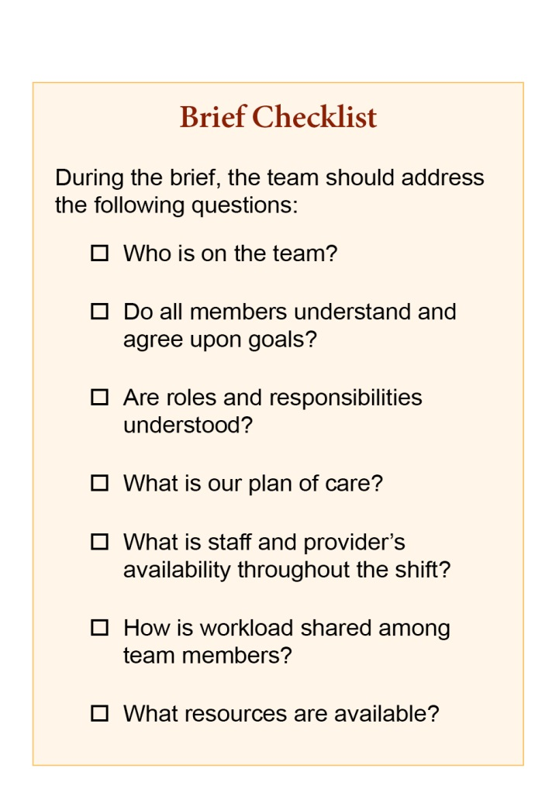
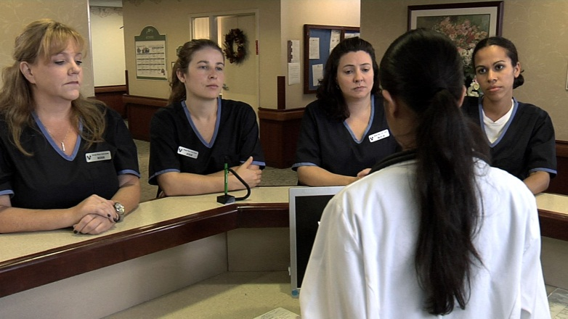

Slide 13
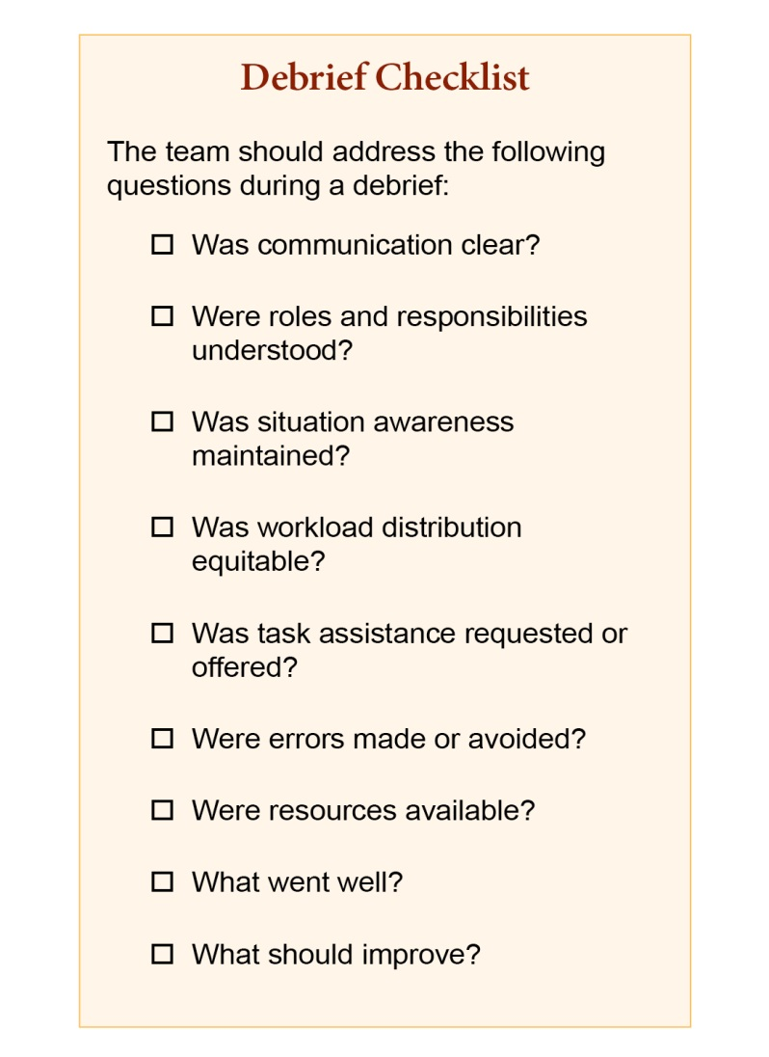

Slide 14
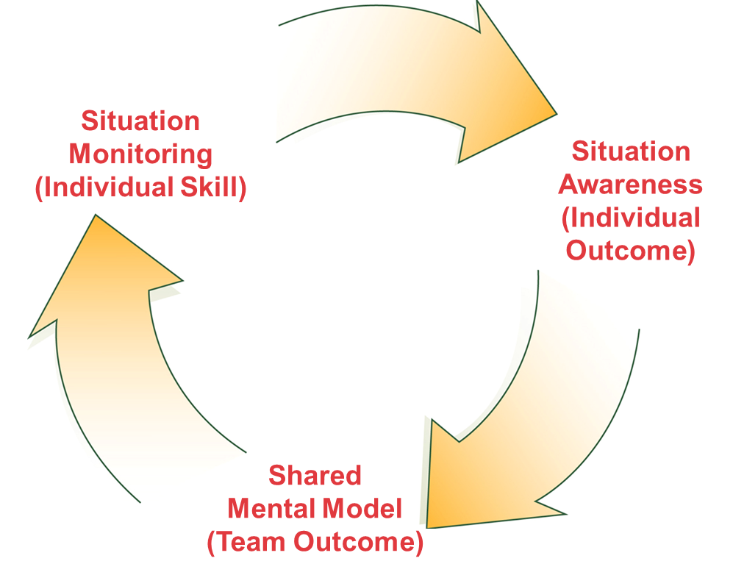
Situation Monitoring Process
Situation monitoring is the process of continually scanning and assessing a situation to gain and maintain an understanding of what’s going on around you.
Situation awareness is the state of “knowing what’s going on around you.”
A shared mental model results from each team member maintaining situation awareness and ensures that all team members are “on the same page.”

Slide 15
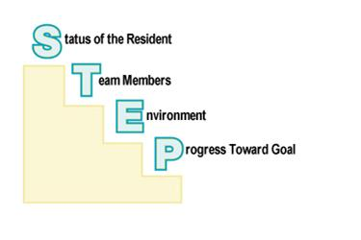
STEP
A tool for monitoring situation in the delivery of health care
Components of Situation Monitoring:

Slide 16
STEP
Tool to help assess health care situations
Status of resident
Resident History
Vital Signs
Medications
Physical Exam
Plan of Care
Psychosocial Issues
Team Members
Fatigue
Workload
Task Performance
Skill
Stress
Environment
Facility Information
Administrative Information
Human Resources
Acuity of Residents
Equipment
Progress Toward Goal
Status of Team’s Resident(s)?
Established Goals of Team?
Tasks/Actions of Team?
Plan Still Appropriate?

Slide 17
Cross-Monitoring
A harm error reduction strategy that involves:
Monitoring actions of other team members
Providing a safety net within the team
Ensuring that mistakes or oversights are caught quickly and easily
“Watching each other’s back”

Slide 18
I’M SAFE Checklist
Each team member is responsible for assessing his or her own safety status
I = Illness
M = Medication
S = Stress
A = Alcohol and Drugs
F = Fatigue
E = Eating and Elimination

Slide 19
Task Assistance
Helping others with tasks builds a strong team. Key strategies include:
Team members protect each other from work overload situations
Effective teams place all offers and requests for assistance in the context of resident safety
Team members foster a climate where it is expected that assistance will be actively sought and offered

Slide 20
Feedback
Information provided to team members for the purpose of improving team performance
Feedback should be:
Timely – given soon after the target behavior has occurred
Respectful – focuses on behaviors, not personal attributes
Specific – relates to a specific task or behavior that requires correction or improvement
Directed toward improvement – provides direction for future improvement
Considerate – considers a team member’s feelings and delivers negative information with fairness and respect

Slide 21
Advocacy and Assertion
Advocate for the resident
Used when team members’ viewpoints don’t agree with that of the decisionmaker
Assert a corrective action in a firm and respectful manner
Make an opening
State the concern
State the problem (real or perceived)
Offer a solution
Reach agreement on next steps

Slide 22
Two-Challenge Rule
Empowers all team members to “stop the line” if they sense or discover an essential safety breach
When an initial assertive statement is ignored:
It is your responsibility to assertively voice concern at least two times to ensure that it has been heard
The team member being challenged must acknowledge that concern has been heard
If the safety issue still hasn’t been addressed:
Take a stronger course of action
Use a supervisor or chain of command

Slide 23
Assertive Statements: CUS

Slide 24
DESC Script
A constructive approach for managing and resolving conflict
D — Describe the specific situation
E — Express your concerns about the action
S — Suggest other alternatives
C — Consequences should be stated

Slide 25
Team Performance Observation Tool for Long-Term Care
Team Structure
Assembles a team
Assigns or identifies team members’ roles and responsibilities
Holds team members accountable
Includes residents and families as part of the team
Communication
Provides brief, clear, specific, and timely information to team members
Seeks information from all available sources
Uses check-backs to verify information that is communicated
Holds team members accountable
Uses SBAR, call-outs, and handoff techniques to communicate effectively with team members
Leadership
Identifies team goals and vision
Uses resources efficiently to maximize team performance
Balances workload within the team
Delegates tasks or assignments, as appropriate
Conducts briefs, huddles, and debriefs
Role models teamwork behaviors
Situation Monitoring
Monitors the status of the resident
Monitors fellow team members to ensure safety and prevent errors
Monitors the environment for safety and availability of resources (e.g., equipment)
Monitors progress toward the goal and identifies changes that could alter the plan of care
Fosters communication to ensure that team members have a shared mental model
Mutual Support
Provides task-related support and assistance
Provides timely and constructive feedback to team members
Effectively advocates for resident safety using the Assertive Statement, Two-Challenge Rule, or CUS
Uses the Two-Challenge Rule or DESC Script to resolve conflict

Slide 26
BARRIERS
TOOLS and STRATEGIES
OUTCOMES
Inconsistency in Team Membership
Lack of Time
Lack of Information Sharing
Hierarchy
Defensiveness
Conventional Thinking
Complacency
Varying Communication Styles
Conflict
Lack of Coordination and Followup With Coworkers
Distractions
Fatigue
Workload
Misinterpretation of Cues
Lack of Role Clarity
Communication
SBAR
Call-Out
Check-Back
Handoff
Leading Teams
Brief
Huddle
Debrief
Situation Monitoring
STEP
I’M SAFE
Mutual Support
Task Assistance
Feedback
Assertive Statement
Two-Challenge Rule
CUS
DESC Script
Shared Mental Model
Adaptability
Team Orientation
Mutual Trust
Team Performance
Resident Safety!!

Slide 27
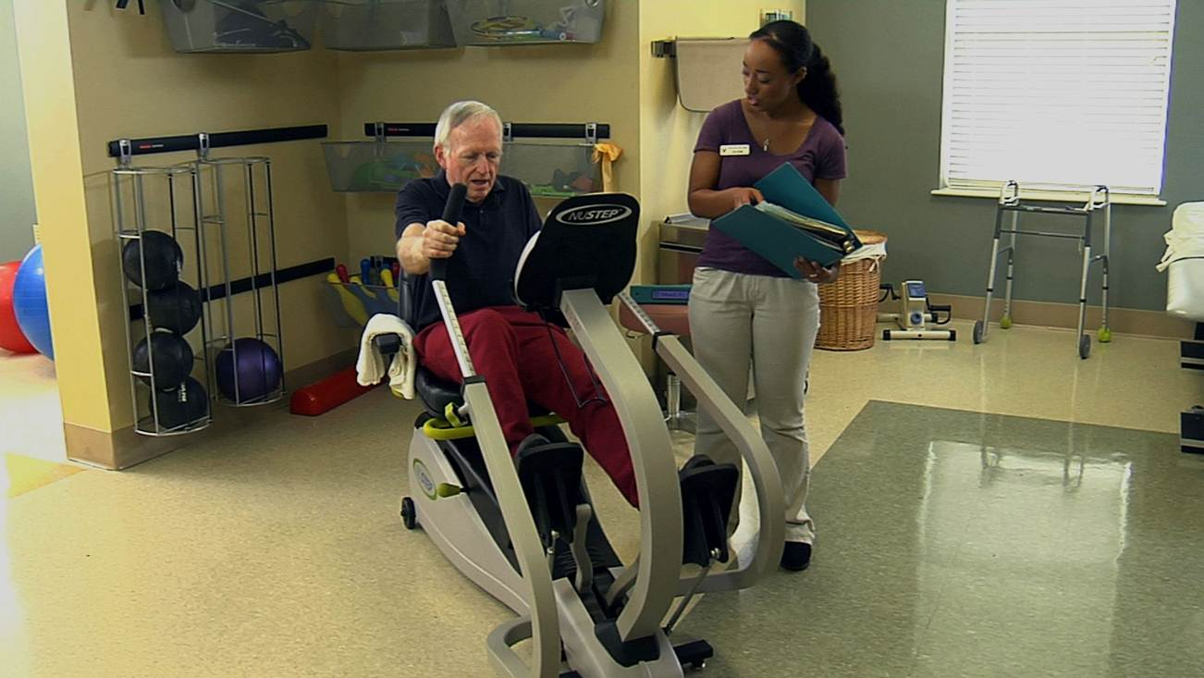
Effective Use of TeamSTEPPS Tools and Strategies

