Slide 1
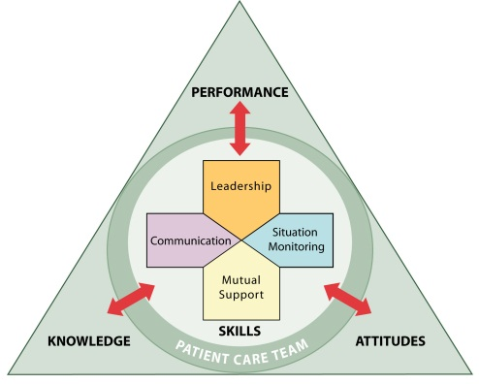
Team Strategies and Tools to Enhance Performance and Patient Safety

Slide 2
Introductions

Slide 3
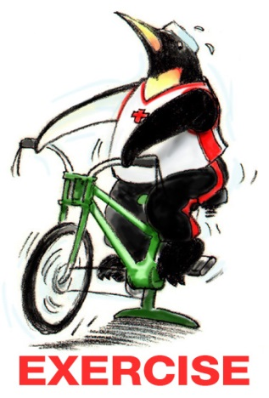
Teamwork Exercise #1

Slide 4
Objectives
Describe the TeamSTEPPS Master Trainer course
Describe the impact of errors and why they occur
Describe the TeamSTEPPS framework
State the outcomes of the TeamSTEPPS framework

Slide 5
Course Agenda
Day 1:
Module 1—Introduction
Module 2—Team Structure
Module 3—Communication
Module 4—Leading Teams
Module 5—Situation Monitoring
Module 6—Mutual Support
Module 7—Pulling It All Together
Day 2:
Change Management:
How To Achieve a Culture
of Safety
Coaching Workshop
Measurement
Implementation Planning

Slide 6
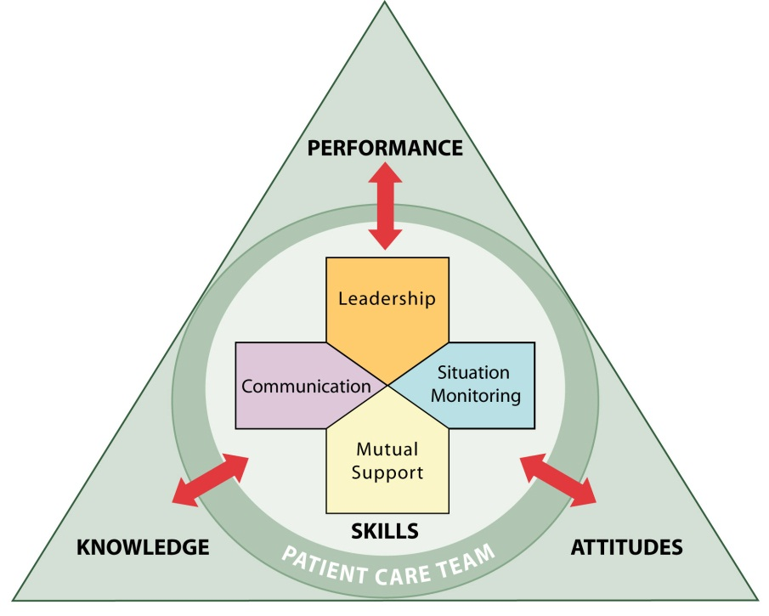
Day 1 - Core Teamwork Skills

Slide 7
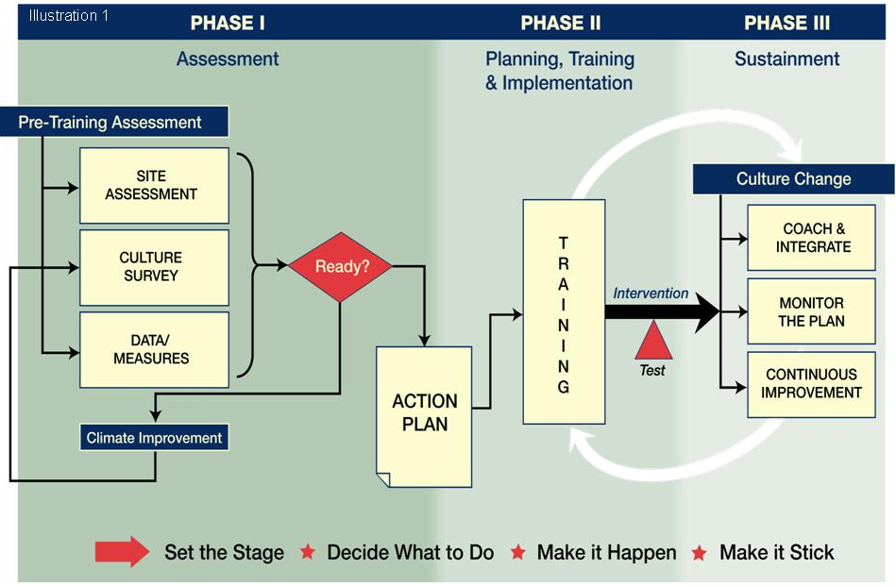
Day 2 – Coach, Implement, Sustain

Slide 8
Master Training Materials
Instructor Manual
  Course Management Guide
  Instructor guides
  Course slides
  Measurement tools
Online Resources
  Customizable materials
  Videos

Slide 9


Sue Sheridan Video

Slide 10
Video Discussion
What breakdowns in teamwork did you observe in the two stories?
How can we prevent errors?

Slide 11
Barriers to Team Performance
Inconsistency in team membership
Lack of time
Lack of information sharing
Hierarchy
Defensiveness
Conventional thinking
Varying communication styles
Conflict
Lack of coordination
and followup
Distractions
Fatigue
Workload
Misinterpretation of cues
Lack of role clarity

Slide 12
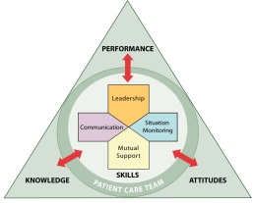








Patient Safety Movement & Team Training
TeamSTEPPS®
TeamSTEPPS Released to the Public
Centers for Medicare & Medicaid Services Partnership for Patients Campaign
“To Err
Is Human”
IOM Report
JCAHO National Patient Safety Goals
TeamSTEPPS National Implementation Program Began
Institute for
Healthcare Improvement
100K lives Campaign
Patient Safety and Quality Improvement
Act of 2005
National Implementation of CUSP
DoD
MedTeams®
ED Study
Executive Memo from President
1995
1999
2001
2003
2004
2005
2006
2007
2008
2011
Medical Team Training

Slide 13

Team Strategies & Tools to Enhance
Performance & Patient Safety
  Based on more than 30 years of research and evidence
  Team training programs have been shown to improve attitudes, increase knowledge, and improve behavioral skills
  Salas, et al. (2008) meta-analysis provided evidence that team training had a moderate, positive effect on team outcomes (ρ = .38)

Slide 14
What Makes Up Team Performance?
Knowledge
Cognitions
“Think”
Attitudes
Affect
“Feel”
Skills
Behaviors
“Do”

Slide 15
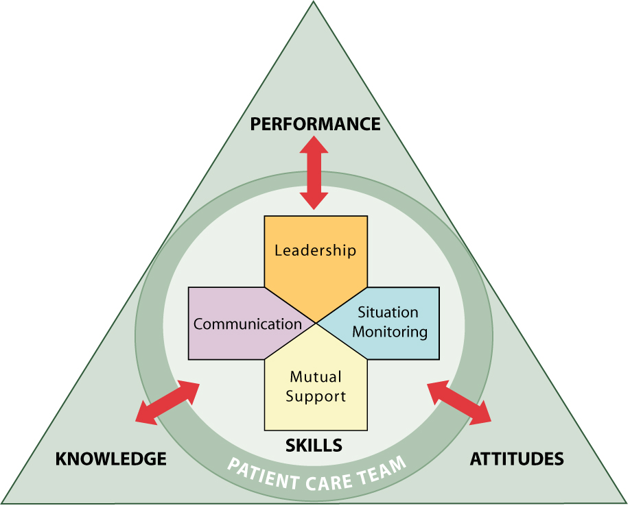
Outcomes of Team Competencies
Knowledge
  Shared Mental Model
Attitudes
  Mutual Trust
  Team Orientation
Performance
  Adaptability
  Accuracy
  Productivity
  Efficiency
  Safety

Slide 16
High-Performing Teams
Teams that perform well:
  Hold shared mental models
  Have clear roles and responsibilities
  Have clear, valued, and shared vision
  Optimize resources
  Have strong team leadership
  Engage in a regular discipline of feedback
  Develop a strong sense of collective trust and confidence
  Create mechanisms to cooperate and coordinate
  Manage and optimize performance outcomes
  (Salas, et al., 2004)

Slide 17
Evidence That TeamSTEPPS Works
Thomas & Galla (2013)
  Systemwide implementation
  Pre- and post-TeamSTEPPS
  training results:
    Significant improvement
    in HSOPS scores on Feedback
    and Communication About
    Error, Frequency of Events
    Reported, Hospital Handoffs and
    Transitions, and Teamwork
    Across Units
    Incremental changes evident
    through reduction of
    nosocomial infections, falls,
    birth trauma, and other incidents
Howe (2014)
  Certified nurse aide
  implementation
  Pre- and post-TeamSTEPPS
  training results:
    Improved scores on several
    Quality of Life survey subscales
    Enhanced perceived
    empowerment of the
    certified nurse aides

Slide 18
Applying TeamSTEPPS Exercise
Please answer the following question on your TeamSTEPPS Implementation Worksheet, which we will continue to complete at the end of each of the Fundamentals Course modules:
What is the resident safety issue your nursing home is facing that is linked to a problem with teamwork?

