Slide 1
Measurement

Slide 2
Objectives
Describe the importance of measurement
Describe the Kirkpatrick model of training evaluation
  Identify measures that can be used to assess the impact of TeamSTEPPS
  Describe the AHRQ Nursing Home Survey on Patient Safety Culture
  Prepare a plan for determining if TeamSTEPPS worked

Slide 3
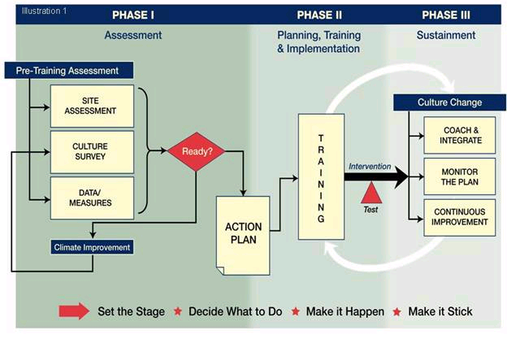
TeamSTEPPS Phases
Requires
Measurement

Slide 4
How To Measure - Kirkpatrick
M
U
L
T
I
L
E
V
E
L
A
P
P
R
O
A
C
H
Level IV – Results
(Organizational results)
Level III – Behavior
(Transfer to the job)
Level II – Learning
(Think, Do, Feel)
Level I – Reactions
(Like it and Useful)

Slide 5
Available Measures
Reactions
  Course Evaluation Form
Learning
  Teamwork Attitudes Questionnaire (T-TAQ) for Long-Term Care
  Learning Benchmarks
  Team Performance Observation Tool for Long-Term Care
  Teamwork Perceptions Questionnaire (T-TPQ) for Long-Term Care
Behavior
  Team Performance Observation Tool for Long-Term Care
  Teamwork Perceptions Questionnaire (T-TPQ) for Long-Term Care
  AHRQ Nursing Home Survey on Patient Safety Culture
Results
  Resident outcome and clinical process measures
  AHRQ Nursing Home Survey on Patient Safety Culture

Slide 6
Course Evaluation Form
Level I Reactions
Includes evaluation questions for all available course modules
Customizable
Provides information about what trainees thought about the training

Slide 7
TeamSTEPPS Teamwork Attitudes Questionnaire (T-TAQ) for Long-Term Care
Level II Learning
30-item self-report tool
Respondents rate their agreement with items on a 5-point
Likert scale
Measures attitudes toward:
  Team Structure
  Leadership
  Situation Monitoring
  Mutual Support
  Communication
Documentation about the development and use of the original
T-TAQ can be found at
https://www.ahrq.gov/teamstepps/instructor/reference/teamattitudesmanual.html

Slide 8
Learning Benchmarks
Level II Learning
A 23-item multiple-choice test
Uses:
  To assess knowledge of teamwork
  To measure changes in knowledge
Caution
  Items tend to be too easy

Slide 9
Team Performance Observation Tool for Long-Term Care
Level II Learning and Level III Behavior
Tool for observing team performance
  Site assessment
  Measure training effectiveness
Observers should practice using the tool
Can be adapted to a particular unit, department, or work area

Slide 10
TeamSTEPPS Teamwork Perceptions Questionnaire (T-TPQ) for Long-Term Care
Level II Learning and Level III Behavior
35-item self-report tool
Respondents rate their agreement with items on a 5-point
Likert scale
Measures staff perceptions of:
  Team Structure
  Leadership
  Situation Monitoring
  Mutual Support
  Communication
  Documentation about the development and use of the original
  T-TPQ can be found at
  https://www.ahrq.gov/teamstepps/instructor/reference/teamperceptionsmanual.html

Slide 11
Level III: Behavior
Measure whether information learned during training is transferred to the job
Two important factors in transfer are:
  Whether there is an opportunity to use the new TeamSTEPPS tools or strategies on the job
  Whether use of the TeamSTEPPS tools and strategies is valued and reinforced

Slide 12
Behavior: Measures
Team Performance Observation Tool for Long-Term Care
Teamwork Perceptions Questionnaire (T-TPQ) for Long-Term Care
AHRQ Nursing Home Survey on Patient Safety Culture

Slide 13
Level IV: Results
Resident Outcome Measures
  Examples: Pressure ulcers, falls, pain, and residents’ perceptions of care and satisfaction with their care
Clinical Process Measures
  Examples: Length of resident wait time, medication administration delays, compliance with infection control protocols, compliance with treatment protocols

Slide 14
AHRQ Nursing Home Survey on Patient Safety Culture
Level III Behavior and Level IV Results
Composed of 42 items
Comprehensive instrument that assesses staff perceptions of resident safety culture
  Within a nursing home
  Specific unit, department, or work area
Comparative database
  Voluntarily submitted data from U.S. hospitals

Slide 15
How Can Hospitals Use the Nursing Home Survey on Patient Safety Culture?
Raise awareness about resident safety issues
Assess resident safety culture
Track changes in resident safety culture over time
Evaluate the impact of resident safety interventions (e.g., TeamSTEPPS)

Slide 16
Survey Composites
12 composites that are important to resident safety (e.g., teamwork, compliance with procedures)
One question about whether respondents would recommend the nursing home to friends
One question asking for an overall rating of resident safety in the nursing home

Slide 17
What Support Is Available?
Nursing Home Survey Toolkit
  Survey forms
  Survey items and dimensions
  Survey User’s Guide
Data entry and analysis tool
Comparative database and reports
    http://www.ahrq.gov/professionals/quality-patient-safety/patientsafetyculture/nursing-home/nh-reports.html
    E-mail Questions to:
    SafetyCultureSurveys@westat.com or
    DatabasesOnSafetyCulture@westat.com

Slide 18
Evaluating TeamSTEPPS Exercise
Teamwork Issue
  Staff from the dementia care unit recently attended the 2-day TeamSTEPPS Master Training course. During the implementation planning session, the team noted that Mr. Stevens has had increasing instances of coming out of his room in just his socks and yelling obscenities during the evening shift change. When this occurs, one of the nurses finds Mr. Stevens, assesses the situation, and tries to get Mr. Stevens settled down and back in his room. Many times additional nurses are required, but the shift change has led to some confusion about who should help. Further, because Mr. Stevens’ room is not visible from the area where the shift change occurs, it is often unclear about whether and how much help the responding nurse might need. Mr. Stevens also becomes more agitated if the nurse talking with him calls for help, causing one or more additional staff to arrive.

Slide 19
Evaluating TeamSTEPPS Exercise (Cont’d)
Teamwork Intervention
  To help keep Mr. Stevens calm while ensuring that the responding nurse has support when needed, the team decides to use CUS as a signal to call for additional help with Mr. Stevens. Because they can hear what is going on in his room from the area where the evening shift change briefing occurs, they agree that if they hear a staff person using CUS with Mr. Stevens, it will result in two additional staff going to provide assistance with Mr. Stevens. They also agree that prior to conducting the shift change briefing, the staff will discuss Mr. Stevens, identify who will initially respond to any disruption, and determine who will provide additional assistance if needed.

