Slide 1

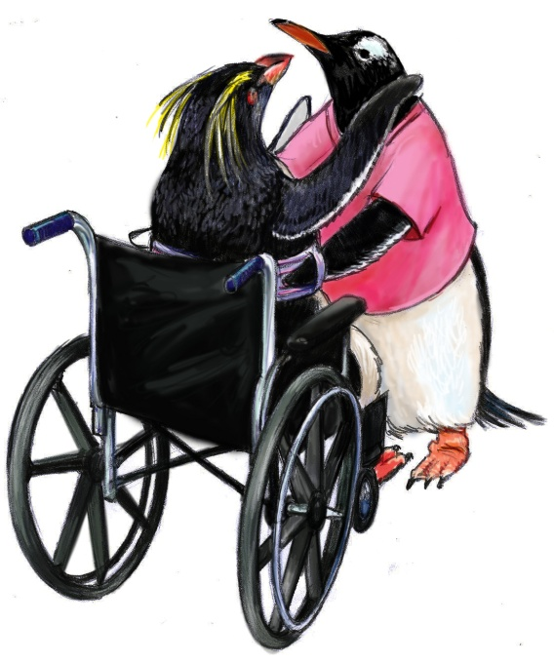
Team Structure

Slide 2
Objectives
Discuss benefits of team structure in teamwork
Define a “team”
Identify the role of residents and their families as part of the care team
Describe the components and composition of a multi-team system

Slide 3
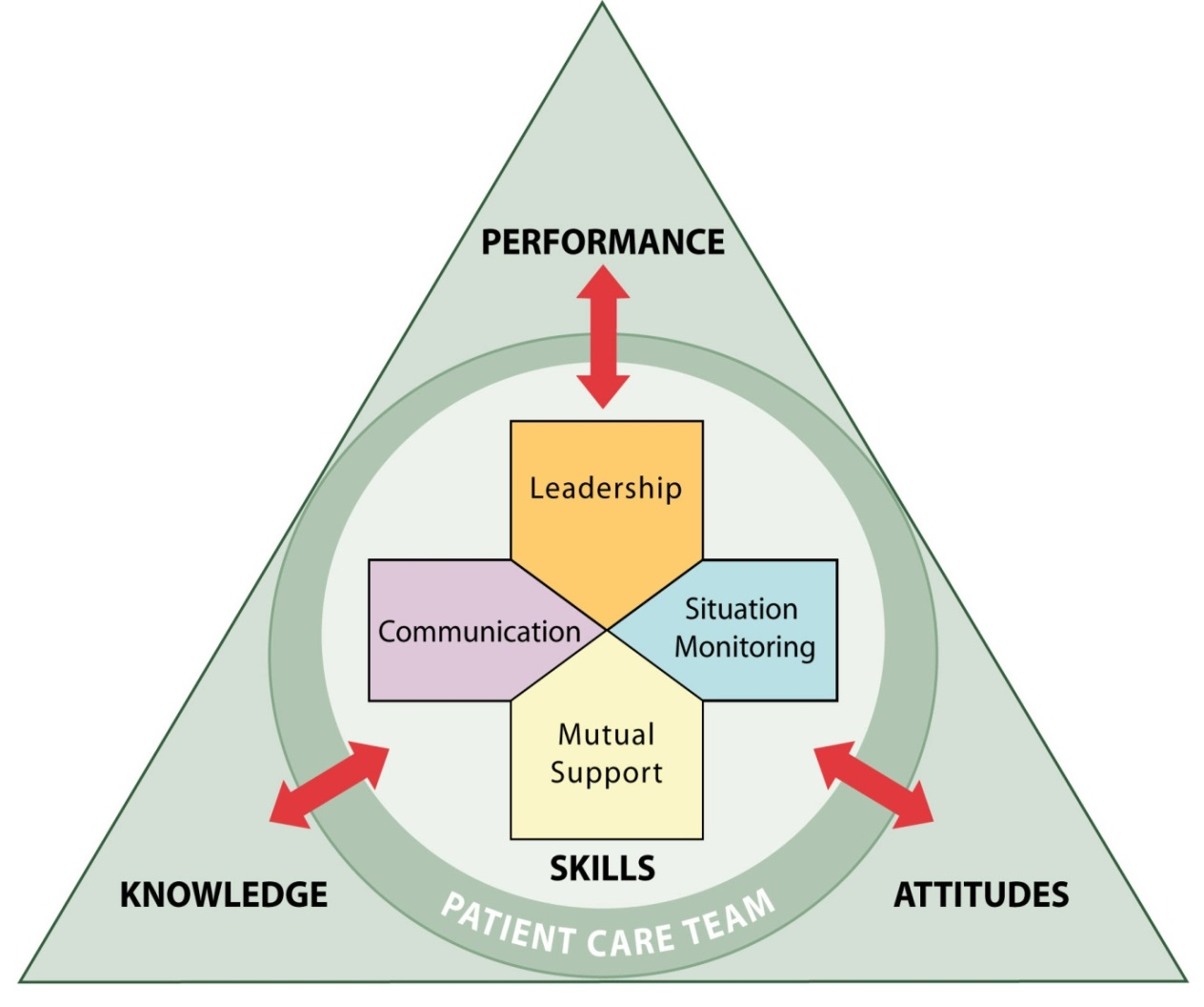
Team Structure
Teamwork cannot occur in the absence of a clearly defined team
Understanding a team’s structure and how multiple teams interact is critical for implementation planning

Slide 4

What Defines a Team?
Two or more people who interact dynamically, interdependently, and adaptively toward a common and valued goal, have specific roles or functions, and have a
time-limited membership

Slide 5

Exercise: Teams and Teamwork
Write down the names (or positions) of the people
in your immediate unit, department, or work area who contribute to successful resident care.

Slide 6
Partnering With the Resident
Strategies for involving residents in their care
  Include residents in care planning
  Conduct handoffs at the resident’s bedside
  Provide residents with tools for communicating with their care team
  Involve residents in key committees
  Actively enlist resident participation

Slide 7
Care Team Responsibilities
Embrace residents and their families as valuable and contributing partners in resident care
  Listen to residents and their families
  Assess residents’ preference regarding involvement
  Ask residents about their concerns
  Speak to them in terms they understand
  Allow time for residents and families to ask questions
  Ask for their feedback
  Give them access to relevant information
  Encourage residents and their families to proactively participate in resident care

Slide 8
Resident and Family Responsibilities
Provide accurate resident information
Comply with the prescribed plan of care (e.g., schedule and attend appointments as directed)
Ask questions and/or voice any concerns regarding the plan of care
Monitor and report changes in the resident’s condition
Manage family members
Follow instructions of the care team

Slide 9
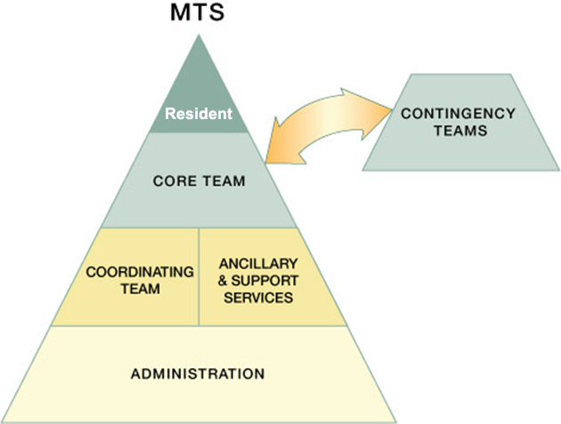
Multi-Team System (MTS) for Resident Care

Slide 10
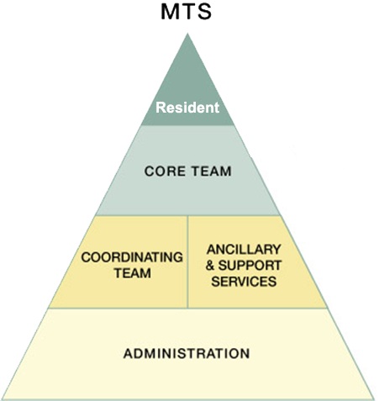
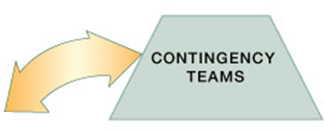
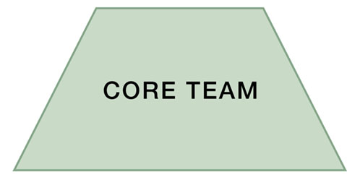
A Core Team is…
A group of care providers who work interdependently to manage a set of assigned residents from point of assessment to disposition
Core Team members have
the closest
contact with
the resident!

Slide 11
A Contingency Team is…
A time-limited team formed for emergent or specific events and composed of members from various teams

Slide 12
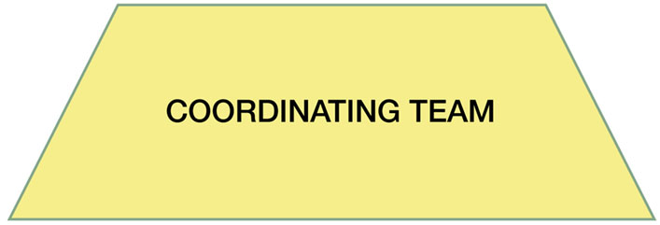
A Coordinating Team is…
A team comprising those work area members who are responsible for managing the operational environment that supports the Core Team

Slide 13
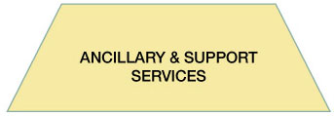
Ancillary and Support Services provide…
Ancillary Services provide direct, task-specific, time-limited care to residents.
Support Services provide indirect service-focused tasks which help to facilitate the optimal health care experience for residents and their families.

Slide 14

The Role of Administration is to…
Establish and communicate vision
Develop policies and set expectations for staff
related to teamwork
Support and encourage
staff during implementation
and culture change
Hold teams accountable
for team performance
Define the culture of
the nursing home

Slide 15


Team Structure Video

Slide 16
Team Structure Video Analysis
What members of the following teams were involved in the scenario?
  Core team
  Coordinating team
  Contingency team
  Ancillary and support services
Where did the breakdowns occur between the components of this multi-team system?
What could the individuals involved in this scenario have done differently to produce a better outcome?

Slide 17

Applying TeamSTEPPS Exercise
Who are the members of the team experiencing a teamwork issue?
Which team or teams within your multi-team system are experiencing the teamwork issue? Which team or teams interact with or are otherwise affected by the team(s) experiencing the issue?

