Slide 1

Leading Teams

Slide 2
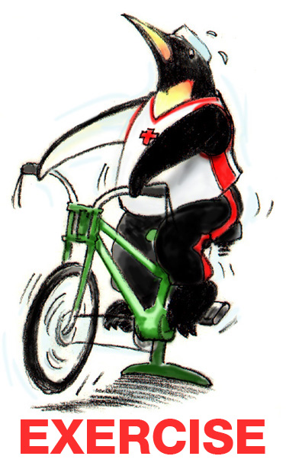
Exercise: Leadership
INSTRUCTIONS:
Begin by selecting a leader and scribe
for your group.
The group will have 10 minutes to address the questions, record your answers, and report back
to the group at large.

Slide 3
Objectives
Describe how leadership affects team processes and outcomes
Identify different types of team leaders
Describe the activities involved in successfully leading teams
Describe the tools for leading teams, including briefs, huddles, and debriefs
Apply the tools for leading teams to specific nursing home scenarios

Slide 4
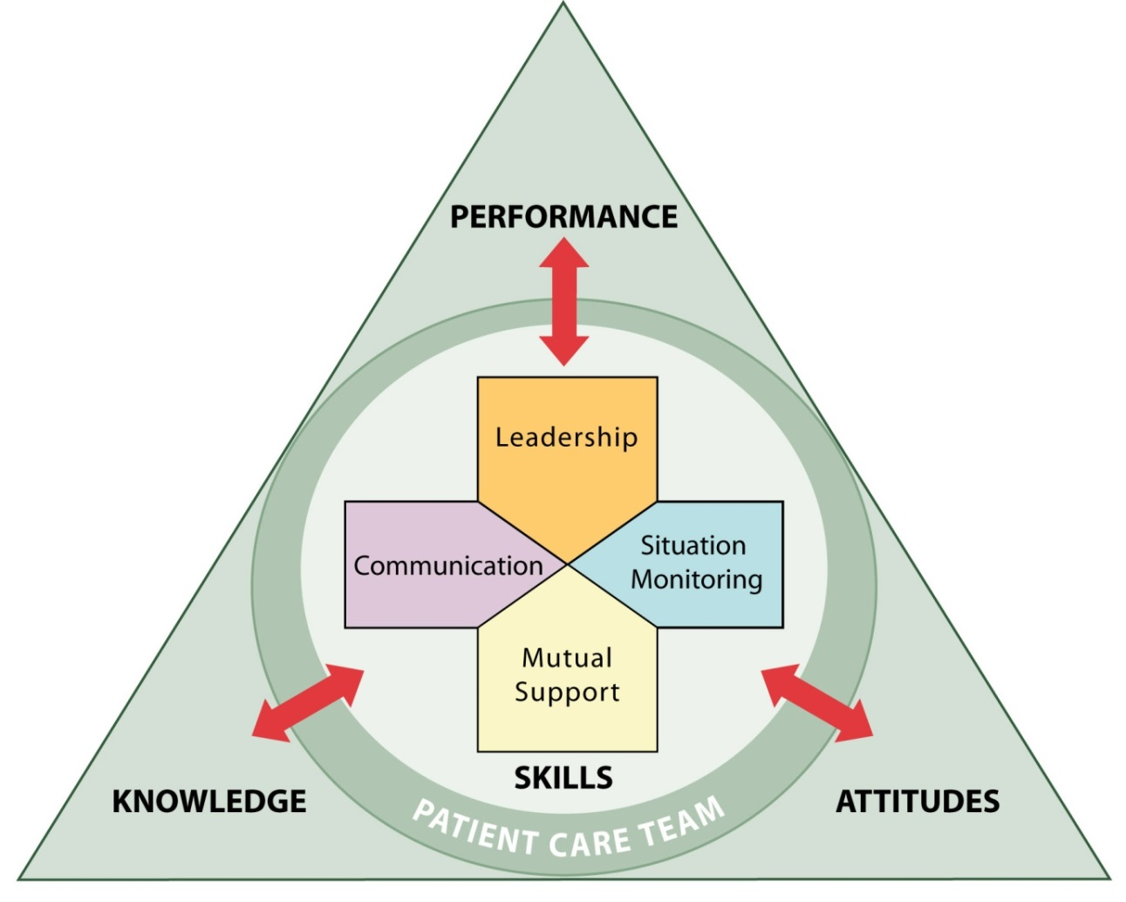

Leadership
Holds a teamwork system together
Ensures a plan is conveyed, reviewed, and updated
Facilitated through communication, continuous monitoring of the situation, and fostering of an environment of mutual support

Slide 5
Types of Team Leaders
Designated – The person assigned to lead and organize a team, establish clear goals, and facilitate open communication and teamwork among team members
Situational – Any team member who has the skills to manage the situation at hand

Slide 6
Effective Team Leaders
Define, assign, share, monitor, and modify a plan
Review the team’s performance
Establish “rules of engagement”
Manage and allocate resources effectively
Provide feedback regarding assigned responsibilities and progress toward the goal
Facilitate information sharing
Encourage team members to assist one another
Facilitate conflict resolution
Model effective teamwork

Slide 7
Defining the Plan
When developing a plan, team leaders should consider:
  Time – How much time is available to complete all the necessary tasks and activities?
  People – Do the available staff have the necessary knowledge and skills to perform their roles?
  Equipment – Is the necessary equipment available and working?
  Information – Has all of the necessary information been collected and reviewed?

Slide 8
Case Study Discussion
  After attending TeamSTEPPS Master Training, two CNAs at a nursing home recommend to the director of nursing that the home develop a more effective plan for responding to resident emergencies that occur outside of the home. For example, the nursing home occasionally holds outdoor picnics on its property, which include most of the residents and some of their family members, staff from several departments, and volunteers. When emergencies have occurred at these events in the past, many people come running and there is general chaos. In addition, because these events do not occur within a unit, but involve residents and staff from multiple units and departments, staff who may be the first to respond may not know the resident.

Slide 9
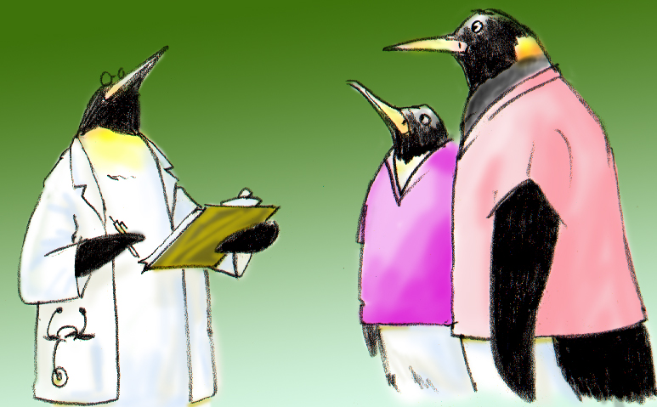
Assigning Tasks and Responsibilities
Determine the tasks and roles to be assigned
Determine which roles must be filled and allocate tasks appropriately
Communicate clear expectations of what team members need to do
Request feedback

Slide 10


Sharing the Plan:
Briefs
A team briefing is an effective strategy for sharing the plan
Briefs should help:
  Form the team
  Designate team roles and responsibilities
  Establish climate and goals
  Engage team in short- and long-term planning

Slide 11
Briefing Checklist Tool
TOPIC
Who is on core team?
All members understand and agree upon goals?
Roles and responsibilities understood?
Plan of care?
Staff availability?
Workload?
Available resources?

Slide 12
Exercise: Briefing
INSTRUCTIONS:
  Break into small groups.
  Identify when, why, and where briefings might be conducted. Note who should lead the brief and who should participate.
  Develop a checklist for guiding the brief.
  Discuss what outcomes you expect to see as a result of implementing briefs.
  At the end of the exercise, present and discuss your plans with the group.

Slide 13
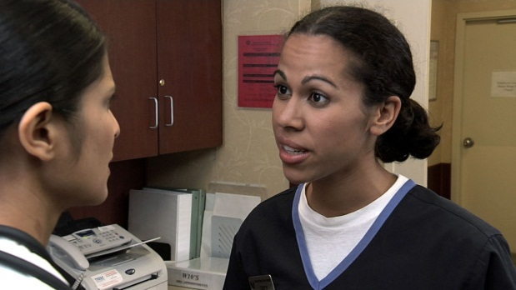

Monitoring & Modifying the Plan: Huddle
  Problem Solving
  Hold “touch base”
  meetings as needed to
  regain situation awareness
  Discuss critical issues
  and emerging events
  Anticipate outcomes
  and likely contingencies
  Assign resources
  Express concerns

Slide 14
Reviewing the Team’s Performance: Debrief
Process Improvement
Short information exchange and feedback sessions
Occur after an event or shift
Designed to improve teamwork skills
Designed to improve outcomes
  An accurate recounting of key events
  Analysis of why the event occurred
  Discussion of lessons learned and reinforcement of successes
  Revised plan to incorporate lessons learned

Slide 15
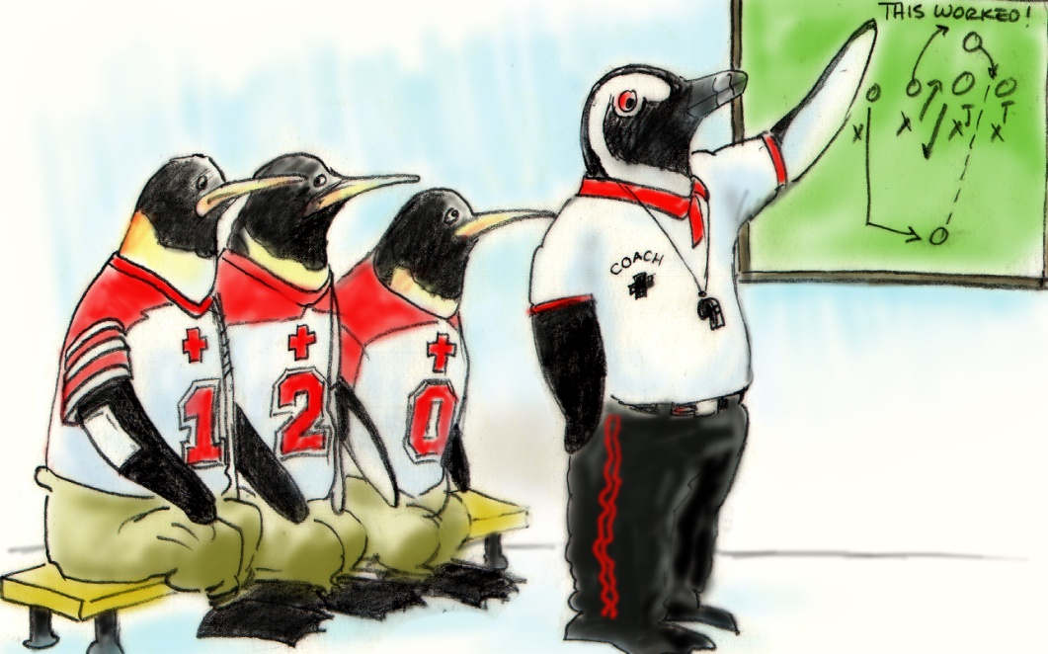
Debrief Checklist
TOPIC
Communication clear?
Roles and responsibilities understood?
Situation awareness maintained?
Workload distribution?
Did we ask for or offer assistance?
Were errors made or avoided?
What went well, what should change, what can improve?

Slide 16
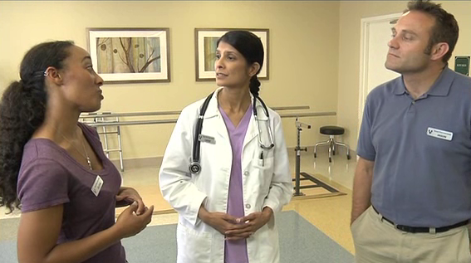

Debrief Video

Slide 17
Facilitating Conflict Resolution
Effective leaders:
  Facilitate conflict resolution to avoid compromising resident safety and quality of care
  Do not allow interpersonal or irrelevant issues to negatively affect the team
  Help team members master conflict resolution techniques

Slide 18
Promoting & Modeling Teamwork
Effective leaders cultivate desired team behaviors and skills through:
  Open sharing of information
  Role modeling and effective cuing of team members to use prescribed teamwork behaviors and skills
  Constructive and timely feedback
  Facilitation of briefs, huddles, debriefs, and conflict resolution
  Mitigation of conflict within the team

Slide 19


Team Formation Video

Slide 20
Tools & Strategies Summary
BARRIERS
Inconsistency in Team Membership
Lack of Time
Lack of Information Sharing
Hierarchy
Defensiveness
Conventional Thinking
Complacency
Varying Communication Styles
Conflict
Lack of Coordination and Followup With Coworkers
Distractions
Fatigue
Workload
Misinterpretation of Cues
Lack of Role Clarity
TOOLS and STRATEGIES
  Communication
  SBAR
  Call-Out
  Check-Back
  Handoff
  Leading Teams
  Brief
  Huddle
  Debrief
OUTCOMES
Shared Mental Model
Adaptability
Team Orientation
Mutual Trust
Team Performance
Resident Safety!!

Slide 21

Applying TeamSTEPPS Exercise
Does the team experiencing the issue in your nursing home have a designated leader? Who is it?
Is your teamwork issue related to the team’s leadership?
If yes, what is the leadership issue?
Which of the tools and/or strategies for leading teams might you consider implementing to address the issue?

