Slide 1
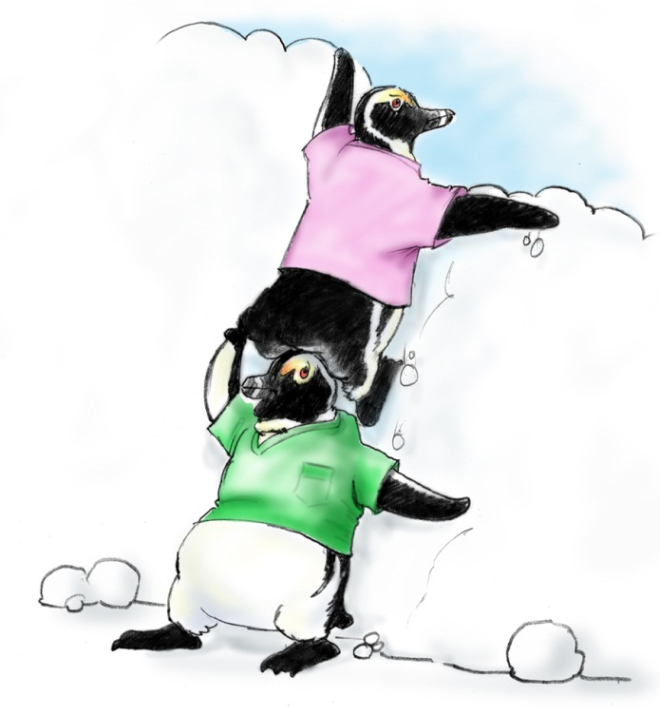
Mutual Support

Slide 2
Objectives
  Describe how mutual support affects team processes and outcomes
  Discuss specific strategies to foster mutual support (e.g., task assistance, feedback)
  Identify specific tools to facilitate mutual support
  Describe conflict resolution strategies

Slide 3
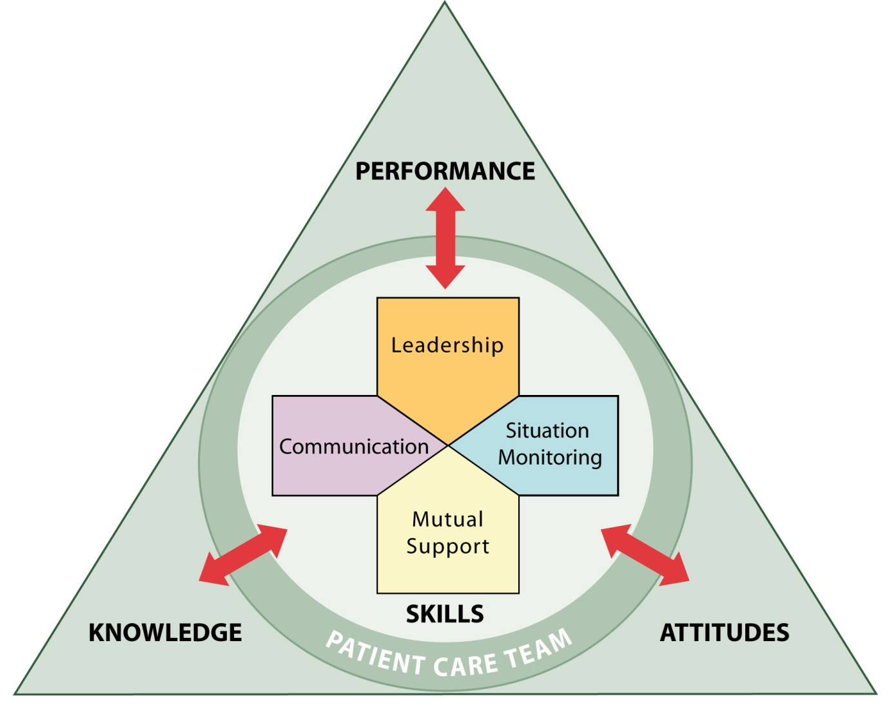

Mutual Support
Dependent upon information gathered through situation monitoring
Moderated by the communication of information
Enhanced by leaders who encourage and role model mutual support behaviors

Slide 4
Mutual Support
  Mutual support involves members:
  Assisting each other
  Providing and receiving feedback
  Exerting assertive and advocacy behaviors when resident safety is threatened

Slide 5
Task Assistance
Team members foster a climate in which it
is expected that assistance will be actively sought and offered as a method for reducing the occurrence of error.

Slide 6
Task Assistance Example
  Two members of the GI Laboratory are assessing a resident who has just had conscious sedation for a colonoscopy. The monitor shows SVT at a rate of 150 and a BP of 76/48. The nurse calls out the vital signs while the physician continues to monitor the rhythm. A nurse passing by the room hears the call-out.

Slide 7
What Is Feedback?
Feedback is information provided for the purpose of improving team performance

Slide 8
Types of Feedback
Formal
  Retrospective and typically scheduled in advance
  Has an evaluative quality
  Examples: Collaborative discussions, case conferences, individual performance reviews
Informal
  Typically in real time
  Provided on an ongoing basis
  Focuses on knowledge and practical skills development
  Examples: Huddles, debriefs

Slide 9
Characteristics of Effective Feedback
Effective feedback is—
  Timely
  Respectful
  Specific
  Directed toward improvement
    Helps prevent the same problem
    from occurring in the future
  Considerate

Slide 10
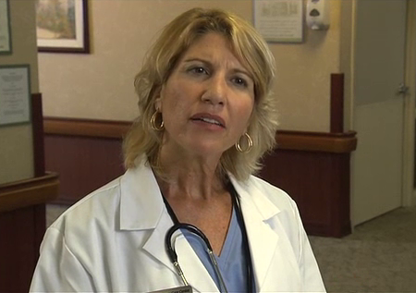

Providing Effective Feedback Video

Slide 11
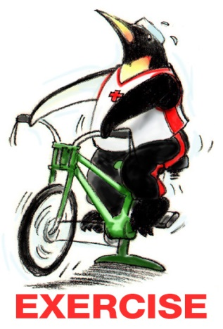
Feedback Exercise
A staff development nurse watches a nursing assistant use a mechanical lift to transfer a resident from the bed to a chair. The nurse pulls the nursing assistant aside and reminds her of the proper positioning of the lift pad, showing the nursing assistant which landmarks to use. She explains how the resident’s position can affect the function of the lift and that friction and sheer to the resident’s skin can result when the resident is not positioned properly.
How would you provide effective feedback?

Slide 12
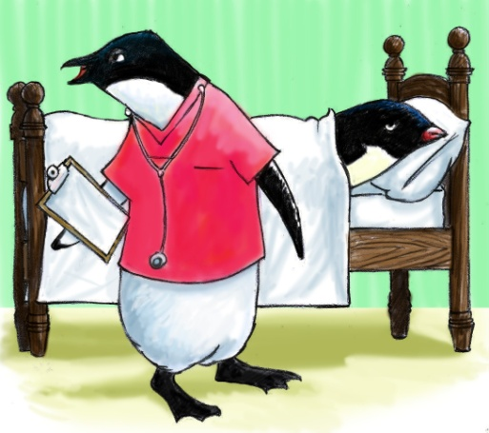
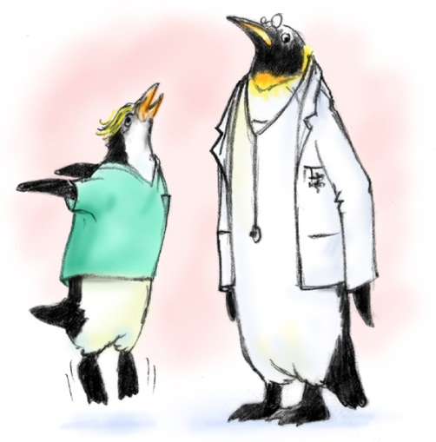
Advocacy and Assertion
Advocate for the resident:
  Used when team members’
  viewpoints don’t agree with
  that of a decisionmaker
Assert a corrective action in a
firm and respectful manner

Slide 13
The Assertive Statement
Respectful and supportive of authority
Clearly asserts concerns and suggestions
Is nonthreatening and ensures that critical information is addressed
Five-Step Process:
        Open the discussion
        State the concern
        State the problem—real or perceived
        Offer a solution
        Obtain an agreement

Slide 14
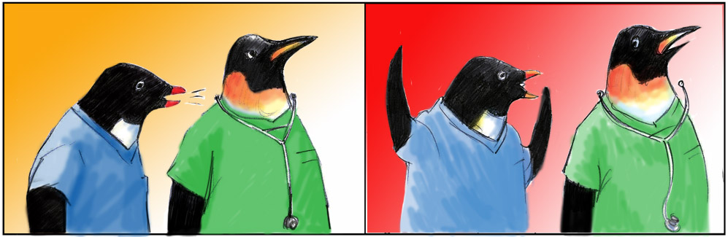
Two-Challenge Rule
1
2

Slide 15
Two-Challenge Rule
Invoked when an initial assertion is ignored…
It is your responsibility to assertively voice your concern at least two times to ensure that it has
been heard
The member being challenged must acknowledge
If the outcome is still not acceptable
  Take a stronger course of action
  Use supervisor or chain of command

Slide 16
Two-Challenge Rule cont.
Empower any team member to “stop the line” if he or she senses or discovers a breach of safety.
This is an action never to be taken lightly, but it requires immediate cessation of the process and resolution of the safety issue.

Slide 17
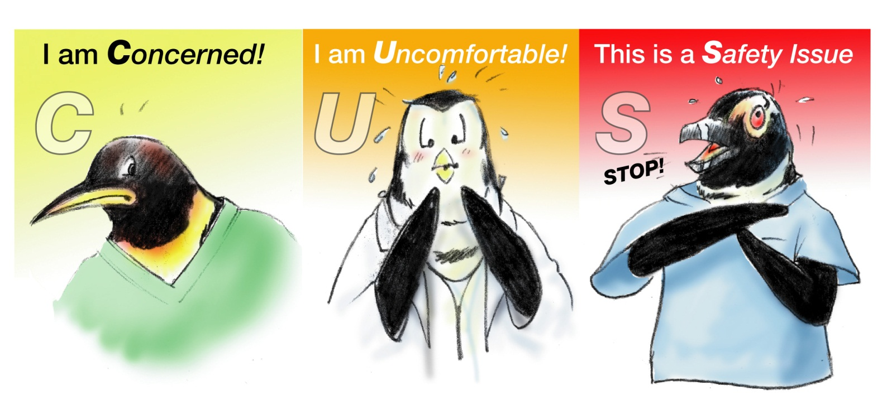

Please Use CUS Words but only when appropriate!

Slide 18
Advocacy and Assertion Scenario
A high school senior working in the Dietary Department is wheeling the steam-tray table down the hall after dinner. Ahead of her, she sees a nursing assistant escort a resident into his room and close the door. As she passes the room, she hears a raised voice and believes it to be the nursing assistant. She feels she should knock on the door or tell someone but doesn’t.

Slide 19
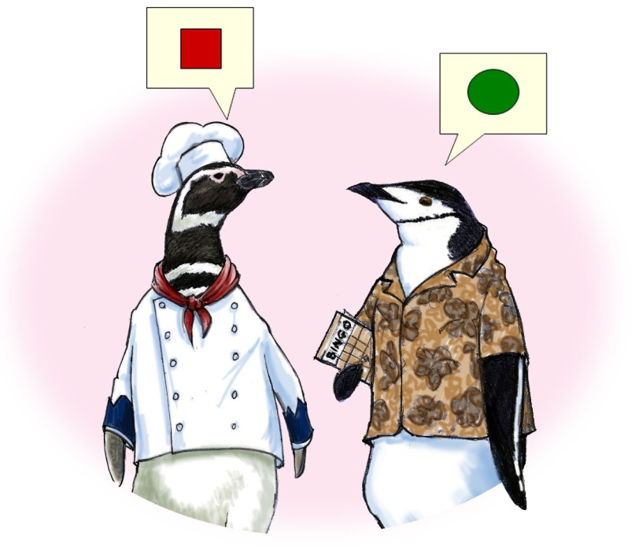
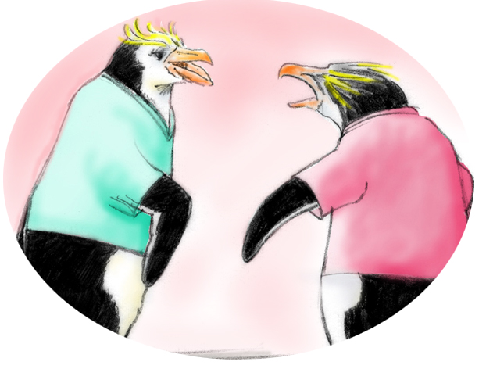
Conflict in Teams
Interpersonal Conflict
(Hostile and harassing behavior)
DESC Script
Informational Conflict
(We have different information!)
Two-Challenge Rule

Slide 20
Conflict Resolution
DESC Script
A constructive approach for
managing and resolving conflict
  D—Describe the specific situation
  E—Express your concerns about the action
  S—Suggest other alternatives
  C—Consequences should be stated

Slide 21
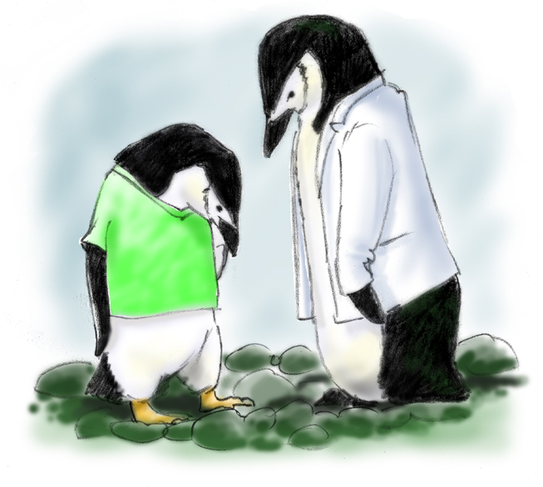
DESC-It
Let’s “DESC-It!”
Have timely discussion
Work on win-win
Frame problem in terms of your own experience
Choose a private location
Use “I” statements; avoid blaming statements
Critique is not criticism
Focus on what is right, not who is right

Slide 22
A DESC Scenario
Two days ago, the charge nurse submitted a maintenance request to fix a window unit air conditioner. While in the resident’s room, the nurse realizes it is warm and the air conditioner still isn’t working properly. She checks the logbook and sees that the maintenance request has not been completed. She doesn’t know that a new unit is being delivered today. Worried about the comfort of her resident, who has difficulty breathing in warm weather, she raises her voice at the director of maintenance in front of staff and residents, criticizing his work ethic.

Slide 23
Tools & Strategies Summary
BARRIERS
Inconsistency in Team Membership
Lack of Time
Lack of Information Sharing
Hierarchy
Defensiveness
Conventional Thinking
Complacency
Varying Communication Styles
Conflict
Lack of Coordination and Followup With Coworkers
Distractions
Fatigue
Workload
Misinterpretation of Cues
Lack of Role Clarity
TOOLS and STRATEGIES
  Communication
  SBAR
  Call-Out
  Check-Back
  Handoff
  Leading Teams
  Brief
  Huddle
  Debrief
  Situation Monitoring
  STEP
  I’M SAFE
  Mutual Support
  Task Assistance
  Feedback
  Assertive Statement
  Two-Challenge Rule
  CUS
  DESC Script
OUTCOMES
Shared Mental Model
Adaptability
Team Orientation
Mutual Trust
Team Performance
Resident Safety!!

Slide 24
Applying TeamSTEPPS Exercise
Is your teamwork issue related to mutual support?
If yes, what is the mutual support issue?
Which mutual support tools or strategies might you consider implementing to address the issue?

