Slide 1



Module 1: Introduction
Welcome to
Office-Based Care Online Course
Notes:
Welcome to the TeamSTEPPS for Office-Based Care Online Course. This is Dr. Brigetta Craft, the course director for the TeamSTEPPS 2.0 Online Master Trainer Course.
As a nurse with years of experience in patient safety and quality, inpatient, ambulatory and office-based care, I am excited to be a part of the development and presentation of the Office-Based Care Online curriculum.
This presentation will cover the introduction to the TeamSTEPPS for Office-Based Care material that you will review as a practice facilitator. As you will soon realize, this introduction module sets the stage for the entire course.

Slide 2

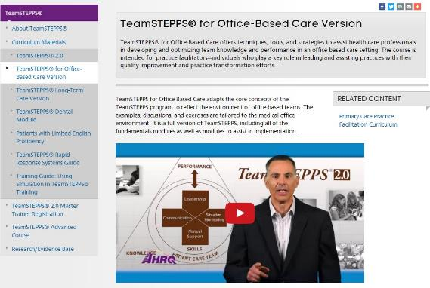
The Materials You Will Use
The Participant Workbook:
Exercises
Video reflections
Scenarios
AHRQ TeamSTEPPS website:
Classroom slides
Instructor Guide (select to view)
Videos
Ancillary materials
Notes:
During this course, the Participant Workbook will be your primary tool for completing all the learning activities such as exercises, video reflections, and case-based scenarios. These will help shape your implementation plan in addition to providing content, discussion questions, and other activities for your change team. Select the link to download the Participant Workbook.
You can also visit the AHRQ TeamSTEPPS website to access the entire TeamSTEPPS for Office-Based Care curriculum. This includes the PowerPoint classroom slides and instructor guides for each module, along with videos and ancillary materials such as handouts and exercises. Select the link to open the AHRQ TeamSTEPPS website.

Slide 3
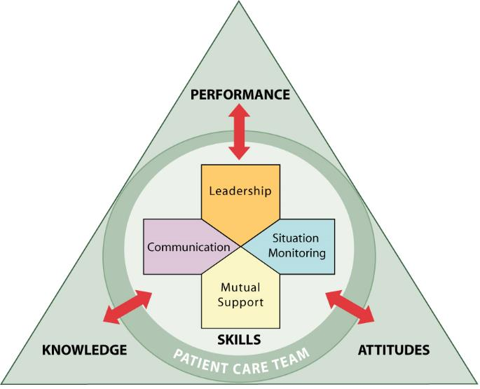
Module Objectives
After completing this module, you will be able to:
Describe the impact of errors and why they occur
Describe the TeamSTEPPS framework
State the outcomes of the TeamSTEPPS
framework
Notes:
After completing this module, you’ll be able to:
Describe the impact of errors and why they occur.
Describe the TeamSTEPPS framework, and
State the outcomes of the TeamSTEPPS framework.

Slide 4
Key Terms and Roles
By completing this course, you will become a TeamSTEPPS Master Trainer
The Fundamentals are covered in Modules 1 through 7
Teaching & Coaching, Change Management, Measurement, and Implementation Planning are covered in Modules 8 through 11
This course uses the Practice Facilitator model
Notes:
As we begin, it is important to have a shared mental model of key terms and roles. By completing this course, you will become a TeamSTEPPS Master Trainer and will receive a certificate of completion. This course will teach you the Fundamentals of TeamSTEPPS and provide you with techniques and tools to teach TeamSTEPPS to others, coach and implement the program. The Fundamentals, Modules 1 through 7 are the “what” of TeamSTEPPS and covers the main tools and principles. Modules 8 through 11, Teaching & Coaching, Change Management, Measurement, and Implementation Planning are the “how” of TeamSTEPPS.
In this course, you are also considered to be the Practice Facilitator of your organization. More details will be provided in Module 7, but a Practice Facilitator’s role is to learn about TeamSTEPPS and then spread it to the office-based care settings they influence. Practice facilitation is a service provided by an individual or individuals to help in the overall improvement of care delivery. Having competencies in many areas, including quality improvement methods, project management, and team facilitation, it is the Practice Facilitator’s background in team facilitation that makes for a comfortable connection with the principles of TeamSTEPPS. But, you do not need to have the title of Practice Facilitator for your organization in order to lead a TeamSTEPPS intervention.

Slide 5
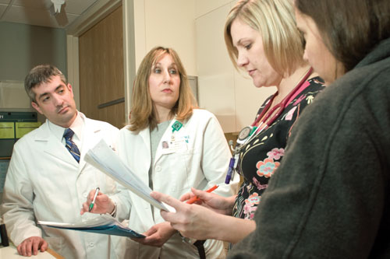
The Practice Facilitator
As the Practice Facilitator leading your TeamSTEPPS intervention:
It is important to have the
support of a Change Team
Take time to identify
members of your
Change Team
Notes:
As the Practice Facilitator leading your TeamSTEPPS intervention, it is important to have the support of a Change Team. Your Change Team should be multi-disciplinary, and the members should be able to help you drive your intervention. While there is not a magic number of individuals that should be on a team, smaller offices should consider having 3-4 individuals and larger offices could have up to 10 members on the change team. These individuals need not have the title of manager or director but they should be leaders in some way and individuals that people trust and that garner respect with all facets of the office team. The change team does not need to watch all of these online modules but it is up to you as the practice facilitator to make sure they understand what you have learned, especially the information contained in modules 1-7.

Slide 6
About TeamSTEPPS®
Collaboration of:
Agency for Healthcare Research and Quality (AHRQ)
Department of Defense
Team Strategies and Tools to Enhance Performance and Patient Safety
Focuses on strengthening the specific knowledge, skills, and attitudes of teamwork
Can be tailored to meet the needs of any team in any setting
  TeamSTEPPS for Office-Based Care tailors to the office-based setting
Notes:
With over a decade of safety-driven collaboration, the Agency for Healthcare Research and Quality and the Department of Defense strive to optimize the lessons learned from multiple initiatives, focused on reducing errors in medicine. One such evidence-based collaborative work is TeamSTEPPS. Despite uncertainties and competing priorities, healthcare teams work to plan, problem-solve, communicate, collaborate, and coordinate to co-create and carry out care with their patients.
The focused, and purpose-driven ability of crew resource management-based teaming behaviors to impact the good outcomes achieved by high-performing teams is well known. TeamSTEPPS is a name, a concept, and a methodology. The acronym stands for Team Strategies and Tools to Enhance Performance and Patient Safety.
As a concept, TeamSTEPPS focuses on strengthening the specific knowledge, skills, and attitudes of teamwork critical to highly reliable team performance and outcomes. As a methodology, TeamSTEPPS conveys to participants the knowledge, skills, tools, and strategies found through decades of research critical to creating and maintaining high-performing teams. TeamSTEPPS curriculum provides the knowledge and critical success factors necessary to achieve excellence in behavioral training and performance simulation, human factors, and cultural change concepts specific to improvements in quality and patient safety.
Adaptable to all environments, TeamSTEPPS can be tailored to meet the needs of any team in any setting. TeamSTEPPS tailors to the office-based setting and uses the evidence-based and many lessons learned from teaming in combat casualty care, and in- and outpatient ambulatory and clinic settings.

Slide 7

Evidence-Based Team Performance Improvement
More than 40 years of research and evidence from high-risk fields
Provides specific tools and strategies for:
  Improving communication in teamwork
  Reducing chance of error
  Enhancing patient safety
Outcomes of a high-performing team are adaptability, accuracy, productivity, efficiency, and safety
Notes:
More than 40 years of research and evidence have been accumulated on teams and team performance in diverse areas, for example, aviation, the military, nuclear power, health care, and business and industry. TeamSTEPPS has evolved from research in these high-risk fields, where the consequences of error are great, to the healthcare field-- a high-risk, high-stakes environment in which poor performance can lead to serious consequences or death.
In effective teams, mistakes are caught, addressed, and resolved before they compromise patient safety. TeamSTEPPS provides specific tools and strategies for improving communication in teamwork, reducing chance of error, and enhancing patient safety. Based on research, we know that teamwork is defined by a set of interrelated Knowledge, Skills, and Attitudes-- or KSAs-- that facilitate coordinated, adaptive performance in support of one's teammates' objectives and mission.
Effective teamwork is dependent on each team member being able to anticipate the needs of others, adjust to each other's actions and to the changing environment, and have a shared understanding of how a procedure should happen in order to identify when errors occur and how to correct for these errors. Team-related knowledge results in a shared mental model. Attitudes result in mutual trust and team orientation. Outcomes of a high-performing team are adaptability, accuracy, productivity, efficiency, and safety.

Slide 8
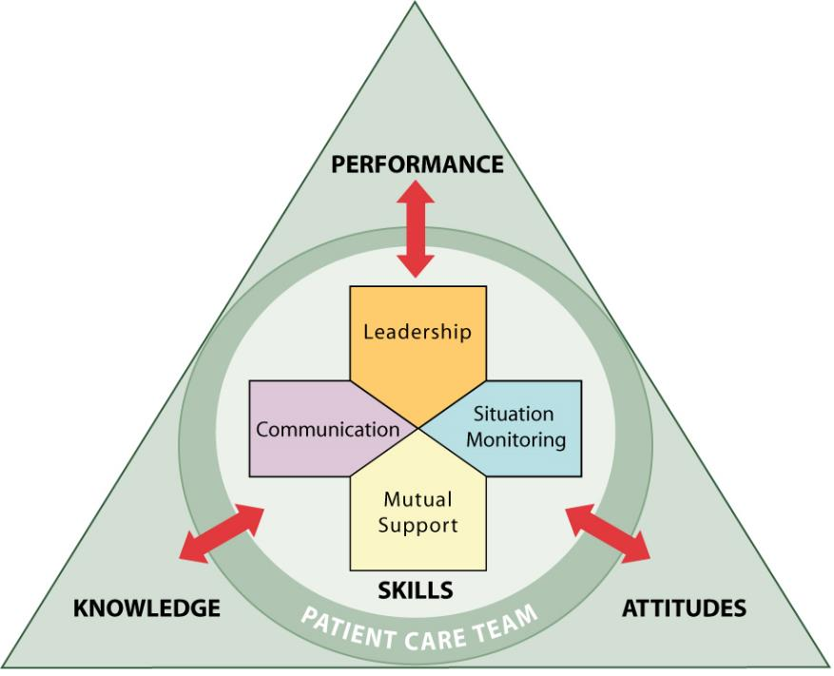
TeamSTEPPS Skills
Notes:
TeamSTEPPS is an evidence-based framework to optimize team performance across the healthcare delivery system. This framework is composed of four teachable, learnable skills-- leadership, situation monitoring, mutual support, and communication. The red arrows on the graphic of the TeamSTEPPS framework depict a two-way dynamic interplay between the four skill areas and team-related outcomes.
Interaction between the outcomes and skills is the basis of a team striving to deliver safe, quality care. Encircling the four skills is the patient care team, which represents not only the patient, but also those who play a supportive role within the healthcare delivery system. More than a logo, this graphic is designed and has become associated with the conceptual model of teaming in healthcare.

Slide 9
Does TeamSTEPPS Work?
Research has found that teamwork plays a critical role in providing quality healthcare
Clinical outcomes include:
50% reduction in the Weighted Adverse Outcome Score (WAOS), which describes the adverse event score per delivery
50% decrease in the Severity Index, which measures the average severity of each delivery with an adverse event
  Mann, S., Marcus, R., Sachs, B. Lessons from the cockpit: How team training can reduce errors on L&D (Grand Rounds) Contemporary OB/Gyn v51 i1:34(8), January 2006.
Reduced rate of adverse drug events
Improved medication reconciliation at patient admission
  Haig, K. Sutton S., Whittington, J. SBAR: A shared mental model for improving communication between clinicians. JL Comm J Qual Patient Saf 32(3):167-75, March 2006.
Notes:
Research has found that teamwork plays a critical role in providing quality healthcare and that there are significant positive results when organizations implement teamwork initiatives. As TeamSTEPPS spreads across the many healthcare settings, the evidence base grows as well.
Some of the current clinical outcomes of team training include the following-- 50% reduction in adverse outcomes based on the average scores after they were weighted for severity; 50% decrease in the severity index, which measures the average severity of each delivery with an adverse event; reduced rate of adverse drug events; and improved medication reconciliation at patient admission.

Slide 10
Does TeamSTEPPS Work?
Teamwork outcomes include:
Significant improvement in communication and supportive behavior
Significant increases in perceptions of teamwork after training
  Weaver, S. J., Rosen, M. A., DiazGranados, D., Lazzara, E. H., Lyons, R., Salas, E., Knych, S. A., McKeever, M., Adler, L., Barker, M., & King, H. B. Does teamwork improve performance in the operating room? A multi-level evaluation. The Joint Commission Journal on Quality and Patient Safety 36(3): 133-142, March 2010.
Reductions in turnover rate
Increases in employee satisfaction
  Leonard, M., Graham, S., Bonacum, D. The human factor: The critical importance of effective teamwork and communication in providing safe care. Qual Saf Health Care 13 Suppl 1:85-90, October 2004.
Notes:
Research also cites outcomes of team training related to the way the team operates, such as the following: significant improvement in communication and supportive behavior, perceptions of teamwork increase significantly after training, reductions in turnover rate, and increases in employee satisfaction. Later on, we will look at some research that demonstrates the importance of teamwork in the healthcare setting.

Slide 11

Medical Office Environment
Do your patients have any idea how chaotic the office really is?
How would they know?
What would they hear or see?
If you could describe the office in one word, what would it be?
If your patients could describe the office in one word, what would it be?
If someone asked you to explain a typical day, what would you say?
If patients described a typical visit, what would they say?
Use page 4 of the Participant Workbook to record your responses
Notes:
This picture represents a moment in the life of the office-based team. What the patient sees and what you see are very different. The general public experiences the office from the perspective of one patient at a time, while office-based team members know the reality of juggling numerous patients over a long period of time. The work of an office-based team does not follow a linear process. It involves numerous parts working independently and interdependently.
Think about how this picture compares with the front desk picture that the average patient has of the medical office. In particular, do you think your patients have any idea how chaotic the office really is?
How would they know? What would they hear or see?
If you could describe the medical office in one word, what would it be? If your patients could describe the medical office in one word, what would it be?
If someone asked you to explain what a typical day at the medical office was like, what would you say? If patients described a typical visit to the medical office, what would they say? You should pose these same questions to your team and discuss the concept of office environment in greater detail.
Please take 10 minutes and open the Participant Workbook to the page shown on the slide and record your responses to these questions.

Slide 12

Medical Office Environment
On the surface, the office environment
can and should appear orderly to patients
Like a duck– calm appearing above the
water while chaos churns below
Medical Office:
  Does not conform to a pattern of work
  Has many components working together
  on multiple tasks simultaneously
  Treats numerous patients simultaneously
Notes:
On the surface, the office environment can and should appear orderly to patients. But to healthcare staff trying to attend to multiple tasks in a short time frame, it may seem chaotic. The analogy of a duck might help you understand what you see versus what the patient sees.
The part of the duck that you see-- the part above the water-- appears calm. But the part below the surface is chaotic with a lot of moving parts. Even though what the patient sees and what the team experiences are different, the actions of the healthcare team have a profound impact on patient care. Thus, when teams fail to work well together, patients know and experience firsthand the confusion, miscommunications, and uncoordinated care that lead to mistakes and negative impacts to patient outcomes.
I
t is vital, therefore, that healthcare professionals utilize proper teamwork strategies and skills. It is important to determine whether the team is currently functioning as a real team. On the next slide, we're going to introduce you to an activity you can use to introduce your team to the teamwork concept.

Slide 13
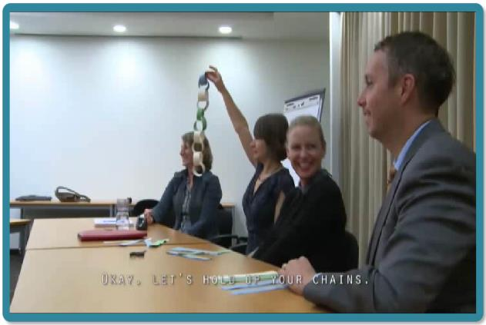
Team-Building Exercise: Paper Chain
On the next slide, you will see a video of a team using the “Paper Chain” activity to better understand teamwork
Download the Paper Chain Facilitator’s Guide
When you are ready, select the arrow to
go to the next slide and watch the video
Notes:
You will be viewing a video of a team using the “Paper Chain” activity to better understand teamwork. You may want to use this activity with your team. If you select the link provided, you can download the complete directions for leading this activity with your team. You may want to review it now before watching the video.
When you are ready, please select the arrow to go to the next slide and watch the video.

Slide 14

Paper Chain Activity Video
https://www.youtube.com/watch?v=1JBJ7zBNCgY

Slide 15
Why Does Teamwork Matter in Medical Offices?
Better continuity of care, access to care, and patient satisfaction
Stevenson K, Baker R, Farooqi A, Sorrie R, Khunti K. Features of primary health care teams associated with successful quality improvement of diabetes care. Fam Pract. 2001;18:21-26
Higher patient-perceived quality of care
Campbell SM, Hann M, Hacker J, et al. Identifying predictors of high quality care in English general practice: observational study. BMJ. 2001;323:1-6.
Superior care for diabetes patients
Bower, P., Campbell, S., Bojke, C., & Sibbald, B. Team structure, team climate, and the quality of care in primary care: An observational study. QSHC. 2003; 12: 273-279.
Notes:
There is a growing body of research that supports the value of teamwork in healthcare.
Research by Stevenson and colleagues indicates that teamwork leads to better continuity of patient care, better access to care, and greater patient satisfaction. A study by Campbell and colleagues has also shown that where there is teamwork among healthcare providers, patients perceive that they are receiving higher-quality healthcare. Also, a 2003 study by Bower and colleagues found that teamwork resulted in superior care for diabetes patients.

Slide 16
Module 1 Summary
In this module you learned to:
Describe the impact of errors and why they occur
Describe the TeamSTEPPS framework
State the outcomes of the TeamSTEPPS framework
Notes:
In this module, you learned to:
Describe the impact of errors and why they occur
Describe the TeamSTEPPS framework, and
State the outcomes of the TeamSTEPPS framework.

