Slide 1
Module 4: Leading Teams
Welcome to
Office-Based Care Online Course
Notes:
Welcome to the TeamSTEPPS for Office-Based Care Online Course. This is Dr. Brigetta Craft. The following presentation will cover Module 4, Leading Teams, that you, as a practice facilitator, will review.

Slide 2
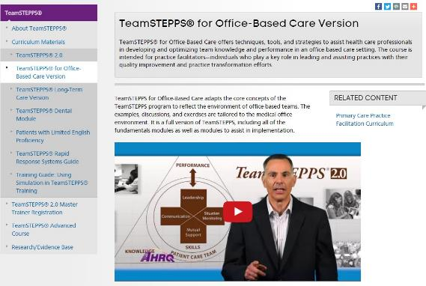
The Materials You Will Use
The Participant Workbook:
Exercises
Video reflections
Scenarios
AHRQ TeamSTEPPS website:
Classroom slides
Instructor Guide (select to view)
Videos
Ancillary materials
Notes:
During this course, the Participant Workbook will be your primary tool for completing all the learning activities, such as exercises, video reflections, and case-based scenarios. These will help shape your implementation plan in addition to providing content, discussion questions, and other activities for your change team. Select the link to download the Participant Workbook.
You can also visit the AHRQ TeamSTEPPS website to access the entire TeamSTEPPS for Office-Based Care curriculum. This includes the PowerPoint classroom slides and instructor guides for each module, along with videos and ancillary materials such as handouts and exercises. Select the link to open the AHRQ TeamSTEPPS website.

Slide 3
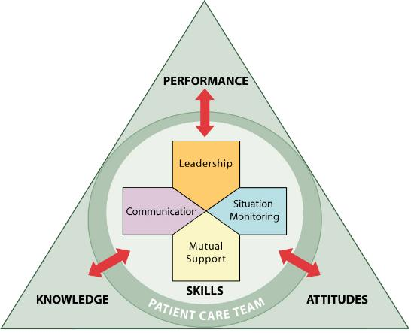
Module Objectives
After completing this module, you will be able to:
Describe how leadership affects team processes and outcomes
Identify characteristics of successful leadership
Describe the activities involved in successfully leading teams
Describe the tools for leading teams, including briefs, huddles, and debriefs
Apply the tools for leading teams specific to office-based care
Notes:
After completing this module, you’ll be able to:
Describe how leadership affects team processes and outcomes.
Identify characteristics of successful leadership.
Describe the activities involved in successfully leading teams.
Describe the tools for leading teams, including briefs, huddles, and debriefs.
And apply the tools for leading teams specific to office-based care.
To begin our discussion on leading teams, I would like to introduce AHRQ’s senior nursing advisor and your host for this module, Dr. Ric Ricciardi.

Slide 4
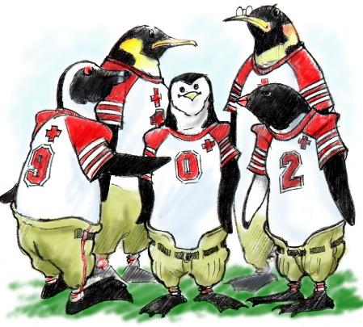
Leading Teams
Definitions of leadership center on the concept of influence
“A process whereby an individual organizes and influences a group of individuals to achieve a common goal.”
Leaders influence team effectiveness by:
Facilitating team actions
Ensuring that teams have the necessary resources
Ensuring that roles and tasks are understood
Being knowledgeable of team members’ skills and expertise
Notes:
Leadership is a critical component of effective team performance, and the second component of TeamSTEPPS that we will consider. Traditional definitions of leadership center on the concept of influence. For example, Peter Northouse refers to leadership as a process whereby an individual organizes and influences a group of individuals to achieve a common goal. Leaders influence team effectiveness by facilitating team actions, ensuring that teams have the necessary resources for optimal performance, ensuring that roles and tasks are understood by all team members, and by being knowledgeable of team members’ skills and expertise in order to properly allocate tasks and material resources.

Slide 5
Characteristics of Effective Leadership
The primary leadership role generally is held by the provider
A second leadership role may be that of administrative personnel
Shared leadership: A partnership where two or more people share power
Characteristics of effective leadership:
Role modeling and shaping teamwork through open sharing of information
Constructive and timely feedback
Facilitation of briefs, huddles, debriefs, and conflict resolution
Notes:
Within the clinical team, the primary leadership role generally is held by the provider. However, each clinical team member must know each other’s role, including strengths and weaknesses and areas of expertise. In the operations team, a second leadership role may be that of administrative personnel, whose tasks include managing medical records, coordinating transfer of patient information, and interfacing with patients on nonmedical issues.
Traditional definitions of leadership have given rise to the concept of shared leadership. Moxley defines leadership as a partnership where two or more people, or a team of people, share power and join forces to move toward the accomplishment of a shared goal. Baker and colleagues found that leaders impact team effectiveness not by handing down solutions, but rather by facilitating team problem solving.
Whether acting in a primary leadership position or in a shared leadership environment, all leaders must develop certain leadership characteristics to be successful.
These characteristics of effective leadership include role modeling and shaping of teamwork through open sharing of information, providing constructive and timely feedback, and facilitating briefs, huddles, debriefs, and resolving conflicts.

Slide 6
Leadership Strategies
Three critical events
Plan
Problem solve
Improve over time
- Briefs
- Huddles
- Debriefs
Leaders are responsible to assemble the team and facilitate team events
But anyone can request a brief, huddle, or debrief
Notes:
High-performing team leaders ensure teams engage in three critical events — to plan, problem solve, and improve over time. Three leadership strategies in the TeamSTEPPS toolkit address these events. They are briefs (for planning purposes), huddles (for problem solving), and debriefs (for reflection and process improvement). We will now explore each of these three in greater detail. As we go forward, keep in mind that although the team leader typically facilitates team events, any team member can request a brief, huddle, or debrief at any time as the need arises. This is an example of shared leadership.

Slide 7
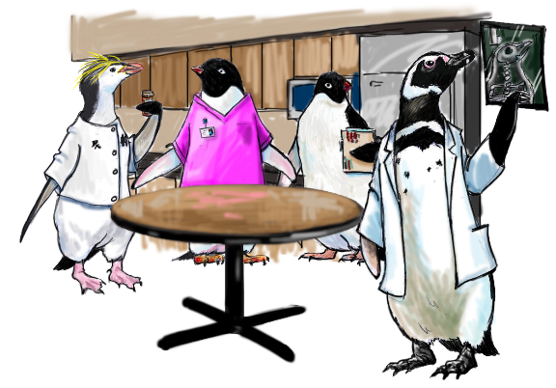
Brief (to Plan)
Briefs are held for planning purposes
The following information should be discussed in a brief:
Team membership and roles and who is the designated leader
Clinical status of the team’s patients
Team goals, pitfalls, and barriers
What is to be accomplished
Issues affecting team operations
Record your answers on page 13 of your Workbook
Notes:
Briefs, sometimes referred to as team meetings, are held for planning purposes. The designated leader is responsible for organizing a 3- to 5-minute brief to discuss essential team information, and all team members are expected to attend.
The following information should be discussed in a brief:
Team membership and roles, who is on the team, and who is the designated team leader.
Clinical status of the team’s patients — the current condition, diagnosis, plan, and status of each patient assigned to the team are reviewed.
Team goals, pitfalls, and barriers.
What is to be accomplished, and who is to do it.
Issues affecting team operations: resources normally available that may be restricted during that particular day.
Successful teams measure their effectiveness in terms of goal achievement. Performance goals typically are set during the team brief. With the team leader facilitating the process, team members actively participate to establish both clinical and teamwork goals.
Consider the following questions and be prepared to discuss them with your team: Where and when does this planning occur for you now? Who attends — clinical or operations, or both? Who should attend?

Slide 8
Briefing Checklist
Use a briefing checklist to plan and manage your briefs
Include the following:
Clarify who will be leading the team
Open lines of communication among team members
Set the tone for the upcoming slate of patients
Establish the protocols, responsibilities, and expected behaviors
Prepare the team for the flow of the day
Specify expectations
TOPIC
Who is on your team today?
All members understand and agree upon goals?
Roles and responsibilities understood?
Staff availability?
Workload?
Available resources?
Review of the day’s patients?
Record your answers on page 14 of your Workbook
Notes:
You should use a briefing checklist to plan and manage your briefs. A briefing checklist is similar to the preflight checklist used in aviation. In aviation, preflight briefings provide the ideal form for building a team dynamic that allows everyone to work together when carrying out routine tasks and when tackling unexpected problems.
Team leaders should cover the items on the checklist so that the briefs will include the following:
One, clarify who will be leading the team so that others know who to look to for guidance.
Two, open lines of communication among team members, ensuring that everyone can contribute their unique knowledge to the task.
Three, set the tone for the upcoming slate of patients or, in some settings, the upcoming clinic session.
Four, establish and reinforce the protocols, responsibilities, and expected behaviors so that possible misunderstandings are avoided.
Five, prepare the team for the flow of the day’s patients, contingency plans, and the means for resolving any unusual circumstances.
And six, specify expectations to increase understanding of what is expected, help prioritize what to do, and reduce chances of getting distracted or forgetting a task altogether.
Have you ever participated in a brief? If so, were the items on the checklist used, or, if not, what was missing? What would you add to the briefing checklist shown here?

Slide 9
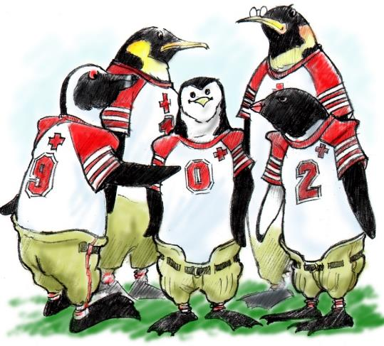
Huddle (for Problem Solving)
A quick, reactive, touch-base meeting to regain situation awareness
It allows team members to:
Discuss critical issues and emerging events
Anticipate outcomes and likely contingencies
Assign resources
Express concerns
Notes:
The second leadership strategy you can use with your team is the huddle. A huddle is a quick, reactive, touch-base meeting tool to help team members regain situation awareness. It is used to reinforce plans that are already in place for treating patients, as well as to assess the need to revise plans. It quickly allows team members to discuss critical issues and emerging events, anticipate outcomes and likely contingencies, assign resources, and express concerns. It is a tool for maintaining shared understanding between team members regarding the plan of care.

Slide 10
Use a Huddle to Change the Plan
Huddles provide an opportunity to informally monitor situations
With a huddle, the leader changes the plan and shares the change with the team
It is an important tool for monitoring and updating the team
Answer the questions on page 15 of your Workbook
Notes:
Huddles provide team leaders with an opportunity to informally monitor patient and team-level situations. The difference between a brief and a huddle is that with a brief, the leader knows and shares the plan. With a huddle, the leader changes the plan and shares the change with the team.
Because information changes over time, the huddle is an important tool for monitoring and updating the team. A sudden increase in the activity level of an individual or of the team signals the need to reevaluate and perhaps redistribute the workload.
Please take a few minutes and answer the questions on the corresponding page of your workbook. List a few examples of when a huddle would be appropriate in your practice.
These examples could be from your actual experience in a medical office or experiences that you imagine could happen. For example, if a team member called in sick or isn’t able to make it in to work, this would be an opportunity to use a huddle because the team strategy for the day will most likely need to be reviewed and revised.
It should not be assumed that everything will be taken care of. Instead, form a huddle and address the ramification of this team member being out for the day, and how the team will make up for his or her absence.

Slide 11
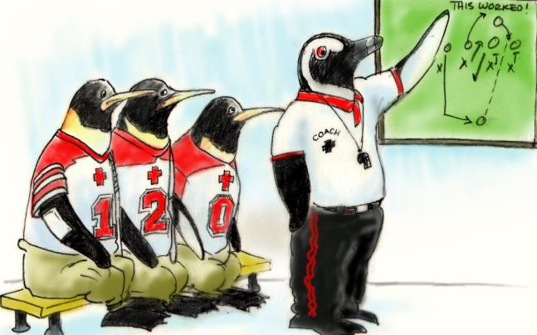
Debrief (for Process Improvement)
Short, informal information exchange used as a process improvement tool
Occur after an event or shift
Designed to improve teamwork skills
Actions and outcomes are discussed
Can include:
An accurate reconstruction of key events
Analysis of what worked or did not work and why
What should be done differently next time
Recognition of good team contributions or catches
Notes:
The third leadership strategy we will discuss is the debrief. The debrief is a short, informal information exchange used as a process improvement tool. It occurs after an event, or shift, and is designated to improve teamwork skills. Team actions and outcomes are discussed against the established plan. You might ask the question “We had a plan — did we achieve the goals of the plan?”
Debriefs are most effective when conducted in an environment where all actions are viewed as learning opportunities. Debriefs can include any of the following — accurate recounting and documentation of key events, analysis of what occurred, what worked and what did not, reflection on why and implications to practice, discussion of lessons learned and how the team will alter the plan next time, establishment of a method to formally change the existing plan to incorporate lessons learned, recognition of good team contributions and catches. Debrief should be a short team event of 3 minutes or less that is typically initiated and facilitated by the team leader.
Debriefs are most useful when they relate to a specific team goal or address particular issues related to recent actions of the team. Debriefs also maintain effectiveness by not assigning blame or failure to an individual. Although the debrief is meant to be a process improvement tool, it may be necessary at times to conduct a complete process review and system redesign, particularly if the same issues or events continue to reoccur. Such reoccurring issues may be identified during a debrief and can then be mapped out and discussed at a designated time in the near future.

Slide 12
Debrief Checklist
Debrief checklist helps ensure that all information is discussed
Assess each of the following:
Team leadership
Situation awareness
Mutual support
Communication
“What are our takeaways or lessons learned from this experience?”
TOPIC
Communication clear?
Situation awareness maintained?
Workload distribution?
Did we ask for or offer assistance?
Were errors made or avoided?
What went well, what should change, what can improve?
Record your answers on page 16 of your Workbook
Notes:
To better manage your debriefs, you should develop a checklist. The debrief checklist helps ensure that all information is discussed relative to the plan established in the team brief. To conduct a debrief, the team leader recaps the established plan and key events that occurred and asks questions related to team performance.
The team should assess how each of the following plays a role in the team’s performance: team leadership, situation awareness, mutual support, and communication. The team leader should then ask “What are our takeaways or lessons learned from this experience?” Following this discussion, the team should set goals for improvement. The checklist shown on the slide is just an example, but could serve as a real-life checklist.

Slide 13
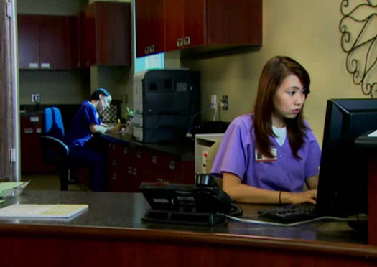
Leadership in the Medical Office
Consider the poor leadership you saw in the video in the Team Structure Module
On the next slide, you will watch them demonstrate proper leadership
While watching the video, record any thoughts you may have on page 18 of your Workbook
Notes:
In the Team Structure Module, you watched an office-based care team demonstrate poor team leadership. On the next slide, you will watch them demonstrate proper leadership. While watching the video, record any thoughts you may have on the corresponding page of your workbook.

Slide 14
Leadership Example Video
https://youtu.be/kefIIW7_DVo

Slide 15
Reflect & Apply to Your Office
How does that video compare to the scenario in the Team Structure Module?
Ask yourself:
How is leadership demonstrated in this video?
Was this strategy effective? Why was it effective or not effective?
Did you see any other opportunities for leadership?
Have you encountered situations similar to this on your team?
Now take a few minutes to think about your own office team
Record your thoughts on page 18 of your Workbook
Notes:
How does that video compare to the video scenario you watched in the Team Structure Module? What went better this time? How did the team leader improve the situation?
As you reflect on what you saw in the video, ask yourself these questions: How is leadership demonstrated in this video? Was this strategy effective? And, why was it effective or not effective?
Did you see any other opportunities for leadership to be demonstrated in this video? Have you encountered situations similar to this on your team?
Now take a few minutes to think about your own office teams in terms of leadership, and whether you have encountered leadership issues. Focus on what has not worked, and not on who has not made it work. Use the reference page number in your workbook to make notes of your thoughts to discuss with your team.

Slide 16
Front Office Scenario
Consider this scenario:
Jack, an elderly man who just had cataract surgery and is not able to drive, was taken to the clinic by his son for a follow-up on his blood pressure and diabetes. While Jack was in the examination room, his son was called away on an emergency.
When Jack finished his appointment and found that his son was not waiting for him, he was very upset. The front desk administrator realized that Jack had no way to get home and called a quick huddle with the nurse and the billing specialist. Together, they decided to arrange for a taxi to transport him home.
The front desk administrator then called Jack after he arrived home to make sure all was well.
Use your Workbook to record how the situation could have been resolved
Notes:
Now, let’s look at the following scenario and see how leadership can be demonstrated in the nonclinical aspects of the team:
Jack, an elderly man who just had cataract surgery and is not able to drive, was taken to the clinic by his son for a follow-up on his blood pressure and diabetes. While Jack was in the examination room, his son was called away on an emergency.
When Jack finished his appointment and found that his son was not waiting for him, he was very upset. The front desk administrator realized that Jack had no way to get home and called a quick huddle with the nurse and the billing specialist. Together, they decided to arrange for a taxi to transport him home.
The front desk administrator then called Jack after he arrived home to make sure all was well.
The outcome in this scenario is only one of many possible outcomes. Can you think of any other way the situation could have been resolved? As you can see from this scenario, the strategies taught in TeamSTEPPS apply to everyone within the office. Leadership is the responsibility of everyone on the team.

Slide 17
Tools & Strategies Summary
BARRIERS
Inconsistency in Team Membership
Lack of Time
Lack of Information Sharing
Hierarchy
Defensiveness
Conventional Thinking
Complacency
Varying Communication Styles
Conflict
Lack of Coordination and Followup With Coworkers
Distractions
Fatigue
Workload
Misinterpretation of Cues
Lack of Role Clarity
TOOLS and STRATEGIES
Communication
SBAR
Call-Out
Check-Back
Handoff
Leadership
Brief
Huddle
Debrief
OUTCOMES
Shared Mental Model
Adaptability
Team Orientation
Mutual Trust
Team Performance
Patient Safety!!
Notes:
Earlier, we discussed the barriers to delivering high quality, safe care in the office setting. Excellent leaders partner with their patients and clinical and operational care team members to take the critical actions necessary to keep the team on track so that the patient’s care is safe and high-quality. To summarize, team briefs, huddles, and debriefs serve to mitigate the barriers to achieve the excellent performance and outcomes that are desired.

Slide 18
Module 4 Summary
In this module you learned to:
Describe how leadership affects team processes and outcomes
Identify characteristics of successful leadership
Describe the activities involved in successfully leading teams
Describe the tools for leading teams, including briefs, huddles, and debriefs
Apply the tools for leading teams specific to office-based care
Notes:
In this module, you learned to:
Describe how leadership affects team processes and outcomes.
Identify characteristics of successful leadership.
Describe the activities involved in successfully leading teams.
Describe the tools for leading teams, including briefs, huddles, and debriefs.
And apply the tools for leading teams specific to office-based care.

