Slide 1
Module 5: Situation Monitoring
Welcome to
Office-Based Care Online Course
Notes:
Welcome to the TeamSTEPPS for Office-Based Care Online Course. This is Dr. Brigetta Craft. This presentation will cover Module 5, Situation Monitoring, that you, as a practice facilitator, will review.

Slide 2
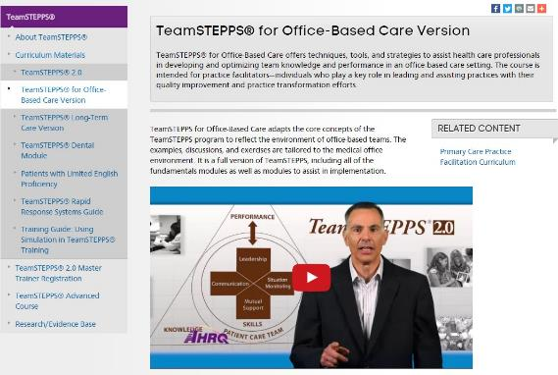
The Materials You Will Use
The Participant Workbook:
Exercises
Video reflections
Scenarios
AHRQ TeamSTEPPS website:
Classroom slides
Instructor Guide (select to view)
Videos
Ancillary materials
Notes:
During this course, the Participant Workbook will be your primary tool for completing all the learning activities, such as exercises, video reflections, and case-based scenarios. These will help shape your implementation plan in addition to providing content, discussion questions, and other activities for your change team. Select the link to download the Participant Workbook.
You can also visit the AHRQ TeamSTEPPS website to access the entire TeamSTEPPS for Office-Based Care curriculum. This includes the PowerPoint classroom slides and instructor guides for each module, along with videos and ancillary materials, such as handouts and exercises. Select the link to open the AHRQ TeamSTEPPS website.

Slide 3
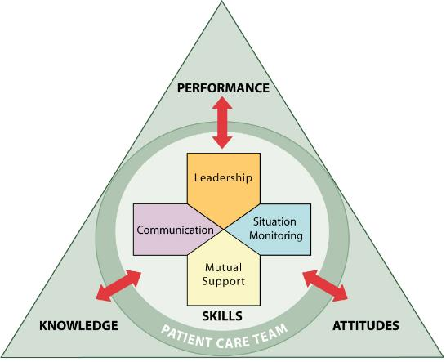
Module Objectives
After completing this module, you will be able to:
Discuss how situation monitoring affects team processes and outcomes
List components of the STEP mnemonic
Define a shared mental model and how it is cultivated within a team
Notes:
After completing this module, you’ll be able to:
Discuss how situation monitoring affects team processes and outcomes.
List components of the STEP mnemonic.
And define a shared mental model and how it is cultivated within a team.

Slide 4
Situation Monitoring
Process of actively scanning behaviors and actions to assess elements of the situation or environment
Enables team members to identify the potential issues or minor deviations early
Benefits:
Fosters mutual respect and team accountability
Includes cross monitoring
Provides safety net for team and patient
Remember, engage the patient whenever possible!
Use page 21 of the Participant Workbook to record your thoughts
Notes:
Situation monitoring is defined as the process of actively scanning behaviors and actions to assess elements of the situation or environment. Situation monitoring is a skill that individual team members can acquire, practice, and improve on. It enables team members to identify the potential issues or minor deviations early enough to correct and handle them before they become a problem or pose harm to the patient.
The benefits of situation monitoring are that it fosters mutual respect and team accountability and, through the process of cross-monitoring, provides a safety net for both the patient and the team. Examples of situation monitoring include assessing the patient’s condition, noting malfunctioning equipment, and being aware of workload spikes and stress levels among team members. It is important to also remember to engage the patient whenever possible. Think about some of the ways in which you monitor the situation in your medical office, and be prepared to discuss them when you meet with your team.

Slide 5
Cross-Monitoring is…
A process of ongoing monitoring to recognize risk or unfolding error
An opportunity to interrupt or correct an action or event before there is harm or injury to the patient
“Watching each other’s back”
Providing feedback to ensure the procedures are being performed appropriately
Think of cross-monitoring examples
Use page 22 of the Participant Workbook to record your thoughts
Mutual performance monitoring has been shown to be an important team competency.
(McIntyre and Salas 1995)
Notes:
Cross-monitoring is a process of ongoing monitoring of the environment of care to recognize risk or unfolding error. It allows for one to take steps to interrupt or correct an action or event before there is harm or injury to the patient. Commonly referred to as “watching each other’s back,” cross-monitoring involves monitoring all actions against the established plan, and advocating or asserting a position or corrective action when the plan and actions differ or when risk is perceived as escalating and task assistance is required. Cross-monitoring actions include providing feedback and keeping track of fellow team members’ behaviors to ensure the procedures are being performed appropriately.
Cross-monitoring is an active patient and caregiver advocacy and allows team members to check and correct their actions if necessary. Cross-monitoring is not a way to spy on other team members; rather, it is a way to provide a safety net or error prevention and/or error interruption mechanism for the team, ensuring that mistakes or oversights are caught early.
When all members of the team trust the intentions of their fellow team members, a strong sense of team orientation and a high degree of psychological safety result. Take a moment to think of an example in which cross-monitoring was successful and one in which cross-monitoring should have been used but was not.

Slide 6
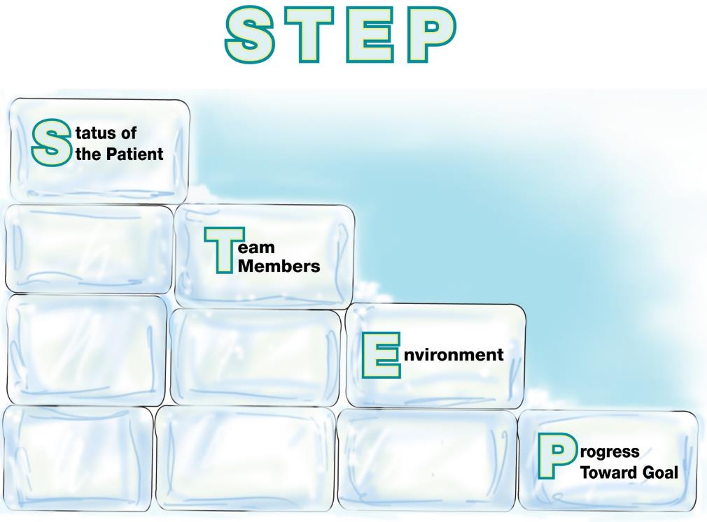
The STEP Process
Steps to monitor the situation
Notes:
How can team members acquire a trained eye as they monitor the situation? What components of the situation provide clues about impending complications or contingencies? The STEP process is a mnemonic tool that can help team members monitor the situation and the overall environment.
The STEP process involves ongoing monitoring of the:
Status of the patient: What are the patient’s status, vital signs, medications, stress level?
Team members: What are my team members doing? What is their workload, fatigue level, stress level, and what is the skill level of the individual team members?
Environment: Are the exam rooms properly stocked? Are the blood pressure cuffs, otoscope, and ophthalmoscopes working properly? Do we need any special equipment for a procedure today? Are there enough staff to handle all the patients?
And Progress towards the goal: What is the progress towards today’s goals? For example, how’s the day going? Are we behind? Are patients waiting too long? Are things being left undone because of time pressure? Is the plan still appropriate, or does it need to be revised?
An example of using STEP in the medical office might include the following: A patient comes in complaining about a sore throat, but it turns out she may have pneumonia.
Status of the patient may be “Patient may have pneumonia.”
Team members: “Physician isn’t available” or “is at lunch.”
Environment: “We need a room with oxygen.”
And progress towards the goal: “Ask the nurse to come in and assess the patient, and administer oxygen. Find a nurse to help her with other duties.”

Slide 7
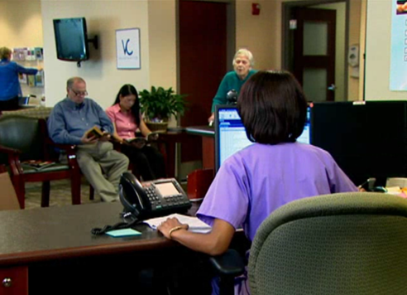
Situation Monitoring in the Medical Office
Consider the poor situation monitoring you saw in the Team Structure module
On the next slide, you will watch them demonstrate proper situation monitoring
Use page 24 of the Participant Workbook to record your thoughts
Notes:
In the Team Structure module you watched an office demonstrate poor situation monitoring. On the next slide, you will watch them demonstrate proper situation monitoring. While watching the video, record any thoughts you may have on the corresponding page of your workbook.

Slide 8
Situation Monitoring Example Video
https://youtu.be/IDoGQFZ6frw

Slide 9
Situation Monitoring Exercise
How does that video compare to the scenario in the Team Structure module?
Ask yourself:
Was situation monitoring demonstrated in this video?
Was this strategy effective? Why was it effective or not effective?
Did you see any other opportunities for situation monitoring?
Have you encountered situations similar to this in your team?
Have you encountered barriers to proper situation monitoring?
Use page 25 of the Participant Workbook to record your thoughts
Notes:
How does that video compare to the video scenario you watched in the Team Structure module? As you reflect on what you saw in the video, ask yourself: Was situation monitoring demonstrated in this video? Was this strategy effective? Why was it effective or not effective? Did you see any other opportunities for situation monitoring to be demonstrated in this video? Have you encountered situations similar to this in your team? If so, how did you overcome it?
Think about your own office team and daily routines in terms of situation monitoring. Have you encountered barriers to proper situation monitoring — or, if not, do you anticipate barriers in this new team structure? Make notes of your thoughts to discuss with your team.

Slide 10
Front Office Scenario
Consider this scenario:
Susan was due for a mammogram, and the provider ordered it. Upon arrival at the mammography service, Susan was told that she would have to pay for the mammogram since her insurance company did not cover it. Confused, Susan returned to the primary care clinic and told the administrative assistant that she did not have the money to pay for this. She was especially upset because her mother was a breast cancer survivor.
The administrative assistant assessed, one, the status of the situation (that a billing specialist was needed); two, the environment (the patient was upset); and three, the progress towards the goal (the patient was being denied access). The billing specialist then called the insurer and clarified that the insurer had the wrong dates and Susan’s mammogram was due. The insurer realized their error and covered the mammogram.
Use page 26 of the Participant Workbook to record your thoughts
Notes:
Now let’s look at the following scenario and see how situation monitoring can be demonstrated in the nonclinical aspects of the office-based care team:
Susan was due for a mammogram, and the provider ordered it. Upon arrival at the mammography service, Susan was told that she would have to pay for the mammogram since her insurance company did not cover it. Confused, Susan returned to the primary care clinic and told the administrative assistant that she did not have the money to pay for this. She was especially upset because her mother was a breast cancer survivor.
The administrative assistant assessed, one, the status of the situation (that a billing specialist was needed); two, the environment (the patient was upset); and three, the progress towards the goal (the patient was being denied access). The billing specialist then called the insurer and clarified that the insurer had the wrong dates and Susan’s mammogram was due. The insurer realized their error and covered the mammogram.
As with leadership, situation monitoring can be practiced by everyone within the office. Remember, teamwork is everyone’s responsibility. Record any thoughts you may have on this scenario on the corresponding page of your workbook.

Slide 11
Tools & Strategies Summary
BARRIERS
Inconsistency in Team Membership
Lack of Time
Lack of Information Sharing
Hierarchy
Defensiveness
Conventional Thinking
Complacency
Varying Communication Styles
Conflict
Lack of Coordination and Followup With Coworkers
Distractions
Fatigue
Workload
Misinterpretation of Cues
Lack of Role Clarity
TOOLS and STRATEGIES
Communication
SBAR
Call-Out
Check-Back
Handoff
Leadership
Brief
Huddle
Debrief
Situation Monitoring
STEP
OUTCOMES
Shared Mental Model
Adaptability
Team Orientation
Mutual Trust
Team Performance
Patient Safety!!
Notes:
This graphic illustrates what this training has covered so far, including situation monitoring. It now shows additional barriers, additional tools and strategies, and additional outcomes. Because teams are typically composed of members with distinct roles who tend to have unique information, it is important to pay attention to the factors that promote and undermine the opportunity for team members to present and discuss their diverse information and observations. The act of sharing and discussing information gained from situation monitoring provides the opportunity to gather more information about the situation, and helps cultivate a mutual understanding, commonly referred to as a shared mental model.

Slide 12
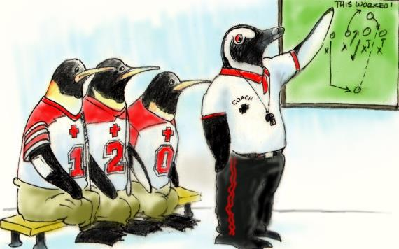
Establish a Shared Mental Model
An organized knowledge structure of relevant facts and relationships about a task or situation that are commonly held by members of a team
Team effectiveness will improve if team members have a shared understanding of the situation
In healthcare, if the wrong plan is developed, potentially all actions that follow are wrong, and the patient and the caregiver are at risk
Notes:
A shared mental model is an organized knowledge structure of relevant facts and relationships about a task or situation that are commonly held by members of a team. The basic premise about the relationship between teamwork and shared mental models is that team effectiveness will improve if team members have a shared understanding of the situation.
Evidence suggests that team members who possess shared mental models yield teams that can anticipate, back up, and fill in for one another, communicate to ensure that team members have the necessary information for task performance, and understand each other’s roles and how they interplay. In healthcare, if the wrong plan is developed, potentially all actions that follow are wrong, and the patient and the caregiver are at risk. A shared mental model serves as an error reduction strategy, and caregivers who understand the plan monitor all actions relative to that plan.

Slide 13
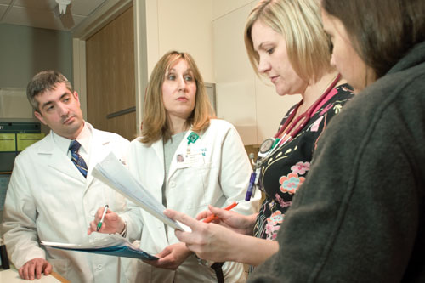
Module 5 Summary
In this module you learned to:
Discuss how situation monitoring affects team processes and outcomes
List components of the STEP mnemonic
Define a shared mental model and how it is cultivated within a team
Notes:
In this module, you learned to:
Discuss how situation monitoring affects team processes and outcomes.
List components of the STEP mnemonic.
And define a shared mental model and how it is cultivated within a team.

