Slide 1
Module 7: Summary: Putting It All Together
Welcome to
Office-Based Care Online Course
Notes:
Welcome to the TeamSTEPPS for Office-Based Care Online Course. This is Dr. Brigetta Craft. This presentation will cover Module 7, Summary: Putting It All Together, that you, as a practice facilitator, will review.

Slide 2
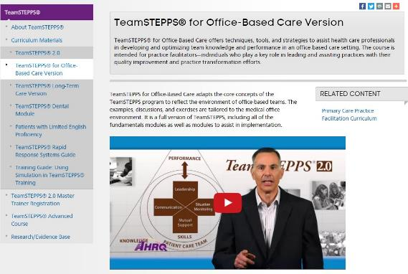
The Materials You Will Use
The Participant Workbook:
Exercises
Video reflections
Scenarios
AHRQ TeamSTEPPS website:
Classroom slides
Instructor Guide (select to view)
Videos
Ancillary materials
Notes:
During this course, the Participant Workbook will be your primary tool for completing all the learning activities, such as exercises, video reflections, and case-based scenarios. These will help shape your implementation plan in addition to providing content, discussion questions, and other activities for your change team. Select the link to download the Participant Workbook.
You can also visit the AHRQ TeamSTEPPS website to access the entire TeamSTEPPS for Office-Based Care curriculum. This includes the PowerPoint classroom slides and instructor guides for each module, along with videos and ancillary materials, such as handouts and exercises. Select the link to open the AHRQ TeamSTEPPS website.

Slide 3
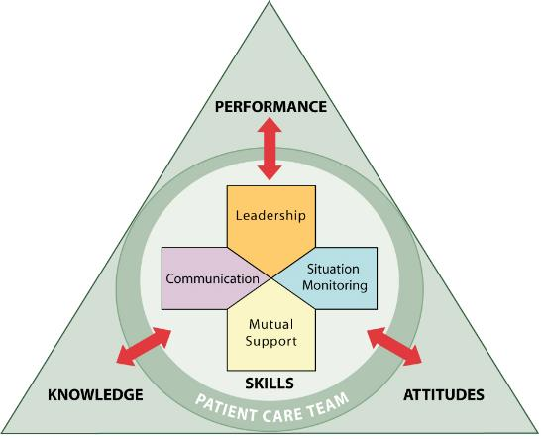
Module Objectives
After completing this module, you will be able to:
Review the tools and principles of TeamSTEPPS
Review the role of Practice Facilitators and the change team in introducing TeamSTEPPS in an office-based care setting
Notes:
After completing this module, you’ll be able to:
Review the tools and principles of TeamSTEPPS.
And review the role of Practice Facilitators and the change team in introducing TeamSTEPPS in an office-based care setting.
To begin our discussion on putting it all together, I would like to introduce your host for this module, Chris Hund.

Slide 4
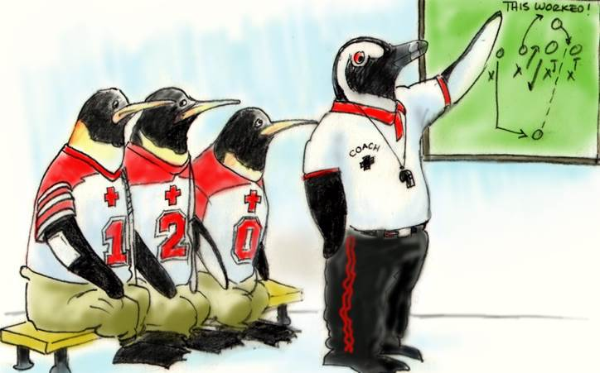
Putting It All Together
This module pulls together everything you have learned in the Fundamentals modules of TeamSTEPPS for Office-Based Care
You'll also be introduced to the Practice Facilitator model
Begin to think about weaving TeamSTEPPS into your quality improvement initiatives
Notes:
Hello. My name is Chris Hund. I am Director of Clinical Quality for the Health Research and Educational Trust of the American Hospital Association. At the American Hospital Association, I direct the work on the national implementation of TeamSTEPPS® and the TeamSTEPPS for Office-Based Care training program. The purpose of this summary module is to pull together everything you have learned in the opening Fundamentals modules of TeamSTEPPS for Office-Based Care. In addition, you'll be introduced to the Practice Facilitator model and how it can help you begin to think about weaving TeamSTEPPS into quality improvement initiatives. We'll begin by reviewing some of the material you have studied in the previous modules.

Slide 5
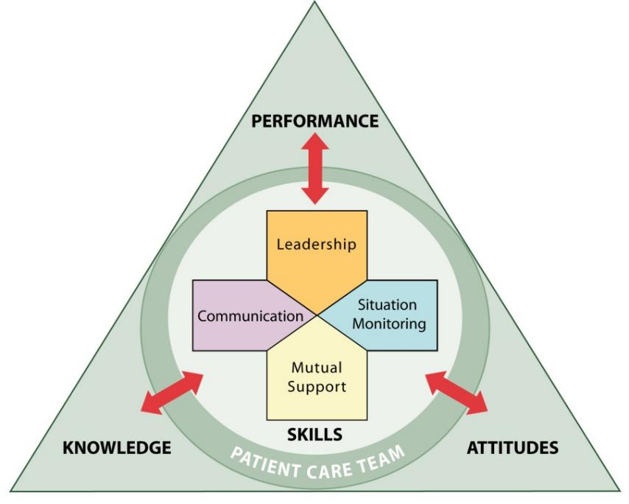
TeamSTEPPS Core Teamwork Skills
Notes:
By now, this triangle should be very familiar to you. It represents the core principles of TeamSTEPPS. These are communication, leading teams, situation monitoring, and mutual support. These core principles represent the modules you have already reviewed. The tools that support these core principles are the tools that you will use to help improve the practice that you and your Change Team work in. The following slides will provide a brief review of each principle and the tools therein.

Slide 6
Communication Tools
SBAR
Situation
Background
Assessment
Recommendation
Call-out
Check-back: Closed loop communication
Handoff
Record your answers to these questions on page 33 of your Workbook
Which communication tools make sense and could work in your office?
Notes:
Communication is the foundation of success for TeamSTEPPS. The four communication tools we discussed in the earlier lesson—SBAR, callout, check back, and handoffs—help ensure that communication is both transmitted and received in a standardized and efficient way. Using these tools will improve communication and make handoffs and other events safer.
If you are sitting with your team, think back to your discussions on the communication tools. Which communication tools make sense and could work in your office? Which ones seem more difficult and might be harder to use effectively? In a later module, we'll discuss some methods for both teaching and coaching these tools and others.

Slide 7
Leading Teams Tools
Briefs
Short session prior to start
Assign roles, establish expectations, anticipate outcomes
Huddles
Ad hoc planning to reestablish/reinforce and assess or adjust plans
Debriefs
Information exchange after the action
How useful did you think briefs, huddles, and debriefs would be?
Record your answers on page 34 of your Workbook
Notes:
The leadership tools we discussed include briefs, huddles, and debriefs. These 3 events happen at the beginning, middle, and end of each event, shift, or even day. They are my favorite tools and can help push the cycle of continuous quality improvement.
As you learned during the lesson itself, there are different ways to use these tools. Make sure, however, to always stay consistent in the way you name and present these tools. Checklists that accompany these tools help you to standardize each of these events so that individuals attending know what to expect from others in the meeting and what is expected of them.
Recall your previous discussions with your team during the module on these tools. How useful did you think briefs, huddles, and debriefs would be? Was there any pushback from individuals on the team, thinking that these would take too much time? If so, how did you respond?

Slide 8
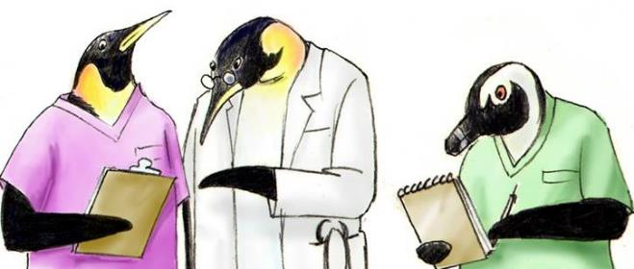
Situation Monitoring Tools
Situation Monitoring = Scanning and assessing what is going on around you and with you
Cross-Monitoring
Watching each other’s backs
Ensuring mistakes/oversights are caught
STEP checklist
Status of the patient
Team members
Environment
Progress toward the goal
What was your reaction to the idea of cross-monitoring?
Record your answers on page 35 of your Workbook
Notes:
Situation monitoring tools are useful in helping you scan and assess what is going on around you and with you; cross-monitoring is a tool for watching other's backs, and the step checklist can help monitor a situation or a patient.
To lead a discussion with your team about situation monitoring tools, ask these questions: What was your reaction to the idea of cross-monitoring? What benefits did you think improved situational awareness would have on your practices? In what specific situation did you feel you could use STEP? Are any of the team members worried that watching each other's backs will be misconstrued as being too intrusive?

Slide 9
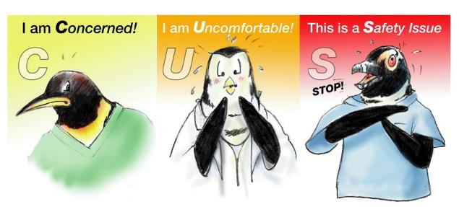
Mutual Support Tools
Provide task assistance
Provide feedback to overcome a problem
Advocacy and assertion
Work through conflict
Two-Challenge Rule
CUS
DESC Script
How have you thought about putting one of these tools in place?
Record your answers on page 36 of your Workbook
Notes:
The mutual support tools are a particularly rich set of tools that help you and your team to: provide task assistance to each other; provide feedback to overcome a problem; use advocacy and assertion to challenge another person in the case of an unsafe and potentially dangerous situation; and work through conflict that can turn a relationship or work environment toxic. Mutual support tools, such as the Two-Challenge Rule, CUS, and the DESC script might seem daunting at first glance and might seem uncomfortable to implement.
Ideas about coaching and teaching these tools will be covered in a later module. How have you thought about putting one of these tools in place? Discuss with your team which of these tools might work best.

Slide 10
Barriers to Team Effectiveness and Solutions
BARRIERS
Inconsistency in Team Membership
Lack of Time
Lack of Information Sharing
Hierarchy
Defensiveness
Conventional Thinking
Complacency
Varying Communication Styles
Conflict
Lack of Coordination and Followup With Coworkers
Distractions
Fatigue
Workload
Misinterpretation of Cues
Lack of Role Clarity
TOOLS and STRATEGIES
Communication
SBAR
Call-Out
Check-Back
Handoff
Leadership
Brief
Huddle
Debrief
Situation Monitoring
STEP
Mutual Support
Task Assistance
Feedback
Assertive Statement
Two-Challenge Rule
CUS
DESC Script
OUTCOMES
Shared Mental Model
Adaptability
Team Orientation
Mutual Trust
Team Performance
Patient Safety!!
Notes:
This slide should also be very familiar to you. It shows a list of barriers to team effectiveness and the tools and strategies that can be used to overcome those barriers. The final column lists the positive outcomes that can be realized with the successful use of the tools and strategies.
How then do we get to the successful outcomes? Honestly, this doesn't happen overnight. The successful implementation and sustainment takes time and dedication.
The remainder of the material in this module and the following four will focus on how you, the Practice Facilitator, can guide and support this change. TeamSTEPPS is culture change, pure and simple. This selection of tools and strategies helps achieve that goal of a new culture of teamwork, effectiveness, and communication.

Slide 11
What Is Practice Facilitation?
Provides a service to office-based care settings by trained individual(s)
Uses a range of approaches and methods from:
Organizational development
Project management
Quality improvement/practice improvement
Builds internal capacity of the practice to conduct improvement activities over time
Differs from other types of consulting:
Longer term relationship, closer connection
Supports broad range of improvement activities
Notes:
The TeamSTEPPS in Office-Based Care program uses a Practice Facilitator model. This person's role is to learn about TeamSTEPPS and then spread it to office-based care settings that they influence. Before we go on, it is important we have the same shared mental model of roles and responsibilities.
Practice facilitation is a service provided to office-based care settings by an individual or individuals to help in the overall improvement of care delivery. Practice Facilitators use principles from the following fields: organizational development, project management, and quality improvement. Practice facilitation builds internal capacity of the practice to conduct improvement activities over time. It differs from other types of consulting, because it develops a longer term relationship to create a closer connection. It also supports a broad range of improvement activities.
By combining these skills, the Practice Facilitator can serve both as a long-term resource and a change leader, in a practice or collection of practices. One tool that a Practice Facilitator can use to drive the overall improvement of a practice is TeamSTEPPS.

Slide 12
Who Is a Practice Facilitator?
Generalists trained in office-based care improvement
Competencies in many areas:
Quality improvement methods
Project management
Team facilitation
May be an internal employee or external consultant
May work in one office or across many
(select to open)
Notes:
Practice Facilitators are individuals trained in or working for care improvement. They have competencies in many areas, including quality improvement methods, project management, and team facilitation. A Practice Facilitator's background in team facilitation makes for a comfortable connection with the principles of TeamSTEPPS. Practice Facilitators may be internal employees or external consultants. They may work in one practice or across many.
It is important to note that you do not need to have the title of Practice Facilitator for your organization in order to lead a TeamSTEPPS intervention. What is important and necessary is that you are familiar with the knowledge, skills, and attitudes of one. This will undoubtedly help you to coordinate the training of others and to run the implementation program from start to finish.
The AHRQ Practice Facilitation Handbook, found on the AHRQ Web site, can help you understand the basic knowledge, skills, and attitudes needed to be a successful Practice Facilitator.

Slide 13
Model of Practice Facilitation for TeamSTEPPS
Practice Facilitator
Change Team
Staff
Notes:
The Practice Facilitator can serve as the Master Trainer for the entire staff. Use the Fundamentals course when presenting the training.
You will also be training a Change Team, many of whom will be coaches who will service as frontline champions for TeamSTEPPS. These coaches on the Change Team are people who understand how TeamSTEPPS can be used on a daily basis in different situations. More information on how to train coaches will be shared later in this course.

Slide 14
External Model of Practice Facilitation
Practice Facilitator
Office Champion
Change Team
Staff
Notes:
Another approach for the Practice Facilitator to spread TeamSTEPPS is through the external model of practice facilitation. This approach is different, in that one individual works to spread the principles across multiple sites. The Practice Facilitator teaches the material of this course in its entirety to one office champion Master Trainer for each site. As a Practice Facilitator, you would do this by providing training using all the sections of this toolkit. The office champion would then train the Change Team as coaches and, with the Change Team, train the entire staff using the Fundamentals course material.

Slide 15
Beginning Your Journey
Watch the video on the next slide to see the beginnings of a TeamSTEPPS initiative started at one office.
In the clip, Valerie has received TeamSTEPPS training from an external Practice Facilitator.
She is not a Practice Facilitator herself, but she is the office champion.
Consider: How does Valerie combine her knowledge of performance improvement methodology with her TeamSTEPPS initiative?
Record your answers on page 37 of your Workbook
Notes:
The upcoming video illustrates the beginnings of a TeamSTEPPS initiative started in one medical office. In the clip, Valerie has received TeamSTEPPS training from an external Practice Facilitator. She herself is not a Practice Facilitator, but she is the office champion. As you watch the video, consider how Valerie combines her knowledge of performance improvement methodology with her TeamSTEPPS initiative. Take the time to record your thoughts on the corresponding page of your workbook.

Slide 16
Video: Beginning Your Journey
https://youtu.be/oIaNZfmrIKQ

Slide 17
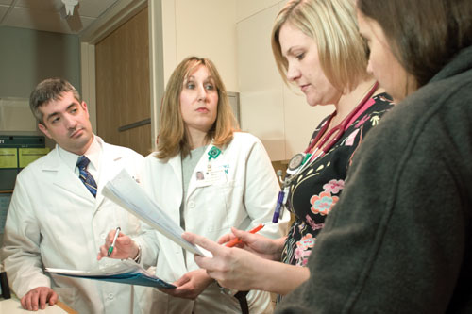
Module 7 Summary
In this module you learned to:
Review the tools and principles of TeamSTEPPS
Review the role of Practice Facilitators and the change team in introducing TeamSTEPPS in an office-based care setting
Notes:
In this module, you learned to:
Review the tools and principles of TeamSTEPPS.
And review the role of Practice Facilitators and the change team in introducing TeamSTEPPS in an office-based care setting.

