Slide 1
for
Office-Based Care Online
Challenges and Successes in the Small Office Setting

Slide 2
This Webinar and Future Webinars
Webinar a part of a library to support and amplify your work on TeamSTEPPS
TeamSTEPPS for Office-Based Care Online is funded by AHRQ

Slide 3
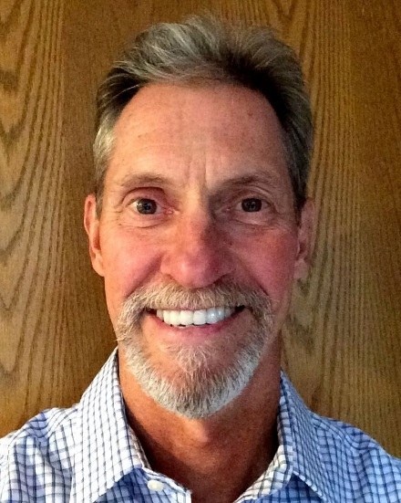
Presenter
Ken Plitt, CRNA, M.B.A.
Principal, Senior Trainer and Consultant
TEAM IQ, LLC Seattle, WA

Slide 4
Disclosures
Independent contractor in consulting and training roles
No financial arrangements with any referenced products or businesses

Slide 5
Objectives
Evaluate characteristics of the office environment that make it susceptible to breakdowns in communication and team performance.
Explore opportunities to develop “change capacity” within the medical office.
Consider practical tips used by master trainers within an office setting to select, introduce, and embed TeamSTEPPS techniques as part of a broader culture of safety.

Slide 6
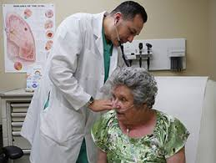
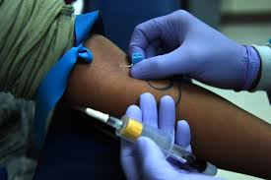
Nature of Risk in the Medical Office

Slide 7
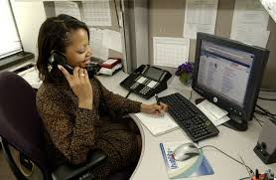
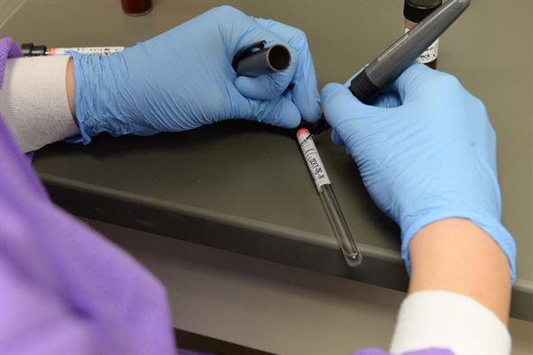
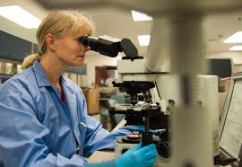
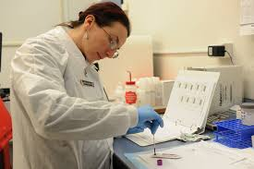
Nature of Risk in the Medical Office

Slide 8
Medical Errors in Ambulatory Care
Each year in the United States:
More than 1 billion ambulatory visits
12 million ambulatory care patients with a diagnostic error
Paid medical liability claims (Bishop, et al., 2011):
Half related to events in the outpatient setting
76% due to errors in diagnosis or treatment

Slide 9
http://effectivehealthcare.ahrq.gov/index.cfm/search-for-guides-reviews-and-reports/?pageaction=displayproduct&productid=2322

Slide 10
Key Informant Findings
Safety Topics
Medication Safety
Diagnosis
Transitions
Referrals
Testing
Focus of Safety Strategies
Communications
Health IT
Teams/Teamwork
Patient Engagement
Organizational Approaches
Safety Culture

Slide 11
Office Characteristics That Affect Team Performance and Safety
Small practices lack sophisticated EHR and other technological tools:
Budget constraints also affect equipment quality and redundancy.
Referrals and diagnostic resources may not be readily accessible.
Traditional visit-based model of care:
Periodic, short visits over long course of time
Practice objective of maximizing volume/throughput
Lack of support staff dedicated to care coordination
Reliance on patient’s/family’s ability to self-manage
Notes:
The time course of ambulatory care is longer; weeks or months can elapse between visits or referrals or diagnostic studies, creating additional challenges for patient safety. Ambulatory providers experience intense time pressure, with current incentives focused on seeing as many patients as possible in a given amount of time, and in small practices, lack support staff for coordination of care.⁷ The presence and composition of teams, including nurses, pharmacists, assistants, and others, in office settings varies greatly and can affect patient safety as well.
Most of the time, patients, especially those with chronic conditions, are actually self- managing.⁸ The role of the patient is very different in ambulatory care settings than in the hospital.⁹ In acute-care settings, patients are under close observation and often passively receive care. In ambulatory settings, patients must decide when to initiate medical care, interact with ambulatory health systems, follow provider recommendations, and perform their daily health- related tasks.
For those with multiple chronic diseases, this process includes following a disease-specific medication, diet, and exercise regimen. Some also adjust their medication based on their measurements, such as using glucose monitoring to adjust insulin dosing. When patients have difficulty with these self-management activities, they are at risk for adverse events.

Slide 12
Office Characteristics That Affect Team Performance and Safety
Nature of Staff-Patient Encounters
Sequential (norm in most offices)
Many individual, autonomous activities
Reliance on multiple handoffs
Pros/cons of duplicative patient assessments
Team Encounters
Lead
Assistant

Slide 13
Let’s Recognize Elephants in the Room Office
By Bit Boy - Flickr: The Elephant in the Room, CC BY 2.0, https://commons.wikimedia.org/w/index.php?curid=20972528

Slide 14
Let’s Recognize Elephants in the Room Office
1. The “MD-eity” Effect
By Bit Boy - Flickr: The Elephant in the Room, CC BY 2.0, https://commons.wikimedia.org/w/index.php?curid=20972528

Slide 15
Let’s Recognize Elephants in the Room Office
2. Power of the Office Manager
By Bit Boy - Flickr: The Elephant in the Room, CC BY 2.0, https://commons.wikimedia.org/w/index.php?curid=20972528

Slide 16
Let’s Recognize Elephants in the Room Office
3. The Office Naysayer
By Bit Boy - Flickr: The Elephant in the Room, CC BY 2.0, https://commons.wikimedia.org/w/index.php?curid=20972528

Slide 17
Let’s Recognize Elephants in the Room Office
4. The “Change Team”
By Bit Boy - Flickr: The Elephant in the Room, CC BY 2.0, https://commons.wikimedia.org/w/index.php?curid=20972528

Slide 18
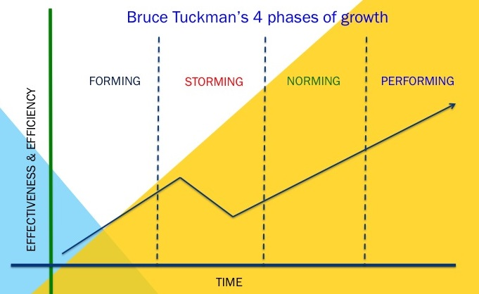
Tuckman’s Four Phases of Growth
Adapted from Tuckman, Stages of Group Development. 1965

Slide 19
Organizational Capacity for Change
“…the overall capability of an organization to either effectively prepare for or respond to an increasingly unpredictable and volatile environmental context. [OCC] enables an organization to upgrade or revise existing organizational competencies while cultivating new competencies that enable the organization to survive and prosper.” (WQ Judge, 2011)
Ingredients:
Human skill sets and resources,
Formal systems and procedures, and
Organizational culture, values, and norms.

Slide 20
How Change Capacity Fits
A WORK
Core Business Activities
Change Efforts:
All change programs intended to improve organizational performance
B WORK
Change Capacity:
Organizational competency in planning, leading, and sustaining change efforts
C WORK

Slide 21
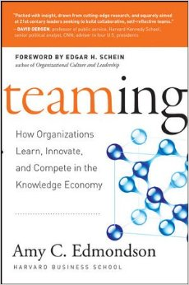
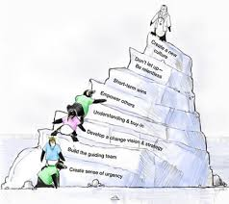
Leveraging Different Approaches to Change
Individual
Working Team
Organizational
www.vitalsmarts.com
Chip and Dan Heath
Amy Edmondson
John Kotter

Slide 22
Master Trainer in the Office: Many Roles/Many Challenges
Strategic planner
Project lead
Evangelist
Staff training and development
QI/safety officer
Coach
“Real” job
Notes:
https://pixabay.com/en/juggle-artists-circus-money-1027844/
CC0 Public Domain
Free for commercial use
No attribution required

Slide 23
A Few Lessons Learned
Appreciate the difference between Ownership and Buy-in

Slide 24
Ownership vs. Buy-in
“Ownership” means…
You own or share the ownership of an idea, a decision, or an action plan.
You have participated in its development and you chose on your own accord to endorse it.
You understand it and believe in it.
You are both willing and ready to implement it.
“Buy-in” is the opposite:
Someone else or some group of people has done the development, the thinking, the cooking and now they have to convince you to come along and implement their ideas/plans.
Henri Lipmanowicz – Liberating Structures http://www.liberatingstructures.com

Slide 25
A Few Lessons Learned
Conditions established by senior management override everything else

Slide 26
Patient Safety
Adapted from Salas
High-Reliability Organization
Supportive Organizational Conditions
High-Reliability Teams
Cooperation
Coaching
Coordination
Cognition
Conflict
Communication

Slide 27
Business Case for Safety Initiatives
“Activities to promote safety are strong contributors to stakeholder satisfaction (patient/family/staff) and the organization’s vision, mission, and values. The degree to which these activities are efficiently and effectively carried out has a direct impact on the financial bottom line.”
Paul Schyve, M.D.
Joint Commission

Slide 28
Business Case for Safety Initiatives How does the activity contribute to…?
Effective?
Efficient?
Notes:
Per Paul M. Schyve, M.D. Activities to promote safety are strong contributors to stakeholder satisfaction (patient/family/staff) and the organization’s vision, mission, and values. The degree to which these activities are efficiently and effectively carried out has a direct impact on the financial bottom line.

Slide 29
A Few Lessons Learned
TeamSTEPPS principles and tools can thrive within a broader approach to a culture of safety (“stealth” strategies work!)

Slide 30
A Few Lessons Learned
Leverage opportunities for training, coaching, monitoring, and sharing progress wherever found

Slide 31
A Few Lessons Learned
Leverage opportunities:
Dedicated training time vs. ad hoc
Replace mandatory drills with simulations:
Technical component
Teamwork component
Communicate/reward “wins”

Slide 32
Discussion

