Slide 1
Teams, TeamSTEPPS, and Team Structures:
Models for Functional Collaboration
February 8, 2017

Slide 2
Rules of Engagement
Audio for the webinar can be accessed in two ways:
Through the phone (*Please mute your computer speakers)
Through your computer
A Q&A session will be held at the end of the presentation
Written questions are encouraged throughout the presentation and will be answered during the Q&A session
To submit a question, type it into the Chat Area and send it at any time during the presentation

Slide 3
Upcoming TeamSTEPPS Events
Master Training Courses
Registration for courses through June 2017 now open
Registration opening on January 18 for courses in April-June 2017
National Conference
June 14-16, 2017
Downtown Hilton, Cleveland, OH
Registration open and filling up fast!

Slide 4
Help Line (312) 422-2609
Or email: AHRQTeamSTEPPS@aha.org

Slide 5
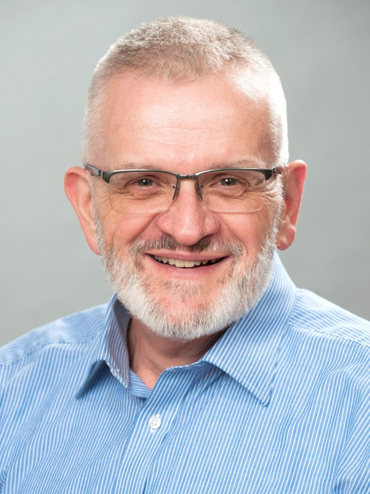
Today’s Presenter
William (Bill) Gordon, DMin, MDiv
Faculty, Department of Interprofessional Healthcare Studies
Rosalind Franklin University of Medicine and Science
North Chicago, IL

Slide 6
No conflicts of interest
I have no conflicts of interest to declare in relationship to this presentation

Slide 7
Objectives
Learn to analyze team structures by reviewing an organizational diagram, hypothesizing the assets and challenges to relationships, communication, and accountability
Differentiate between hierarchy, heterarchy, and holacracy as models of team organizational strategies
Evaluate these structures utilizing the TeamSTEPPS domains of leadership, situation monitoring, mutual support, and communication
Consider possibilities of hybridized organizational models for task or time specific teams

Slide 8
Groups and Teams
In a group, focus is on individual results
People are free to act independently, regardless of the behavior of others

Slide 9
In a team, success belongs to the whole, not to individuals
People are interdependently related, rather than being independent

Slide 10
TeamSTEPPS Definition
Two or more people who interact
dynamically, interdependently,
and adaptively
toward a common and valued goal,
have specific roles or functions,
and have a time-limited membership

Slide 11
Two or more people who interact
dynamically, interdependently,
and adaptively
toward a common and valued goal,
have specific roles or functions,
and have a time-limited membership
This definition is largely behavioral, describing how members interact
It does not, by definition, require a team to be interprofessional or even multidisciplinary

Slide 12
Team Structures
How teams are structured or organized may affect:
How team members understand relationships to one another
How communication flows
Levels of personal accountability (based on decision-making strategies)

Slide 13
* Variations are possible, largely based on leadership styles and skills

Slide 14
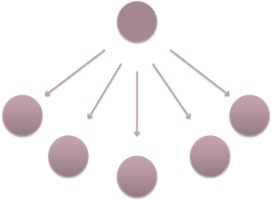
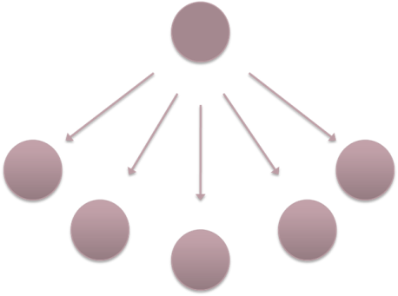
Relationships
Communication
Personal Accountability
You are Here

Slide 15
The Vision is here (heroic model)
You are here

Slide 16
Hierarchy
Characterized by “single node ascendancy” (Hero)
One person or group is in charge
In compliance driven hierarchies, power distribution is seen as “power-over” rather than “power-shared”
Election to leadership is often based factors such as longevity/seniority

Slide 17
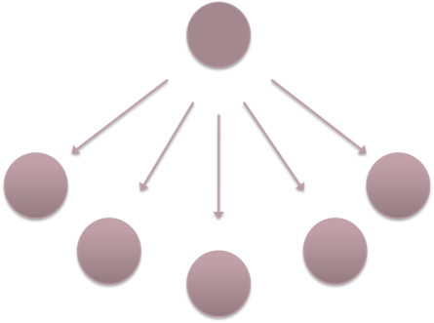
Strengths of Hierarchies
Efficiency and Familiarity
Very efficient model for the transfer of information to a group of limited size (i.e. small)
Hierarchies can structure information flow
Many organizational structures in our culture are built on hierarchies

Slide 18
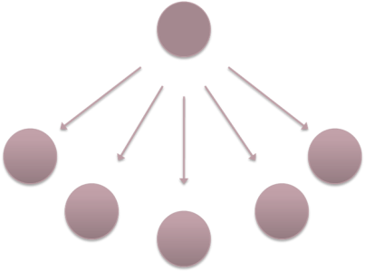
Liabilities of Hierarchies
Communication
Can be compromised by lack of trust and lack of access to decision-makers
Disengagement
Lack of power at the edges may impact “buy-in”
Poor accountability
As long as compliance-driven orders are received, workers can defer to having followed those instructions, and are not considered culpable

Slide 19
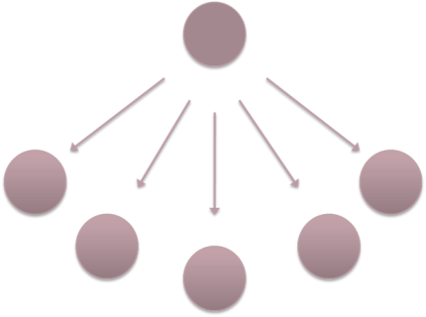
Where hierarchies are successful
Public safety
Military
Emergent situations where information flow is uni-directional
Teaching/education
Hierarchies in and of themselves are not bad.
Non-reflective use or abuse of power within hierarchies amplifies their liabilities

Slide 20
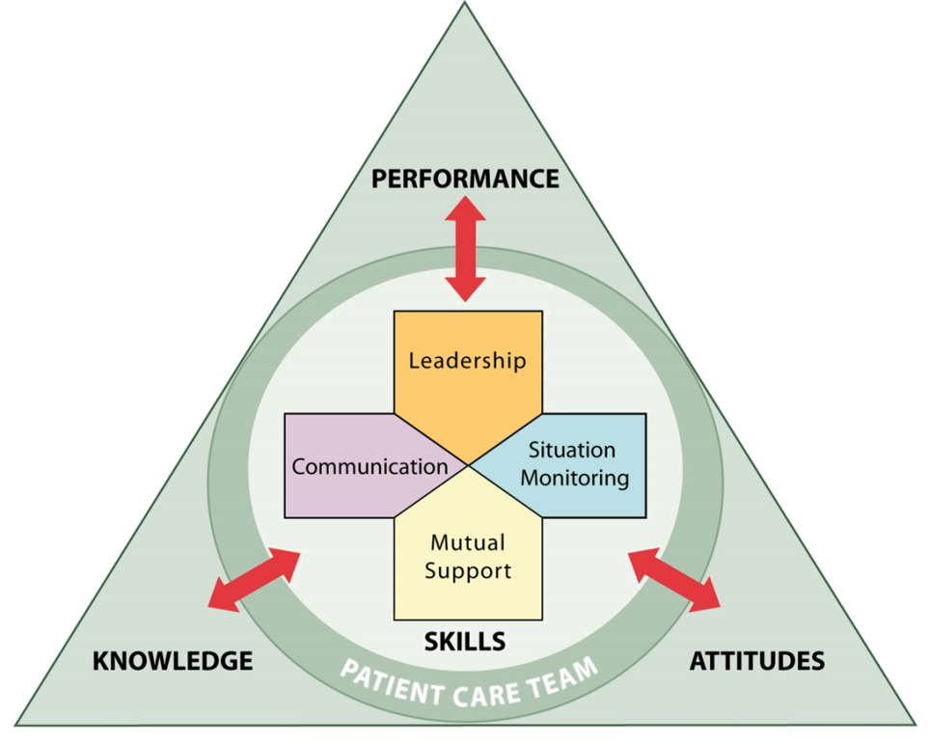
Leadership: Potentially less- or non-collaborative, may not foster a relational model
Situation Monitoring: May be difficult to see the “big picture” as relationships are defined by position
Mutual Support: Depending on leadership, lateral access/communication may be difficult
Communication: Can be compromised by poor lateral communication and by filtering effects of passing information through layers of organization

Slide 21
Relationships
Communication
Personal Accountability

Slide 23
Heterarchy
Characterized by shared organizational structure that is web-like or hive-like
Generally considered to be a decentralized or shared power structure
Power transfers are fluid (happen easily and quickly)
Leadership may be based on information rather than education, position, longevity, title, etc.

Slide 24
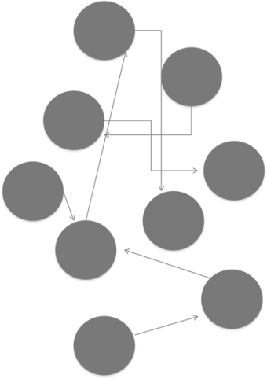
Decisions and Communication
Information flows non-symmetrically across the network
There is no formal “chain of command”
Because of the shared power structure, edges are less likely to be constrained
Relationships tend to be non-linear

Slide 25
Strengths of Heterarchies
Fluidity
The structure adaptable to challenges and changes
Transparency
Because communication is transparent, trust is generated
Accountability
Movement away from individual successes, elevation toward team accountability

Slide 26
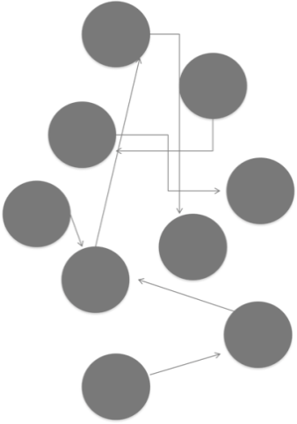
Liabilities of Heterarchies
Uncertainty
Unfamiliarity with structure leads to concern that “nobody is in charge”
Informal channels of communication
Not all information permeates the entire structure
Information flow tends to follow a pattern of needs
Maintenance
Requires reflective process among team members

Slide 27
Leadership: Tends to be more fluid, based on information rather than titles, seniority, etc.
Situation Monitoring: Transparency is possible through open communication and access
Mutual Support: Vision is held by the whole, reinforcing need for enabling success of each team member. We all succeed or no one does.
Communication: Open, undefined by title, based on need, can be targeted to specific areas

Slide 28
Relationships
Communication
Personal Accountability

Slide 30
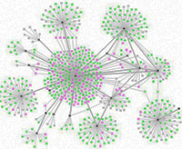
Holacracy
Requires team members be fully calibrated to the stated vision
Team members assume roles based on team need
Assignments are fluid based on need in alignment with vision
Team member contributions may vary greatly across function and task
(Self-organizing, autopoietic)

Slide 31
Decisions and Communication
More autonomy is given to individuals to make decisions
Can lead to high innovation
Requires a strong sense of team values
Communication must be central to team functioning
Requires reflective ability
and calls to accountability

Slide 32
Strengths of Holacracies
Fluidity
Adaptive structure
Valuing of Individuals
High importance placed on every member of the team
On-going opportunities for collaboration
Connection
Increasing connection (and adaptation) of
structure to team vision

Slide 33
Liabilities of Holacracies
Emergence
No hard rules, emerging organizational structure
May be more difficult to implement where established roles and responsibilities are more rigid/clearly defined
Non-participation
Potential for passengers. Requires trust and development of organizational culture
Tracking
Completion of tasks in a timely fashion may be harder to track

Slide 34
Leadership: A lot of member autonomy and empowerment changes leadership model to “facilitator”
Situation Monitoring: Transparency allows view of larger organization (and possibly more experience across differentiated tasks)
Mutual Support: Early reports are this model engenders positive relations (i.e. “my community” rather than “my job”)
Communication: Can be challenging to be certain all who need to know are informed; may be more difficult to track tasks

Slide 35
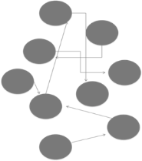
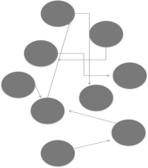
Possibilities to consider
Hybridizing
Consider for
task or time
specific teams
Perhaps the biggest
challenge will be to
reframe leadership

Slide 36
Learning to be on a team
Being on a team requires a different focus by individual members.
Focus is on team outcomes, not individual successes or “wins”
The team succeeds or fails together (as a team)

Slide 37
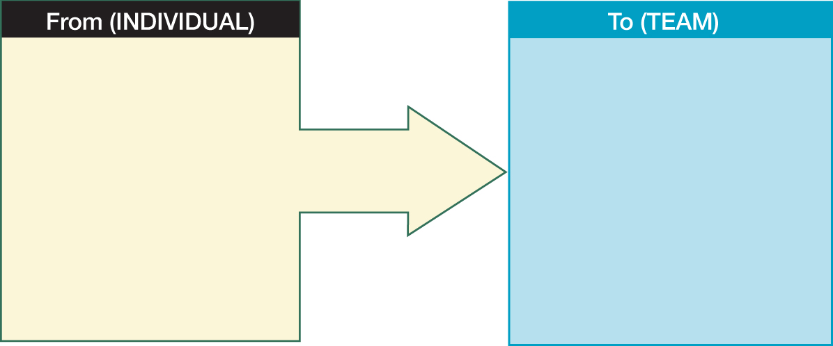
Paradigm Shift to Team Approach
Single focus (practice skills)
Individual performance
Under-informed decision-making
Loose concept of teamwork
Unbalanced workload
Having information
Self-advocacy
Self-improvement
Individual efficiency
Dual focus (practice and team skills)
Team performance
Informed decision-making
Clear understanding of teamwork
Managed workload
Sharing information
Mutual support
Team improvement
Team efficiency
Practice skills refers to those skills you must have to do your job. The term applies to sets of clinical and/or non-clinical skills

Slide 38
Teams and Communication
One of the greatest challenges about learning to collaborate with others is to find a system for communicating effectively
One-on-one conversations are different from team communications

Slide 39
Ultimately
Not all leaders or leaderships styles are successful with all types of organizational structure (i.e. compliance driven leadership may not be suited for collaborative teams)
How we organize our teams may impact, or perhaps even dictate how those teams can function, and what their outcomes will be
We have choices.

Slide 40
References
Graphics are generated by Bill Gordon and may be used freely without attribution.
Images (with the exception of the presenter’s photograph) are from the Public Domain collection of the New York Public Library
https://www.nypl.org/research/collections/digital-collections/public-domain?gclid=COOb-ern2NECFYa6wAod1lMMiw (retrieved 1/23/2017)
Mattessich, P. W., & Monsey, B. R. (2001). Collaboration--what makes it work: a review of research literature on factors influencing successful collaboration. St. Paul, MN: Fieldstone Alliance.
Robertson, B. J. (2015). Holacracy: the revolutionary management system that abolishes hierarchy. London: Portfolio Penguin.
Weiss, D., Tilin, F. J., & Morgan, M. J. (2014). The interprofessional health care team: leadership and development. Burlington, MA: Jones & Bartlett Learning.
Wheatley, M. (2006). Leadership and the new science: discovering order in a chaotic world, 3rd ed. San Francisco, Calif: Berrett-Koehler.

Slide 41
Contact Information
Dr. Bill Gordon
William.Gordon@rosalindfranklin.edu
847-578-8327

Slide 42
Questions and Answers
For more information, please contact our team at:
AHRQTeamSTEPPS@aha.org

