Slide 1
Teams Saving Brains One Minute at a Time
April 12, 2017

Slide 2
Rules of Engagement
Audio for the webinar can be accessed in two ways:
Through the phone (*Please mute your computer speakers)
Through your computer
A Q&A session will be held at the end of the presentation
Written questions are encouraged throughout the presentation and will be answered during the Q&A session
To submit a question, type it into the Chat Area and send it at any time during the presentation

Slide 3
Upcoming TeamSTEPPS Events
Master Training Courses
Registration for courses through June 2017 now open
Registration opening on March 15 for courses in July-September 2017
Advanced Courses
July 18 at UCLA
August 1 at Northwell Health
August 11 at the University of Washington
August 25 at MetroHealth
Accepting applications through May 19

Slide 4
Help Line (312) 422-2609
Or email: AHRQTeamSTEPPS@aha.org

Slide 5
Today’s Presenters
Susan Coffey Zern, MD, MSMS, CHSE
Director, Virtual Education and Simulation Training (VEST) Center
Christiana Care Health System
Barbara Albani, MD
Director, Neurointerventional Surgery
Christiana Care Health System

Slide 6
Thank you for inviting us to present today’s webinar

Slide 7
Objectives
Describe the process of improving stroke team response using TeamSTEPPS® framework and tools
Recognize the value of an iterative approach to improving team effectiveness
Discuss the importance of using clinical data and feedback to improve and sustain team effectiveness

Slide 9
Christiana Care Health System (CCHS) Volume
Outpatient Visits: 582,257
Home Health Care Visits: 312,537
22nd in U.S. Admissions: 53,259
28th in U.S. Surgeries: 39,102
21st in U.S. ED Visits: 197,340
31st in U.S. Births: 6,545

Slide 10
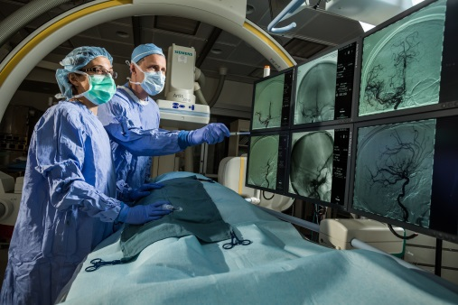
Strokes at CCHS
Christiana Care is one of the top 10 stroke centers in volume in the country. Nearly 2,000 stroke patients are treated per year with the number of large vessel occlusions increasing yearly
It is designated as only DE Comprehensive Stroke Center, the most advanced level of expertise in stroke care, by the Joint Commission

Slide 11
Background
For every minute that passes in patients with an acute ischemic stroke, there are millions of neurons lost
For every 15 minutes of time that the vessel remains occluded, there is a significant decrease in the patient’s functional outcome
Despite the clear time sensitivity, time was wasted
Lack of a sense of urgency
Inefficiencies of time management

Slide 12
Background
Recent American Heart Association (AHA) guidelines
“embolectomy needs to be performed as rapidly as possible for the greatest clinical benefit, and is best when performed within 6 hours from onset of symptoms” (AHA Class I, level of evidence A)
Complex operational process to get patient to endovascular treatment, involving an interprofessional team
Variability in time from cath lab door to incision was identified, independent of patient severity
Relatively low volume, but high acuity situation with no formal training

Slide 14
Goal
Cath lab door to incision
Reduce time
<20 minutes
Consistently
>50% time

Slide 15
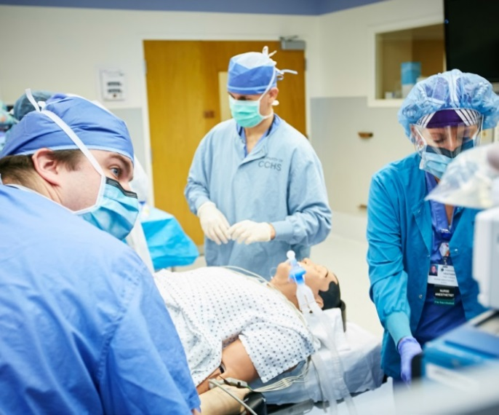
Process Evaluation
Winter 2013
Assessed stroke team process using high fidelity simulation scenarios in the simulation center
Roles and Responsibilities – lack of clarity
No formal team leader
Teamwork and communication was lacking among the team members (parallel, uncoordinated actions)

Slide 16
Solutions Implemented
Spring 2014
Roles and Responsibilities - defined by entire team
Team leader defined as circulating nurse – new role
Began simulation sessions with the team in the simulation center to test new roles and responsibilities in the stroke response process

Slide 17
Team Leader Training
Training for the nurses in this new role – TeamSTEPPS®
“need to know” information
Expectations of a team leader
Resource management
Delegation
Situational monitoring
Cross Monitoring

Slide 18
Action Plan: Solutions Implemented
Summer
2014
Began in situ simulations in Cath lab two Wednesday mornings per month for one hour with interprofessional team – Anesthesia, Emergency Medicine, cath lab team, Neuro ICU
Debriefed team after each in situ session
Exposed opportunities for improvement
Revealed gaps in teamwork and communication

Slide 19
Formal Handoff
Christiana Care in situ simulation team training
Cath lab team, ED Nurse, NCCU Nurse, Anesthesia, VEST Simulation Center Standardized Patient

Slide 20
In situ Simulations
Outcomes associated with in situ simulation
Improves individual team member technical abilities
Reinforces individual and team member behaviors
Identifies active and latent system issues
Catalyzes change in clinical care systems
Improves clinical outcomes
Henriksen, K. (2008). Advances in Patient Safety: New Directions and Alternative Approaches, Vol. 3: Performance And Tools. Agency for Healthcare Research and Quality. Pages 1-18.

Slide 21
Clinical Data

Slide 22
Solutions Implemented
2014-2015
Continued in situ simulations in cath lab bimonthly
Debriefing the team after each simulation allowed iterative changes to the stroke code process i.e. team neuro exam at bedside to assess for changes, closed loop communication, ‘loud and proud’ handoff, etc.

Slide 23
Data

Slide 24
Ongoing Training
Teamwork and communication training and practice needs to be continuous to sustain the change
Resumed in situ simulations again in during the 4th quarter of 2016
Developed a best practice video for participants to view prior to simulation
TeamSTEPPS® tools and strategies are highlighted and explicitly demonstrated in the video using the front line providers

Slide 25
Path Forward/ Next Steps
Broaden the scope
Safely optimize time from ED door to incision (Cath lab) to improve clinical outcomes through more efficient, consistent and safer delivery of embolectomy
Develop Method for stroke team performance feedback
Video recording “actual” stroke cases
Debrief following cases for performance improvement

Slide 26
Contact information
Susan Coffey, MD
scoffey@christianacare.org
Barbara Albani, MD
balbani@christianacare.org

Slide 27
Questions and Answers
For more information, please contact our team at:
AHRQTeamSTEPPS@aha.org

