Slide 1
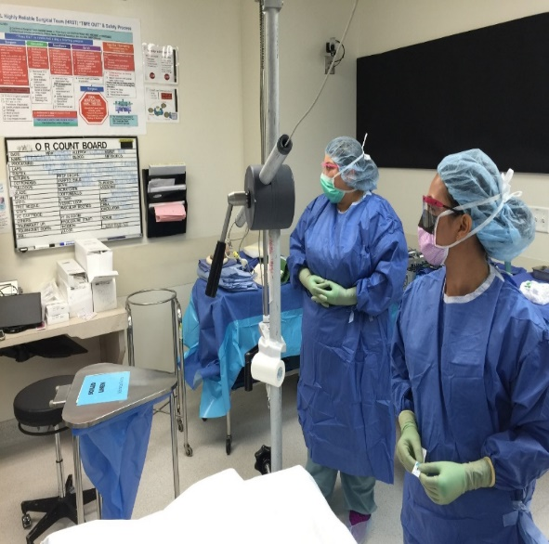
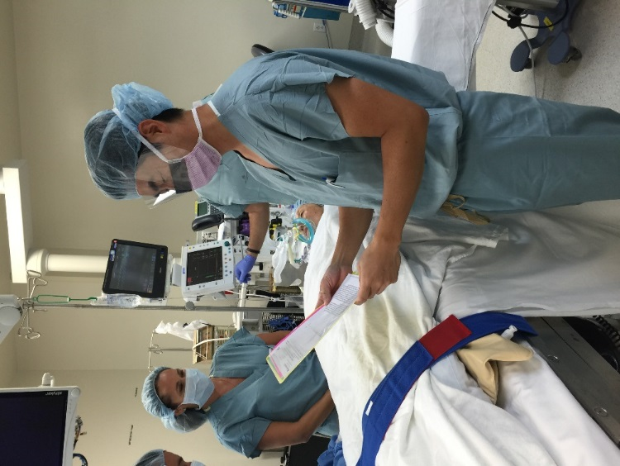
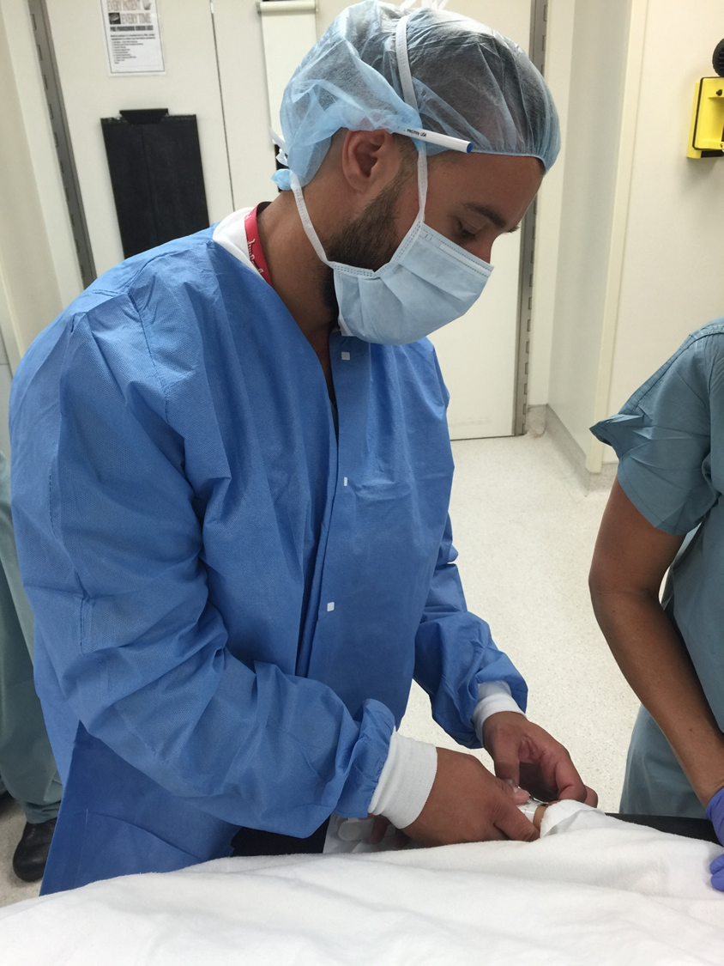
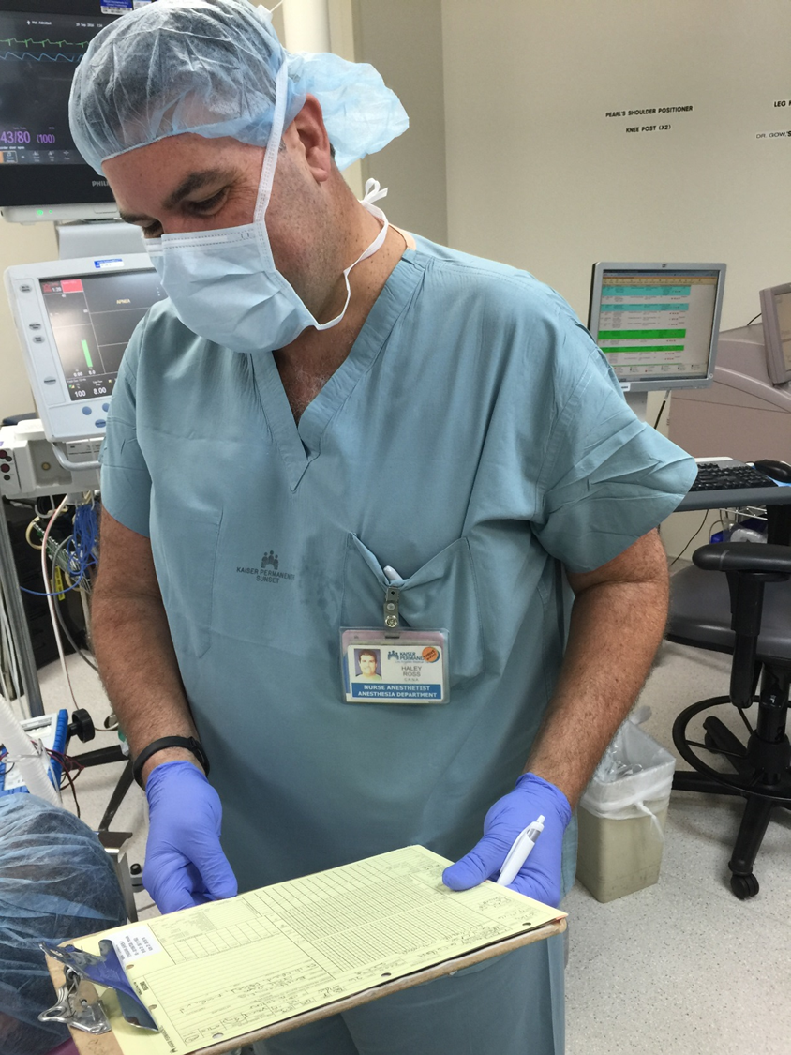
Implementing TeamSTEPPS to the Perioperative Service Area
May 10, 2017

Slide 2
Rules of Engagement
Audio for the webinar can be accessed in two ways:
Through the phone (*Please mute your computer speakers)
Through your computer
A Q&A session will be held at the end of the presentation
Written questions are encouraged throughout the presentation and will be answered during the Q&A session
To submit a question, type it into the Chat Area and send it at any time during the presentation

Slide 3
Upcoming TeamSTEPPS Events
Master Training Courses
Registration for courses through September 2017 now open
Advanced Courses
July 18 at UCLA
August 1 at Northwell Health
August 11 at the University of Washington
August 25 at MetroHealth
Now accepting applications

Slide 4
Help Line (312) 422-2609
Or email: AHRQTeamSTEPPS@aha.org

Slide 5
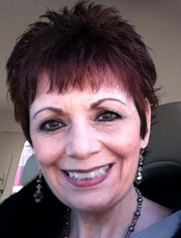
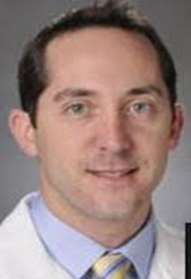
Today’s Presenters
Barbara Helliwell, RN, BSN, PHN
Director, Patient Safety & Risk Management Kaiser Permanente, Los Angeles Medical Center (LAMC)
LAMC TeamSTEPPS Champion
Mark Lassoff, MD, MPH, MBA
Director, Perioperative Services, Kaiser Permanente, Los Angeles Medical Center (LAMC)
Assistant Chief of Urology
LAMC Physician TeamSTEPPS Champion

Slide 6
Objectives
Describe strategies for implementing TeamSTEPPS in a large interdisciplinary session
Discuss how to customize learning materials to increase stakeholder buy-in
Explain how customized TeamSTEPPS training can be more effective in addressing facility specific needs
Describe how to measure and interpret the results implementing specific TeamSTEPPS interventions

Slide 7
About Kaiser Los Angeles Medical Center
6th largest hospital in Metro LA and 12th in California
Largest Heart Center in the Western U.S.
460 Licensed Beds
28 ORs including:
4 suite CVOR
5 suite ASU
23,000+ Surgeries including:
Cardiac - Head & Neck - Ortho
Neuro - Spine – Pediatric - Urology - Oncology - Robotic – Ob/Gyn.
Vascular - Ophthalmology - General - Maxillofacial

Slide 8
How our Journey Began…
Kaiser Corporate Risk & Patient Safety introduced TeamSTEPPS in 2015
Mandated all 13 So. Cal. KP facilities implement TeamSTEPPS beginning in 2016
Required each facility to sign a Memorandum of Understanding committing to TeamSTEPPS & Simulation Training
Provided TeamSTEPPS Trainer Classes and materials, e.g. shared drive
Allowed individual facilities to define their own priorities and training methodology

Slide 9
Set the Stage for Change in the OR
Educate Senior Leaders on the benefits of TeamSTEPPS & get their support
Socialize TeamSTEPPS with Perioperative Leaders:
Surgical Chiefs of Service
Surgical Service Managers
Anesthesia Leaders
Develop an interdisciplinary core team of Peri Op TeamSTEPPS Trainers
Physician Champions
Nurse Leaders
Patient Safety Leader

Slide 10
Establish the Training Mission
Train the entire service line at one time
Include all surgical specialties & departments
Train surgeons, residents, nurses, surgical techs, and support staff together in groups
Train maximum amount of people per session
Minimize disruption to surgery & clinic schedules
Tie TeamSTEPPS to existing Peri Op initiatives
Make the training relevant to all participants
Make the training memorable and fun

Slide 11
Identify the Training Logistics
Set training target at 80% of entire population – 480/600
Find a convenient training location
Schedule 4 training sessions over 2 consecutive days
Find room large enough to train 120 people per session
Send Save the Date announcement 8 wks. in advance
Allow departments to self schedule
Send out TeamSTEPPS pre-survey 2-3 weeks prior to training
Set out frequent flyers and reminders
Streamline registration, but assign seats

Slide 12
Connect the Content to the Need
Identify the Patient Safety Needs, e.g. Why Now?
RFOs Missing instruments
Wrong Implants Missing specimens
Late Starts Poor handoffs
Answer “Why TeamSTEPPS?” – use national data
Share Pre-Survey results & discuss
Tie existing Peri Op Initiatives* with TeamSTEPPS*
Briefing* Prior to Induction* = Shared Mental Model*
Debriefs* = Improved Communication & Efficiency*
Safety Checklists* = Shared Mental Model*
Mutual Support* = Improved Efficiency & Productivity*

Slide 13
Keep it Relevant
Have Senior Leadership open each training session
Celebrate successes, e.g. 244 Days between Events
Set the tone for the training sessions
Be transparent about the Peri Op safety events & trends
Weave custom video clips through presentation
Match TeamSTEPPS tools to key Peri Op initiatives
Use a variety of videos including TeamSTEPPS, commercial, and custom made
Build in time for audience participation & feedback

Slide 14
Custom Videos

Slide 15
Results
1st Training: (2) Days / (4) Sessions = 472/480 (98%)
2nd Training: (1) Day / (1) Session = 94/163 (58%)
Total # of Physicians Trained: 224/251 (89%)
Total # of Staff Trained: 275/392 (87%)
Total # Trained Overall: 566/643 (88%)

Slide 16
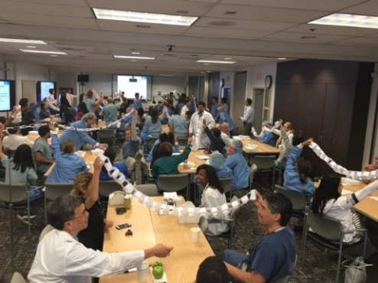
What Worked?
Self Scheduling
Assigned Seating
Short Sessions
Leadership Intro
Audience Participation
Multidisciplinary Presenters
Games & Prizes
Custom Videos
Food
What Didn’t Work?
Self Scheduling
Assigned Seating
Pre-Survey
Room Size
Audience Participation
Audio Visual Glitches
Play Acting Skit

Slide 17
Changes Since TS Training
Increased reporting of patient safety events, good catches and near misses
Sustained reduction in Retained Foreign Objects thru:
Use of Call Out/Check Back
Mutual Support
Implementation of a multiphase Debrief/Handoff tool
Regular Leadership Rounding by the PLT
Improved Team communication & collaboration
Improved Psychological Safety
Common lexicon established

Slide 18
Improved Reporting Culture

Slide 19
Building TeamSTEPPS into Everything We Do
Key Points:
Include SCDs in Briefing
Cross Monitor alarms
Perform hourly checks
Consider special circumstances

Slide 20
Speaking Up for Patient Safety

Slide 21
Where do we go from here?
Continue Leadership rounding and TeamSTEPPS coaching
Build TeamSTEPPS into Perioperative Simulation Training
Spread TeamSTEPPS to all procedural areas: GI Lab, Interventional Radiology, Cardiac Cath Lab, Labor & Delivery
Continue to measure progress towards Peri Op goals including: increased reporting, decreased untoward events, reduced SSI, improved morale
Continue to reward and recognize staff and physicians for escalating Patient Safety concerns

Slide 22
Conclusions
TeamSTEPPS can improve clinical performance and patient safety by:
Developing expertise in team training and HRO fundamentals in the leadership team
Integrating teamwork and communication principals into the daily work flows, e.g. “way we do business”
Optimizing patient outcomes by early identification and resolution of patient safety concerns
Reducing adverse patient events related to communication breakdowns and poor teamwork

Slide 23
Acknowledgements
Southern California Kaiser Permanente Risk & Patient Safety Leadership Team
Kaiser Permanente Los Angeles Medical Center Senior Leadership Team
Kaiser Permanente Los Angeles Medical Center Perioperative Leadership Team
Special Thanks to:
Monica M. Metzdorff, MD
Dr. Stephen Munz, MD
And the Perioperative TeamSTEPPS Trainers:
John Alquitran, RN, MSN
Kurt Birusingh, MD
Brenda Catt, RN, MSN
Vincent Chen, MD
Richard Kim, MD
Danielle Stranc, MD
Christina Unzueta, RN

Slide 24
Questions?

Slide 25
Questions and Answers
For more information, please contact our team at:
AHRQTeamSTEPPS@aha.org

