Slide 1


Introduction to the Fundamentals of TeamSTEPPS Concepts and Tools (Part 1 of 3)
Wednesday, July 12, 2017
Notes:
Introduction to the Fundamentals of TeamSTEPPS Concepts and Tools (Part 1 of 3)
Wednesday, July 12, 2017

Slide 2
Rules of Engagement
Audio for the webinar can be accessed in two ways:
  Through the phone (*Please mute your computer speakers)
  Through your computer
A Q&A session will be held at the end of the presentation.
Written questions are encouraged throughout the presentation and will be answered during the Q&A session.
  To submit a question, type it into the Chat Area and send it at any time during the presentation.

Slide 3
Upcoming TeamSTEPPS Events
Master Training Courses
  Registration for courses through September 2017 now open
Advanced Course
  August 25 at MetroHealth
  Now accepting applications

Slide 4
Help Line (312) 422-2609
Or email: AHRQTeamSTEPPS@aha.org

Slide 5
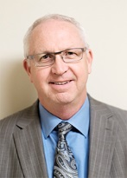



Today’s Presenter(s)
Ross Ehrmantraut, R.N., Clinical Director of Team Performance, WISH
Megan Sherman, M.A.Ed.H.D., Associate Director of WISH
Farrah Leland, J.D., Associate Director of WISH

Slide 6

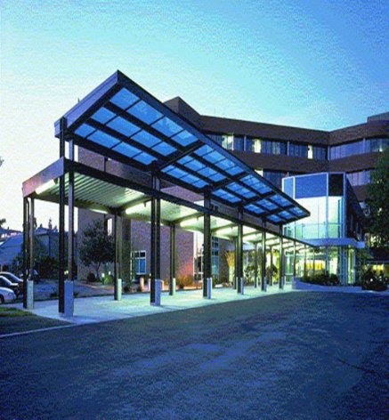
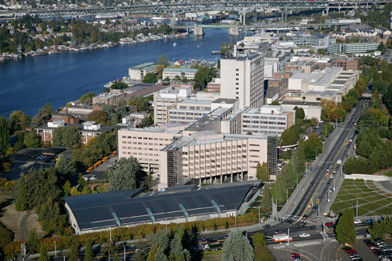
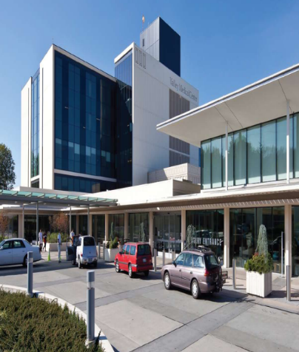
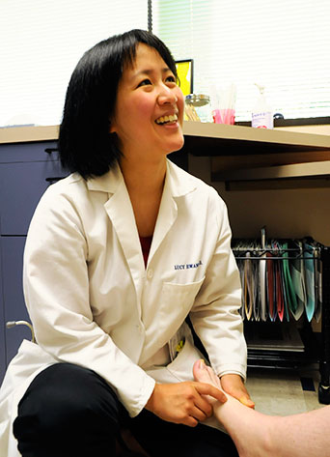
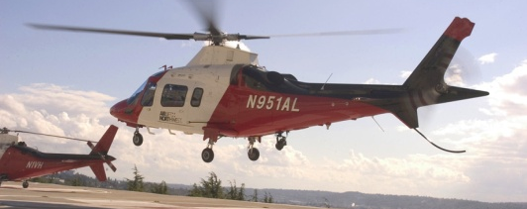
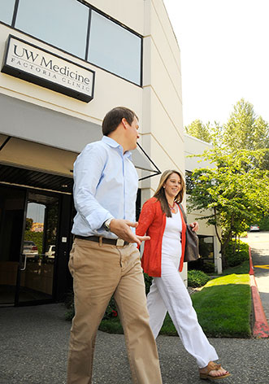
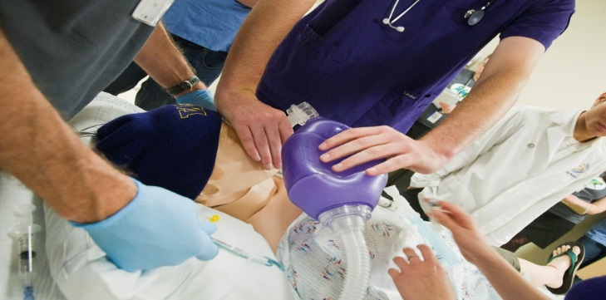
UW Medicine
Notes:
UW Medicine

Slide 7
University of Washington Medicine
2,400+ faculty members in 30 departments.
4,700+ clinical faculty across WWAMI region.
4,500 students and trainees.
  Medical students, residents, fellows
  Physician assistants, physical and occupational therapy, medical technologists
  PhD students in basic sciences
27,000+ employees

Slide 8
Objectives
Discuss how Implementing TeamSTEPPS in health care can lead to improved patient outcomes through better communication and teamwork.
Identify the TeamSTEPPS tools associated with the 100-, 200-, and 300-level concepts and discuss how and when they may be best applied in a team setting.
Describe the contributing factors to medical errors and the need for improved communication and teamwork in health care.

Slide 9
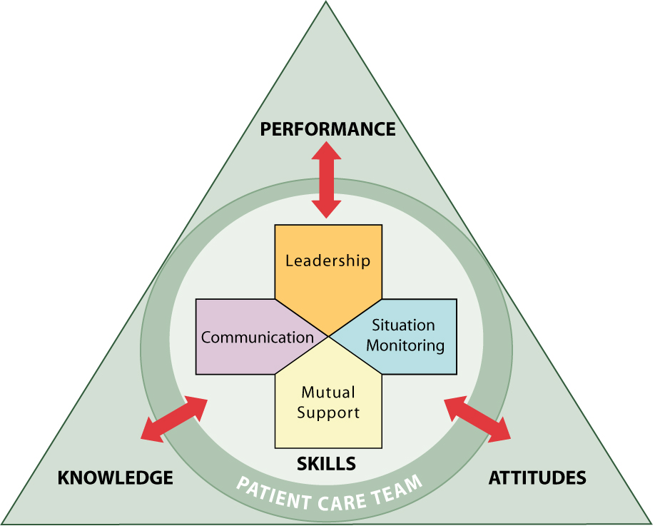
Notes:
TeamSTEPPS Logo:
The TeamSTEPPS triangle logo is a visual model that represents some basic but critical concepts related to teamwork training as explained below.
Individuals can learn four primary trainable teamwork skills. These are:
Leadership.
Communication.
Situation monitoring.
Mutual support.
If a team has tools and strategies it can leverage to build a fundamental level of competency in each of those skills, research has shown that the team can enhance three types of teamwork outcomes:
Performance.
Knowledge.
Attitudes.

Slide 10
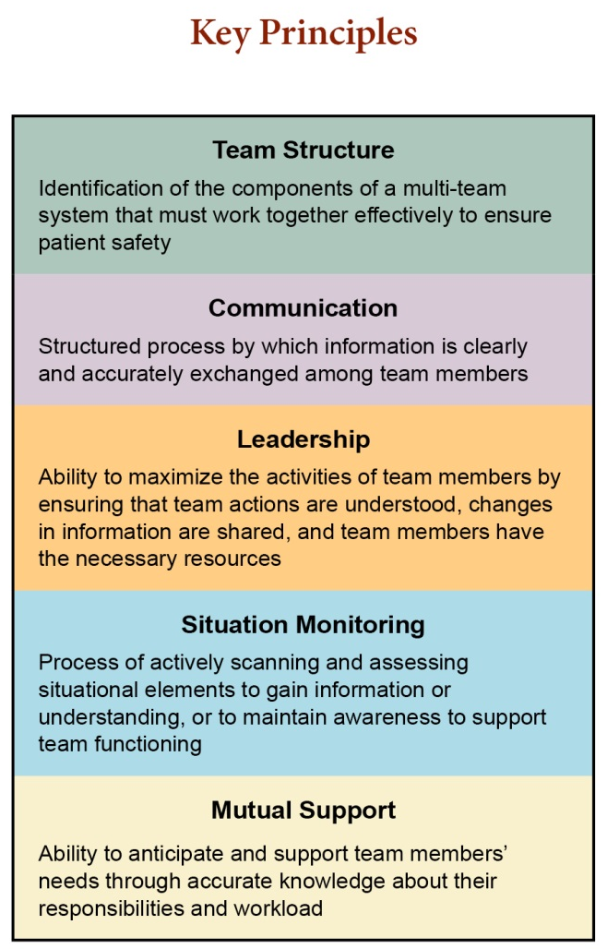
Notes:
Key Principles:
Team Structure—Identification of the components of a multi-team system that must work together effectively to ensure personal safety.
Communication—Structured process by which information is clearly and accurately exchanged among team members.
Leadership—Ability to maximize the activities of team members by ensuring that team actions are understood, changes in information are shared, and team members have the necessary resources.
Situation Monitoring—Process of actively scanning and assessing situational elements to gain information or understanding, or to maintain awareness of team functioning.
Mutual Support—Ability to anticipate and support team members’ needs through accurate knowledge about their responsibilities and workload.

Slide 11
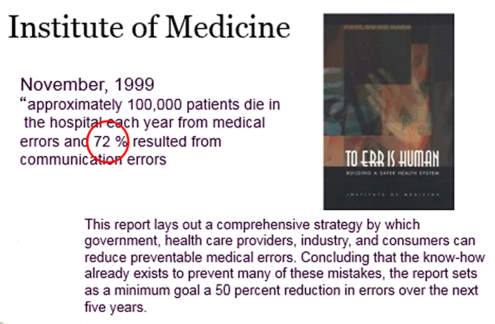
Notes:
Institute of Medicine
November 1999
“approximately 100,000 patients die in the hospital each year from medical errors and 72% resulted from communication errors.”
This report lays out a comprehensive strategy by which government, health care providers, industry, and consumers can reduce preventable medical errors. Concluding that the know-how already exists to prevent many of these mistakes, the report sets as a minimum goal a 50 percent reduction in errors over the next five years.

Slide 12

….14 Years Later
September, 2013
Journal of Patient Safety, John T. James, Ph.D.
IOM figure was probably underestimated:
  210,000 – 440,000 deaths due to preventable medical errors
May, 2016
BMJ, (Markary & Daniel)
  Third-leading cause of death in America, behind heart disease and cancer

Slide 13
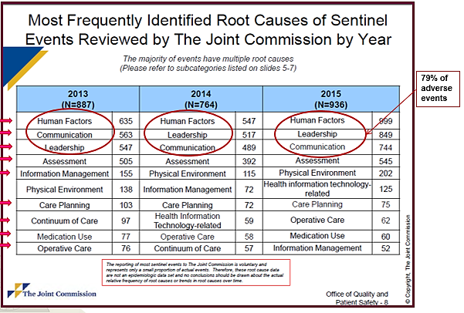
Notes:
A table shows the Most Frequently Identified Root Causes of Sentinel Events Reviewed by The Joint Commission by Year. Human Factors, Communication, and Leadership are in the top three positions for 2013, 2014, and 2015, totaling 79% of adverse events.

Slide 14
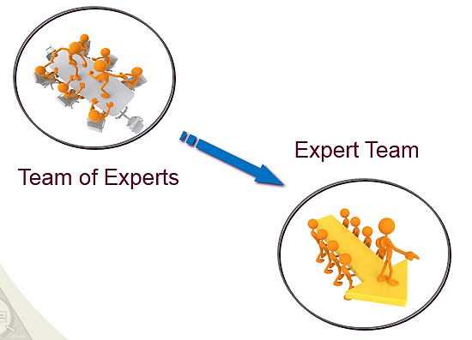
Notes:
A team of experts becomes an Expert Team.

Slide 15

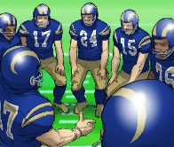

TeamSTEPPS Concepts
Concept | Definition
Call-Out | To Request or Provide Information
Cross-Check | Parroting Requests for Confirmation of Understanding
Check-Back | Closing the loop of communication.
SBAR | Situation, Background, Assessment, Recommendation
Brief | Short planning session prior to start
Huddle | Team regroup to reestablish awareness and planning
Hand-Off | Transfer of information during transitions
CUS | I’m Concerned, I’m Uncomfortable, This is a Safety Issue
Two-Challenge | It is your responsibility to assertively voice a concern at least two times to ensure it had been heard.
SBAR
CUS
Notes:
TeamSTEPPS Concepts
Call-Out--To Request or Provide Information
Cross-Check--Parroting Requests for Confirmation of Understanding
Check-Back--Closing the loop of communication.
SBAR--Situation, Background, Assessment, Recommendation
Brief--Short planning session prior to start
Huddle--Team regroup to reestablish awareness and planning
Hand-Off--Transfer of information during transitions
CUS--I’m Concerned, I’m Uncomfortable, This is a Safety Issue
Two-Challenge--It is your responsibility to assertively voice a concern at least two times to ensure it had been heard.

Slide 16
Review of SKILLS
100-Level Skills | 200-Level Skills | 300-Level Skills
Request Call-Out Cross-Check Check-Back SBAR Brief | Huddle Debrief Handoff Cross-Monitoring STEP Task Assistance Shared Mental Model | CUS Two-Challenge Rule DESC I’M SAFE

Slide 17
Effective Communication
Complete: relevant information; avoid unnecessary detail
Clear: standard terminology; minimize use of acronyms
Brief: be concise
Timely: avoid delays; verify, validate, and acknowledge

Slide 18
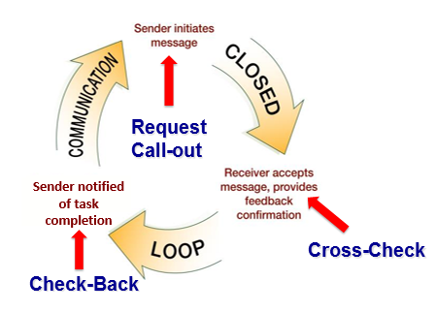
Notes:
Check-back is a circular process with three parts. Communication goes through Sender initiates message. This leads to Closed, which goes through Receiver accepts message and provides feedback confirmation. This leads to Loop, which goes through Sender verifies message was received. This leads back to Communication, which continues the process.

Slide 19
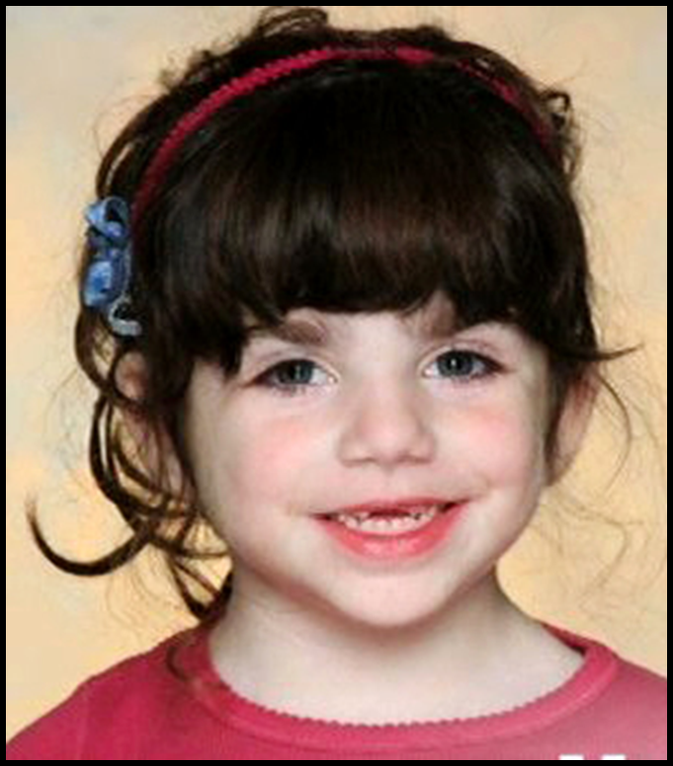
IMPACT of Communication on Patients
Source: Seattle Times

Slide 20
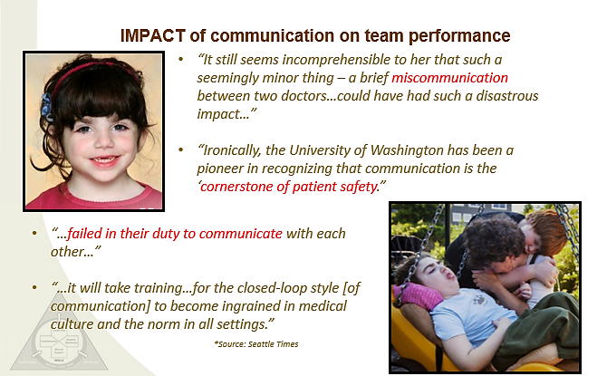
Notes:
IMPACT of communication on team performance
“It still seems incomprehensible to her that such a seemingly minor thing—a brief miscommunication between two doctors… could have had such a disastrous impact… ”
“Ironically, the University of Washington has been a pioneer in recognizing that communication is the ‘cornerstone of patient safety.’”
“…failed in their duty to communicate with each other…”
“…it will take training… for the closed-loop style [of communication] to become ingrained in medical culture and the norm in all settings.”
Source: Seattle Times

Slide 21
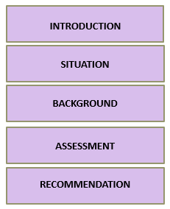
SBAR
A communication technique that provides a standardized framework to communicate about a patient’s condition. (Can also be referred to as ISBAR, where I stands for introductions)

Slide 22
SBAR Example
Intro: Hi, Dr. Wilson, this is Ann. I’m calling about Baby Girl Disher.
Situation: She’s having a lot of ABD events that are now requiring stimulation.
Background: She is 29 weeks corrected and was the baby that you evaluated earlier for increased apnea and bradycardia events.
Assessment: She is still on room air but her color doesn’t look right. I think she is getting sicker. Assessment is that she may be getting sicker.
Recommendation: I recommend we do an evaluation, maybe some labs.

Slide 23
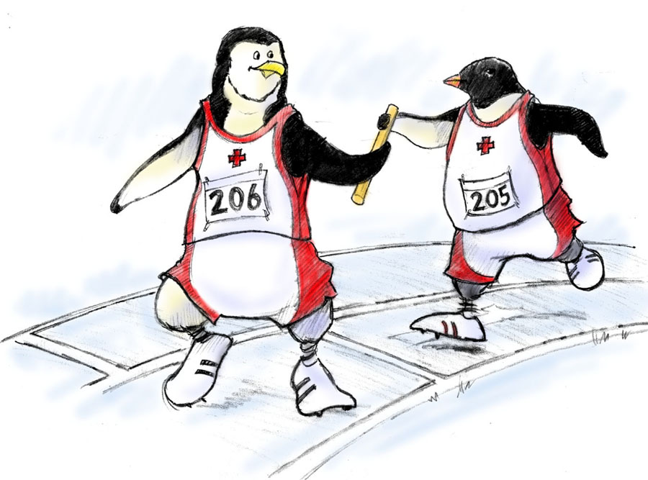
Handoff is…
The transfer of information during transitions in care across the continuum
  Includes an opportunity to ask questions, clarify, and confirm

Slide 24

“I PASS THE BATON”
Introduction: Introduce yourself and your role/job (include patient)
Patient: Identifiers, age, sex, location
Assessment: Present chief complaint, vital signs, symptoms, and
diagnosis
Situation: Current status/circumstances, including code status,
level of uncertainty, recent changes, and response to treatment
Safety: Critical lab values/reports, socioeconomic factors, allergies, and alerts
(falls, isolation, etc.)
THE
Background: Comorbidities, previous episodes, current medications, and family history
Actions: What actions were taken or are required? Provide brief rationale
Timing: Level of urgency and explicit timing and prioritization of actions
Ownership: Who is responsible (nurse/doctor/team)?
Include patient/family responsibilities
Next: What will happen next? Anticipated changes?
What is the plan? Are there contingency plans?

Slide 25
Other Examples of Handoff Tools
ANTICipate
  Administrative Data; New clinical information; Tasks to be performed; Illness severity; Contingency plans for changes
I PASS
  Illness severity; Patient Summary; Action list for the new team; Situation awareness and contingency plans; Synthesis and “read back” of the information
SHARQ
  Situation; History; Assessment; Recommendations/Result; Questions

Slide 26
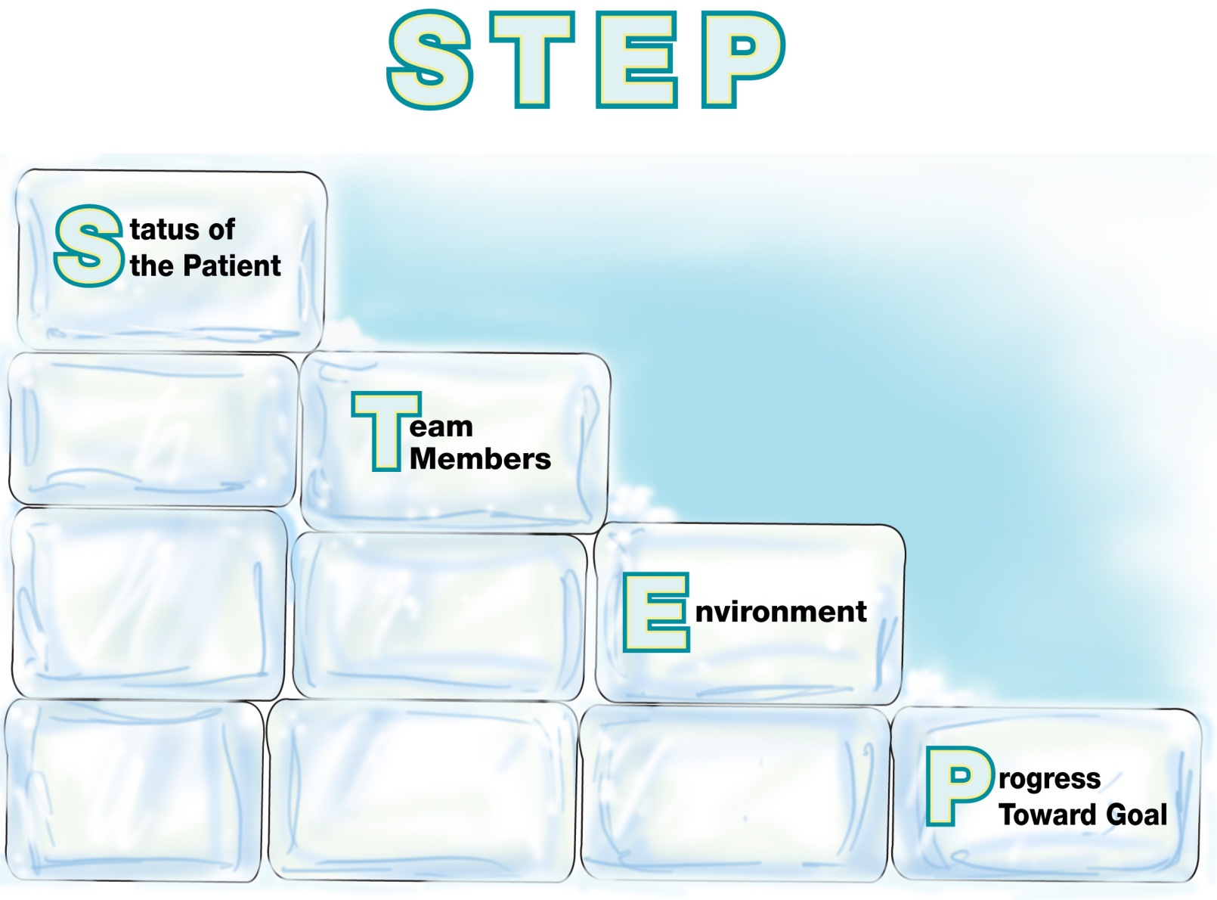
Components of Situation Monitoring:
Notes:
The STEP process involves ongoing situation monitoring of the following components:
Status of the patient.
Team members.
Environment.
Progress toward the goal.

Slide 27
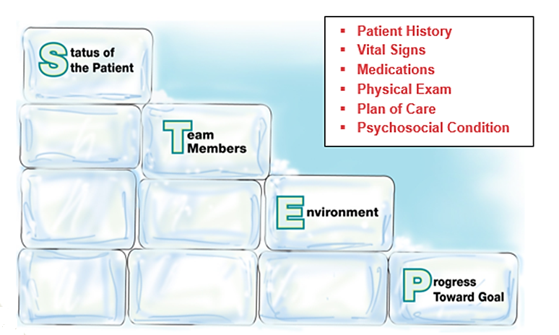
Status of the Patient

Slide 28
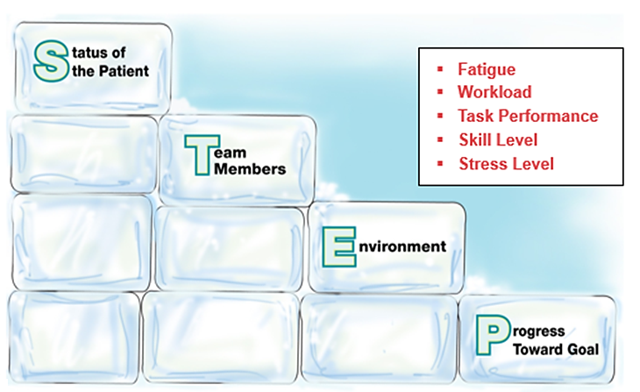
Team Members

Slide 29
I’M SAFE Checklist
I = Illness
M = Medication
S = Stress
A = Alcohol and Drugs
F = Fatigue
E = Eating and Elimination

Slide 30
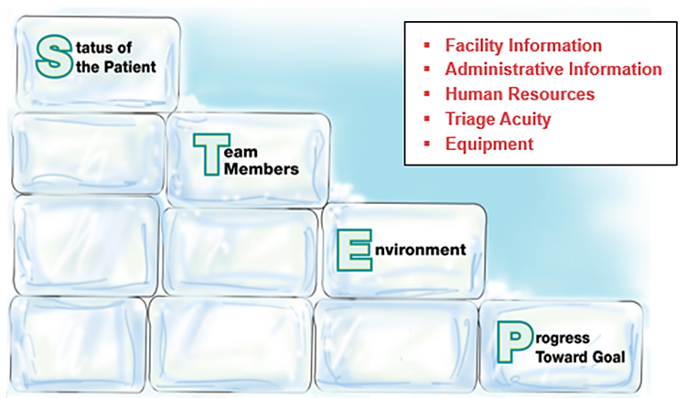
Environment

Slide 31
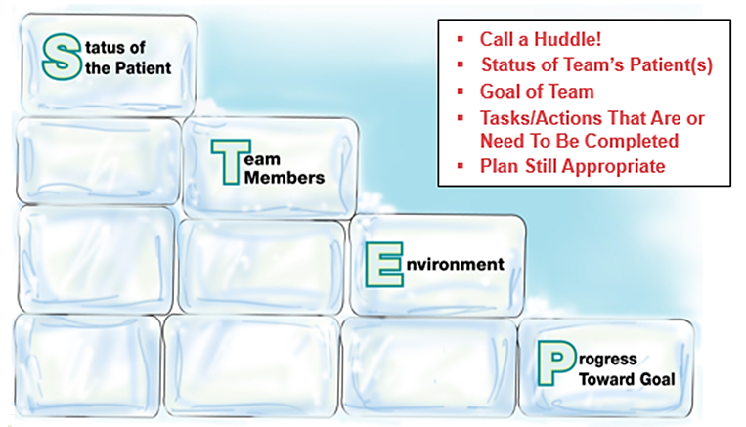
Progress Toward Goal

Slide 32
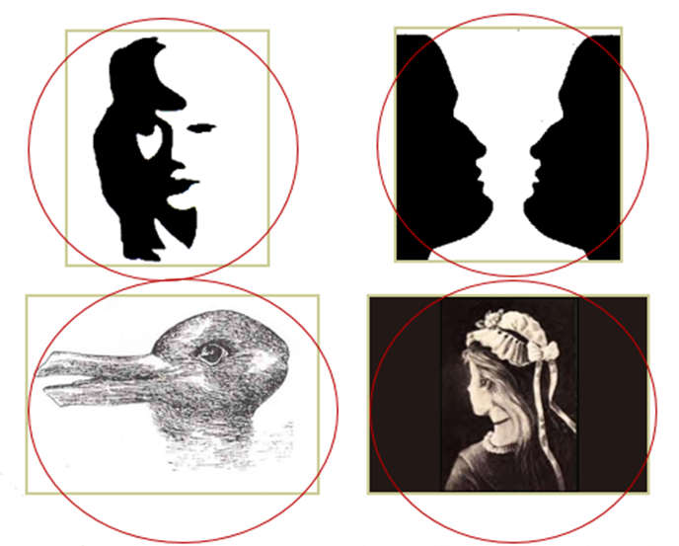
SHARED MENTAL MODEL
Notes:
Shared mental model – demonstrates we can both be seeing the same thing, but have two different interpretations, so communication is key.

Slide 33
How To Get To a Shared Mental Model
How: Call Outs Cross-Checks Call Backs SBAR | When: Briefs Huddles Debriefs Transitions in Care

Slide 34
Leading Teams
Briefs
  Short session to plan
  Assign roles, establish expectations, anticipate outcomes
Huddles
  Ad hoc planning to reestablish/reinforce and assess or adjust plans
Debriefs
  Information exchange after the action

Slide 35
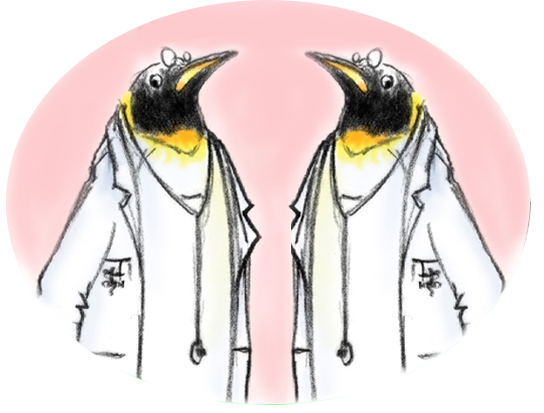
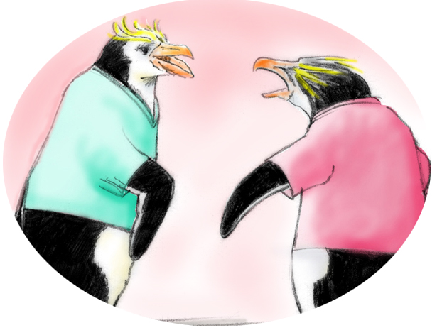
Conflict in Teams
Interpersonal Conflict
(Hostile and harassing behavior)
DESC Script
Informational Conflict
(We have different information!)
Two-Challenge Rule
CUS

Slide 36
Conflict Resolution
DESC Script
A constructive approach for
managing and resolving conflict
  D—Describe the specific situation
  E—Express your concerns about the action
  S—Suggest other alternatives
  C—Consequences should be stated

Slide 37
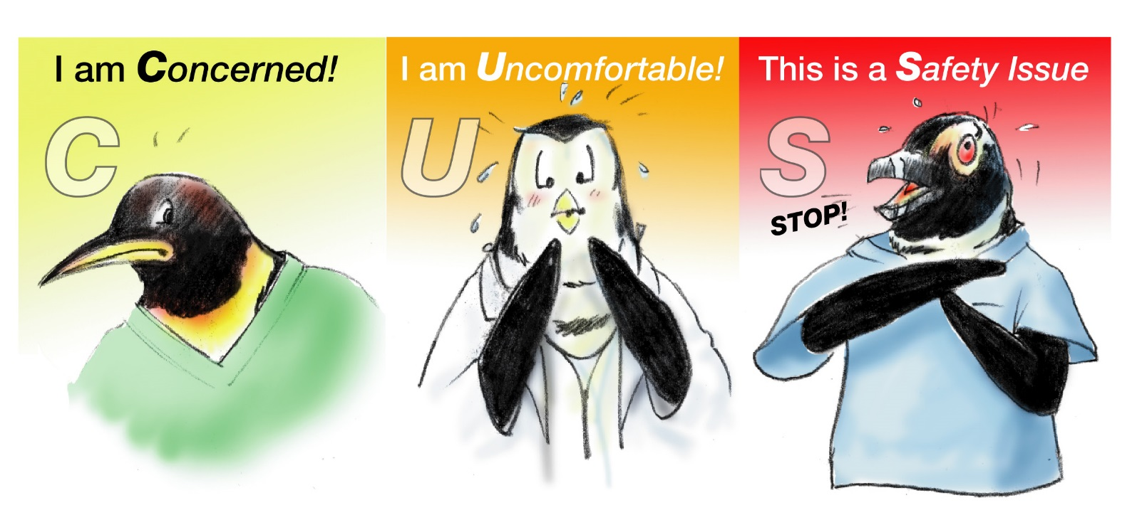
Please Use CUS Words but only when appropriate!

Slide 38
Review of SKILLS
100-Level Skills | 200-Level Skills | 300-Level Skills
Request Call-Out Cross-Check Check-Back SBAR Brief | Huddle Debrief Handoff Cross-Monitoring STEP Task Assistance Shared Mental Model | CUS Two-Challenge Rule DESC I’M SAFE

Slide 39
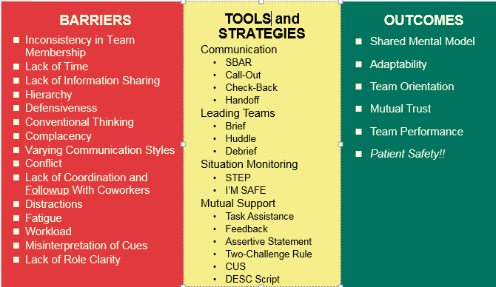
Tools & Strategies Summary
BARRIERS
Inconsistency in Team Membership
Lack of Time
Lack of Information Sharing
Hierarchy
Defensiveness
Conventional Thinking
Complacency
Varying Communication Styles
Conflict
Lack of Coordination and Followup With Coworkers
Distractions
Fatigue
Workload
Misinterpretation of Cues
Lack of Role Clarity
TOOLS and STRATEGIES
  Communication
  SBAR
  Call-Out
  Check-Back
  Handoff
  Leading Teams
  Brief
  Huddle
  Debrief
  Situation Monitoring
  STEP
  I’M SAFE
  Mutual Support
  Task Assistance
  Feedback
  Assertive Statement
  Two-Challenge Rule
  CUS
  DESC Script
OUTCOMES
Shared Mental Model
Adaptability
Team Orientation
Mutual Trust
Team Performance
Patient Safety!!

Slide 40
Thank You!

Slide 41
Contact Information
Ross Ehrmantraut, R.N. – rherma@uw.edu
Megan Sherman, M.A.Ed.H.D. – shermm@uw.edu
Farrah Leland, J.D. – batchel@uw.edu
UW Medicine WISH – 206-598-2710

Slide 42
Questions and Answers
For more information, please contact our team at:
AHRQTeamSTEPPS@aha.org

