Slide 1
Using TeamSTEPPS To Create Change at the Organizational, Team, and Individual Level (Part 2 of 3)
Wednesday, July 12, 2017

Slide 2
Rules of Engagement
Audio for the webinar can be accessed in two ways:
Through the phone (*Please mute your computer speakers)
Through your computer
A Q&A session will be held at the end of the presentation
Written questions are encouraged throughout the presentation and will be answered during the Q&A session
To submit a question, type it into the Chat Area and send it at any time during the presentation

Slide 3
Upcoming TeamSTEPPS Events
Master Training Courses
Registration for courses through September 2017 now open

Slide 4
Help Line (312) 422-2609
Or email: AHRQTeamSTEPPS@aha.org

Slide 5
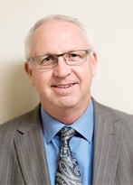
Today’s Presenters
Ross Ehrmantraut, RN, Clinical Director of Team Performance, WISH
Megan Sherman, MAEdHD, Associate Director of WISH
Farrah Leland, JD, Associate Director of WISH

Slide 6
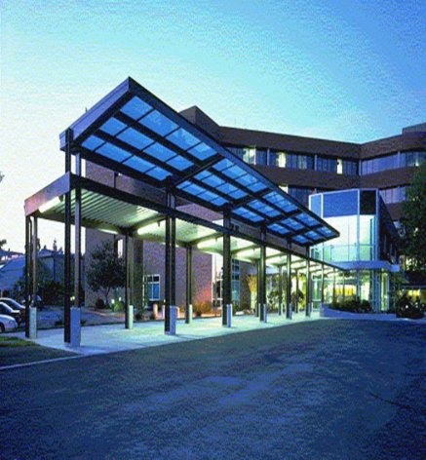
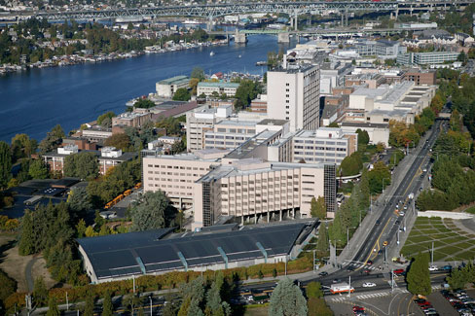
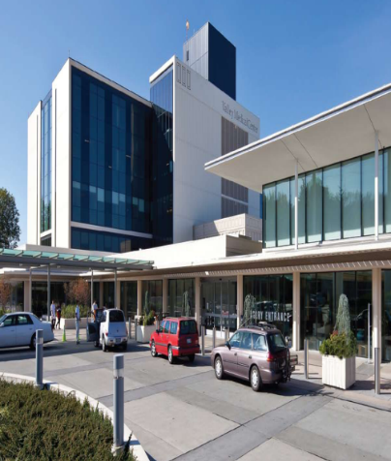
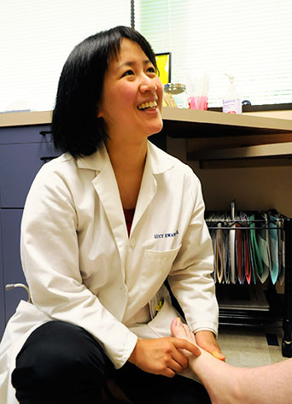
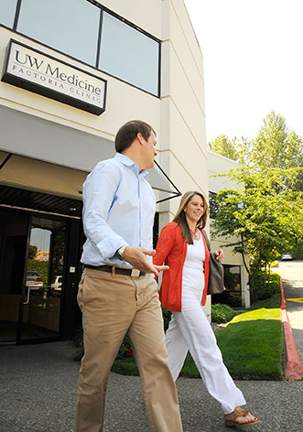
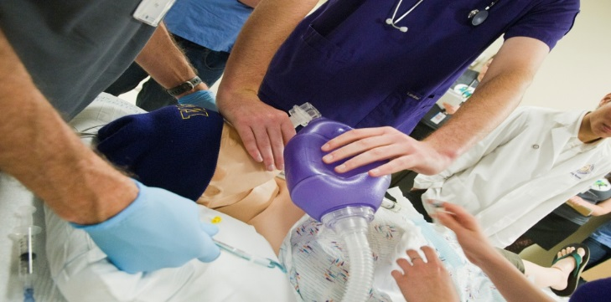
UW Medicine
Notes:
UW Medicine

Slide 7
The University of Washington Medicine
2,400+ faculty members in 30 departments.
4,700+ clinical faculty across WWAMI region.
4,500 students and trainees.
Medical students, residents, fellows
Physician assistants, physical and occupational therapy, medical technologists
PhD students in basic sciences
27,000+ employees

Slide 8
Objectives
Identify and address resistance to change at its source/core level
Understand the difference between ownership and buy-in and why ownership is essential in implementation
Identify opportunities to incorporate models of change at different levels in the organization

Slide 9
Change…
Cross our arms……
Now, cross your arms the other way…..
Notes:
Like all change…it can be new and exciting. Sometimes change is necessary…

Slide 10
TeamSTEPPS
Tools
Change Team
Vision/Mission
Communication
Brief
Huddle
Debrief
Mutual Support
Request
Call-Out
Cross-Check
Check-back
SBAR

Slide 11
Choluteca Bridge – Honduras

Slide 12
Choluteca Bridge – After Hurricane Mitch

Slide 13
How Do We Usually Make Change in an Organization?
We reach for the data:
Business case
Memos
PowerPoints

Slide 14
The Way We Think
Two Independent Systems of our brain
Rational System
Conscious
Deliberative
The human part that analyzes
Emotional System
Unconscious
Automatic
Cannot Resist (Giant Elephant)
Tremendous Imbalance of Power

Slide 15
THREE PART FRAMEWORK FOR CHANGE

Slide 16
Direct the Rider
Rational/Logical Argument
Develop a Destination Postcard
“You’ll be third graders soon”
Find the Bright Spots
Jerry Sternin
Script the Critical Moves
1% Milk

Slide 17
Destination Postcard
Problem Statement:
There is a common disconnect in developing a shared mental model for all cases throughout the day
Destination Postcard:
Implement a morning brief in every OR to plan for entire day in each room
Notes:
ARnold

Slide 18
Direct the Rider
Rational/Logical Argument
Develop a Destination Postcard
“You’ll be third graders soon”
Find the Bright Spots
Jerry Sternin
Script the Critical Moves
1% Milk

Slide 19
Why Do We Resist Change?
Fear
Distrust
Lack of Communication
Fad
Challenges Routine
Initiative Fatigue
Lack of Understanding

Slide 20
Overcoming Resistance
Sources of Resistance
Technical:
“We’ve already spent so much time/money on X.”
Concerns costs associated with creating/implementing change.
Political:
“But the Board told us last year that this is how it should be done.”
Threatens stakeholders or calls into question past decisions of high-ranking personnel
Cultural or Individual:
“This is how we’ve always done it and it works OK.”
Challenges current understanding, processes, job duties and the status quo.

Slide 21
Resistance Audit
Observable Behavior | Often Misread as | Usually Caused by | Resolved through
Delays and excuses | Incompetence or poor attitude | Confusion over roles and /or priorities | Explicit instructions and proactive management of competing commitments
Obsessive questioning and need for hand-holding | Reluctance or skepticism | Cognitive overload and/or pace of change | Adapt to strength for better fit
Errors | Lack of engagement | Role confusion and/or immature team infrastructure | Role clarity and cross-functional agreement's
Derailing or acting out | Resisting the change itself | Style conflict and/or excessive complexity | Candid feedback Mentoring/coaching

Slide 22
Motivate the Elephant
Emotional/Visceral Argument
Find the Feeling
Chemo Videogame
Shrink the Change
5 Min Room Rescue
Grow Your People
Improved Employee
Satisfaction

Slide 23
Shape the Path
Make the RIGHT Thing the EASY Thing to do
Tweak the Environment
Airplane bathrooms
Build Habits
Checklists, Action-Triggers
Rally the Herd
Seeding Tip Jars
Hotel Towels

Slide 24
S
W
I
T
C
H
F
r
a
m
e
w
o
r
k
D
i
r
e
c
t
t
h
e
R
i
d
e
r
•
S
t
r
a
t
e
g
y
:
D
e
s
t
i
n
a
t
i
o
n
P
o
s
t
c
a
r
d
P
e
o
p
l
e
n
e
e
d
t
o
k
n
o
w
w
h
e
r
e
y
o
u
a
r
e
g
o
i
n
g
,
a
n
d
w
h
y
i
t
w
i
l
l
b
e
n
e
f
i
t
t
h
e
m
.
•
S
t
r
a
t
e
g
y
:
S
c
r
i
p
t
t
h
e
C
r
i
t
i
c
a
l
M
o
v
e
s
B
e
c
l
e
a
r
a
b
o
u
t
h
o
w
p
e
o
p
l
e
s
h
o
u
l
d
a
c
t
;
w
h
a
t
a
r
e
k
e
y
,
s
p
e
c
i
f
i
c
b
e
h
a
v
i
o
r
s
t
h
e
y
c
a
n
t
a
k
e
?
•
S
t
r
a
t
e
g
y
:
F
i
n
d
t
h
e
B
r
i
g
h
t
S
p
o
t
s
E
x
p
l
o
r
e
w
h
a
t
i
s
w
o
r
k
i
n
g
a
n
d
d
e
t
e
r
m
i
n
e
h
o
w
t
o
d
o
m
o
r
e
o
f
i
t
.
M
o
t
i
v
a
t
e
t
h
e
E
l
e
p
h
a
n
t
•
S
t
r
a
t
e
g
y
:
F
i
n
d
t
h
e
F
e
e
l
i
n
g
T
a
p
i
n
t
o
p
e
o
p
l
e
’
s
e
m
o
t
i
o
n
;
s
h
o
w
i
n
g
t
h
e
m
s
o
m
e
t
h
i
n
g
(
i
.
e
.
a
n
i
m
a
g
e
)
i
s
b
e
t
t
e
r
t
h
a
r
n
e
a
d
i
n
g
i
t
.
•
S
t
r
a
t
e
g
y
:
S
h
r
i
n
k
t
h
e
C
h
a
n
g
e
B
r
e
a
k
t
h
i
n
g
s
d
o
w
n
i
n
t
o
s
m
a
l
l
e
r
c
h
u
n
k
s
s
o
f
o
l
k
s
d
o
n
’
t
f
e
e
l
o
v
e
r
w
h
e
l
m
e
d
.
•
S
t
r
a
t
e
g
y
:
G
r
o
w
y
o
u
r
P
e
o
p
l
e
C
r
e
a
t
e
a
s
e
n
s
e
o
f
t
e
a
m
i
d
e
n
t
i
t
y
a
n
d
f
o
s
t
e
r
a
g
r
o
w
t
h
m
i
n
d
s
e
t
.
S
h
a
p
e
t
h
e
P
a
t
h
•
S
t
r
a
t
e
g
y
:
T
w
e
a
k
t
h
e
E
n
v
i
r
o
n
m
e
n
t
W
h
a
t
s
m
a
l
l
c
h
a
n
g
e
s
c
a
n
p
e
o
p
l
e
t
r
y
t
o
m
a
k
e
t
h
i
n
g
s
b
e
t
t
e
r
o
r
e
a
s
i
e
r
?
•
S
t
r
a
t
e
g
y
:
B
u
i
l
d
H
a
b
i
t
s
E
s
t
a
b
l
i
s
h
“
a
c
t
i
o
n
t
r
i
g
g
e
r
s
”
t
o
h
e
l
p
k
e
e
p
y
o
u
(
a
n
d
o
t
h
e
r
s
)
o
n
t
r
a
c
k
a
n
d
a
c
c
o
u
n
t
a
b
l
e
.
•
S
t
r
a
t
e
g
y
:
R
a
l
l
y
t
h
e
H
e
r
d
C
a
l
l
o
u
t
a
n
d
e
m
p
h
a
s
i
z
e
e
a
r
l
y
s
u
c
c
e
s
s
e
s
;
l
e
v
e
r
a
g
e
s
o
c
i
a
l
/
p
e
e
r
p
r
e
s
s
u
r
e
t
o
h
e
l
p
d
r
i
v
c
e
h
a
n
g
e
.
So
u
r
c
e
:
S
w
i
t
c
h
:
H
o
w
t
o
C
h
a
n
g
e
T
h
i
n
g
s
W
h
e
n
C
h
a
n
g
e
i
s
H
a
r
d
C
h
,
i
p
a
n
d
D
a
n
H
e
a
t
h
,
2
0
1
0
U
W
r
g
a
n
i
z
a
t
i
o
n
a
l
D
e
v
e
l
o
p
m
e
n
t
a
n
d
T
r
a
i
n
i
n
g
Notes:
SWITCH Framework
Direct the Rider:
Strategy: Destination Postcard – People need to know where you are going and why it will benefit them.
Strategy: Script the Critical Moves – Be clear about how people should act; what are key, specific behaviors they can take.
Strategy: Find the Bright Spots – Explore what is working and determine how to do more of it.
Motivate the Elephant
Strategy: Find the Feeling – Tap into people’s emotion; showing them something is better than reading it.
Strategy: Shrink the Change – Break things down into smaller chunks so folks don’t feel overwhelmed.
Strategy: Grow your People – Create a sense of team identity and fost a growth mindset.
Shape the Path
Strategy: Tweak the Environment – What small changes can people try to make things better or easier?
Strategy: Build Habits – Establish ‘actions triggers’ to help keep you (and others) on track and accountable.
Strategy: Rally the Herd – Call out and emphasize early successes; leverage social/peer pressure to help drive change.

Slide 25
Change is Not Easy
If you want change, failure is part of the deal
Not failure of the mission, but failure in route.

Slide 26
Contact Information
Ross Ehrmantraut, RN – rherma@uw.edu
Megan Sherman, MAEdHD – shermm@uw.edu
Farrah Leland, JD – batchel@uw.edu
UW Medicine WISH – 206-598-2710

Slide 27
Questions and Answers
For more information, please contact our team at:
AHRQTeamSTEPPS@aha.org

Slide 28
Thank You!
Notes:
Thank you!

