Slide 1
Maintaining the Gains of The TeamSTEPPS Program (Part 3 of 3)
Wednesday, September 13, 2017

Slide 2
Rules of Engagement
Audio for the webinar can be accessed in two ways:
Through the phone (*Please mute your computer speakers)
Through your computer
A Q&A session will be held at the end of the presentation
Written questions are encouraged throughout the presentation and will be answered during the Q&A session
To submit a question, type it into the Chat Area and send it at any time during the presentation

Slide 3
Help Line (312) 422-2609
Or email: AHRQTeamSTEPPS@aha.org

Slide 4
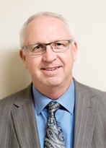
Today’s Presenters
Ross Ehrmantraut, RN, Clinical Director of Team Performance, WISH
Megan Sherman, MAEdHD, Associate Director of WISH
Farrah Leland, JD, Associate Director of WISH

Slide 5
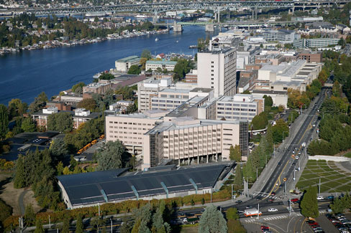
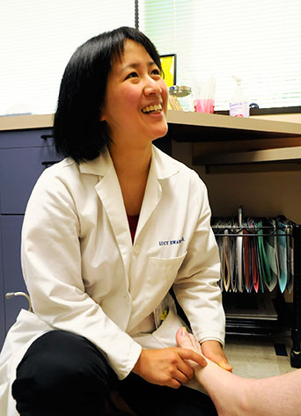
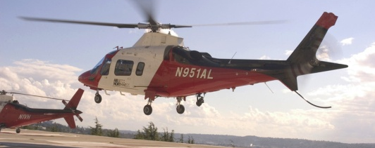
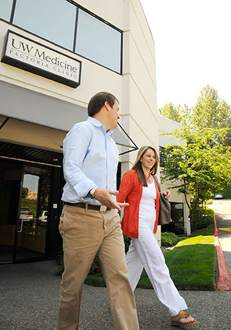
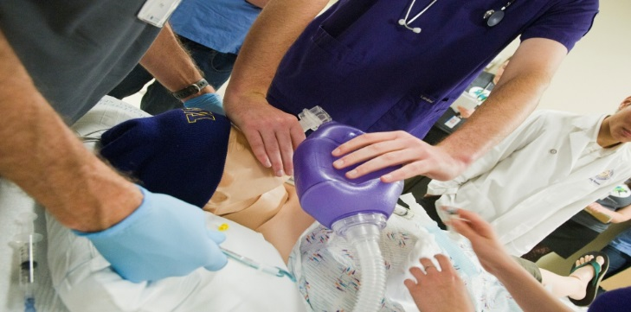
UW Medicine

Slide 6
UW Medicine Community
2,400 faculty members in 30 departments
4,700 clinical faculty across WWAMI region
4,500 students and trainees
Medical students, residents, fellows
Schools of Nursing
Pharmacy, PA, Rehab Therapies, RT
Other Ancillary Health Sciences Schools
27,000+ employees

Slide 7
Objectives
Identify bright spots in the implementation process and how to leverage those bright spots
Understand the need to evaluate the process frequently and adjust the plan as needed
Understand the importance of celebrating short-term wins and being transparent with process measures to maintain momentum

Slide 8
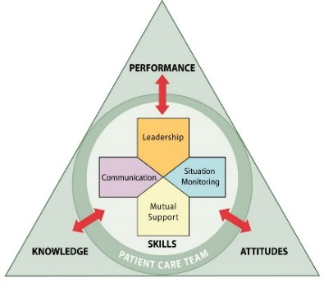
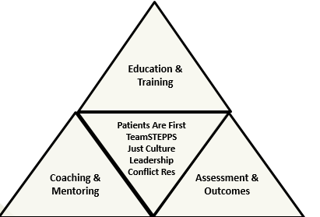
TeamCORE
Changing And Sustaining the Culture
Team Collaboration for Organizational Excellence
TeamSTEPPS
TeamCORE
Education & Training
Patients Are First
TeamSTEPPS
Just Culture
Leadership
Conflict Res
Coaching & Mentoring
Assessment & Outcomes

Slide 9
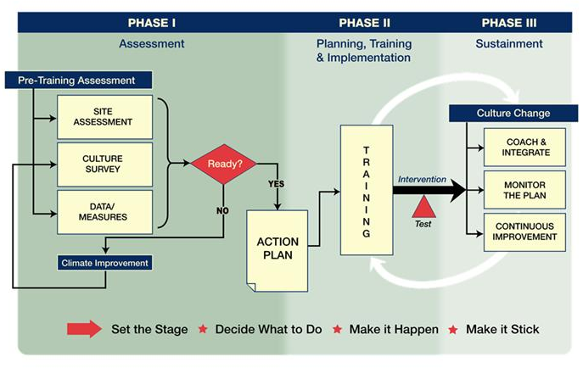
Shift Toward a Culture of Safety

Slide 10
UW Medicine TeamCORE
Ongoing Coaching and Role Modeling for Change Team Leaders
Pre-Training Assessment
Assessment
Leading Change
TeamSTEPPS Generic
Targeted Training
Curriculum/Skill Building
Site Assessment
Team Perceptions
Annual Culture of Safety
HCAHPS - Satisfaction
Core Measures
Incident Reports
Adverse Events
Switch Model
Fundamentals of TeamSTEPPS
Simulation
Involve Pt. Advisory
Formation of Change Team
Action Planning
First interventions
Introduction to Coaching
Identify Coaches and Leaders
Combined 2-8 Hours
Phase 1
Phase 2
Phase 3

Slide 11
Switch Model
Direct the Rider
Develop a Destination Postcard
Change is easier when you know where you are going and why it’s worth it
What looks like resistance is often lack of clarity
Find the Bright Spots
Investigate what’s working and clone
Script the Critical Moves
Don’t think big picture, think in terms of specific behaviors
Motivate the Elephant
Find the Feeling
Knowing something isn’t enough to cause change; make people feel something
Shrink the Change
Break down the change until it no longer spooks the elephant
Grow Your People
Cultivate a sense of identity and instill the growth mindset
Shape the Path
Tweak the Environment
When the situation changes, the behavior changes, so change the situation
Build Habits
When behavior is habitual, it’s “free” – it doesn’t tax the rider
Rally the Herd
Behavior is contagious - Help it spread
Source: Switch: How to Change Things When Change is Hard, Chip and Dan Heath, 2010

Slide 12
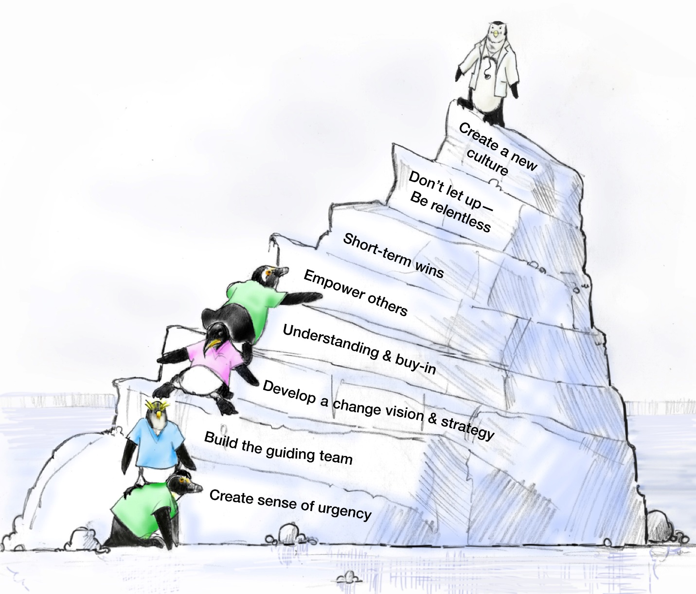
Kotter 8 Steps of Change for an Organization
Grounds The Change
In New Culture To
Ensure Sustainability
Introduces
New Practices
Unfreezes The
Status Quo

Slide 13
TeamSTEPPS Tools by Skill Level
100-Level Skills | 200-Level Skills | 300-Level Skills
Request Call-Out Cross-Check Check-Back SBAR Brief | Huddle Debrief Handoff Cross-Monitoring STEP Task Assistance Shared Mental Model | CUS Two-Challenge Rule DESC I’M SAFE

Slide 14
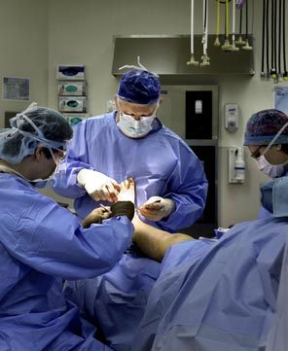
Surgical Services
25 Operating Rooms
11 Service lines
Pre/Post Anesthesia Care Unit
Central Processing Unit
Pre-Anesthesia Clinic
Ambulatory Surgery Pre-op area

Slide 15
10 Steps of Implementation Planning
Create a Change Team
Define the problem, challenge, or opportunity for improvement
Define the aim(s) of your TeamSTEPPS intervention
Design a TeamSTEPPS intervention
Develop a plan for testing the effectiveness of your TeamSTEPPS intervention
Develop an implementation plan
Develop a plan for sustained continuous improvement
Develop a communications plan
Develop a TeamSTEPPS Implementation Plan timeline
Review your TeamSTEPPS Implementation Plan with key stakeholders and modify according to input
https://www.ahrq.gov/teamstepps/instructor/essentials/implguide.html

Slide 16
Interprofessional Change Team
Surgeons
Anesthesiologists
CRNAs
RNs/STs
EVS
Radiology
PACU
CPU
Developed a 30/60/90 day plan in second meeting

Slide 17
Destination Postcard
Problem Statement:
There is a common disconnect in developing a shared mental model for all cases throughout the day
Destination Postcard:
Implement a morning brief in every OR to plan for entire day in each room

Slide 18
10 Steps of Implementation Planning
Create a Change Team
Define the problem, challenge, or opportunity for improvement
Define the aim(s) of your TeamSTEPPS intervention
Design a TeamSTEPPS intervention
Develop a plan for testing the effectiveness of your TeamSTEPPS intervention
Develop an implementation plan
Develop a plan for sustained continuous improvement
Develop a communications plan
Develop a TeamSTEPPS Implementation Plan timeline
Review your TeamSTEPPS Implementation Plan with key stakeholders and modify according to input
https://www.ahrq.gov/teamstepps/instructor/essentials/implguide.html

Slide 19
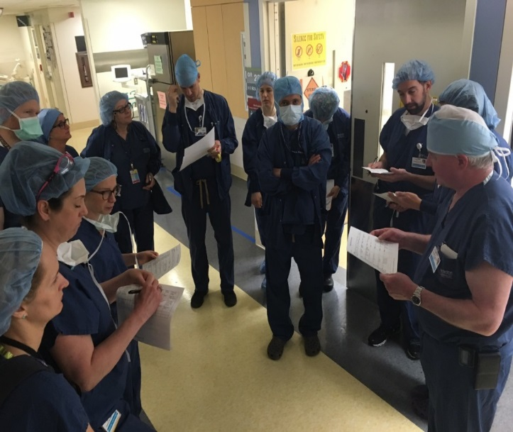
A Small Test of Change
Brief Pilot – three surgeons implemented the morning brief
September 2016
Tested the form designed by change team
Tracked:
Time to do the brief
First case start time
How often brief was done
Attendees
Significant information learned
Expanded to 16 general surgeons – November 2016

Slide 20
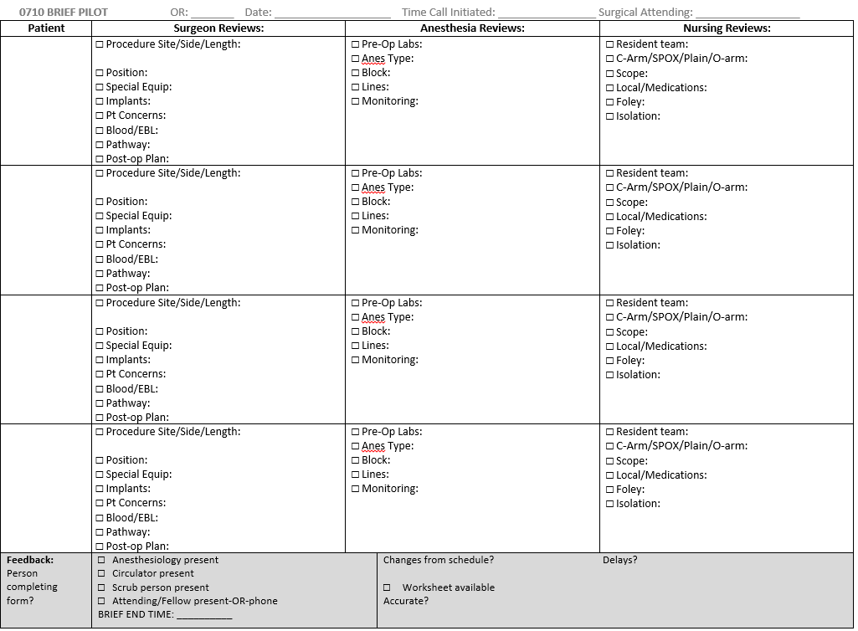

Slide 21
Brief Implementation
I

Slide 22
Brief Implementation
New information was noted in 91% of briefs during early stages of pilot, which provided early motivation to do it.

Slide 23
10 Steps of Implementation Planning
Create a Change Team
Define the problem, challenge, or opportunity for improvement
Define the aim(s) of your TeamSTEPPS intervention
Design a TeamSTEPPS intervention
Develop a plan for testing the effectiveness of your TeamSTEPPS intervention
Develop an implementation plan
Develop a plan for sustained continuous improvement
Develop a communications plan
Develop a TeamSTEPPS Implementation Plan timeline
Review your TeamSTEPPS Implementation Plan with key stakeholders and modify according to input
https://www.ahrq.gov/teamstepps/instructor/essentials/implguide.html

Slide 24
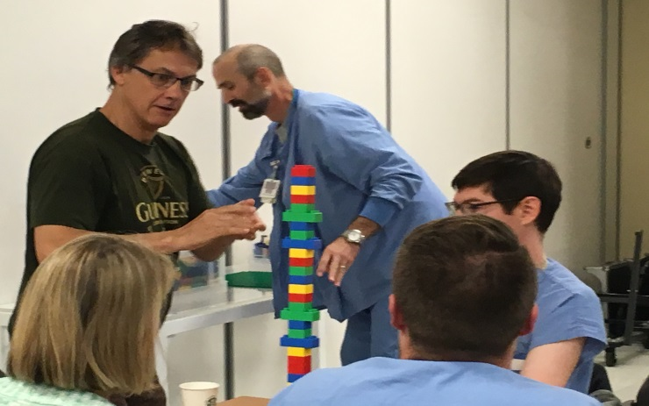
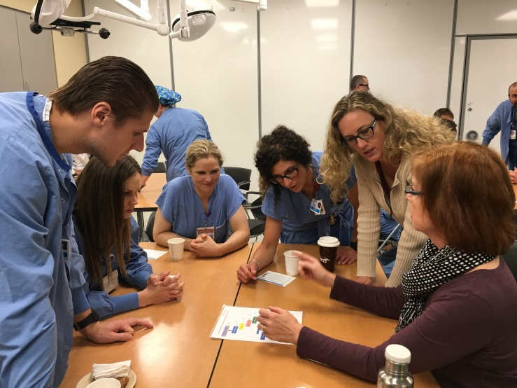
Training Plan
Oversight Committee/Change Team started meeting in July 2015
TPQ administered in September 2015
Safety Summit 2015 and 2016
Pilot teams shared their thoughts on experience with brief
Innovative training plan – August 2016-January 2017
TeamSTEPPS fundamentals training
Discussion on how to implement brief
Introduced morning briefs in the OR
Complete rollout of briefs – January 2017

Slide 25
10 Steps of Implementation Planning
Create a Change Team
Define the problem, challenge, or opportunity for improvement
Define the aim(s) of your TeamSTEPPS intervention
Design a TeamSTEPPS intervention
Develop a plan for testing the effectiveness of your TeamSTEPPS intervention
Develop an implementation plan
Develop a plan for sustained continuous improvement
Develop a communications plan
Develop a TeamSTEPPS Implementation Plan timeline
Review your TeamSTEPPS Implementation Plan with key stakeholders and modify according to input
https://www.ahrq.gov/teamstepps/instructor/essentials/implguide.html

Slide 26
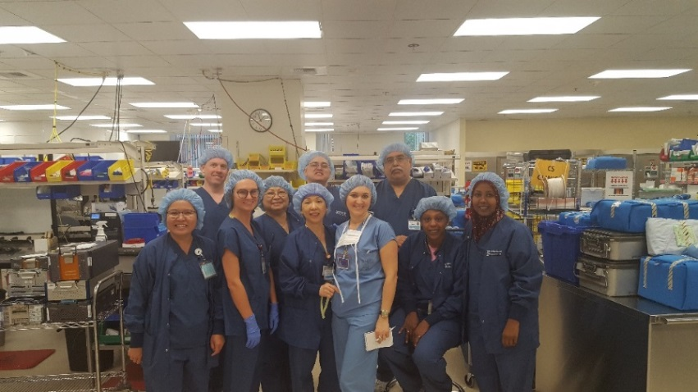
Bright Spots
No delay in first case start times
Important information noted 91% of pilot, and 70% once implemented
Mostly positive anecdotal comments
Sterile processing better informed
Presented at national conferences
Shared results:
Every Wednesday at staff inservice
Updated surgical council monthly
Discussed in grand rounds
Patient Safety Committee
We tend to want to focus on why something won’t work – TBU – Let’s focus on how it will work

Slide 27
Addressing Challenges
New hires
Ways to address resisters
Need to acknowledge resisters
Concerns about competing priorities
Top-down push
Concerns about delaying cases
Timing of brief difficult
Changed the time to 7:00

Slide 28
Resistance Audit
Observable Behavior | Often Misread as | Usually Caused by | Resolved Through
Delays and excuses | Incompetence or poor attitude | Confusion over roles and/or priorities | Explicit instructions and proactive management of competing commitments
Obsessive questioning and need for hand holding | Reluctance or skepticism | Cognitive overload and/or pace of change | Adapt to strength for better fit
Errors | Lack of engagement | Role confusion and/or immature team infrastructure | Role clarity and cross-functional agreements
Derailing or acting out | Resisting the change itself | Style conflict and/or excessive complexity | Candid feedback Mentoring/coaching

Slide 29
10 Steps of Implementation Planning
Create a Change Team
Define the problem, challenge, or opportunity for improvement
Define the aim(s) of your TeamSTEPPS intervention
Design a TeamSTEPPS intervention
Develop a plan for testing the effectiveness of your TeamSTEPPS intervention
Develop an implementation plan
Develop a plan for sustained continuous improvement
Develop a communications plan
Develop a TeamSTEPPS Implementation Plan timeline
Review your TeamSTEPPS Implementation Plan with key stakeholders and modify according to input
https://www.ahrq.gov/teamstepps/instructor/essentials/implguide.html

Slide 30
Ongoing Evaluation and Next Steps
Monthly change team meetings to review progress – briefs are occurring 80% of the time
Start times changed
Additional measures of success
Followup TPQ in October 2017
Simulations of intraoperative emergencies
In situ simulations of mock codes and other emergencies

Slide 31
Implementation in a ChildBirth Center

Slide 32
Childbirth Center
Interprofessional Change Team
Developed 4-hour training sessions
Conducted 12 sessions
Incorporated Leading Change into training
Initial tools:
Briefs
Huddles
CUS
Closed-Loop Communication

Slide 33
Sustaining the Momentum
Continued monthly Change Team meetings
Incorporated TeamSTEPPS tools into the evaluation of emergency bleeding simulations
Holding quarterly training courses for new staff and doctors
Acknowledging top performers

Slide 34
Team Perception Questionnaire

Slide 35
Team Perception Questionnaire

Slide 36
Team Perception Questionnaire

Slide 37
Team Perception Questionnaire

Slide 38
Key Factors in Implementation Planning
Develop a 30/60/90 Day Plan with Change Team – continues to evolve
Job #1 – Develop a Destination Postcard
Consider:
Reframing
Change Models
Switch
Kotter
Influencer
Ownership vs. Buy-in

Slide 39
Key Factors in Implementation Planning, continued
Don’t declare victory too soon
Continue to meet on a regular basis to maintain momentum
Hold ongoing training for new hires
Eventually, it will be “just the way we do business”
Start small – one to three tools to begin
A systematic approach to achieve early success

Slide 40
Contact Information
Ross Ehrmantraut, RN – rherma@uw.edu
Megan Sherman, MAEdHD – shermm@uw.edu
Farrah Leland, JD – batchel@uw.edu
UW Medicine WISH – 206-598-2710

Slide 41
Questions and Answers
For more information, please contact our team at:
AHRQTeamSTEPPS@aha.org

Slide 42
Thank You!

