Slide 1
Brain Based Learning Strategies to Improve TeamSTEPPS® Deployment and Health Care High Reliability January 11, 2017

Slide 2
Rules of Engagement
Audio for the webinar can be accessed in two ways:
Through the phone (*Please mute your computer speakers)
Through your computer
A Q&A session will be held at the end of the presentation
Written questions are encouraged throughout the presentation and will be answered during the Q&A session
To submit a question, type it into the Chat Area and send it at any time during the presentation

Slide 3
Upcoming TeamSTEPPS Events
Master Training Courses
Registration for courses in January-March 2017 now open
Registration opening on January 18 for courses in April-June 2017
National Conference
June 14-16, 2017
Downtown Hilton, Cleveland, OH
Registration open
Call for Webinar Presenters
Apply here to present on March 8, April 12, or May 10

Slide 4
Contact Us
Phone: 312-422-2652
Email: AHRQTeamSTEPPS@aha.org
Web Site: https://www.ahrq.gov/teamstepps/index.html

Slide 5
Today’s Presenter
Oren Guttman, MD, MBA, CHSE
Director for Multi-Disciplinary Team Training
UT Southwestern Medical Center
oren.guttman@utsouthwestern.edu

Slide 6
Brain Based Learning Strategies to Improve TeamSTEPPS Deployment and Health Care High Reliability
Oren Guttman, MD, MBA, CHSE
Director for Multi-Disciplinary Team Training
UT Southwestern Medical Center
oren.guttman@utsouthwestern.edu

Slide 7
Hello From UTSW

Slide 8
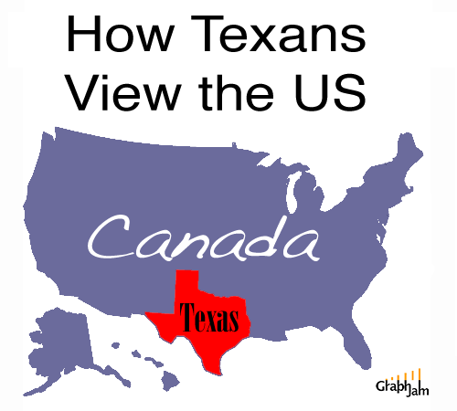
Texan Thinking…

Slide 9
Disclosures
None

Slide 10
Learning Objectives
Demonstrate specific brain based strategies to engage participant in new initiatives (K1 Reactions)
Review how to leverage our current understanding of the human cognitive architecture to improve learning (K2 Learning)
Understand the psychobiology of social influence in human choice (K3 Behavioral Change)

Slide 11
Brain Based Culture Change
The strategy of leveraging our current understanding of human cognitive architecture to design more successful change paradigms

Slide 12
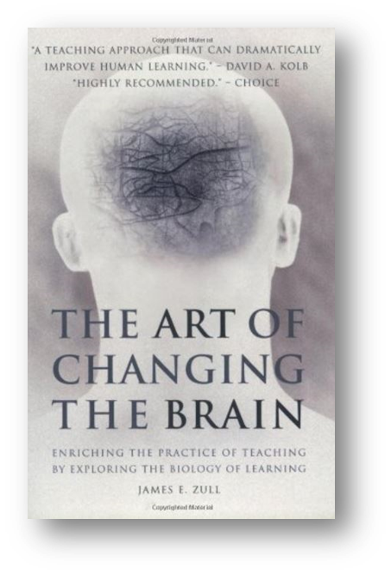
Brain Based Learning Theory
“The Art of Changing the Brain.”
-James Zull
Zull, J. 2002. The art of Changing the Brain. Stylus, Sterling, VA.

Slide 13
Most Great Ideas Strike Out!

Slide 14
How will this one be different?

Slide 15
Effective Training (Kirkpatrick Ladder)
Impact/Results
K4-End Points
THEN…
Embedding New Paradigms
Actions
K3-Behavior
HOW,IF
Thoughts
K2-Learning
WHAT
Emotions
K1-Reaction
WHY
http://www.kirkpatrickpartners.com/OurPhilosophy/tabid/66/Default.aspx

Slide 16
Emotions are More Powerful than Logic
“Reason and Intellect only control individuals after emotion and impulse have lost their impetus…”
Dis-engaged Engaged
Descartes' Error, Antonio Damasio (1994)

Slide 17
Meet John-John…
Heads….
You win $10,000 Cash now
Tails….
You pay me $2,000 Cash now
You have only two choices—you either play or pay $100 cash now to get out of the bet….

Slide 18
Poll the Crowd….

Slide 19
Loss Aversion—preference for certainty
“A Bird in the Hand is better than 2 in the Bush”….
Expected Value=Probability x Pay-off
Scenario 1—Play the Game:
Heads EV= 0.5 x $10,000= $5,000
Tails EV= 0.5 x -$2,000= -$1,000
TOTAL EV= +$4,000.
Scenario 2—Don’t Play the Game:
Total EV= 1 x $100= -$100.
It hurts more to loose than it does to win…..

Slide 20
4 Primal Emotions

Slide 21
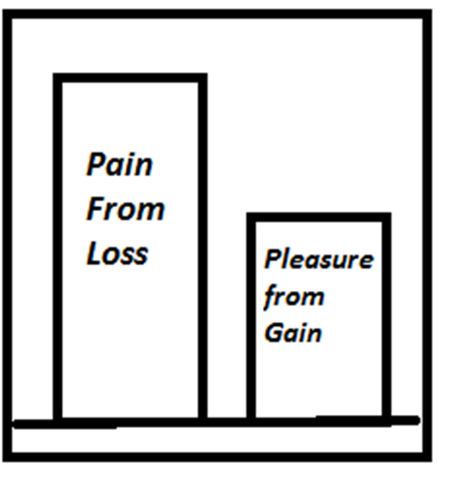
Loss Aversion—Avoiding Emotional Pain
Higgins, E. T. 1997. Beyond pleasure and pain. American Psychologist, 52: 1280-1300.

Slide 22
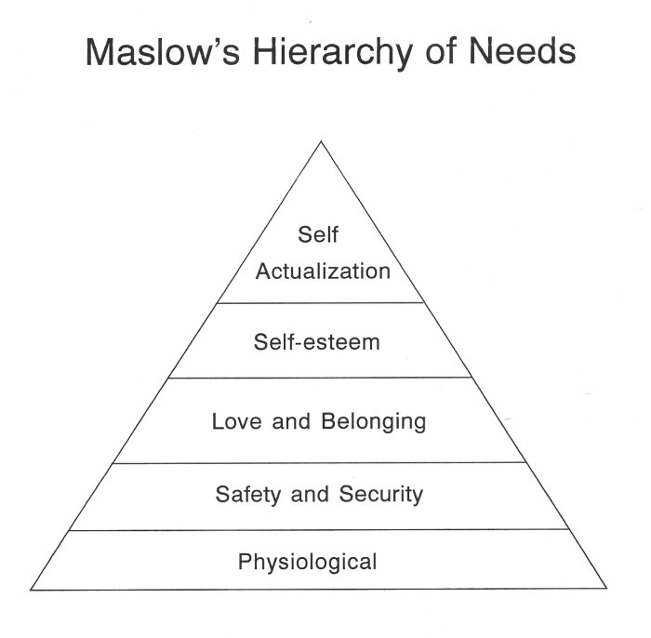
De-motivators can be more powerful than Motivators
meaningful day, autonomy, empowerment
Motivators
Respect, Positive Feedback, Recognition
Joy at work, belonging, climate, collaboration
De-Motivators
Job security/stability, Financial Loss, Benefits
Work conditions/hrs/work-life balance

Slide 23
Power of Framing…
They showed a video of a car crash to 100 college students and asked..
How Fast were the cars going when they bumped into each other?

Slide 24
Power of Framing…
They then showed the same video of a car crash to a different 100 college students and asked..
How Fast were the cars going when they smashed into each other?

Slide 25
Power of Framing…
The group primed with Smashed estimated a 9 mi per hour faster estimate than Bumped.
Do you recall glass breaking in the video?
**THERE WAS NO GLASS BREAKING IN THE VIDEO**
Bumped Group said “yes” 14% of the time.
Smashed Group said “Yes” 32% of the time.

Slide 26
The Power of Positive Framing
“This study asked 167 subjects to imagine they had lung cancer, half were told:
“of 100 people having surgery, 10 will die during surgery,
32 will have died by one year, and 66 will have died by five years.”
“of 100 people having radiation therapy, none will have died during treatment, 23 will die by one year. And 78 will die by five years.”
50% Surgery
50% Radiation
Study reported in NEMJ V. 306 #21, 1982

Slide 27
The Power of Positive Framing
“This study asked 167 subjects to imagine they had lung cancer, half were told:
“of 100 people having surgery, 10 will die during surgery,
32 will have died by one year, and 66 will have died by five years.”
“of 100 people having radiation therapy, none will have died during treatment, 23 will die by one year. And 78 will die by five years.”
physicians
90 will survive the
68 will survive past
34 will survive past
all will survive the
77 will survive past
22 will survive past
50% Surgery
50% Radiation
84% Surgery
16% Radiation
Change of 34%
Study reported in NEMJ V. 306 #21, 1982

Slide 28
Take Home Point—Remove De-motivators and Frame Positively
Avoid Loss Aversion and Emotional Reasoning:
State with transparency why the initiative is being done and announce it openly
Expel myths about loss (sadness, fear) and quite hallway talk about false reasons why the initiative is being done (anger)
Utilize Positive Framing:
Frame the challenge being addressed as an opportunity to “win” not only at the organizational level, but at the individual employee level.
Be ready to answer “what is in it for me”? What tangible benefit/win will the employee get for engagement?
Anticipate the concerns of the employee and speak out potential questions and solutions?

Slide 29
Effective Training (Kirkpatrick Ladder)
Impact/Results
K4-End Points
THEN…
Actions
K3-Behavior
HOW,IF
Embedding New Paradigms
Thoughts
K2-Learning
WHAT
Emotions
K1-Reaction
WHY
http://www.kirkpatrickpartners.com/OurPhilosophy/tabid/66/Default.aspx

Slide 30
What is Successful Learning?
Successful Information Processing:
Encoding and Storage (Left Prefrontal Cortex)
Retention and Retrieval (Right Prefrontal Cortex)
Understanding
Evaluation and Extrapolate
Integration and Application
Projection

Slide 31
Brain Based Learning
3 Critical Features Needed to Optimize Learning:
Engaging Sensorium→ Orchestrated Immersion
Activate your Emotions→ Relaxed Alertness
Enable Deliberate Mindfulness→ Active Processing
Caine, G. & Caine, R. Making connections: Teaching and the human brain. Addison-Wesley. 1994

Slide 32
Goal of Orchestrated Immersion → Episodic Memory
Goal of Orchestrated Immersion is to create Episodic Memory.
Memory is centered on the details of personal experience (sensory and emotional experiences)
Context (e.g. the situation) and Content (i.e. what was done or learned) are linked together.
Holistic approach to understanding encoding, storage, and retrieval of information
Formed by medial temporal lobe ‘binds together’ the various neurological traces of an episode.
Tulving E. Precis of elements of episodic memory. Behav Brain Sci 1984;7:223-68

Slide 33
Seductive Detail Effect
What is this?
When information is introduced to learners that is interesting but unrelated to the learning objectives (John Dewey,1913).
Text, Photos, illustrations, sounds, music, etc…
Why is this done?
A common way to try and increase your learner engagement, by interweaving small/short pieces of anectodal information to make the educational material more interesting.
Why does this matter?
Park CS. et al SSIH, 2014. Vol. 9, Number 2, Pg. 85-93

Slide 34
Seductive Detail Effect
These details represent an extraneous Cognitive Load and tax on short term memory
Results:
Diminish Acquisition and Transfer of Learning:
Particularly true for High Load Complex Procedural Tasks (i.e. initial acquisition of Laparoscopic Surgery Skills)
Particularly true when placed at the beginning of a lesson
Reduce Metacognition (self assessment of learning)
Improves motivation in low load situations
Gardner AK. Surgery. 2016 Sep;160(3):580-5.
Harp et al. J of Educ Psychology, Vol 90(3), Sept 1988, Pg 414-434.
Park, B. et al. Computers in Human Behavior. 44: 267–278. (March 2015).

Slide 35
Relaxed Alertness--Cortex and Brainstem
Rostral Brain (amygdala) Hijacking of the Cortex, “Downshifting”
Hart, L. (1983). Human brain, human learning. New York, NY: Longman.

Slide 36
Relaxed Alertness
Cortical Engagement, Executive Function, and Long Term Memory formation are inhibited by perception of threat.
Jensen, E. 1996, Brain-based learning. Del Mar, CA: Turning Point Publishing

Slide 37
Relaxed Alertness
Too Much Stress, No Cortex Engagement, No learning
Not Enough Stress, No hippocampus activation, no long term memory “Episidic Memory formation”
Acute Stress
Hart, L. 1983. Human Brain, human learning. Longman: NY.

Slide 38
Fear of Making Mistakes/Errors
Dror I. Medical Teacher, 2011, 33:1, 34-38

Slide 39
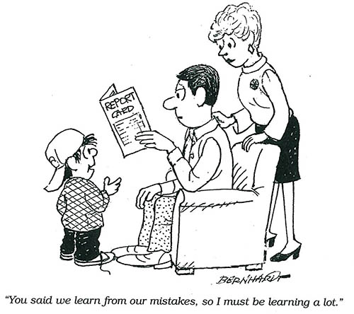
Frame Errors Positively
Dror I. Medical Teacher, 2011, 33:1, 34-38

Slide 40
Error Management Theory
Learning Strategy that promises to improve long term retention, emotional resiliency, contextualization of learning.
Rather than avoid errors, learners are asked to embrace errors as part of the initial events of learning
learners are asked to understand what “wrong is”, or identify errors, error detection, and how best to manage the error, or error recovery.
Dror I. Medical Teacher, 2011, 33:1, 34-38

Slide 41
Error Management Learning Paradigm
Error Recovery
Subtle Errors
(Self)
Obvious Errors
(Self)
Subtle Errors
(Others)
Obvious Errors
(Others)
Dror I. Medical Teacher, 2011, 33:1, 34-38

Slide 42
Error Management Theory
Phase 1– Obvious Error Detection in Others (misattribution theory)
Interactive Videos, Simulations, Gaming which highlight embedded key errors
Learner plays an active role in detecting as many errors as they can
Learners get positive encouragement and reinforcement when an error is detected
Initially errors can be exaggerated (i.e. caricature effect) to enable their discovery
Phase 2—Subtle Error Detection in Others
As learner skill in error detection progresses, the errors are progressively introduced with increasing complexity and subtleness.
when errors are not detected, Learners get more information on how to detect them.
all errors need to be represented—slips, errors, mistakes
Dror I. Medical Teacher, 2011, 33:1, 34-38

Slide 43
Error Management Theory
Phase 3—Obvious Self Error Detection
Learners train in how to detect their own errors
Phase 4—Subtle Self Error Detection
Creative ways to introduce errors are necessary
Competition among learners (total number)
Speed of recognition
Sabotage
Distraction
Time Pressure
Dror I. Medical Teacher, 2011, 33:1, 34-38

Slide 44
Error Management Theory
Phase 5—Error Recovery
When an error is detected, an appropriate protocol is offered to the learner, highlighting how to recover
As complexity is increased, a list of possible interventions is offered to the learner
Next, not only is a list of possible interventions offered, but within an intervention, the learner is asked to identify the correct prioritization and sequencing of steps for recovery.
Finally, the learner is asked to generate the recovery actions themselves.
Dror I. Medical Teacher, 2011, 33:1, 34-38

Slide 45
Error Management Theory
Study looking at Central Venous Annulation (IJ, SC lines) Skill Retention in surgical interns (n=30)
Instructional videos (correct only vs correct + error)
Practiced for 30 min. c validated checklist
Tested 30 days later on Femoral line Placement
Gardner AK. et al. J Surg Educ. 2015 Nov-Dec;72(6):e158-62.

Slide 46
Error Management Theory
Retention is Improved
Transfer is Improved
Gardner AK. et al. J Surg Educ. 2015 Nov-Dec;72(6):e158-62.

Slide 47
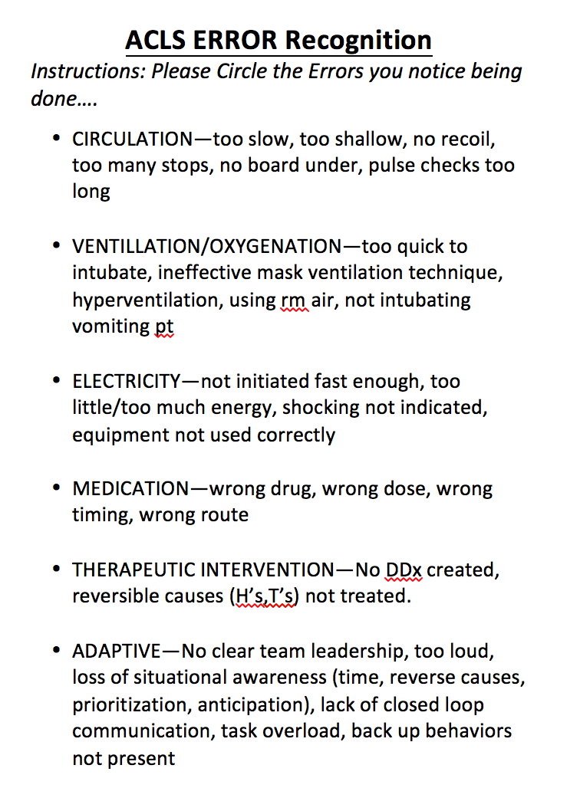
EMT and In-Situ Simulation
Study the paper (Prime)
Watch a live Terrible code
Debrief by calling out errors seen
Actual simulation
Team A debriefs Team B

Slide 48
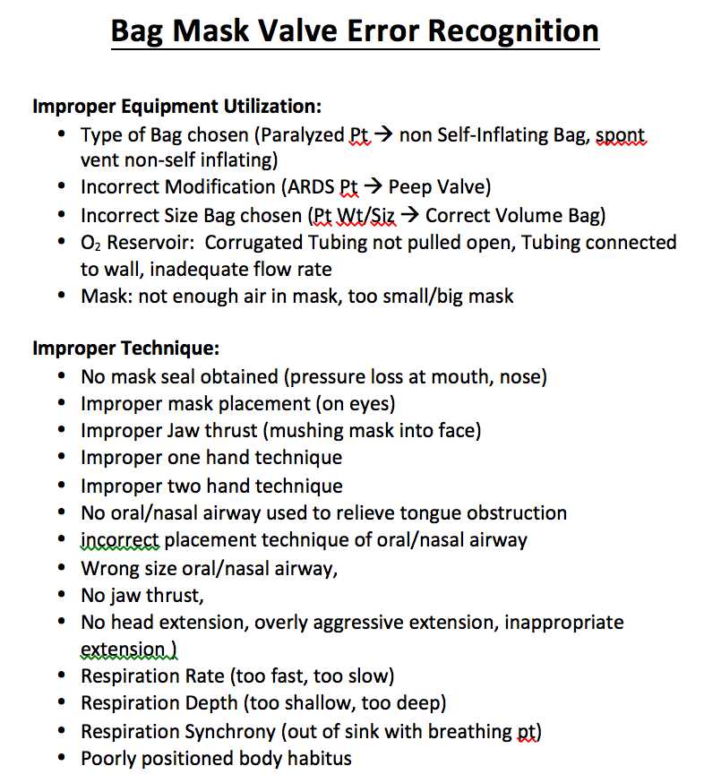
EMT and Just In Time Learning
ICU Rounding team, 7 minutes, Start the clock….
Show a short video/do a demonstration of wrong
Ask the participant to grade/find as many errors as they can
Then have participant commite those errors themselves (with praise by team)
Competition—ask teams to perform subtle errors and the other team grade them (they circle the errors they will perform ahead of time on this sheet) and we check off whats called out by competing team
Candy for all

Slide 49
Reflection—Active Processing
Experiential learning theory tells us that experiences alone will not magically transform into learning.
Reflection is a pro-active cognitive process that looks to enable a learner to understand each experience’s relationship and connection to other ideas, concepts, and experiences.
Two Types:
Reflection During/In Midst Action…
Reflection ON/After Action…
Schon, D.A. 1983. The Reflective Practitioner: How Professionals Think in Action. Basic Books, NY.

Slide 50
Reflection—Active Processing
Safe to Reflect
Adapted from Russell, J. A., & Feldman Barrett, L. (1999). Journal of Personality and Social Psychology, 76, 805-819.
Notes:
Active Processing—Transform experiences into learning through sense-making…

Slide 51
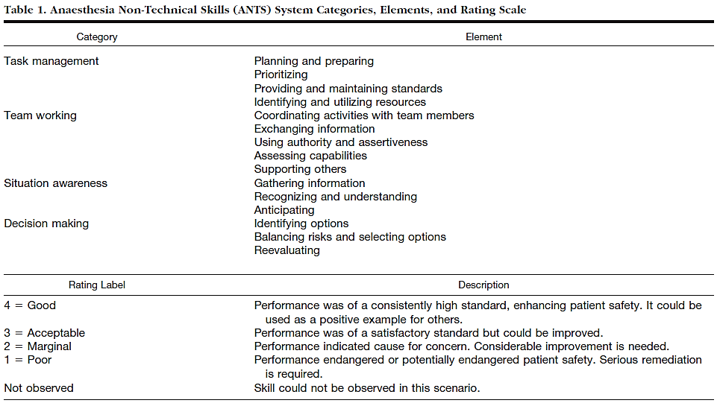
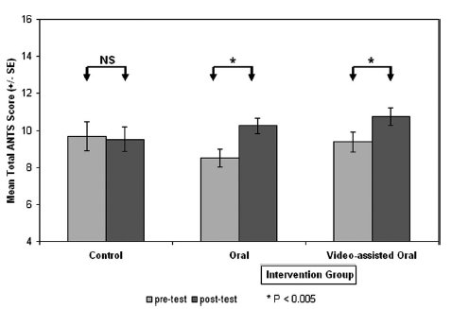
No Change in Non-Technical Skills w/o Reflection (Debriefing)
No Debriefing
Yes Debriefing
Savoldelli, Anesthesiology 2006; 105: 279-285

Slide 52
Human Cognitive Limitation
The brain has limited resources and cognitive processing capacity
Pay selective attention to Information
Filters Information
Prioritizes Information
Mechanisms it utilizes to do this are creating:
Schemata: simplified mental structure of our knowledge of the world around us
Automaticity: ability to do things without mindfulness
Chunking: individual pieces of information are bound together into a meaningful whole
Dror, I.E. (2011). The paradox of human expertise: Why experts can get it wrong. In N. Kapur (Ed.),
The Paradoxical Brain (pp. 177-188). Cambridge, UK: Cambridge University Press.

Slide 53
Cognitive Load Theory
Cognitive Load: the total amount of effort used for your short term memory
Measured by Task-Invoked Pupillary Response (Sympathetic >Parasympathetic) → Pupillary Dilation.
Learning → Working Memory → Long Term Memory or Schemata (Sweller 1988)
LTM are structures that permit us to perceive, think, and problem solve.
www.humanmemory.net

Slide 54
Strategies to Optimize Cognitive Load
Intrinsic Load
The subject itself is simply difficult
Management Strategy: Segmentation, or Working examples
Extrinsic Load
The subject itself is not difficult, but the manner of presentation is difficult
Management Strategy: Avoid redundancy and generalization
Germane Load
The subject is not difficult, but how it relates and integrates with other knowledge
Management Strategy: Active linking and contextual examples of relevance
Sweller, J., Cognitive load during problem solving: Effects on learning, Cognitive Science, 12, 257-285 (198)

Slide 55
Caricature Advantage Effect
Comes from the Facial Recognition literature.
Based on concept of Categorical Perception: after we process data, our brain then looks to clump and categorize various stimuli (details) into mental representations (i.e. dimensions) in order to recognize and sense make what we experience.
When we make mental representations of the world, the manner in which we process stimuli affects the extent and ease to which these stimuli are sorted, labeled, and differentiated from one another.
Goldstone, R. L., Steyvers, M., & Rogosky, B. J. (2003).bConceptual
interrelatedness and caricatures. Memory & Cognition, 31, 169–180.

Slide 56
Caricature Advantage Effect
Definition: creating systematic distortions, aimed to increase and exaggerate the distinctiveness and uniqueness of an item, improve the accuracy and the speed of processing.
It looks to emphasize and magnify differences that ordinarily go undetected.
An “expert”, from a cognitive perspective, is the ability to discriminate information with more narrowed definitions and into more detailed quanta of information, in an accelerated pace.
Rhodes, G., Brennan, S., & Carey, S. (1987). Identification and ratings of caricatures:
Implications for mental representations of faces. Cognitive Psychology, 19, 473–497.

Slide 57
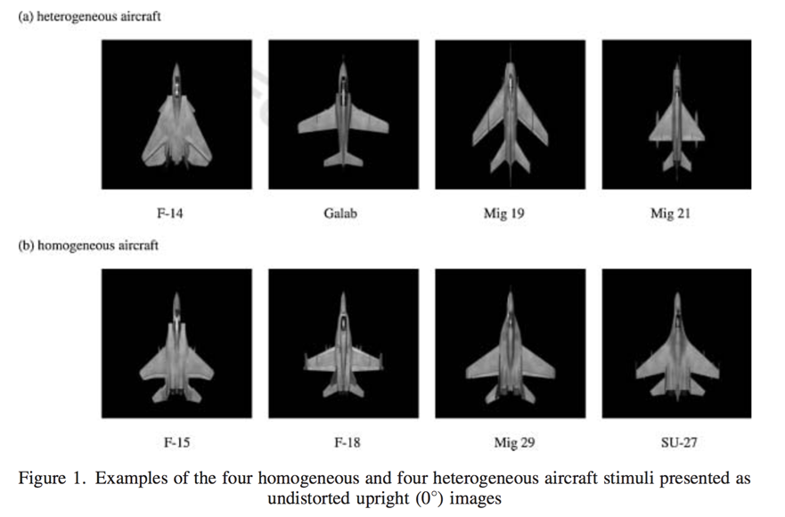
Caricature Advantage Effect
Study looking at Aircraft Identification Performance
Dror I et al. Appl. Cognit. Psychol. 22: 573–584 (2008)

Slide 58
Caricature Advantage Effect
N=113 participants asked to learn 4 aircrafts from a highly similar (homogeneous) group and 4 from a more distinctive (heterogeneous) group, from a variety of angles.
Group A- studied non enhanced images
Group B- studied enhanced, caricaturized images
Learning phase and a testing phase
Following a learning phase, participants completed an identification task.
Speed of accurate identifications was recorded during both learning and subsequent testing phases and represented the dependent variable.
Dror et al. Appl. Cognit. Psychol. 22: 573–584 (2008)

Slide 59
Caricature Advantage Effect
Learning Phase:
960 images shown per set of planes (homo, heter)
1920 randomized images shown total
Name and Picture shown for 5 sec, after which time image disappeared and Participant’s task was to press the appropriate key to indicate name of aircraft they were looking at.

Slide 60
Caricature Advantage Effect
Testing (i.e. Over-learning ) Phase
320 randomized pictures split into 5 sequences of 64 pictures.
two previously unseen distractor aircrafts were randomized into the pot of images. These were included to minimize the influence of guess responses.
participant’s task was to indicate which aircraft they were looking at by pressing one of the four known aircraft names, or a fifth key to indicate a ‘new aircraft’.
Images remained in view until the participant had responded, and feedback was again given in the form of a beep to indicate an incorrect response.
Dror et al. Appl. Cognit. Psychol. 22: 573–584 (2008)

Slide 61
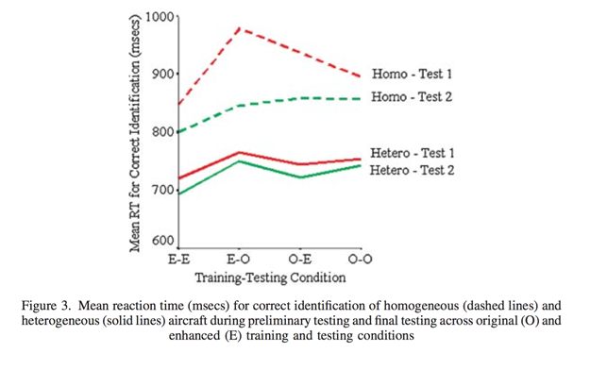
Caricature Advantage Effect
RESULTS:
Homogeneous clearly easier
Performance was consistently aided by the presentation of caricaturized images.
Presentation of caricaturized images led to significantly faster response latencies than the presentation of original images.
Effect was consistent regardless of the initial similarity of the stimuli, or the stage of training.
red=original
green= enhanced
Dror et al. Appl. Cognit. Psychol. 22: 573–584 (2008)
Notes:
performance was consistently aided by the presentation of enhanced images.

Slide 62
Take Home—Amplify and differentiate the new way
By caricaturizing specific important details, that differentiate the new way from the old way, you accelerate expertise faster and more accurately to novice learners.
Curriculum design should take into account distinctiveness and detail of subject matter and exaggerate those aspects in training to enhance the learners ability to differentiate detail.
Dror et al. Appl. Cognit. Psychol. 22: 573–584 (2008)

Slide 63
Metacognition—Experts vs Novices
Thinking about the way (HOW) we think and (WHY) we think….
Coaching
Goal Setting
Deliberate Practice

Slide 64
Coaching and Learning
Coaching is a social interaction that aims to enable a learner to gain increased self-awareness and metacognition about their current state, thereby improving performance, through structured and objective feedback and specific goal setting.
Its focus is constructive, not corrective
Its utilizing inquiry and encourages development

Slide 65
Coaching and Learning
Structured coaching can improve new procedural task learning in experts
Laparoscopic Suturing
Experts prefer reflection On practice rather than In practice (desire to appear competent >> desire for continuous improvement)
Huge role for Video Based Coaching
Palter VN et al. Surgery. 2016 Jun 11. pii: S0039-6060(16)30124-6. Greenber CC et al. Ann Surg. 2015 Aug; 262 (2): 217-9

Slide 66
Deliberate Practice--Goal Setting
Enhances Engagement with the Learning
Enhances Metacognition
Effect most noticeable in new learners
Stefanidis, D., Acker, C.E., Greene, F.L. Performance
goals on simulators boost resident motivation and skills
laboratory attendance. J Surg Educ. 2010;67:66–70.

Slide 67
Prime and Goal Set Pre Simulation
WHAT ROLES DO WE NEED IN Arrest?
Event Manager (TL) to run the code
CPR Team
Access (hemorrhage, need large bore access)
Airway management team
Time keeper and recorder
Med admiration and preparation
Electricity administration
Cognitive 5h and 5T
Historian--Chart Biopsy
Goffer to get equipment
Security—crowd control
Liaison—call consultants
In the orientation, we remind the team of the various roles and responsibilities needed to manage a crisis…

Slide 68
Metacognition and Deliberate Practice in In-Situ Simulation
Give out the NASA-TLX after all in-situ simulations as a means of enabling staff to reflect more objectively and gain increased awareness of their cognitive architecture during the simulation.

Slide 69
Effective Training (Kirkpatrick Ladder)
Impact/Results
K4-End Points
THEN…
Embedding New Paradigms
Actions
K3-Behavior
HOW,IF
Thoughts
K2-Learning
WHAT
Emotions
K1-Reaction
WHY
http://www.kirkpatrickpartners.com/OurPhilosophy/tabid/66/Default.aspx

Slide 70
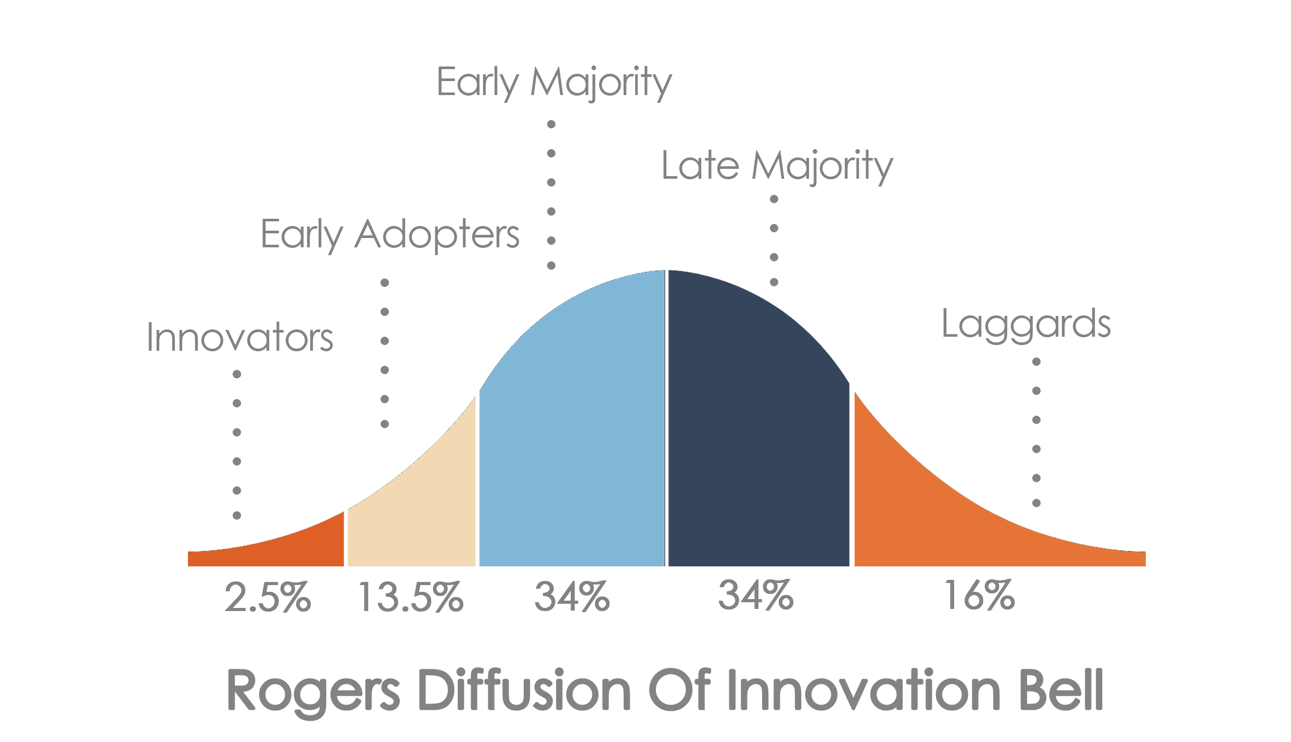
Behavioral Change is about Mimicry
Persuasion= Observability + Triability + Risk Tolerance
Rogers EM. Diffusion of Innovations. 5th ed. New York, NY: Free Press; 1995
Disseminating innovations in Health Care JAMA, April 2003, Vol 289, No.15

Slide 71
Social Influence Primes us for Action
Change in an individual’s thoughts, feelings, attitudes, or behaviors that results from interaction with another individual or a group.

Slide 72
Ever seen this…
T. Chartrand and J. Bargh. “The chameleon effect: The perception-behavior link and social interaction.” Journal of Personality and Social Psychology, 76, 1999. p. 893 – 910.
Notes:
“What’s that she is having over there (next table)…I’ll have what she’s having…”

Slide 73
Mirror Neurons
A mirror neuron is a neuron that fires both when an animal acts and when the animal observes the same action performed by another. Thus, the neuron "mirrors" the behavior of the other, as though the observer were itself acting.
By watching others do a behavior ( the activation of sensory neurons and motor neurons), doing an action oneself is much more likely because “neurons that fire together, wire together."
Rizzolatti, Giacomo; Craighero, Laila (2004). "The mirror-neuron
system" (PDF). Annual Review of Neuroscience. 27 (1): 169–192.

Slide 74
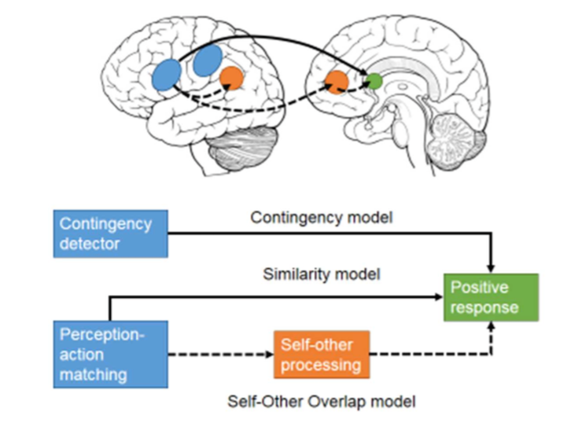
Neuro-Biology of Mirror Neurons
Brain regions associated with being mimicked. Unconscious recognition of a perception-action matching during mimicry increases activity in TPJ and right inferior parietal cortex.
Being mimicked increases functional connectivity between vmPFC and striatum/insula reflecting reward and positive responses to being mimicked.
Hale J1, Hamilton AF2. Cognitive mechanisms for responding to mimicry from others. Neuroscience Biobehavioral Rev. 2016 Apr;63:106-23.

Slide 75
Mirror Neurons and The Power of Mimicry
Improves Sales: Simply mimicing the mirror the verbal and non-verbal behaviors of random Customers, prospective customers that where “mirrored” purchased an MP3 player 79% of the time vs non-mirrored customers, at 62%. 17% difference.
Inspires Trust and Action: mirrored customers were more likely to act upon the sales person’s recommendations because mirroring someone’s behavior induces the feelings of sameness, which inspires trust.
More successful Negotiation: mirroring others in negotiation results in the other side perceiving your request favorably and increases your chance of the other side complying with a request.
W.W. Maddux, E. Mullen and A.D. Galinsky. “Chameleons bake bigger pies and take bigger pieces: Strategic behavioral mimicry facilitates negotiation outcomes.” Journal of Experimental Social Psychology, 44, 2008. p. 461 – 468.
“Idea Watch: Monkey See, Monkey Buy.” Harvard Business Review, January - February, 2012. p. 28.
Bailenson, J. N., & Yee, N. (2005). Digital Chameleons Automatic Assimilation of Nonverbal Gestures in Immersive Virtual Environments. Psychological Science, 16(10), 814–819. http://doi.org/10.1111/j.1467-9280.2005.01619.x

Slide 76
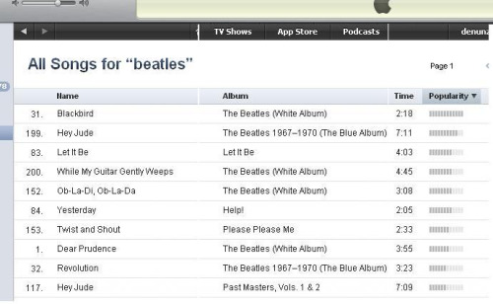
Take Home Point: Leverage Group Think or Social Conformity
Social conformity refers to changing one’s attitudes, beliefs or behaviors to match group norms.
Human attitudes and preferences are susceptible to social influence.
Attributed to the posterior medial frontal cortex (pMFC).
Current Opinion in Neurobiology 2013, 23:456–462

Slide 77
Take Home Point—Don’t Underestimate the power of competition

Slide 78
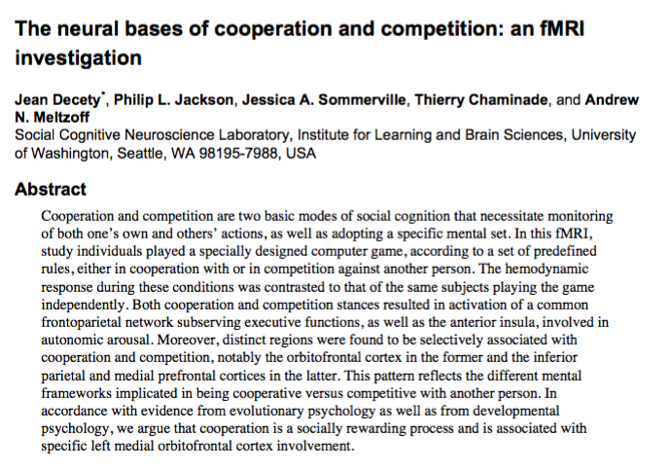
It is more Cognitively rewarding to Cooperate than Resist
Neuroimage. 2004 October ; 23(2): 744–751.

Slide 79
Questions?
Thank You
oren.guttman@utsouthwestern.edu

Slide 80
Questions and Answers
For more information, please contact our team at:
AHRQTeamSTEPPS@aha.org

