Slide 1
for
Office-Based Care Online
Planning and Assessing a TeamSTEPPS Program

Slide 2
This Webinar and Future Webinars
Webinar a part of a library to support and amplify your work on TeamSTEPPS
TeamSTEPPS for Office-Based Care Online is funded by AHRQ

Slide 3
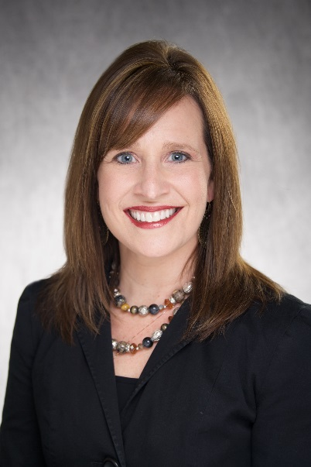
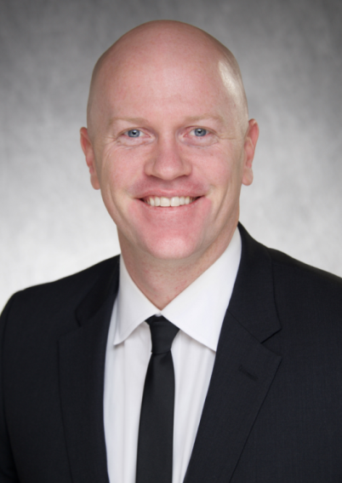
Today’s Presenters
Michelle Turner, RN, B.S.N.
Nurse Manager at UIHC – Iowa River Landing
Co-Project Lead – TeamSTEPPS at IRL
Kip Pedersen
Manager of Frontline Operations at UIHC – Iowa River Landing
Co-Project Lead – TeamSTEPPS at IRL

Slide 4
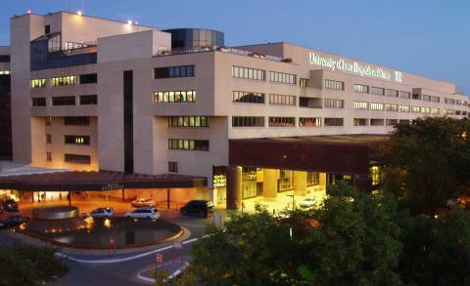
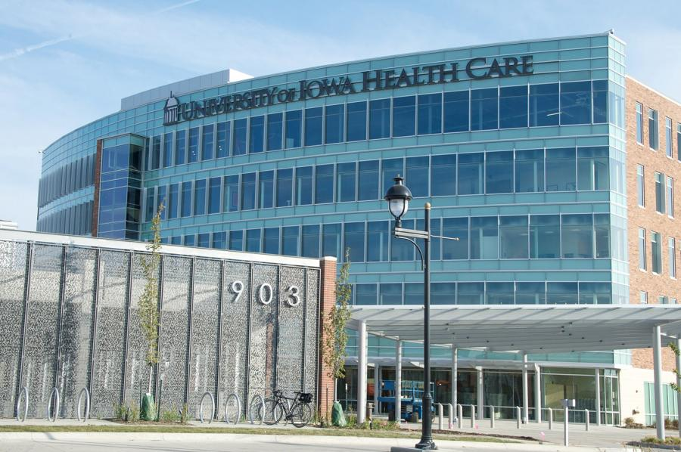
Background of Iowa River Landing

Slide 5
Today’s Objectives
Identifying a champion
Organizing your change team
Selecting the area of implementation and assessing the environment
“Alone we can do so little;
together we can do so much.”
—Helen Keller

Slide 6
TeamSTEPPS
What is TeamSTEPPS?
TeamSTEPPS is an evidence-base communication toolkit to improve performance across the health care delivery system.
Team Competency Outcomes:
Knowledge – Develop skill set to be on the “same page.”
Empowerment – Ensure everyone’s voice is heard.
Attitude – Be TEAM oriented.
Performance – Improve safety and the patient experience in your daily practice.

Slide 7
Identifying a champion

Slide 8
Champions at IRL
Role at IRL
Frontline operations and clinical influence
Viewed as leaders among staff and administration
High energy and consistent approach to teamwork
Ability to fluctuate our schedules to accommodate implementation
Strong working relationship with providers

Slide 9
Desired Skill Set
Is highly respected by all staff; can motivate others and influence change
Has consistent positive approach to teamwork at all times
Has strong communication and organizational skills
Notes:
Chris Question: Does a champion need to be an executive or someone else in a formal leadership position?
Potential follow-up question: Can you explain more about what a “situational leader” is?

Slide 10
Organizing your change team

Slide 11
Designing Your Change Team (Core Team)
First: We educated our Management team on TeamSTEPPS, shared our goals for implementation, and got a commitment from each of them.
We provided our project plan and the importance of establishing a strong foundation of teamwork and culture.
We trained our managers on the TeamSTEPPS fundamental tools: Situational Awareness, SBAR, CUS, and DESC.
Notes:
Chris Question: Why did you choose those Fundamental Tools to start? How did you know which ones would be best to introduce your managers to first?

Slide 12
Characteristics of Core Team
Defined the characteristics we wanted from each individual on our core team:
Passionate, outgoing
Viewed as leaders in their respected areas, respected by their peers, and have strong communication skills
Were strategic in choosing champions from each discipline within our facility:
Frontline Operations, Clinical (Medical Assistants and Nurses), Pharmacy, Lab, Radiology, and Housekeeping
Celebrate the Invitation!
Notes:
Chris Question: What is the role of the change team members at IRL?

Slide 13
Getting Physician Buy-in
Identify the physicians who possess the core characteristics you are looking for and define their role on our team.
Communicate to your Administrative Lead so together you can present TeamSTEPPS.
Meet with them in person.
Great Example:
One of our physicians previously participated in TeamSTEPPS and was very passionate about the concepts.
He shared his experiences in class and immediately generated excitement within our building – Quick Win!
Notes:
Chris Question: I entirely agree it is important to get physicians on the team. How do you encourage them to really own TeamSTEPPS as opposed to just agreeing it is a good thing to do.

Slide 14
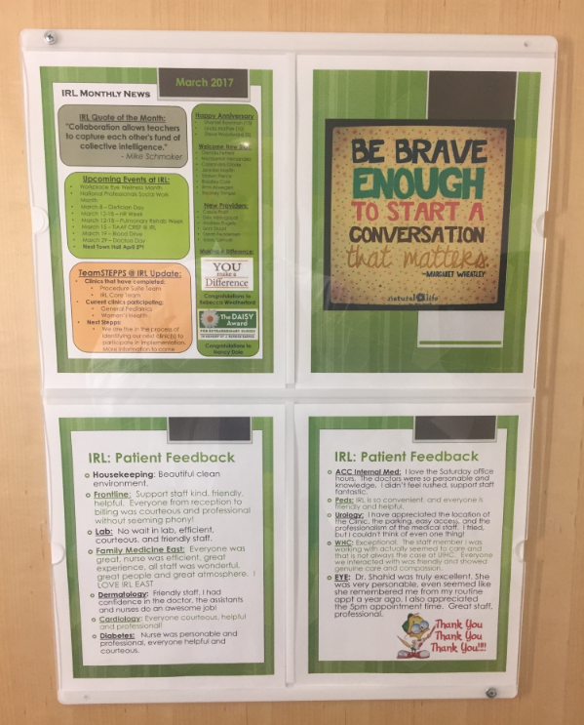
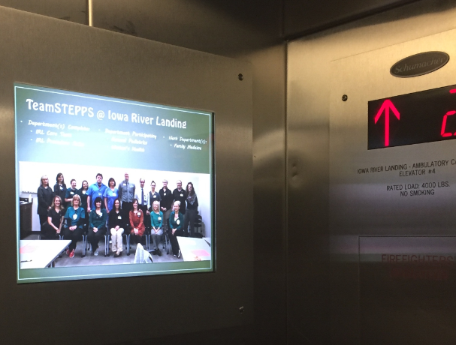
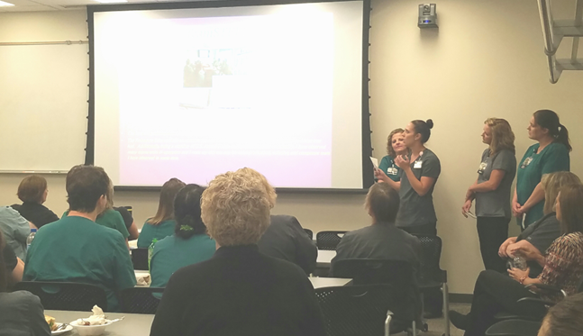
Generate Excitement
Post in employee elevators, hold town halls, and post in employee common places.

Slide 15
Meeting With Your Team
Finding a time to meet:
We need Administration support to conduct meetings during work hours:
Hold first Tuesday of every month from 7:30 a.m.-9:00 a.m.
Schedule all meetings at once so staff can prepare.
TeamSTEPPS is a way of life at IRL, not a program of the month.
Notes:
Chris Question: : How did you find time to meet that worked for everyone? What about smaller practices? How would you organize this in a small primary care office that doesn’t have a lot of administrative support in place?
Chris Question: How did you message that TeamSTEPPS is a not just a flavor of the month, especially before people actually saw the benefit of using the tools? How did you convince them

Slide 16
implementation & assessing the environment

Slide 17
Where To Start
How to choose which area to start if there are multiple areas/clinics/offices:
Start with your highest functioning clinic.
Get that quick win and create early momentum:
Team qualities: Great culture of teamwork, staff empowerment, high patient satisfaction, high staff satisfaction and engagement, and low workplace drama
IRL – Procedure Suite & Core Team
“Success breeds success!”
Notes:
Chris Question: What would you do in a small office if there was only one option of where to start? Do you wait until all the conditions are “perfect” or do you move forward regardless of the conditions?

Slide 18
Assessing The Environment
Staff Satisfaction
Clinical Observations
Staff feedback, workflows, communication, clinic efficiency, areas of opportunity, team cohesiveness
Team Definition of Culture
Rating their team culture/environment before and after implementation
Silent Brainstorming

Slide 19
Assessing the Environment Silent Brainstorming
Questions We Ask: (Color Coded)
What gets in your way of providing excellent patient care?
What do patients/families see, hear, and feel when they come to your clinic?
If you could change one thing that would improve care for our patients/families, what would it be?

Slide 20
Reviewing the Data
TeamSTEPPS Teamwork Attitudes Questionnaire (T-TAQ)
TeamSTEPPS Teamwork Perceptions Questionnaire (T-TPQ)
https://www.ahrq.gov/teamstepps/officebasedcare/tools.html
Patient Satisfaction
Percentile Rank and Top Box Score
Staff working together, likelihood to recommend, and CP included in decisionmaking
Important to proactively identify trends
Patient Comments
Clinic Reporting:
Clinic and staff efficiency

Slide 21
Planning and Assessing
Lessons Learned:
Engage physicians.
Adjust your approach per department.
With busier clinics, divide the team to avoid negatively affecting the patient experience.
Schedule all the meetings at once and commit.
Generate excitement.

Slide 22
IRL TeamSTEPPS Motto:
One Team + One Goal = Exceptional Patient Care

Slide 23
Discussion

