Slide 1
for
Office-Based Care Online
TeamSTEPPS Training & Implementation

Slide 2
This Webinar and Future Webinars
Webinar is part of a library to support and amplify your work on TeamSTEPPS
TeamSTEPPS for Office-Based Care Online is funded by AHRQ

Slide 3
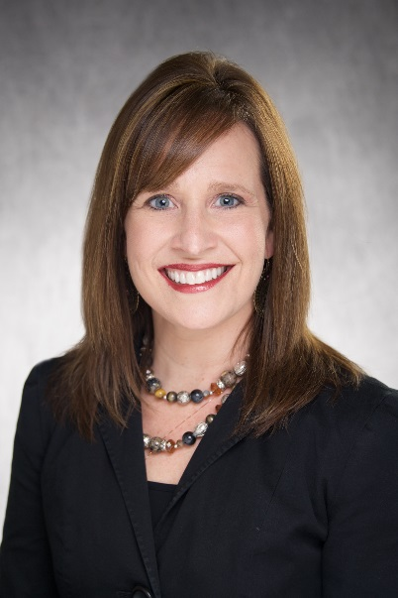
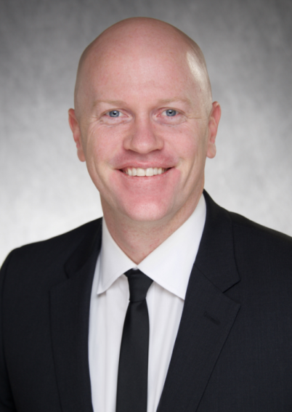
Today’s Presenters
Michelle Turner, RN, B.S.N.
Nurse Manager at UIHC – Iowa River Landing
Co-Project Lead – TeamSTEPPS at IRL
Kip Pedersen
Manager of Frontline Operations at UIHC – Iowa River Landing
Co-Project Lead – TeamSTEPPS at IRL

Slide 4
Background of Iowa River Landing

Slide 5
Today’s Objectives
Planning for TeamSTEPPS and implementation
Training options
Master Training and Fundamentals
Implementation
Maintaining and sustaining
Notes:
Part of a library – planning and assessing we’ll review at a high level our talking points.
Our future third webinar will be more in depth on maintaining & sustaining

Slide 6
TeamSTEPPS
What is TeamSTEPPS?
TeamSTEPPS is an evidence-base communication toolkit to improve performance across the health care delivery system.
Team Competency Outcomes:
Knowledge – Skill set to be on the “same page”
Empowerment – Everyone’s voice is heard
Attitude – Be TEAM oriented
Performance – Improve safety and the patient experience in your daily practice

Slide 7
Planning for Implementation
Define your scope and project plan
Identify your quick win
Develop your champions and change team
Generate excitement and present in person if at all possible
Celebrate the invitation
Get provider buy-in
Identify your provider champion
Gain buy-in
Notes:
How to identify your quick win
PRC Suite – Stand your ground and don’t start with a difficult or complex clinic or enviroment

Slide 8
Logistics and Considerations
Amount of time available
Schedule your meeting(s) in advance and commit
Once a month: 60-90 minutes
Proper learning environment
Concepts/Tools
Don’t use a cookie cutter approach (Do your homework)
Review: Pre-survey questionnaire, clinical observations, and clinical reports
TeamSTEPPS Teamwork Attitudes Questionnaire (T-TAQ)
TeamSTEPPS Teamwork Perceptions Questionnaire (T-TPQ)
https://www.ahrq.gov/teamstepps/officebasedcare/tools.html
Example: Silent Brainstorming
Notes:
Time is adapabtible – but this method has worked best for us
Ideally 90 minutes is ideal
Use a Qualtrics Picture
Break up cliques – have people mixed up

Slide 9
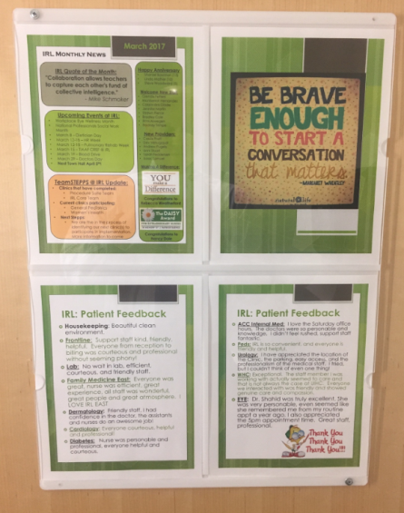
Not Just Another Initiative
Lead by example and consistently promote the tools you have implemented:
Celebrate best practices and good catches
Address opportunities we could have used TeamSTEPPS
Monthly town hall presentations
Employee “Potty Pushers”
Employee Elevator Monitors
TeamSTEPPS – Tool of the Month
Notes:
Add huddles – Keep the buzz going before and after

Slide 10
Training Options

Slide 11
Master Training
What does it mean to be a Master Trainer?
Understand the TeamSTEPPS concepts and approaches
Change Agent
Coach/mentor others during the implementation phase and beyond
Lead by example and hold others accountable
Develop a plan for implementation and sustainment
Quick win and how to implement?
Identify possible barriers and plan accordingly
What are your measures?
Notes:
What does it mean to be a master trainer of us at IRL.
High level definition of Change Agent
- We are the only master trainers at IRL – Staff go through our customized TeamSTEPPS program

Slide 12
Master Training Continued
How to become a Master Trainer
National Implementation
Online
In-person
You do it!
Not everyone needs to be a Master Trainer

Slide 13
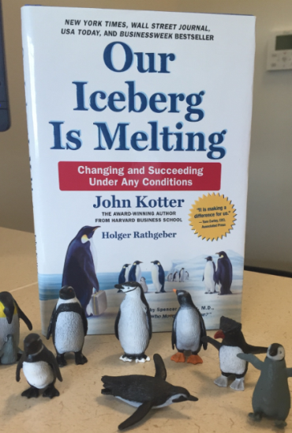
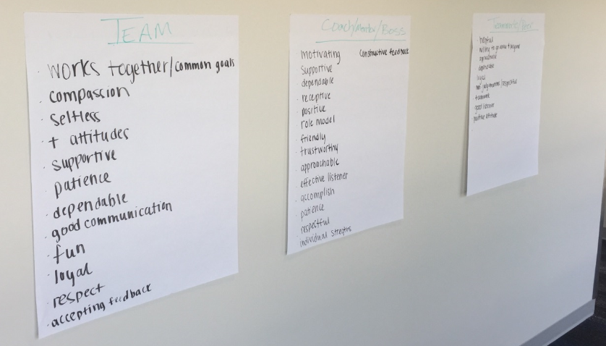
Fundamental Concepts
Build a strong team foundation first
Develop a fun interactive presentation that generates excitement and team cohesiveness
Example: Team-building exercises
Building Bridges, making chains, and reading Our Iceberg Is Melting
What are you looking for in a team, mentor/leader, and teammate?
Notes:
We are instilling the bite chunk pieces of TeamSTEPPS based on the Department needs

Slide 14
Fundamental Tools
Taking a STEPP by STEPP approach
Situational Awareness
You can’t identify there is an issue without removing your blinders
STEP
Status of patient, status of other Team members, Environmental conditions, current Progress toward the goal
Activities:
Videos: The Monkey Business Illusion or Whodunnit?
Pictures such as 2-in-1 illusions
Real-life examples
Notes:
- 90 minutes presentation specifically on difficult conversations
Add debriefing and Huddling
Real Life examples – locked in on your computer, cell phone, personal conversations

Slide 15
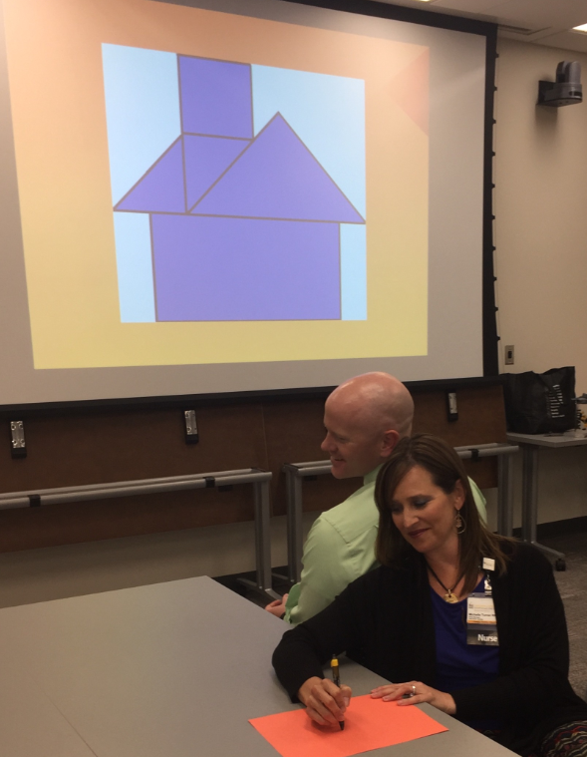
Effective Communication and Difficult Conversations
Effective Communication:
Complete, clear, concise, and timely
“Be brave enough to start a conversation that matters”
DISC Assessment
Activities:
1:1 conversations
Word game
Drawing game

Slide 16
TeamSTEPPS Tools
Depends on clinical need on which tool to start with
TeamSTEPPS 101:
Huddle/Debriefing
SBAR
CUS
DESC
Activities:
Role playing real scenarios
Provide real time feedback

Slide 17
Implementation

Slide 18
Ground Rules / Information
Show respect for everyone
Start and end on time
Please put cell phones and pagers on silent/vibrate
Ask away! There are no “dumb” questions
Do not leave in silent disagreement
Take a spelling/writing holiday
Have Fun ☺

Slide 19
Implementation
STEPP #1: Team Building & Defining Current State
STEPP #2: Situational Awareness & Effective Communication
STEPP #3: Difficult Conversations & DISC Assessment
STEPP #4: SBAR, CUS, and DESC
STEPP #5: Summary Wrap-Up

Slide 20
What Happens After Implementation?
Post-TeamSTEPPS Survey
Pre & Post Report
Schedule followup meeting every 6 weeks with department
Certification of Completion

Slide 21
What Happens After Implementation?
Celebrate the team’s completion and success
Town hall and employee recognition board
Identify champions on your change team
Expand our management team knowledge
Sent additional staff to complete TeamSTEPPS Master Training

Slide 22
Lessons Learned
Identify your scope and develop project plan
Identify your champions – must have provider buy-in
Know your audience and do your homework
Pre-survey, clinical observations, and staff feedback
Identify your TeamSTEPPS tools and possible quick wins
Make implementation interactive and take chances
Have fun and generate excitement!

Slide 23
IRL TeamSTEPPS Motto:
One Team + One Goal = Exceptional Patient Care

Slide 24
Discussion

